Slide 1
Multi-Class Weather Classification
using different deep learning architectures

Slide 2
Contents :
Paper representation
Dataset
Problems with dataset
How to make specific solution ?
Analysis and visualization dataset
Preprocessing of the dataset
Build deep learning solution
CNN implementation Model
CNN implementation Model with Augmentation
What is transfer learning ?
Preprocessing of transfer learning
Res_Net 50 with Augmentation and CNN Model
Res_Net 101 with Augmentation and CNN Model
Res_Net 152 with Augmentation and CNN Model
VGG 16 with Augmentation and CNN Model
VGG 19 with Augmentation and CNN Model
Efficientnet with Augmentation and CNN Model
Xception with Augmentation and CNN Model

Slide 3
Paper representation
Dataset contain images of cloudy , rain , shine and sunrise
Making preprocessing of the images :
Image Resize: This operation is responsible to unify the image dimensions and depth for all images in the dataset to accommodate the input size for the ResNet-18. Thus, we have developed a MATLAB function to convert all images into 3D matrices (RGB images) with image dimension of 224 x 224 x 3
all with JPG image extension.
Label Encoding: This operation is responsible to encode the categorical labels into numerical labels to be understood by machine learning models. Therefore, we have used the integer encoding technique to end up with four labels as follows: cloudy:1, rainy:2, shiny:3, and sunrise:4.
Dataset Shuffling: This operation is responsible to randomly rearrange the dataset images to enhance the
classification by generating unbiased distribution of the dataset which avoid model biasing toward specific class(s).
Data Augmentation: This operation is responsible to effectively increase the amount of training data by applying randomized augmentation operations on the dataset. Augmentation process configures a set of preprocessing options such as resizing, cropping, rotation, reflection, invariant distortions, and others
Data Distribution: This operation is responsible to randomlysplit the dataset into training set and testing (validation) set. To ensure high level of unpredictability, random-cross validation process to examine the accuracy of the model at different distributions of dataset.

Slide 4
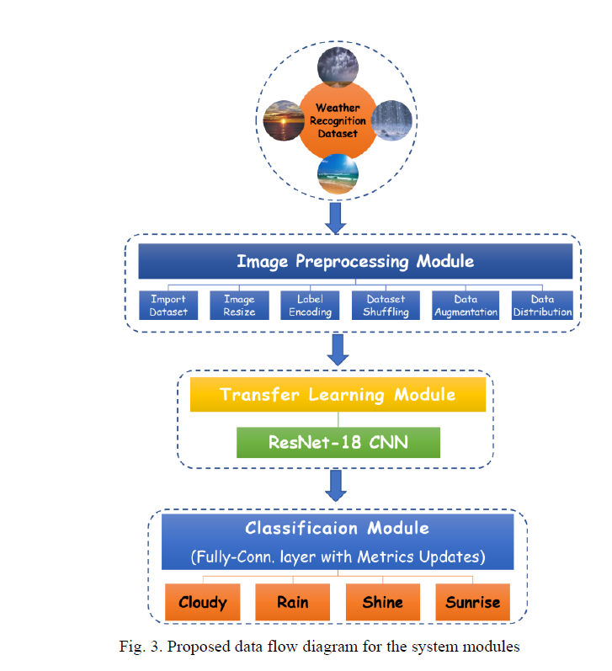
Paper representation

Slide 5
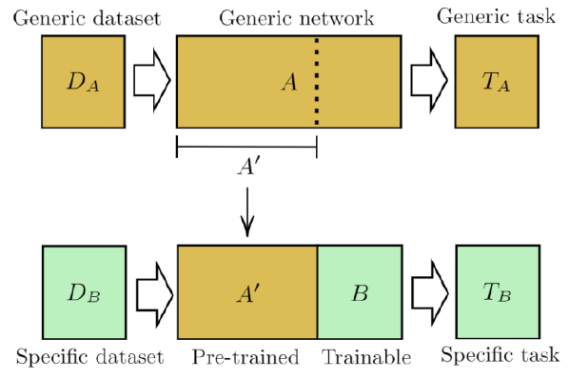
Paper representation
Transfer learning Module :This module is responsible of feature extraction and learning to accomplish a particular image classification application. However, with the transfer learning technique, there is no need to perform the long-time training process from scratch for the new classification task, instead, it’s possible to
use any well-known deep neural network that is pretrained on a specific dataset to perform new classification tasks, but with fine-tuning for the learning parameters. As reported in [28], transfer learning is an optimization, a shortcut to saving timeor getting better performance

Slide 6
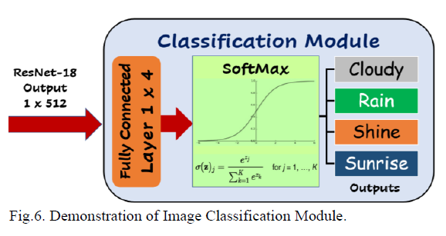
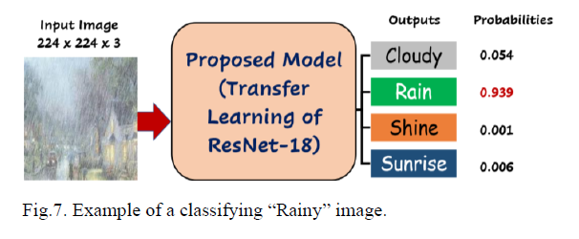
Paper representation
Classification Module : This module is responsible of categorizing the collected dataset into different classes for the purpose based on the recognized or extracted patterns or features. A classification module utilizes a fully connected layer and computes the cross-entropy loss for multi-class classification problems with mutually exclusive classes [6]. For better demonstration for the classification module, we show the connection layers of the is module in Fig

Slide 7
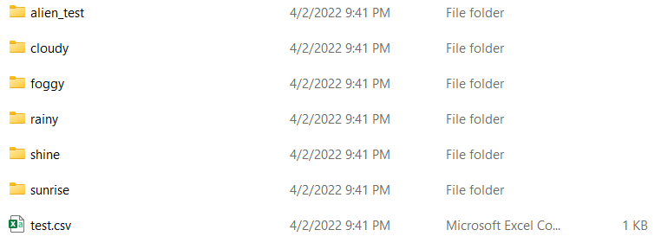
Dataset
The dataset was created, the various images are downloaded and saved in the local disk which contains weather depicting images. The dataset was labelled by identifying objects in the image such as cloudy, foggy, rainy, shine and sunrise.
The dataset features 5 different classes of weather collected from the above said different sources, however it's real life data so any system for weather classification must be able to handle this sort of images. Training set includes about 1500 labelled images including the validation images. Images are not of fixed dimensions and the photos are of different sizes. Images do not contain any border
Each image has only one weather category and are saved in separate folder as of the labelled class. The images are saved in folders as shown in following figure:

Slide 8

Problems with dataset
This dataset train and test only then must be have validation dataset then making python code to split training dataset 85% and 15% validation
1274 images belonging to 5 classes
26 images belonging to 5 classes.

Slide 9
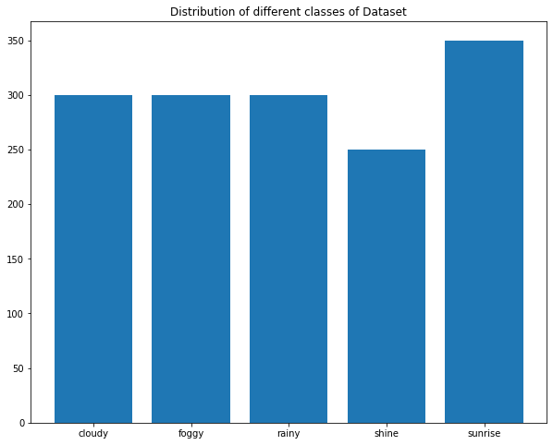
Analysis and visualization dataset
Training dataset before split :

Slide 10
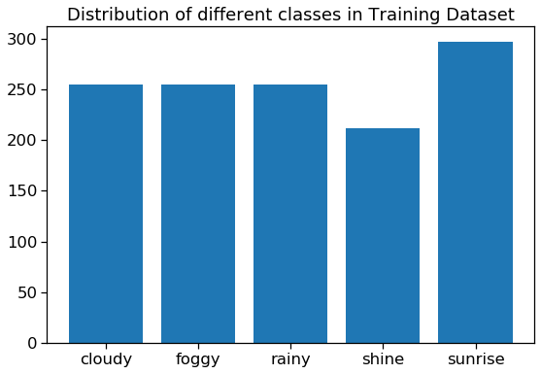
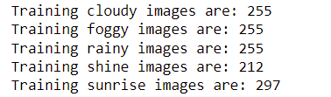
Analysis and visualization dataset
Training dataset after split :

Slide 11
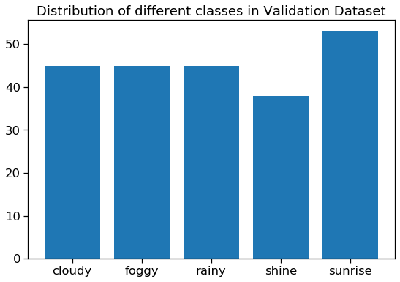
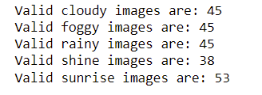
Analysis and visualization dataset
Validation dataset after split :

Slide 12
Preprocessing of the dataset
Images of Cloud
The category for images showing cloudy outdoor scenes was built using terms in English, Hindi and French. The terms included cloudy and clouds, and returned a decent number of images that are included in the dataset. From the returned images, the 300 most representative images are included in the Weather Dataset
Images of Fog
The task to look for images depicting foggy weather was relatively easy, as the different image hosting web sites have a decent collection of this type of pictures. However, the use of synonyms, as well as terms in other languages was required to find the total number images that compose the foggy category. The foggy category of the Weather Dataset contains 300 images
Images of Rain
Collecting images of rainy weather condition was a challenge. Since many of the images which were tagged as “rainy” on the platforms were representation of raindrops on glass scene and indoor activities for rainy days. However, 300 quality images with landscapes and urban scenes of rainy days are represented in this category of the dataset.

Slide 13
Images of Shine
Collecting images of shiny weather condition was a little bit difficult. The terms included shine, shiny and beach, and returned a decent number of images that are included in the dataset. From the returned images, the 250 most representative images are included in the Weather Dataset.
Images of Sunrise
Collecting images of sunrise was relatively easy, as the different image hosting web sites have a decent collection of this type of pictures. The terms included sunrise, early morning and returned a decent number of images that are included in dataset. This category of the Weather Dataset contains 350 images
Then Making the same preprocessing as the paper :
Image Resize
Label Encoding
Dataset Shuffling
Data Augmentation
Data Distribution

Slide 14
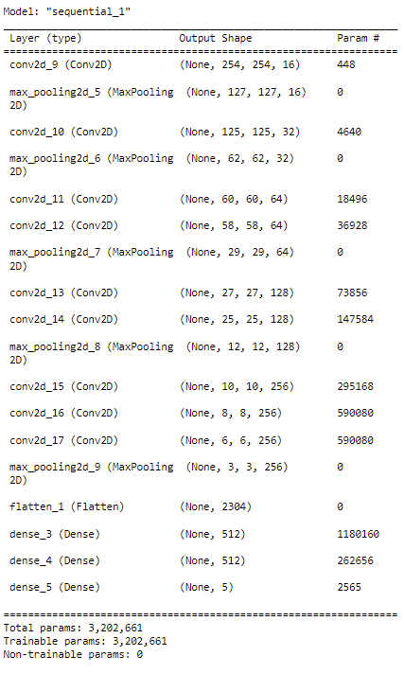
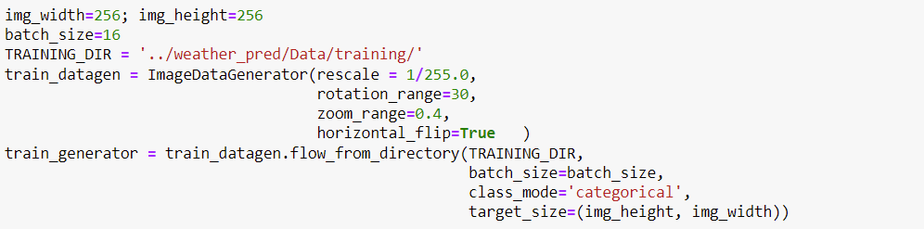
Build deep learning solution
CNN implementation Model with Augmentation
Traning and validation result :
Augmentation details:

Slide 15
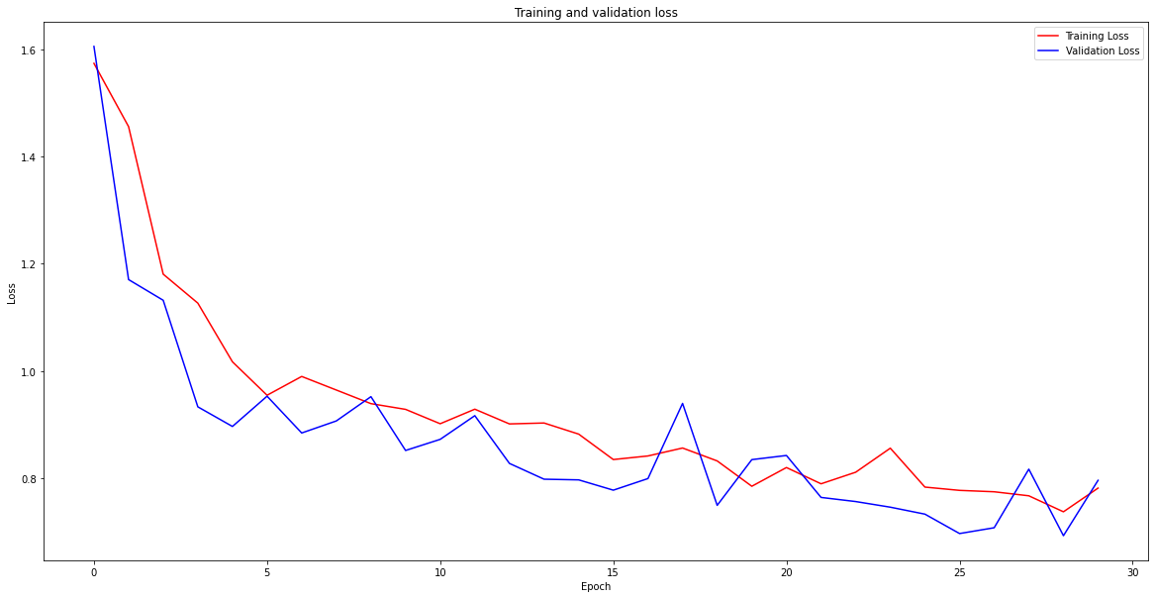
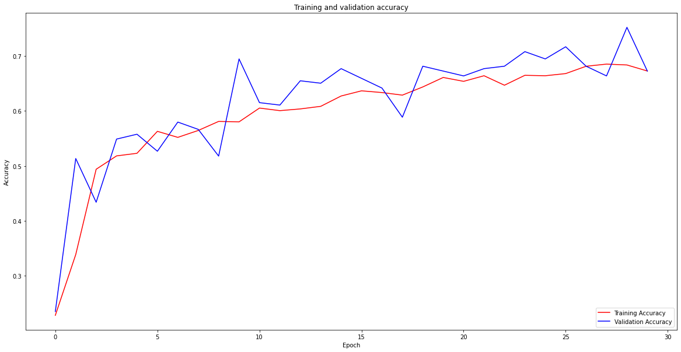
Build deep learning solution
CNN implementation Model with Augmentation
Loss_curve_CNN_256_with_Aug
Accuracy_curve_CNN_256_with_Aug

Slide 16
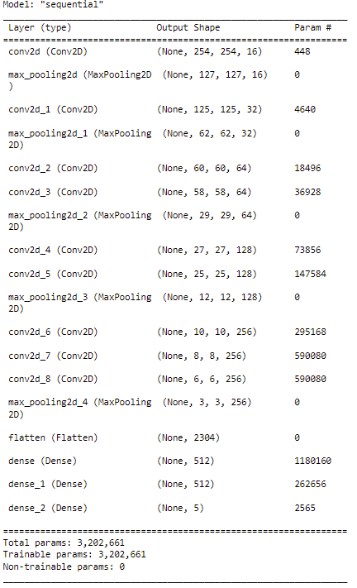
Build deep learning solution
CNN implementation Model
Traning and validation result :

Slide 17
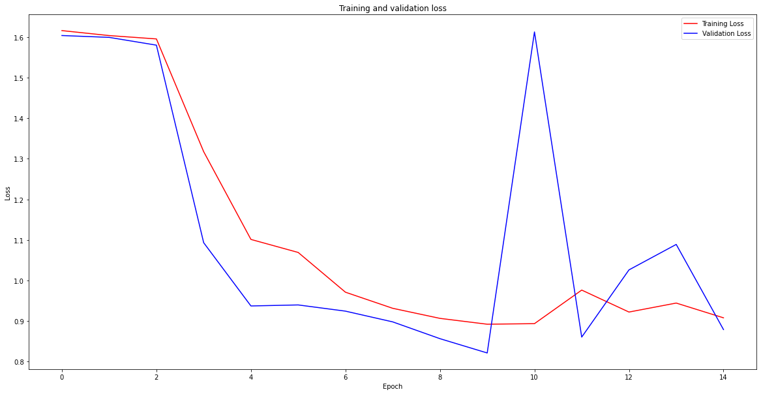
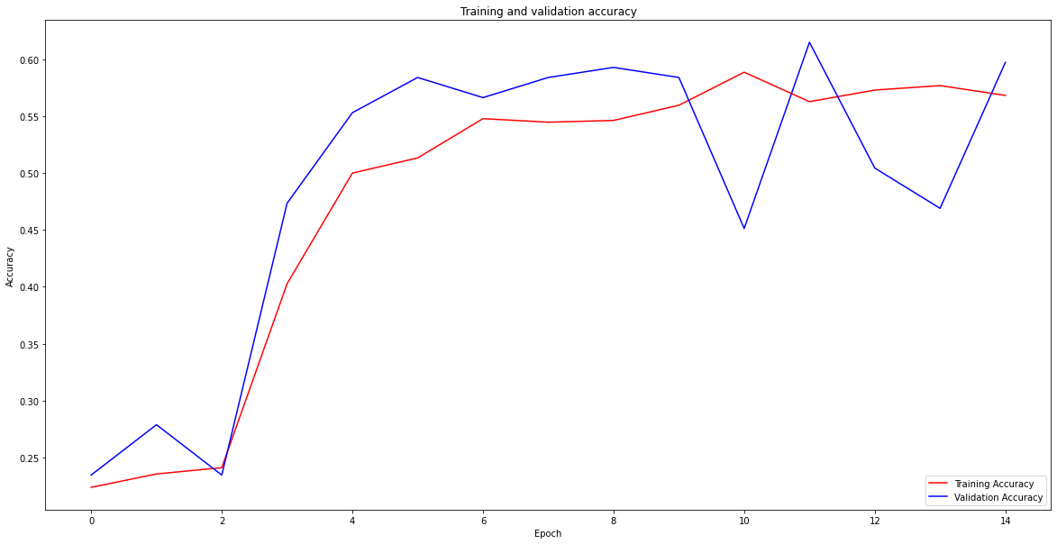
Build deep learning solution
CNN implementation Model without Augmentation
Loss_curve_CNN_256_without_Aug
Accuracy_curve_CNN_256_without_Aug

Slide 18
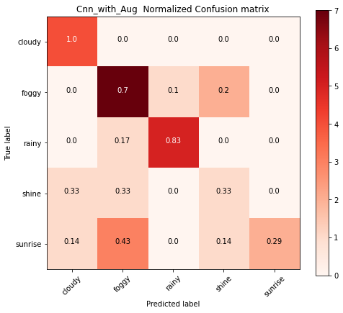
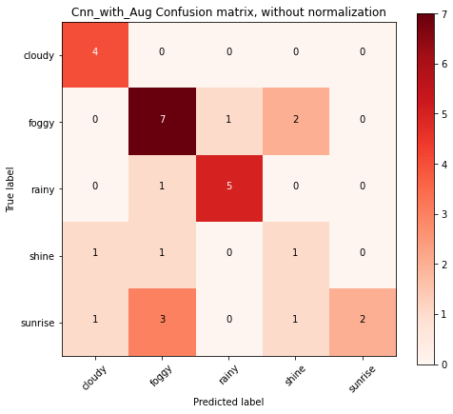
Build deep learning solution
Testing:
Cnn_with_Aug

Slide 19
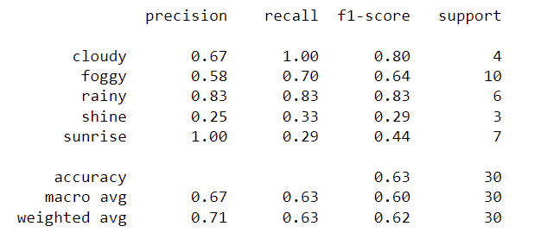
Build deep learning solution
Testing:
Cnn_with_Aug
classification_report
Accuarcy:

Slide 20
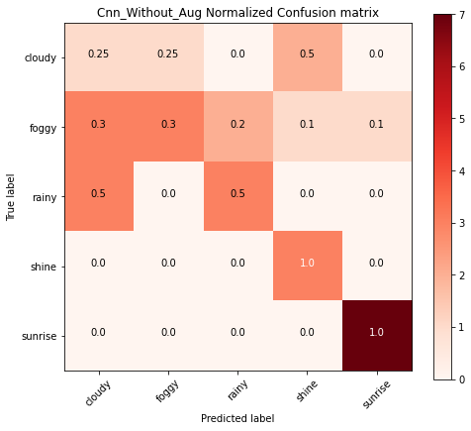
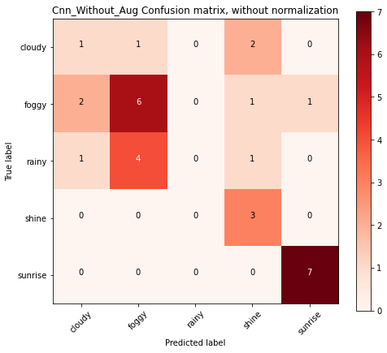
Build deep learning solution
Testing:
Cnn_without_Aug

Slide 21
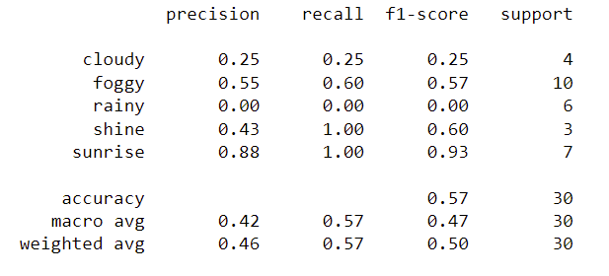
Build deep learning solution
Testing:
Cnn_without_Aug
classification_report
Accuarcy:

Slide 22
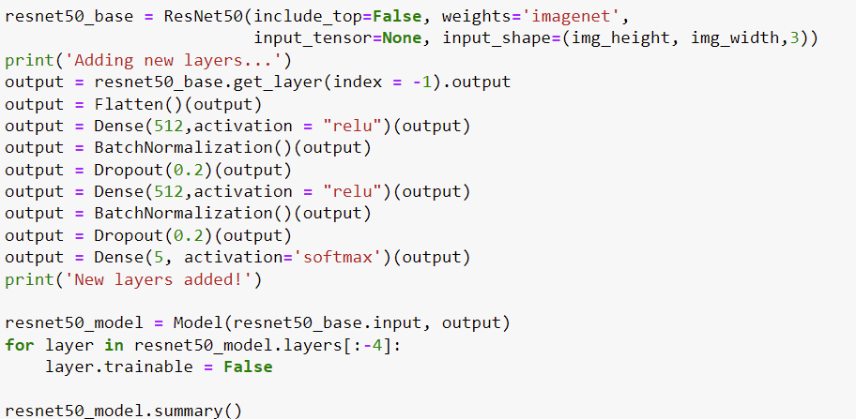
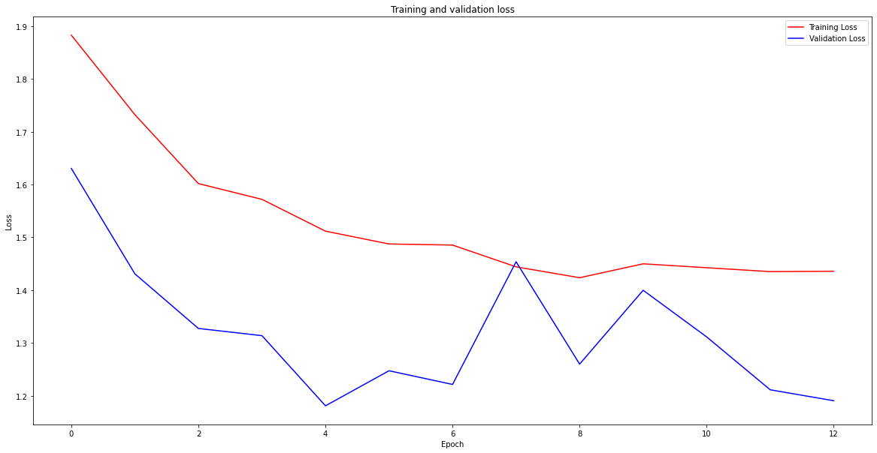
Build deep learning solution
Using:
Optimizer : Adam
Loss : categorical_crossentropy
Metrics: accuracy
Training accuracy : 0.39 %
Validation accuracy : 0.589 %
transfer learning architectures
Res-Net50 with CNN Layers with Augmentation
Structure:

Slide 23
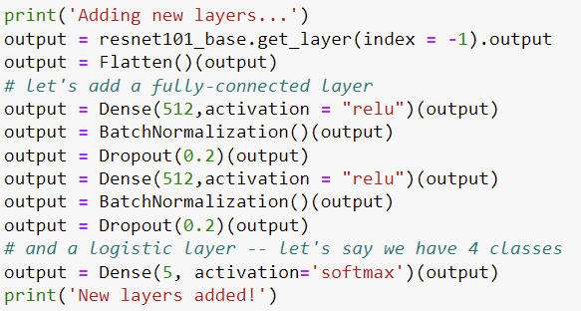
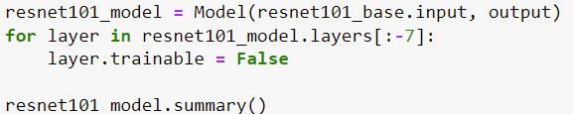
Build deep learning solution
Using:
Optimizer : Adam
Loss : categorical_crossentropy
Metrics: accuracy
Training accuracy : 0.95 %
Validation accuracy : 0.97 %
transfer learning architectures
Res-Net101 with CNN Layers with Augmentation
Structure:

Slide 24
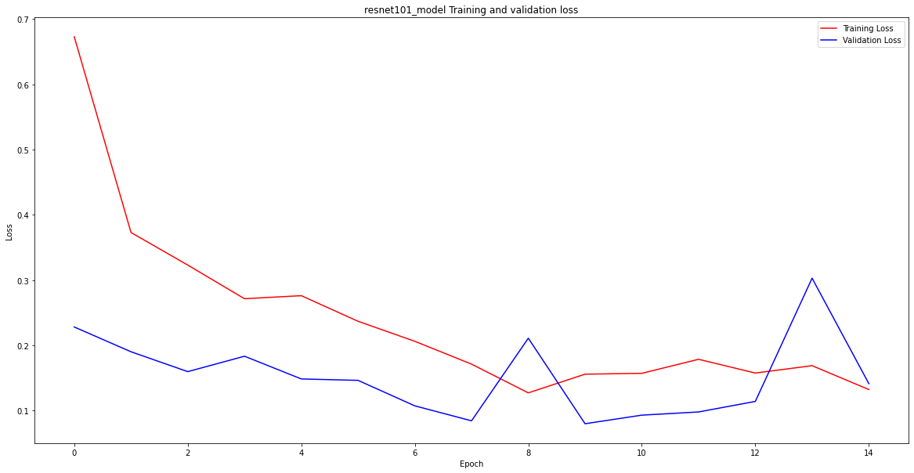
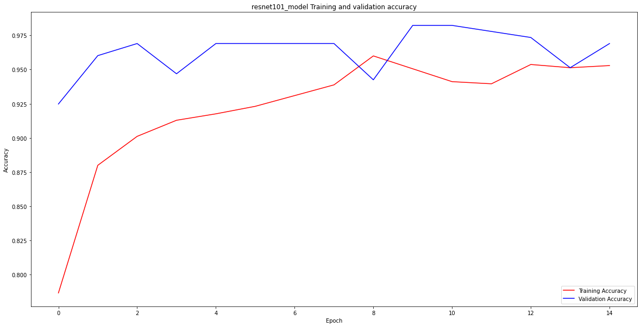
Build deep learning solution
transfer learning architectures
Res-Ne101 with CNN Layers with Augmentation
Loss_curve
Accuracy_curve

Slide 25
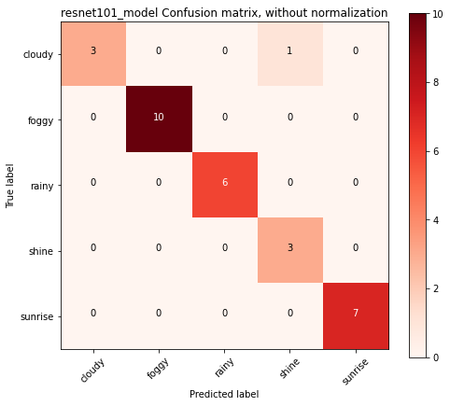
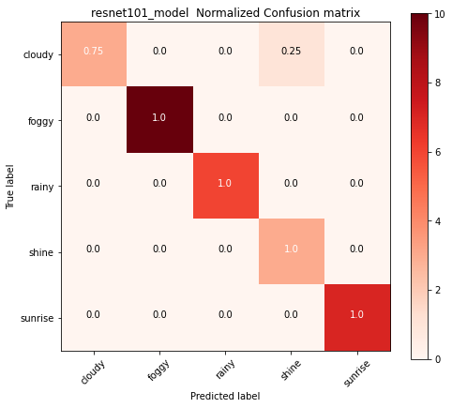
Build deep learning solution
transfer learning architectures
Res-Ne101 with CNN Layers with Augmentation
Test:

Slide 26
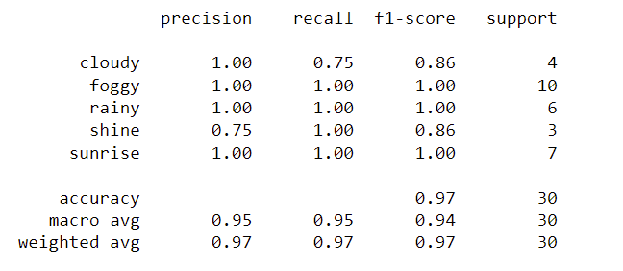
Build deep learning solution
transfer learning architectures
Res-Ne101 with CNN Layers with Augmentation
Test:
classification_report
Accuarcy: 0.97%

Slide 27
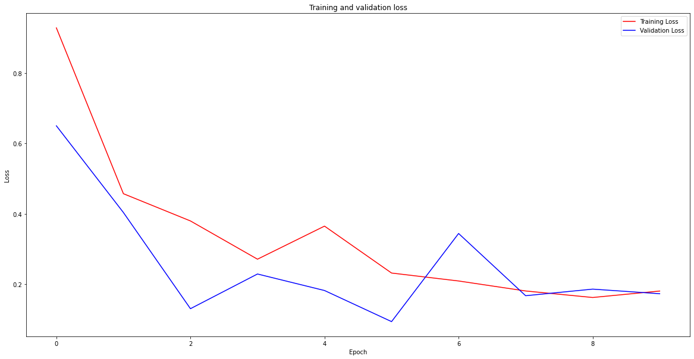
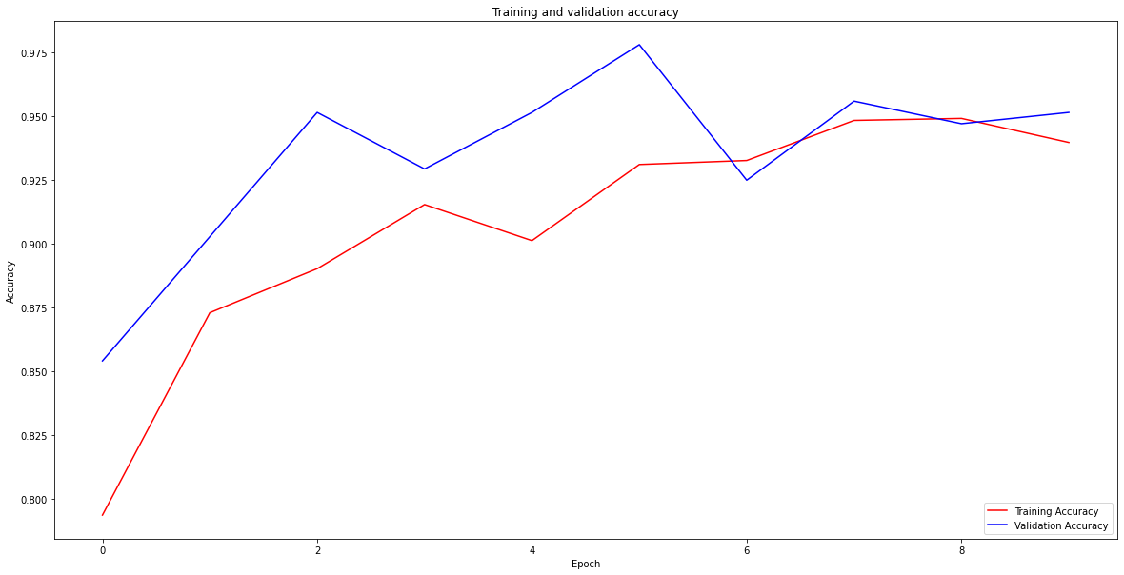
Build deep learning solution
Using:
Optimizer : Adam
Loss : categorical_crossentropy
Metrics: accuracy
Training accuracy : 0.94 %
Validation accuracy : 0.95 %
transfer learning architectures
Res-Net152 with CNN Layers with Augmentation
Structure: Same Structure of Res-Net101
Loss vcurve
Accuracy curve

Slide 28
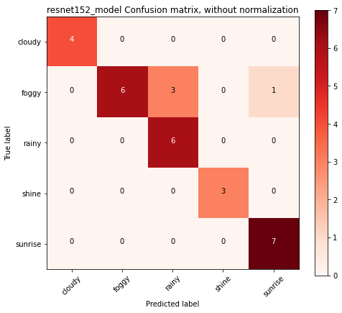
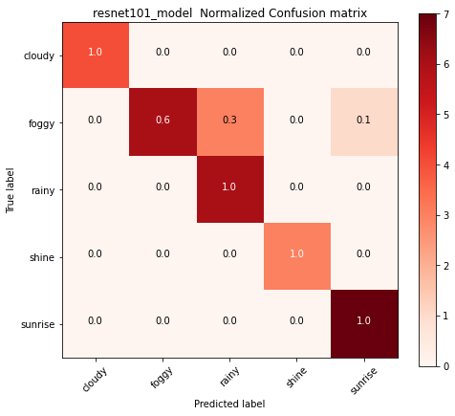
Build deep learning solution
transfer learning architectures
Res-Ne152 with CNN Layers with Augmentation
Test :

Slide 29
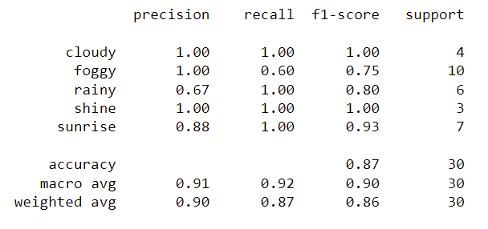
Build deep learning solution
transfer learning architectures
Res-Ne152 with CNN Layers with Augmentation
Test :
classification_report
Accuarcy: 0.87%

Slide 30
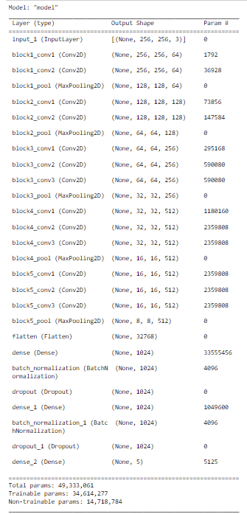
Build deep learning solution
transfer learning architectures
VGG 16 with CNN Layers with Augmentation
Structure :
Using:
Optimizer : Adam
Loss : categorical_crossentropy
Metrics: accuracy
Training accuracy : 0.94 %
Validation accuracy : 0.95 %

Slide 31
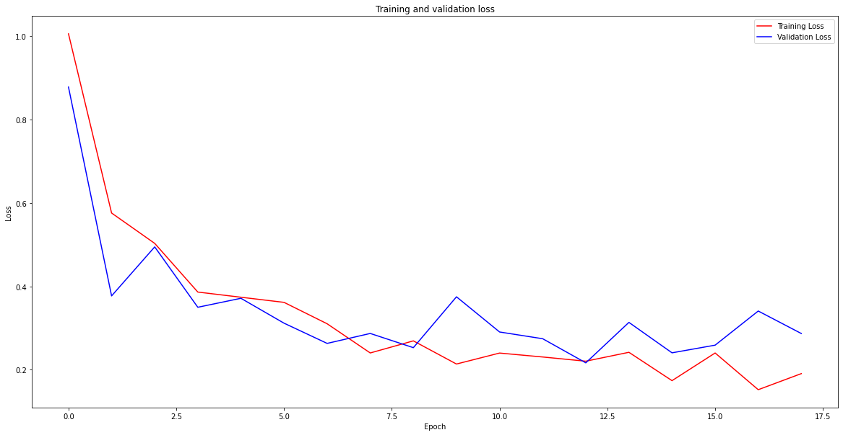
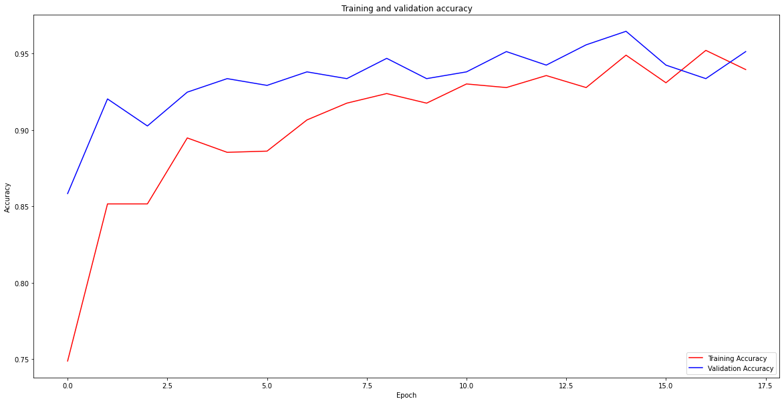
Build deep learning solution
transfer learning architectures
VGG 16 with CNN Layers with Augmentation
Loss curve
Accuracy curve

Slide 32
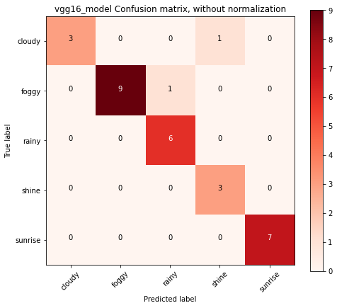
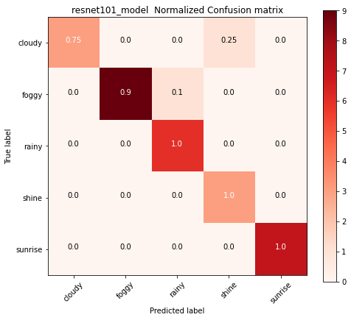
Build deep learning solution
transfer learning architectures
VGG 16 with CNN Layers with Augmentation
Test :

Slide 33
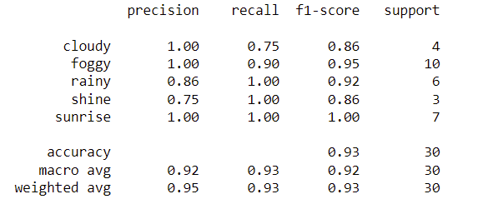
Build deep learning solution
transfer learning architectures
VGG 16 with CNN Layers with Augmentation
Test :
classification_report
Accuarcy: 0.93%

Slide 34
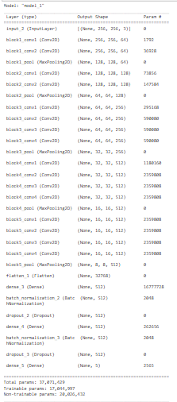
Build deep learning solution
transfer learning architectures
VGG 19 with CNN Layers with Augmentation
Structure :
Using:
Optimizer : Adam
Loss : categorical_crossentropy
Metrics: accuracy
Training accuracy : 0.96 %
Validation accuracy : 0.96 %

Slide 35
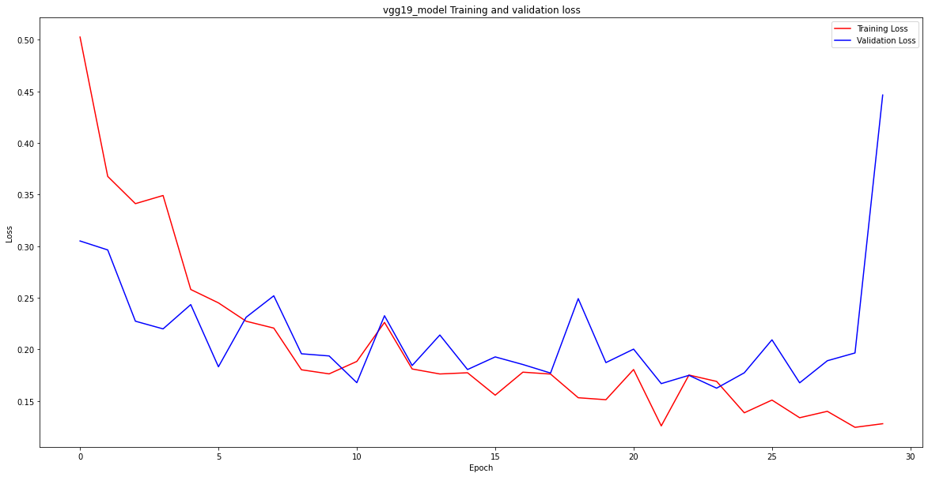
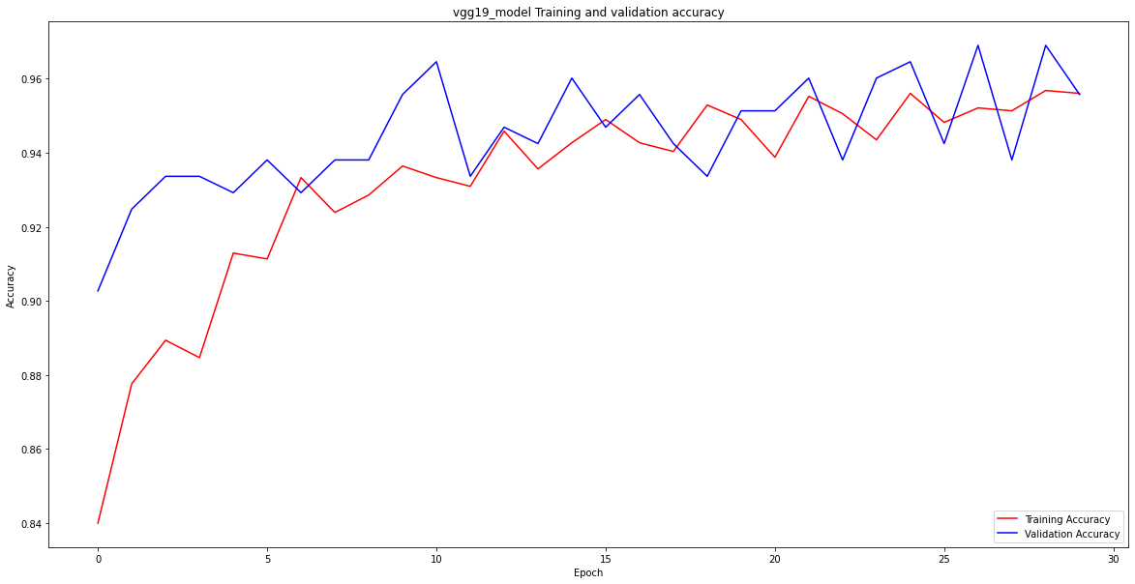
Build deep learning solution
transfer learning architectures
VGG 19 with CNN Layers with Augmentation
Loss curve
Accuracy curve

Slide 36
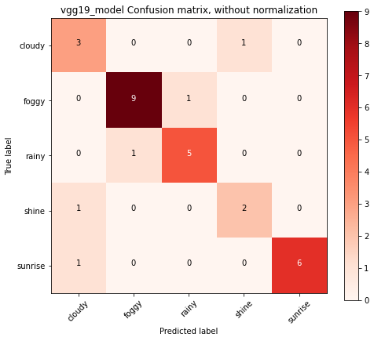
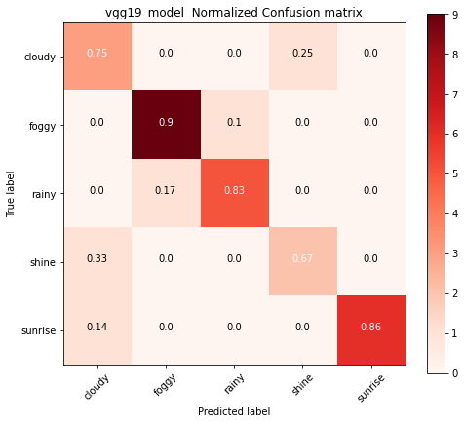
Build deep learning solution
transfer learning architectures
VGG 19 with CNN Layers with Augmentation
Test :

Slide 37
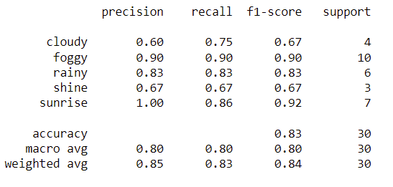
Build deep learning solution
transfer learning architectures
VGG 19 with CNN Layers with Augmentation
Test :
classification_report
Accuarcy: 0.84%

Slide 38
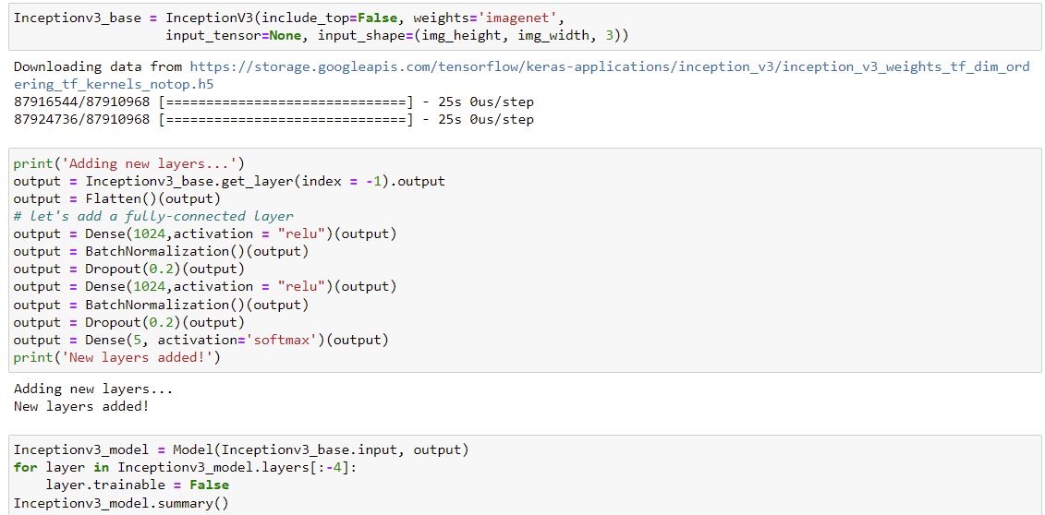
Build deep learning solution
Using:
Optimizer : Adam
Loss : categorical_crossentropy
Metrics: accuracy
Training accuracy : 0.81 %
Validation accuracy : 0.85 %
transfer learning architectures
Inceptionv3 with CNN Layers with Augmentation
Structure :

Slide 39


Build deep learning solution
transfer learning architectures
Inceptionv3 with CNN Layers with Augmentation
Loss curve
Accuracy curve

Slide 40


Build deep learning solution
transfer learning architectures
Inceptionv3 with CNN Layers with Augmentation
Test:

Slide 41

Build deep learning solution
transfer learning architectures
Inceptionv3 with CNN Layers with Augmentation
Test:
classification_report
Accuarcy: 0.30%

Slide 42

Build deep learning solution
Using:
Optimizer : Adam
Loss : categorical_crossentropy
Metrics: accuracy
Training accuracy : 0.92 %
Validation accuracy : 0.92 %
transfer learning architectures
Efficientnet with CNN Layers with Augmentation
Structure :

Slide 43


Build deep learning solution
transfer learning architectures
Efficientnet with CNN Layers with Augmentation
Loss curve
Accuracy curve

Slide 44


Build deep learning solution
transfer learning architectures
Efficientnet with CNN Layers with Augmentation
Test :

Slide 45

Build deep learning solution
transfer learning architectures
Efficientnet with CNN Layers with Augmentation
Test :
classification_report
Accuarcy: 0.80%

Slide 46
Final :
Using Res-Ne101 with CNN Layers with Augmentation
Has 97 % accuracy

