Slide 1

Hospital System
Team:
Name: Mina Samy
Name: Kirollos Atef

Slide 2
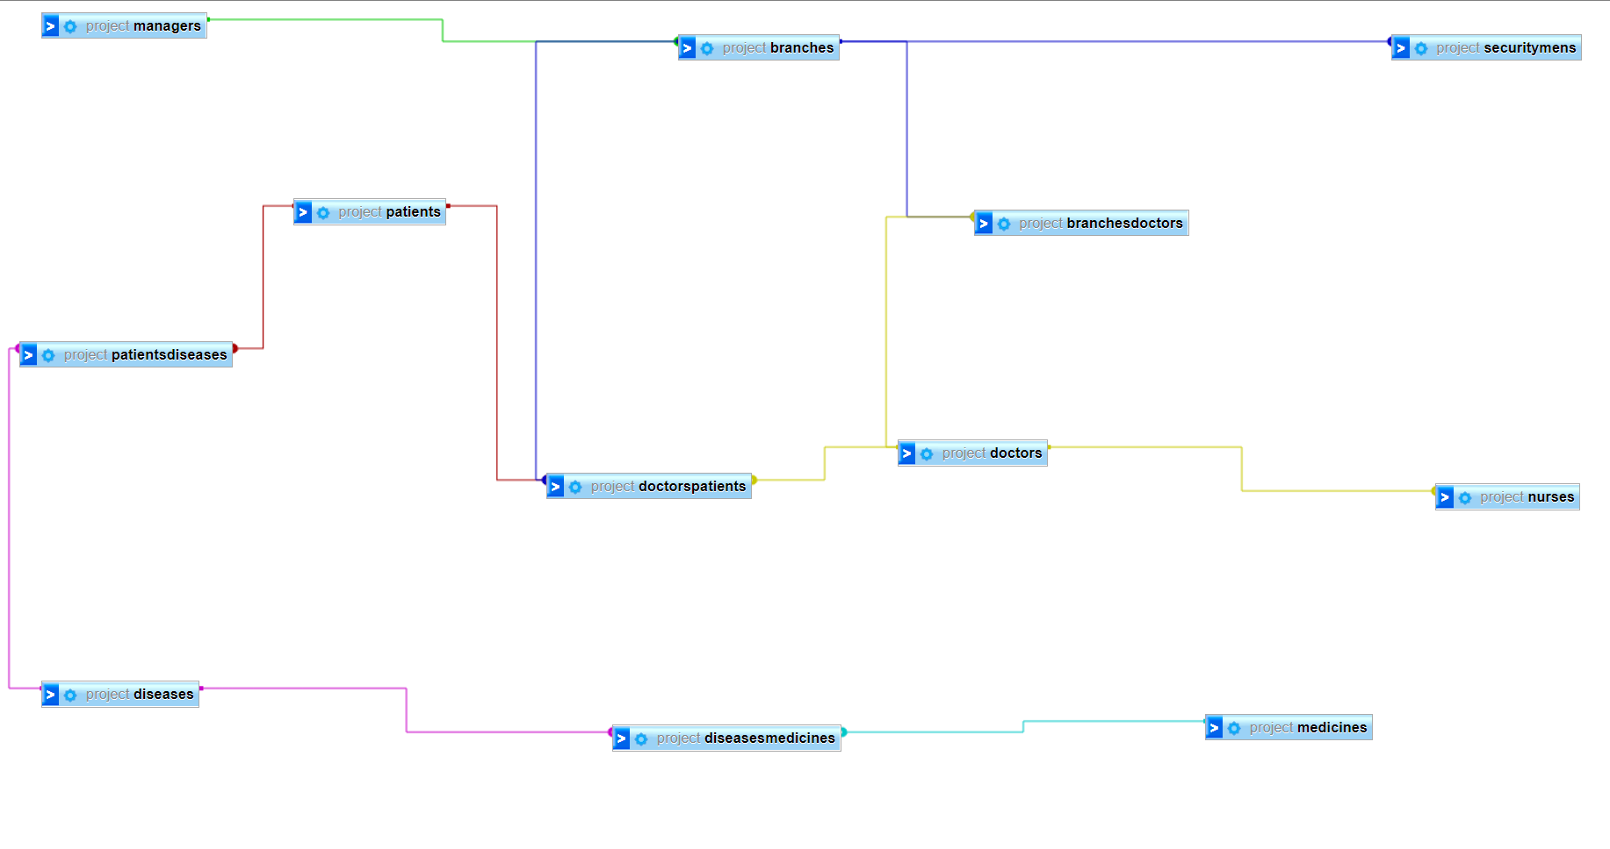
conceptual model

Slide 3
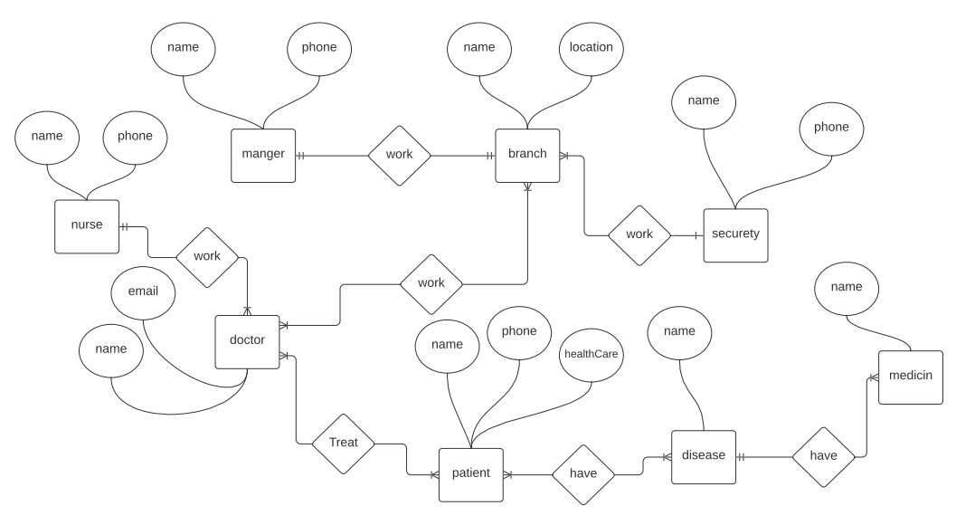
ERD

Slide 4
 | Mangers | Branches | Doctors | Nurses | Patients | Diseases | Medicines | Security
Mangers | - | Manage | - | - | - | - | - | -
Branches | Managed by | - | have | - | - | - | - | have
Doctors | have | Work in | - | have | treat | - | - | -
Nurses | - | - | Work with | - | - | - | - | -
Patients | - | - | Treat with | - | - | have | - | -
Diseases | - |  | - | - | Affect | - | have | -
Medicines | - | - | - | - | - | Treat | - | -
Security | - | Work in | - | - | - | Treat | - | -
Relationship matrix

Slide 5
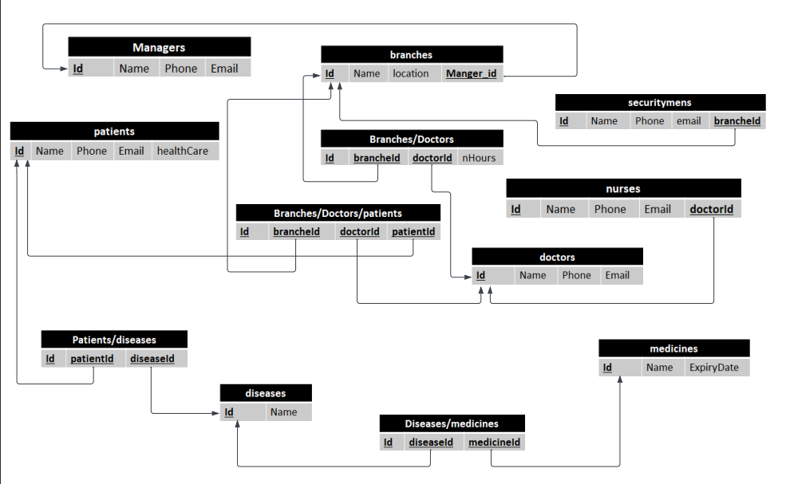
mapping

Slide 6
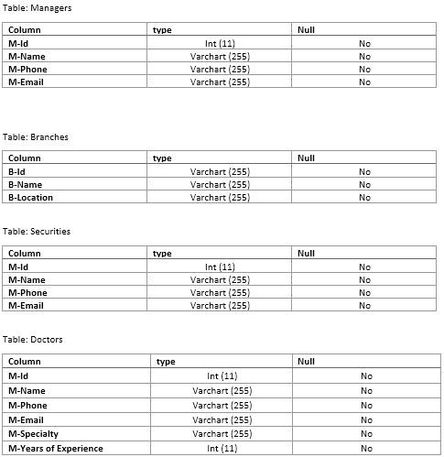
data dictionary
1

Slide 7
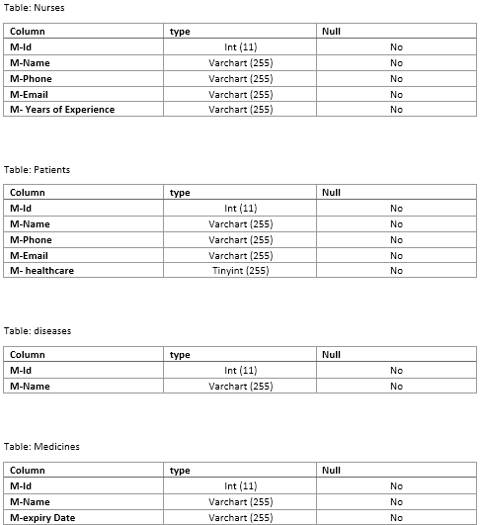
data dictionary
2

Slide 8
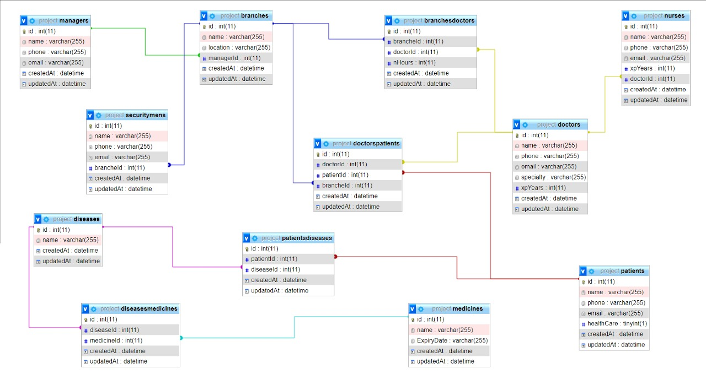
Finally schema

