Slide 1










SUPERSTORE SALES
Presented by:
Abanoub Bassem Mikhael Heshamt
Yousef Ahmed ElAzab Dagher

Slide 2


AGENDA
01
Introduction
02
Cleaning
03
Analysis Phase
04
Visualization
05
Conclusion
06
Recommendations

Slide 3

Cleaned raw data using Excel, Python, and SQL
Fixed inconsistencies, handled missing values, and standardized formats
Validated data accuracy for reliable analysis
Analyzed dataset to answer key business questions
Built interactive dashboards for stakeholders to explore insights
INTRODUCTION

Slide 4

CLEANING

Slide 5
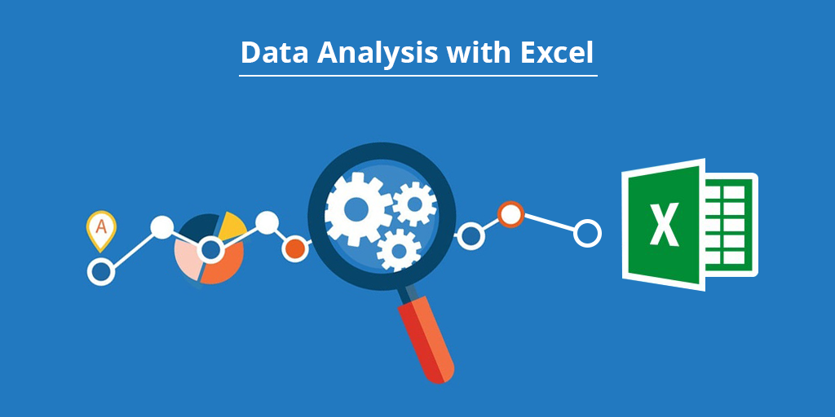

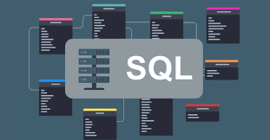
CLEANING
Used Excel for initial data cleaning to create a clean baseline
Removed duplicates and corrected typos
Fixed formatting issues and standardized date/text fields
Handled missing values for consistency
Used Python (Pandas) for advanced, automated data cleaning
Detected outliers and normalized column types
Merged large datasets and validated values
Applied rule-based corrections to improve consistency and reduce error
Used SQL to enforce data integrity and prepare a reliable dataset
Enforced referential integrity and validated table relationships
Removed invalid records and standardized keys
Enabled accurate, analysis-ready dashboards

Slide 6

PYTHON CLEANING
Used Python to clean and structure the dataset for analysis
Handled missing values and removed duplicates
Standardized formats and corrected inconsistencies
Reshaped data for deeper analysis
Ensured accurate and trustworthy insights

Slide 7
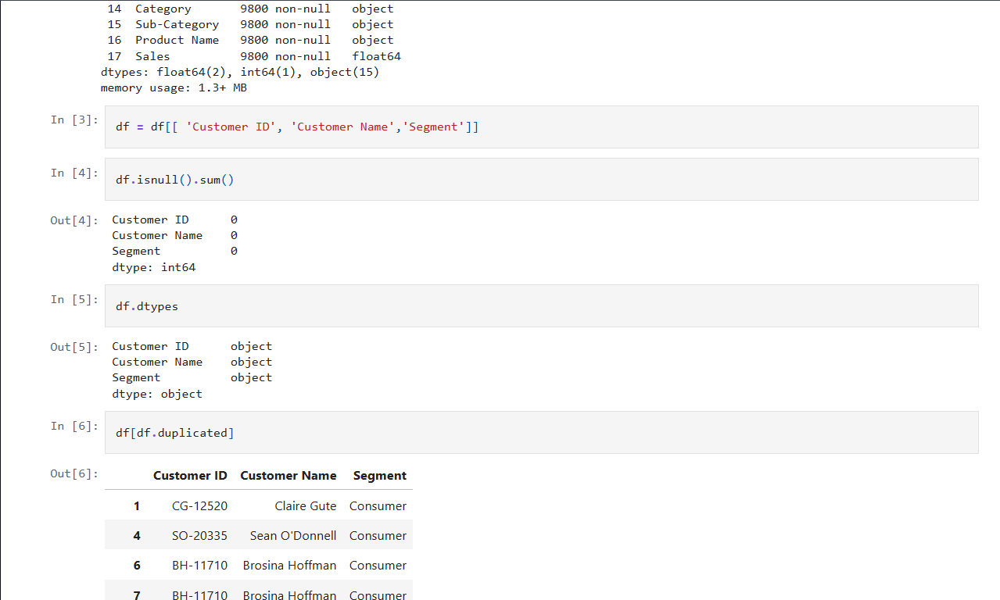
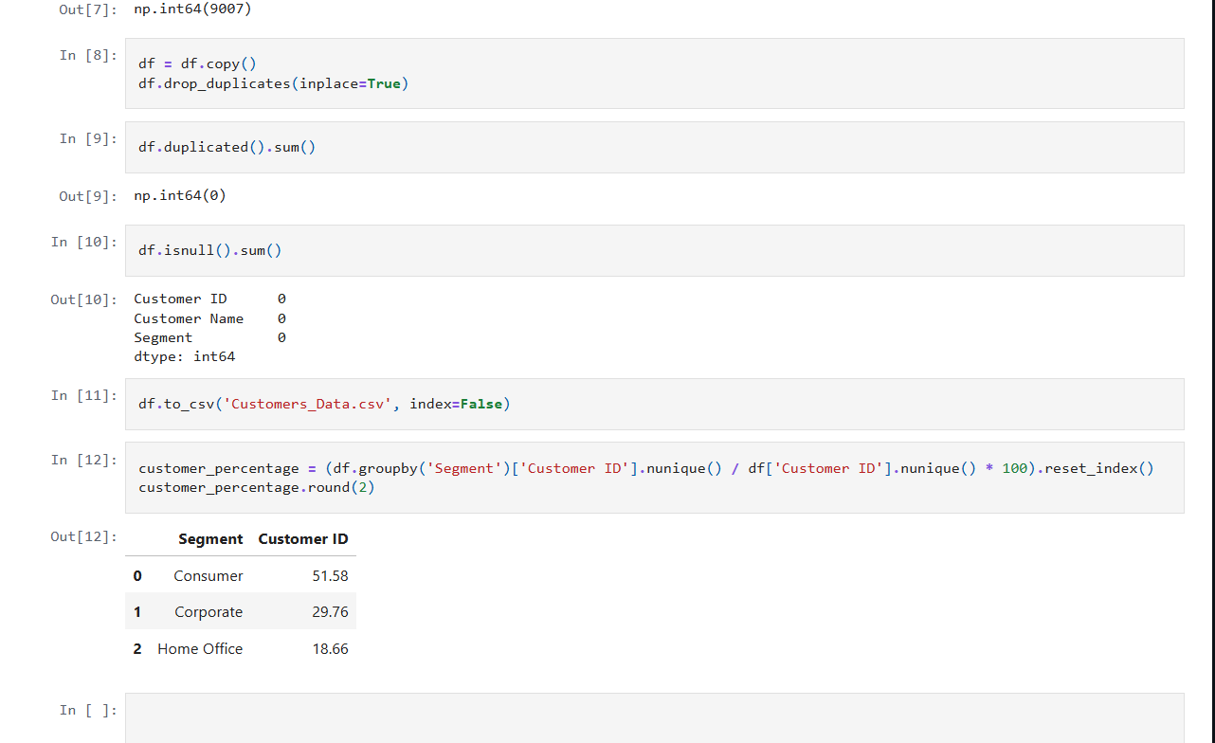
PYTHON CLEANING

Slide 8
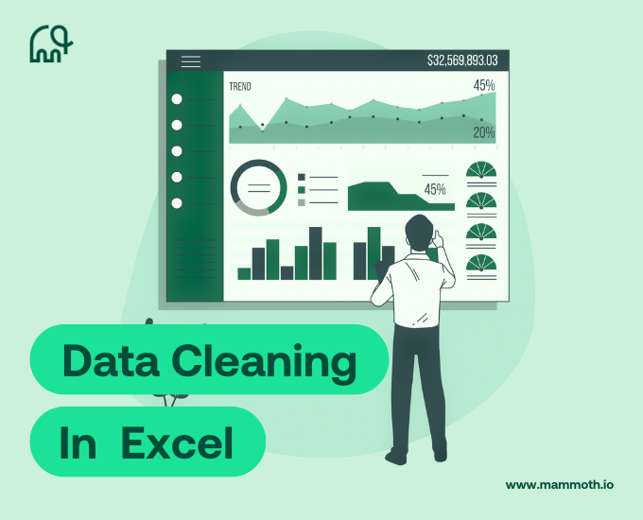
EXCEL CLEANING
Used Excel to clean and structure the dataset
Removed duplicates and fixed inconsistent entries
Applied data validation and unified formats (dates & numbers)
Organized dataset into a logical, easy-to-navigate layout
Provided a solid foundation for analysis and tool integration

Slide 9
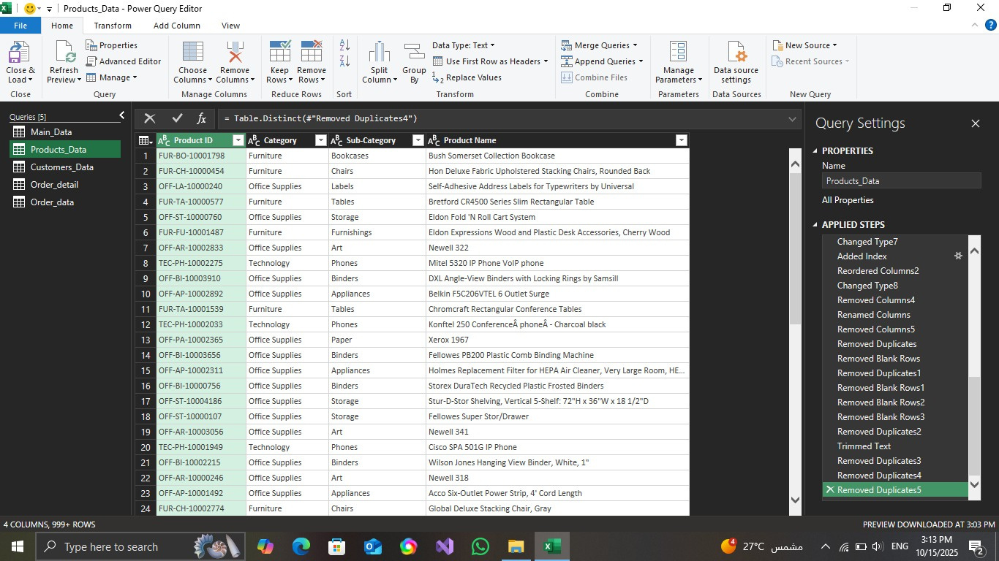
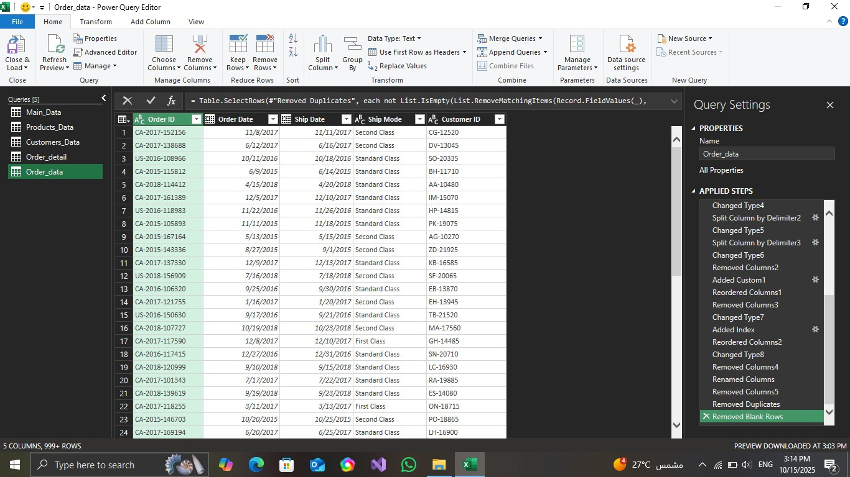
EXCEL CLEANING

Slide 10

SQL CLEANING
Used SQL to import, structure, and optimize data
Resolved null values and fixed inconsistencies
Normalized tables and enforced primary & foreign keys
Created a well-organized relational database
Enabled fast, accurate, and scalable analysis

Slide 11
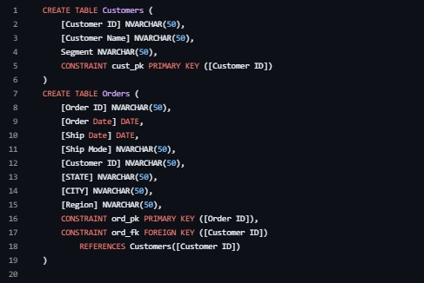
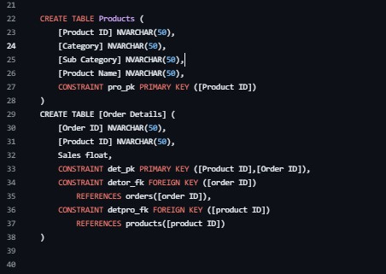
SQL CLEANING

Slide 12
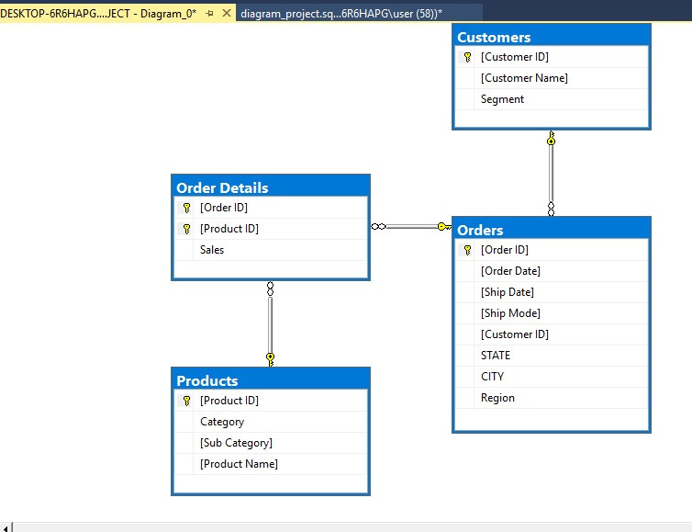
DATABASE DIAGRAM
RELATIONAL DATABASE STRUCTURE OVERVIEW
ER diagram shows main dataset tables and their relationships
Key tables: Customers, Orders, Order_Details, Products
Tables are connected through primary and foreign keys
Forms the foundation for accurate analysis and dashboard creation

Slide 13
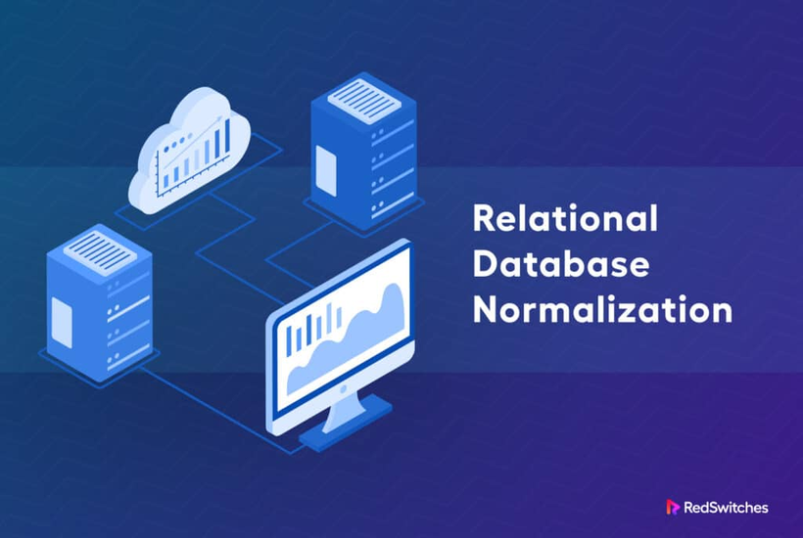
NORMALIZATION
Cleaned dataset and removed duplicates
Fixed inconsistencies and validated key fields
Reorganized data into four structured tables: Orders, Customers, Products, Order_Details
Assigned primary and foreign keys for relationships
Maintained referential integrity across tables
Optimized structure for efficient data analysis

Slide 14
ANALYSIS PHASE

Slide 15
CUSTOMERS

Slide 16


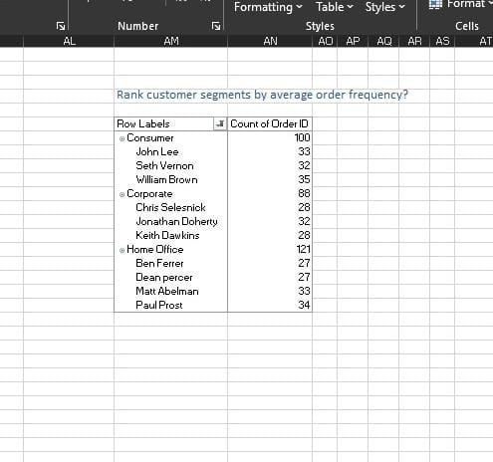
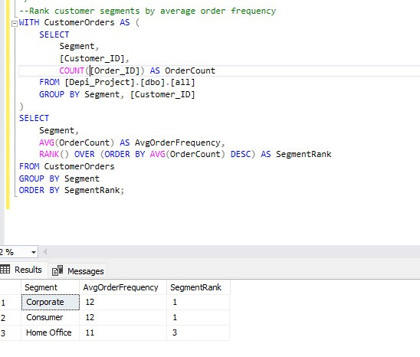
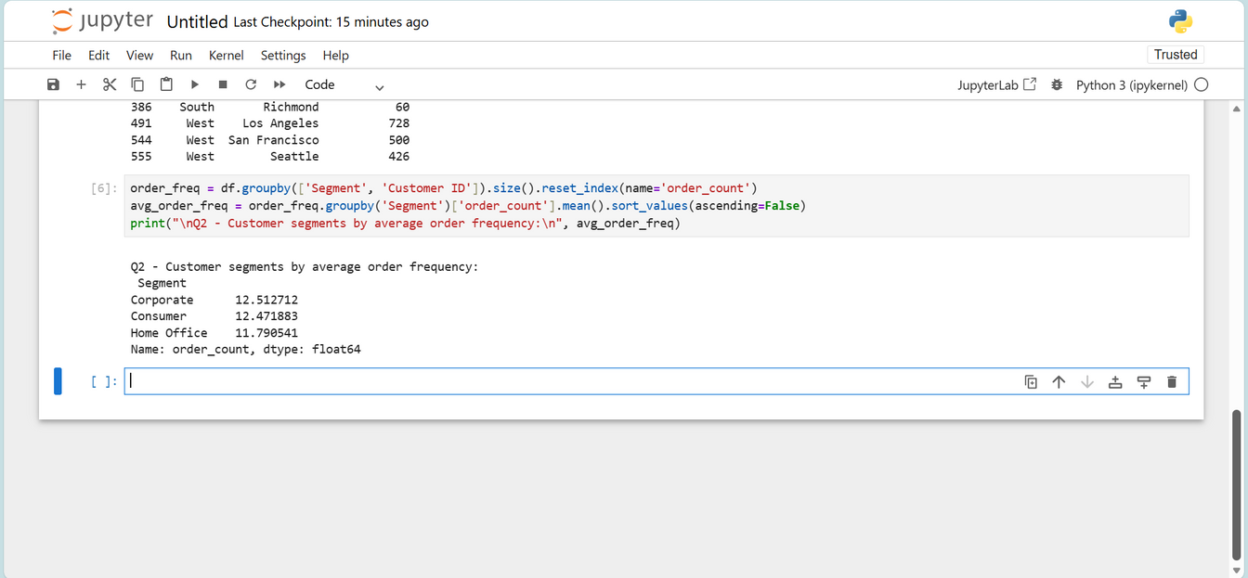
Q1-RANK CUSTOMER SEGMENTS BY AVERAGE ORDER FREQUENCY
EXCEL ANSWER
SQL ANSWER
PYTHON ANSWER

Slide 17
PRODUCTS

Slide 18
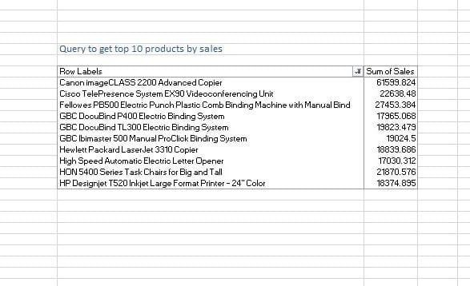
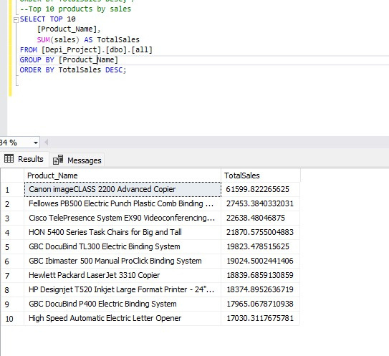
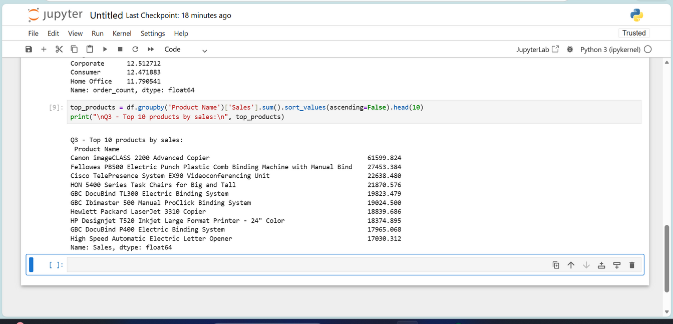
Q2- TOP 10 PRODUCTS BY SALES
EXCEL ANSWER
SQL ANSWER
PYTHON ANSWER

Slide 19
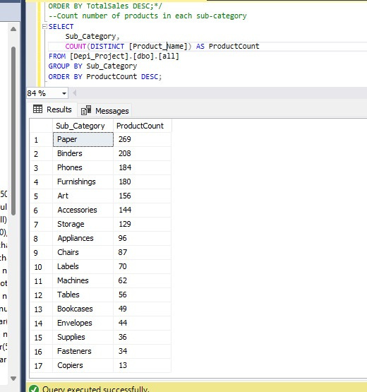
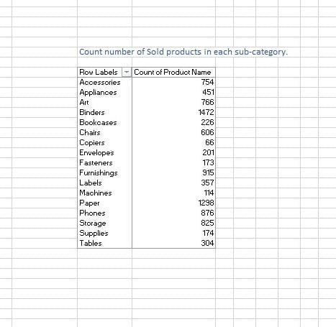
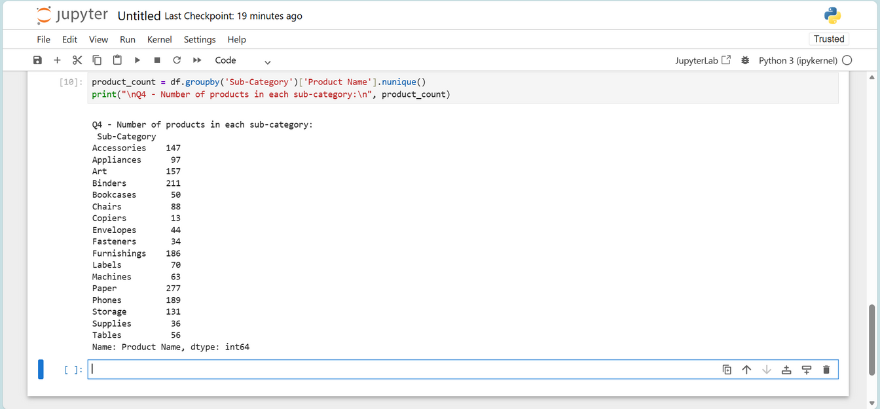
Q4- NUMBER OF PRODUCTS IN EACH SUB-CATEGORY
EXCEL ANSWER
SQL ANSWER
PYTHON ANSWER

Slide 20
ORDERS

Slide 21
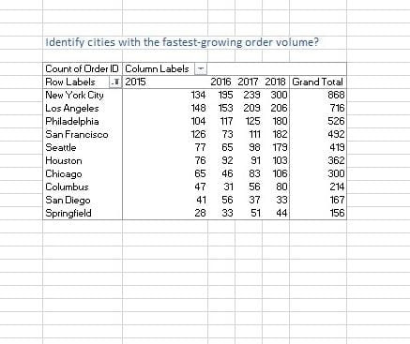
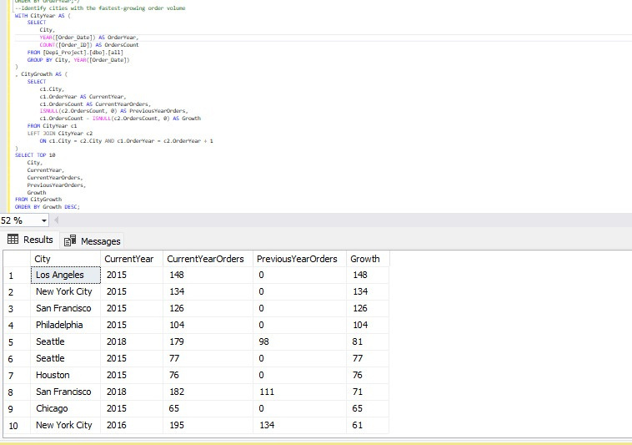
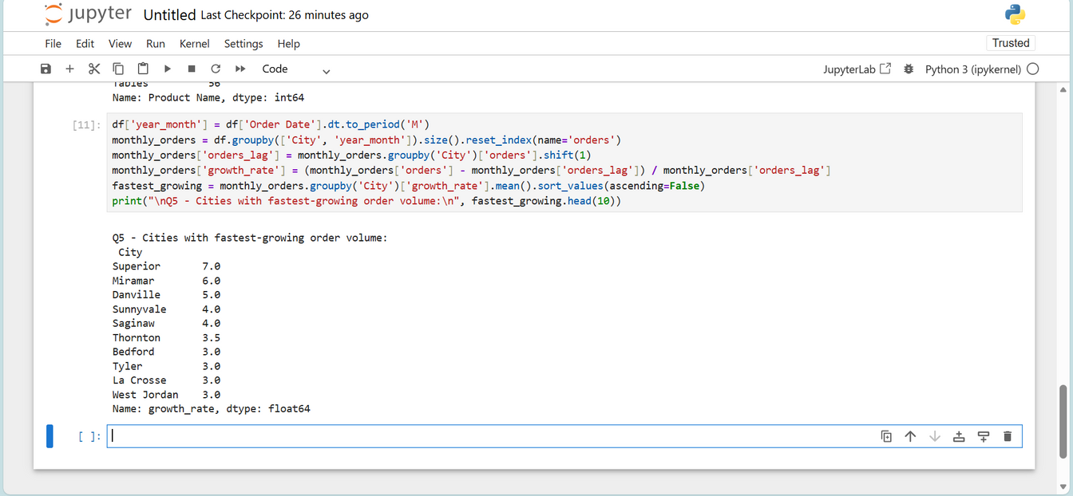
Q5- IDENTIFY CITIES WITH THE FASTEST-GROWING ORDER VOLUME
EXCEL ANSWER
SQL ANSWER
PYTHON ANSWER

Slide 22
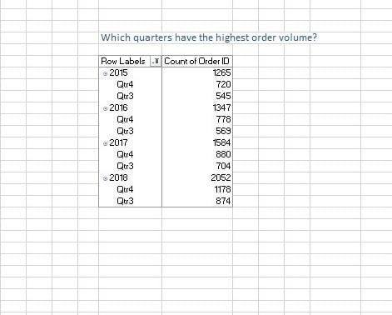
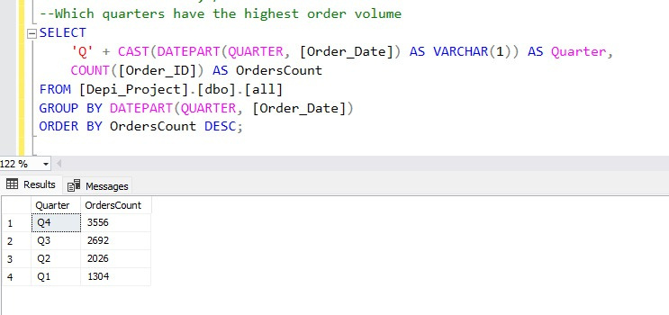
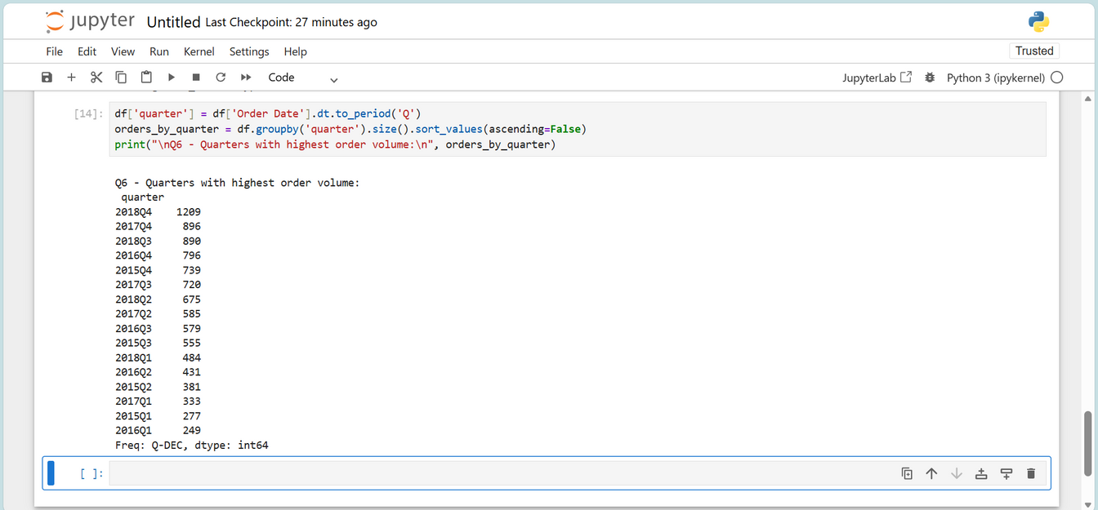
Q6- WHICH QUARTERS HAVE THE HIGHEST ORDER VOLUME
EXCEL ANSWER
SQL ANSWER
PYTHON ANSWER

Slide 23
SHIPING

Slide 24
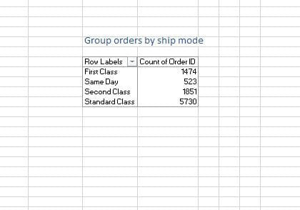
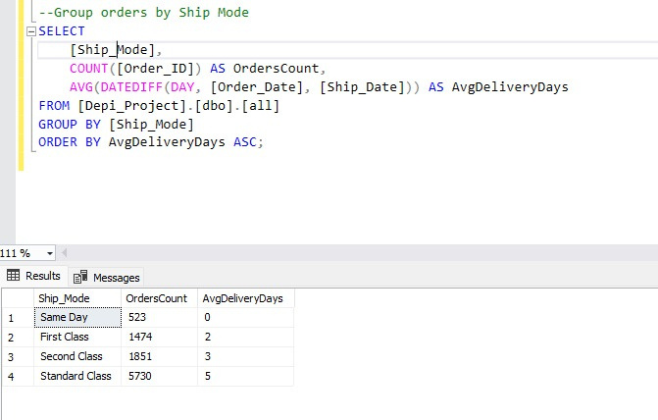
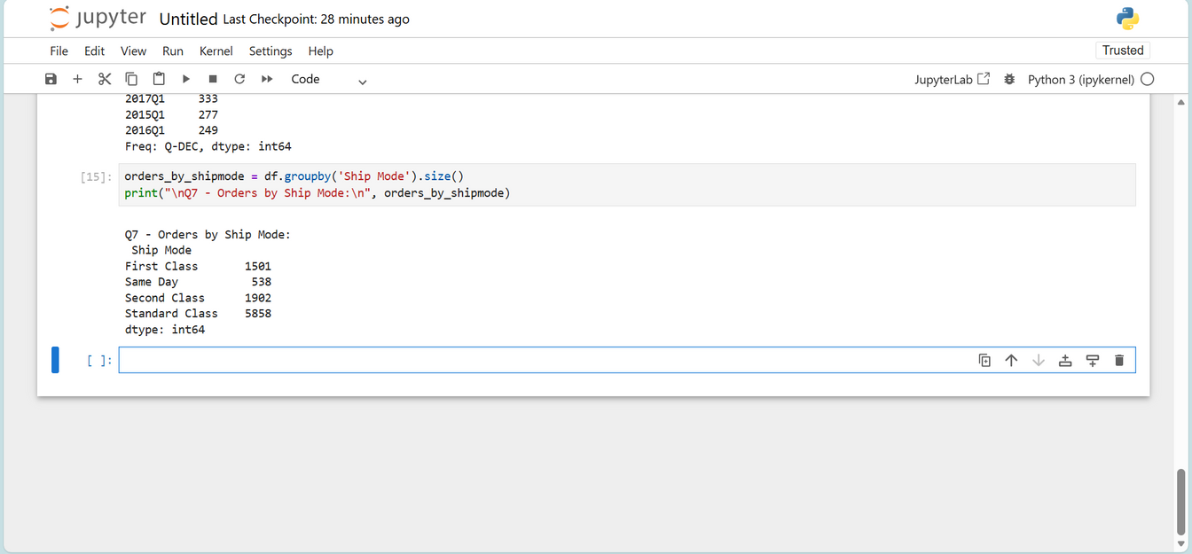
Q7- GROUP ORDERS BY SHIP MODE
EXCEL ANSWER
SQL ANSWER
PYTHON ANSWER

Slide 25
SALES

Slide 26
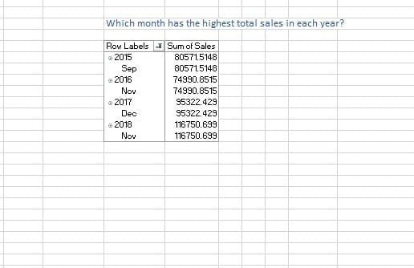
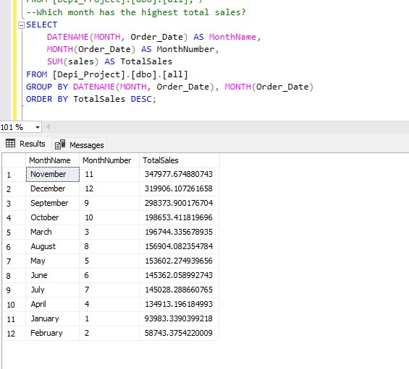
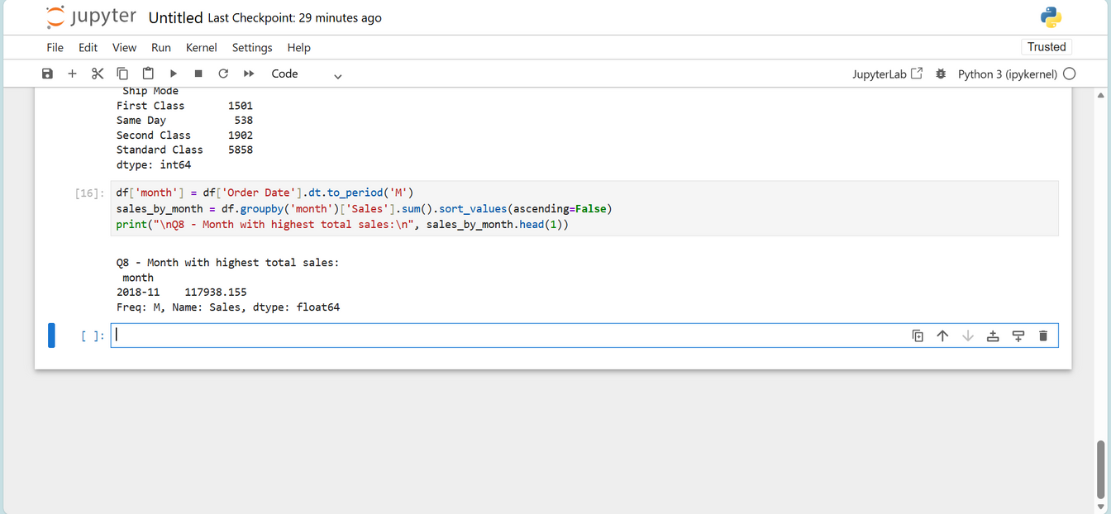
Q8- WHICH MONTH HAS THE HIGHEST TOTAL SALES
EXCEL ANSWER
SQL ANSWER
PYTHON ANSWER

Slide 27
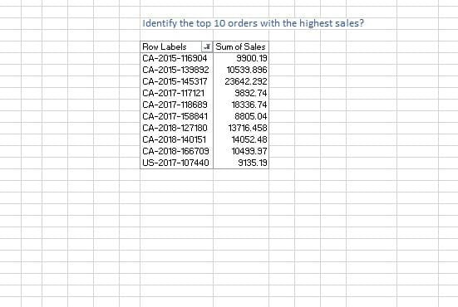
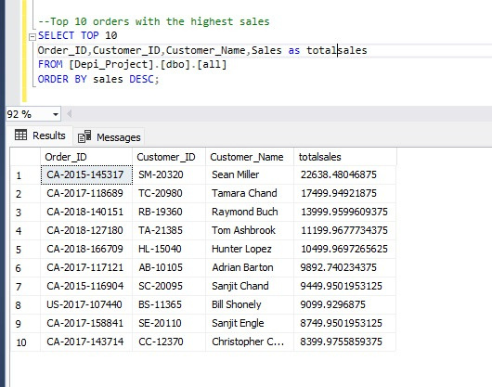
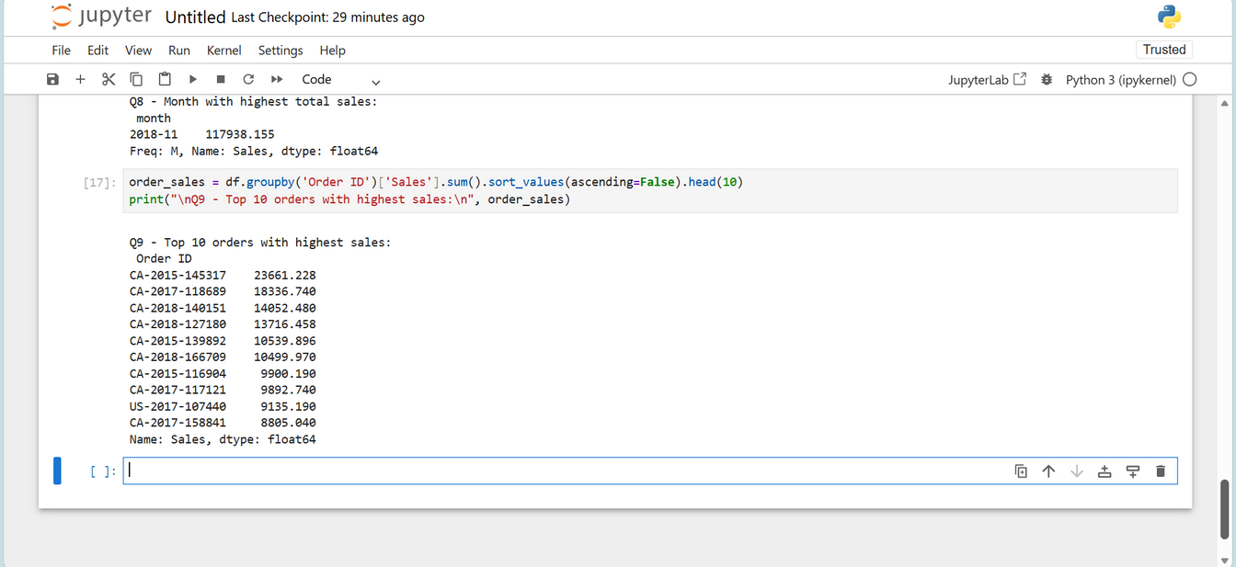
Q9- IDENTIFY THE TOP 10 ORDERS WITH THE HIGHEST SALES?
EXCEL ANSWER
SQL ANSWER
PYTHON ANSWER

Slide 28
VISUALIZATION

Slide 29
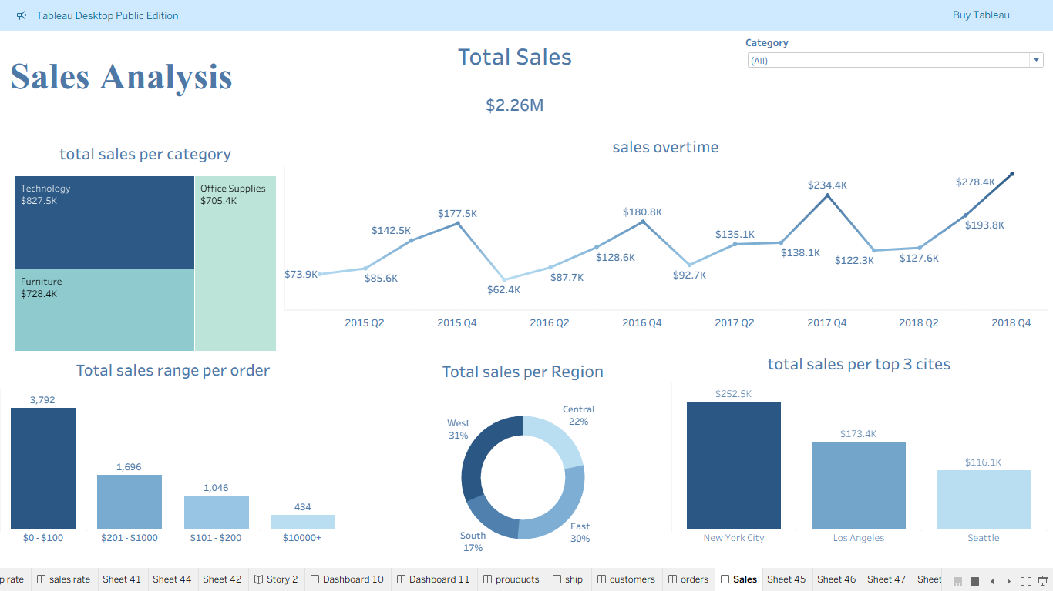
TABLEAU

Slide 30
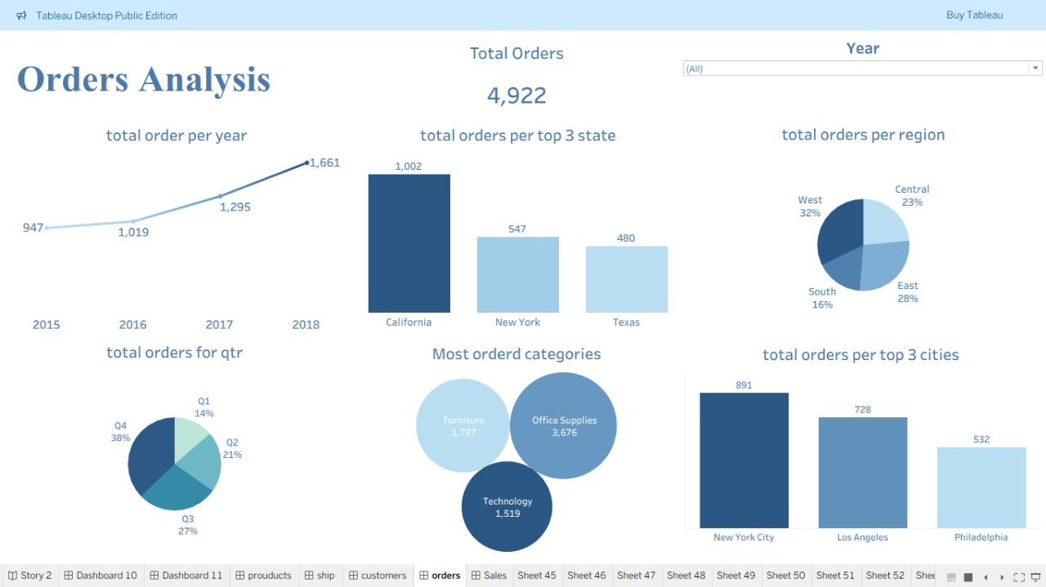
TABLEAU

Slide 31
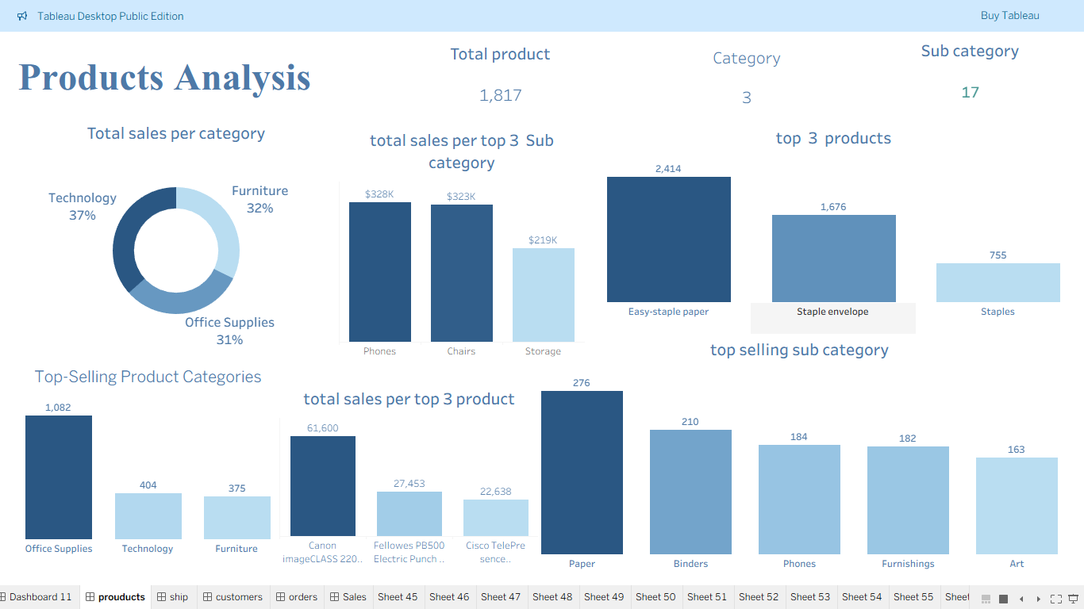
TABLEAU

Slide 32
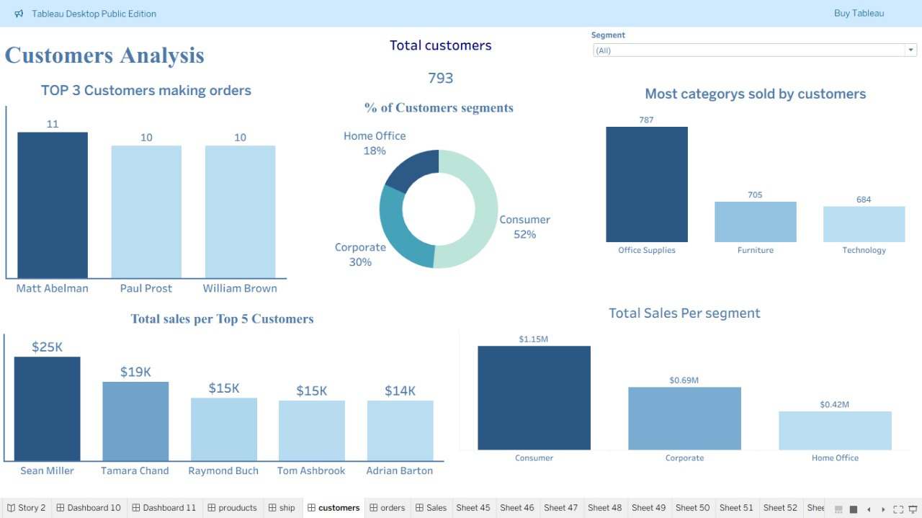
TABLEAU

Slide 33
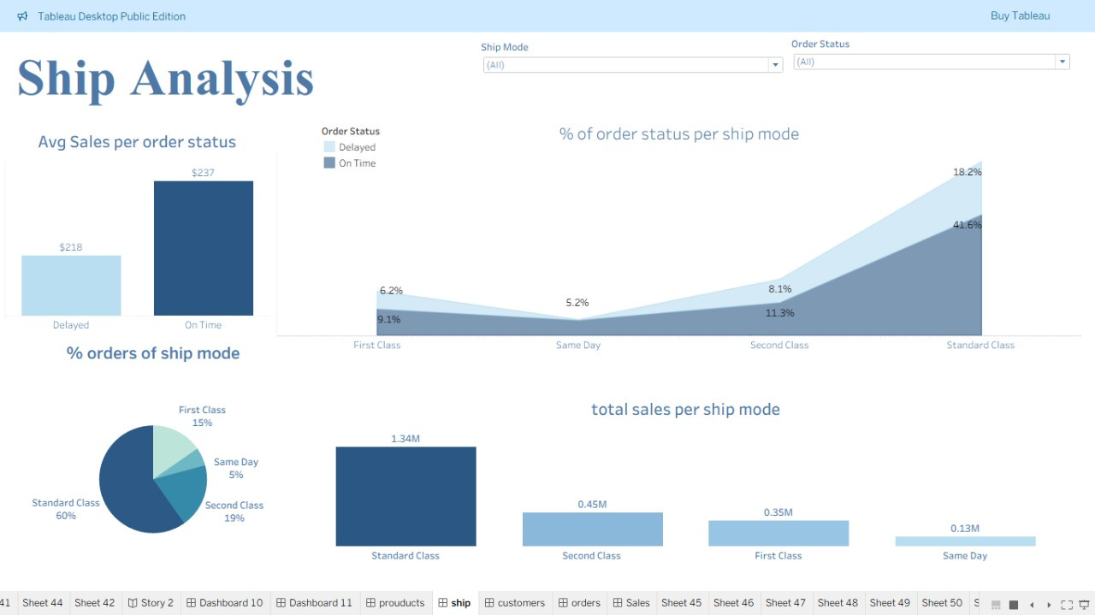
TABLEAU

Slide 34
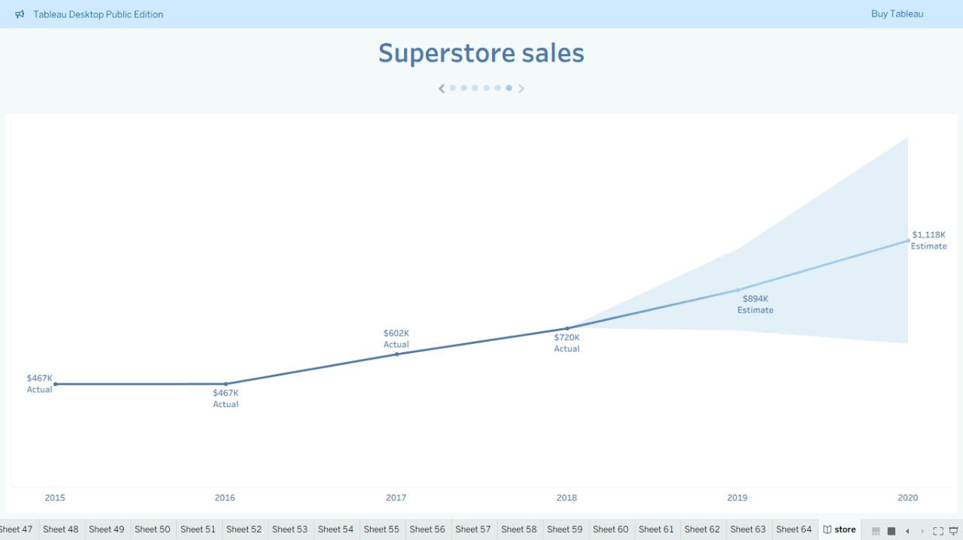
TABLEAU : FORCASTING

Slide 35

CONCLUSION
Dataset is now consistent, structured, and analysis-ready
Reduced redundancy and strengthened table relationships
Supports faster, more accurate reporting and insights
Provides a solid foundation for data-driven decision-making

Slide 36

RECOMMENDATIONS

Slide 37
1. Improve Shipping Performance
Reduce delivery time for Standard Class by partnering with faster logistics providers.
Reallocate inventory to warehouses closer to high-demand regions.
Implement route optimization to reduce delays.
2. Increase Profit From the Phones Sub-Category
Expand phone product availability into international markets with emerging demand.
Introduce promotional bundles (e.g., phones + accessories) to increase average order value.
Strengthen marketing strategies for regions with growing technology adoption.

Slide 38
THANK YOU
Our GitHub: Depi_Project_GitHub

