Slide 1

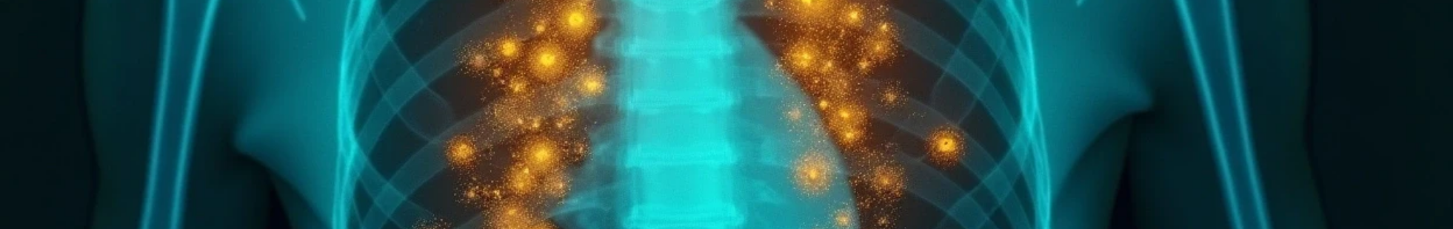
Explainable AI for Tuberculosis Classification from Chest X-Rays Using Grad-CAM for Explainability

Slide 2






Team Members
Rawan Khaled Fakhry
1
2
Mohamed Essam Askar
3
Kirolos Anwar Wassef
Email: Rawankhaledfakhry@gmail.com
Email: askermohamed174@gmail.com
Email: Kokoanwar006@gmail.com
4
Thomas Safwat Nazeer
5
Supervisor
6
Research Focus
Eng/George Samuel
Email:
Thomasyokeem@gmail.com
Classifying Chest X-Rays using Grad-CAM

Slide 3

CONTENTS
3. Data Preprocessing
1. Introduction
2. Data Description
4. Modelling
4. Results
5. Generate Report

Slide 4


01
Introduction

Slide 5
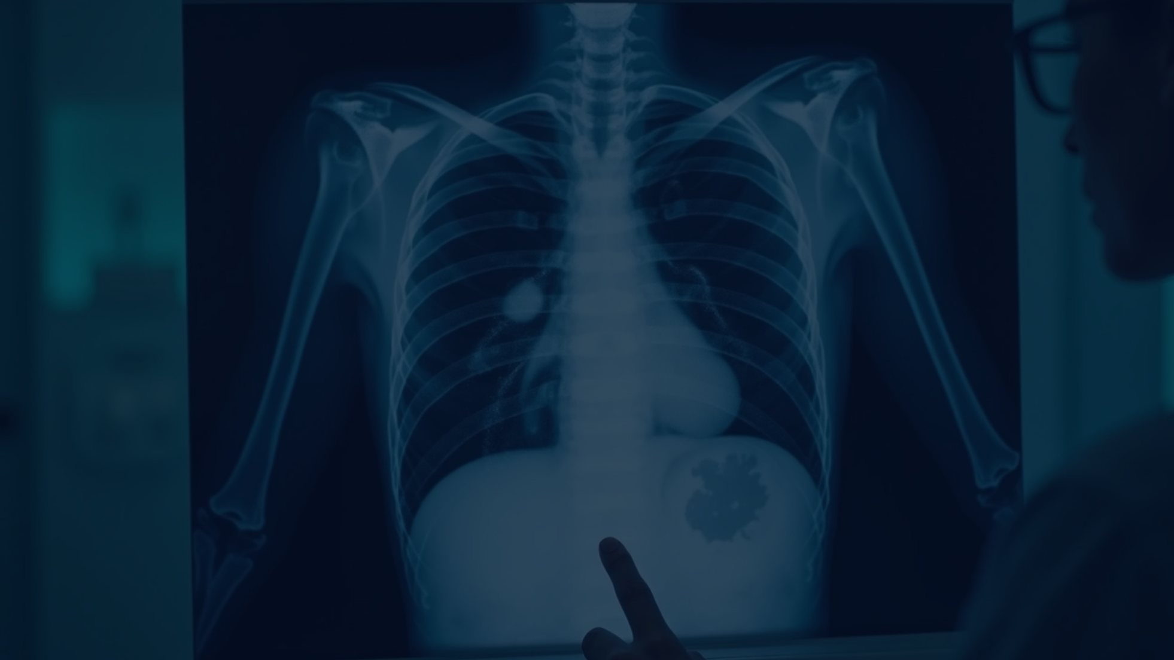
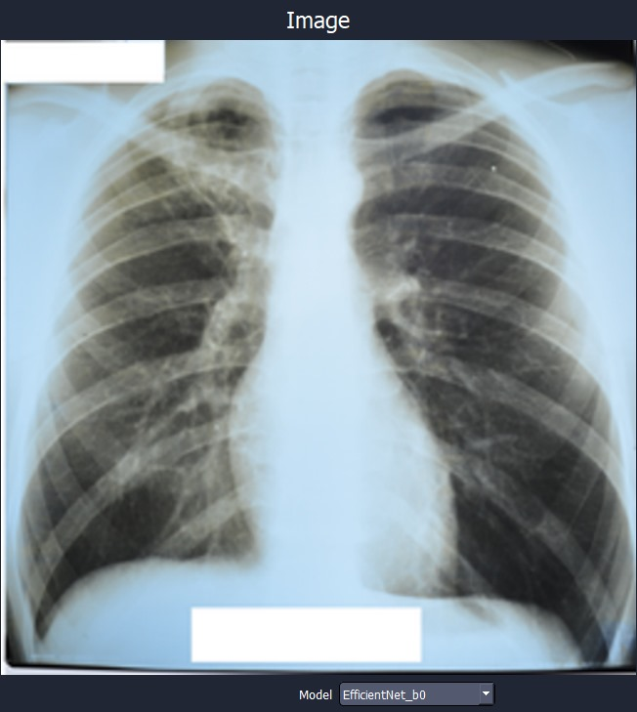
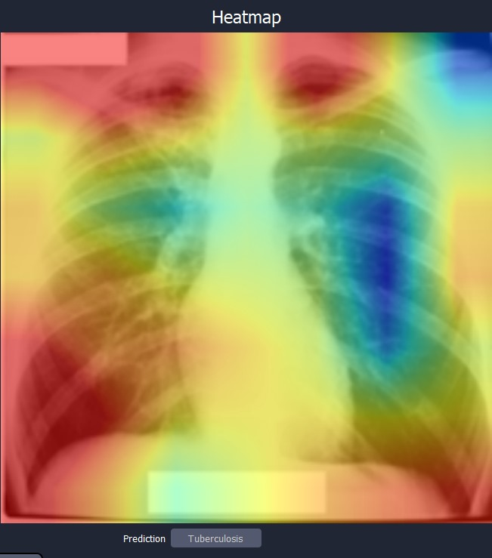
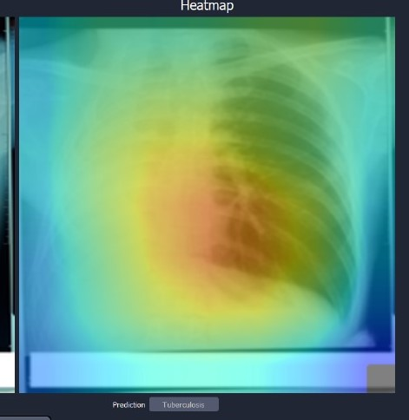
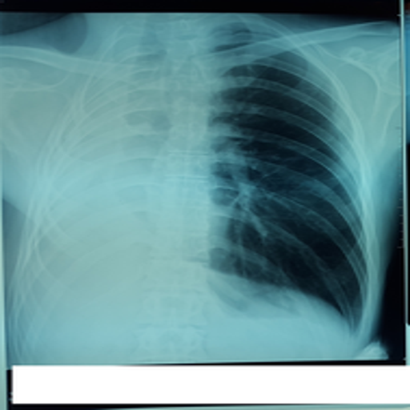
Introduction
Problem:
TB is a leading cause of illness & death worldwide, especially in children.
Pediatric chest X-ray interpretation is difficult and prone to errors.
Solution:
Use Deep Learning (CNNs) [EfficientNet or Resnet ] for automated chest X-ray classification.
Apply Grad-CAM for model interpretability (highlights critical lung regions).
Results:
Model classifies Normal vs. TB with 99.9% accuracy.
Provides reliable, explainable support for clinicians.

Slide 6

02
Data Description

Slide 7
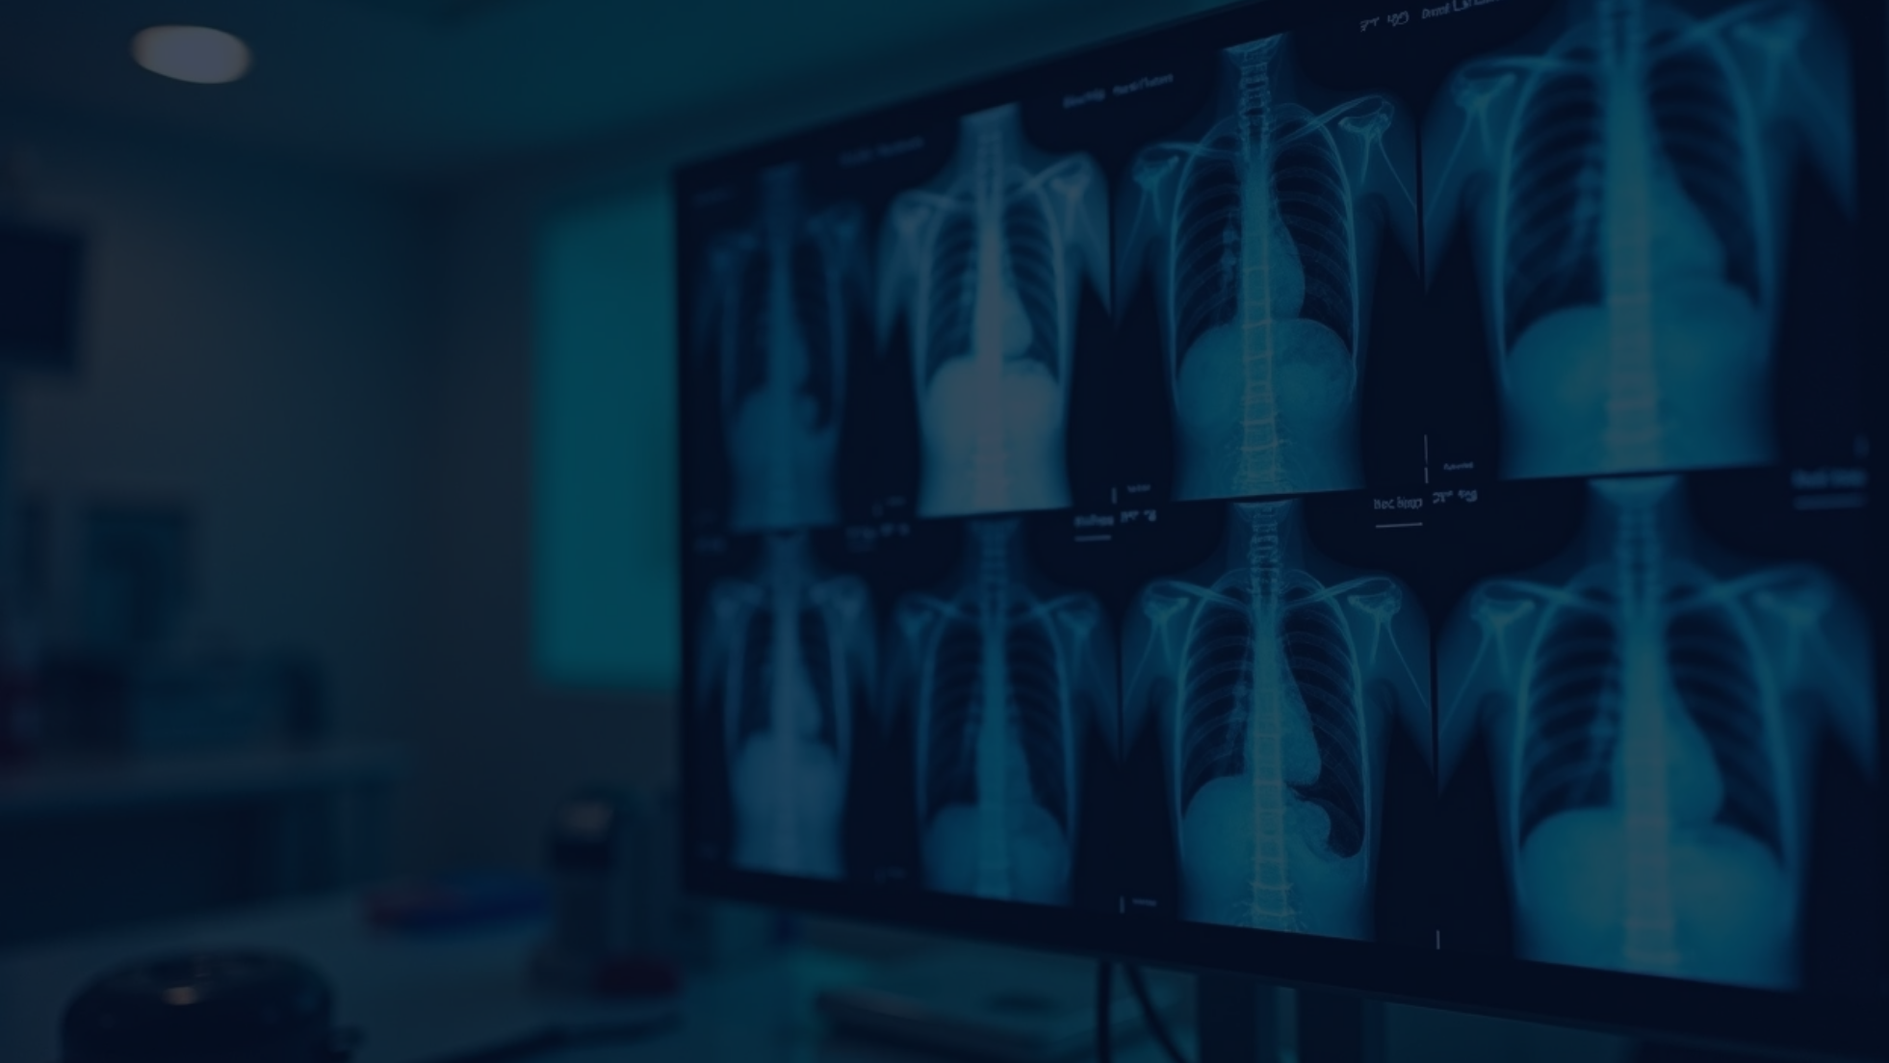

Data
4200 images
Normal
Tuberculosis
3500 images
700 images
Training set
Validation set
Test set
2,939 images
630 images
631 images

Slide 8

03
Data Preprocessing

Slide 9
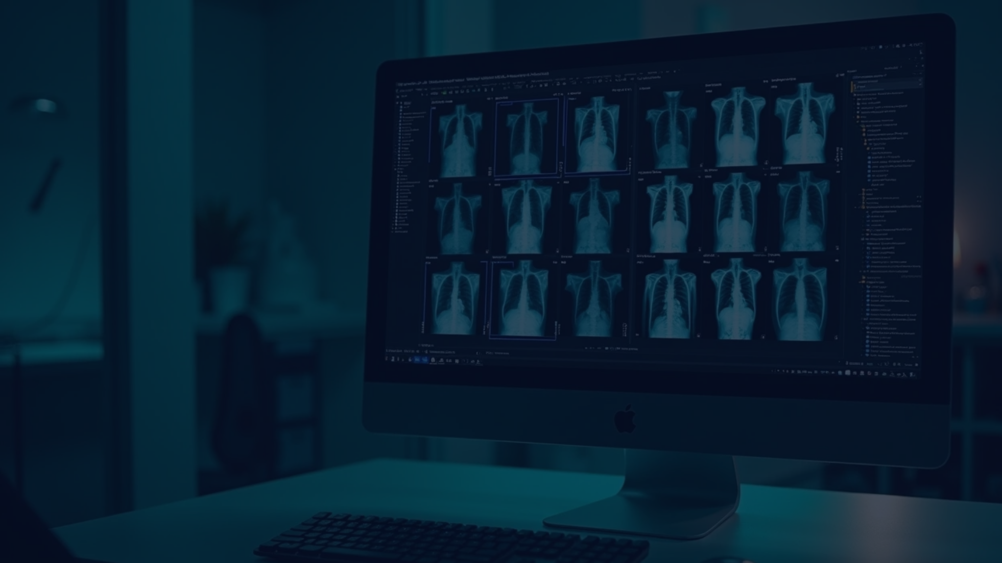
Data Preprocessing
Image Preprocessing:
All images were converted to RGB to standardize the input format.
Images were resized to 224×224 pixels, which is the input size required by CNN models such as EfficientNet and ResNet.
Normalization:
mean = [0.485, 0.456, 0.406]std = [0.229, 0.224, 0.225]
This improves training stability and model convergence.
Label Encoding :
A Bidirectional Map was used to convert class names (Normal / Tuberculosis) into numeric labels and back.
Class Distribution Visualization

Slide 10
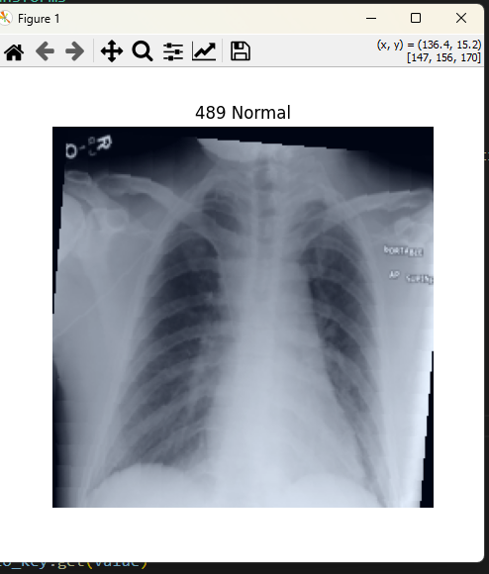
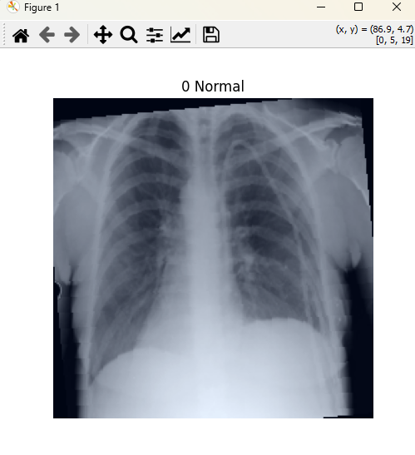
Data Augmentation
Random Resized Crop for random zooming.
Random HorizontalFlip for mirroring images.
Color Jitter for brightness, contrast, and color variations.
Random Affine for small rotations and translations.
Random Grayscale to randomly convert some images to grayscale.
These techniques help increase data diversity and reduce overfitting.

Slide 11

04
Modelling

Slide 12
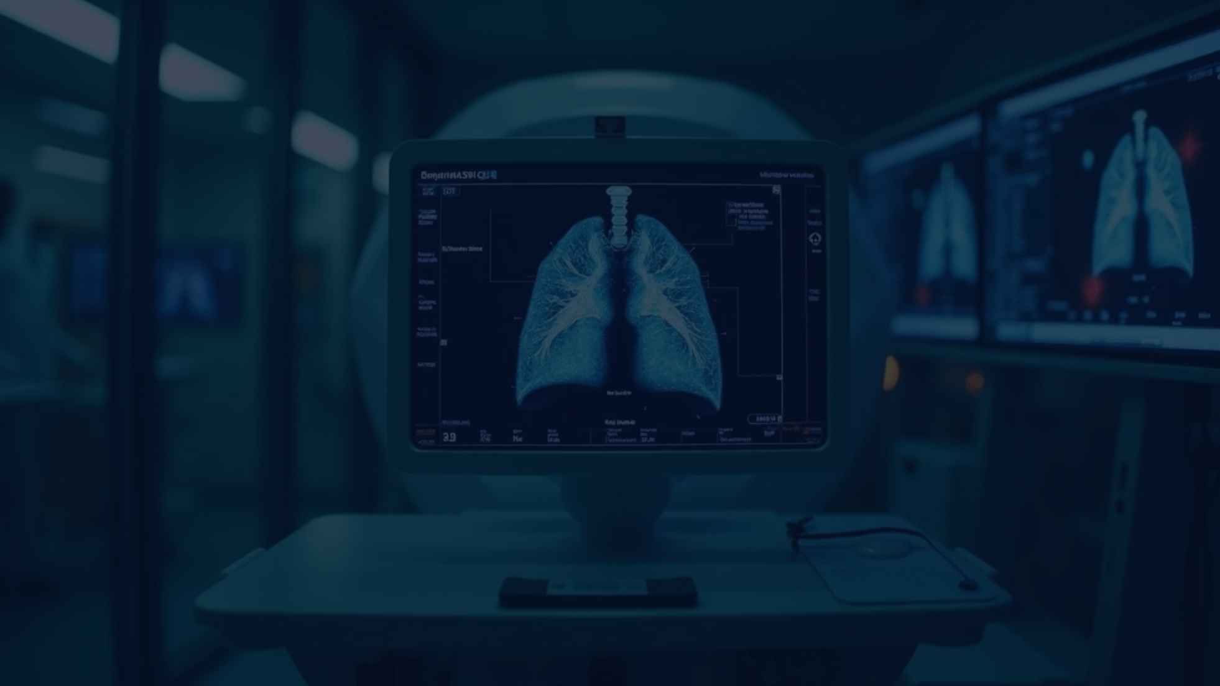
Modelling
In this study, different deep learning architectures were explored to identify the most suitable model for classifying medical images. The goal was to evaluate multiple approaches and select the one that provided the best balance between accuracy, efficiency, and generalization performance. Among the tested models, *EfficientNet* and *ResNet* were implemented and compared.
*EfficientNet* was initially applied as it is known for its computational efficiency and strong performance on image classification tasks. It employs a compound scaling method that balances network depth, width, and resolution, enabling high accuracy with relatively fewer parameters. Although EfficientNet achieved promising results in terms of speed and parameter optimization, it did not outperform ResNet in this specific application.
**ResNet*, on the other hand, was also implemented due to its proven effectiveness in addressing the vanishing gradient problem through residual connections. This architecture allows for training very deep networks without performance degradation. When applied to the dataset, ResNet demonstrated superior accuracy and generalization ability compared to EfficientNet. Consequently, ResNet was selected as the final model for the study, as it provided the most reliable performance in classifying the medical images.

Slide 13



Model Architecture
1
2
3
Backbone: A convolutional neural network pretrained on ImageNet was utilized as the feature extractor. The input images were resized to 224 × 224 × 3 (RGB) to match the expected dimensions of the backbone.
Fully Connected Layers: The extracted features were passed through fully connected layers, followed by dropout regularization to mitigate overfitting.
Output Layer: A dense layer with 2 output neurons was used, corresponding to the two classes (Normal and Tuberculosis). A softmax activation was applied to obtain class probabilities.

Slide 14
1.Efficientnet
We used EfficientNet-B0, a lightweight yet powerful CNN architecture pre-trained on ImageNet.The final fully connected layer was replaced with a new layer matching the number of target classes (Normal / Tuberculosis).
Transfer Learning & Fine-Tuning:
Pre-trained weights were leveraged to speed up training and improve performance.
Only the final layers were fine-tuned, while the earlier layers remained frozen to retain general visual features.
Loss Function:
We used Focal Loss instead of standard Cross-Entropy.
This helps handle class imbalance by focusing more on hard-to-classify samples.
Optimizer & Learning Rate:
Adam optimizer with a learning rate of 5e-4 and no weight decay.
Training performed using mixed precision (AMP) to improve efficiency and reduce memory usage.
Training Setup:
Training was conducted for up to 20 epochs.
Performance was monitored using accuracy and loss curves, as well as the confusion matrix to evaluate classification performance between the two classes (Normal / Tuberculosis)..

Slide 15
2. ResNet18
We used ResNet18, a residual neural network pre-trained on ImageNet.The last fully connected (FC) layer was replaced with a new linear layer matching the number of target classes (Normal / Tuberculosis).
Transfer Learning & Fine-Tuning:
All layers were initially frozen to keep the pre-trained weights.
Only the final layers (layer4 + FC) were unfrozen and fine-tuned on our dataset.
This reduced training time while still adapting the model to medical images.
Loss Function:
We used Focal Loss to deal with class imbalance and focus more on hard misclassified cases.
Optimizer & Learning Rate:
Adam optimizer with a learning rate of 5e-4.
Training used mixed precision (AMP) for efficiency and reduced memory usage.
Training Setup:
Training was conducted for up to 20 epochs.
Performance was monitored using accuracy and loss curves, as well as the confusion matrix to evaluate classification performance between the two classes (Normal / Tuberculosis)..

Slide 16

Performance Monitoring
Model | Fold | Accuracy | Recall | Precision | F1 Score
Efficientnet | 1 | 90.2% | 91.6% | 93.5% | 92.5%
 | 2 | 93.8% | 94.9% | 94% | 94.4%
 | 3 | 95.5% | 97.3% | 96.8% | 97%
 | 4 | 98.9% | 99.9% | 99.8% | 98.8%
Resnet | 1 | 92.8% | 93.7% | 94.8% | 94.2%
 | 2 | 94.9% | 95.6% | 96.5% | 95.9%
 | 3 | 96.7% | 98.8% | 98.7% | 98.7%
 | 4 | 99.9% | 100% | 99.9% | 100%

Slide 17
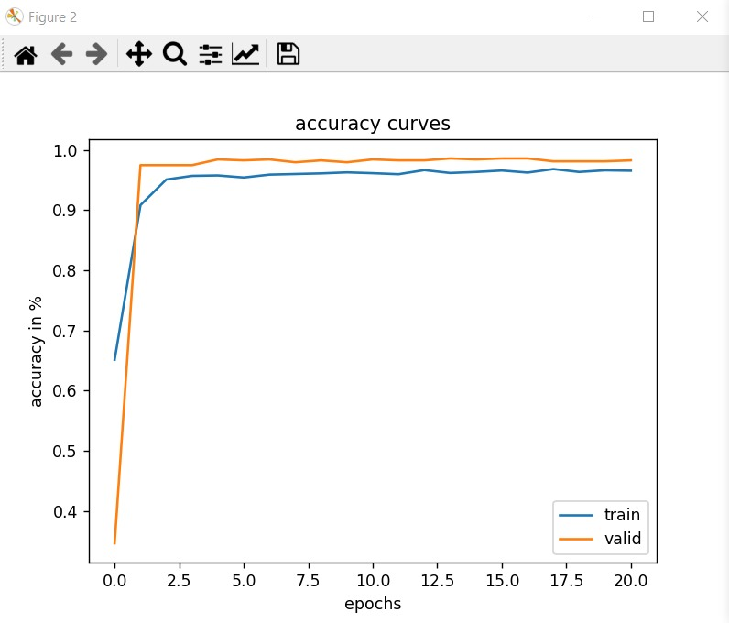
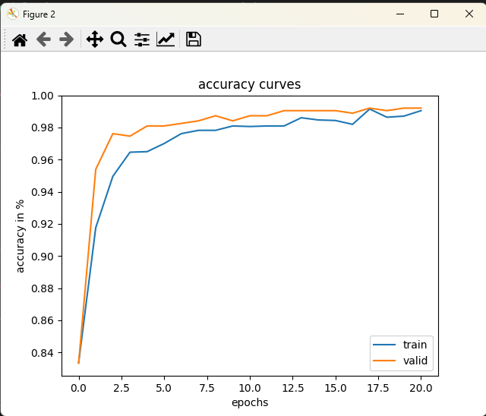
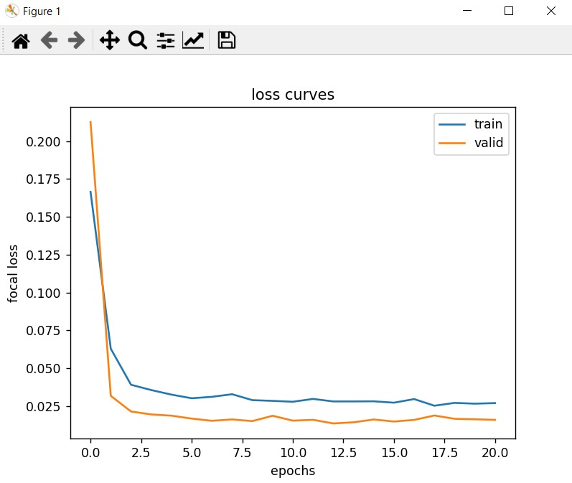
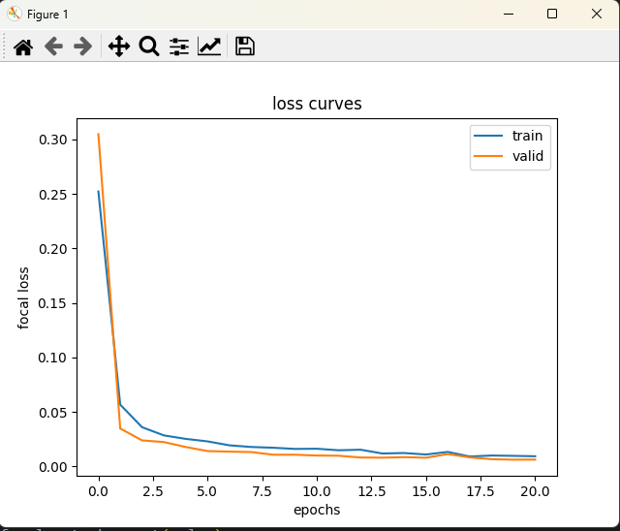
1.Efficientnet
2. ResNet18

Slide 18

06
Result

Slide 19
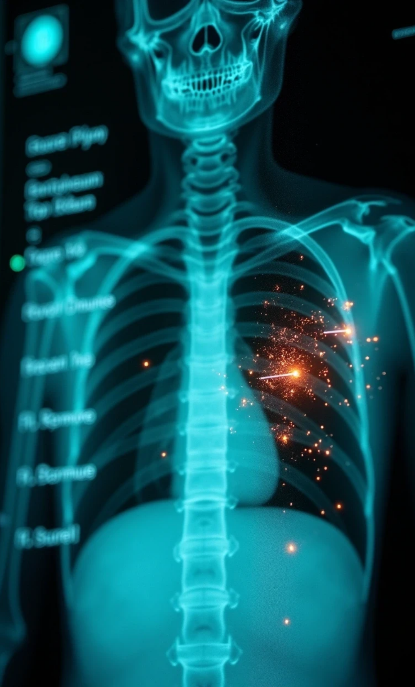
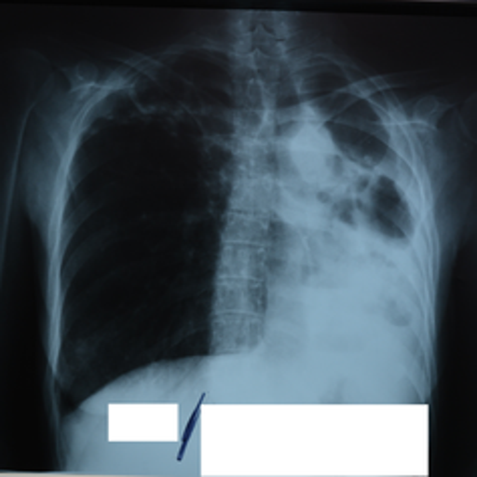
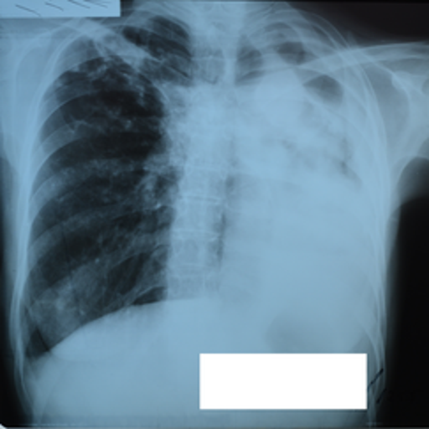

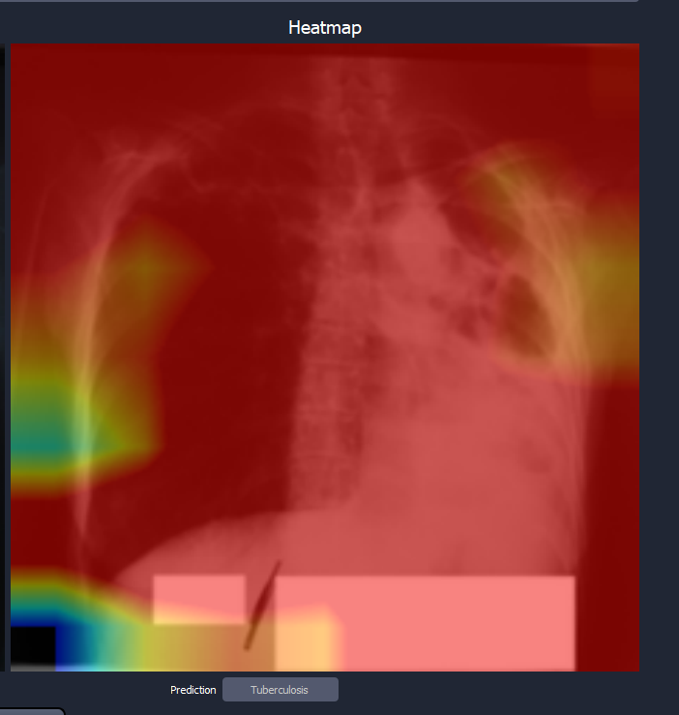
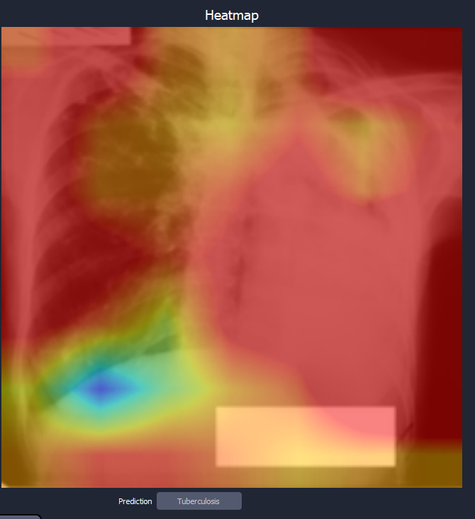
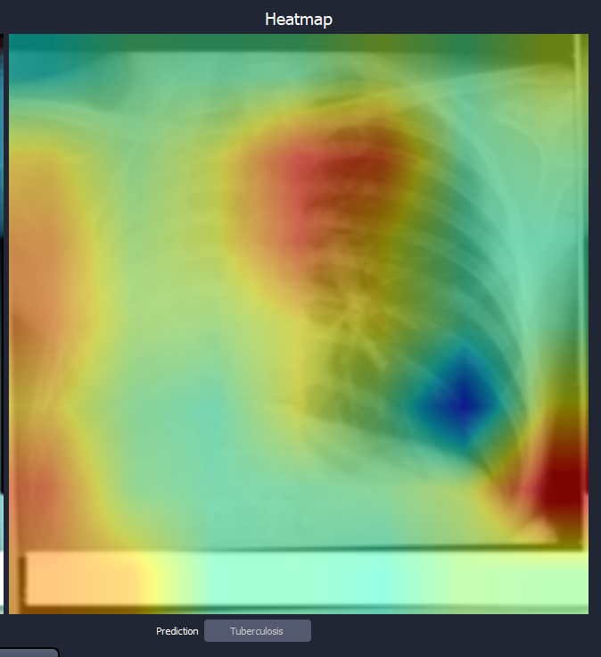
1.Efficientnet

Slide 20
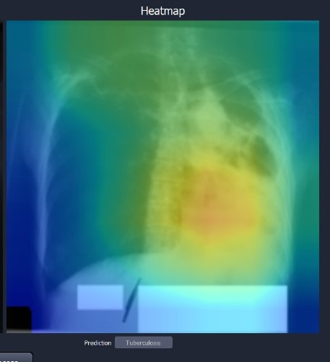
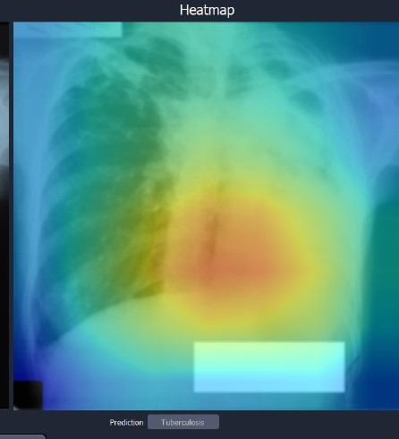
1.Resnet

Slide 21
Generate Report with chatbot

Slide 22
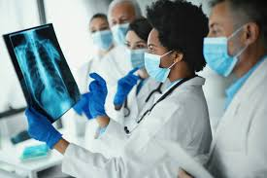
Problem Statement
Chest X-rays are one of the most common tools for diagnosing lung diseases.
Manual interpretation is time-consuming and requires expert radiologists.
High workload may lead to human errors and delayed diagnosis.
Many regions lack access to experienced radiologists

Slide 23
Objective
Analyze chest X-ray images using deep learning techniques.
Detect and classify multiple lung diseases with high accuracy.
Generate structured and descriptive medical reports automatically.
Assist radiologists by reducing workload and minimizing human errors.
Use chatbot to explain the medical reports
Provide faster, more reliable, and accessible diagnostic support, especially in remote or under-resourced areas.

Slide 24
Objective
Analyze chest X-ray images using deep learning techniques.
Detect and classify multiple lung diseases with high accuracy.
Generate structured and descriptive medical reports automatically.
Assist radiologists by reducing workload and minimizing human errors.
Use chatbot to explain the medical reports
Provide faster, more reliable, and accessible diagnostic support, especially in remote or under-resourced areas.

Slide 25
Dataset
Source
image link: https://openi.nlm.nih.gov/imgs/collections/NLMCXR_png.tgz
report link: https://openi.nlm.nih.gov/imgs/collections/NLMCXR_reports.tgz
Size:
ChestX-ray14 → over 7471 X-ray images.
Diseases Covered:
degenerative change Pleural Effusion
atelectasis
opacity
cardiomegaly
and more (multi-label classification).
Preprocessing Steps:
Image enhancement (contrast, noise reduction).
Data augmentation (rotation, flipping, scaling).
Normalization and resizing for deep learning models.

Slide 26
Methodology
1.Model Development
Use deep learning models (Densenet121, Bio_ClinicalBERT).
Train on large chest X-ray datasets.
Apply multi-label classification for multiple diseases.
2.Explainability
Use Grad-CAM / Heatmaps to highlight disease regions.
Improve trust and interpretability for radiologists.
3.Report Generation
Convert predictions into structured text reports.
Option for free-text or template-based medical summaries.
Compare between original report and generated report
4. Interactive Chatbot Assistant
A medical chatbot integrated with the system.
Doctors can ask questions about the report.
Chatbot explains results in simple, conversational language.
Supports multilingual responses .

Slide 27
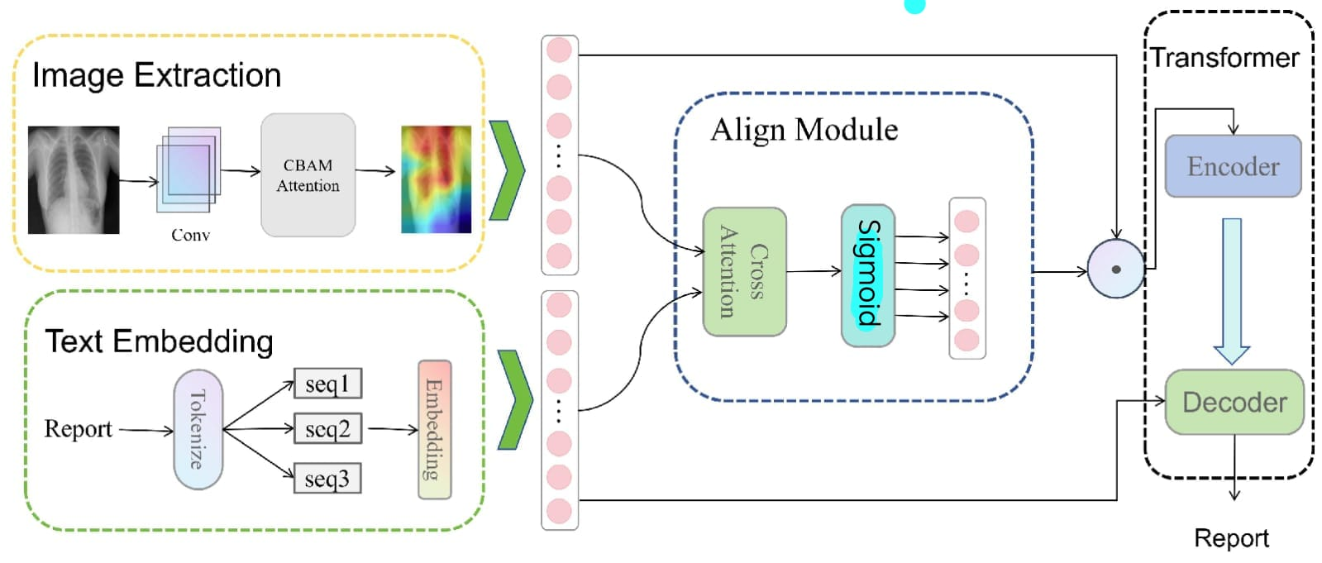
System Architecture

Slide 28
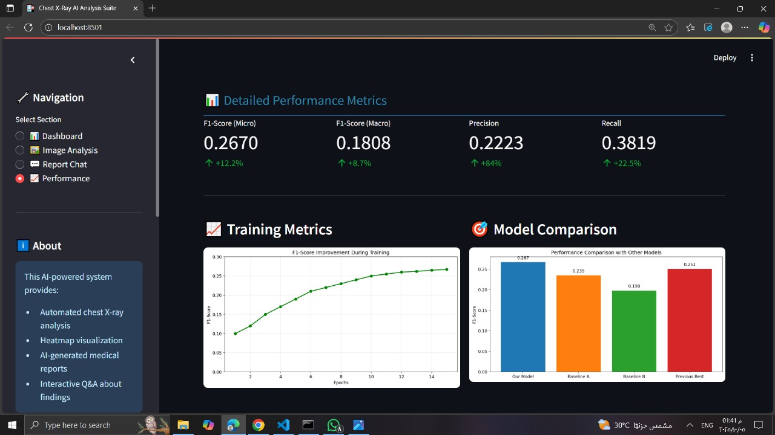
Metrics

Slide 29
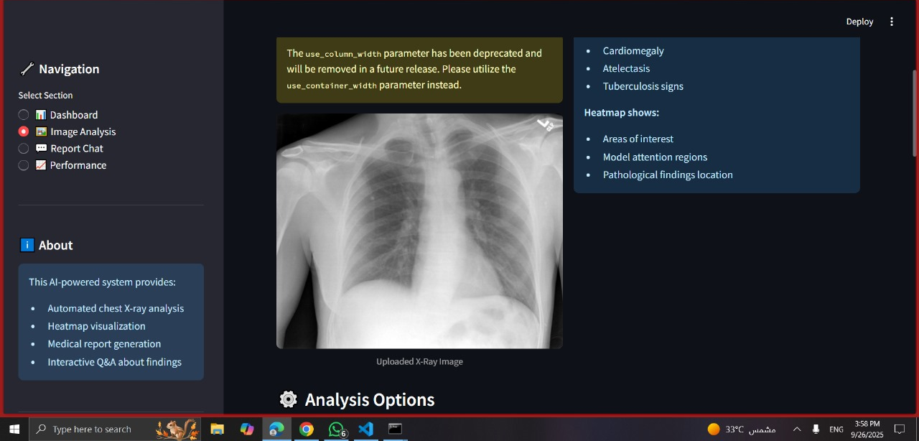
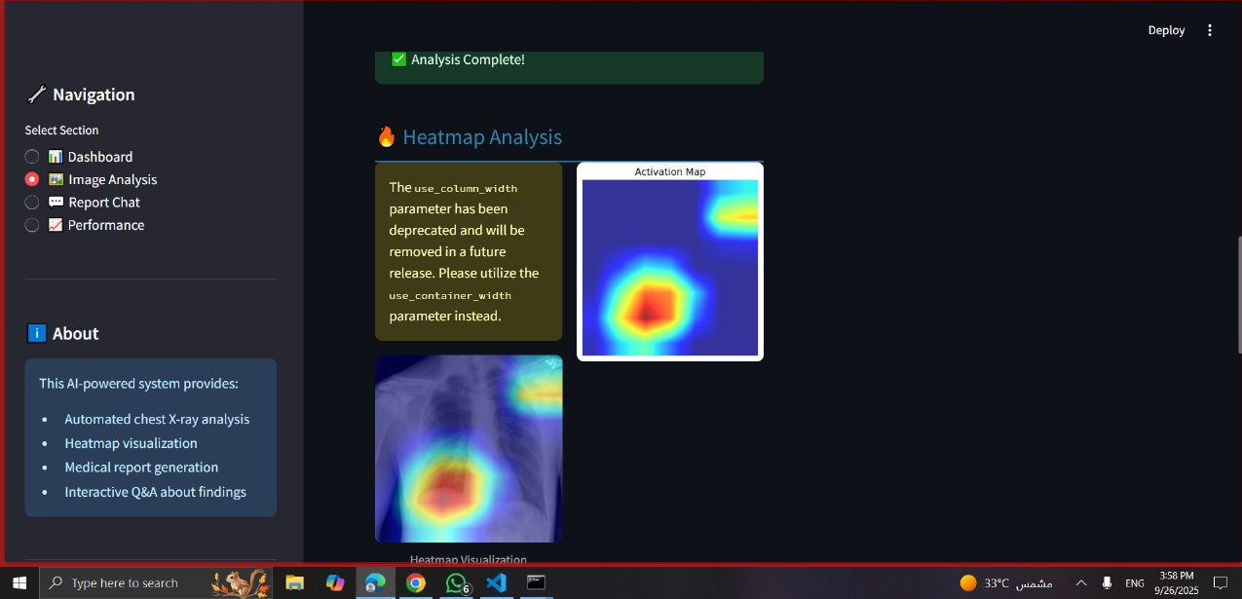
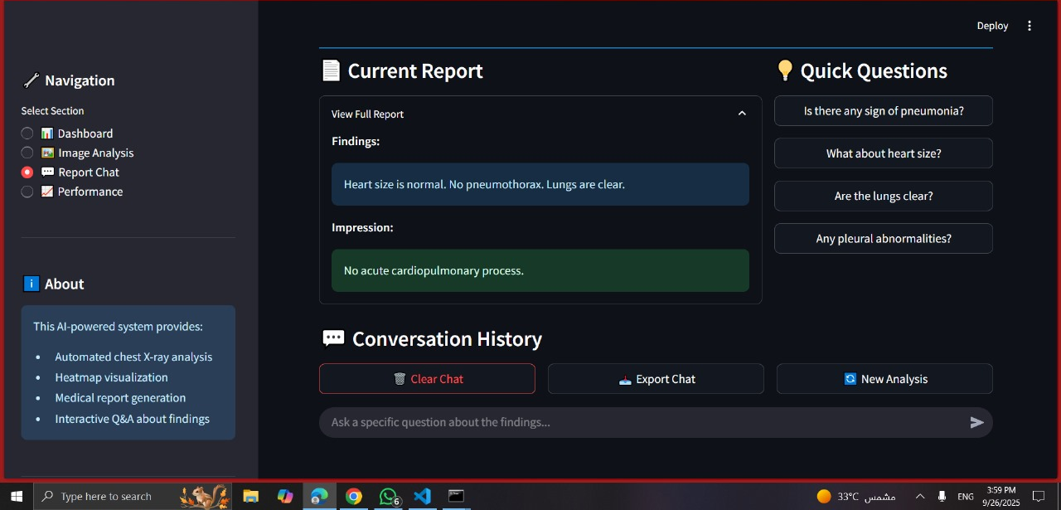
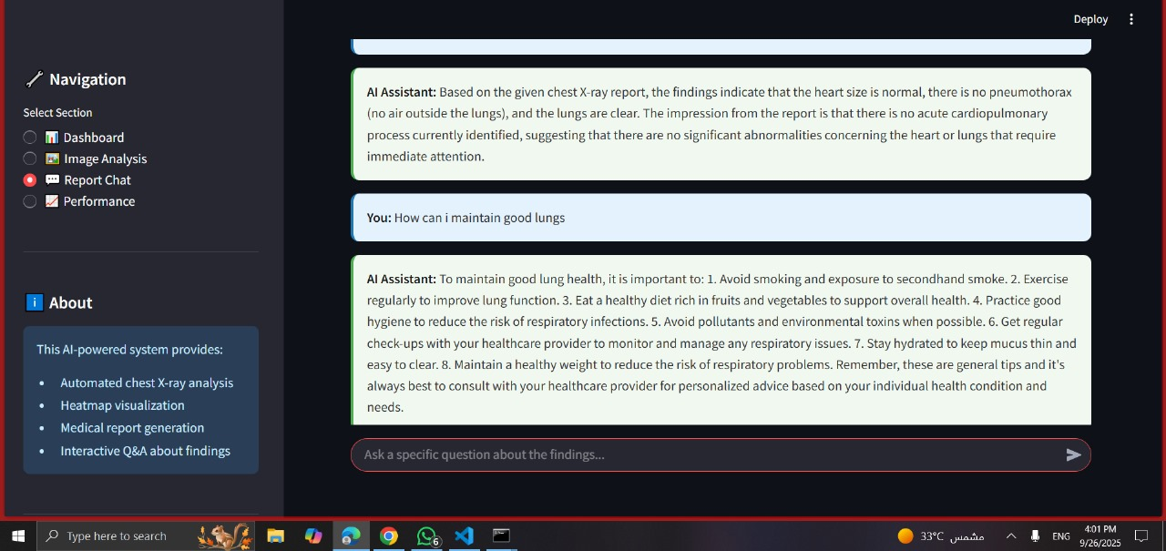
Results

Slide 30

Thank You

