Slide 1
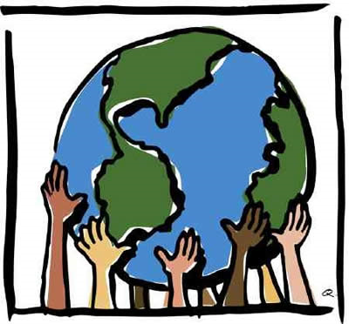
Social Earth
Project by
Raghavi Kirouchenaradjou
Menita Koonani
Divya Priya Emmanuel

Slide 2
Problem Statement
It is a busy world where there is no time to even notice a child who needs a positive change, a homeless man in street suffering from cold weather or a blissful river spoiled by chemical oil flow

Slide 3
Project Objective :
Our application provides a virtual environment which enables us to contribute to our society
The social responsibility of an individual is to give back to the world just as it gives to us. The purpose of the application is to thrive global community that lifts humanity and enhances the resources on which all life depends
It aids each individual who are part of our application community to empower decisions that create social, environmental and economic benefits for everyone by providing a platform

Slide 4
Approach
Our Application exposes enthusiastic volunteers to participate in a wide pool of events that provide platform to aid society
The tool provides volunteer to browse and register for the available events hosted by Event managers
It also provides transport facility to reach the respective event venue
The tool gives a chat facility for volunteer convenience

Slide 5
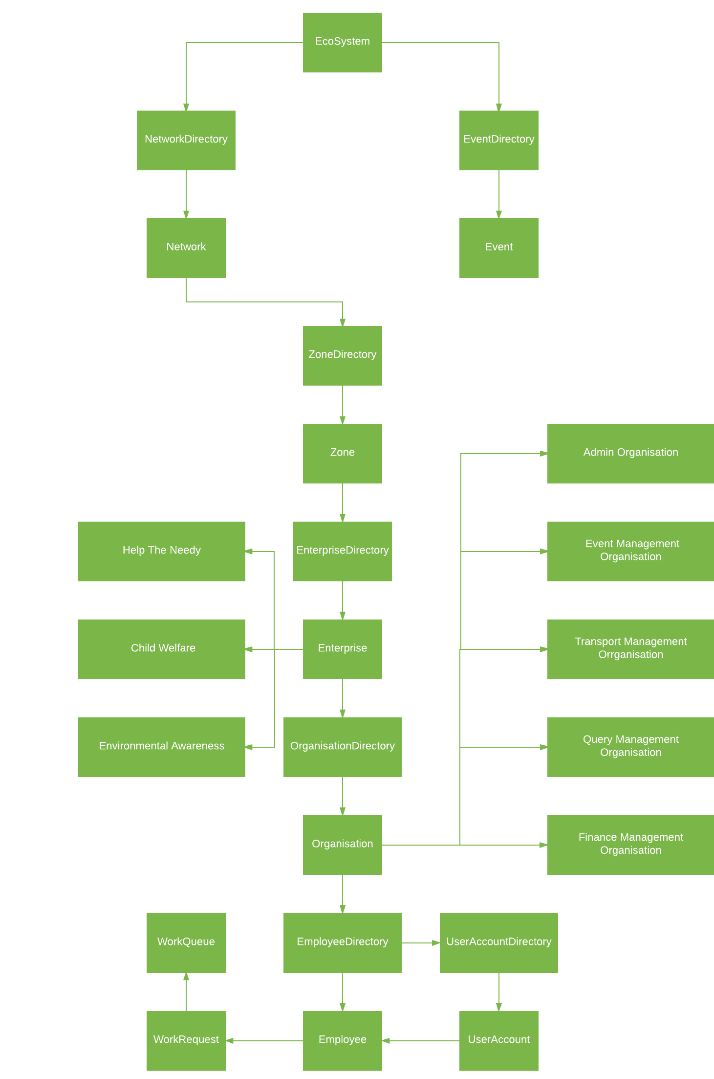
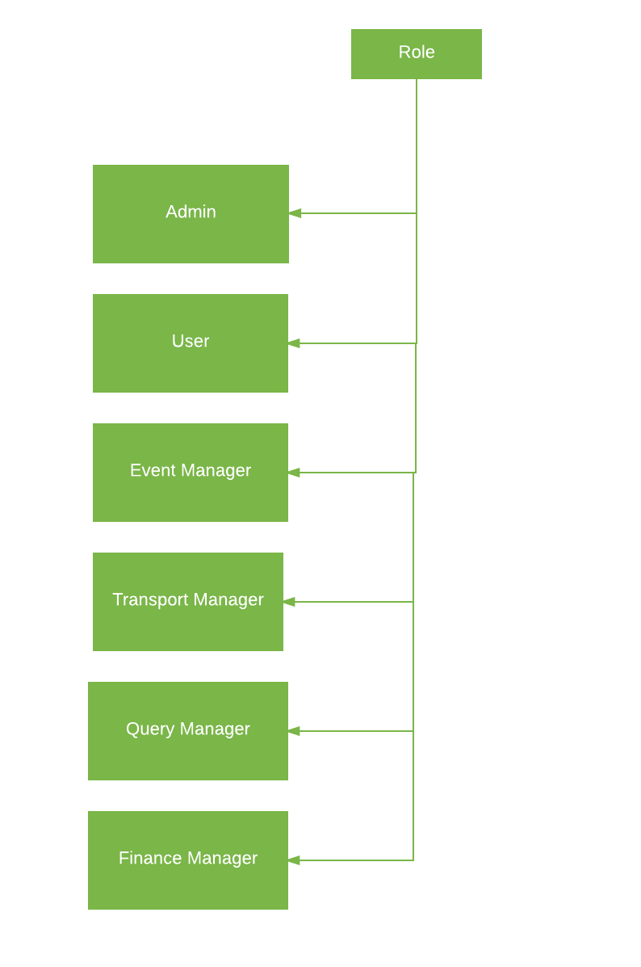
Object Model :

Slide 6
Use Cases:
Admin role for managing Enterprises
User Registration
Event Registration
Email notification sent to user registering for events
Providing shuttle services (with Google Location API)
Providing chat for user queries (with XMPP protocol , SMACK API – Google Talk)
Manage Enterprise Admin
Manage Event organisation employees and work request
Manage Transport organisation employees and work request
Manage Finance organisation employees and work request
Analysis and budgeting for Finance organisation ( using jFreeChart)

Slide 7
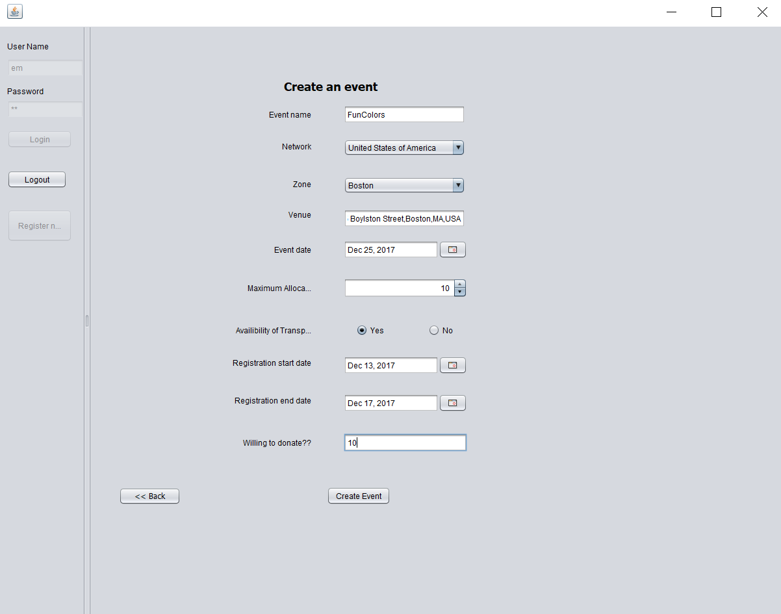
Create an Event

Slide 8
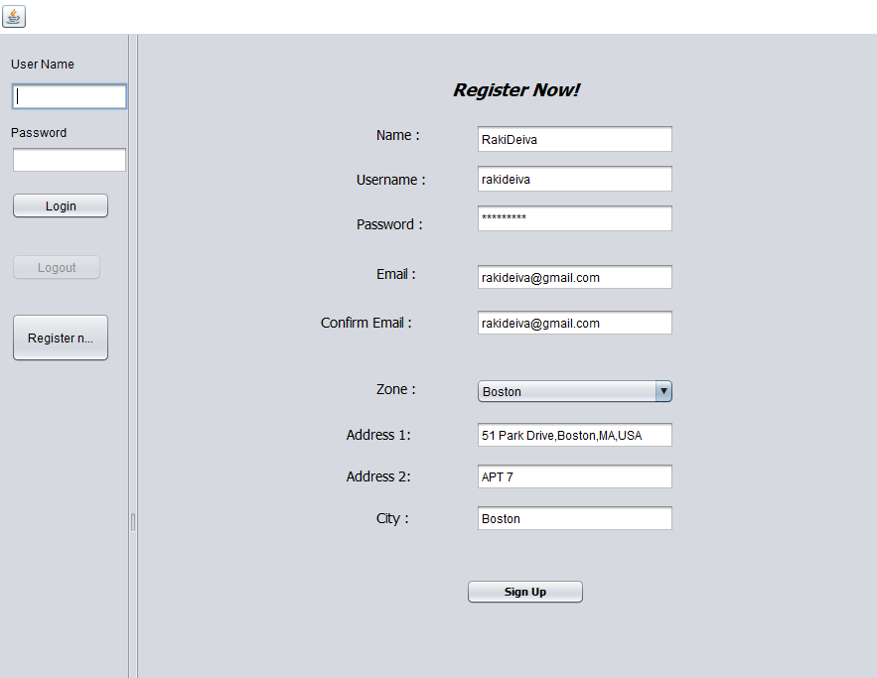
User Registration

Slide 9
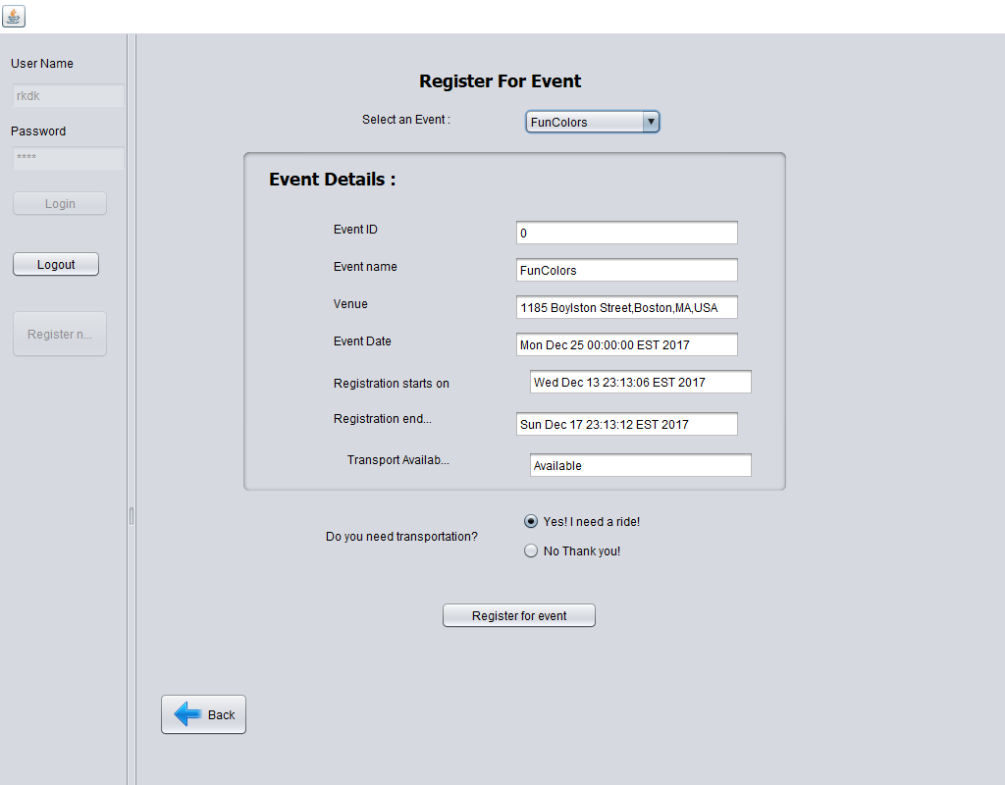
Register for the Event – Nearby Event

Slide 10
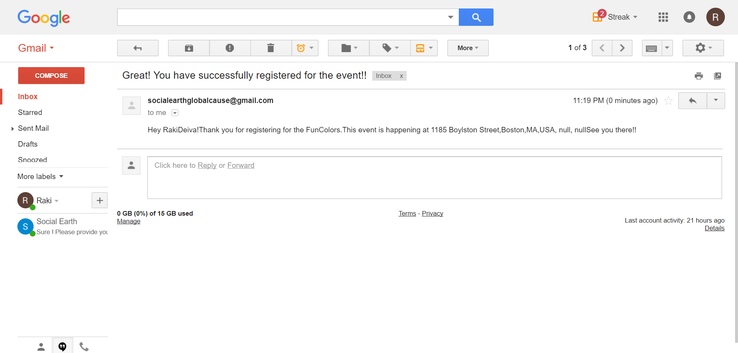
Email Notification

Slide 11
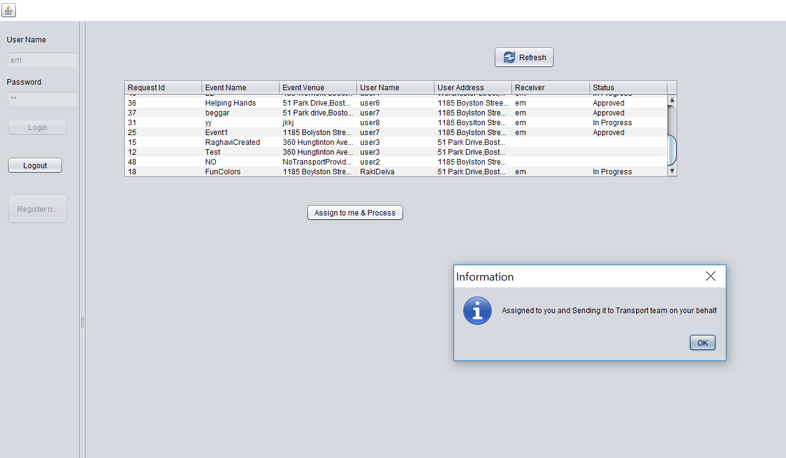
Event Manger to Transport Manager

Slide 12
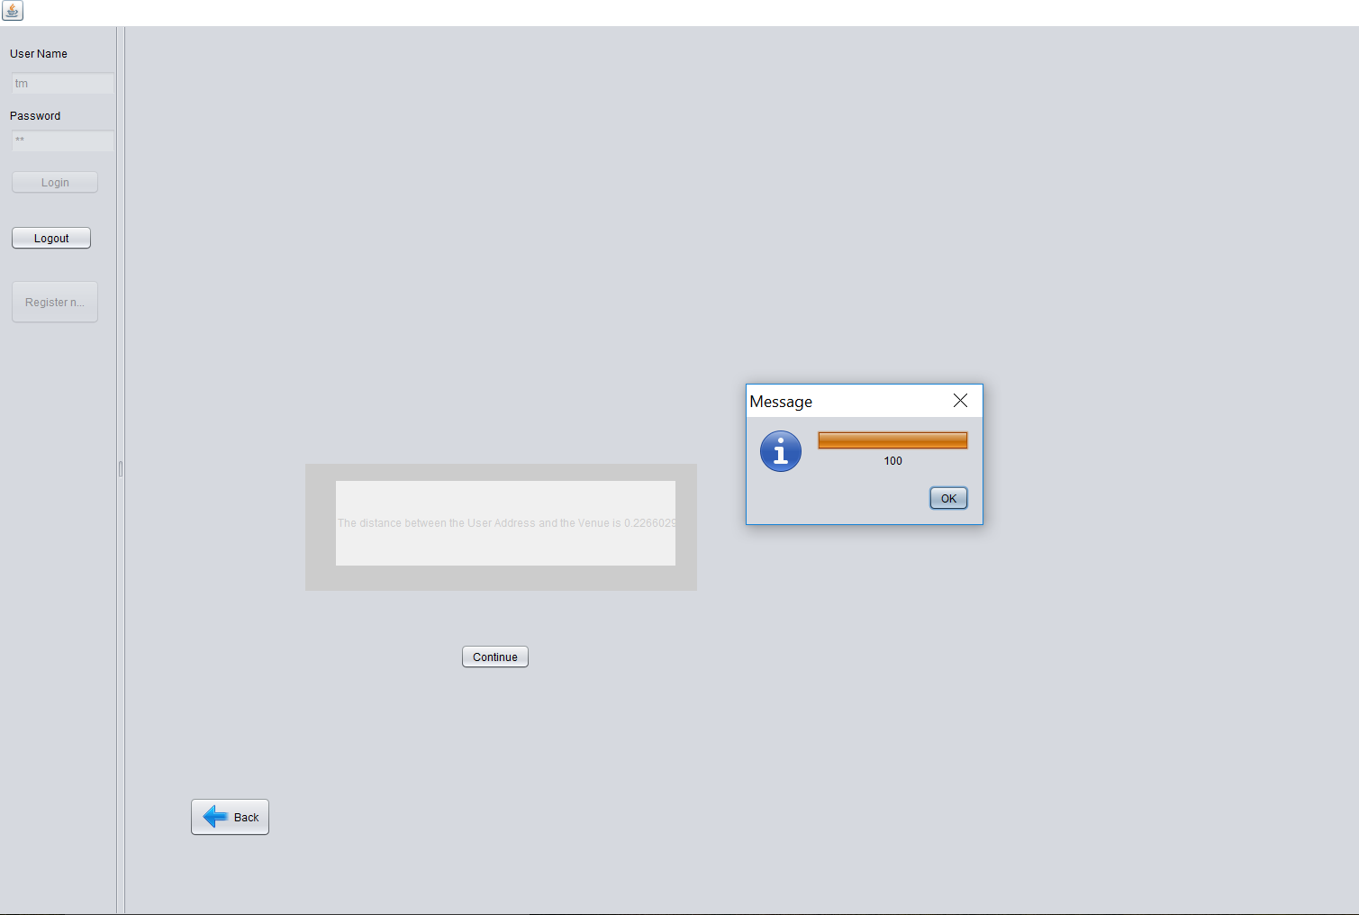
Transport checking for the location – GOOGLE API

Slide 13
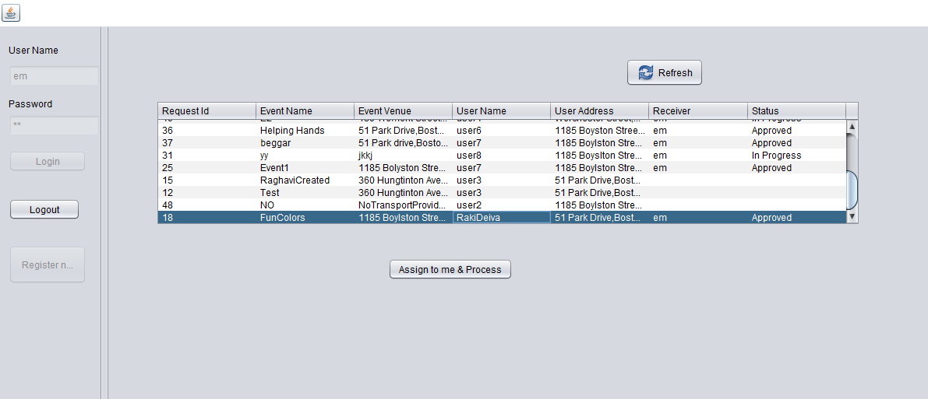
Approval from Transport Manager

Slide 14
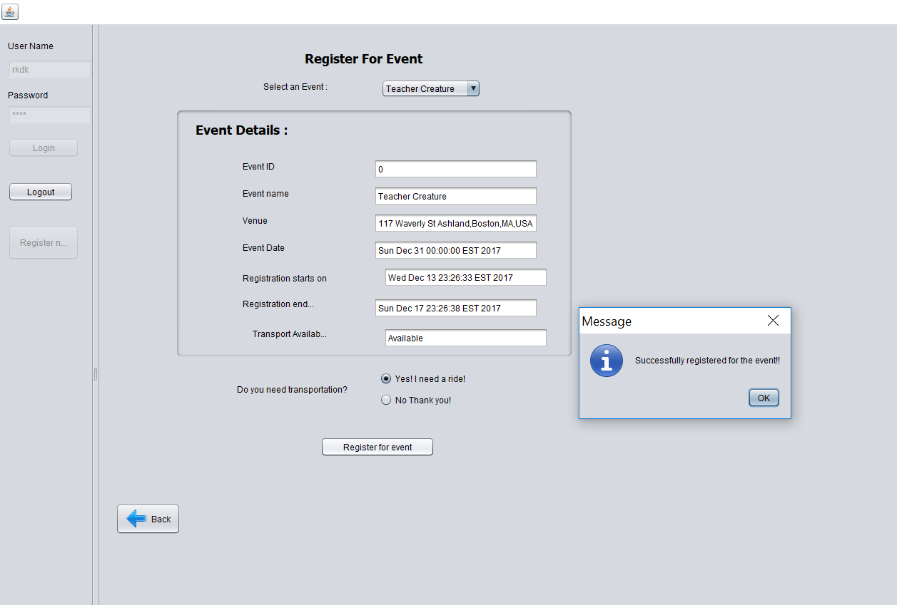
Reject from TM

Slide 15
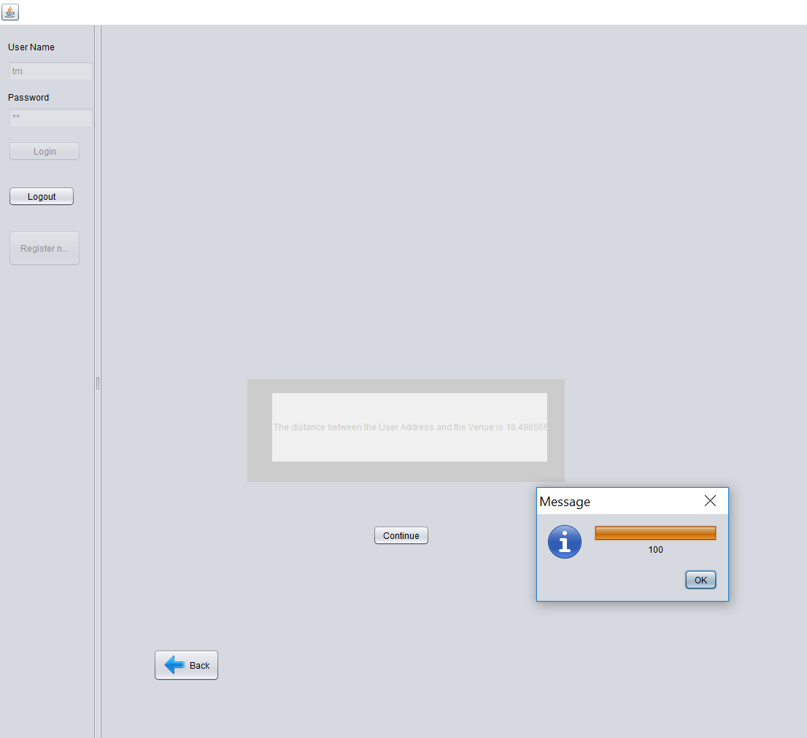
Rejection from Transport

Slide 16
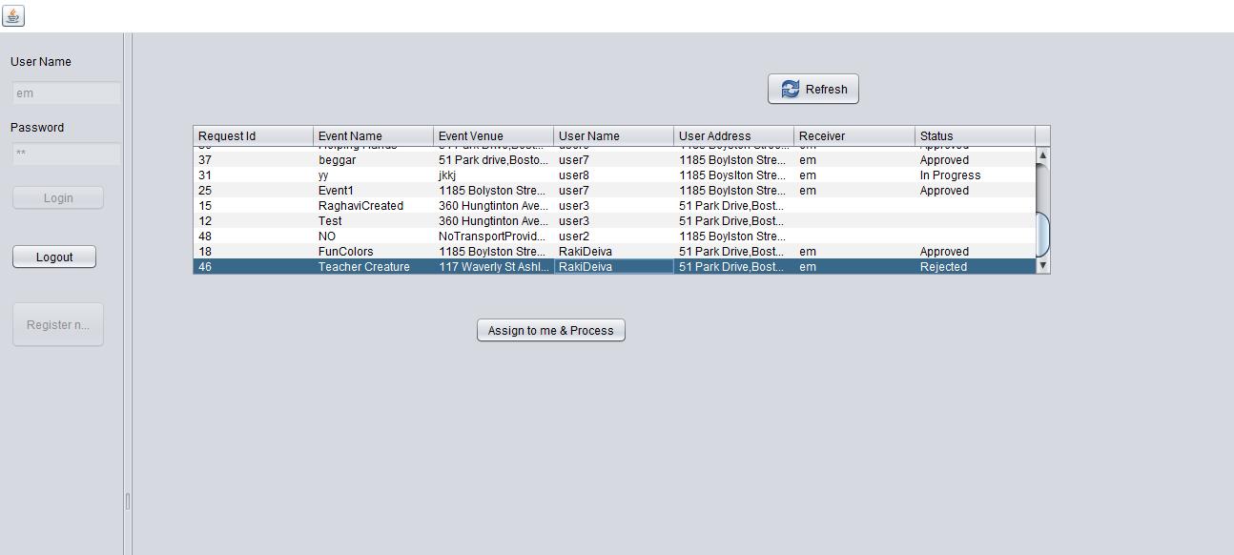

Slide 17
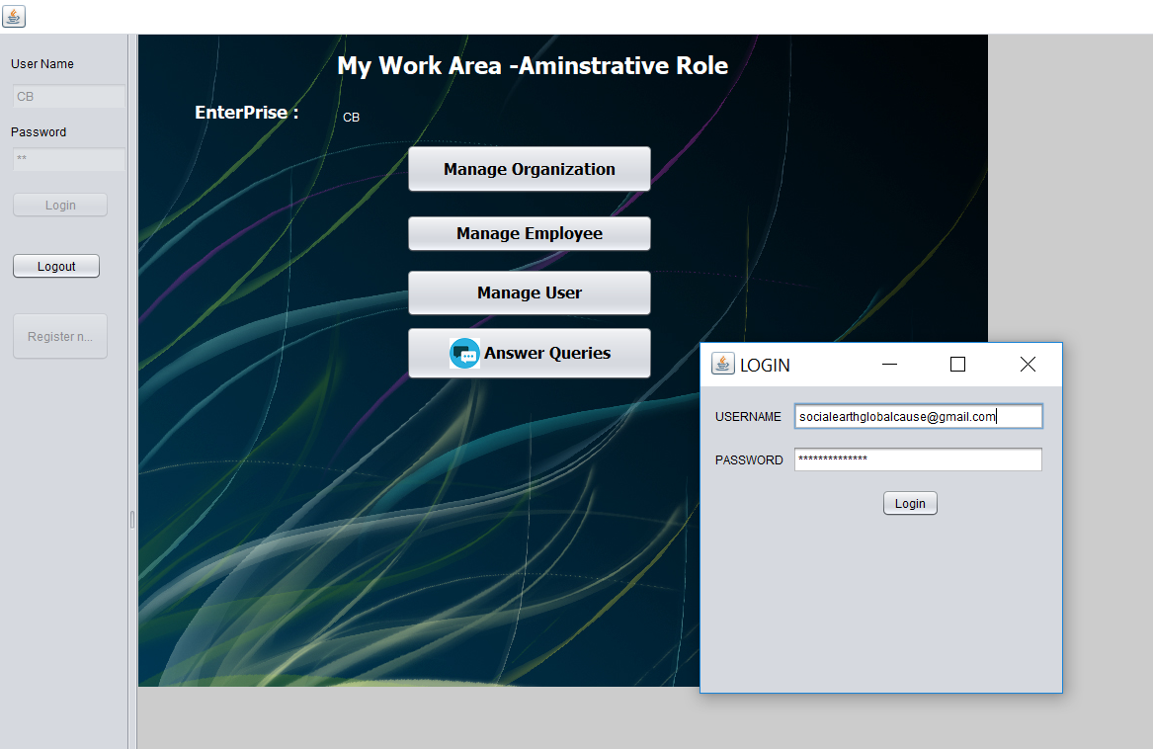
Chat workflow

Slide 18
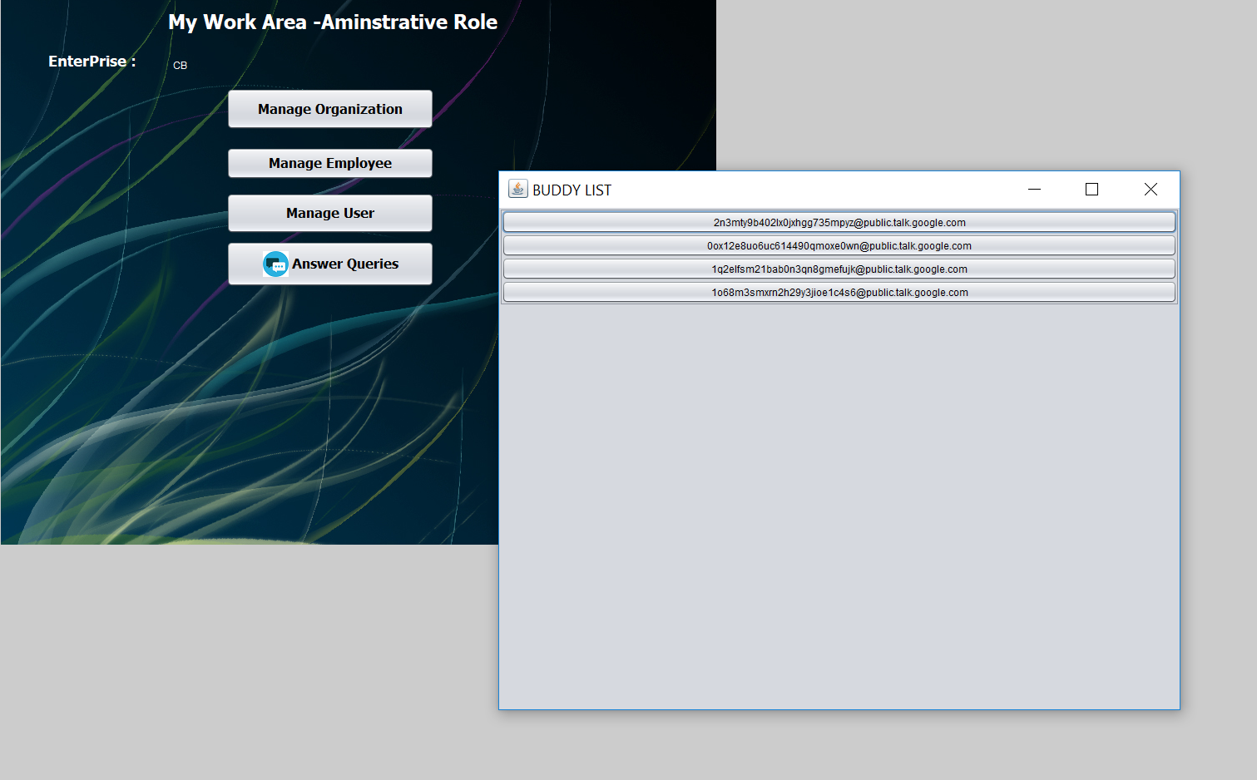

Slide 19
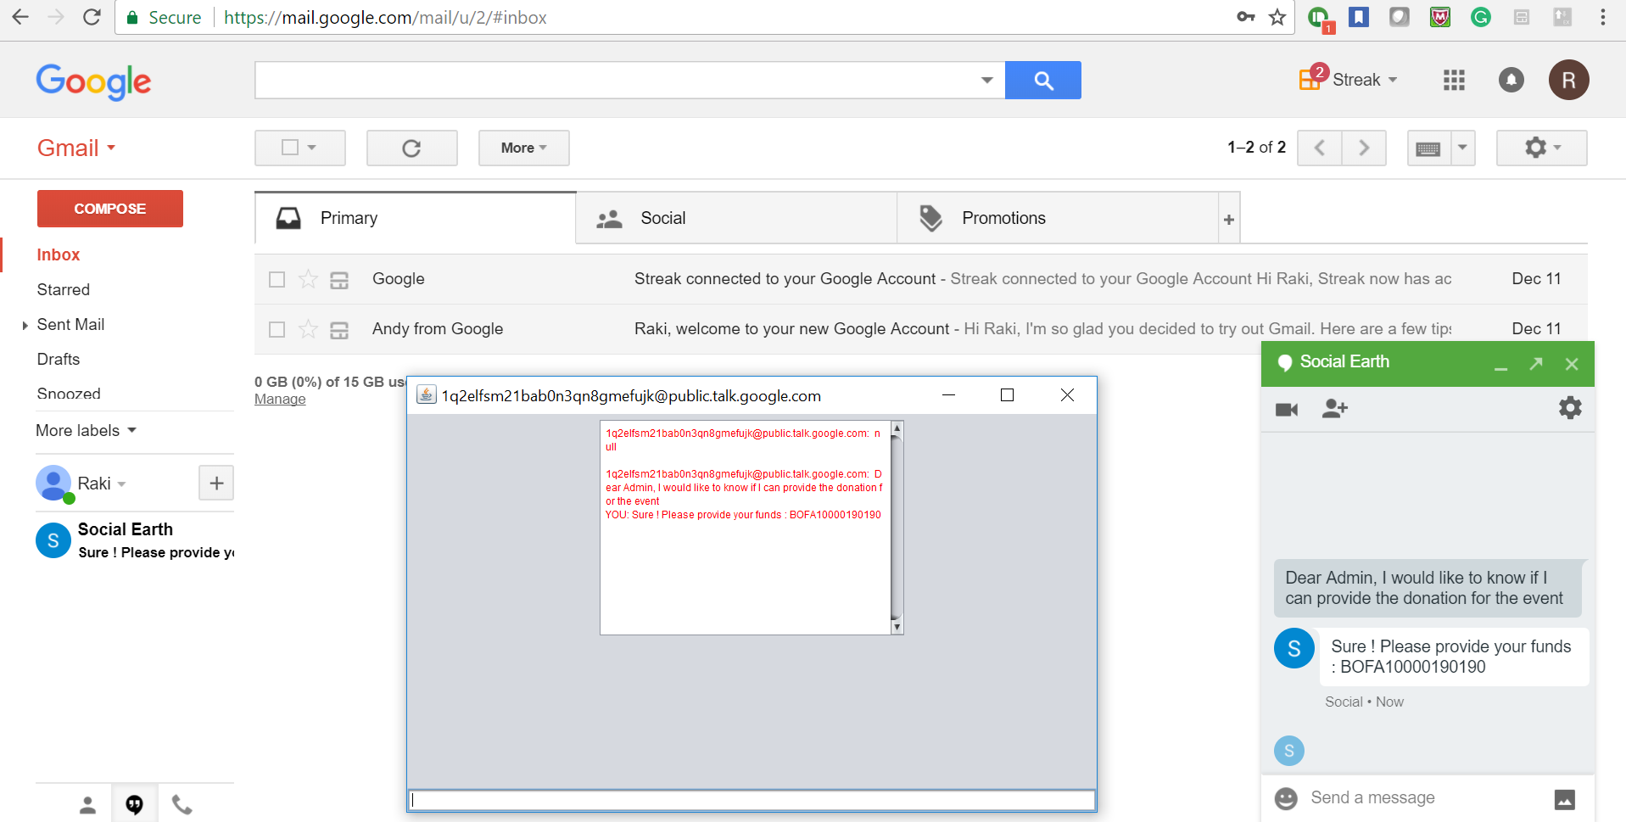

Slide 20
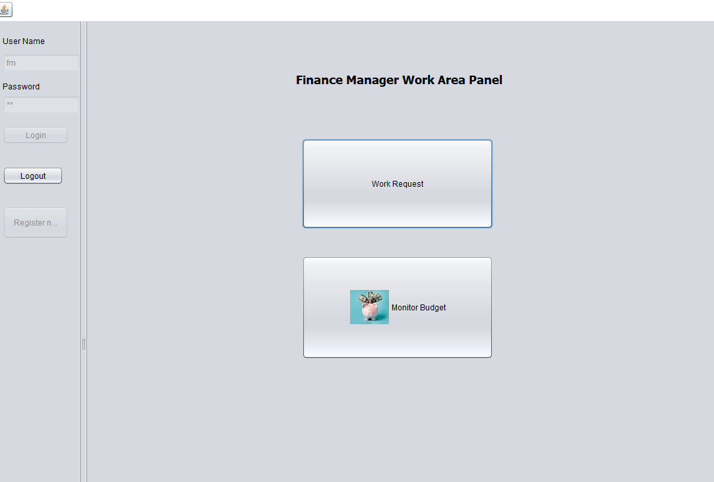
Finance and Budgetting

Slide 21
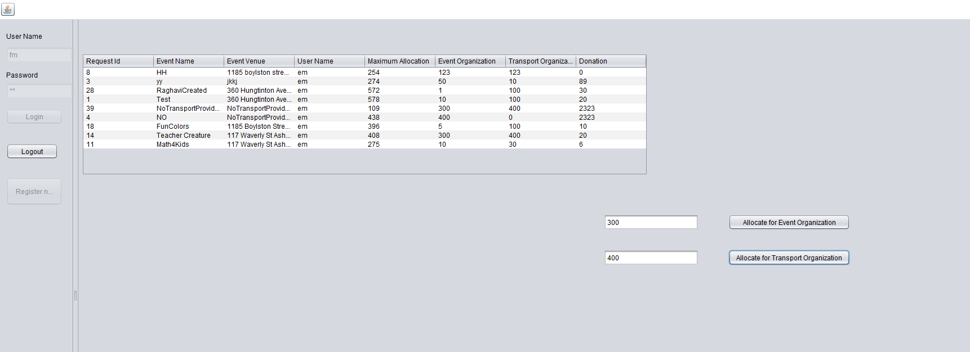
Work request

Slide 22
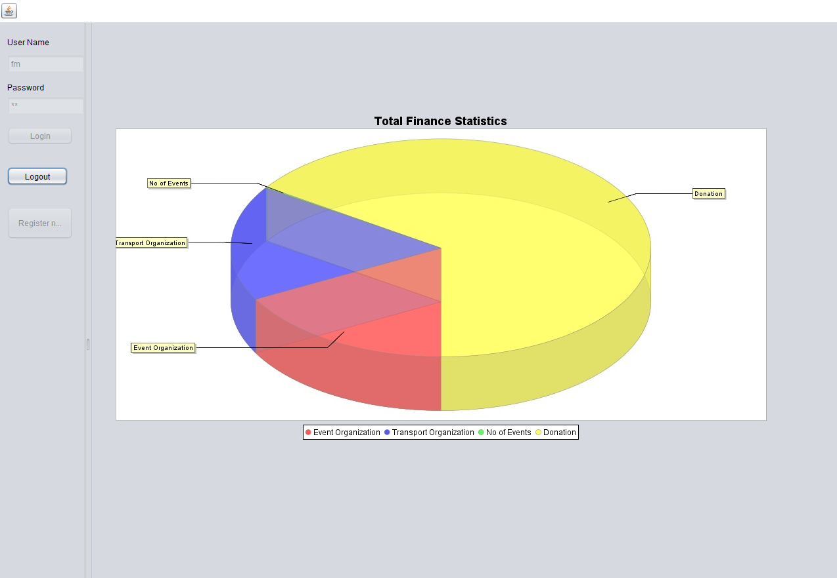

Slide 23
Thank You!!!

