Slide 1

EMPOWERMENT
Women
Empowerment
in Rural Villages
Transforming communities through education,
economic inclusion & social justice
Presented By : Kirpashini T
Kiruthika A
Bharathi S
A Global Development Initiative

Slide 2

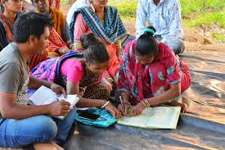
INTRODUCTION
Why Rural Women's
Empowerment Matters
Rural women make up nearly 43% of the agricultural workforce globally, yet face persistent barriers to equality.
Empowering rural women is not just a moral imperative — it is a proven catalyst for reducing poverty, improving nutrition, and driving sustainable development.
When women thrive, entire communities transform — educating children, building resilient households, and creating lasting change.
43%
of ag workforce
2×
faster poverty reduction
1.5B
rural women worldwide

Slide 3






CHALLENGES
Barriers Faced by Rural Women
Limited Education
Legal Inequality
Poor Healthcare
Girls drop out early due to poverty, early marriage, and distance to schools.
Lack of property rights and limited access to formal justice systems.
High maternal mortality, malnutrition, and lack of reproductive health services.
Economic Exclusion
Social Norms
Environmental Burden
Denied credit, banking, and formal employment opportunities.
Patriarchal customs restrict mobility, decision-making, and public participation.
Women bear the greatest cost of climate change in rural livelihoods.

Slide 4

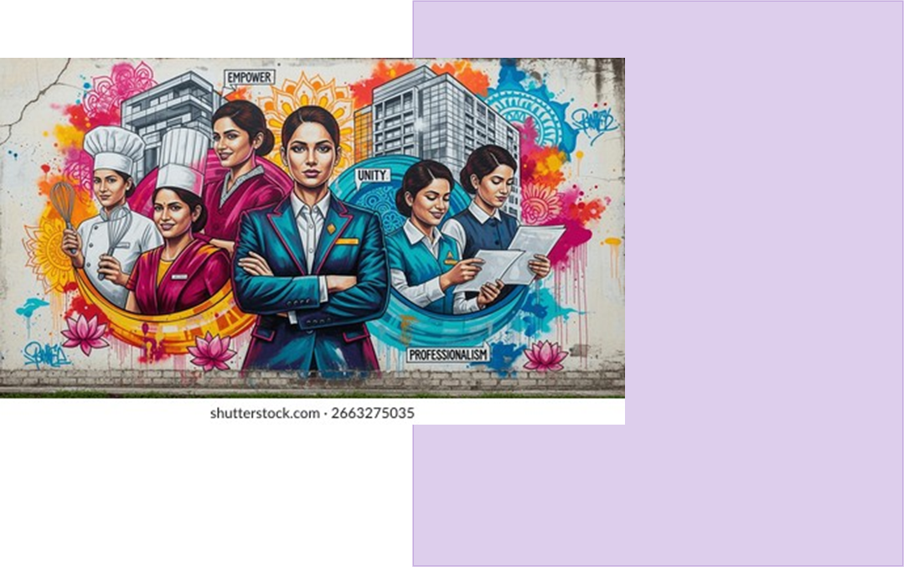
PILLAR 1: EDUCATION
Education as the
Foundation of Change
Girls with secondary education earn up to 25% more in adulthood
Educated mothers are 50% more likely to immunize their children
Community literacy programs reduce early marriage rates
Digital skills training opens remote work opportunities for rural women
Scholarships & mid-day meals keep girls enrolled in school
"Education is the most powerful tool for rural women's liberation."

Slide 5

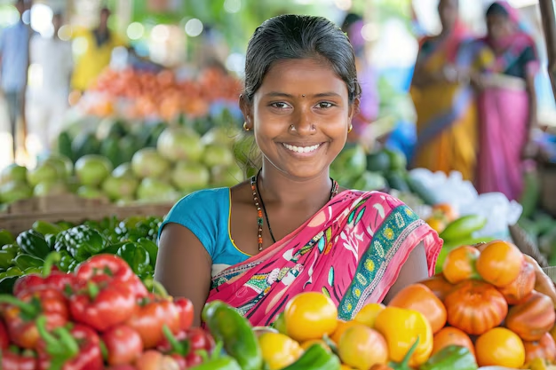



PILLAR 2
Economic
Empowerment
Microfinance & SHGs
Self-Help Groups give rural women access to credit and savings
Entrepreneurship
Handicrafts, agri-business, and digital marketplaces
Fair Wages
Closing the rural gender wage gap through policy reform
Every $1 invested in rural women yields $7 in community growth

Slide 6

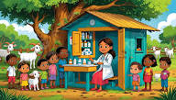
PILLAR 3: HEALTH & WELL-BEING
Healthy Women,
Healthy Villages
295,000
Women die annually from preventable childbirth complications
60%
Reduction in maternal mortality with trained midwives
800M
Women lack access to basic sanitation in rural areas

Slide 7

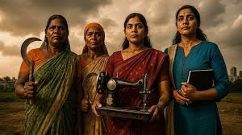
PILLAR 4: POLITICAL VOICE
Rural Women as
Leaders & Decision-Makers
Women in local governance lead to better spending on schools, water, and healthcare
Panchayat reservations in India gave 1.3 million women elected positions
Female leaders are more likely to address gender-based violence
Women's collectives serve as powerful platforms for civic engagement

Slide 8

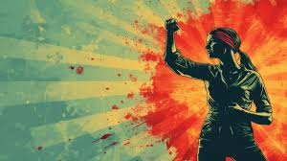
SUCCESS MODEL: SELF-HELP GROUPS
The Power of Women's Collectives
Microfinance Access
Small, low-interest loans for business and household needs
Skill Development
Workshops on farming, crafts, digital literacy, and health
Collective Bargaining
United voice for fair wages and market access
Social Safety Net
Peer support for domestic violence and mental health

Slide 9


TECHNOLOGY & INNOVATION
Digital Tools Bridging
the Rural Divide
Mobile Banking
E-Learning Platforms
M-Pesa and similar platforms give rural women financial independence
Online courses reach women in remote villages with no schools nearby
AgriTech Apps
Telemedicine
Crop pricing, weather data, and market access via smartphones
Virtual health consultations reduce barriers to maternal care

Slide 10
GLOBAL CASE STUDIES
Real-World Successes from
Around the Globe
🇮🇳 India
2.5M women in cooperative; 40% income increase for members
SEWA Movement
🇧🇩 Bangladesh
Lifted 8M women out of extreme poverty through microfinance
BRAC Programs
🇰🇪 Kenya
2M rural women escaped poverty via mobile money access
M-Pesa Banking
🇷🇼 Rwanda
64% female parliament; led to stronger health & education budgets
Political Quotas

Slide 11
BY THE NUMBERS
The Impact of Empowering Rural Women
12%
25%
$360B
Increase in crop yields when
women have equal access to resources
More children survive to age 5
with educated mothers
Unlocked GDP potential by
closing rural gender gaps
50%
3×
70%
Reduction in domestic violence
in communities with women's groups
More likely to reinvest earnings
in families compared to men
Of the world's poor are women —
most in rural areas

Slide 12
STAKEHOLDERS & SOLUTIONS
Who Drives Change?
Government
NGOs & Civil Society
Private Sector
Gender-responsive budgeting
Land & property rights reforms
Female-quota policies
Subsidized education for girls
Grassroots organizing
Legal aid and advocacy
Vocational training centers
Domestic violence shelters
Women-focused microfinance
Fair trade sourcing
AgriTech for rural women
Corporate mentorship programs

Slide 13

COMMUNITY VOICES
Stories of Transformation
"After joining the self-help group, I started my own tailoring business. My children are now in school and I have a voice in village meetings."
— Savitha, 34 — Karnataka, India
"The mobile banking app changed everything. I no longer have to walk 8 km to the bank or depend on my husband for money."
— Amara, 28 — Nakuru, Kenya
"Our women's group helped me escape an abusive marriage. They gave me legal help, shelter, and taught me to read at age 40."
— Rina, 42 — Sylhet, Bangladesh

Slide 14
CALL TO ACTION
What You Can Do
To Help
01
Donate to women's SHGs and microfinance organisations
02
Advocate for gender-responsive rural development policies
03
Support girls' education through scholarships and mentoring
04
Buy from women-led rural cooperatives and fair trade products
05
Amplify rural women's voices in media, research, and policy

Slide 15


- OUR WEBSITE DASHBOARD
United Nations SDG 5: Gender Equality | SDG 1: No Poverty | SDG 2: Zero Hunger

Slide 16

- OUR WEBSITE CAMPAIGNS
United Nations SDG 5: Gender Equality | SDG 1: No Poverty | SDG 2: Zero Hunger

Slide 17
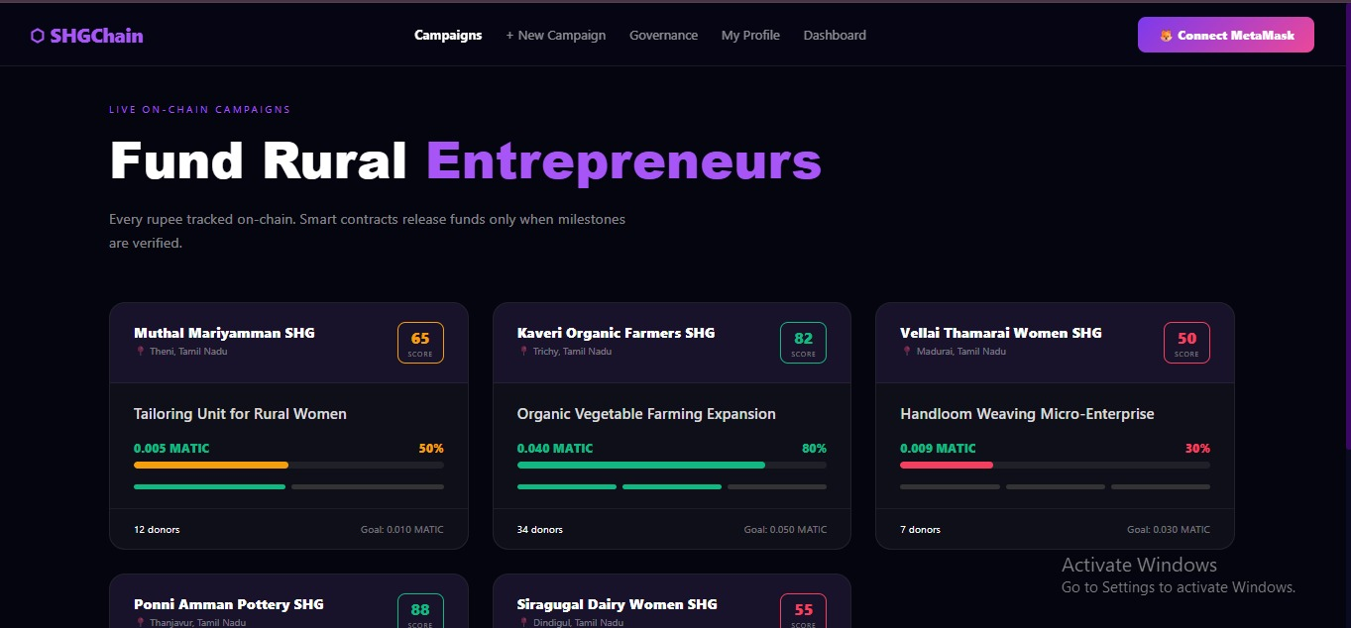
United Nations SDG 5: Gender Equality | SDG 1: No Poverty | SDG 2: Zero Hunger

Slide 18

- NEW COMPAIGN
United Nations SDG 5: Gender Equality | SDG 1: No Poverty | SDG 2: Zero Hunger

Slide 19

- GOVERNANCE
United Nations SDG 5: Gender Equality | SDG 1: No Poverty | SDG 2: Zero Hunger

Slide 20
NEW COMPAIGN
United Nations SDG 5: Gender Equality | SDG 1: No Poverty | SDG 2: Zero Hunger

Slide 21
NEW COMPAIGN
United Nations SDG 5: Gender Equality | SDG 1: No Poverty | SDG 2: Zero Hunger

Slide 22
THANK YOU!!
🌺 Happy International Women's Day! 😊🌸
"Think like a queen. A queen is not afraid to fail"
United Nations SDG 5: Gender Equality | SDG 1: No Poverty | SDG 2: Zero Hunger

