Slide 1
Village Vets
Database
& Dashboard
By Kirsten Baltazar

Slide 2
Overview
01
02
03
Tools + Applications
Sample Visualisations
Benefits

Slide 3
Tools & Applications - Who Needs What?
01
Business Executives
‘Birds-eye view’ -> Long-term Decisions
Branch Staff
02
Resource Monitor-> Everyday Decisions
03
Customers
Convenience-> Gain loyalty

Slide 4

Tools & Applications - A Simple, Scalable System
1. Sign-in Forms
Daily data-gathering
Customers

Slide 5

Tools & Applications - A Simple, Scalable System
1. Sign-in Forms
Daily data-gathering
Automated
Customers
2. Update Records
Forms linked with spreadsheet

Slide 6

Tools & Applications - A Simple, Scalable System
1. Sign-in Forms
3. Clean w/ python
Daily data-gathering
For security & quality ! +++
Automated
Customers
Staff
2. Update Records
Forms linked with spreadsheet

Slide 7

Tools & Applications - A Simple, Scalable System
1. Sign-in Forms
3. Clean w/ python
Daily data-gathering
For security & quality ! +++
Automated
Customers
Staff
Everyone
2. Update Records
4. Dashboarding
Forms linked with spreadsheet
For executive and daily insights

Slide 8
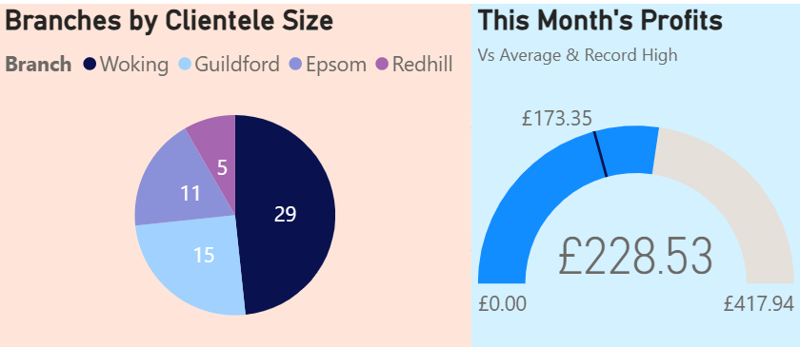
Sample Visualisations – The Executive Dashboard
The Most Popular Branch?
Woking
This Month’s Profits?
30% above Avg
* Based on the limited sample data provided

Slide 9
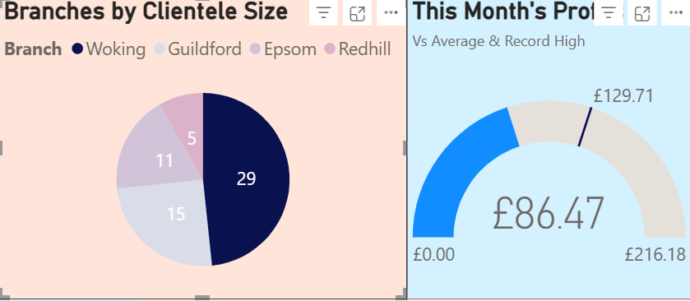
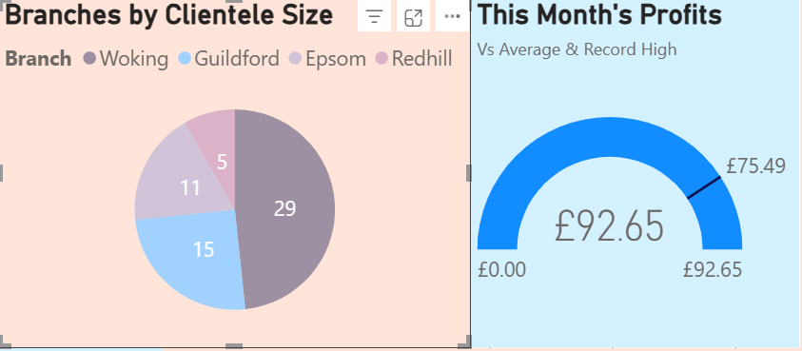
Sample Visualisations – Built-in Interactivity
The Most Popular Branch?
Woking
This Month’s Profits?
30% above Avg
* Based on the limited sample data provided

Slide 10
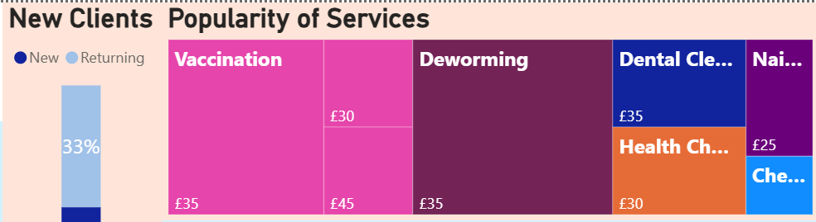
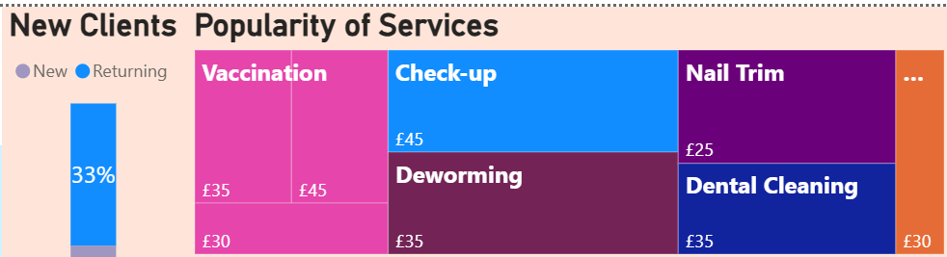
Sample Visualisations – Depth & Breadth
How many customers return?
1 in 3
What for?
For routine services
(check-up, nail trim,
dental cleaning)
* Based on the limited sample data provided

Slide 11
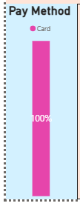
Sample Visualisations – Depth & Breadth
True for
Check-Up
& Dental Cleaning
What does payment method reveal?
Potential for
Subscription
Services
* Based on the limited sample data provided

Slide 12
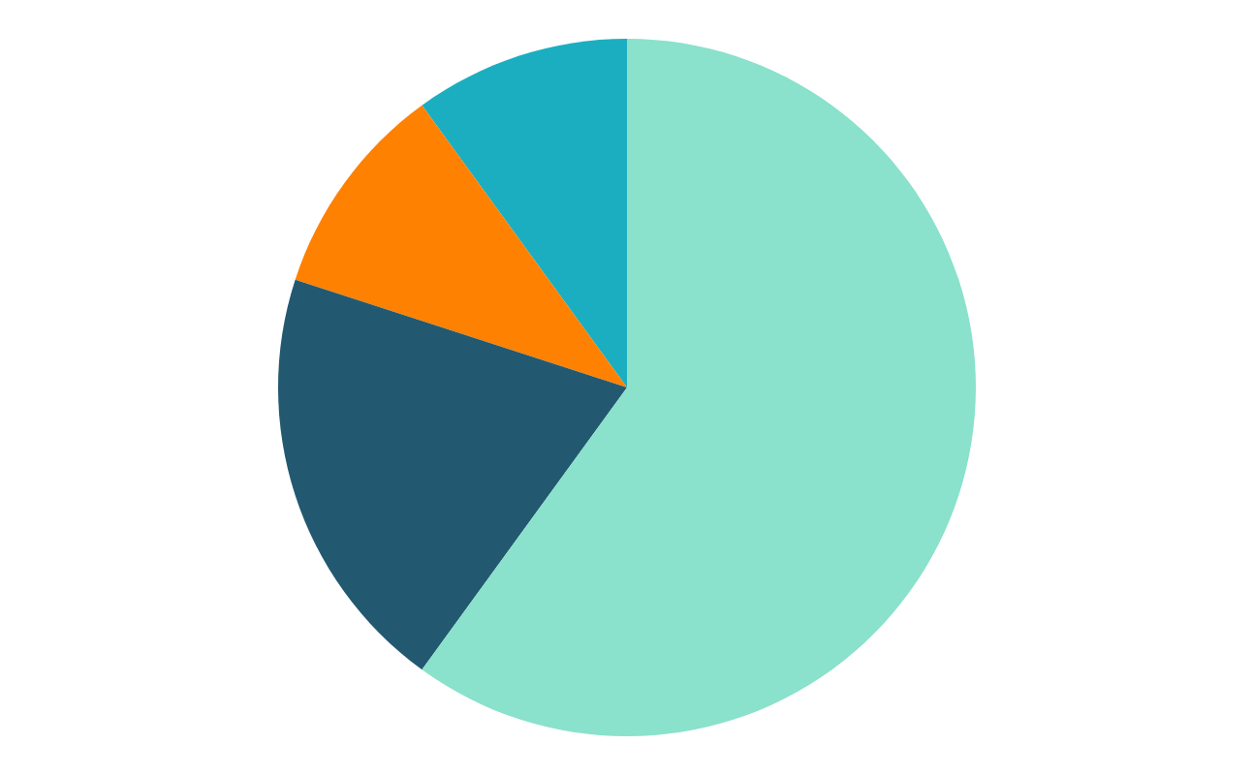
Sample Visualisations – Tell a Story
How many customers return?
The Most Popular Branch?
1 in 3
Woking
This Month’s Profits?
What does payment method reveal?
30% above Avg
Potential for
Subscription
Services
* Based on the limited sample data provided

Slide 13
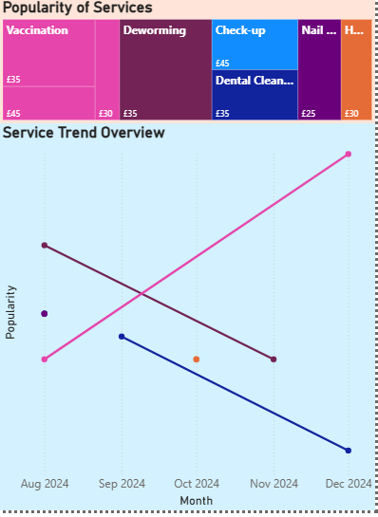
Sample Visualisations – For Branch Dashboard
What services were most popular?
-> Materials for restocking
What is the trend in services?
-> Staff rotations

Slide 14
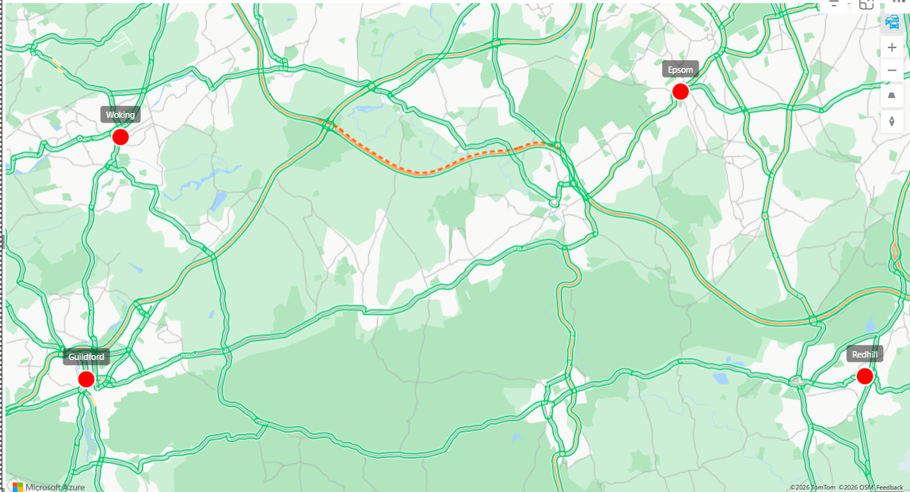
Sample Visualisations – Other Ideas
LIVE interbranch activity sharing
(Services available,
customer traffic,
road traffic,
contact details)

Slide 15

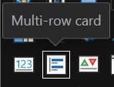
Sample Visualisations – With More Data…
Customer Account Dashboard
Account Number (Shareable)
Owner Contact Details (Number, email)
Pet Name
Age, Height, Weight
Conditions
Preferred Vet
Visit History (Service, Date)
Medication History (Routine Prescriptions)
Upcoming Routine Services
Loyalty Discounts/ Active Subscriptions

Slide 16
Benefits
Automated Data System
Convenient for Customers
01
02
Informed Decisions
Cost-effective Investment
06
03
Minimal Training
Market Edge
05
04
The design of a dashboard ultimately benefits from user research i.e. your feedback throughout development is valuable!

Slide 17
Thank You

