Slide 1
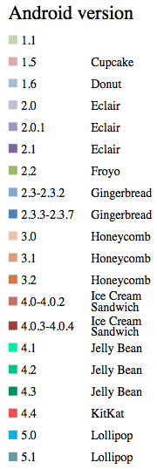




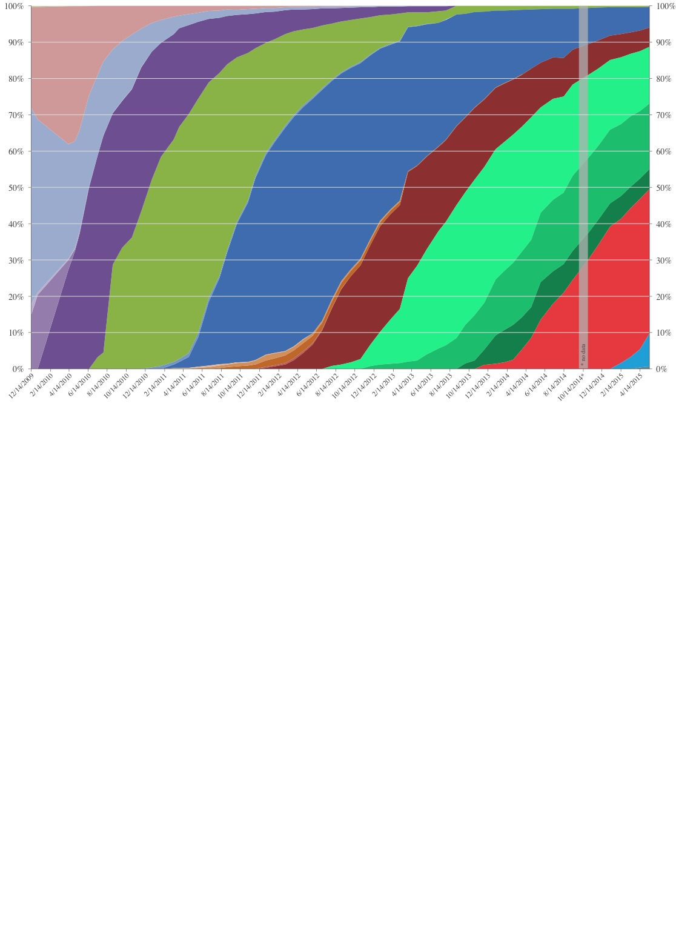
Quelle Bild: https://upload.wikimedia.org/wikipedia/commons/e/ee/Android_historical_version_distribution_-_vector.svg
Sonstige Quellen: http://www.androidvulnerabilities.org, BA Maier
RageAgainstTheCage
Psneuter/KillingInTheN
Zimperlich
Gingerbreak
Levitator
ZergRush
ExynosAbuse
Several Qualcomm vul.
Sev. APK vulnerabilities
Fake ID
TowelRoot
2011
2012
2013
2014
[Power SGX chip]
[Samsung devices]
1.5
2.3
4.2
1.6
4.0
4.1
2.1
2.2
4.4
5.0

