Slide 1
SOFTWARE ENGINEERING
Modeling the Process and Lifecycle

Slide 2



软件过程之父的经典谚语
If you don’t know where you are，a map won’t help
Watts S.humphrey
一个有效的改变程序需要对当前状态的理解

Slide 3
A process defines who is doing what, when and how, in order to reach a certain goal.
New or changed
Software Engineer Process
New or changed
requirement
system

Slide 4
What is Process
A Series of steps involving activities, constraints, and resources that produce an intended output of some kind.
A process usually involves a set of tools and techniques

Slide 5
Process Characteristics
The process prescribes all major process activities
Process uses resources, subject to set of constraints
Composed of subprocesses, with hierarchy or links
Each activity has entry and exit criteria
Activities are organized in a sequence, so timing is clear
Has a set of guiding principles that explain the goals of each activity
constraints or controls may apply to an activity, resource or product
预定了所有主要过程活动
占用资源、服从于一组约束(such as schedule)
可由子过程组成，具有分层结构
活动有入口和出口标准
活动按顺序组织，活动期是很清楚的
每个过程包含指导原则以解释每个活动的目标
对每一个活动、资源或产品可进行约束与控制

Slide 6
Life Cycle
When the process involves the building of some product, we sometimes refer to the process as a life cycle.
The software development process is sometimes called the software life cycle.

Slide 7
Processes are important
They impose consistency and structure on a set of activities.
The process structure guides our actions by allowing us to examine, understand, control, and improve the activities that comprise the process.
Enabling us to capture our experiences and pass them along to others.

Slide 8
软件过程
软件过程是将用户的需求转化成有效的软件解决方案的一系列活动。
软件过程
过程具有一系列的性质：时间性、并发性、嵌套性和度量性等。
许多软件组织无法正确定义和控制这一过程，但这恰恰是组织改进的关键。

Slide 9

软件过程
现在的软件生命周期过程包括：
早期：
需求分析
编码
交付
退役
立项
设计
测试
维护
又加入了：
管理各种活动
质量保证
环境基础设施配置
文档管理

Slide 10
软件生存期的阶段划分
(1)可行性研究与计划
(2)需求分析
上游
(3)总体设计
(4)详细设计
(5)实现
(6)集成测试
下游
(7)确认测试
(8)使用和维护
（根据国标《计算机软件开发规范》）

Slide 11
新的国际标准定义的软件生存过程
（1995 ISO/IEC 12207）
软件生存期过程
主要过程
支持过程
组织过程
获
取
过
程
供
应
过
程
开
发
过
程
运
行
过
程
维
护
过
程
文
档
编
制
过
程
配
置
管
理
过
程
质
量
保
证
过
程
验
证
过
程
确
认
过
程
联
合
评
审
过
程
审
核
过
程
问
题
解
决
过
程
管
理
过
程
基
础
设
施
过
程
改
进
过
程
培
训
过
程

Slide 12



Why software process modeling
Some model are prescriptions for the way software development should progress, and others are descriptions of the way software development is done in actuality.
Writes down a description of development process, forms a common understanding of the activities, resources, and constraints involved in software development.

Slide 13
Why software process modeling
Helps the development team find inconsistencies, redundancies, and omissions in the process and in its constituent parts.
The model reflects the goals of development, such as building high-quality software finding faults early in development, and meeting required budget and schedule constraints.
Every process should be tailored for the special situation in which it will be used.

Slide 14



Typical process models
Waterfall model 瀑布模型
Prototyping 原型化模型
V-model V-模型
Operational specification 操作说明模型
Transformational model 变换模型
Phased development: increments and iteration 增量和迭代模型
Spiral model 螺旋模型

Slide 15
Waterfall model瀑布模型
Requirements Analysis
System Design
Program Design
Coping
Unit & Inte-gration Testing
System Testing
Acceptance Testing
Operation & Maintenance

Slide 16
Characters of Waterfall model
One development stage should be completed before the next begins.
Include stages of requirements analysis, system design, program design, coding, unit & integration testing, acceptance testing, operation & maintenance
Steps don’t goes backward.

Slide 17
Merits of Waterfall model
Has been used to prescribe software development activities in a variety of contexts.
Is very useful in helping developers lay out what they need to do.
Easy to explain to customers who are not familiar with software development
It makes explicit which intermediate products are necessary in order to begin the next stage.
More complex models are really just embellishments of the waterfall.

Slide 18
Software development process in reality
Requirements Analysis
System Design
Maintenance
Delivery
Program Design
System Testing
Program implementation
Integration Testing
Unit Testing

Slide 19
Shortage of Waterfall model
Does not reflect the way code is really developed, software is usually developed with a great deal of iteration.
The model imposes a project management structure on system development.
Fail to treat software as a problem-solving process.
The model was derived from the hardware world.

Slide 20
Enhance of Waterfall model
Requirements Analysis
validate
System Design
verify
Program Design
Coping
Unit & Inte-gration Testing
System Testing
Prototyping
Acceptance Testing
Operation & Maintenance

Slide 21
V-model V-模型
Operation & Maintenance
Requirements Analysis
Validate Requirements
Acceptance Testing
System Design
System Testing
Verify Design
Program Design
Unit & Inte-gration Testing
Coping

Slide 22
Prototyping 原型化模型
LIST OF REVISIONS
LIST OF REVISIONS
LIST OF REVISIONS
revise prototype
user/
customer
review
PROTOTYPE
REQUIREMENTS
PROTOTYPE
DESIGN
PROTOTYPE
SYSTEM
TEST
SYSTEM
REQUIREMENTS
(sometimes informal or incomplete)
DELIVERED
SYSTEM

Slide 23

A Prototype is a partially developed product that enables customers and developers to examine some aspect of the proposed system and decide if it is suitable or appropriate for the finished product.

Slide 24
Operational specification
操作说明模型
Execute and Revise
Operational Specification
（problem-oriented）
Transformed Specification
（implementation-oriented）
test
Delivered system
System Requirements
（sometimes informal or incomplete）

Slide 25
Transformational model 变换模型
Compare with requirements；update and needed
Formal Development Record
Sequence of transformations plus rationale for them
Transform ……
Formal Specification
Transform 2
Test
Transform 1
Delivered System
System Requirements
（sometimes informal or incomplete）

Slide 26
Using automated support, the transformational process applies a series of transformations to change a specification into a deliverable system.
Sample transformation can include
changing the data representations
selecting algorithms
optimizing
compiling

Slide 27
Phased development: increments and iteration 增量和迭代模型
Development Systems
Build Release 1
Build Release 2
Build Release 3
Developers
Time
Users
Use Release 1
Use Release 2
Use Release 3
Production Systems

Slide 28
Incremental Development
Iterative Development

Slide 29
Incremental Development:
the system as specified in the requirements documents is partitioned into subsystems by functionality. The releases are defined by beginning with one small, functional subsystem and then adding functionality with each new release.
Iterative development:
delivers a full system at the very beginning and the changes the functionality of each subsystem with new release.

Slide 30
Training can begin on an early release.
Market can be created early for functionality that has never before been offered.
Frequent releases allow developers to fix unanticipated problems globally and quickly, as they are reported form the operational system.
The development team can focus on different areas of expertise with different releases.

Slide 31

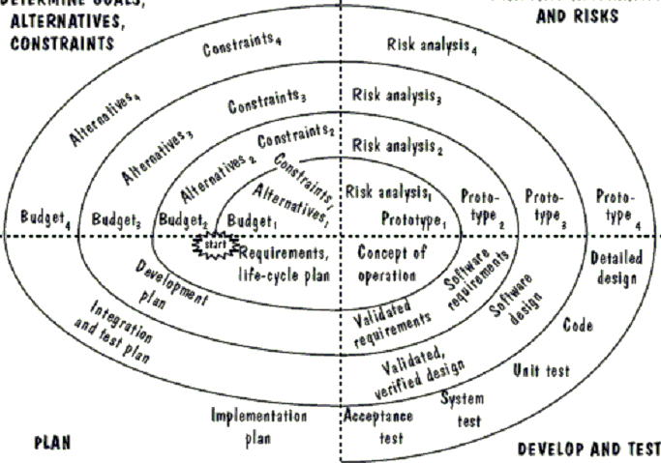
Spiral model螺旋模型
Determine Goals、
Alternatives、
Constraints
Evaluate Alternatives
And Risks
Develop And Test
Plan

Slide 32
“Add Your Company Slogan”
Thank You !

