Slide 1




Taming the Hydra
Targeted Control-Flow Transformations
for Dynamic Symbolic Execution
Charitha Saumya *
Intel
Muhammad Hassan *
Virginia Tech
Speaker
Rohan Gangaraju
UT Austin
Milind Kulkarni
Purdue University
Kirshanthan Sundararajah
Virginia Tech
OOPSLA '26
* Denotes equal contribution
1
Notes:
Intro
Lets start with an intro on Symbolic execution

Slide 2
Symbolic Execution Is Theoretically Perfect But …
2

Slide 3
Symbolic Execution Is Theoretically Perfect But …
Executes program with symbolic inputs to find bugs and prove correctness
Executes program with symbolic inputs ⟹
find bugs, prove correctness, and verify programs
2
Notes:
Execute program with symbolic inputs. And with that we cover the paths in the program, find bugs, prove correctness and verify program

Slide 4
Symbolic Execution Is Theoretically Perfect But …
Executes program with symbolic inputs to find bugs and prove correctness
Executes program with symbolic inputs ⟹
find bugs, prove correctness, and verify programs
Complete path coverage ⟹ entire input space explored
2
Notes:
If we cover all paths, we have a a guaranteed all input space exploration

Slide 5
Symbolic Execution Is Theoretically Perfect But …
Executes program with symbolic inputs to find bugs and prove correctness
Executes program with symbolic inputs ⟹
find bugs, prove correctness, and verify programs
Complete path coverage ⟹ entire input space explored
Entire input space explored ⟹ all reachable bugs found
2
Notes:
Theoretically find every reachable bug

Slide 6
Symbolic Execution Is Theoretically Perfect But …
Executes program with symbolic inputs to find bugs and prove correctness
Executes program with symbolic inputs ⟹
find bugs, prove correctness, and verify programs
Complete path coverage ⟹ entire input space explored
Entire input space explored ⟹ all reachable bugs found
So why doesn’t it scale for real programs with lots of control-flow?
2
Notes:
So why is not everyone using it for real programs with lots of control flow??

Slide 7



Tools for Symbolic Execution
KLEE
Manticore
Java Pathfinder
Angr
Our implementation builds on klee
3
Notes:
There’s quite a few tools for symbolic exeuction
Our implementation builds on klee

Slide 8
It has practical challenges
4
Notes:
Now lets understand what are the practical challenges with these tools

Slide 9

It has practical challenges
It’s Slow
hours on small programs
3
4
Notes:
Its slow. It itakes hours to run even on small programs

Slide 10

It has practical challenges
It’s Slow
hours on small programs
Memory Hungry
tens of GBs
3
4
Notes:
It requires huge amount of memory to run, and manage all the states

Slide 11

It has practical challenges
It’s Slow
hours on small programs
Memory Hungry
tens of GBs
Doesn’t scale
paths explosion
3
4
Notes:
And doesn’t scale well when we start to increase the program size
All these make a theoretically perfect technique, practically imperfect.
Lets take a quick look on how it actually creates problem.

Slide 12
How Symbolic Execution Works
1 x = input()
2 if (x > 10)
3 y = 100 / (x - 11)
4 else
5 y = 0
6 return y
3
5
Notes:
Lets go over an example of how it works
Explain example
It has an obvious bug in one of the branches

Slide 13
How Symbolic Execution Works
1 x = input() <-- X is Symbolic
2 if (x > 10)
3 y = 100 / (x - 11)
4 else
5 y = 0
6 return y
3
5

Slide 14
How Symbolic Execution Works
1 x = input() <-- X is Symbolic
2 if (x > 10) <-- Can X be > 10? We Fork
3 y = 100 / (x - 11)
4 else
5 y = 0
6 return y
3
5
Notes:
We ask the question whether X can be greater than 10.
We don’t know for sure, so we fork. We take care of both scenarios

Slide 15
How Symbolic Execution Works
1 x = input() <-- X is Symbolic
2 if (x > 10) <-- Can X be > 10? We Fork
3 y = 100 / (x - 11) <-- Given X > 10, can x – 11 be 0
4 else
5 y = 0
6 return y
3
5
Notes:
Now we ask whether we can hit that bug

Slide 16
How Symbolic Execution Works
1 x = input() <-- X is Symbolic
2 if (x > 10) <-- Can X be > 10? We Fork
3 y = 100 / (x - 11) <-- Given X > 10, can x – 11 be 0
4 else
5 y = 0
6 return y
We encode the question and hand it to an SMT solver
5
Notes:
We econde the semantics of the question and pass it an SMT solver.

Slide 17
How Symbolic Execution Works
1 x = input() <-- X is Symbolic
2 if (x > 10) <-- Can X be > 10? We Fork
3 y = 100 / (x - 11) <-- Given X > 10, can x – 11 be 0
4 else
5 y = 0
6 return y
We encode the question and hand it to an SMT solver
X = 11
5
Notes:
We find that the value 11 can be used to satisfy this equation

Slide 18
What is this SMT Solver?
3
6

Slide 19
What is this SMT Solver?
Ask: does a logical formula φ have a satisfying assignment?
φ : (x > 10) ∧ (x - 11 = 0)
3
6
Notes:
We ask whether a formula has a satisfying value

Slide 20
What is this SMT Solver?
Ask: does a logical formula φ have a satisfying assignment?
φ : (x > 10) ∧ (x - 11 = 0)
SAT
∃ satisfying assignment
3
6

Slide 21
What is this SMT Solver?
Ask: does a logical formula φ have a satisfying assignment?
φ : (x > 10) ∧ (x - 11 = 0)
SAT
∃ satisfying assignment
UNSAT
∄ satisfying assignment
3
6
Notes:
Now that we have this information, lets go back to why symbolic execution fails in practice

Slide 22
Lets Understand Why Symbolic Execution Doesn’t Scale
entry block
1 x = input()
2 if (x > 10)
3 y = 100 / (x - 11)
4 else
5 y = 0
6 return y
if
true
false
path 1
path 2
merge
7

Slide 23
Lets Understand Why Symbolic Execution Doesn’t Scale
2
entry block
paths
if
true
false
path 1
path 2
merge
7

Slide 24
Lets Understand Why Symbolic Execution Doesn’t Scale
2
2
entry block
paths in an iteration
paths
if
true
false
path 1
path 2
We can solve this quickly
merge
7

Slide 25

The Problem Arises….
entry block
if
symbolic
1 x = input() <-- X is Symbolic
2 if (x > 10)
3 y = 100 / (x - 11)
4 else
5 y = 0
6 return y
true
false
path 1
path 2
merge
8
Notes:
Now what if the if condition was symbolic?

Slide 26
The Problem Arises….
2
entry block
symbolic
paths
if
true
false
path 1
path 2
merge
8
Notes:
We still have 2 paths
But

Slide 27
The Problem Arises….
2
entry block
paths
if
symbolic
true
false
path 1
path 2
but now we have to fork for both paths
merge
8
Notes:
Now we have to fork

Slide 28
The Problem Arises….
2
entry block
paths
if
symbolic
true
false
but now we have to fork for both paths
path 1
path 2
merge
duplicated states
8
Notes:
But this problem can get much worse

Slide 29
Wrap it in a Loop
entry block
symbolic
0 for (i = 0; i < N; i++) ← new
1 x = input()
2 if (x > 10)
3 y = 100 / (x - 11)
4 else
5 y = 0
6 return y
if
true
false
path 1
path 2
merge
9
Notes:
We introduce a loop to this piece of code
Now it doesnt have 2 paths anymore

Slide 30
And Now We Have A Problem
2^N
entry block
symbolic
paths in N iterations
if
true
false
path 1
path 2
merge
9

Slide 31
And Now We Have A Problem
entry block
if
symbolic
path 1
path 2
2^N
entry block
merge
symbolic
if
symbolic
paths in N iterations
if
true
false
path 1
path 2
merge
path 1
path 2
if
symbolic
path 1
path 2
merge
merge
if
symbolic
path 1
path 2
merge
Repeat
9

Slide 32
And Now We Have A Problem
2^N
entry block
symbolic
paths in N iterations
if
true
false
OOT
path 1
path 2
vanilla KLEE at N=50
We can solve this quickly
merge
9

Slide 33
And Now We Have A Problem
2^N
entry block
symbolic
paths in N iterations
if
true
false
OOT
path 1
path 2
vanilla KLEE at N=50
We can solve this quickly
merge
Every query ⇒
initiation + solving time
9
Notes:
For each query we have to first send it to solver and then solve.
Sending out a query is slow
Even very simple queries take time

Slide 34
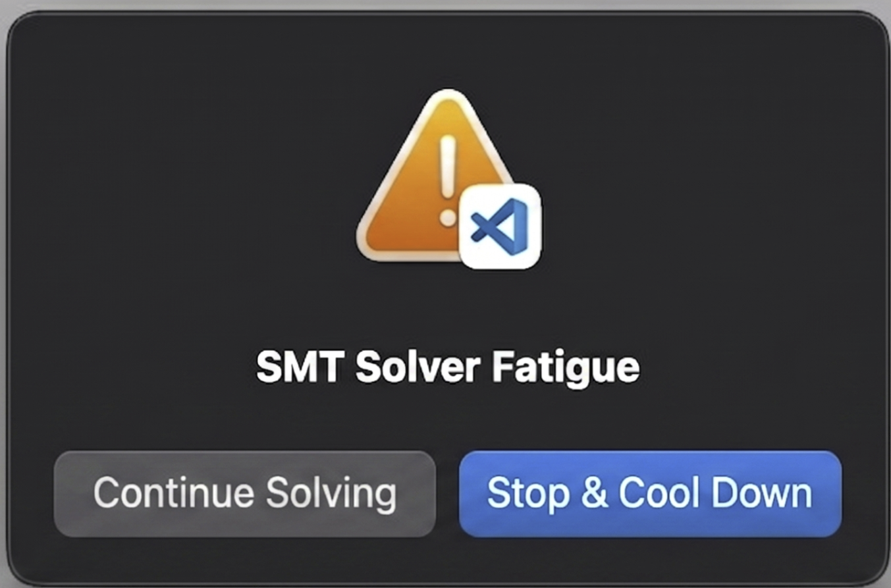
Solver Gets Overloaded
4ᴺ
paths after N loop iters
OOT
Exponential number of SMT queries
10
Notes:
We end up in solver fatigue

Slide 35
How we currently deal with this?
The foundational technique for path explosion is State Merging
01
Fork & Merge
Paths that rejoin are merged into one state.
11
Notes:
The current state of the art is state merging
After each fork we try to merge the states

Slide 36
How we currently deal with this?
The foundational technique for path explosion is State Merging
01
02
Fork & Merge
Paths that rejoin are merged into one state.
Why it works
Some states stay linear instead of growing at exponentially.
11
Notes:
Instead of exponentially increasing the states, the grow linearly for the example that Is showed you guys earlier

Slide 37
How we currently deal with this?
The foundational technique for path explosion is State Merging
01
02
03
Fork & Merge
Paths that rejoin are merged into one state.
Why it works
Some states stay linear instead of growing at exponentially.
When it happens
At runtime, after each fork.
11
Notes:
But we have to do this after each fork. If we fork a thousand times, we do state merging a thousand times

Slide 38
Why This Isn’t Enough
12

Slide 39
Why This Isn’t Enough
01
Forking still requires solving
Checking if both paths are possible still means calling the solver first.
12
Notes:
The merge happens too late.
We still have to solve both parts before we can merge the states
So even if we merge the states back together later, we've already paid for those solver calls
And remember the earlier slide: every query costs setup time plus solving time.

Slide 40
Why This Isn’t Enough
01
02
Forking still requires solving
Checking if both paths are possible still means calling the solver first.
States, not paths
Merging reduces the states tracked, not the paths forked.
12
Notes:
We are reducing the states, not the paths.
the branch is still in the program. KLEE still splits at it, explores each side, and only then joins them back together.
We are trying to clean up this mess instead of preventing it

Slide 41
Why This Isn’t Enough
01
02
Forking still requires solving
Checking if both paths are possible still means calling the solver first.
States, not paths
Merging reduces the states tracked, not the paths forked.
Path Explosion makes symbolic execution not scalable
12
Notes:
And that path explosion is what makes symbolic execution not scale

Slide 42
Our Solution
Don’t Worry About the
Hydra
13

Slide 43
Our Solution
Don’t Worry About the
Hydra
Just
Restructure It
13

Slide 44
Our answer
CFM-SE
control-flow melding for symbolic execution
14

Slide 45
How CFM-SE Does It
We merge the paths within a branch statically with the compiler.
15
Notes:
We merge the paths in a branch statically and with that we move the overhead of interpretation to compilation

Slide 46
How CFM-SE Does It
We merge the paths within a branch statically with the compiler.
01
Two basic blocks become one
B1
B1_B2
B2
cfm-se rewrites the if and else paths into a single block using select operators.
15

Slide 47

How CFM-SE Does It
We merge the paths within a branch statically with the compiler.
01
02
Two basic blocks become one
No fork, no solver call
B1
B1_B2
B1_B2
solver idle
B2
cfm-se rewrites the if and else paths into a single block using select operators.
With one block instead of two there is nothing to branch on, so KLEE never queries the solver here.
15

Slide 48
How CFM-SE Does It
We merge the paths within a branch statically with the compiler.
01
02
03
Two basic blocks become one
No fork, no solver call
Paid once, not every time
B1
B1_B2
B1_B2
Compile
once
Run * N
no extra cost
solver idle
B2
cfm-se rewrites the if and else paths into a single block using select operators.
With one block instead of two there is nothing to branch on, so KLEE never queries the solver here.
The rewrite happens at compile time. DSE never revisits it, however many times the code runs.
15

Slide 49
Let's look at an example
void to_upper(char *text, int n) {
for (int i = 0; i < n; i++) {
if ((text[i] >= 'a') & (text[i] <= 'z'))
text[i] = text[i] - 'a' + 'A';
}
}
16

Slide 50
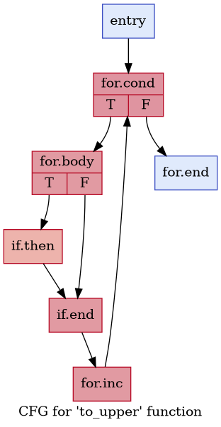
Let's look at an example
void to_upper(char *text, int n) {
for (int i = 0; i < n; i++) {
if ((text[i] >= 'a') & (text[i] <= 'z'))
text[i] = text[i] - 'a' + 'A';
}
}
16
Notes:
Explain the control-flow graph
Path explosion will be caused by if branch. Our ultimate goal is to remove this if branch. So how do we actually remove this branch?

Slide 51
Compilers can remove branches: If-conversion
br c
t = a + 1
t = b + 1
merge
17
Notes:
Compilers already know how to remove branches.
One technique for this is called if-conversion.
Here's a simple example: we check a condition, and depending on the answer we add one to either a or b.
Notice that both sides are doing almost the same thing.

Slide 52
Compilers can remove branches: If-conversion
br c
s = select c, a , b
t = s + 1
t = a + 1
t = b + 1
merge
17
Notes:
The compiler can pick which value to use, a or b, and then does the addition once.
The branch is gone, and we're left with one straight path through the code.

Slide 53
Where if conversion falls short
br c
Nothing to match against
if
no else
18
Notes:
But our case is different.
We have an if statement, but there is no corresponding else statement.
So this kind of merging doesnt have anything to work with
So what can we do here?

Slide 54

Example of Melding- Intermediate Representation
Block 1
Block 1
1 if ((text[i] >= 'a')
2 && (text[i] <= 'z')){
3 t1 = text[i]
4 t2 = t1 - 'a';
5 t3 = t2 + 'A';
6 t4 = text[i];
7 text[i] = t3;
8 }
19
Notes:
Well if we dont have an else block. We create an else block
Clone the instructions into the else block

Slide 55
Example of Melding - Intermediate Representation
Block 1
Block 1
Block 2
1 if ((text[i] >= 'a')
2 && (text[i] <= 'z')){
3 t1 = text[i]
4 t2 = t1 - 'a';
5 t3 = t2 + 'A';
6 t4 = text[i];
7 text[i] = t3;
8 }
// extra instructions
1 else {
2 t5 = text[i];
3 t6 = t5 - 0;
4 t7 = t6 + 0;
5 t8 = text[i];
6 text[i] = t8;
7 }
19
Notes:
Now we start to look for similarity in the two blocks

Slide 56
Example of Melding - Intermediate Representation
Block 1
Block 1
Block 2
1 if ((text[i] >= 'a')
2 && (text[i] <= 'z')){
3 t1 = text[i]
4 t2 = t1 - 'a';
5 t3 = t2 + 'A';
6 t4 = text[i];
7 text[i] = t3;
8 }
// extra instructions
1 else {
2 t5 = text[i];
3 t6 = t5 - 0;
4 t7 = t6 + 0;
5 t8 = text[i];
6 text[i] = t8;
7 }
unsigned is_lower = (text[i] >= 'a') & (text[i] <= 'z');
19
Notes:
Now we find the similarity in instrcutions

Slide 57
Example of Melding - Intermediate Representation
Block 1
Block 1
Block 2
1 if ((text[i] >= 'a')
2 && (text[i] <= 'z')){
3 t1 = text[i]
4 t2 = t1 - 'a';
5 t3 = t2 + 'A';
6 t4 = text[i];
7 text[i] = t3;
8 }
// extra instructions
1 else {
2 t5 = text[i];
3 t6 = t5 - 0;
4 t7 = t6 + 0;
5 t8 = text[i];
6 text[i] = t8;
7 }
t1_t5 = text[i];
19
Notes:
For read we can just read from the variable

Slide 58
Example of Merging - Intermediate Representation
Block 1
Block 1
Block 2
1 if ((text[i] >= 'a')
2 && (text[i] <= 'z')){
3 t1 = text[i]
4 t2 = t1 - 'a';
5 t3 = t2 + 'A';
6 t4 = text[i];
7 text[i] = t3;
8 }
// extra instructions
1 else {
2 t5 = text[i];
3 t6 = t5 - 0;
4 t7 = t6 + 0;
5 t8 = text[i];
6 text[i] = t8;
7 }
s1 = is_lower == 0 ? 0 : 'a';
t2_t6 = t1_t5 - s1;
19
Notes:
For write we either write the supposed correct value, or a dummy value.
We do this for all values. Then we combine the block

Slide 59
Melded Block from Block 1 and Block 2
Block 1_2
1 unsigned is_lower =
2 (text[i] >= 'a') & (text[i] <= 'z');
4 t1_t5 = text[i];
5 s1 = is_lower == 0 ? 0 : 'a';
6 t2_t6 = t1_t5 - s1;
7 s2 = is_lower == 0 ? 0 : 'A';
8 t3_t7 = t2_t6 + s2;
9 t4_t8 = text[i];
10 s3 = is_lower == 0 ? t4_t8 : t3_t7;
11 text[i] = s3;
20
Notes:
We convert those two blocks into a single block.
So now instead of choosing between taking the if block or not, we always take this new block

Slide 60
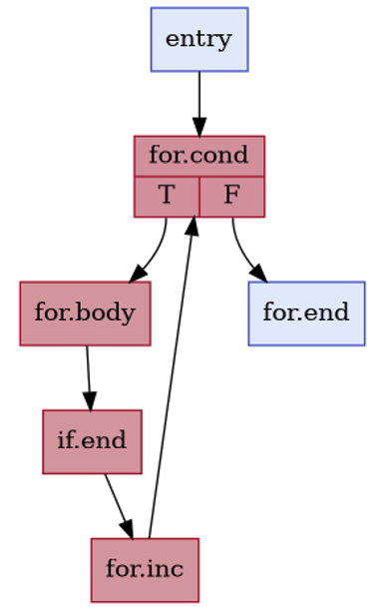
Melded Block from Block 1 and Block 2
Block 1_2
1 unsigned is_lower =
2 (text[i] >= 'a') & (text[i] <= 'z');
4 t1_t5 = text[i];
5 s1 = is_lower == 0 ? 0 : 'a';
6 t2_t6 = t1_t5 - s1;
7 s2 = is_lower == 0 ? 0 : 'A';
8 t3_t7 = t2_t6 + s2;
9 t4_t8 = text[i];
10 s3 = is_lower == 0 ? t4_t8 : t3_t7;
11 text[i] = s3;
20
Notes:
The if block is now linearized

Slide 61
Does this always work?
21

Slide 62
Melding can cause memory errors
Original
int func(int *p, int *out, int n) {
int r;
if (p != NULL)
r = *p + n; // load *p
else
r = n;
return r; }
22
Notes:
Some of you may have noticed this has a memory problem.
For those of you who didn’t, let me explain
We start with this function that is guarded by a Null check.
This ensures P i not NULL

Slide 63
Melding can cause memory errors
Original
Melded
int func(int *p, int *out, int n) {
int r;
if (p != NULL)
r = *p + n; // load *p
else
r = n;
return r; }
int func(int *p, int *out, int n) {
int r;
int c = (p != NULL)
int temp = *p; // accessing *Null
r = c ? temp + n : n;
return r; }
22
Notes:
After melding we access P unconditionally. Meaning it can be NULL in some cases.
Now this is a problem because. We get segmentation fault.
What can we do here?

Slide 64
Introduce safe memory address
Original
Melded
int func(int *p, int *out, int n) {
int r;
if (p != NULL)
r = *p + n; // load *p
else
r = n;
return r; }
int func(int *p, int *out, int n) {
int r;
int c = (p != NULL)
int *q = c ? *p : &safe_address
int temp = *q; // never Null
r = c ? temp + n : n;
return r; }
23
Notes:
We introduce a safe memory address.
now it will either read from a safe memory address that we created, or the actual memory address it was supposed to.
Temp variable will never be NULL now.

Slide 65
Not semantics-preserving, but failure preserving
01
Keeps every real crash
Every failure in the original program still exists.
24
Notes:
We ensure all crashes that exists in the original program, would still exist in the melded program.

Slide 66
Not semantics-preserving, but failure preserving
01
02
Keeps every real crash
Every failure in the original program still exists.
May add crashes
if (i < n) x = a[i]
it loads from array unconditionally
24
Notes:
We may introduce up some crashes that did not originally exist in the original program

Slide 67
Not semantics-preserving, but failure preserving
01
02
03
Keeps every real crash
Every failure in the original program still exists.
May add crashes
if (i < n) x = a[i]
it loads from array unconditionally
Filter false positives
Replay the input on original program
24
Notes:
But we have a way to catch those and filter out the false positives.
We can take the crashing input from the melded program, and replay on the original program
Now that we have the technique, lets move on to the important question

Slide 68
Why any of this matters
25

Slide 69
What is actually happening?
Branches eliminated
26

Slide 70
What is actually happening?
Branches eliminated
States never forked
26

Slide 71
What is actually happening?
Branches eliminated
States never forked
Exploration runs faster
fewer paths to walk
26

Slide 72
What is actually happening?
Branches eliminated
States never forked
Exploration runs faster
fewer paths to walk
Higher coverage, reached sooner
26

Slide 73
What is actually happening?
Branches eliminated
States never forked
Exploration runs faster
fewer paths to walk
States survive longer
less memory pressure
Higher coverage, reached sooner
26

Slide 74
What is actually happening?
Branches eliminated
States never forked
Exploration runs faster
fewer paths to walk
States survive longer
less memory pressure
Higher coverage, reached sooner
Deeper bugs found
26

Slide 75
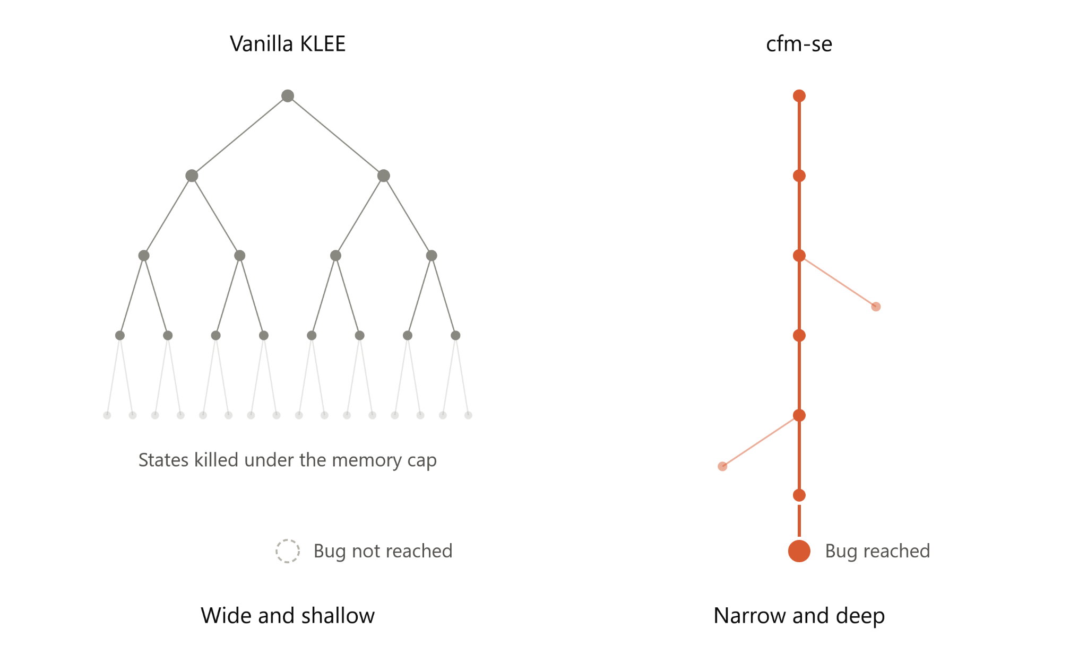
How the search space is explored?
Vanilla KLEE
Wide and Shallow
27
Notes:
Klee tries to keep the states in memory
We can not goo deeper into program because states are getting killed

Slide 76
How the search space is explored?
Vanilla KLEE
CFM-SE
Wide and Shallow
Narrow and Deep
27
Notes:
With cfmse we are minimizing the paths at the start so we can actually go deepr
We are taking multiple simple queries and merging them to make a single complex query

Slide 77
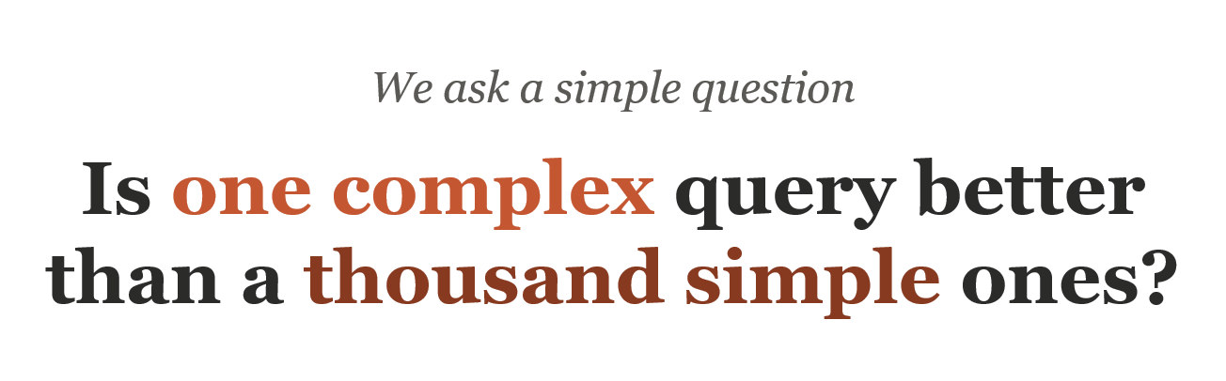
28

Slide 78
We ask a simple question
Is one complex query better than a thousand simple ones?
The answer depends on scale
28

Slide 79
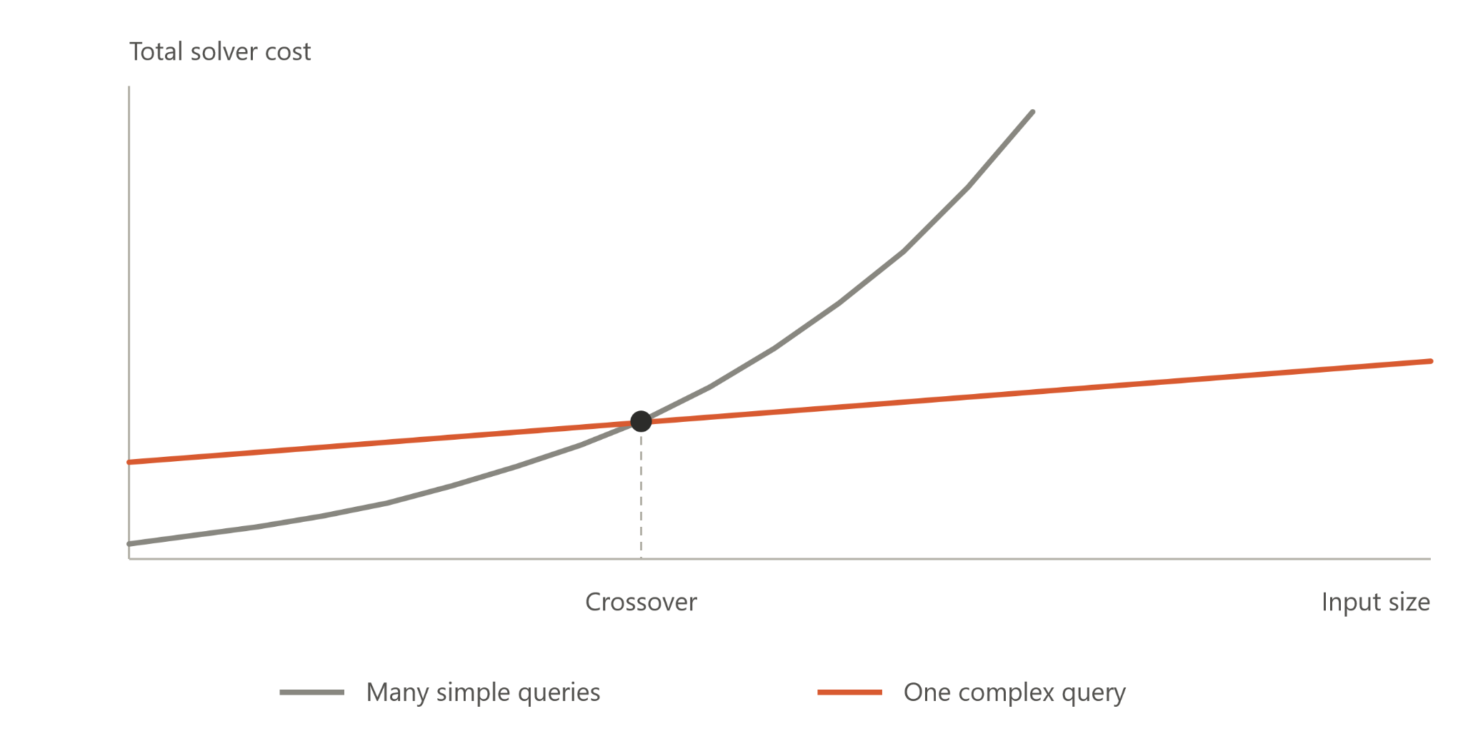
Where does the crossover sit?
29
Notes:
Explain the crossover
now that we understand this, lets move on the research questions

Slide 80
The questions we asked
Question
What counts as a win
Measured on
How much solver work goes away
Fewer solver calls and faster exploration
11 kernels with varying input sizes
RQ1
30

Slide 81
The questions we asked
Question
What counts as a win
Measured on
How much solver work goes away
Fewer solver calls and faster exploration
11 kernels with varying input sizes
RQ1
Do we cover program lines sooner
Same or higher coverage inside a fixed budget
9 real programs with 1 hour budget
RQ2
30

Slide 82
The questions we asked
Question
What counts as a win
Measured on
How much solver work goes away
Fewer solver calls and faster exploration
11 kernels with varying input sizes
RQ1
Do we cover program lines sooner
Same or higher coverage inside a fixed budget
9 real programs with 1 hour budget
RQ2
Are deep bugs found faster
Injected deep bugs found in less time
5 real-world libraries with bugs injected
RQ3
30

Slide 83
Lets visit our ToUpper example from earlier
Input Size = 50 | KLEE
Paths | 10.5 M
Solver Queries (Within the loop) | Timed Out
Time | Timed Out
31

Slide 84
Lets visit our ToUpper example from earlier
Input Size = 50 | KLEE | State Merging
Paths | 10.5 M | 51
Solver Queries (Within the loop) | Timed Out | 51
Time | Timed Out | 0.69s
31

Slide 85
Lets visit our ToUpper example from earlier
Input Size = 50 | KLEE | State Merging | CFMSE
Paths | 10.5 M | 51 | 1
Solver Queries (Within the loop) | Timed Out | 51 | 0
Time | Timed Out | 0.69s | 0.00s
31

Slide 86
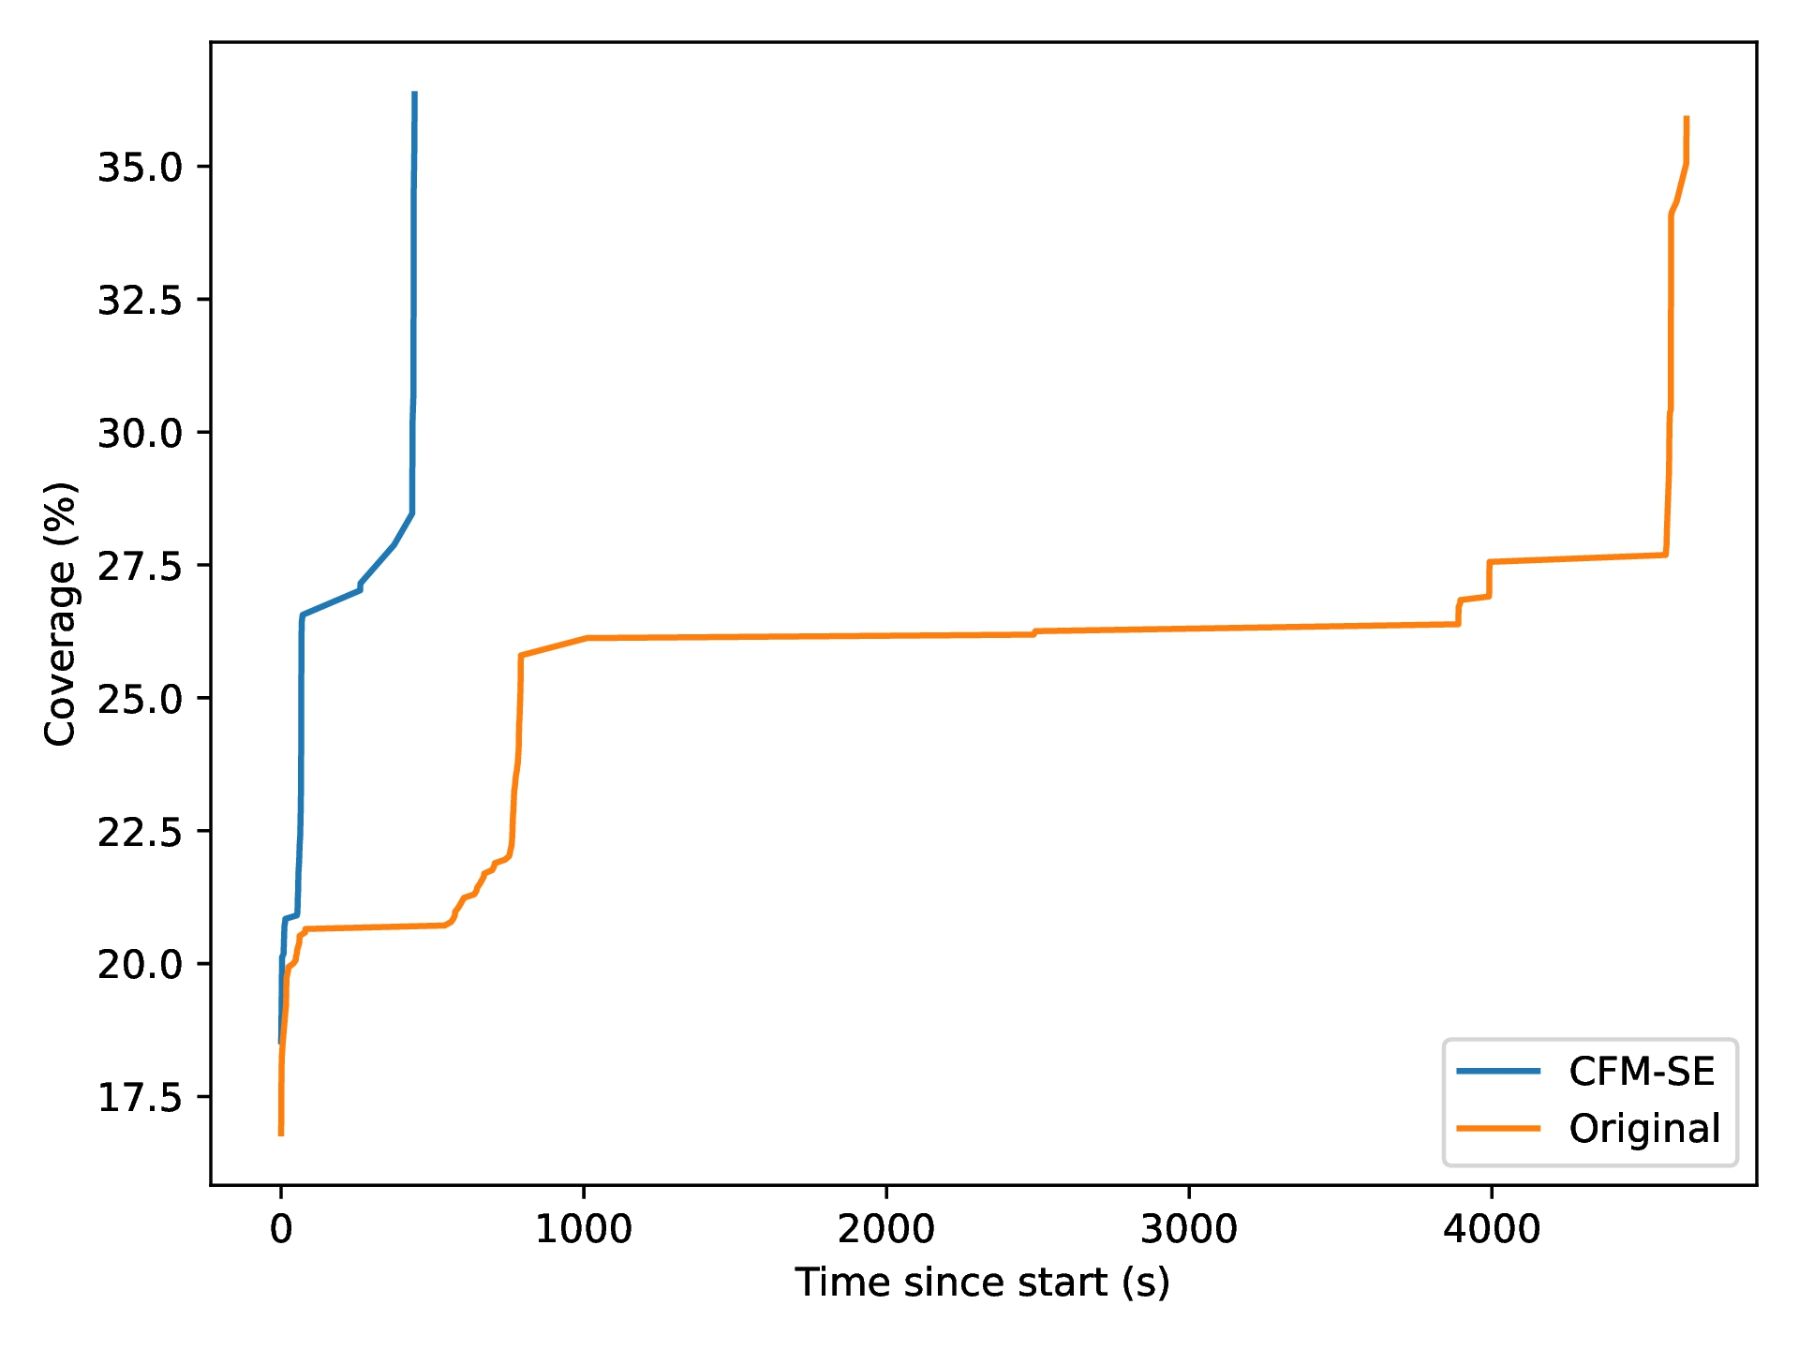
Same or higher coverage, but sooner
libosip
32

Slide 87
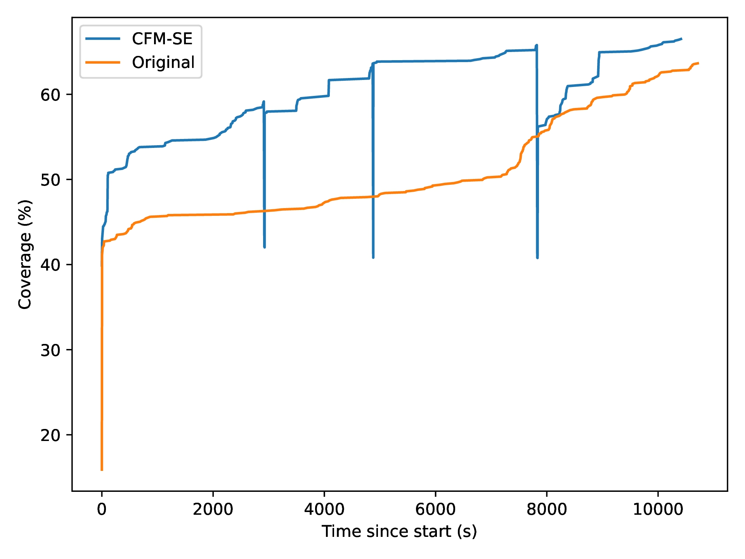
Same or higher coverage, but sooner
libosip
json.h
32
Notes:
False positive crashes

Slide 88
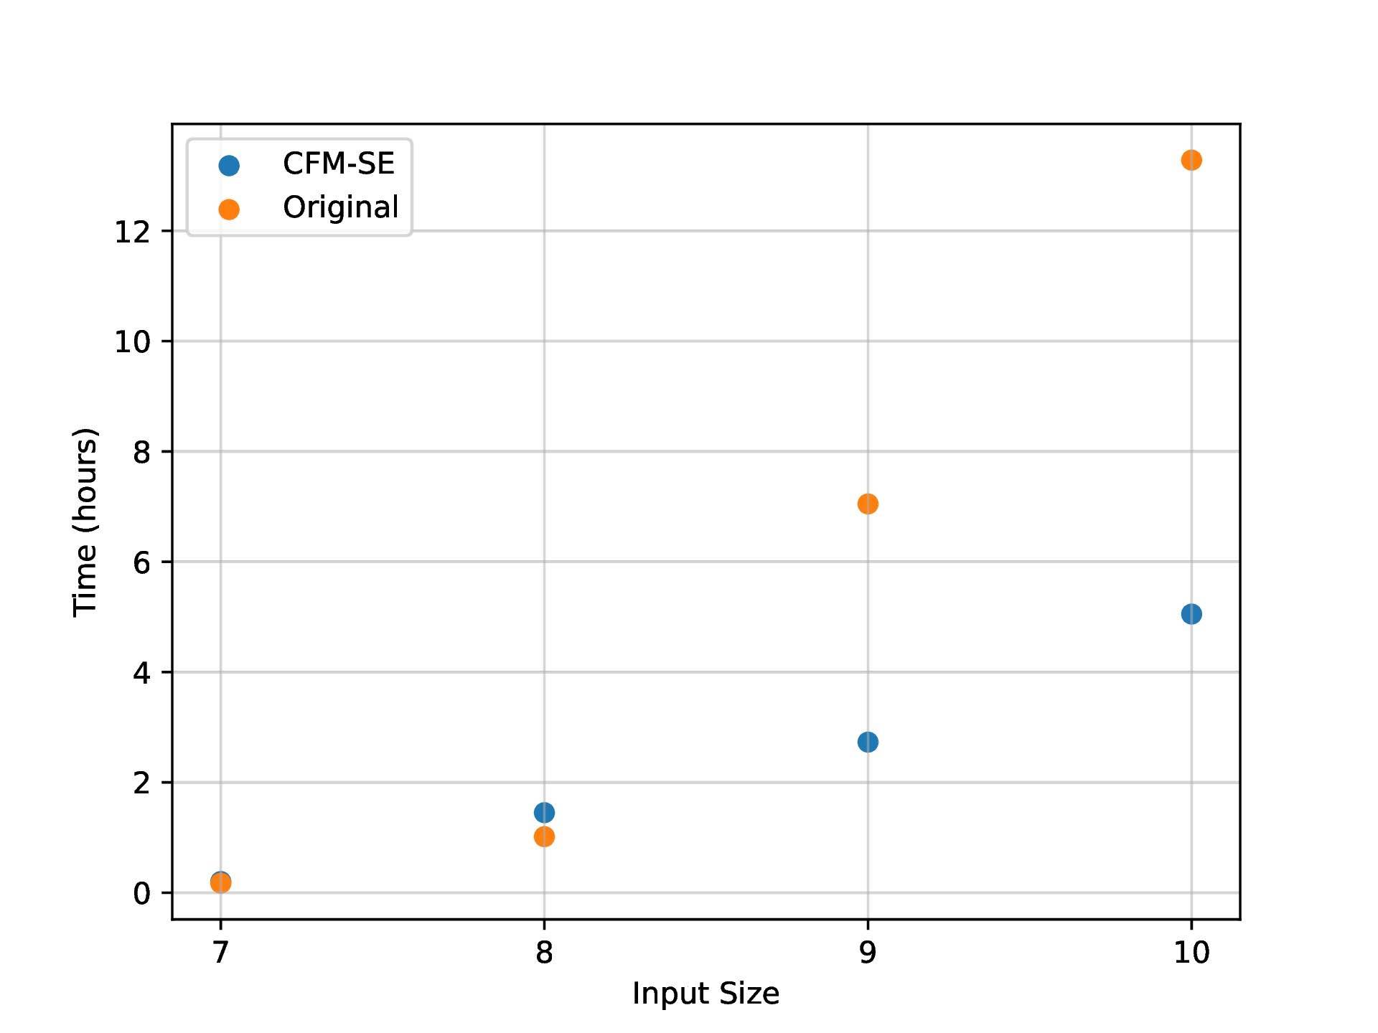
Why cfmse wins as libyaml grows
Hours to find a bug
One injected bug, 20 GB of memory
33
Notes:
We have a chart that shows we can find bugs faster.
Why are we actually able to find bugs faster.
lets look at libyaml. 20 GB of memory to run Symbolic Exeuction.
Size 7 and 8 we have similar times with KLEE being a little bit faster
From input size 9, CFMSE can find the bug hours faster than vanilla KLEE
lets look at why that is

Slide 89
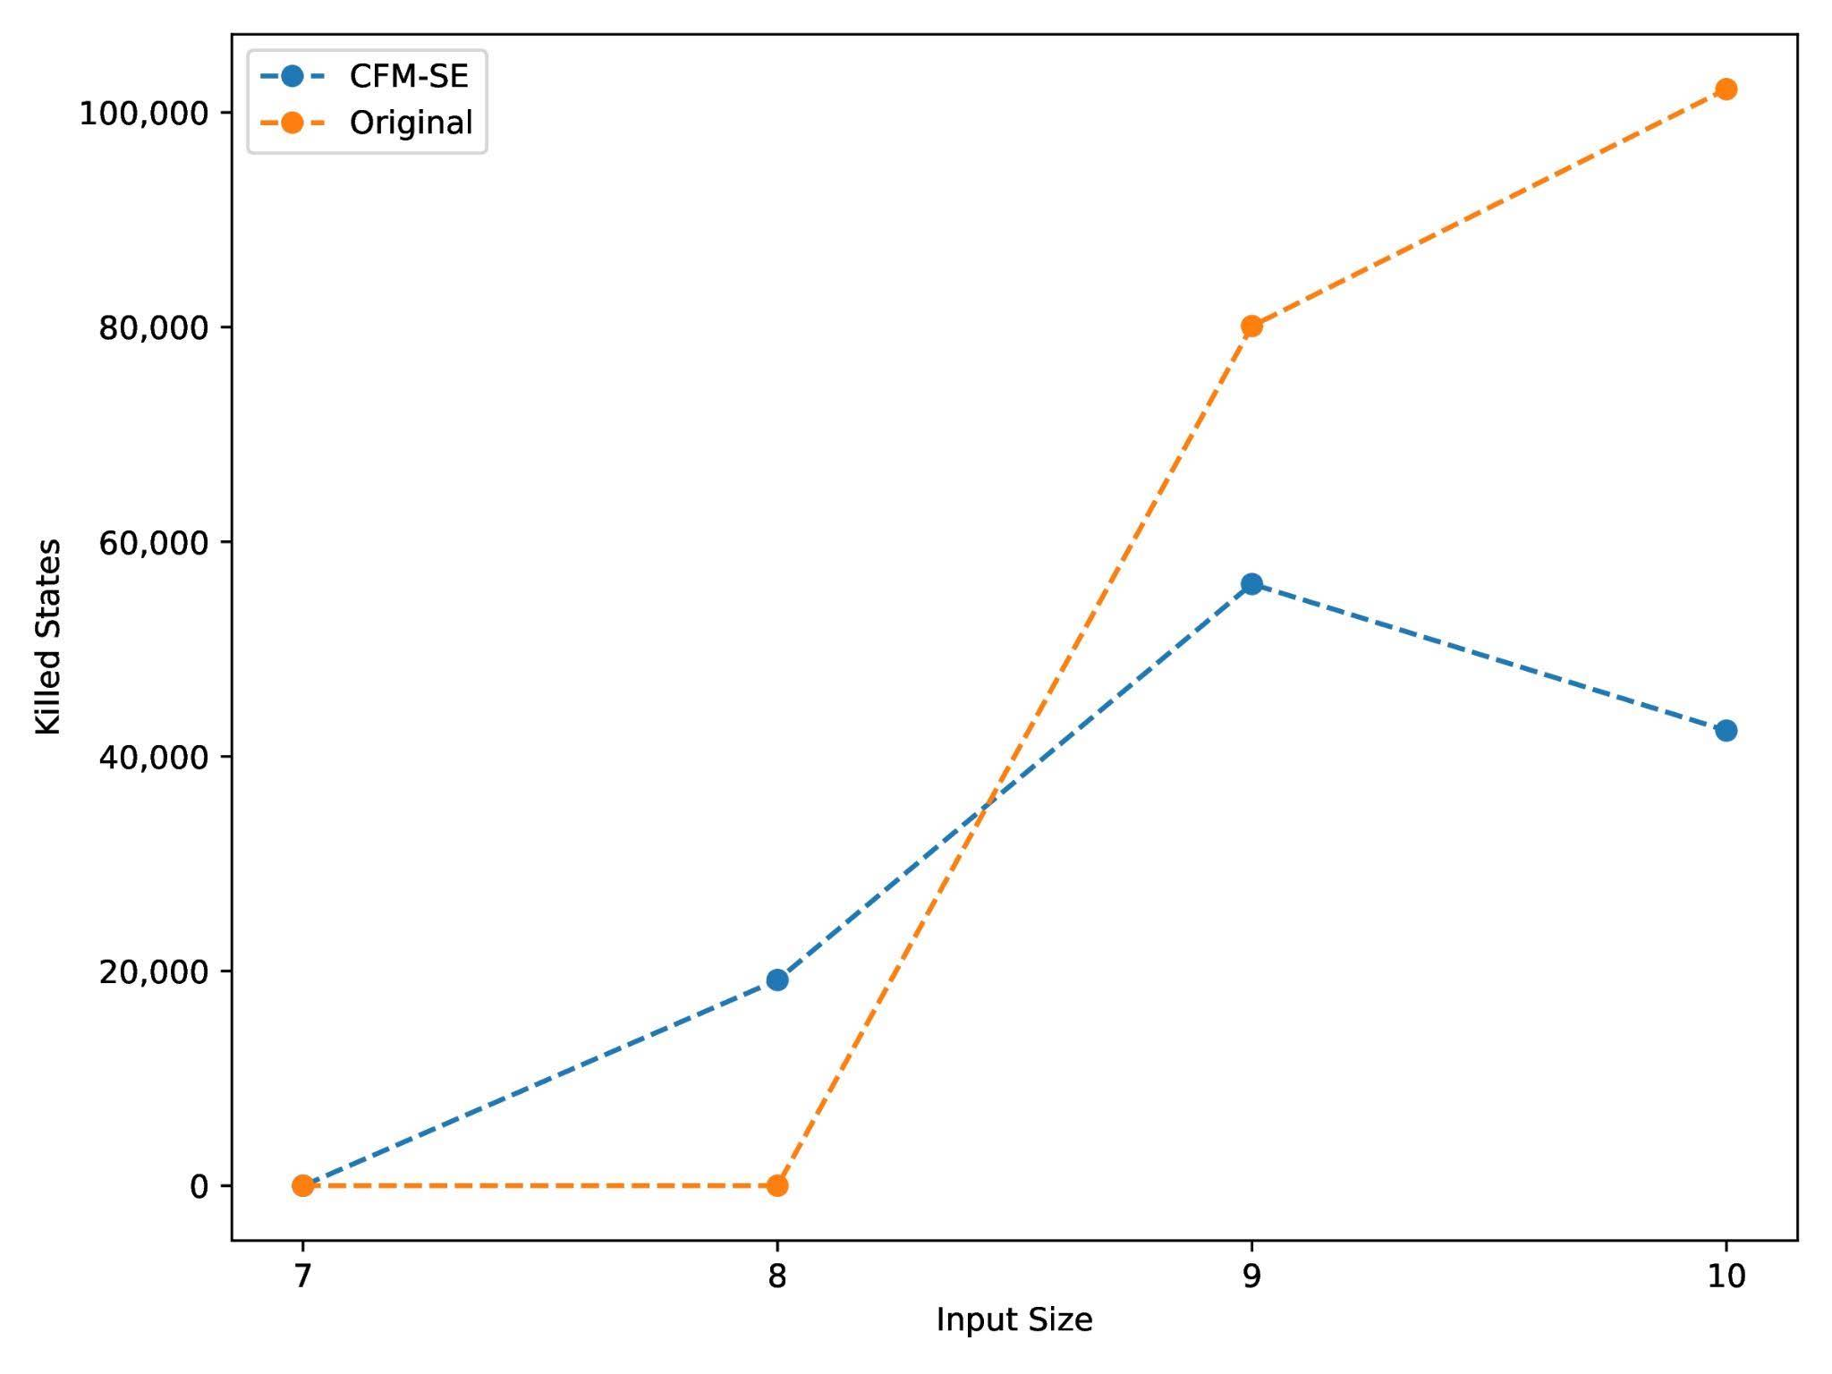
Why cfmse wins as libyaml grows
Hours to find a bug
One injected bug, 20 GB of memory
Fewer states killed,
so the bug is found sooner.
States killed by memory cap
33
Notes:
We have to kill fewer states, program is easily able to get deeper and find the bug

Slide 90
Why cfmse wins as libyaml grows
Hours to find a bug
One injected bug, 20 GB of memory
Fewer states killed,
so the bug is found sooner.
This is where 20 GB stops being enough
States killed by memory cap
33
Notes:
The two crossover points line up. As soon as KLEE starts killing more states than cfm-se, cfm-se starts winning.

Slide 91

More in Paper
11 Benchmarks for path explosion
9 programs for coverage
5 programs with injected bugs
under 2ms compile time
34

Slide 92


Try out CFMSE on existing examples or add your examples
35

Slide 93
Thank You!
Paper
Artifact
OOPSLA '26
36

Slide 94
Where melding fails - symbolic array access
Symbolic Execution Branching
Merge Sort
i is symbolic
while (i < n1 && j < n2) {
if (L[i] <= R[j]) {
arr[k] = L[i];
i++;
}
else {
arr[k] = R[j];
j++;
}
k++;
}
if
arr[k] = L[i]
arr[k] = R[i]
Merging makes it worse
Instead of 1 solver call, we now have 2 solver calls
Adds the overhead of interpretation

Slide 95
Branch cases can be complex
br
c>lo
Compilers skip branches that do not align
br
c<hi
c = c-32
hits+=1
CFM-SE aligns uneven paths and merge them into one
merge
Notes:
Compilers already know how to remove branches.
One technique for this is called if-conversion.
Here's a simple example: we check a condition, and depending on the answer we add one to either a or b.
Notice that both sides are doing almost the same thing.

Slide 96
Every branch is a disaster
4ᴺ
paths after N loop iters
while (*hp != '\r') {
if (*hp) {
if (*hp >= '0' && *hp <= '9')
hp++;
else if (*hp == '.')
hp++;
else return OSIP_SYNTAXERROR;
} else return OSIP_SYNTAXERROR;
}
OOT
Exponential number of SMT queries

