Slide 1


Splyce: SIMD Vectorization of Sparse Coiteration
Kabilan Mahathevan | Poorna Gunathilaka | Kirshanthan Sundararajah
Virginia Tech
PACT 2026

Slide 2
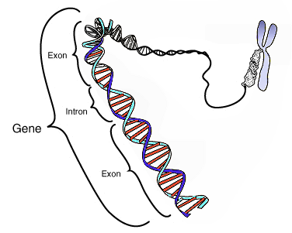
Coiteration
Iterating two or more Collections together
Inner Join
Order Table
User Table
X
ID | Order
1 | Pizza
1 | Biryani
2 | Ice Cream
2 | Taco
2 | 4 | 4 | 6 | 7 | 9 | 11 | 12
ID | Name
1 | Kabilan
2 | Poorna
3 | Krish
Merge Phase
4 | 6 | 9 | 12
Library-Based Approach
2 | 4 | 7 | 11
ID | Name | Order
1 | Kabilan | Pizza
1 | Kabilan | Biryani
2 | Poorna | Ice Cream
2 | Poorna | Taco
Notes:
Before we look at sparse tensors, let’s look at the fundamental operation at the heart of our work; Coiteration.
At the simplest, coiteration is just the process of iterating through two or more collections simultaneously to find where they align.
You already know this pattern well. For example, you can take the merge phase of the merge sort algorithm. During this merge phase, we take two sorted sub-arrays and compare each element in both sub-array to build the final sorted array as a single merged output.
This exact same two-finger structure appears in different domains. You can see this in database engines. Relational databases use this identical pattern to execute join operations, stepping through sorted keys to match users to their orders.
Even bioinformaticians use it to scan through millions of base pairs, coiterating variant datasets against DNA intervals to find the genetic overlaps.
It’s a beautiful, universal code pattern but it has many critical flaws for modern hardware optimization.
Therefore, all these applications have their own library solution to efficiently execute this on modern hardwares. But if this code pattern is being generated by a compiler for many different cases, a library solution can never fix it. This is what happens in Sparse Tensor Compilers.

Slide 3
Sparse Tensor Compilers
A_{ij} = B_{ik} * C_{kj}
CSR (B_{ik})
CSC (C_{kj})
c₁₁ | c₁₂ | c₁₃
c₂₁ | c₂₂ | c₂₃
c₃₁ | c₃₂ | c₃₃
Ptr
b₁₁ | b₁₂ | b₁₃
b₂₁ | b₂₂ | b₂₃
b₃₁ | b₃₂ | b₃₃
0 | 0 | c₁₃
c₂₁ | 0 | 0
0 | 0 | c₃₃
0 | 2 | 2 | 4
0 | 1 | 1 | 3
b₁₁ | b₁₂ | 0
0 | 0 | 0
b₃₁ | 0 | b₃₃
X
Index /
Coord
0 | 1 | 0 | 2
1 | 0 | 2
Value
b₁₁ | b₁₂ | b₃₁ | b₃₃
c₂₁ | c₁₃ | c₃₃
_{N x M = N x K * K x M}
for (int i = 0; i < N; ++i)
for (int j = 0; j < M; ++j)
for (int k = 0; k < K; ++k)
A[i][j] += B[i][k] * C[k][j]
B_{i}
A_{i}
i
C_{j}
A_{j}
j
C_{k}
B_{k}
k
Notes:
To explain this coiteration problem in sparse tensor compilers, I am going to use a well-known tensor computation, which is General Matrix-Matrix-Multiplication.
In this computation, we take one row of a matrix and multiply each element with its corresponding column of the subsequent matrix and accumulate the results.
We generally call this tensor contraction. For this case, it’s very intuitive to write a simple loop nest as follows.
Here you can see none of the loop indices depends on each other, which allows for many different loop optimizations.
But the problem with modern data is that it contains a lot of useless or repeating data points like 0s in this case.
Because of this sparsity in the data, to reduce the memory footprint, it’s stored in compressed formats.
Let’s take two such well-known compressed formats for Matrices, called CSR and CSC both of which are represented using three arrays. First two arrays, pointer and index array record the coordinates of the non-zero values and a final array to store the actual non-zeros.
Now that we have the data in compressed formats, we need to write loop nests to iterate through this compressed data without materializing them into dense format. To generate such loop nests, Sparse Tensor Compilers rely on an abstraction called Iteration Graph. Let’s look at the iteration graph for this example.

Slide 4
Sparse Tensor Compilers
A_{ij} = B_{ik} * C_{kj}
CSR (B_{ik})
CSC (C_{kj})
c₁₁ | c₁₂ | c₁₃
c₂₁ | c₂₂ | c₂₃
c₃₁ | c₃₂ | c₃₃
Ptr
b₁₁ | b₁₂ | b₁₃
b₂₁ | b₂₂ | b₂₃
b₃₁ | b₃₂ | b₃₃
0 | 0 | c₁₃
c₂₁ | 0 | 0
0 | 0 | c₃₃
0 | 2 | 2 | 4
0 | 1 | 1 | 3
b₁₁ | b₁₂ | 0
0 | 0 | 0
b₃₁ | 0 | b₃₃
X
Index /
Coord
0 | 1 | 0 | 2
1 | 0 | 2
Value
b₁₁ | b₁₂ | b₃₁ | b₃₃
c₂₁ | c₁₃ | c₃₃
_{N x M = N x K * K x M}
for (int i = 0; i < N; ++i)
for (int j = 0; j < M; ++j)
for (int k = 0; k < K; ++k)
A[i][j] += B[i][k] * C[k][j]
B_{i}
A_{i}
B_{1d}
A_{1d}
for (int i = 0; i < N; ++i)
for (int j = 0; j < M; ++j)
i
i
C_{j}
A_{j}
C_{2d}
A_{2d}
j
j
C_{k}
B_{k}
C_{1c}
B_{2c}
k
k
Notes:
We have two output indices “i” and “j”. Let’s now focus on the input indices. We have first index dimension “i” in matrix B. This dimension is not-compressed when we represent the matrix B in CSR format. That means in this compressed format, the first dimension, which is the row dimension, can be accessed randomly. Same as in Matrix C where the data is represented in CSC format, the second dimension “j” is not compressed.
Therefore these two dense dimension generates a simple affine loops to iterate through all values in that dimension.
Finally, we have index dimension “k”, which is shared between both input matrix B and C. Not only that this dimension is compressed in both matrices. Because of such conditions, the compiler needs to generate a loop to coiterate both compressed dimensions together.

Slide 5
Sparse Tensor Compilers
A_{ij} = B_{ik} * C_{kj}
CSR (B_{ik})
CSC (C_{kj})
c₁₁ | c₁₂ | c₁₃
c₂₁ | c₂₂ | c₂₃
c₃₁ | c₃₂ | c₃₃
Ptr
b₁₁ | b₁₂ | b₁₃
b₂₁ | b₂₂ | b₂₃
b₃₁ | b₃₂ | b₃₃
0 | 0 | c₁₃
c₂₁ | 0 | 0
0 | 0 | c₃₃
0 | 2 | 2 | 4
0 | 1 | 1 | 3
b₁₁ | b₁₂ | 0
0 | 0 | 0
b₃₁ | 0 | b₃₃
b₁₂
0 | 2
0 | 1
X
c₂₁
Index /
Coord
0
1
1
0 | 1 | 0 | 2
1
1 | 0 | 2
Value
b₁₁ | b₁₂ | b₃₁ | b₃₃
c₂₁ | c₁₃ | c₃₃
b₁₂
c₂₁
_{N x M = N x K * K x M}
for (int i = 0; i < N; ++i)
for (int j = 0; j < M; ++j)
for (int k = 0; k < K; ++k)
A[i][j] += B[i][k] * C[k][j]
B_{i}
A_{i}
B_{1d}
A_{1d}
for (int i = 0; i < N; ++i)
for (int j = 0; j < M; ++j)
while (B_ptr_{i} < B_ptr_{i+1} && C_ptr_{j} < C_ptr_{j+1})
if (B_ind_{i} == C_ind_{j})
A[i][j] += B_value_{i} * C_value_{j}
else // Pointer Arithmetic
(B_ind_{i} < C_ind_{j}) ? B_ptr_{i}++ : C_ptr_{j}++
i
i
A_{j}
A_{2d}
Loop Carried Dependencies
C_{j}
C_{2d}
Data-dependent Branches
for (int k = 0; k < K; k+=4)
j
j
A[i][j] += B[i][k] * C[k][j]
A[i][j] += B[i][k+1] * C[k+1][j]
A[i][j] += B[i][k+2] * C[k+2][j]
A[i][j] += B[i][k+3] * C[k+3][j]
C_{1c}
C_{k}
B_{k}
B_{2c}
Data-dependent Pointer Arithmetic
k
k
Notes:
For this coiteration pattern of the tensor contraction, compilers generate a while loop which checks whether we have non-zero values in both compressed dimension.
Then before doing any tensor arithmetic, it checks whether those non-zero values are in matching coordinates.
Here you can see that, the coordinates does not match, therefore in such case, we increment the smallest pointer to consider the next non-zero element. In this case, we can see they are in the matching coordinate, and only then we compute the tensor contraction.
If we look at the dense counterpart of the loop nest, it is straightforward to change the step value from 1 to 4 and unroll the loop. This allows the compiler to use SIMD registers to do the tensor contraction directly on them.
But this is nearly impossible in the Sparse loop nest because of Loop Carried Dependencies, Data-dependent Branches and Non-affine Pointer Arithmetic.
//
If this code pattern is such a problem, how does modern compiler frameworks handle them.
For example, take PyTorch. PyTorch has an experimental support to compute sparse matrix multiplication, but when it is met with this sparse-coiteration. they completely avoid this by translating the compressed format from CSC to CSR. But when the data starts to grow bigger, this translation cost becomes expensive.

Slide 6

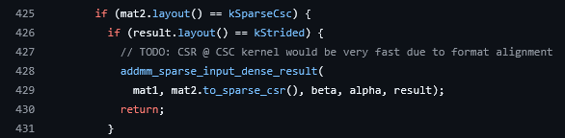
Sparse Tensor Compilers
Vectorization
A_{ij} = B_{ik} * C_{kj}
CSR (B_{ik})
CSC (C_{kj})
b₁₁ | b₁₂ | 0
0 | 0 | 0
b₃₁ | 0 | b₃₃
0 | 0 | c₁₃
c₂₁ | 0 | 0
0 | 0 | c₃₃
Ptr
0 | 2 | 2 | 4
0 | 1 | 1 | 3
b₁₂
0 | 2
0 | 1
X
c₂₁
Index /
Coord
0
1
1
0 | 1 | 0 | 2
1 | 0 | 2
Value
b₁₁ | b₁₂ | b₃₁ | b₃₃
c₂₁ | c₁₃ | c₃₃
b₁₂
c₂₁
_{N x M = N x K * K x M}
for (int i = 0; i < N; ++i)
for (int j = 0; j < M; ++j)
for (int k = 0; k < K; ++k)
A[i][j] += B[i][k] * C[k][j]
B_{i}
A_{i}
B_{1d}
A_{1d}
for (int i = 0; i < N; ++i)
for (int j = 0; j < M; ++j)
while (B_ptr_{i} < B_ptr_{i+1} && C_ptr_{j} < C_ptr_{j+1})
if (B_ind_{i} == C_ind_{j})
A[i][j] += B_value_{i} * C_value_{j}
else // Pointer Arithmetic
(B_ind_{i} < C_ind_{j}) ? B_ptr_{i}++ : C_ptr_{j}++
i
i
A_{j}
A_{2d}
Loop Carried Dependencies
C_{j}
C_{2d}
Data-dependent Branches
for (int k = 0; k < K; k+=4)
j
j
Not Scalable!
A[i][j] += B[i][k] * C[k][j]
A[i][j] += B[i][k+1] * C[k+1][j]
A[i][j] += B[i][k+2] * C[k+2][j]
A[i][j] += B[i][k+3] * C[k+3][j]
C_{1c}
C_{k}
B_{k}
B_{2c}
Data-dependent Pointer Arithmetic
k
k
https://github.com/pytorch/pytorch/blob/adfcc41be5e71e46ab25d23ae81a1a80e1535703/aten/src/ATen/native/mkl/SparseBlasImpl.cpp#L425
Notes:
If this code pattern is such a problem, how does modern compiler frameworks handle them.
For example, take PyTorch. PyTorch has an experimental support to compute sparse matrix multiplication, but when it is met with this sparse-coiteration. they completely avoid this by translating the compressed format from CSC to CSR. But when the data starts to grow bigger, this translation cost becomes expensive.
Therefore, this is not a scalable solution. We need to optimize this sparse-coiteration as much as possible.
//
To do that, let’s first try to unroll this loop.

Slide 7
Vectorization
A_{ij} = B_{ik} * C_{kj}
for (int i = 0; i < N; ++i)
for (int j = 0; j < M; ++j)
while (B_ptr_{i} < B_ptr_{i+1} && C_ptr_{j} < C_ptr_{j+1})
if (B_ind_{i} == C_ind_{j})
A[i][j] += B_value_{i} * C_value_{j}
else // Pointer Arithmetic
(B_ind_{i} < C_ind_{j}) ? B_ptr_{i}++ : C_ptr_{j}++
for (int i = 0; i < N; ++i)
for (int j = 0; j < M; ++j)
while (condition_a)
← condition_a
// Phase 1: Load data
load B_ind_{i}, C_ind_{j}
….
load B_ind_{i}+4, C_ind_{j}+4
load B_value_{i}, C_value_{j}
….
load B_value_{i}+4, C_value_{j}+4
Notes:
To unroll this loop, first we need to characterize all the computations within this region. I am going to break them into 3 different regions. First, data loading. When we look at these operations from high-level we don’t see much, but they are actually loading those index and value data into registers before doing any computation. Therefore, our first operation is to load the data.
Since we are unrolling this loop, we are going to load 4 values at once.
//
Then we have the actual computation representing the tensor contraction. Since we already have the data loaded, we can simply operate on these loaded data.

Slide 8
Vectorization
A_{ij} = B_{ik} * C_{kj}
for (int i = 0; i < N; ++i)
for (int j = 0; j < M; ++j)
while (B_ptr_{i} < B_ptr_{i+1} && C_ptr_{j} < C_ptr_{j+1})
if (B_ind_{i} == C_ind_{j})
A[i][j] += B_value_{i} * C_value_{j}
else // Pointer Arithmetic
(B_ind_{i} < C_ind_{j}) ? B_ptr_{i}++ : C_ptr_{j}++
for (int i = 0; i < N; ++i)
for (int j = 0; j < M; ++j)
while (condition_a)
← condition_a
// Phase 1: Load data
load B_ind_{i}, C_ind_{j}
….
load B_ind_{i}+4, C_ind_{j}+4
load B_value_{i}, C_value_{j}
….
load B_value_{i}+4, C_value_{j}+4
// Phase 2: Computation
A[i][j]+=(B_value_{i} * C_value_{j})
….
A[i][j]+=(B_value_{i}+4 * C_value_{j}+4)
// Phase 3: Pointer Advancement
Notes:
Then we have the actual computation representing the tensor contraction. Since we already have the data loaded, we can simply operate on these loaded data, and that’s our Phase 2.
//
Then the final and the most important part is the pointer arithmetic. Which element to process in the next cycle is determined by this pointer advancement.

Slide 9
Vectorization
A_{ij} = B_{ik} * C_{kj}
for (int i = 0; i < N; ++i)
for (int j = 0; j < M; ++j)
while (B_ptr_{i} < B_ptr_{i+1} && C_ptr_{j} < C_ptr_{j+1})
if (B_ind_{i} == C_ind_{j})
A[i][j] += B_value_{i} * C_value_{j}
else // Pointer Arithmetic
(B_ind_{i} < C_ind_{j}) ? B_ptr_{i}++ : C_ptr_{j}++
for (int i = 0; i < N; ++i)
for (int j = 0; j < M; ++j)
while (condition_a)
← condition_a
// Phase 1: Load data
load B_ind_{i}, C_ind_{j}
….
load B_ind_{i}+4, C_ind_{j}+4
load B_value_{i}, C_value_{j}
….
load B_value_{i}+4, C_value_{j}+4
// Phase 2: Computation
A[i][j]+=(B_value_{i} * C_value_{j})
….
A[i][j]+=(B_value_{i}+4 * C_value_{j}+4)
// Phase 3: Pointer Advancement
Notes:
Then the final and the most important part is the pointer arithmetic. Which element to process in the next iteration is determined by this pointer advancement.
//

Slide 10
Vectorization
A_{ij} = B_{ik} * C_{kj}
for (int i = 0; i < N; ++i)
for (int j = 0; j < M; ++j)
while (B_ptr_{i} < B_ptr_{i+1} && C_ptr_{j} < C_ptr_{j+1})
if (B_ind_{i} == C_ind_{j})
A[i][j] += B_value_{i} * C_value_{j}
else // Pointer Arithmetic
(B_ind_{i} < C_ind_{j}) ? B_ptr_{i}++ : C_ptr_{j}++
for (int i = 0; i < N; ++i)
for (int j = 0; j < M; ++j)
while (condition_a)
← condition_a
—————— ( condition_c )
// Phase 1: Load data
load B_ind_{i}, C_ind_{j}
….
load B_ind_{i}+4, C_ind_{j}+4
load B_value_{i}, C_value_{j}
….
load B_value_{i}+4, C_value_{j}+4
// Phase 2: Computation
// Phase 3: Pointer Advancement
B_ptr_{i} = B_ptr_{i} + 4
C_ptr_{j} = C_ptr_{j} + 4
0 | 0 | 0 | 0 | 0 | 2
1 | 0 | 6 | 4 | 0 | 2
0 | 0 | 0 | 0 | 0 | 0
1 | 0 | 0 | 0 | 0 | 0
0 | 0 | 0 | 0 | 0 | 0
0 | 0 | 0 | 0 | 0 | 0
… | 0 | 0 | 0 | 0 | 0
… | 0 | 0 | 0 | 0 | 0
… | 0 | 5 | 0 | 0 | 0
… | 0 | 0 | 0 | 0 | 0
… | 1 | 0 | 0 | 0 | 0
… | 0 | 0 | 7 | 0 | 0
4 | 0 | 0 | 0 | 0 | 0
0 | 0 | 0 | 0 | 0 | 0
0 | 3 | 0 | 0 | 0 | 0
0 | 0 | 0 | 0 | 0 | 0
0 | 0 | 0 | 1 | 0 | 0
0 | 0 | 0 | 0 | 0 | 0
… | 0 | 3 | 0 | 0 | 0
… | 0 | 1 | 0 | 0 | 0
… | 0 | 0 | 0 | 0 | 0
… | 0 | 0 | 0 | 0 | 0
… | 0 | 6 | 0 | 0 | 0
… | 0 | 8 | 7 | 0 | 0
X
condition_c →
B_ptr_{i} + 4 < B_ptr_{i+1} && C_ptr_{i} + 4 < C_ptr_{i+1}
Notes:
Since we are processing 4 elements per iteration, and to keep it simple for now, we can increment each pointers by 4 values.
We have many problems here. Let’s take a sample matrix.
In this matrix, we can see there are rows with only one non-zero element and if we try to load 4 indices and values, we will actually be loading data from the next dimension. To fix this, we introduce a new while-loop condition. This new condition check whether we have atleast 4 elements in that dimension, before loading them.
Since we have unrolled the loop, you would think that we could simply load them to vector registers and computer the tensor contraction. But we have another important problem. Let’s look at the sample matrices. We have a row and a corresponding column with 4 elements. But the elements are not in the matching coordinates. We cannot take any 4 elements to operate them. We still need to handle the control flow which checks for the matching coordinates.
Let’s look at how we can translate this control control flow into data-flow to avoid any branch mispredictions, through a dataflow circuit diagram.

Slide 11
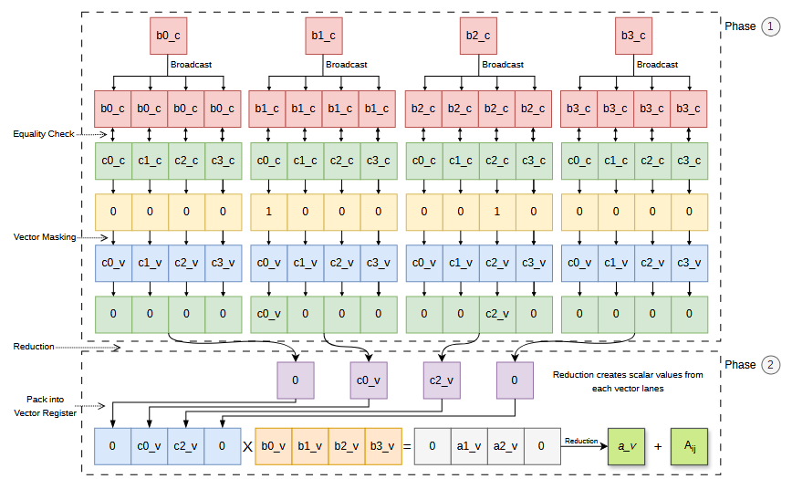
Execution Phases
A_{ij} = B_{ik} * C_{kj}
Notes:
For the purpose of simplicity, let me take the same example fo SpGEMM and explain how data flows through each phase.
First, we take 4 coordinates of non-zero elements from Matrix B and then broadcast them to vector registers. We also take the 4 coordinates from Matrix C and compare it element-wise with B’s coordinate. This creates vector masks. This vector mask act as a mechanism to determine matching coordinates for the tensor contraction without any conditional branches. Using this vector mask, we can extract the matching non-zero elements from Matrix C.
Then a horizontal reduction for each vector registers give the matching non-zero values from Matrix C. This completes the Phase 1 of loading the data.
Then for the Phase 2, we can then repack these individual values to a vector register and multiply with Matrix B and accumulate.

Slide 12
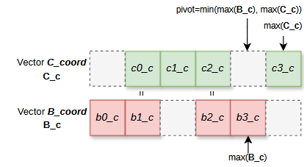
Execution Phases
A_{ij} = B_{ik} * C_{kj}
C
2 | 5 | 7 | 9
B
0 | 2 | 7 | 8
9
8
Notes:
We then move to the final phase; which is Pointer advancement.
To calculate the increment value of each pointers, we first calculate a pivot value that indicates; how many elements have been processed in both Matrix B and C.
In almost all compressed formats, the coordinate values are strictly increasing. Therefore, we take the minimum coordinate between both processed coordinate vector registers. With that we can safely assume, any coordinate values greater than pivot value is not processed in the current loop cycle, therefore the pointers needs to be adjusted accordingly.
To explain this further, I am gonna take an example for B and C’s coordinates. Here you can see, there are two matching coordinates, 2 and 7.
From B’s coordinate we can see any element less than or equal to 8 has been processed in this cycle. That means, all 4 values in B’s coordinate have been processed.
But when you look at C’s coordinate you see there are only 3 elements that are less than or equal to 8. The last element in C’s coordinate can have a matching coordinate from B in the next loop cycle. Therefore, we need to move the C’s pointer only by 3 values.

Slide 13
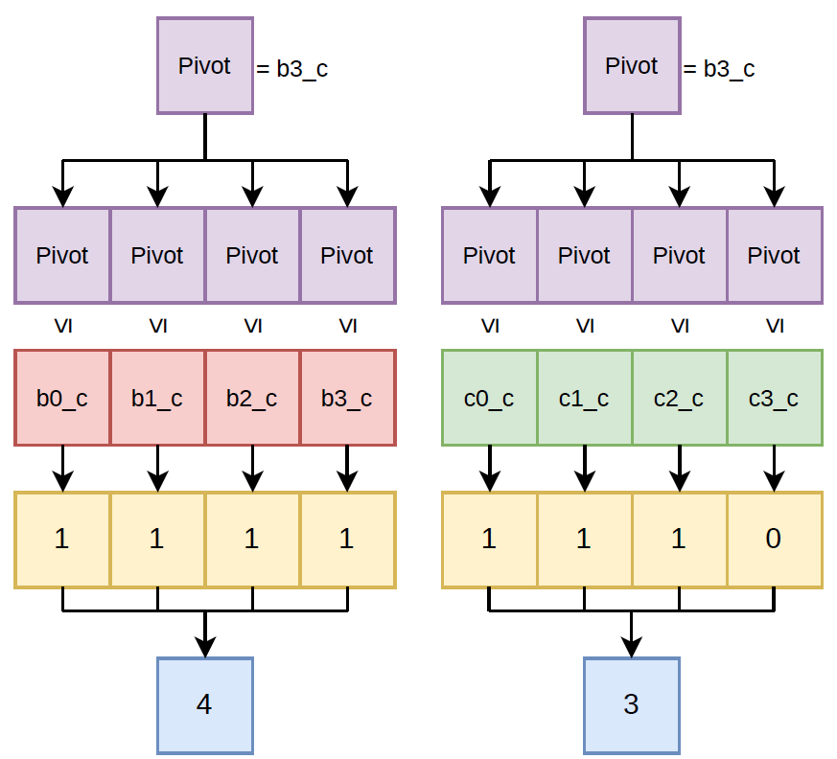
Execution Phases
A_{ij} = B_{ik} * C_{kj}
8
8
8
8
8
8
8
8
8
8
0
2
7
8
2
5
7
9
2 | 5 | 7 | 9
0 | 2 | 7 | 8
8
Notes:
To do that, we take the pivot value and broadcast it to a vector register, similar to Phase 1 and Compare it with Matrix B and C’s coordinate values to find how many such coordinates are less than or equal to this pivot value. Then we do a horizontal reduction to find the increment value for each pointer and advance the pointer. And that concludes the Phase 3.
//
As you might have noticed that we are doing a lot of horizontal reduction and packing values to vector register which are somewhat expensive operations.

Slide 14
Execution Phases
Phase 1 – Vector/Scalar
Phase 2 – Vector/Scalar
Phase 3 – Vector/Scalar
Notes:
As you might have noticed that we are doing a lot of horizontal reduction and packing values to vector register which are somewhat expensive operations.
Instead, we can take all three phases and decide on whether we want to use vector register or not, since any operations on a vector register can be done using simple scalar register.
Depending on your hardware, this decision can change the overall performance of this transformation. For example, in Phase 2, instead of re-packing those scalar values into a vector register, you can simply operate on the scalar registers itself.

Slide 15
Vectorization
A_{ij} = B_{ik} * C_{kj}
for (int i = 0; i < N; ++i)
for (int j = 0; j < M; ++j)
while (condition_a)
if (B_ind_{i} == C_ind_{j})
A[i][j] += B_value_{i} * C_value_{j}
else// Pointer Arithmetic
(B_ind_{i} < C_ind_{j}) ? B_ptr_{i}++ : C_ptr_{j}++
for (int i = 0; i < N; ++i)
for (int j = 0; j < M; ++j)
while (condition_c)
while (condition_a)
if (B_ind_{i} == C_ind_{j})
A[i][j] += B_value_{i} * C_value_{j}
else// Pointer Arithmetic
(B_ind_{i} < C_ind_{j}) ? B_ptr_{i}++ : C_ptr_{j}++
// Phase 1: Load data
// Phase 2: Computation
// Phase 3: Pointer Advancement
SIMD Fast Lane
Scalar Slow Lane
(Handles Epilogue)
0 | 0 | 0 | 0 | 0 | 2
1 | 0 | 6 | 4 | 0 | 2
0 | 0 | 0 | 0 | 0 | 0
1 | 0 | 0 | 0 | 0 | 0
0 | 0 | 0 | 0 | 0 | 0
0 | 0 | 0 | 0 | 0 | 0
… | 0 | 0 | 0 | 0 | 0
… | 0 | 0 | 0 | 0 | 0
… | 0 | 5 | 0 | 0 | 0
… | 0 | 0 | 0 | 0 | 0
… | 1 | 0 | 0 | 0 | 0
… | 0 | 0 | 7 | 0 | 0
4 | 0 | 0 | 0 | 0 | 0
0 | 0 | 0 | 0 | 0 | 0
0 | 3 | 0 | 0 | 0 | 0
0 | 0 | 0 | 0 | 0 | 0
0 | 0 | 0 | 1 | 0 | 0
0 | 0 | 0 | 0 | 0 | 0
… | 0 | 3 | 0 | 0 | 0
… | 0 | 1 | 0 | 0 | 0
… | 0 | 0 | 0 | 0 | 0
… | 0 | 0 | 0 | 0 | 0
… | 0 | 6 | 0 | 0 | 0
… | 0 | 8 | 7 | 0 | 0
X
condition_c →
B_ptr_{i} + 4 < B_ptr_{i+1} && C_ptr_{i} + 4 < C_ptr_{i+1}
Notes:
Now let’s look at the overall code transformation. There is a major problem in this transformation. Let’s look at the same example matrices and consider these two rows and columns. We can clearly see, there is a matching non-zero element in both row and the corresponding column. But our new while-loop condition c will require 4 non-zero element to process them and therefore this valid computation will be skipped. In conclusion, this transformation is not semantically correct.
To fix this, we can use the previous scalar loop as a fall-back mechanism.
Now we have dual-path execution strategy where execution path will be decided by the data being processed.
First one is the SIMD fast lane where data is processed in vector registers and then we have a scalar epilogue to handle the tail values.

Slide 16
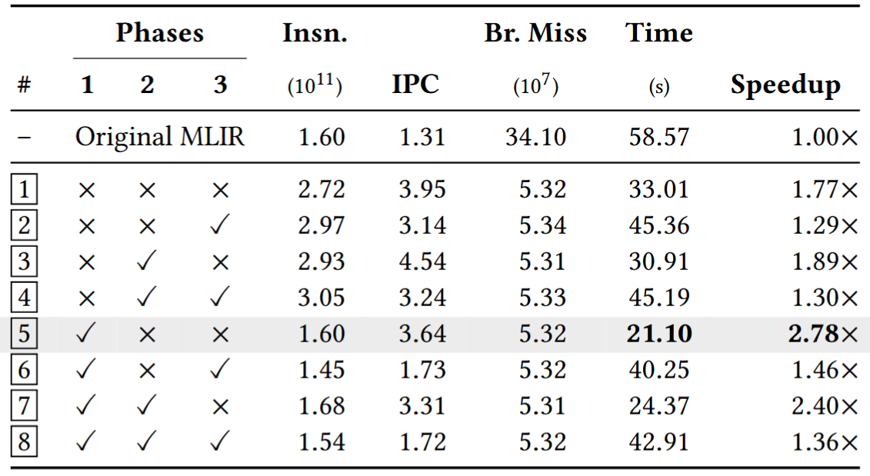
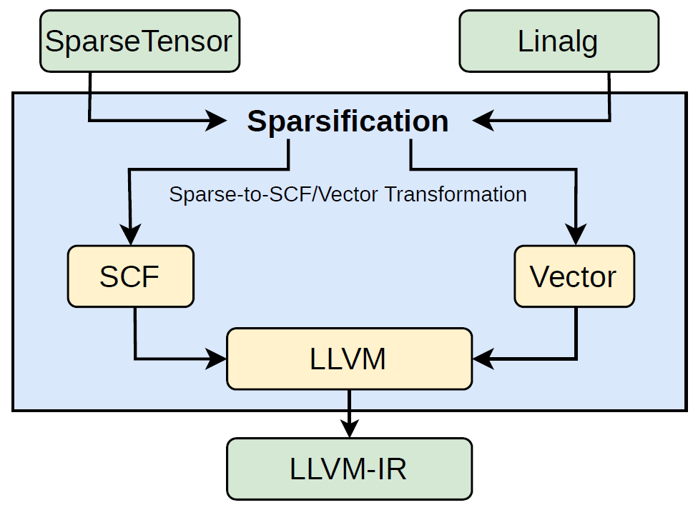
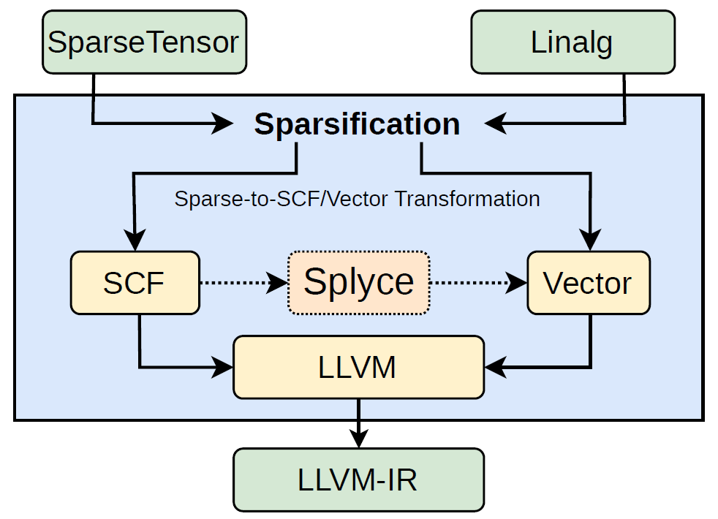
Introducing Splyce
Implemented as an MLIR Pass
Configurable Phase Vector/Scalar Decision
  Configuration 5
Configurable Vector Width
  Default : 4
Notes:
We introduce this auto-vectorization technique for sparse tensor contraction as Splyce.
Splyce is implemented as an MLIR optimization pass. MLIR already has a sparsification pipeline which take sparse tensor contraction from high-level linalg dialect and gradually lower them to SCF dialect (SCF is basically all the control flow structure). Splyce intercepts this lowering pipeline to convert this SCF dialect to Vector dialect.
We also made a few code transformation decision as compiler flags. For example, one can decide on which permutation of the phases needs to vectorized. Also, one can also decide on what vector width to use for the computation. This can change depending on their hardware environment.
Both the phase selection and the vector width decision are defaulted to a particular values based on our experiments and evaluation.

Slide 17
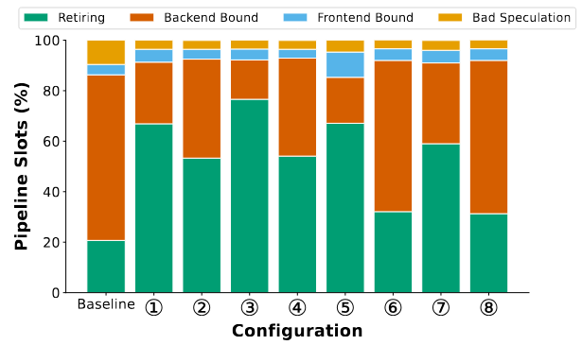
Evaluation
Evaluated on Intel Xeon Gold Sapphire Rapids
  Has AVX512 Support (Vector Width 8 for fp64)
Phase Decision & Vector Width (With SpGEMM)
  Phase 1: Vector
  Phase 2: Scalar
  Phase 3: Scalar
Instruction Level Parallelism
Overhead of Vector Scatter/Gather
Notes:
And we ran Splyce on an Intel Xeon Gold Sapphire Server which has AVX512 support. That means, we can use vector width of 8. We conducted some experiments to determine which phases need to use Vector register for this hardware with the help of same SpGEMM kernel. The Ablation study we conducted to determine which phases to vectorize as indicated in the table shows vectorizing only Phase 1 is beneficial in terms of speedup.
There are many reasons behind why this particular phase configuration performs better than other and I encourage everyone to read our paper to understand the micro-architectural performance analyzes.
//
We also found that only using vector width 4 is comparatively better at any sparsity level, even though the AVX512 support 8 vector width.

Slide 18
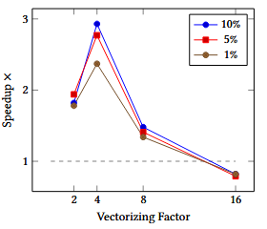
Evaluation
Evaluated on Intel Xeon Gold Sapphire Rapids
  Has AVX512 Support
Phase Decision & Vector Width (With SpGEMM)
  Phase 1: Vector
  Phase 2: Scalar
  Phase 3: Scalar
  Vector Width: 4
Instruction Level Parallelism
Overhead of Vector Scatter/Gather
Limited Vector Masking Registers
Notes:
We also found that only using vector width 4 is comparatively better at any sparsity level, even though the AVX512 support 8 vector width.
This is mainly because of the architectural constraints with masking registers.
//
Based on these decisions we compiled the Splyce MLIR Pass for this hardware.

Slide 19
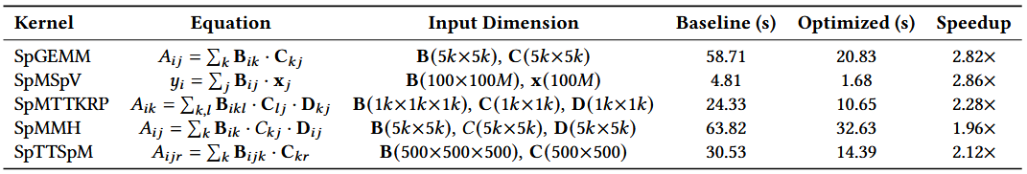
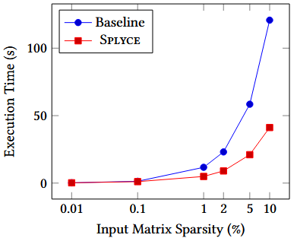
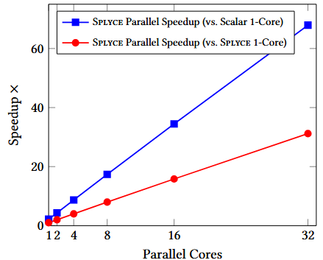
Evaluation
Experimented on Synthetic Data
  Data is generated with uniform random sparsity of 5%
On SpGEMM Kernel
Notes:
Based on these decisions, we compiled the Splyce MLIR Pass for this hardware and used some synthetic data with uniform random sparsity of 5% on 5 basic Sparse tensor kernels. The results shows a speedup between 1.96 times to 2.86 times compared to the baseline. Here the baseline is source program without using the Splyce Pass but with all other optimizations within MLIR and LLVM.
Even with extremely sparse synthetic data, we don’t see any negative speedup. Also, all Splyce optimization is constraint within one single core. When using multiple core, it shows linear increase in the speedup that is proportional to the number of cores used.

Slide 20
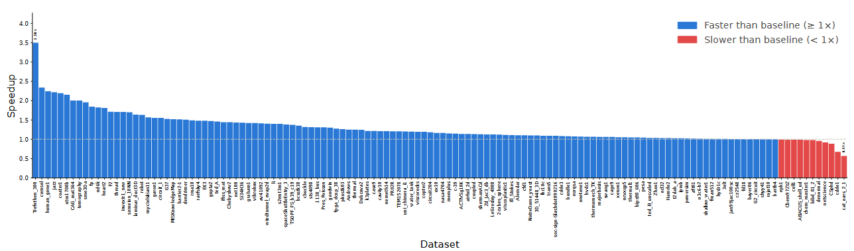
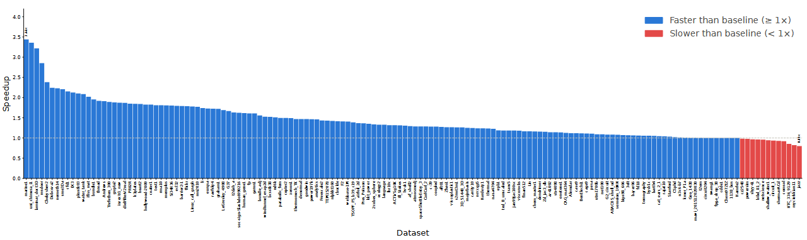
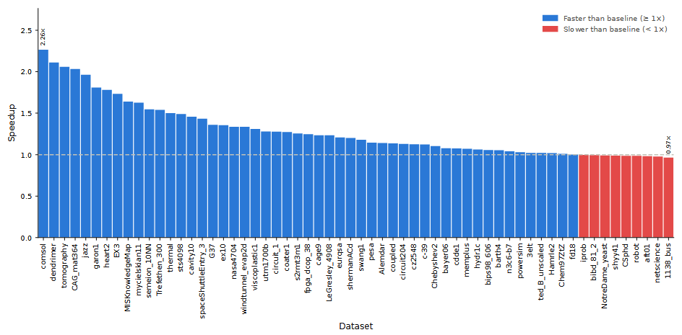
Evaluation
Evaluation Result on Real-world Sparse Tensor Data (SuiteSparse Matrix Collection)
SpGEMM
1.24x Geo-mean Speedup
SpMSpV
SpMTTKRP
1.37x Geo-mean Speedup
1.25x Geo-mean Speedup
Notes:
We also evaluated Splyce on some highly sparse real-world data from SuiteSparse Collection. It shows consistent speedup in majority of the dataset.

Slide 21






Thank You!
Contact: kabilan.info
Repository
Zenodo
Paper
Notes:
Ultimately, Splyce provides a foundation for bridging the gap between irregular sparse algorithm and parallel hardware architectures using a dual-path strategy where the program execution can have different versions of the same program and dynamically chose the execution path.

Slide 22
Backup Slides

Slide 23
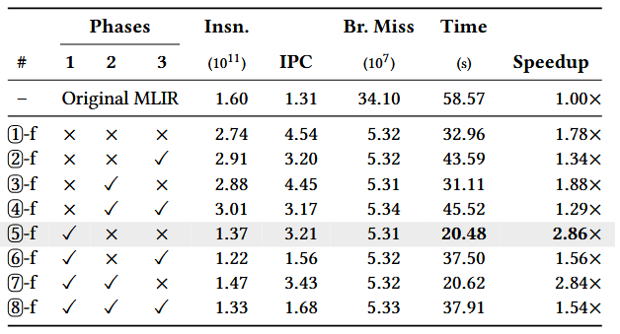
Phase Ablation with Reassociation

Slide 24
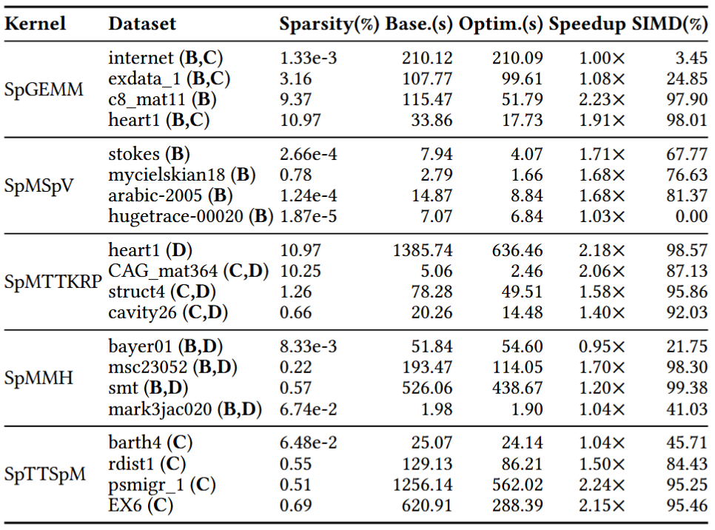
Real Word Sparse Data Speedup on Splyce

Slide 25
Masking Registers AVX512
Spill and Reuse
K1
K2
K3
K4
K5
K6
K7
K0
K1
k1 – k7 : Masking Registers
vaddps zmm0 {k1}, zmm1, zmm2
k0 : Unmasked Operation
vaddps zmm0 {k0}, zmm1, zmm2

