Slide 1


Locality Transformations for Nested Recursive Iteration Spaces
Kirshanthan Sundararajah, Laith Sakka and Milind Kulkarni
School of Electrical and Computer Engineering

Slide 2
Locality Enhancing Transformations
Scheduling Transformations
Rearrange the Operations
Multiple Dynamic Instances of Same Static Code
Where such code appears ?
Notes:
Let’s talk about locality enhancing transformations.

Slide 3
Locality Enhancing Transformations
for (…){
…
}
for (…){
…
}
Loops
for (…){
for (…){
…
}
}
Loop Fusion
Loop Interchange and Tiling
Unimodular and Polyhedral Frameworks [Banerjee1991, Feautrier1992, Bondhugula2008]

Slide 4
Locality Enhancing Transformations
foo (…);
bar (…);
foo & bar are
Recursive Functions
for (…){
foo(…);
}
Traversal Fusion and Deforestation
Point Blocking and
Traversal Splicing
[Walder1990, Rajbhandari2016]
[Jo2011, Jo2012]
Nested Recursion
foo (…){
bar(…);
}
?

Slide 5
Nested Recursion
Node root_o, root_i;
recurseOuter(Node o){
if ( o == NULL ) return;
recurseInner(o, root_i);
recurseOuter(o.left);
recurseOuter(o.right);
}
recurseInner(Node o, Node i){
if ( i == NULL ) return;
join(o.data, i.data);
recurseInner(o, i.left);
recurseInner(o, i.right);
}
A
1
B
E
2
5
C
D
F
G
3
4
6
7
Outer
Y
X
Inner
Notes:
We have seen
Similar to increment operation in for loops they have recursive calls.
Finally the work happens inside the inner recursion. If we consider such nested recursion in a scenario of tree traversals, it would be like this….
First animation then code

Slide 6
Nested Recursion
A B C D E F G
A
1
1
2
B
E
2
5
3
Good Locality for Nodes A-G
Bad Locality for Nodes 1-7
4
C
D
F
G
3
4
6
7
5
Outer
Inner
6
*Reuse distance : Number of unique locations accessed between use and reuse of a location
7
Notes:
Important thing that we have to notice here is that the reuse of these tree nodes, node A is reused in every instance of column one here but node 1 is reused only after the whole traversal of inner tree.
If the inner tree is big enough not to fit in the cache then this poor locality may result in bad performance. So the thing naturally comes to our mind is, “Can’t we do something like loop interchange?”
Comes from recursion. Just like loops

Slide 7
Contributions
Developed locality transformation for nested recursive iteration spaces
Introduced recursion twisting, a recursion-friendly analog of loop titling
Handling recursive iteration spaces with irregular bounds
Achieved ~4x geo-mean performance enhancement using our transformations
Notes:
Min 6 you should be here

Slide 8
Nested Recursion
Node outer, inner;
recurseOuter(Node o, Node i){
if ( truncateOuter?(o) ) return;
recurseInner(o, i);
recurseOuter(o.c1);
recurseOuter(o.c2);
}
recurseInner(Node o, Node i){
if ( truncateInner1?(i) || truncateInner2?(o, i) ) return;
work(o, i);
recurseInner(o, i.c1);
recurseInner(o, i.c2);
}
Node outer, inner;
recurseOuter(Node o, Node i){
if ( truncateOuter?(o) ) return;
recurseInner(o, i);
recurseOuter(o.c1);
recurseOuter(o.c2);
}
recurseInner(Node o, Node i){
if ( truncateInner1?(i) ) return;
work(o, i);
recurseInner(o, i.c1);
recurseInner(o, i.c2);
}
NOP
Notes:
Let’s consider a more general template for nested recursion in the context of tree traversals.
Essentially we are considering complete cross product of two trees instead of vectors as in the loop example.

Slide 9
Recursion Interchange
A B C D E F G
A
1
1
2
B
E
2
5
3
Good Locality for Nodes 1-7
Bad Locality for Nodes A-G
4
C
D
F
G
3
4
6
7
5
Inner
Outer
6
*Reuse distance : Number of unique locations accessed between use and reuse of a location
7
Notes:
Now the original outer tree named with alphabets will be the traversed by the inner recursion while the original inner tree named with numbers traversed by the outer recursion.
It is similar as loop interchange. The problems are same as well.
If the original outer tree is big enough not to fit in cache it will result in poor performance.
The natural question comes to our mind is “Can’t we block this code in any way like loop titling?”
So now let’s dive into the recursion twisting.

Slide 10
Recursion Interchange
Node outer, inner;
recurseOuterSwapped(Node o, Node i){
if ( truncateInner1?(i) ) return;
recurseInnerSwapped(o, i);
recurseOuterSwapped(o.c1, i);
recurseOuterSwapped(o.c2, i);
}
recurseInnerSwapped(Node o, Node i){
if ( truncateOuter?(o) ) return;
work(o, i);
recurseInnerSwapped(o, i.c1);
recurseInnerSwapped(o, i.c2);
}
A B C D E F G
1
2
3
4
5
6
7
Notes:
Old code to new code, Overlay on the slides

Slide 11
Recursion Twisting
A B C D E F G
A
1
1
2
B
E
2
5
3
4
C
D
F
G
3
4
6
7
5
Outer
Inner
6
7
Notes:
Swapping animation of outer and inner recursion
Highlight the tree
Key slide to the whole talk
Putting the box, and not showing the whole iteration space
Tile them too.

Slide 12
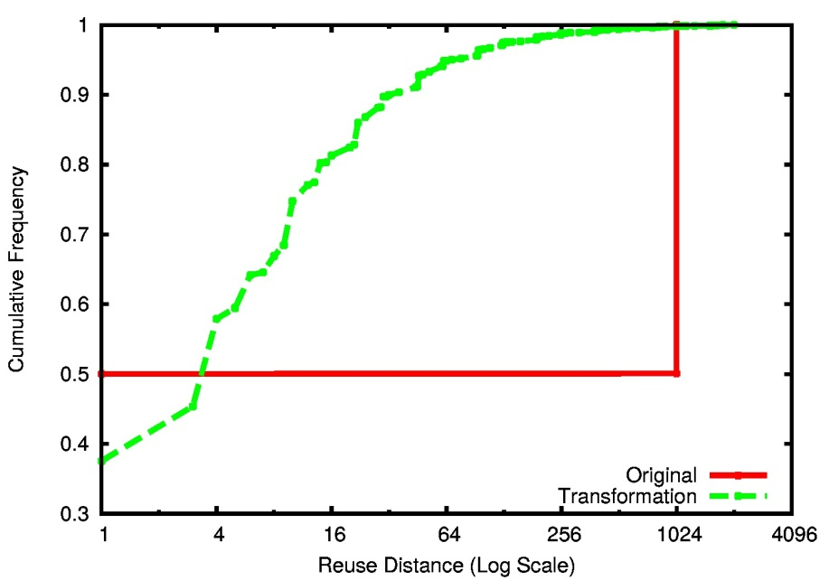
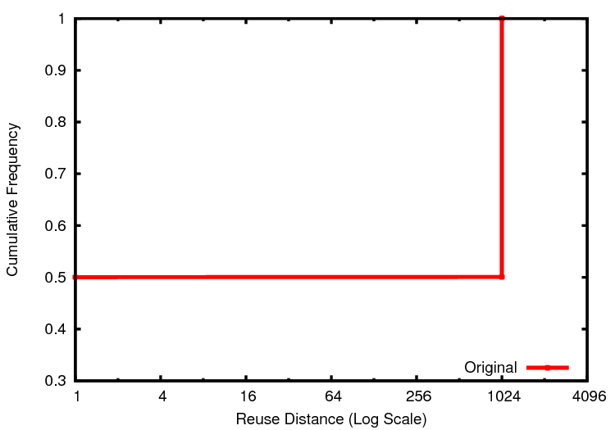
Locality Improvement
A B C D E F G
1
2
3
Tiling for All Levels of Cache
4
5
6
7
Notes:
We have a transformation that enhances the locality, does it always result in correct code?
Parameterless naturally fitting them in cache
Locality

Slide 13
Soundness of Recursion Twisting
Recursion twisting may not be always sound
Recursion twisting is sound whenever recursion interchange is sound
Finding Soundness criterion for recursion interchange is difficult
Recursion interchange is sound for cases where iterations of outer recursion independent of each other [Rinard1997]
Notes:
Very quickly

Slide 14
Nested Recursion
Node outer, inner;
recurseOuter(Node o, Node i){
if ( truncateOuter?(o) ) return;
recurseInner(o, i);
recurseOuter(o.c1);
recurseOuter(o.c2);
}
recurseInner(Node o, Node i){
if ( truncateInner1?(i) || truncateInner2?(o, i) ) return;
work(o, i);
recurseInner(o, i.c1);
recurseInner(o, i.c2);
}
NOP
Notes:
“OK, but recursion doesn’t always look like a complete tree join. Traversals may truncate…”

Slide 15
Irregular Iteration Space
recurseOuter(Node o, Node i){
if ( o == NULL ) return;
recurseInner(o, i);
recurseOuter(o.left, i);
recurseOuter(o.right, i);
}
recurseInner(Node o, Node i){
if ( i == NULL ||
o.label == B && i.label == 2) return;
join(o.data, i.data);
recurseInner(o, i.left);
recurseInner(o, i.right);
}
A B C D E F G
1
2
3
4
5
6
7
Notes:
Irregular iteration spaces

Slide 16
Irregular Iteration Space
recurseOuterSwapped(Node o, Node i){
if ( i == NULL ||
o.label == B && i.label == 2) return;
recurseInnerSwapped(o, i);
recurseOuterSwapped(o, i.left);
recurseOuterSwapped(o, i.right);
}
recurseInnerSwapped(Node o, Node i){
if ( o == NULL ) return;
join(o.data, i.data);
recurseInnerSwapped(o.left, i);
recurseInnerSwapped(o.right, i);
}
A B C D E F G
1
2
3
4
5
6
7

Slide 17
Truncation Handling
Reducing Wasted Work
Truncation Tracking
Sub-Tree Truncation
Reducing Instruction Overhead
Truncation Flag and Path Counting
Notes:
Getting right, getting it efficient, getting it work with recursion twisting

Slide 18
Implementation & Evaluation
Clang tool – Semi-automatic Source to Source Transformation Tool
Benchmark Programs
Complete Tree Cross Products
Tree Join (TJ)
Matrix Multiplication (MM)
Dual-Tree N-Body Codes [Curtin2013]
Point Correlation (PC)
Nearest Neighbor (NN)
K-Nearest Neighbor (KNN)
VP-Tree (VP)
}
Regular Iteration spaces
}
Irregular Iteration spaces
Notes:
Irregular truncation conditions

Slide 19
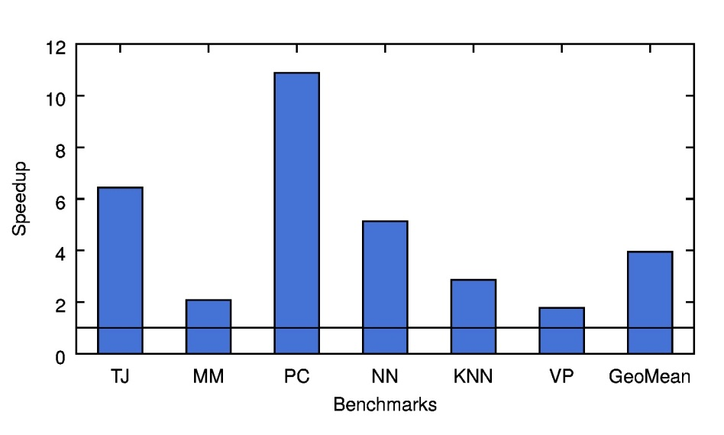
Evaluation
Speedup of recursion twisting
Evaluation Platform
Dual 12-core Intel Xeon 2.7 GHz
L1 - Cache 32K
L2 - Cache 256K
L3 - Cache 20 MB
3.94x
Notes:
Arrow near geo mean
Just the speed up.
Axis explanation
Relative computation intensity
Truncation conditions

Slide 20
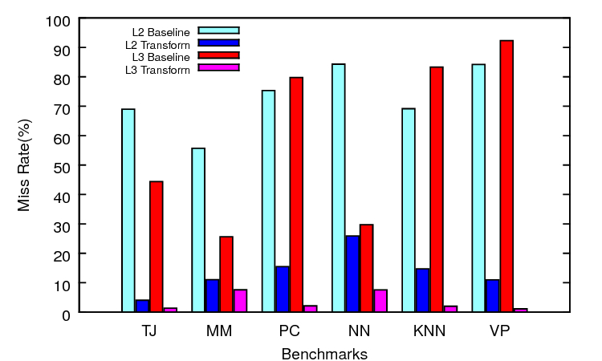
Evaluation
Locality Benefits
Evaluation Platform
Dual 12-core Intel Xeon 2.7 GHz
L1 - Cache 32K
L2 - Cache 256K
L3 - Cache 20 MB

Slide 21
Conclusion
Scheduling transformations mostly focused on loops
Our transformation targets nested recursion
The very first transformations for nested recursive iteration spaces
Recursion twisting is a locality transformation for all levels of cache
Achieved ~4x geo-mean performance enhancement using our transformations

Slide 22
Thank You Questions?

Slide 23
Locality Transformations for Nested Recursive Iteration Spaces
Kirshanthan Sundararajah, Laith Sakka and Milind Kulkarni
School of Electrical and Computer Engineering
Notes:
Hi Everyone, I am Kirshanthan Sundararajah. I am here to present our work, Locality Transformations for Nested Recursive Iteration Spaces. This is a joint work done myself, Laith Sakka and our adviser Prof. Milind Kulkarni.

Slide 24
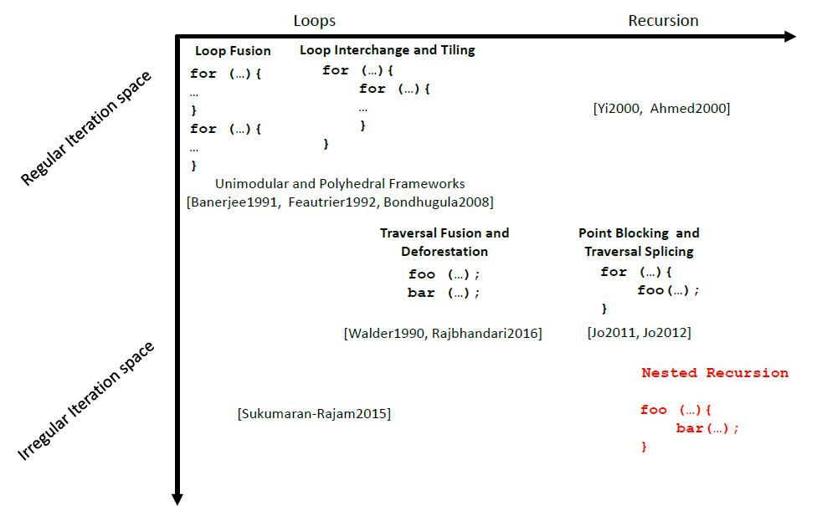
Big Picture

Slide 25
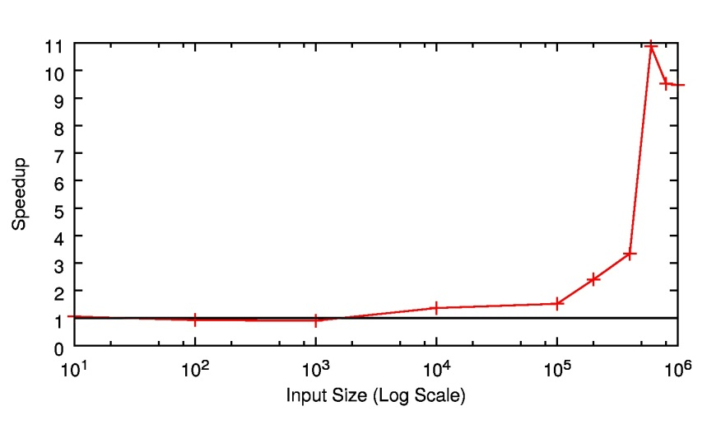
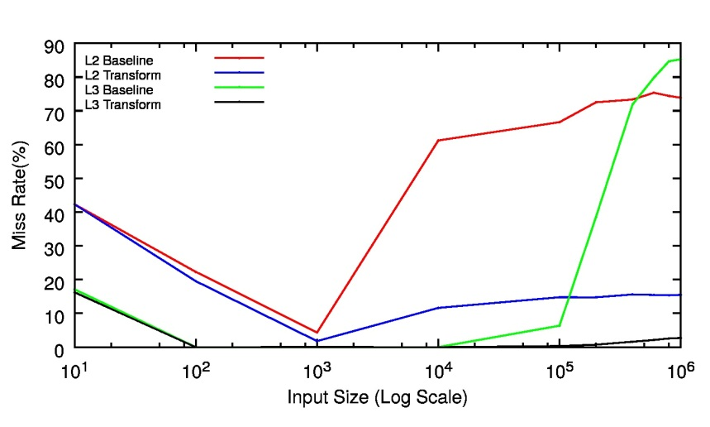
Evaluation
Scalability

Slide 26
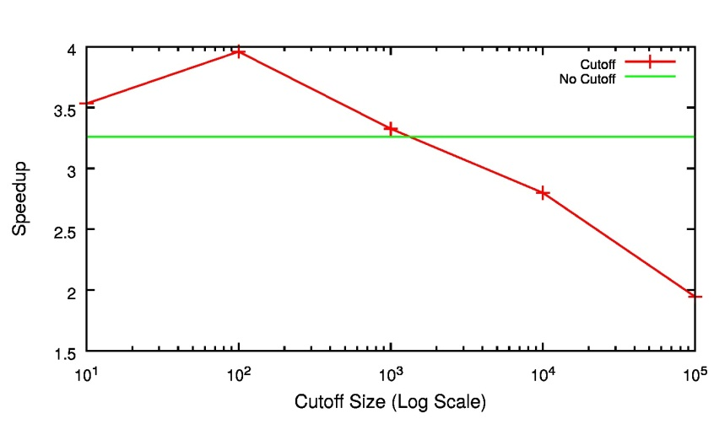
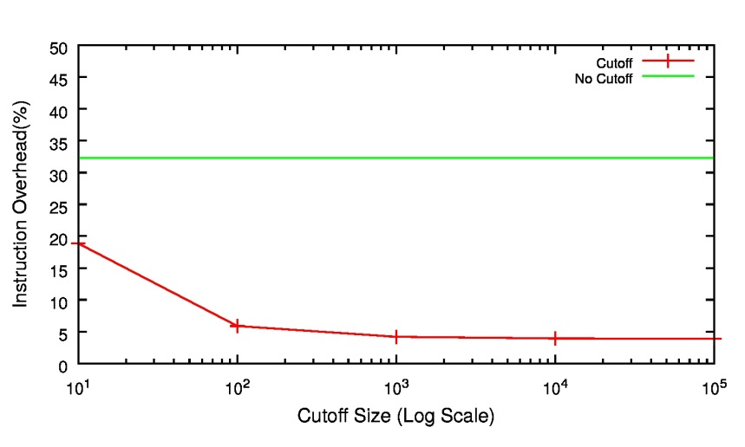
Future Work
The price of parameterlessness

Slide 27
Future Work
Cache obliviousness
Shrinking the working set until it fits in cache
Loop nests and multi-level loop tiling
Translating loops into recursion [Yi2000, Ahmed2000]
Parallelism
Locality vs. Parallelism
Layout Transformations [Chilimbi1998, Chilimbi1999]
Complementary to our approach

Slide 28
Recursion Twisting
recurseOuter(Node o, Node i){
if ( truncateOuter?(o) ) return;
recurseInner(o, i);
if ( o.c1.size <= i.size ) recurseOuterSwapped(o.c1, i);
else recurseOuter(o.c1, i);
if ( o.c2.size <= i.size ) recurseOuterSwapped(o.c2, i);
else recurseOuter(o.c2, i);
}
recurseOuterSwapped(Node o, Node i){
if ( truncateInner1?(i) ) return;
recurseInnerSwapped(o, i);
if ( i.c1.size <= o.size ) recurseOuter(o, i.c1);
else recurseOuterSwapped (o, i.c1);
if ( i.c2.size <= o.size ) recurseOuter(o, i.c2);
else recurseOuterSwapped (o, i.c2);
}
Notes:
Now we have original outer recursion and interchanged outer recursion.
The only change here is that these functions can invoke either themselves or the other. Which means the original outer recursion can invoke either interchanged outer recursion or itself based on some condition.
What this condition? the size of the sub-tree this recursion are going to be invoked.
This essentially means we are always trying to keep the smaller tree for the inner recursion.

Slide 29
Truncation Handling
A B C D E F G
1
2
B
3
4
unTrunc set
5
A B C D E F G
6
Truncation Field
7

Slide 30
Truncation Handling
recurseOuterSwapped(TreeNode o, TreeNode i){
if ( truncateInner1?(i) ) return;
Set unTrunc = new Set<TreeNode>();
recurseInnerSwapped(o, i, unTrunc);
recurseOuterSwapped(o, i.c1);
recurseOuterSwapped(o, i.c2);
foreach (TreeNode n : unTrunc) n.trunc = false;
}
recurseInnerSwapped(TreeNode o, TreeNode I, Set<Node> unTrunc){
if ( truncateOuter?(o) ) return;
if ( truncateInner2?(o, i) ){ o.trunc = true; unTrunc.add(o); }
if ( o.trunc != true ) work(o, i);
recurseInnerSwapped(o.c1, i, unTrunc);
recurseInnerSwapped(o.c2, i, unTrunc);
}

Slide 31
Recursion Interchange
Node outer, inner;
recurseOuterSwapped(Node o, Node i){
if ( truncateInner1?(i) ) return;
recurseInnerSwapped(o, i);
recurseOuterSwapped(o.c1, i);
recurseOuterSwapped(o.c2, i);
}
recurseInnerSwapped(Node o, Node i){
if ( truncateOuter?(o) ) return;
work(o, i);
recurseInnerSwapped(o, i.c1);
recurseInnerSwapped(o, i.c2);
}
A B C D E F G
1
2
3
4
5
6
7
Notes:
Old code to new code, Overlay on the slides

Slide 32
Nested Loops
for (int i = 1; i <= n; i++)
for (int j = 1; j <= m; j++)
w[i][j] = u[i] * v[j];
U₁
V₁
V₂
…
V_{m}
V
Reuse Distances
U : O(1)
V : O(m)
U₂
…
U_{n}
U
Notes:
This is a visual example of an iteration space, where dynamic instances of code or work shown in the order that they are executed/done.
Explain the reuse distance of U and V properly with an example.

Slide 33
Loop Interchange
for (int j = 1; j <= m; j++)
for (int i = 1; i <= n; i++)
w[i][j] = u[i] * v[j];
U₁
V₁
V₂
…
V_{m}
V
Reuse Distances
U : O(n)
V : O(1)
U₂
…
U_{n}
U
Notes:
Explain the reuse distance of U and V properly with an example
If U fits in cache ~~

Slide 34
Loop Tiling
for (int j = 1; j <= m; j+=b)
for (int i = 1; i <= n; i+=b)
for (int j1 = j; j1 < j + b; j1++)
for (int i1 = i; i1 < i + b; i1++)
w[i1][j1] = u[i1] * v[j1];
U₁
V₁
V_{b}
…
V_{m}
V
Reuse Distances
U : O(b)
V : O(b)
U_{b}
…
U_{n}
U
Notes:
Explain the reuse distance of U and V properly with an example.
What about when the repeated operations come from recursive methods instead?

