Slide 1

TenSure: Fuzzing Sparse Tensor Compilers
Kabilan Mahathevan, Yining Zhang, Muhammad Ali Gulzar, Kirshanthan Sundararajah
Fuzzing Workshop 2026
27-Feb-2026
Virginia Tech

Slide 2

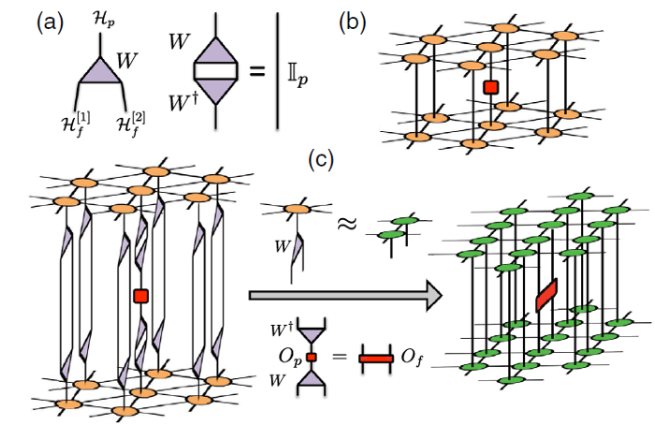
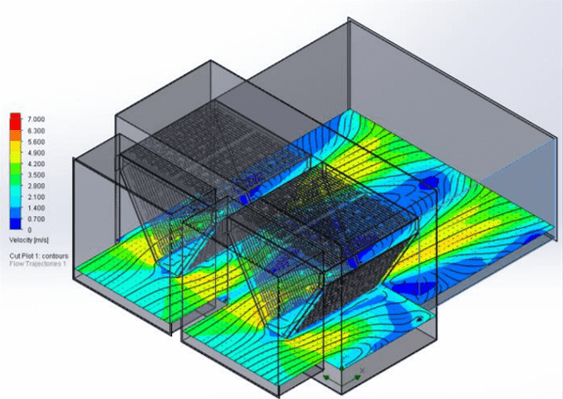









Tensors
Data Analytics
Machine Learning
Scientific Computing
Amazon Review
Quantum Many-body
system
CFD Airflow Simulation
Spatio-Temporal
Data
User Comments

Slide 3
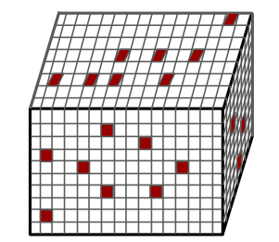
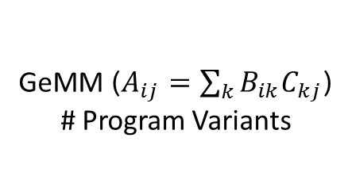
Sparse Tensors
Data Analytics
Compressed Formats
GeMM ($A_{ij}$ $=\sum_{k}{B_{ik}C_{kj}}$)
# Program Variants
CSR 1 x 1 x 1 = 1
CSC 2 x 2 x 2 = 8
COO 3 x 3 x 3 = 27
CSF 4 x 4 x 4 = 64
BSR 5 x 5 x 5 = 125
ELL 6 x 6 x 6 = 216
BCSR 7 x 7 x 7 = 343
DIA 8 x 8 x 8 = 512
… …
Amazon Review
Spatio-Temporal
Data
User Comments
81.9 Exabytes of 3-D tensor data.
Only 34.92 GB of NNZ.
3-D Tensor
Sparse Tensor Compilers (STC)

Slide 4

Metamorphic Testing
Reference Output
Seed Program
=
=
≠
Equivalent Program
=

Slide 5
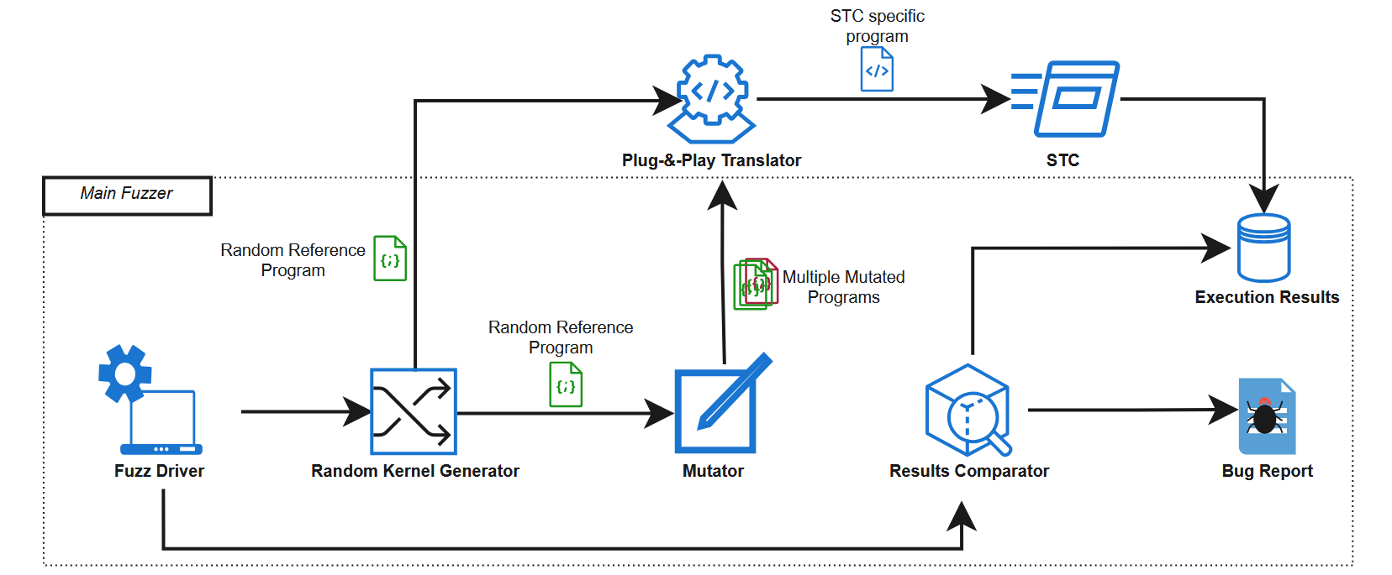
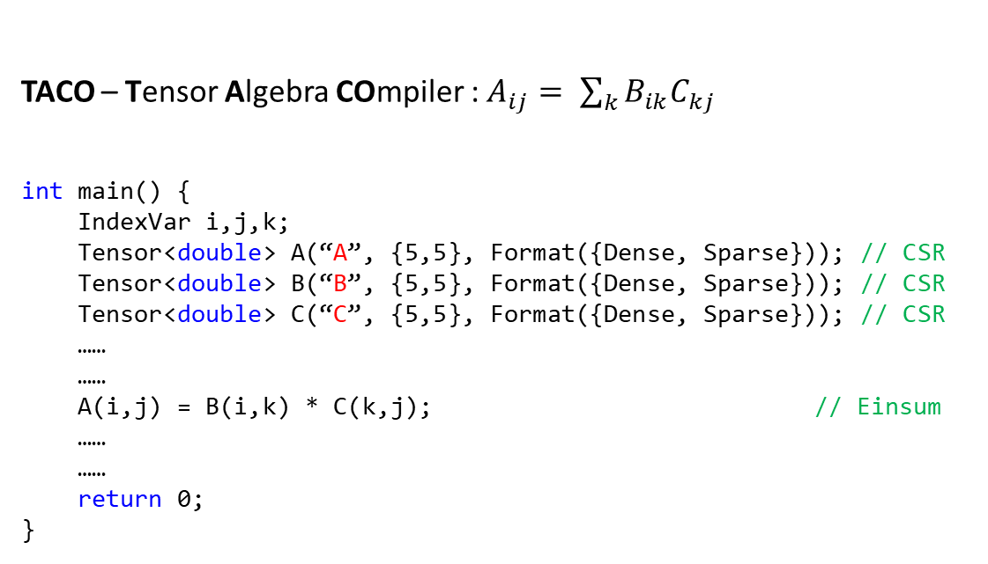
Metamorphic Testing STCs
Seed Program
Random Program Generator
TACO – Tensor Algebra COmpiler : $A_{ij}= \sum_{k}{B_{ik}C_{kj}}$
int main() {
IndexVar i,j,k;
Tensor<double> A(“A”, {5,5}, Format({Dense, Sparse})); // CSR
Tensor<double> B(“B”, {5,5}, Format({Dense, Sparse})); // CSR
Tensor<double> C(“C”, {5,5}, Format({Dense, Sparse})); // CSR
……
……
A(i,j) = B(i,k) * C(k,j); // Einsum
……
……
return 0;
}
Equivalent Programs
Mutation Operator
5

Slide 6
Metamorphic Testing STCs
Seed Program
Random Program Generator
TACO – Tensor Algebra COmpiler : $A_{ij}= \sum_{k}{B_{ik}C_{kj}}$
int main() {
IndexVar i,j,k;
Tensor<double> A(“A”, {5,5}, Format({Dense, Sparse})); // CSR
Tensor<double> B(“B”, {5,5}, Format({Dense, Sparse})); // CSR
Tensor<double> C(“C”, {5,5}, Format({Dense, Sparse})); // CSR
……
……
A(i,j) = B(i,k) * C(k,j); // Einsum
……
……
return 0;
}
Equivalent Programs
Mutation Operator
Equivalence Mutation Operator
Storage Format Heterogeneity
B -> CSR
6

Slide 7
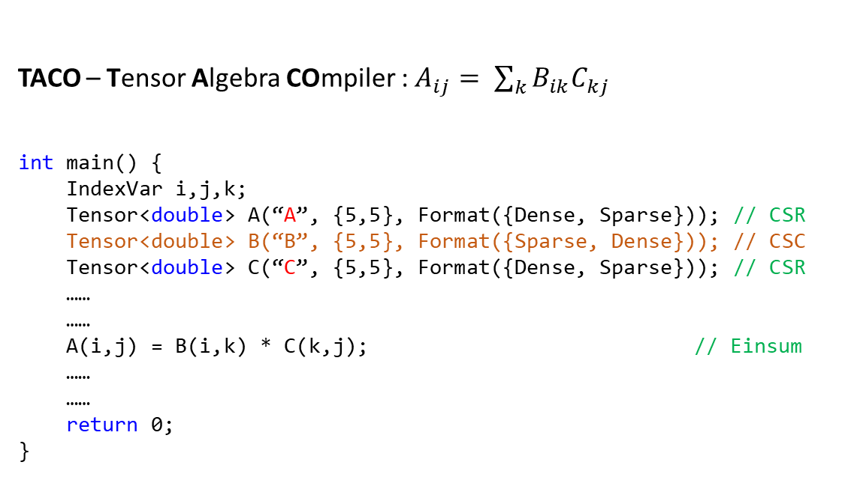
Metamorphic Testing STCs
Seed Program
Random Program Generator
TACO – Tensor Algebra COmpiler : $A_{ij}= \sum_{k}{B_{ik}C_{kj}}$
int main() {
IndexVar i,j,k;
Tensor<double> A(“A”, {5,5}, Format({Dense, Sparse})); // CSR
Tensor<double> B(“B”, {5,5}, Format({Sparse, Dense})); // CSC
Tensor<double> C(“C”, {5,5}, Format({Dense, Sparse})); // CSR
……
……
A(i,j) = B(i,k) * C(k,j); // Einsum
……
……
return 0;
}
Equivalent Programs
Mutation Operator
Equivalence Mutation Operator
Storage Format Heterogeneity
Algebraic Commutativity
B -> CSR
B -> CSC
7

Slide 8
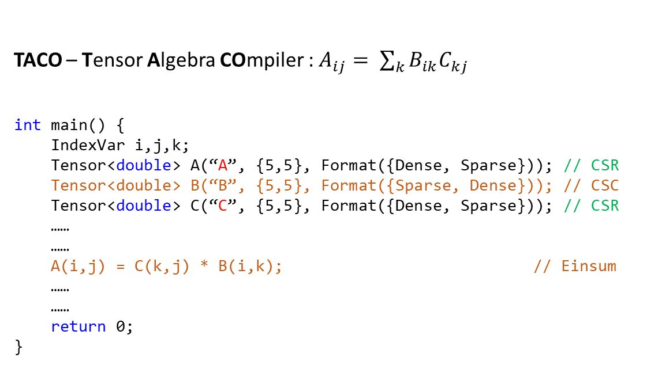
Metamorphic Testing STCs
Seed Program
Random Program Generator
TACO – Tensor Algebra COmpiler : $A_{ij}= \sum_{k}{B_{ik}C_{kj}}$
int main() {
IndexVar i,j,k;
Tensor<double> A(“A”, {5,5}, Format({Dense, Sparse})); // CSR
Tensor<double> B(“B”, {5,5}, Format({Sparse, Dense})); // CSC
Tensor<double> C(“C”, {5,5}, Format({Dense, Sparse})); // CSR
……
……
A(i,j) = C(k,j) * B(i,k); // Einsum
……
……
return 0;
}
Equivalent Programs
Mutation Operator
Equivalence Mutation Operator
Storage Format Heterogeneity
Algebraic Commutativity
A(i,j) = B (i,k) * C(k,j)
A(i,j) = C (k,j) * B(i,k)
8

Slide 9
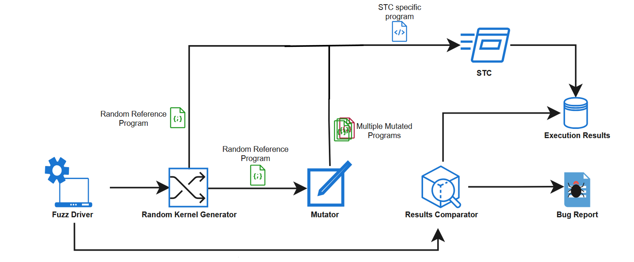
Metamorphic Testing STCs
Random Program Generator
Mutation Operator
9

Slide 10
Metamorphic Testing STCs
Random Program Generator
Mutation Operator
Oracle
10

Slide 11
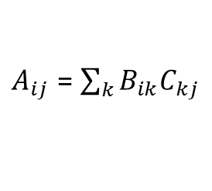
Metamorphic Testing STCs
Random Program Generator
TACO – C++
Finch – Julia
PyTorch – Python
MLIR – Sparse Dialect
$A_{ij}$ = $\sum_{k}{B_{ik}C_{kj}}$
Mutation Operator
Einsum
Oracle
A(i,j) = B(i,k) * C(k,j)
Abstraction Layer
NOT SCALABLE!
11

Slide 12
Metamorphic Testing STCs
Random Program Generator
TACO – C++
Finch – Julia
PyTorch – Python
MLIR – Sparse Dialect
$A_{ij}$ = $\sum_{k}{B_{ik}C_{kj}}$
Mutation Operator
Einsum
Oracle
A(i,j) = B(i,k) * C(k,j)
Abstraction Layer
12

Slide 13
Metamorphic Testing STCs
Random Program Generator
TACO – C++
Finch – Julia
PyTorch – Python
MLIR – Sparse Dialect
$A_{ij}$ = $\sum_{k}{B_{ik}C_{kj}}$
Mutation Operator
Einsum
Oracle
A(i,j) = B(i,k) * C(k,j)
Abstraction Layer
13

Slide 14
Metamorphic Testing STCs
Random Program Generator
Random Einsum Generator
A(i,j) = B(i,k) * C(k,j)
How to generate random Einsum Kernel?
Use grammar-based program generators.
Grammarinator ¹
Context-Sensitive
~3.3% Validity rate.
¹ https://github.com/renatahodovan/grammarinator

Slide 15
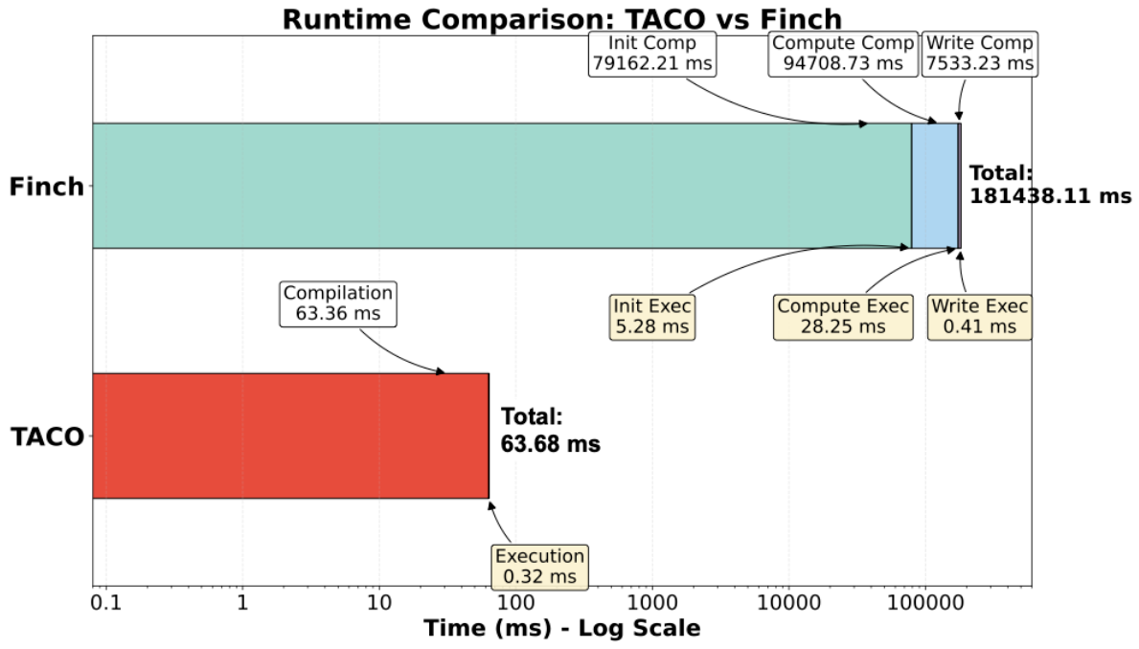
Results & Limitations
Integrated TenSure into TACO and Finch. (6 Hours of Fuzz Cycle)
STCs | # Iterations | Programs Rejected by the STCs | Program Crash | Miscompilation Bug
TACO | 267K | 236K | 14.4K | 5,758
Finch | 1,619 | 7 | 57 | 0

Slide 16
Future Work
Increase the fuzz testing period.
Integrate MLIR Sparse Dialect and PyTorch Sparse.
Introduce tensor transpose-based mutation operator.
A(i,j) = B(i,k) * C(k,j)

Slide 17
Future Work
Increase the fuzz testing period.
Integrate MLIR Sparse Dialect and PyTorch Sparse.
Introduce tensor transpose-based mutation operator.
Evaluate the generation algorithm with modern context-sensitive program generators.
A(i,j) = B(i,k) * C(k,j)
B^{T}
A(i,j) = B^{T}(k,i) * C(k,j)

Slide 18
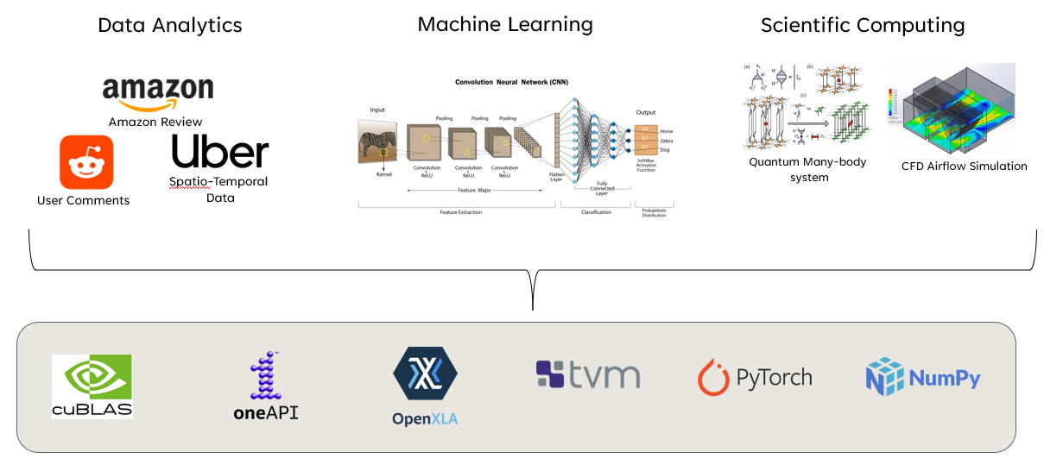
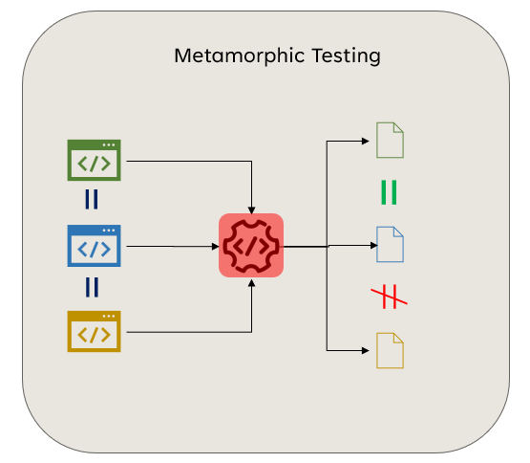
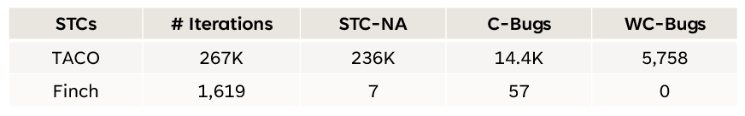
Thank You
Kabilan Mahathevan
kabilan@vt.edu

