Slide 1


SparseLNR: Accelerating Sparse Tensor Computations Using Loop Nest Restructuring
Adhitha Dias, Kirshanthan Sundararajah, Charitha Saumya, Milind Kulkarni Purdue University
ICS '22 | June 27th – 30th 2022
Notes:
Hello everyone!
My name is Adhitha Dias. I am a PhD student at Purdue University.
In this talk, I will be presenting our work on "SparseLNR: Accelerating Sparse Tensor Computations Using Loop Nest Restructuring".
This is joint work with Krish, Charitha and my advisor Milind Kulkarni at Purdue University.

Slide 2
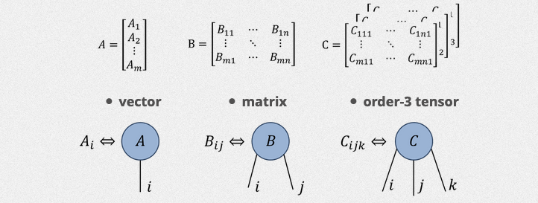

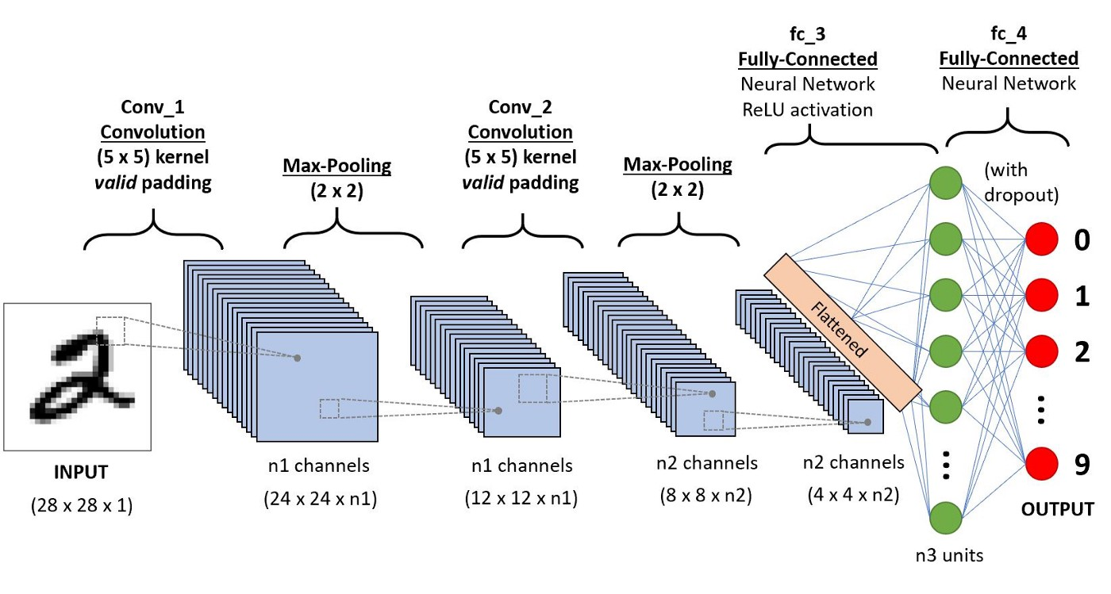
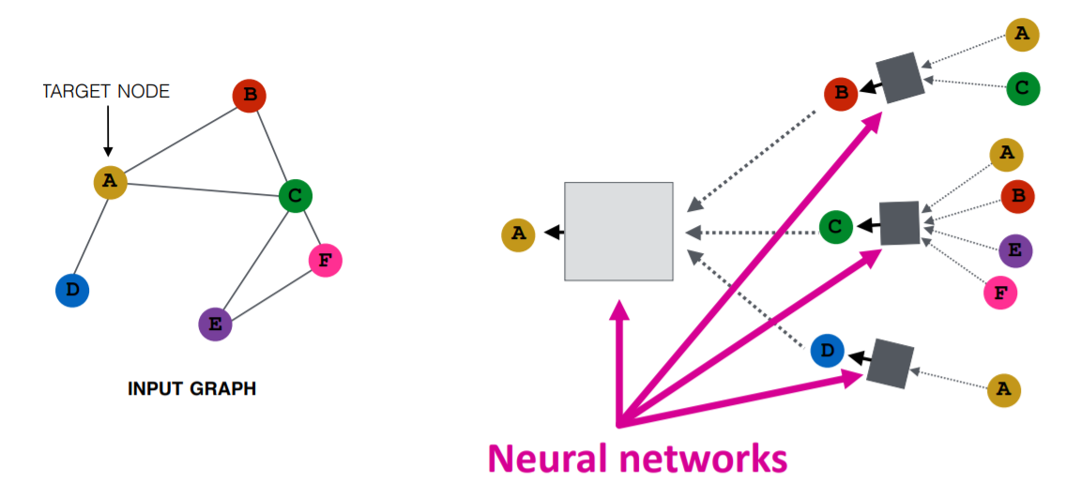
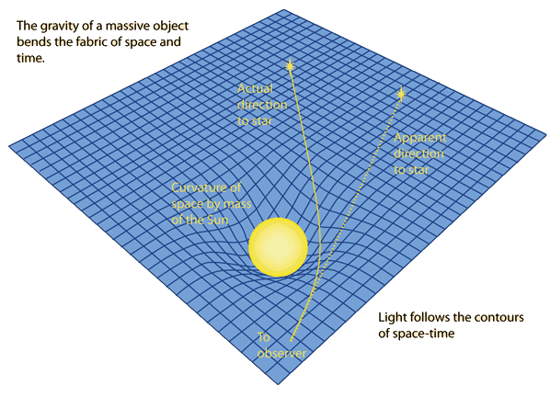
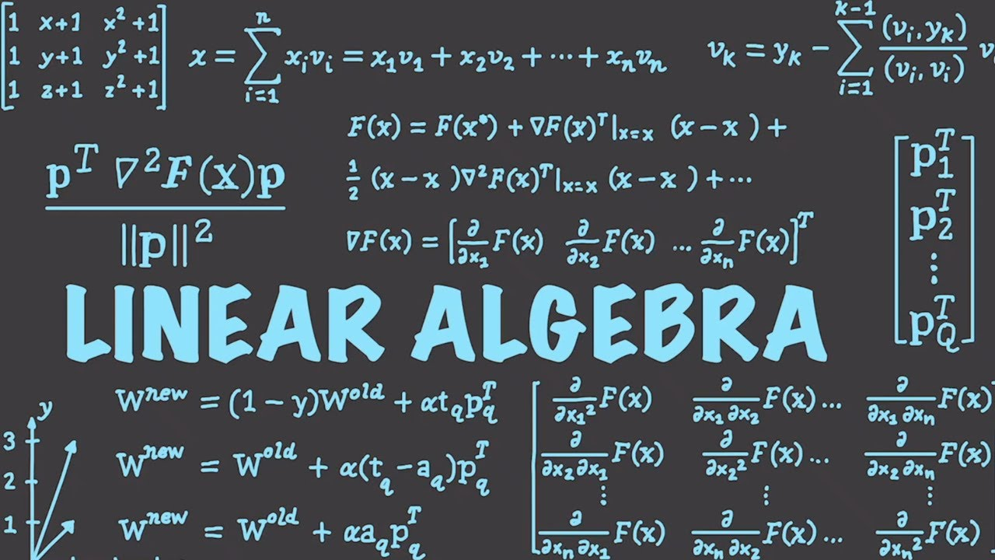
Tensors are everywhere
Machine Learning
Science and Engineering, Data Analytics
Convolutional Neural Networks
Quantum Chemistry (Circuit Simulations)
Analytics for movie ratings, product recommendations, social suggestions
Graph Neural Networks
General Relativity
Any application that uses linear algebra
Notes:
Tensor computations are an important class of computation used in machine learning and other science and engineering fields such as quantum chemistry, general relativity, data analytics and any application that uses linear algebra.

Slide 3




Tensor Computations
A tensor is an N-dimensional array of data
Tensor contractions are a class of tensor computations
$$A_{ik}=\sum_{k}{B_{ij}C_{jk}}$$
$$A_{ij}=B_{ij}C_{ij}$$
Matrix Multiplication
Hadamard Product
Order 0 scalar
Order 1 vector
Order 2 matrix
$$A_{ijl}=\sum_{k}{B_{ijk}C_{kl}}$$
$$A_{ij}=\sum_{k}{B_{ijk}C_{kl}D_{jl}}$$
MTTKRP Matricized tensor times Khatri-Rao product
Tensor Times Matrix
Order 3 tensor
Order 4 tensor
Notes:
Tensors are a generalization of matrices. There are various tensor operations that you can perform.

Slide 4
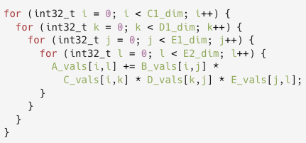

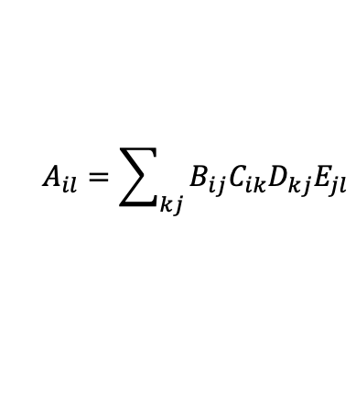
Complex Tensor Expression
$$A_{il}=\sum_{kj}{B_{ij}C_{ik}D_{kj}E_{jl}}$$
Time Complexity $$O(IJKL)$$
Notes:
Consider the complex tensor computation involving dense matrix multiplication and element-wise matrix multiplication shown.
[click]
This computation can be performed using an iterator with 4 perfectly nested for loops i, j, k and l.
[click]
The overall time complexity of this computation would be O of IJKL.

Slide 5

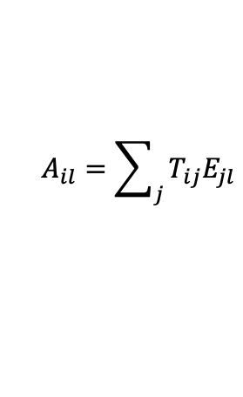
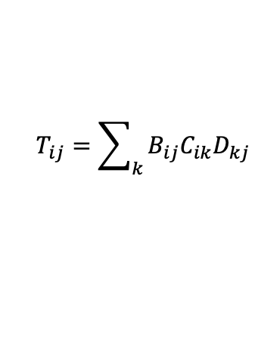
Can we reduce the time complexity?
Need to store $T_{ij}$ , which may lead to bad cache behavior
$$A_{il}=\sum_{kj}{B_{ij}C_{ik}D_{kj}E_{jl}}$$
$$T_{ij}=\sum_{k}{B_{ij}C_{ik}D_{kj}}$$
$$A_{il}=\sum_{j}{T_{ij}E_{jl}}$$
Time Complexity $$O\left(IJK+IJL\right)=O(IJ\left(K+L\right))$$
Time Complexity $$O(IJKL)$$
Notes:
But can we reduce the time complexity?
We can break down the tensor expression to multiple smaller tensor expressions so that the overall time complexity of the entire computation is reduced. However, this introduces a temporary tensor to hold the intermediate result.
[click] Although, executing them separately results in a lower time complexity.
[click] the requirement to store T can lead to bad cache behavior.

Slide 6
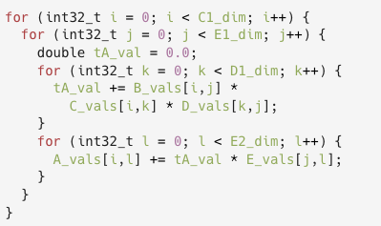

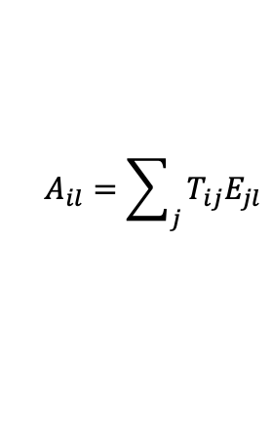
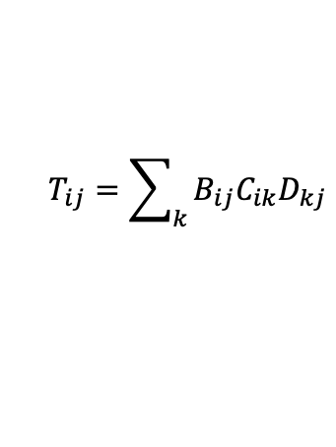
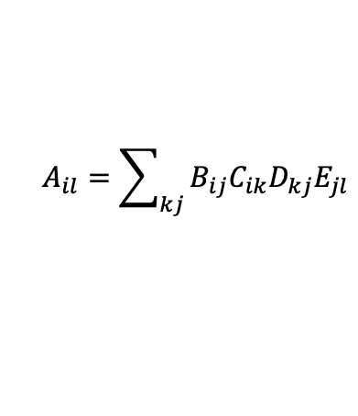


Can we reduce both complexity and memory usage?
$$A_{il}=\sum_{kj}{B_{ij}C_{ik}D_{kj}E_{jl}}$$
Time Complexity $$O(IJKL)$$
$$T_{ij}=\sum_{k}{B_{ij}C_{ik}D_{kj}}$$
$$A_{il}=\sum_{j}{T_{ij}E_{jl}}$$
Time Complexity $$O(IJ\left(K+L\right))$$
Time Complexity $$O\left(IJK+IJL\right)=O(IJ\left(K+L\right))$$
Notes:
Now we ask the question, can we reduce both the time complexity and memory usage?
[click]
Yes, it is possible to find another solution, or a compromise between the solutions we discussed, such that the time complexity is low and at the same time using minimal additional temporary memory. This can be achieved by fusing kernels.
[click]
The compute code shown performs the same computation now using [click] a scalar intermediate and low time complexity.

Slide 7
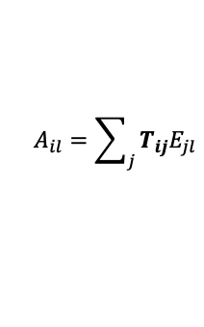
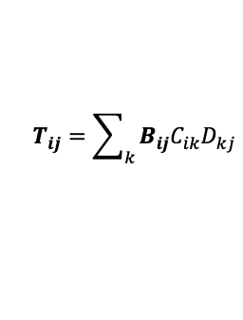
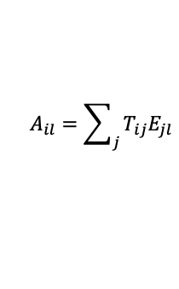
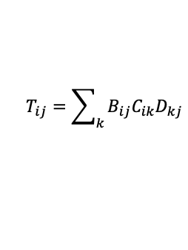
Sparse Tensors
0 | 1 | 2 | 3
0
1
2
A | B
 |  | C
 | D |  | E
Sampled Dense-Dense Matrix Multiplication
$$T_{ij}=\sum_{k}{B_{ij}C_{ik}D_{kj}}$$
$$T_{ij}=\sum_{k}{B_{ij}C_{ik}D_{kj}}$$
A | B |  |  |  |  | C |  |  | D |  | E
Dense data structure
Sparse Matrix Multiplication
$$A_{il}=\sum_{j}{T_{ij}E_{jl}}$$
$$A_{il}=\sum_{j}{T_{ij}E_{jl}}$$
pos
0 | 2 | 3 | 5
cols
0 | 1 | 2 | 1 | 3
Compressed, uses less storage
But sparse tensors do not have random access
A | B | C | D | E
Sparse data structure
Notes:
In some tensor computations, some or all tensors can be sparse, in which case it becomes a sparse computation. The kernels sampled dense-dense matrix multiplication and sparse matrix multiplication are two key kernels in graph embedding networks. But due to access constraints imposed by the structure of sparse tensor and because they do not have random access, code generation is not as simple as for the dense case.

Slide 8
Sparse Tensors
0 | 1 | 2 | 3
0
1
2
A | B
 |  | C
 | D |  | E
Sampled Dense-Dense Matrix Multiplication
$$T_{ij}=\sum_{k}{B_{ij}C_{ik}D_{kj}}$$
$$T_{ij}=\sum_{k}{B_{ij}C_{ik}D_{kj}}$$
A | B |  |  |  |  | C |  |  | D |  | E
Generating code for sparse tensors requires new techniques to deal with the complex data structures!
Dense data structure
Sparse Matrix Multiplication
$$A_{il}=\sum_{j}{T_{ij}E_{jl}}$$
$$A_{il}=\sum_{j}{T_{ij}E_{jl}}$$
pos
0 | 2 | 3 | 5
cols
0 | 1 | 2 | 1 | 3
Compressed, uses less storage
But sparse tensors do not have random access
A | B | C | D | E
Sparse data structure
Notes:
Therefore, generating code for sparse tensors requires new techniques to deal with the complex data structures.
People don’t know how to fuse sparse tensor kernels.
And we ask the question, can the sparse kernels be fused as we did for dense kernels?

Slide 9
SparseLNR
Dense
Sparse
Single
No large temporary needed. Bad time complexity.
Single
Fused
SparseLNR*
???
Best of both worlds
Separate
Separate
Good time complexity.
Bad memory usage.
Notes:
[click]
We have a case where we can have a single kernel with perfectly nested loops which does not require temporary memory, but they have bad time complexities for complex tensor expressions.
[click]
We have a case where we can have many smaller kernels with good time complexity, but they have bad memory usage with bad cache behavior.
[click]
By using kernel fusion, we can achieve the best of both worlds. Fusion is well studied for dense tensor algebra. Frameworks like Polyhedral framework brings forth many ways of fusing dense kernels.
[click]
But fusion of sparse tensor algebra kernels is not fully studied, and hence remains an open problem.
[click] Therefore, we introduce SparseLNR to solve part of this open problem.

Slide 10
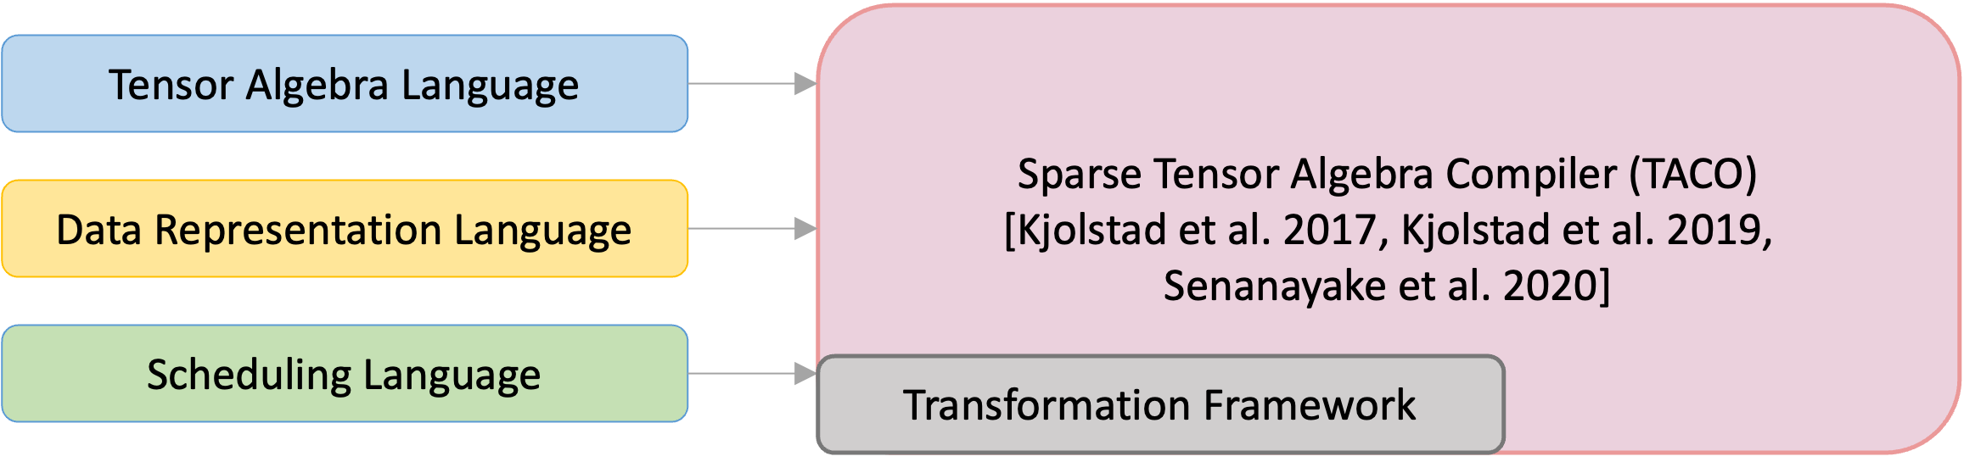
Contributions
New representation called a branched iteration graph.
New scheduling primitive for loop distribution and fusion that allow programmers to generate the branched iteration graph.
Adapt TACO’s code generation strategies to the branched iteration graph, allowing SparseLNR to generate sparse iteration code.
Notes:
TACO, the sparse tensor algebra compiler, is specialized for sparse code generation. Please read our paper for more information on the TACO framework.
There are three main contributions in our work.
[click] One, we introduce branch iteration graph, a novel representation for sparse iteration spaces.
[click] Two, we have a new scheduling primitive, that the programmers can use to invoke the transformation.
[click] Finally, we adapt TACO’s code generation strategies to the branched iteration graph, allowing us to generate sparse iteration code.

Slide 11
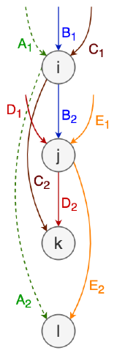
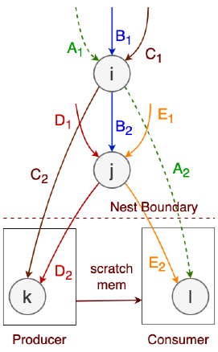
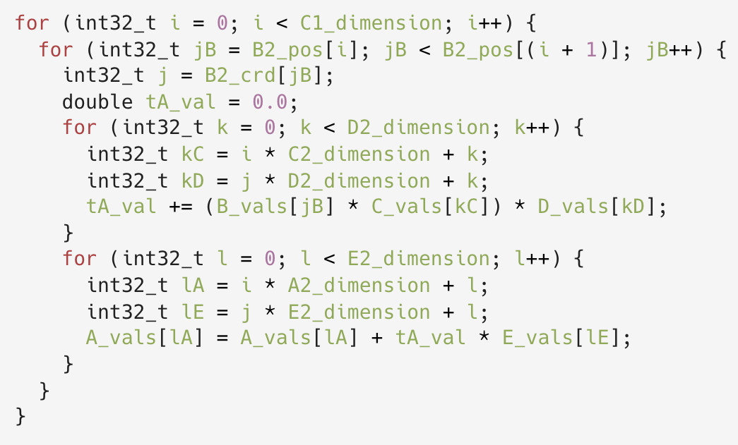

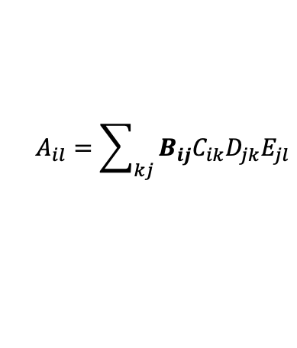

Restructuring loop nests
<SDDMM, SpMM>
$$A_{il}=\sum_{kj}{B_{ij}C_{ik}D_{jk}E_{jl}}$$
Time Complexity $$O(nnz\left(B_{IJ}\right)(K+L))$$
Time Complexity $$O(nnz\left(B_{IJ}\right)KL)$$
Notes:
Now let’s consider our combined complex sparse tensor kernel example.
[click] For this sparse tensor computation, we start with an intermediate representation called iteration graph. If you generate code for this iteration graph, it will have a time complexity of non-zero values of B into KL.
[click]
We transform this linear iteration graph to a branched iteration graph to introduce the nesting structure to the sparse computation and fuse kernels.
[click]
So that the new computation would only have the time complexity of non-zero values of B into K plus L, which lower than what we started with.
Please read our paper to see a more detailed description on the loop nest restructuring transformation.

Slide 12
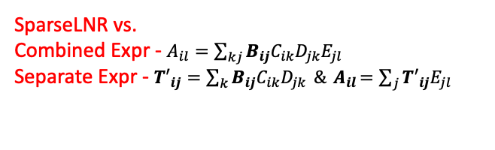
Evaluation
System Specs
SparseLNR vs.
Combined Expr - $A_{il}=\sum_{kj}{B_{ij}C_{ik}D_{jk}E_{jl}}$
Separate Expr - ${T′}_{ij}=\sum_{k}{B_{ij}C_{ik}D_{jk}} \&{ A}_{il}=\sum_{j}{{T′}_{ij}E_{jl}}$
64-Core AMD Ryzen Threadripper 3990X @ 2.2 GHz
32KB L1 data cache
512KB shared L2 cache
16MB shared L3 cache
GCC 7.5.0 with –O3
Benchmarks
<SDDMM, SpMM>
<SpMMH, GEMM>
<SpMM, GEMM>
<SDDMM, SpMM, GEMM>
<MTTKRP, GEMM>
<SpTTM, SpTTM>
Datasets
SuiteSparse matrix collection
Network Repository
FROSTT Tensors
& DARPA Dataset
Notes:
We compare our results with the kernels generated by TACO.
We evaluate 6 benchmarks with sparse tensors. We evaluate both single thread and multi-thread performance. And we do this for many real-world data sets.
--------------
One slide for evaluation, behcmarks, evaluation, speedups, sensitivity study, big speedup vs complex tensor epression and the smaller kernel execution. There is a lot more details on the paper.

Slide 13
Evaluation
Speedups of 0.27-1997x for single-thread and 0.51-1263x for multi-threads.
Good scaling
Sensitivity analysis with varying dense dimensions
Notes:
We show that our transformation, in general gives good speedups.
We also show that our transformation has good scaling compared to the baselines.
In addition, we also provide a case study of sensitivity analysis for our transformation.

Slide 14
Evaluation
Benchmark | TACO Separate | TACO Original
<SDDMM, SpMM> | 0.91-1.50 | 10.75-33.39
<SpMMH, GEMM> | 1.60-1.99 | 1.29-50.55
<SpMM, GEMM> | 1.23-3.27 | 6.91-79.86
<SDDMM, SpMM, GEMM> | 1.20-2.26 | 93-1997
<MTTKRP, GEMM> | 0.85-1.86 | 27.05-89.12
<SpTTM, SpTTM> | 0.27-2.08 | 1.88-66.20
Benchmark | TACO Separate | TACO Original
<SDDMM, SpMM> | 0.90-1.23 | 3.31-16.05
<SpMMH, GEMM> | 1.28-2.40 | 1.66-36.50
<SpMM, GEMM> | 0.86-3.16 | 2.44-139.0
<SDDMM, SpMM, GEMM> | 1.06-2.09 | 19-1263
<MTTKRP, GEMM> | 0.86-1.81 | 9.56-72.76
<SpTTM, SpTTM> | 0.51-2.70 | 0.98-28.98
Notes:
[click]
In general, the speedups we see against the TACO original comes from the reduction in time complexity. We see this behavior in both single threaded and multi-threaded executions.

Slide 15
Evaluation
Benchmark | TACO Separate | TACO Original
<SDDMM, SpMM> | 0.91-1.50 | 10.75-33.39
<SpMMH, GEMM> | 1.60-1.99 | 1.29-50.55
<SpMM, GEMM> | 1.23-3.27 | 6.91-79.86
<SDDMM, SpMM, GEMM> | 1.20-2.26 | 93-1997
<MTTKRP, GEMM> | 0.85-1.86 | 27.05-89.12
<SpTTM, SpTTM> | 0.27-2.08 | 1.88-66.20
Benchmark | TACO Separate | TACO Original
<SDDMM, SpMM> | 0.90-1.23 | 3.31-16.05
<SpMMH, GEMM> | 1.28-2.40 | 1.66-36.50
<SpMM, GEMM> | 0.86-3.16 | 2.44-139.0
<SDDMM, SpMM, GEMM> | 1.06-2.09 | 19-1263
<MTTKRP, GEMM> | 0.86-1.81 | 9.56-72.76
<SpTTM, SpTTM> | 0.51-2.70 | 0.98-28.98
Notes:
[click]
The speedups we see against the TACO separate comes from not using a large temporary tensor and cache benefits. We see the same behavior in both single threaded and multi-threaded executions.

Slide 16
Scaling
Circuit5M Graph (59.52M non-zeros)
Webbase Graph (3.11M non-zeros)
Notes:
SparseLNR scales with increasing number of threads. We see good scaling in SparseLNR and TACO-Separate versions for the <SDDMM, SpMM> benchmark. SparseLNR delivers comparable scaling to the best alternative approach. We observed similar scaling results for other benchmarks and datasets.

Slide 17
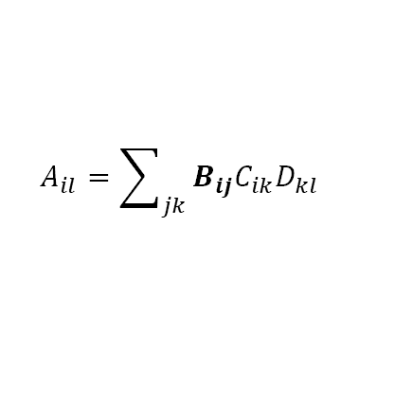
Varying Dimensions
TACO-Sep. vs. SparseLNR
TACO-Orig. vs. SparseLNR
$$A_{il}=\sum_{jk}{B_{ij}C_{ik}D_{kl}}$$
Notes:
We also evaluate how a kernel behaves with varying dense dimensions. In general, we see that SparseLNR performs better with increasing sizes. [click] we see the best performance within the area highlighted and the performance starts to degrade beyond this region because the temporary tensors get too large.

Slide 18
Conclusions
Sparse loop fusion or loop nest restructuring is a performance critical optimization.
Current automated sparse code generation techniques do not support loop fusion that requires imperfect loop nesting.
We propose a novel method for restructuring loop nests in the context of sparse tensor algebra computations.
Our transformation shows good performance on various real-world datasets and benchmarks.
Notes:
In summary, we can say that
[click] Sparse loop fusion or loop nest restructuring is a performance critical optimization.
[click] Current automated sparse code generation techniques do not support loop fusion that requires imperfect loop nesting.
[click] We propose a novel method for restructuring loop nests in the context of sparse tensor algebra computations.
[click] Our transformation shows good performance on various real-world datasets and benchmarks.

Slide 19
SparseLNR: Accelerating Sparse Tensor Computations Using Loop Nest Restructuring
Adhitha Dias, Kirshanthan Sundararajah, Charitha Saumya, Milind Kulkarni Purdue University
Contact: kadhitha@purdue.edu
ICS '22 | June 27th – 30th 2022
Notes:
If you have any questions, please forward them during the question-and-answer session at the international conference on supercomputing 22 or contact us by email. Thank you for listening to the presentation.

