Slide 1

Final Project bank customer data
Mia curtopelle
Kirsten Fischl
Tajahnei williams

Slide 2
About the dataset
Dataset from a German bank regarding customers applying for a loan
N = 1,000
20 attributes (numerical and qualitative)
Status of existing checking account, duration of checking account life, credit history, purpose of application, credit amount, savings account/bonds, employment, installment rate in percentage of disposable income, personal status and sex, other debtors, present resident since, property, age, other installment plans, housing, existing credits at this bank, job, number of people liable to provide maintenance for, telephone, and foreign worker
Two outcome classes (good or bad customer)

Slide 3
approach
Supervised
Binary classification
Three tested models
Support vector model (linear)
Logistic regression
Random forest

Slide 4

sampling
 | Original Dataset | Training Dataset (imblearn.over_sampling)
Bad customers (0) | 300 | 527
Good customers (1) | 700 | 523

Slide 5
Support vector model
Classification Report
GridSearch
param_grid = {'C': [1, 5, 10, 50],
'gamma': [0.0001, 0.005, 0.001, 0.005]}
Best parameters: C:1, gamma: 0.0001
Improved accuracy score to 73.5%
 | Precision | Recall | F1-Score
Bad | 69% | 76% | 72%
Good | 74% | 67% | 70%
Accuracy |  |  | 71%
Average | 72% | 71% | 71%

Slide 6
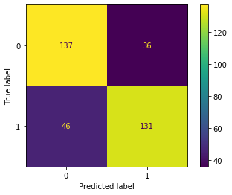
Svm confusion matrix

Slide 7
Logistic regression

Slide 8
Random forests

Slide 9
Model performance
Weaker
Stronger
Support Vector Model | Logistic Regression | Random Forest
Accuracy: 71% Accuracy after testing different regularizing and parameters: 73.5% | Scores here? | Scores here?

