Slide 1
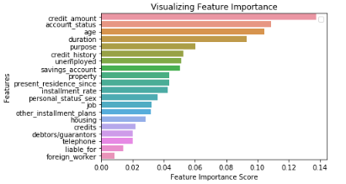
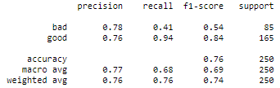
Random Forest classification
The first model was trained using 1000 decision trees on scaled, but imbalanced data. It reached an accuracy score of 76%
To improve the model, we compared the importance of the features to find out which ones could be dropped

Slide 2
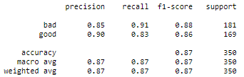
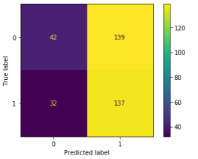
The least significant columns were dropped and by using the RandomOverSampler method, the data was balanced
The second model trained with 3000 decision trees, balanced data and less features reached an accuracy score of 87%

