Slide 1
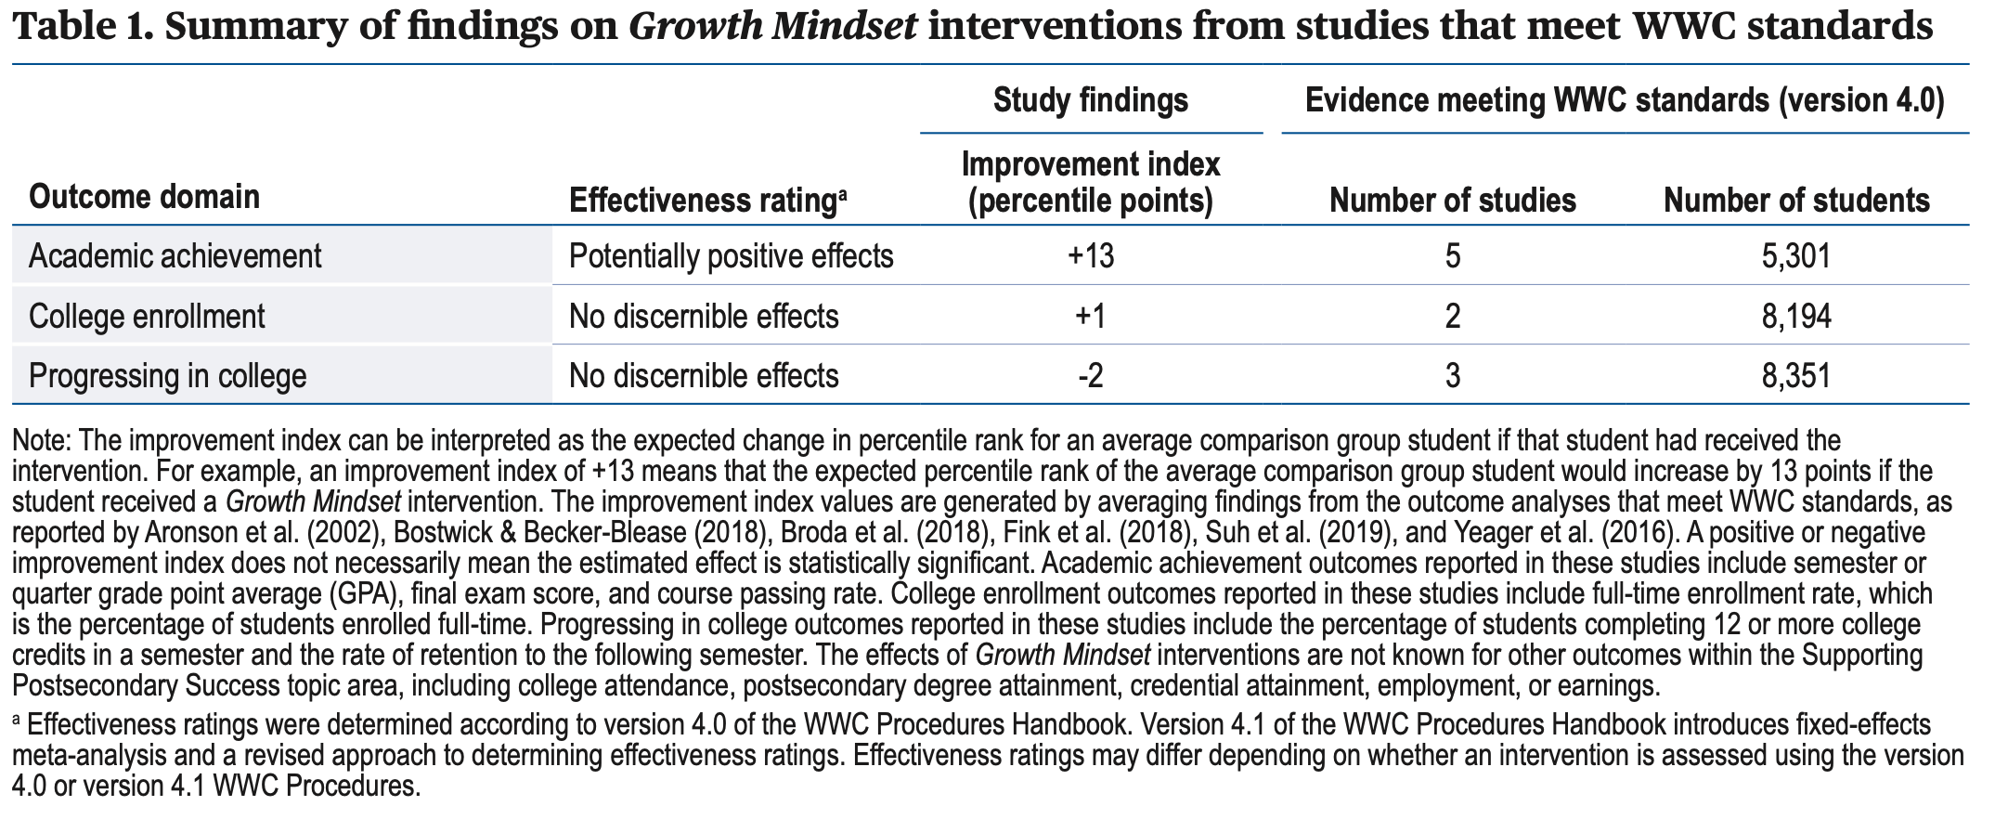
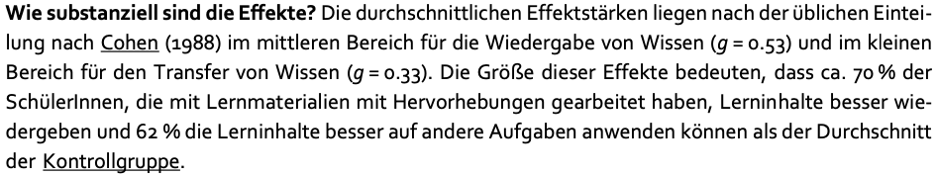
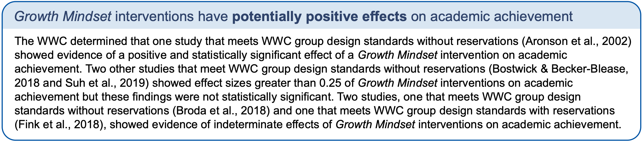
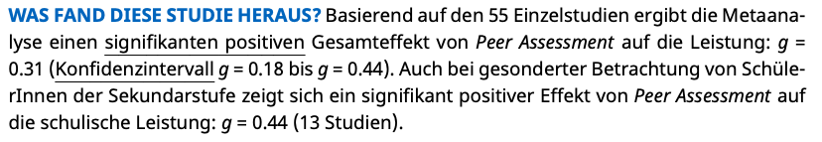
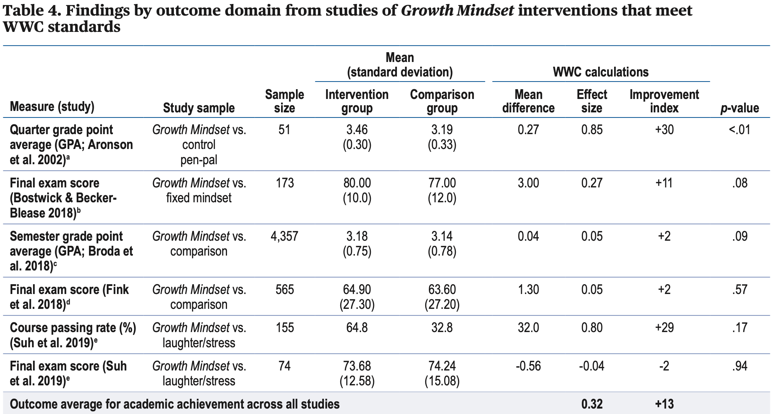
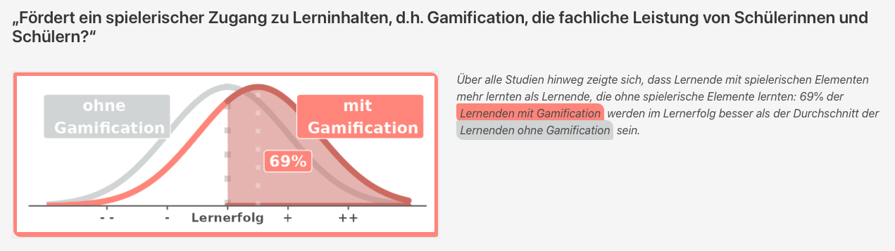
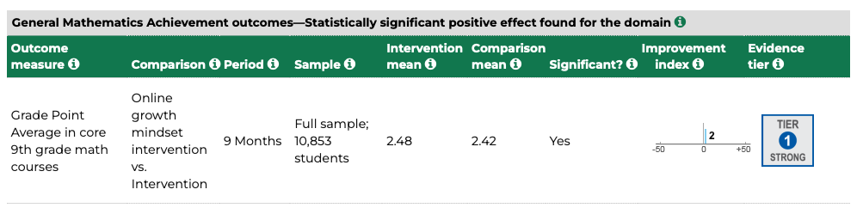
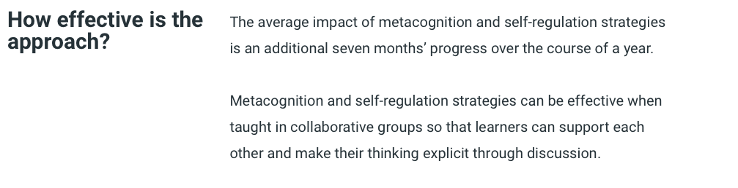
What Works Clearinghouse
Clearinghouse Unterricht München
Quelle: Wiesbeck et al., 2018, S. 5
Quelle: Diery et al., 2021, S. 3
Tüdibase
Quelle: Backfisch et al. (2021)
Quelle: What Works Clearinghouse, 2022, S. 1,4 & 5
Teaching and Learning Toolkit
Quelle: What Works Clearinghouse, 2021

