Slide 1
Developing Microsoft SQL Server Databases
Christian Bolton | Technical Director, Coeo
Graeme Malcolm | Microsoft

Slide 2
Course Topics
Developing Microsoft SQL Server Databases
01 | Implementing Tables & Views | 06 | Optimizing & Troubleshooting Queries
02 | Understanding Indexes
03 | Using Stored Procedures & Functions
04 | Managing Transactions
05 | Implementing In-Memory Objects

Slide 3
02 | Understanding Indexes
Christian Bolton | Technical Director, Coeo
Graeme Malcolm | Microsoft

Slide 4
Module Overview
Clustered and nonclustered Indexes
Covering indexes and the INCLUDE clause
Obtaining index information from DMVs
Filtered Indexes
Statistics
Index Maintenance

Slide 5

Index Fundamentals
SQL Server accesses data using a table scan or an index
In a table scan SQL Server reads all the pages
When using an index, SQL Server will use the index pages to find the required rows
Indexes can be clustered or non-clustered
Create indexes directly or by specifying a PRIMARY KEY
Root node
Leaf nodes

Slide 6
Clustered Indexes
Rows are stored in a logical order
Only one clustered index per table
A table without a clustered index is known as a heap
All data is stored in the leaf nodes
Analogous to the contents page of a book
Defines the physical ordering of the contents

Slide 7
Operations on Clustered Indexes
INSERT
Each new row must be placed into the correct logical position
May involve splitting pages of the table
UPDATE
The new row can either remain in the same place if it still fits and if the clustering key value is still the same
If the row no longer fits on the page, the page needs to be split
If the clustering key has changed, the row needs to be removed and placed in the correct position
DELETE
Frees up space by flagging the data as unused
SELECT
Queries related to the clustering key can seek
Queries related to the clustering key can scan and void sorts

Slide 8
Working with Clustered Indexes

Slide 9
Non-Clustered Indexes
Table is structured as a heap or clustered index
Heap = Index ID 0
Clustered Index = Index ID 1
Additional indexes can be created
These are called nonclustered indexes (Index ID 2+)
Separate objects to the table
Leaf level contains a pointer to the table where the rest of the columns can be found

Slide 10
Non-Clustered Indexes on Heaps
id | index_id>=2 |  | root_page
Root Index Page
Index Pages
Leaf Nodes
Contain Row IDs
id | index_id=0
Data Pages
Heap

Slide 11
Non-Clustered Indexes on Clustered Indexes
id | index_id>=2 |  | root_page
Root Index Page (non-clustered index)
Index Pages
Leaf Nodes
Contain Keys
Clustering Key
Root Index Page (clustered index)
id | index_id=1 |  | root_page
Index Pages Containing Data
Clustered Index

Slide 12
Covering Indexes and INCLUDE
A covering index is an index that can provide all the column data required to fulfil a query
Provides better performance as it removes the need to lookup the data in the table structure
Prior to SQL Server 2005 you had to create a composite index across multiple columns which was expensive
Now the INCLUDE clause is used to insert column data into the leaf node of a non-clustered index
Root Index Page (non-clustered index)
Index Pages
Leaf nodes contain all columns in the SELECT clause (so no need to look up data pages in heap or clustered index)

Slide 13
Working with Non-Clustered Indexes

Slide 14
Index DMVs
sys.dm_db_index_physical_stats
Index size and fragmentation statistics
sys.dm_db_index_operational_stats
Current index and table I/O statistics
sys.dm_index_usage_stats
Index usage statistics by access type

Slide 15
Obtaining index information from DMVs

Slide 16
Filtered Indexes
Filtered indexes use a WHERE clause to limit the rows that the index includes
Benefits of filtered indexes include
Faster response times
Small storage requirement
Faster rebuild operations
Shares some similarities with Indexed Views
CREATE NONCLUSTERED INDEX
NC_EMP_ADDRESS
ON HR.Address
(
AddressLine1,
AddressLine2
)
WHERE City='New York'

Slide 17
Index Fragmentation
Fragmentation occurs when data changes cause index pages to split
Internal fragmentation when pages are not full
External fragmentation when pages are not in logical sequence
Detecting fragmentation
Index properties in SQL Server Management Studio
sys.dm_db_index_physical_stats

Slide 18
FILLFACTOR and PAD_INDEX
ALTER TABLE Person.Contact
ADD CONSTRAINT PK_Contact_ContactID
PRIMARY KEY CLUSTERED
(
ContactID ASC
) WITH (PAD_INDEX = ON, FILLFACTOR = 70);
GO
FILLFACTOR leaves space in index leaf-level pages for new data to avoid page splits
PAD_INDEX uses the value specified in FILLFACTOR for the intermediate pages of the index

Slide 19
Removing Fragmentation
REBUILD
Rebuilds the whole index
Needs free space in the database
Performed as a single transaction
Beware of log space requirements
REORGANIZE
Sorts the pages and is always online
Less transaction log usage
Work isn’t lost if interrupted
ALTER INDEX IX_Contact_LastName
ON Person.Contact
REBUILD;
ALTER INDEX IX_Contact_City
ON Person.Contact
REORGANIZE;

Slide 20
Online Index Operations
ALTER INDEX IX_Contact_EmailAddress
ON Person.Contact
REBUILD
WITH (ONLINE = ON, MAXDOP = 4 );
Enterprise Edition of SQL Server can rebuild indexes online
Enables concurrent user access
Slower than the equivalent offline operation
Effectively creates a new index in parallel with the old so space in the data file is a consideration
Lots of updates during the rebuild will use tempdb heavily

Slide 21
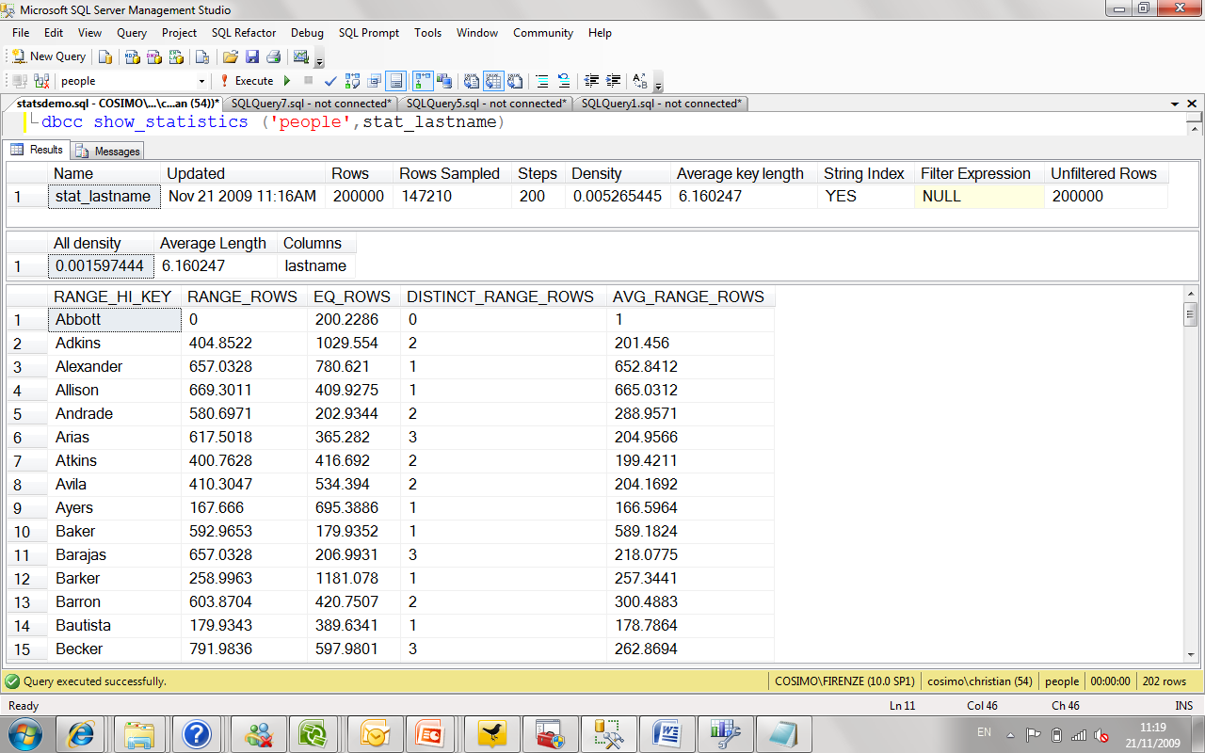
Statistics
Statistics exist to help the optimiser choose a good execution plan
They’re used to help estimate the selectivity of an operation

Slide 22
Updating Statistics
As data changes, statistics become outdated
Updated automatically or on demand
AUTO_UPDATE_STATISTICS
Database option on by default
UPDATE STATISTICS
Manually trigger an update for a table or specific statistics
sp_updatestats
Updates all statistics in a database
ALTER INDEX REBUILD
Also rebuilds the statistics with FULLSCAN

Slide 23
Maintaining Indexes

Slide 24
Understanding Indexes
Summary
Clustered and nonclustered Indexes
Covering indexes and the INCLUDE clause
Obtaining index information from DMVs
Filtered Indexes
Statistics
Index Maintenance

