Slide 1
Sensitivity analyses
Oversampled districts (n>10) downsampled randomly
Keeping minimum of 100seq

Slide 2
Transition | Change
north → south | ↓ ~5%
south → north | ↑ ~34%
✔ still directional constraint
north → south consistently stronger
Full:
~3.0× stronger north → south
DS:
~2.1×
Directionality exists (north → south ~3× → 2.1×)
But asymmetry shrinks more under downsampling (~30% reduction)
Weak direction becomes stronger when data are removed
Partial/ episodic constraint

Slide 3
Transition | Relative change
periurban → urban | ↓ ~30%
urban → periurban | ↓ ~44%
Statistical support remains despite drop
(decisive to v strong)
Full model
~3.7× stronger urban → periurban flow
DS
~3.0× stronger urban → periurban flow
Downsampling reduces inferred movement intensity (30–45%) but preserves the overall directional structure of urban–periurban transitions
Asymmetry pattern is robust, magnitude is moderately sensitive (primarily driven by Cerro Colorado?)

Slide 4
High-support transitions remain broadly stable
Lower-supported routes have greater variability in both BF and MJ (BF>50 as a threshold?)
Core movement network remains stable
Cerro Colorado routes (particularly to yura) are sample-sensitive but real

Slide 5
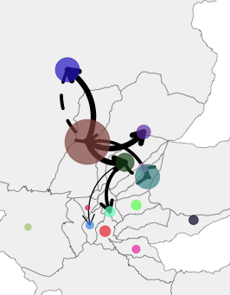
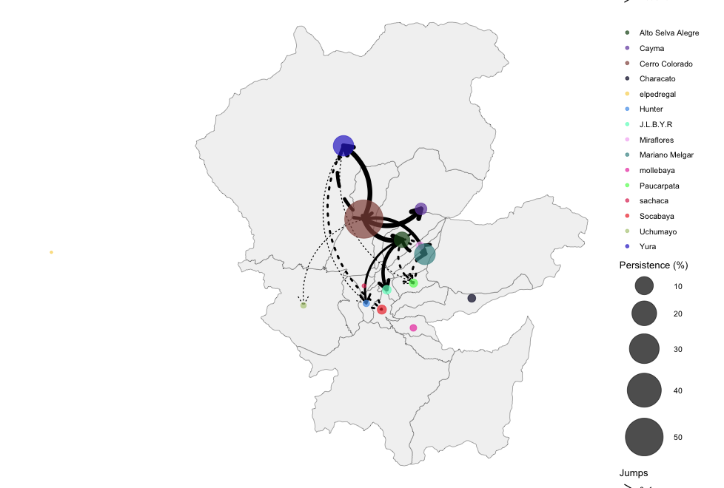
Removing BF<50
Original
BF>10

Slide 6
Overall
Urbanicity = most stable directional system
River = intermediate stability, more sampling-sensitive
District = heterogeneous / edge-dependent stability

Slide 8
16 years of epidemiological silence in Arequipa City
Rabies re-emergence and persistence
REDIPRA declares Arequipa rabies-free
Rabies re-emerges in Arequipa city
Rabies persistence in Arequipa City
2009
2014
2021/22
2013
2015
2025
Last detected case in Arequipa region
Two canine rabies cases in Camina
Rabies outbreaks in El Pedregal

Slide 9
16 years of epidemiological silence in Arequipa City
Rabies re-emergence and persistence
REDIPRA declares Arequipa rabies-free
Rabies re-emerges in Arequipa city
Rabies persistence in Arequipa City
2009
2014
2021/22
2013
2015
2025
Last detected case in Arequipa region
Two canine rabies cases in Camina
Rabies outbreaks in El Pedregal

Slide 10
16 years of epidemiological silence in Arequipa City
Rabies re-emergence and persistence
REDIPRA declares Arequipa rabies-free
Rabies re-emerges in Arequipa city
Rabies persistence in Arequipa City
2009
2014
2021/22
2013
2015
2025
Last detected case in Arequipa region
Two canine rabies cases in Camina
Rabies outbreaks in El Pedregal
<AQP city: cases and seq cases?>

Slide 11
16 years of epidemiological silence in Arequipa City
Rabies re-emergence and persistence
REDIPRA declares Arequipa rabies-free
Rabies re-emerges in Arequipa city
2nd rabies outbreak in El Pedregal
2009
2014
2021
2025+
2013
2015
2022
Last detected case in Arequipa region
Two canine rabies cases in Camina
1st rabies outbreak in El Pedregal
Rabies persistence in Arequipa City

