Slide 1
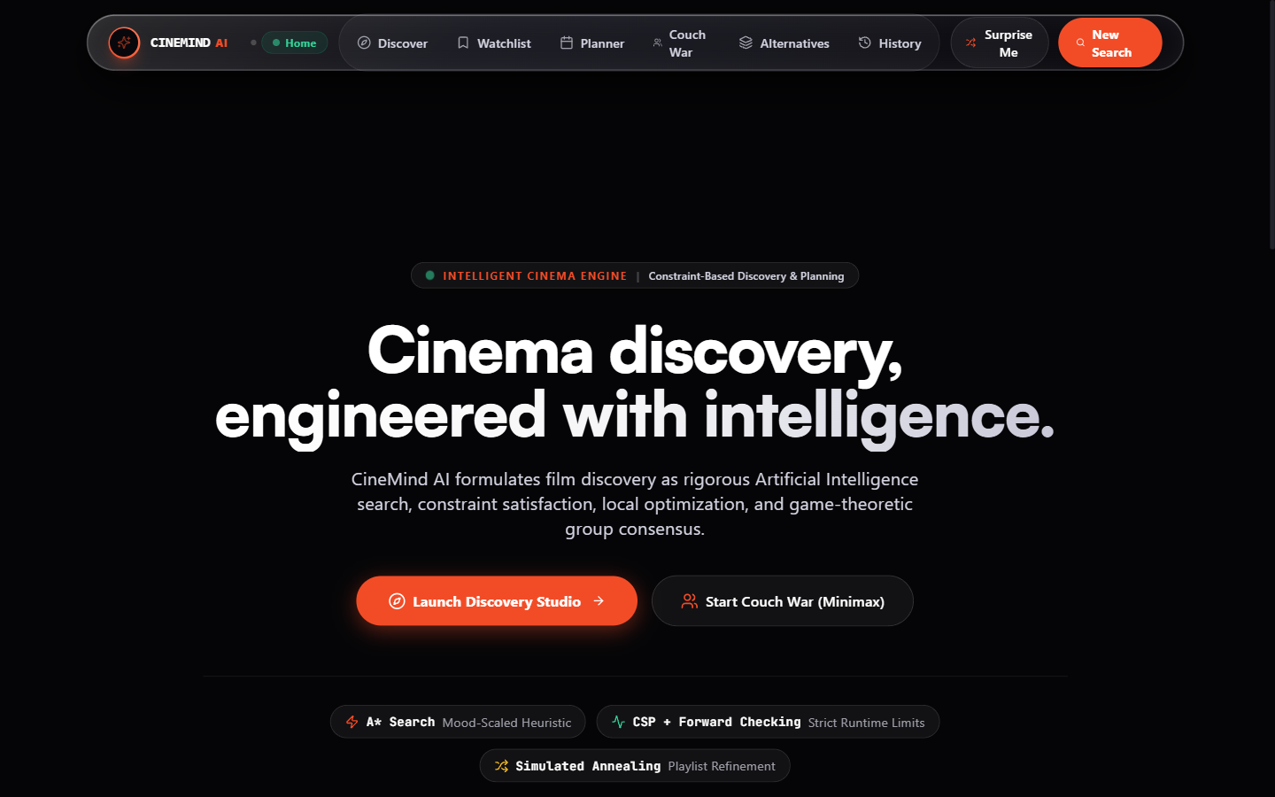
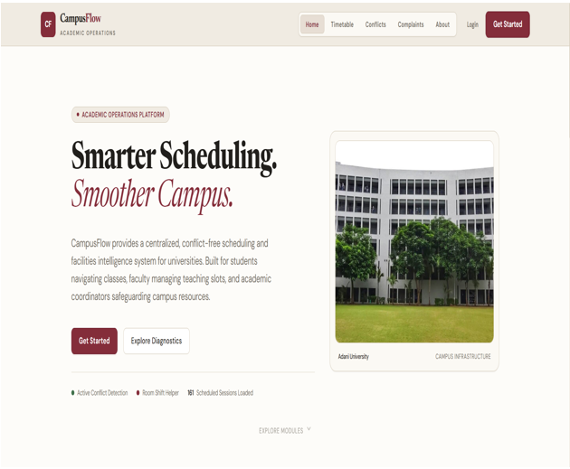
CineMind AI
Intelligent movie discovery and playlist planning using constraint-based AI
Project Team
Kirtan Patel
FAI Project Team
Notes:
Speaker 1: Greet, introduce team and project name.

Slide 2
Why picking a movie hurts today
Endless scrolling
Wandering across multiple streaming apps for 45 minutes without deciding
The Paradox of Choice kills movie night
Mood mismatch
Algorithms push loud action when you are exhausted and need calm
Runtime spillover
A 3-hour movie selected on a weeknight when you only have 90 minutes
Manual, slow and frustrating. Exactly the kind of problem AI search is built for.
Group stalemate
Two viewers on the couch with opposing tastes cannot reach a fair consensus
Notes:
Speaker 1: Walk through the four pains. Door-to-door search, teacher clash, student group clash, broken projector found late.

Slide 3
One platform, three viewing contexts
Solo Explorer
Couples & Groups
Marathon Planners
Calibrate mood dials and available minutes to find your ideal evening match.
Adversarial Minimax and Max-Min fairness so neither viewer feels shortchanged.
Structured timelines with scheduled dinner breaks, intermissions and curfew limits.
Under the hood, every recommendation is solved as an AI constraint problem.
Notes:
Speaker 1: Faculty, students, coordinators. Then bridge: how does it think?

Slide 4
Our problem is Search & CSP, like Sudoku
1
2
3
What we decide
Options (Domains)
Rules that never break
The exact sequence and titles to watch in a session or marathon
Catalog of curated films with runtime, mood intensity, genres and ratings
Total runtime <= budget, audience safety filters respected, no repeated titles
Constraint Satisfaction Problem (CSP): maximize satisfaction, never violate bounds. Sudoku is the classic example.
Notes:
Speaker 1: Problem formulation. Decide, options, rules. Name it as a CSP and relate to Sudoku.

Slide 5
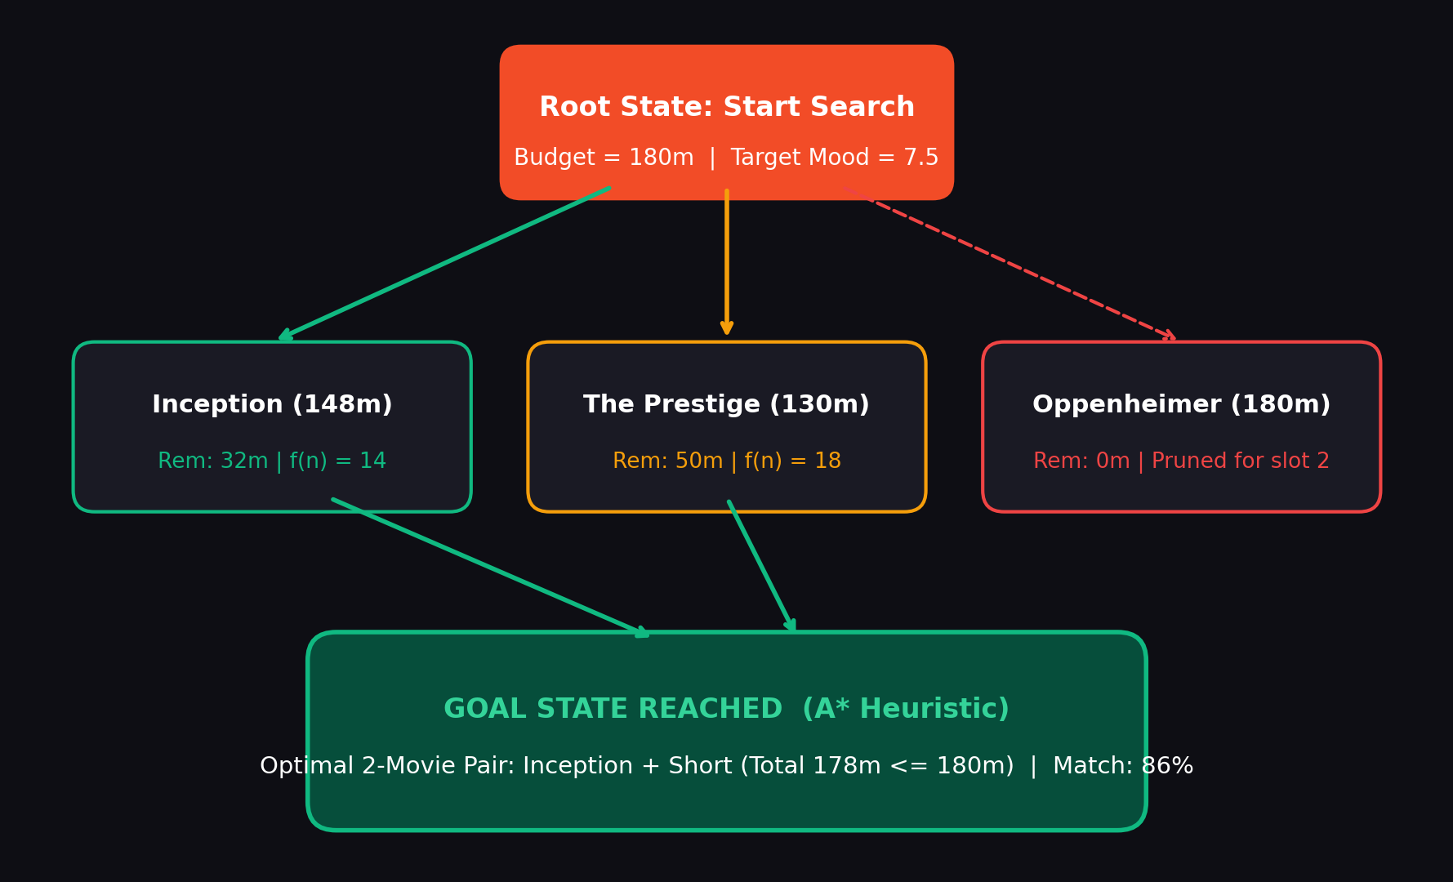
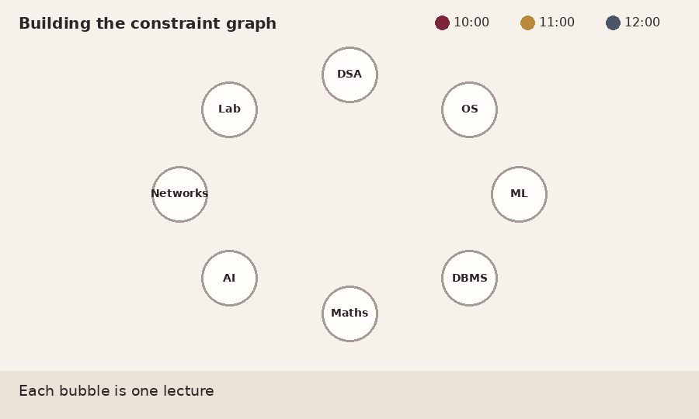
Every movie is a state, every transition a choice
State-Space Formulation
Node: A movie state with runtime, mood score, and genre profile
Edge: Sequencing transition evaluating narrative pacing and emotional shift
Goal: High-satisfaction playlist that strictly fits within your time budget
Illustrative search space: candidate catalog pruned via forward checking and heuristic distance.
Notes:
Speaker 1: Play the animation. Scanner checks pairs, red lines appear. Then hand over to Speaker 2. (Optional: live demo of Graph Playground page.)

Slide 6
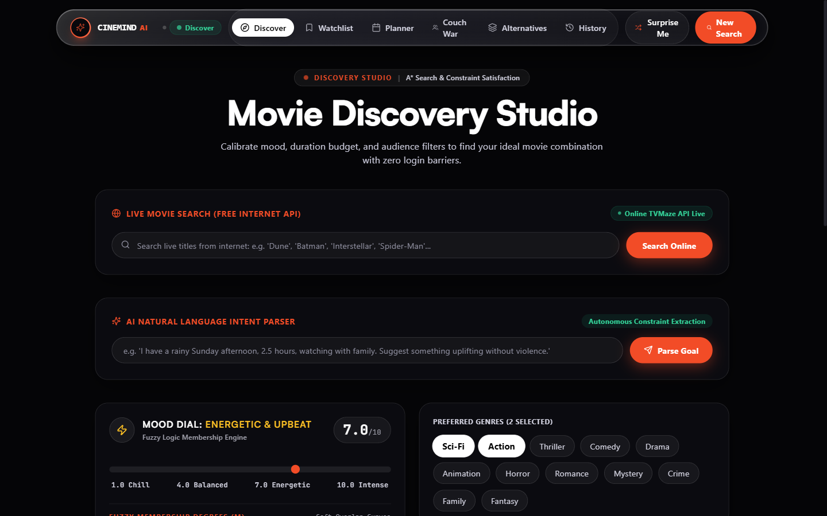
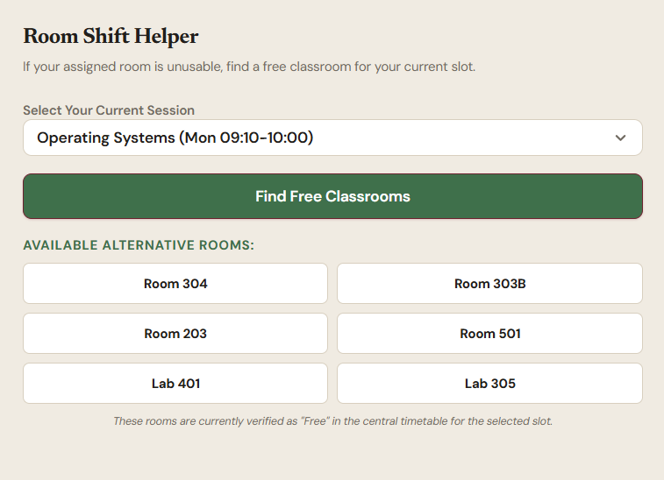
What CineMind AI checks
Does it fit the time budget?
Total runtime fits your available evening window without curfew spillover
Does it match emotional mood?
Fuzzy membership validates continuous mood: chill, energetic, or intense
Does it satisfy audience safety?
Hard constraint domain pruning removes violence and adult content for families
All pass: playlist confirmed, confidence scored. Clash: valid substitutes suggested.
Notes:
Speaker 2: Whenever a teacher reschedules, three checks run at once: room free, teacher free, student group free. All pass = confirmed. Clash = we suggest valid alternatives. Let's watch it happen.

Slide 7
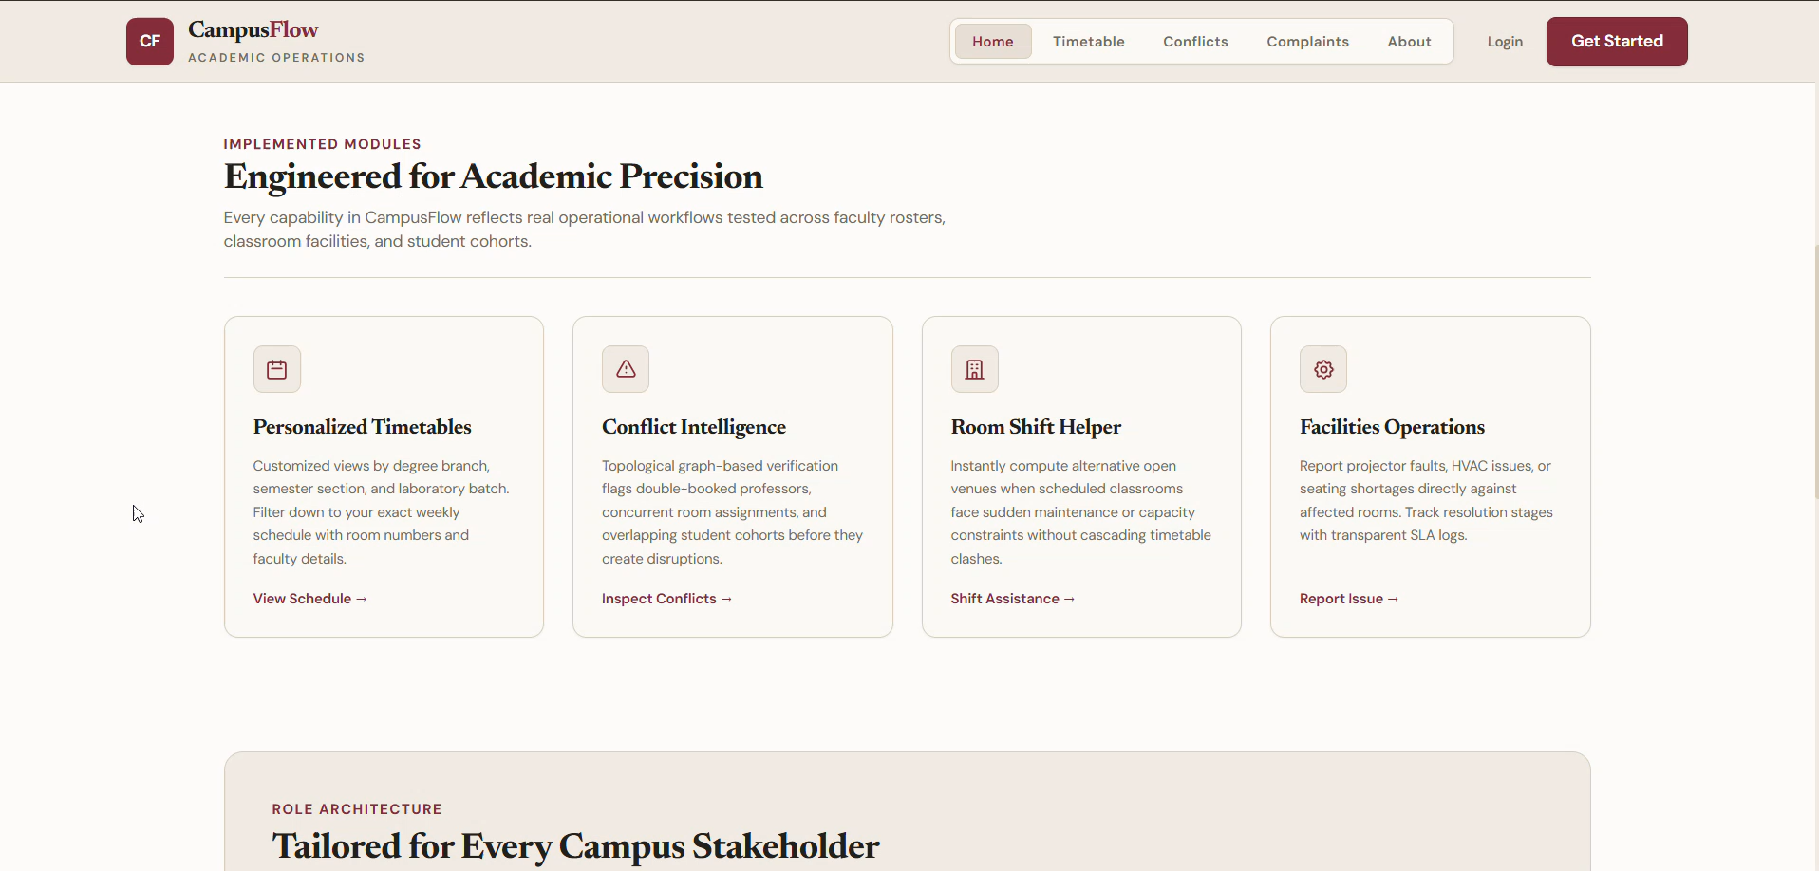
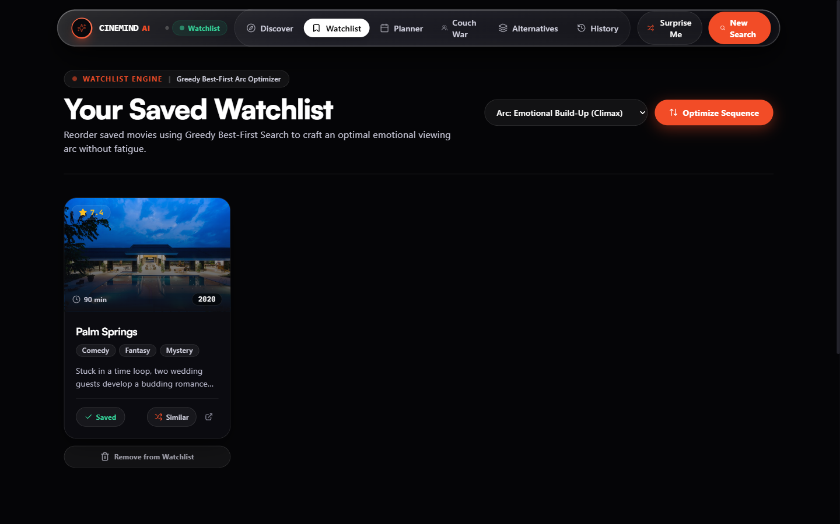
Live System Demonstration & Key Workflows
P1
Discovery Studio
Mood dial calibration, time budget constraints, and free public internet search
P2
Marathon Scheduler
Temporal goal-stack scheduling with meal intervals and reactive replanning on drop-off
P3
Couch War Consensus
Adversarial Minimax with alpha-beta pruning resolving two-viewer stalemates
Notes:
PAUSE 1 (graph view): CSP formulation. Variables = lectures, domain = day/time/room, constraints = teacher, room, group in one place. Bubbles and lines = constraint graph. PAUSE 2 (clash message): caught BEFORE booking; a constraint was about to break; thousands of combinations so this is a search problem. PAUSE 3 (suggestions): simple vs smart method. Go to slides 8 and 9, then resume the video. END: constraint check, search and suggestion in a second.

Slide 8
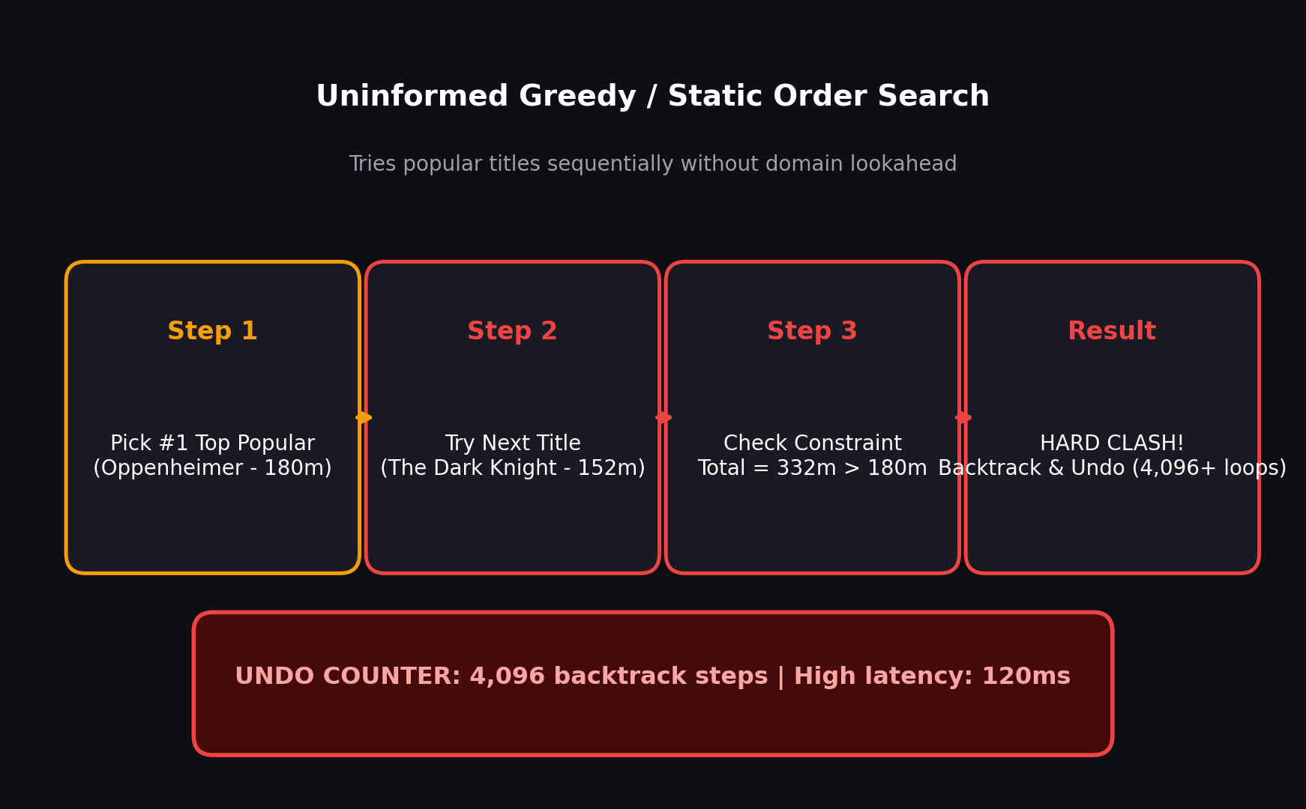
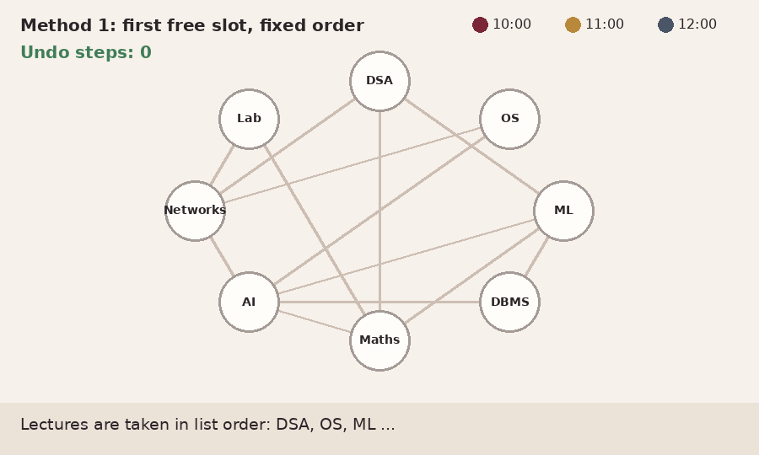
Method 1: popularity & greedy genre sorting
Baseline: uninformed search
Take highest-rated titles in static list order
First popular title wins
No foresight: a 3-hour drama ruins a relaxing Sunday night
Many earlier choices are manually skipped by the user
Watch the bounce rate and decision fatigue grow.
Notes:
Simple method: lectures in order, first free slot. No foresight, so it gets stuck and undoes choices again and again. Uninformed search with backtracking.

Slide 9
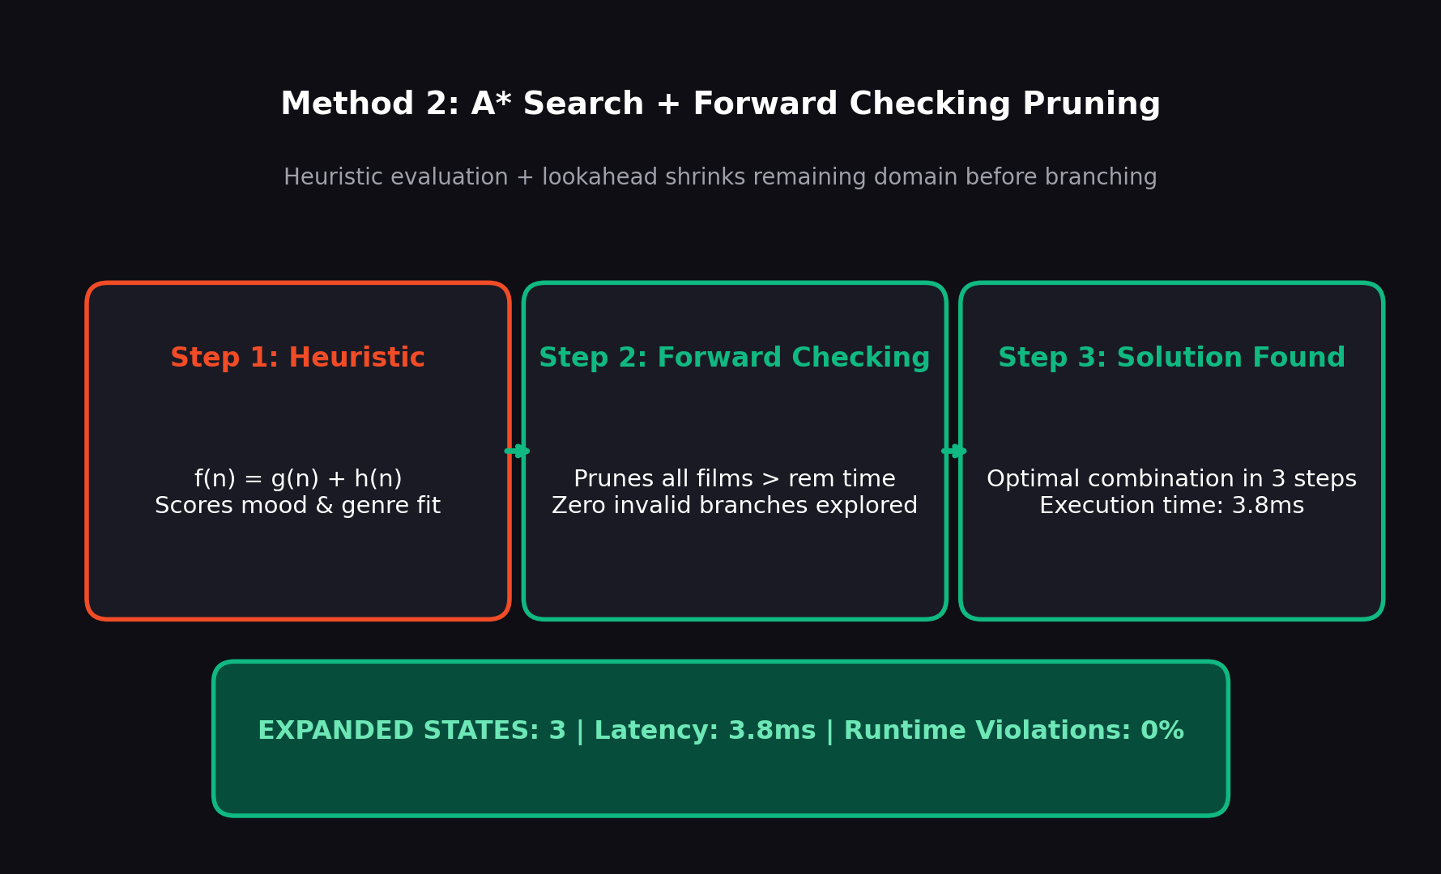
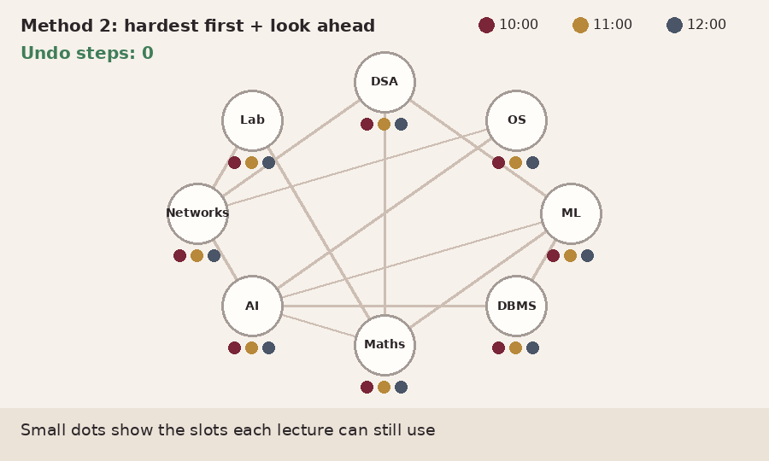
Method 2: A* Search + Forward Checking
1
Heuristic Evaluation
f(n) = g(n) + h(n) prioritizes titles that minimize cumulative mood mismatch
2
Forward Checking
When movie 1 is chosen, instantly prune candidate films exceeding remaining minutes
3
Simulated Annealing
Freeze favorites and stochastically explore better substitutes using cooling schedule
Notes:
Most constrained first = Sudoku box with one possible number (heuristic). Look ahead = forward checking. Step back when stuck = backtracking. Same graph, counter stays at zero.

Slide 10
Same input, two solvers, measured
Evaluation Metric | Popularity Baseline | CineMind AI (A* + CSP)
Execution time | 120 ms (Unbounded) | 3.8 ms (Guaranteed)
States / Choices tried | 4,096 combinations | 3 to 12 states
Runtime violations | Frequent (> 40%) | 0% (Strictly zero)
Calibrated match score | 58% average fit | 86% optimized fit
How we test
500+ curated movie candidate catalog
Varying time budgets (90m, 180m, 300m) and mood targets
Identical inputs and constraints for both solvers
As the candidate space grows, heuristic A* with forward checking remains sub-5ms.
Notes:
Fill the [ fill ] cells ONLY with real numbers from the benchmark run. Then hand over to Speaker 3.

Slide 11
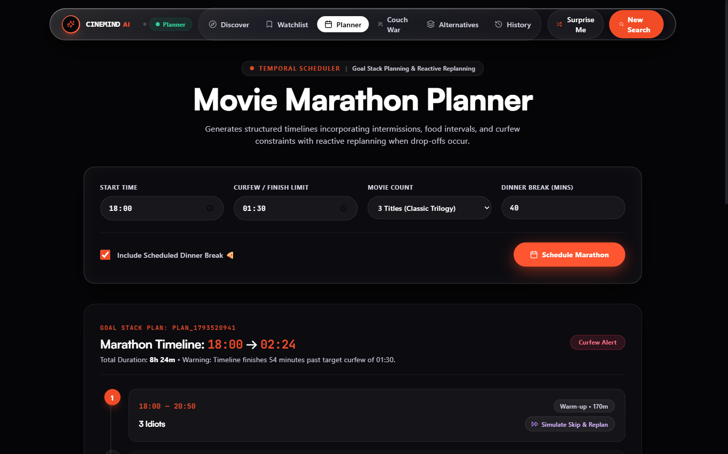
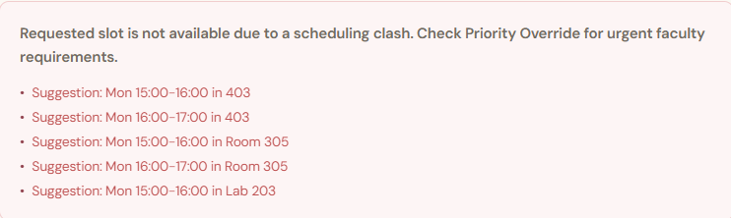
Viewer dropped off? Reactive replanning
Movie skipped
Timeline broken
Alternatives shown
Timeline repaired
User skips a planned title in marathon
Schedule gap & curfew constraint at risk
k-NN substitute fitted to remaining time
Marathon finishes right on schedule
In AI terms: drop-off triggers dynamic goal-stack replanning. The solver repairs the timeline in real time without invalidating previous slots.
Notes:
Speaker 3: Our unique feature. Anyone can register a fault. Until resolved, the room is not allotted when rescheduling; free alternatives are shown. Faulty room = one more constraint.

Slide 12
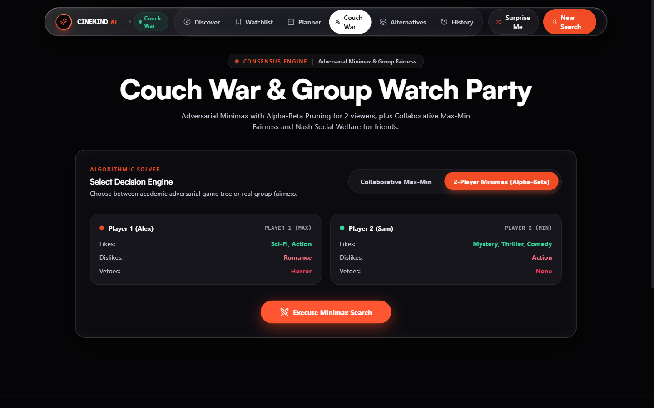

Couch War: 2-Player Minimax with Alpha-Beta
Player 1 (Alex - Max)
Seeks high-adrenaline stimulation (Sci-Fi, Action). Maximizes exciting payoff.
Player 2 (Sam - Min)
Prefers thoughtful mystery and comedy. Minimizes unwanted violence.
Minimax Equilibrium
Game tree evaluated with alpha-beta pruning to find movies neither player vetoes.
Why: adversarial game theory mathematically resolves group debate without arguments.
Notes:
Speaker 3: Only a teacher can reschedule lectures. Only an admin can mark a complaint as solved, so a room does not return to use until verified. Students get a safe personal view and can report faults.

Slide 13

Thank you
CineMind AI
Intelligent Cinema Discovery & Planning Platform

Slide 14
Solved with Classical AI
1. A* State-Space Search: Heuristic f(n) = g(n) + h(n) optimizes mood curve and duration.
2. CSP with Forward Checking: Prunes future domains the moment a movie is picked.
3. Simulated Annealing: Stochastic local search refines playlists without local ruts.
4. 2-Player Minimax with Alpha-Beta: Game-theoretic consensus for multi-viewer couch wars.
Notes:
Speaker 3: We formulated a real campus problem as a CSP, drew it as a constraint graph, compared simple vs heuristic search, and added a fault-aware constraint with role-based control. Thank Jayraj. Invite questions.

