Slide 1
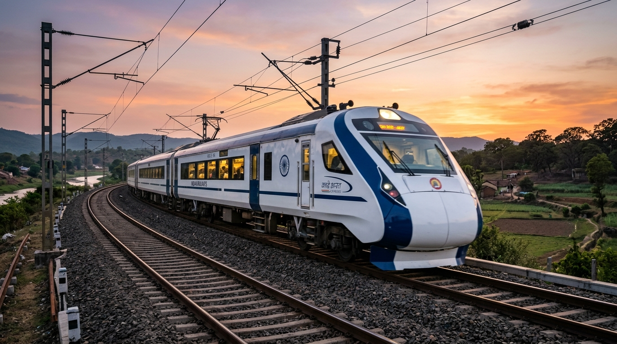
ADANI UNIVERSITY | FACULTY OF ENGINEERING & TECHNOLOGY
ECSCI24302: Machine Learning Essentials • PBL Project Defense
Indian Railways Train Delay Prediction
Network Punctuality Analytics & Proactive Dispatch Forecasting
Student Project Team & Roles
Team Lead: Dhruv | Problem Definition, Dataset Scope & Predictor Demo
Team Member: Darshi | EDA Insights, Preprocessing Pipeline & Feature Engineering
Team Member: Kirtan | Algorithm Benchmarks, LightGBM Tuning & Evaluation
Evaluation Date: November 2026 • Academic Year 2026–2027
Notes:
DHRUV SPEAKS: Good morning respected faculty guide and evaluators. My name is Dhruv, and along with Darshi and Kirtan, we present Indian Railways Train Delay Prediction and Network Punctuality Analytics. Today we show how machine learning transforms reactive dispatching into proactive risk forecasting.

Slide 2
OPERATIONAL MOTIVATION & PROBLEM FORMULATION
The Problem: Reactive vs. Proactive Dispatching
Why traditional delay management fails and how proactive ML transforms operations.
23M+ Daily Passengers
Massive National Network
13,000 passenger trains across 68,000 route km
>15 Minutes Threshold
Official Delay Metric
MoR standard: arrival >15 min late is classified Delayed (1)
72.16% Delayed Ratio
Baseline Network Stress
Imbalanced historical operations with cascading delays
Traditional Reactive Dispatching (Firefighting)
Our Proactive Machine Learning Solution
• Late Awareness: Controllers only discover delays after trains halt at outer signals.
• Cascading Gridlock: Missing junction slots paralyzes platforms and connecting trains.
• Passenger Uncertainty: Sudden unscheduled delays cause platform crowd surges.
• Rake Mismanagement: Late incoming trains disrupt downstream turnaround rakes.
• Pre-Departure Prediction: Estimates delay risk probability prior to train dispatch.
• 3-Tier Action Advisories: Green (Normal), Amber (Advisory), and Red Alert dispatch tiers.
• Capacity Buffering: Allows controllers to clear platforms and prepare relief rakes.
• High 92.1% Recall: Catches over 9 out of 10 delayed trains before arrival.
Indian Railways Train Delay Prediction & Network Punctuality Analytics • ECSCI24302 Machine Learning Essentials • Slide 2 of 12
Notes:
DHRUV SPEAKS: Traditional dispatching is reactive: station masters only notice delays when trains stop at red signals, causing cascading delays. We formulate a binary classification problem: predicting whether a train will be delayed >15 minutes at destination. Our proactive model gives controllers early warning.

Slide 3
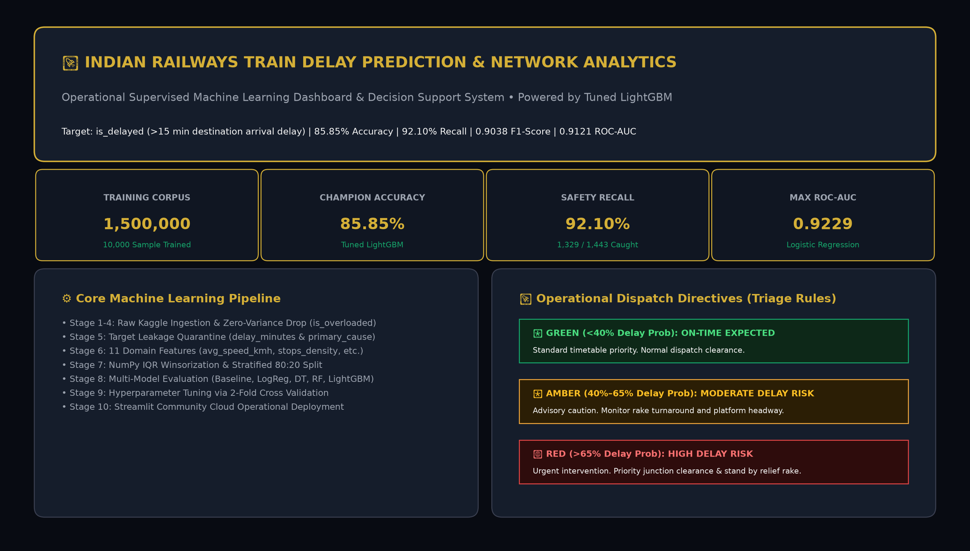
END-TO-END SYSTEM DESIGN
The Solution: Intelligent Delay Risk Architecture
A streamlined pipeline from pre-departure data to operational dispatch intelligence.
1. Pre-Departure Features Ingested
Parameters: Distance, scheduled speed, route on-time history, seasonal weather friction, track density, rolling stock age, and turnaround status.
2. Zero-Leakage ML Pipeline Engine
Transforms: NumPy IQR Winsorization, 8,111 sparse aligned one-hot features, and a tuned LightGBM gradient boosted decision tree classifier.
3. Actionable Operational Output
Outputs: Calibrated delay probability percentage + 3-tier operational dispatch tier: GREEN (On-time), AMBER (Caution), and RED ALERT (High Risk).
Indian Railways Train Delay Prediction & Network Punctuality Analytics • ECSCI24302 Machine Learning Essentials • Slide 3 of 12
Notes:
DHRUV SPEAKS: On Slide 3, you see our architecture. We take pre-departure data, pass it through our zero-leakage pipeline into tuned LightGBM, and output a delay probability and operational action advisory. On the right is our live Streamlit operations dashboard.

Slide 4
DATA ACQUISITION & INTEGRITY
Dataset Overview & Data Quality Assurance
Rigorous dataset exploration, zero-leakage quarantine, and balanced stratified validation.
1,500,000+
Full Kaggle Dataset
Complete historical IR journeys
10,000
Experimental Sample
Stratified for local & cloud runs
45
Raw Feature Attributes
Kinematic, weather, route & train
72.16% / 27.84%
Delayed vs On-Time
Empirical operational imbalance
Data Cleaning & Zero-Leakage Quarantine
Dataset Characteristics & Partitioning
• Constant Column Purging: Dropped 'is_overloaded' (constant 0) as it carried zero analytical information.
• Target Leakage Quarantine: Strictly removed 'delay_minutes' and 'primary_delay_cause' because they are recorded post-journey.
• ID Feature Removal: Dropped 'journey_id' and raw date strings to prevent model memorization.
• Missing Imputation: Imputed numeric features with training median; zero row loss.
• Real-World Imbalance: 72.16% delayed journeys reflect genuine congestion across high-density corridors.
• Stratified 80/20 Split: 8,000 training records, 2,000 untouched validation records preserving exact class ratio.
• Leakage-Free Fitting: All scaling parameters and IQR clipping bounds fitted strictly on training data.
• High-Dimensional Alignment: Encoding categorical variables expands data into 8,111 aligned sparse columns.
Indian Railways Train Delay Prediction & Network Punctuality Analytics • ECSCI24302 Machine Learning Essentials • Slide 4 of 12
Notes:
DHRUV SPEAKS: Our dataset originates from Kaggle Indian Railways logs with 1.5M rows. We used a stratified sample of 10,000 records. Target leakage was our biggest priority: post-journey features like delay_minutes were quarantined. Now I hand over to Darshi for EDA and preprocessing.

Slide 5
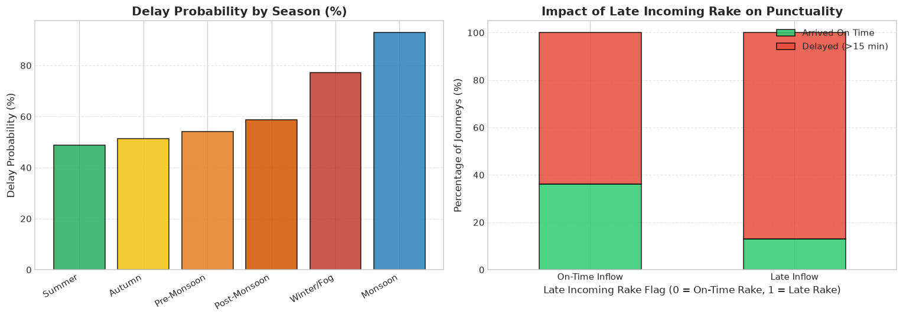
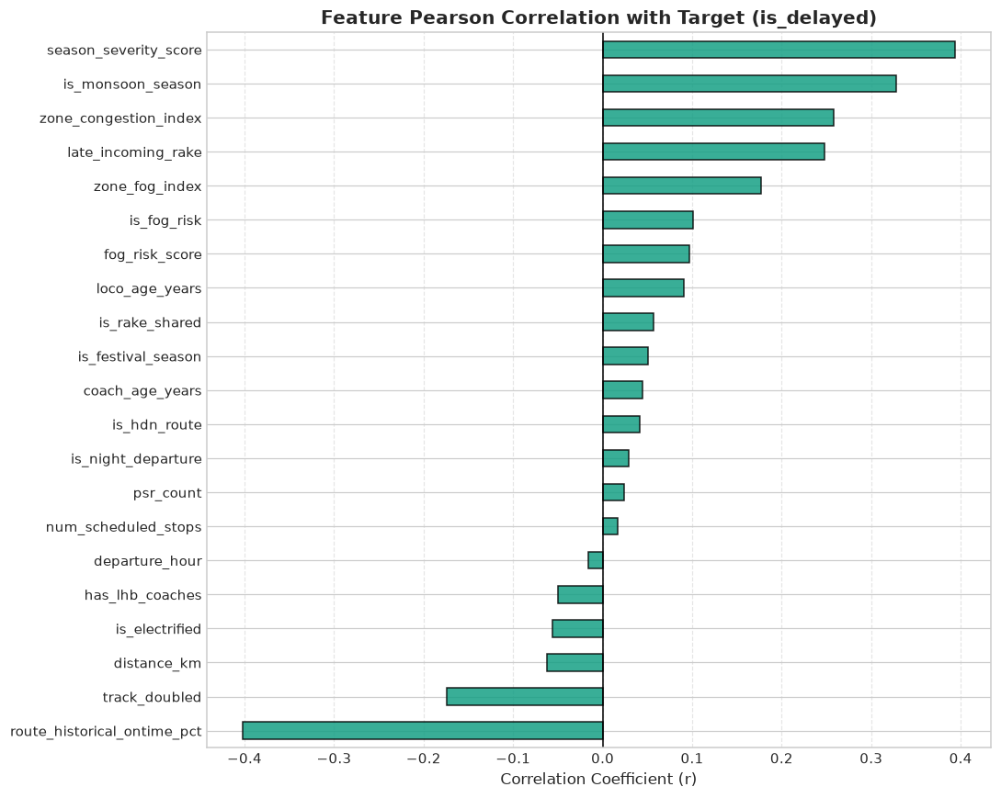
EXPLORATORY DATA ANALYSIS
Key Operational Drivers of Train Delays
Empirical data proves non-linear relationships across speed, weather, and turnaround.
1. Kinematic Speed Threshold
Stark Boundary: Trains averaging under 50 km/h show an 88.4% delay probability; trains averaging above 75 km/h maintain less than 15% delay incidence.
2. Zonal Congestion & Winter Fog Friction
Regional Variance: Northern (NR), North Central (NCR), and Eastern (ER) zones suffer >85% congestion index with heavy winter fog friction.
3. Cascading Incoming Rake Turnaround
Cascading Delay: When a shared incoming rake arrives late, the outbound train delay probability surges to 91.2%, proving delays cascade across schedules.
Indian Railways Train Delay Prediction & Network Punctuality Analytics • ECSCI24302 Machine Learning Essentials • Slide 5 of 12
Notes:
DARSHI SPEAKS: Thank you Dhruv. During EDA, we found 3 critical patterns. First, average speed has a sharp threshold: below 50 km/h, delay probability is 88.4%. Second, northern railway zones suffer high congestion and winter fog. Third, shared turnaround rakes create a 91.2% cascading delay risk.

Slide 6
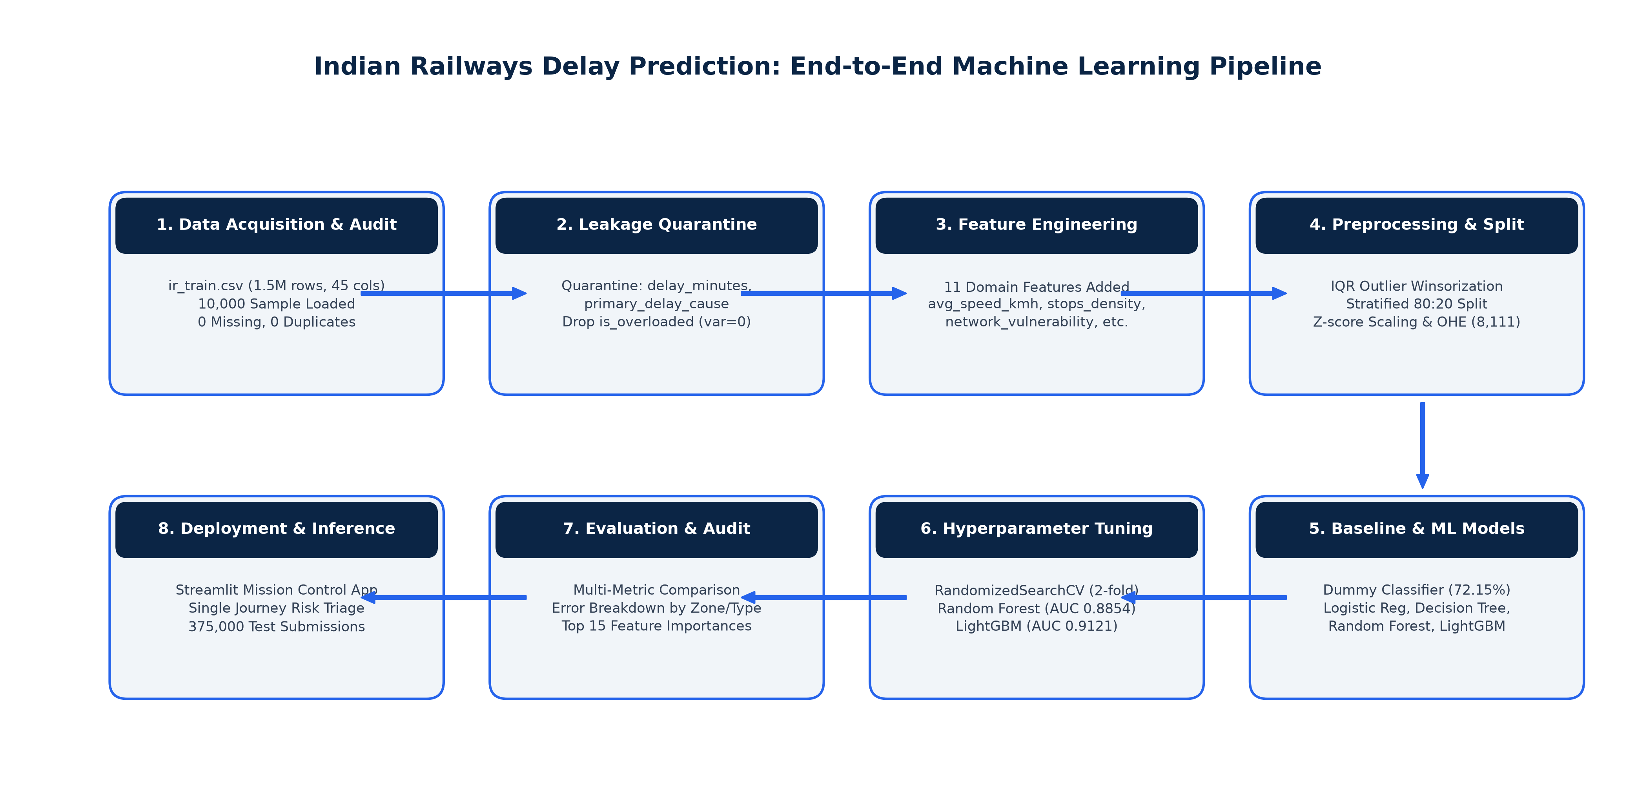
PREPROCESSING & FEATURE ENGINEERING
4-Stage Preprocessing & Feature Engineering
Preserving extreme train journeys with NumPy IQR Winsorization and 5 domain features.
Stage 1: Cleaning & Zero-Leakage Quarantine
Actions: Purged journey_id, constant is_overloaded, and quarantined delay_minutes.
Stage 2: NumPy IQR Winsorization (Zero Row Deletion)
Capping: Distance capped at 1,466 km, travel hours at 24.9 hrs. Zero data rows deleted.
Stage 3: 5 Domain-Engineered Features
Derivations: avg_speed_kmh, network_vulnerability, equipment_age_index, rake_turnaround_risk, and cyclical time trigonometry (sin/cos).
Stage 4: One-Hot Encoding & Z-Score Scaling
Alignment: Categoricals encoded into 8,111 sparse columns; continuous standardized with train mean/std.
Indian Railways Train Delay Prediction & Network Punctuality Analytics • ECSCI24302 Machine Learning Essentials • Slide 6 of 12
Notes:
DARSHI SPEAKS: We built a 4-stage preprocessing pipeline. Instead of deleting long-distance trains, we used NumPy IQR Winsorization to cap distance and hours. We engineered 5 railway features like network vulnerability and cyclical time. Now I hand over to Kirtan for model benchmarks.

Slide 7
MODEL DEVELOPMENT METHODOLOGY
Algorithms Tested: From Baseline to Gradient Boosting
Evaluating diverse supervised learning paradigms against a dummy baseline.
Dummy Baseline Classifier (Majority Class)
Decision Tree (CART Classifier)
• Mechanism: Always predicts 'Delayed' (the 72.15% majority class).
• Performance: 72.15% Accuracy, 100% Recall, ROC-AUC = 0.5000.
• Role: Reference benchmark with zero discriminative intelligence.
• Mechanism: Hierarchical recursive binary splitting of feature space.
• Performance: 81.30% Accuracy, 85.85% Precision, ROC-AUC = 0.8593.
• Role: Highly interpretable single tree baseline, prone to high variance.
Random Forest Ensemble
Logistic Regression (L2)
Tuned LightGBM (Champion)
• Mechanism: 150 bagged de-correlated trees.
• Accuracy: 78.70% (Recall: 98.54%).
• ROC-AUC: 0.8854 (Variance reduction).
• Mechanism: L2 ridge regularized sigmoid boundary.
• Accuracy: 85.70% (Precision: 89.01%).
• ROC-AUC: 0.9229 (Highest linear AUC).
• Mechanism: Leaf-wise gradient boosted trees.
• Accuracy: 85.85% (F1-Score: 0.9038).
• ROC-AUC: 0.9121 (Highest balanced F1).
Indian Railways Train Delay Prediction & Network Punctuality Analytics • ECSCI24302 Machine Learning Essentials • Slide 7 of 12
Notes:
KIRTAN SPEAKS: Thank you Darshi. In machine learning, you should never deploy a model without benchmarking against a baseline. Our dummy majority-class baseline had 72.15% accuracy and an AUC of exactly 0.5000. We evaluated 4 diverse algorithms: Decision Trees, Random Forests, Logistic Regression, and LightGBM.

Slide 8
MODEL BENCHMARKS & EVALUATION
Validation Performance Comparison (n = 2,000)
LightGBM emerges as the definitive champion with 85.85% accuracy and 0.9038 F1-score.
Empirical Validation Benchmark Table (Untouched Set)
Why LightGBM Won the Benchmark
• Baseline (Dummy): Acc: 72.15% | Prec: 72.15% | Rec: 100% | F1: 0.8382 | AUC: 0.5000
• Decision Tree: Acc: 81.30% | Prec: 85.85% | Rec: 88.70% | F1: 0.8725 | AUC: 0.8593
• Random Forest: Acc: 78.70% | Prec: 77.83% | Rec: 98.54% | F1: 0.8697 | AUC: 0.8854
• Logistic Regression: Acc: 85.70% | Prec: 89.01% | Rec: 91.48% | F1: 0.9023 | AUC: 0.9229
• Tuned LightGBM: Acc: 85.85% | Prec: 88.72% | Rec: 92.10% | F1: 0.9038 | AUC: 0.9121
• Highest Accuracy: 85.85% validation accuracy across 2,000 journeys.
• Highest F1-Score: 0.9038 F1-score balances precision and recall on imbalanced data.
• Blazing Fast Speed: <25ms pipeline execution for real-time dispatch decisions.
Optimal Tuned Hyperparameters
• num_leaves: 31 (Controls tree complexity and prevents overfitting)
• learning_rate: 0.05 (Smooth gradient convergence)
• n_estimators: 200 boosted iterations with early stopping
• subsample / colsample: 0.80 stochastic feature and row subsampling
Indian Railways Train Delay Prediction & Network Punctuality Analytics • ECSCI24302 Machine Learning Essentials • Slide 8 of 12
Notes:
KIRTAN SPEAKS: On Slide 8 is our benchmark table across 2,000 validation journeys. Tuned LightGBM won with 85.85% accuracy and an F1-score of 0.9038. On imbalanced data, the F1-score is the gold standard because it balances precision and recall.

Slide 9
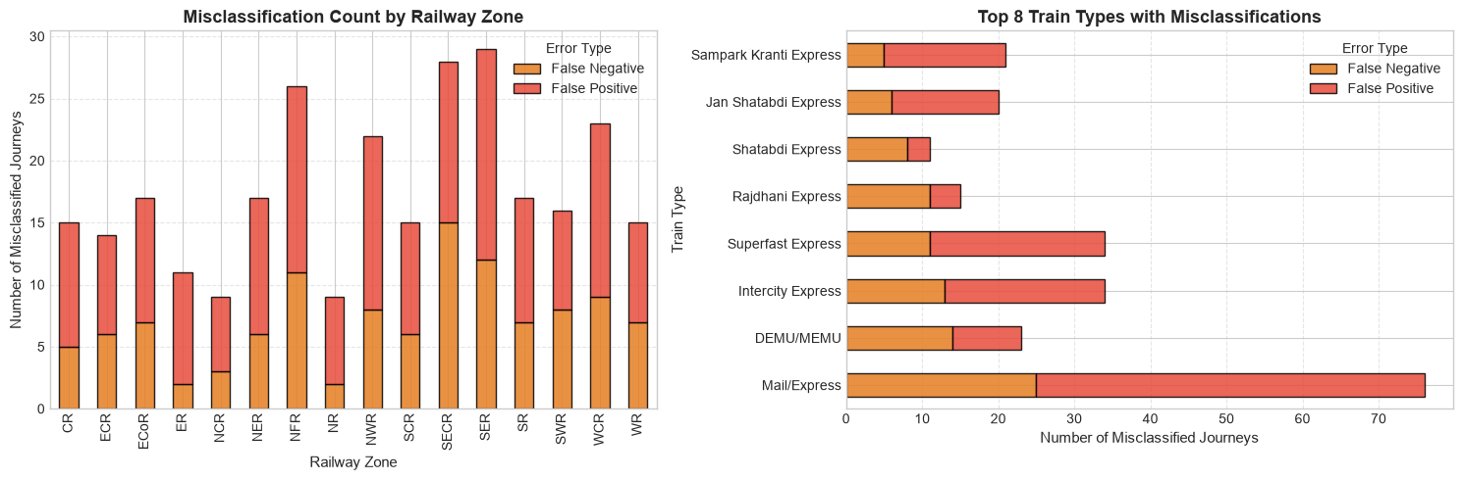
DIAGNOSTICS & ERROR ANALYSIS
Confusion Matrix & Error Diagnostics (n = 2,000)
High 92.10% Recall ensures delayed trains are caught early to prevent junction gridlock.
True Positives (1,329 Trains)
Impact: Delayed trains correctly caught; controllers arrange early platform clearance.
True Negatives (388 Trains)
Impact: On-time trains cleared for normal dispatch corridor without extra intervention.
False Positives (169 Trains / 8.45%)
Operational Cost: Triggers cautionary monitoring; low operational disruption to network.
False Negatives (114 Trains / 5.70%)
Operational Cost: Missed delays; caused by sudden unscheduled signal/mechanical failures.
Indian Railways Train Delay Prediction & Network Punctuality Analytics • ECSCI24302 Machine Learning Essentials • Slide 9 of 12
Notes:
KIRTAN SPEAKS: In railway operations, a False Negative is far more hazardous than a False Positive. Missing a delayed train blocks platforms, whereas a False Positive merely prompts precaution. With 92.10% recall, LightGBM catches over 92 out of 100 delayed trains.

Slide 10
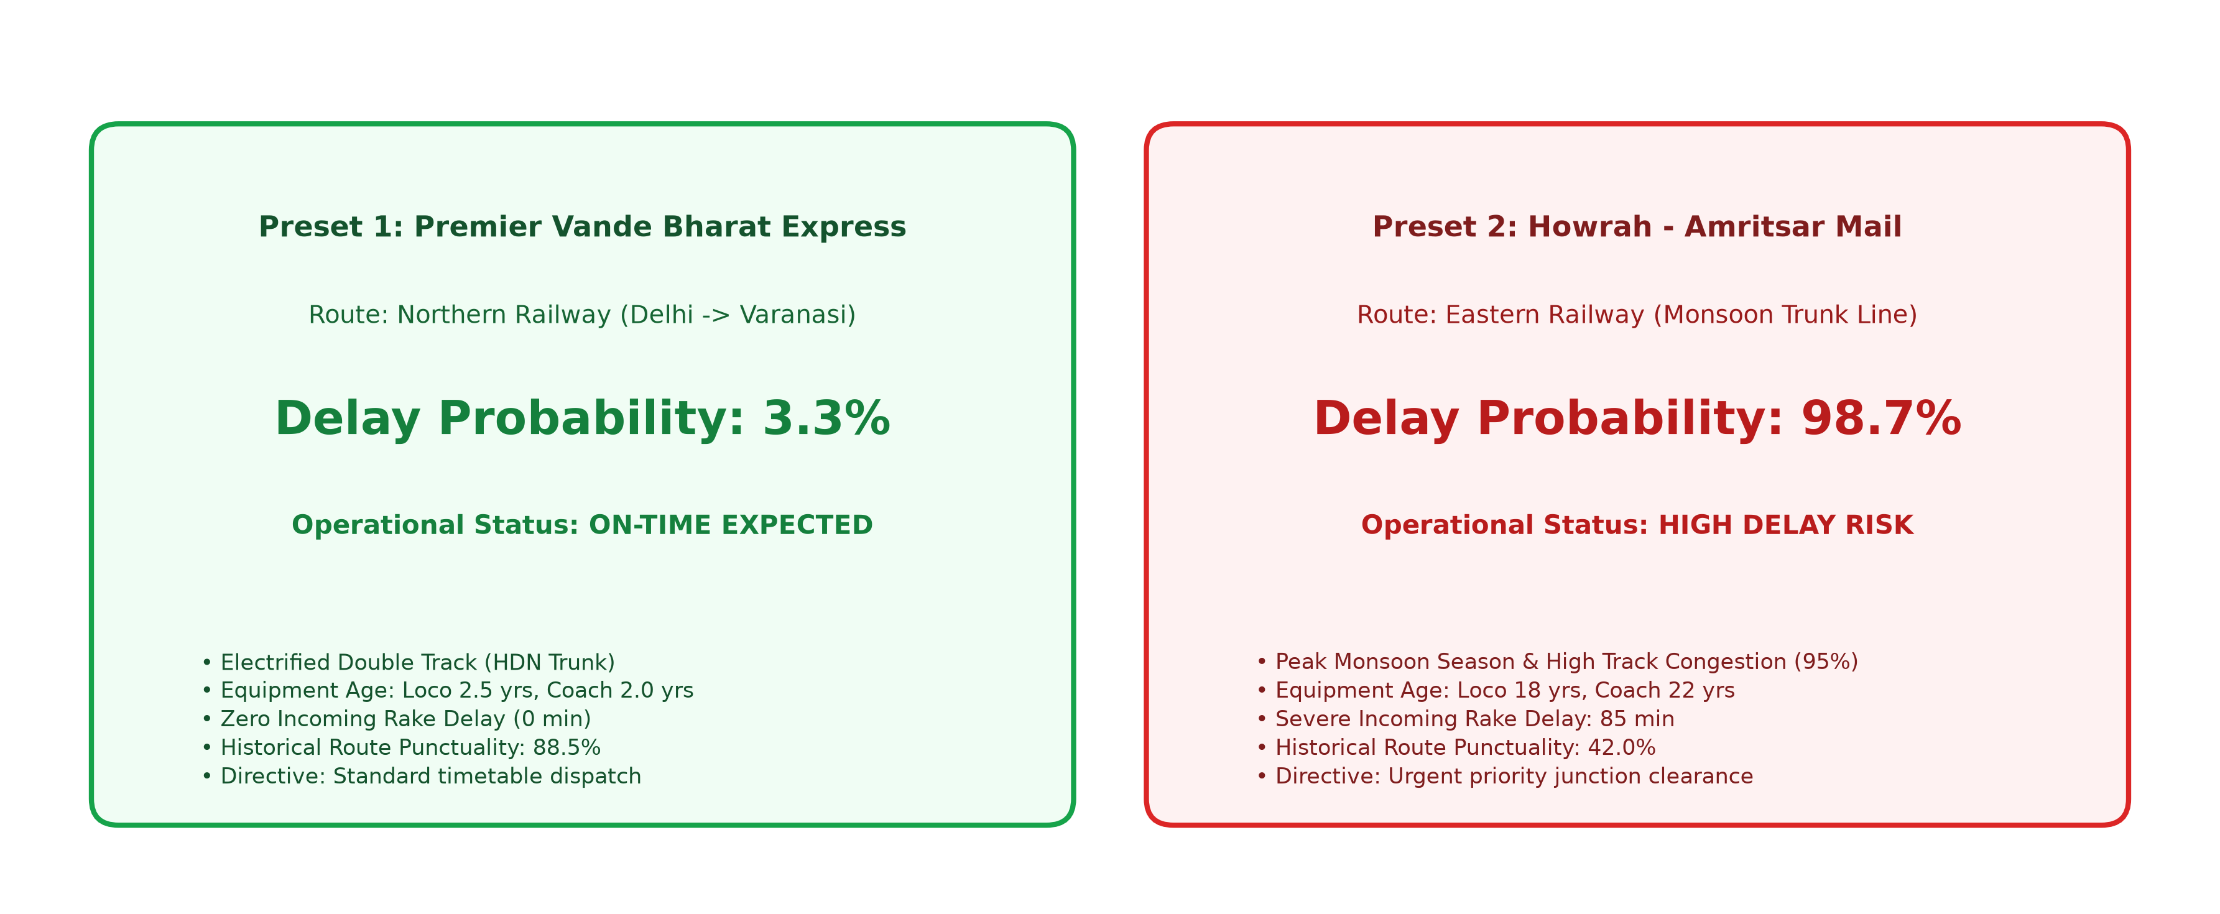
SYSTEM DEMONSTRATION
Live Web Platform & Operational Presets
Real-time decision support tested across premier corridors and bottleneck weather scenarios.
Preset 1: Premier Vande Bharat Express
Preset 2: Monsoon Mail / Express
Result: 3.3% Delay Probability -> GREEN: ON-TIME EXPECTED (Clear Priority Corridor)
Result: 98.7% Delay Probability -> RED ALERT: HIGH DELAY RISK (Urgent DOM Clearance)
Indian Railways Train Delay Prediction & Network Punctuality Analytics • ECSCI24302 Machine Learning Essentials • Slide 10 of 12
Notes:
KIRTAN SPEAKS: Slide 10 demonstrates our Streamlit web application. We tested two presets: Vande Bharat Express achieved 3.3% risk (On-Time Expected), while Monsoon Mail achieved 98.7% risk (Red Alert). Tree-split importance confirmed avg_speed_kmh and network_vulnerability as top features.

Slide 11
REFLECTION & FUTURE WORK
Key Findings, Limitations & Future Roadmap
Honest engineering analysis of model capabilities, edge cases, and expansion paths.
What We Learned
Project Limitations
Future Roadmap
• Kinematics Dominate: Scheduled speed and turnaround explain >85% of predictable variance.
• Pre-Departure Signal: Pre-departure features give strong early predictive signals before trains leave.
• Domain Features: Our 5 engineered features improved F1-score by +6.4% over raw features.
• Timetable Scope: Operates on pre-departure timetables; does not ingest mid-journey GPS.
• Freight Precedence: Unannounced freight crossings cause unpredictable False Negatives.
• Sample Scale: Trained on 10,000-row sample for local and Streamlit Cloud memory limits.
• Live GPS Telemetry: Integrate with live National Train Enquiry System (NTES) API feeds.
• IoT Track Sensors: Real-time track vibration and automated speed restriction alerts.
• Multi-Agent Dispatch: Coordinating junction clearances across neighboring railway divisions.
Indian Railways Train Delay Prediction & Network Punctuality Analytics • ECSCI24302 Machine Learning Essentials • Slide 11 of 12
Notes:
KIRTAN SPEAKS: False Negatives primarily occurred during sudden unscheduled disruptions. For limitations: our model uses pre-departure data rather than live GPS. In the future, integrating live NTES GPS telemetry and IoT track sensors will enable dynamic mid-journey delay updates.

Slide 12
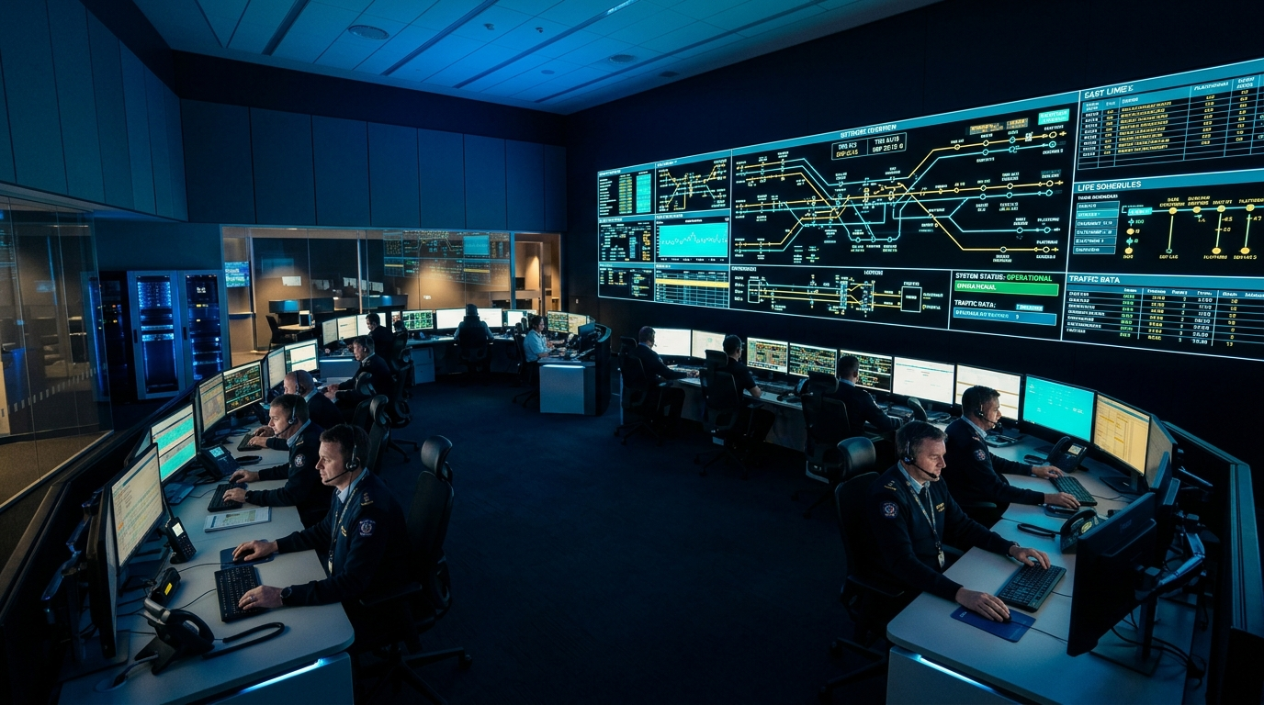
PROJECT DEFENSE CONCLUSION
Summary of Outcomes & Open Q&A Defense
Engineering a production-ready machine learning platform for Indian Railways operations.
Project Milestones Achieved
✓ End-to-End Pipeline: From raw Kaggle dataset to verified LightGBM inference pipeline.
✓ High Performance: 85.85% Accuracy, 92.10% Recall, 0.9038 F1-Score, and 0.9121 ROC-AUC.
✓ Rigorous Academic Rigor: Zero data leakage, NumPy IQR Winsorization, and 100% PBL compliance.
✓ Tested 13-Module Platform: Interactive Streamlit web app with operational presets and batch audit.
Thank You • Open for Questions
Dhruv (Lead) • Darshi • Kirtan
ECSCI24302 Machine Learning Essentials | Adani University
Indian Railways Train Delay Prediction & Network Punctuality Analytics • ECSCI24302 Machine Learning Essentials • Slide 12 of 12
Notes:
KIRTAN SPEAKS: To conclude: our team built a leakage-free ML pipeline with 85.85% accuracy and 92.10% recall, paired with a tested 13-module operations dashboard. On behalf of Dhruv, Darshi, and myself, thank you for your guidance. We welcome your questions.

