Slide 1
Alzheimer’s Detection Using Transfer Learning on MRI Images
Kirtanaa Anandakumaran - 21BCE1321
Asam Ignatious Abhinaya - 21BCE5407

Slide 2
Abstract
Alzheimer's disease is a progressive neurodegenerative disorder that leads to cognitive and behavioral decline, ultimately progressing to fatality in its advanced stages. Accurate staging of Alzheimer's is essential for timely and appropriate intervention. In this study, we perform and analyse the results of multiclass classification of Alzheimer's stages using MRI scans of the brain. Our methodology employs deep learning models to distinguish among various stages of the disease, leveraging MRI imaging data. Additionally, we incorporate explainable AI techniques, specifically SHAP and LIME, to assess feature importance on individual scans, providing interpretability to the classification process. This approach aims to enhance clinical decision-making by offering insights into the progression and stage-specific characteristics of Alzheimer’s disease.

Slide 3
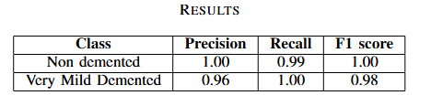
Results
The proposed model achieved an overall accuracy of 99.33% and a weighted F1-score of 0.99.

Slide 4
Motivation
Research on Alzheimer’s stage classification is crucial for timely and personalized patient care. Early-stage detection enables targeted interventions to slow disease progression, while accurate staging informs tailored treatment planning and supports efficient resource allocation for patients and caregivers. Classifying Alzheimer’s into distinct stages helps researchers better understand how the disease progresses, which can inform future studies aimed at discovering the mechanisms underlying each stage. This understanding is crucial for the development of stage-specific therapies that may eventually slow or halt progression.

Slide 5
Dataset Used
The dataset used in this study is the ‘Augmented Alzheimer MRI Dataset’. It contains four stages of the disease – non demented, very mild demented, mild demented and moderate demented. It contains augmented data, which we use as the training set and original data which will be used for validation.

Slide 6
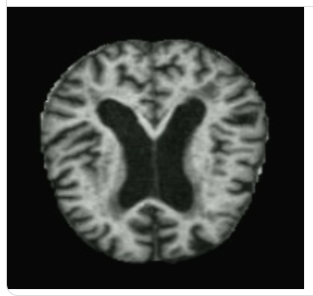
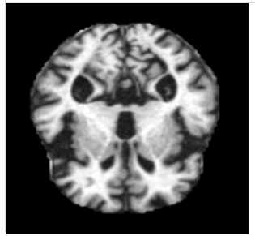
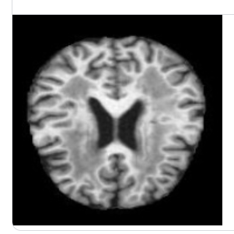
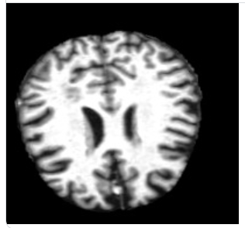
MRI SCANS OF THE BRAIN
Mild demented
Moderate demented
Non demented
Very mild demented

Slide 7
Objectives
Use image processing techniques
Perform multiclass classification and classify the stages of Alzheimer’s
Test and analyze the performance of transfer model VGG16

Slide 8
Role of Image Processing
Image processing techniques can be used in the preprocessing stage to reduce noise and normalize intensity to ensure consistent quality of images.
Key features indicative of Alzheimer’s stages, such as changes in brain volume and structure are identified through segmentation and region detection. These features are used by deep learning models for precise classification.
Image processing methods, such as rotation, scaling, and flipping, are used to artificially expand the dataset, which is implemented in the augmented images of the selected dataset.

Slide 9
Expected Outcome
The ideal outcome of this research is to outperform the previously achieved accuracy in multiclass classification of various stages of Alzheimer’s disease. Additionally, incorporating explainable AI, such as SHAP and LIME is a novel approach. This not only increases the accuracy of stage detection but also enhances transparency. This approach aids clinicians and researchers in understanding which features in MRI scans are most indicative of specific stages, fostering trust in AI-assisted diagnoses and supporting medical professionals with interpretable insights.

Slide 10
Pre-processing techniques
Images resized to 224 x 224 pixels
Pixel values normalized to range [0,1]
Labels are converted to one-hot encoding format
Dataset it batched in sizes of 32

Slide 11
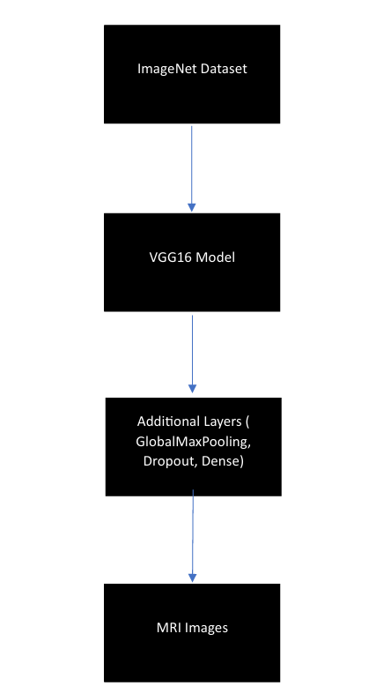
Proposed Methodology
The diagram follows the proposed methodology our research. The VGG16 is a pre-trained model, which is trained on the ImageNet dataset. This model is amplified with additional layers to enhance its ability to learn the features of the images. This enhanced model is trained on the MRI Images from the Augmented Alzheimer MRI Dataset.

Slide 12
Model architecture
VGG16 model as base
A Global Average Pooling layer to reduce spatial di-mensions, which reduces overfitting and retains the mostimportant features.
A Batch Normalization layer which normalizes the inputsto each layer. This reduces sensitivity to weight initial-ization and stabilizes learning.
A dense layer with ReLU activation.
A dropout layer of 30% to prevent overfitting.
Another dense layer with ReLU activation.
A final dense layer with a softmax activation function formulticlass classification of the four disease stages.

Slide 13
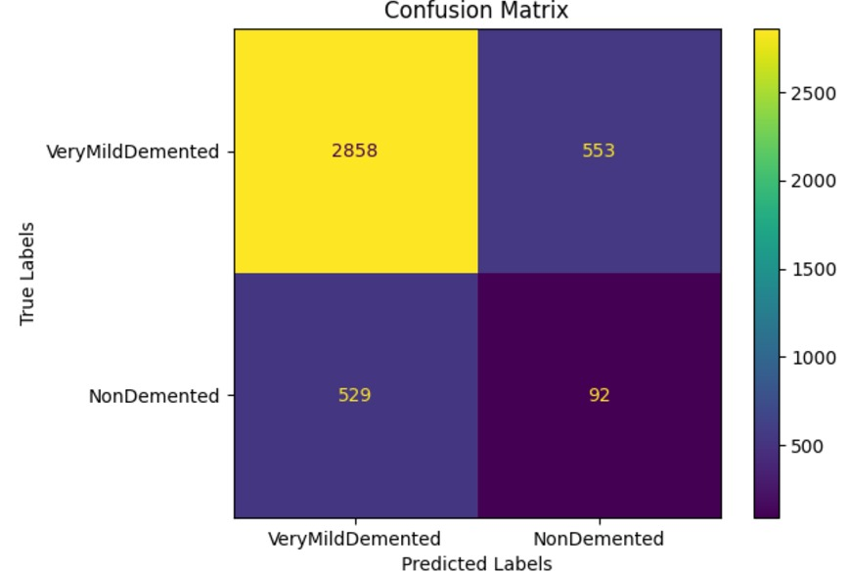
Results
Correct classification: - 2858 samples of very mild demented
- 92 samples of non demented

Slide 14
References
1.DeTure M.A., Dickson D.W. The Neuropathological Diagnosis of Alzheimer’s Disease. Mol. Neurodegener. 2019;14:32. doi: 10.1186/s13024-019-0333-5. [DOI] [PMC free article] [PubMed] [Google Scholar]
2.Kocaelli H., Yaltirik M., Yargic L.I., Özbas H. Alzheimer’s Disease and Dental Management. Oral Surg. Oral Med. Oral Pathol. Oral Radiol. Endod. 2002;93:521–524. doi: 10.1067/moe.2002.123538. [DOI] [PubMed] [Google Scholar]
3.Chassain C., Cladiere A., Tsoutsos C., Pereira B., Boumezbeur F., Debilly B., Marques A.-R., Thobois S., Durif F. Evaluation of Common and Rare Variants of Alzheimer’s Disease-Causal Genes in Parkinson’s Disease. Park. Relat. Disord. 2022;97:8–14. doi: 10.1016/j.parkreldis.2022.05.007. [DOI] [PubMed] [Google Scholar]
4.Kalaria R. Similarities between Alzheimer’s Disease and Vascular Dementia. J. Neurol. Sci. 2002;203:29–34. doi: 10.1016/S0022-510X(02)00256-3. [DOI] [PubMed] [Google Scholar]
5.Sarasso E., Gardoni A., Piramide N., Volontè M.A., Canu E., Tettamanti A., Filippi M., Agosta F. A Multiparametric MRI Study of Structural Brain Damage in Dementia with Lewy Bodies: A Comparison with Alzheimer’s Disease. Park. Relat. Disord. 2021;91:154–161. doi: 10.1016/j.parkreldis.2021.09.003. [DOI] [PubMed] [Google Scholar]
6.Simic G., Stanic G., Mladinov M., Jovanov-Milosevic N., Kostovic I., Hof P. Does Alzheimer’s Disease Begin in the Brainstem? Neuropathol. Appl. Neurobiol. 2009;35:532–554. doi: 10.1111/j.1365-2990.2009.01038.x. [DOI] [PMC free article] [PubMed] [Google Scholar]
7.Desai A.K., Grossberg G.T. Diagnosis and Treatment of Alzheimer’s Disease. Neurology. 2005;64((Suppl. 3)):S34–S39. doi: 10.1212/WNL.64.12_suppl_3.S34. [DOI] [PubMed] [Google Scholar]
8.Menagadevi M., Mangai S., Madian N., Thiyagarajan D. Automated Prediction System for Alzheimer Detection Based on Deep Residual Autoencoder and Support Vector Machine. Optik. 2023;272:170212. doi: 10.1016/j.ijleo.2022.170212. [DOI] [Google Scholar]
9.Murugan S., Venkatesan C., Sumithra M.G., Gao X.Z., Elakkiya B., Akila M., Manoharan S. DEMNET: A Deep Learning Model for Early Diagnosis of Alzheimer Diseases and Dementia from MR Images. IEEE Access. 2021;9:90319–90329. doi: 10.1109/ACCESS.2021.3090474. [DOI] [Google Scholar]
10.Loddo A., Buttau S., Di Ruberto C. Deep Learning Based Pipelines for Alzheimer’s Disease Diagnosis: A Comparative Study and a Novel Deep-Ensemble Method. Comput. Biol. Med. 2022;141:105032. doi: 10.1016/j.compbiomed.2021.105032. [DOI] [PubMed] [Google Scholar]
11.Sharma S., Gupta S., Gupta D., Altameem A., Saudagar A.K.J., Poonia R.C., Nayak S.R. HTLML: Hybrid AI Based Model for Detection of Alzheimer’s Disease. Diagnostics. 2022;12:1833. doi: 10.3390/diagnostics12081833. [DOI] [PMC free article] [PubMed] [Google Scholar]

Slide 15
References
12.Mohammed B.A., Senan E.M., Rassem T.H., Makbol N.M., Alanazi A.A., Al-Mekhlafi Z.G., Ghaleb F.A. Multi-Method Analysis of Medical Records and MRI Images for Early Diagnosis of Dementia and Alzheimer’s Disease Based on Deep Learning and Hybrid Methods. Electronics. 2021;10:2860. doi: 10.3390/electronics10222860. [DOI] [Google Scholar]
13.Balasundaram A., Srinivasan S., Prasad A., Malik J., Kumar A. Hippocampus Segmentation-Based Alzheimer’s Disease Diagnosis and Classification of MRI Images. Arab. J. Sci. Eng. 2023:1–17. doi: 10.1007/s13369-022-07538-2. online ahead of print . [DOI] [PMC free article] [PubMed] [Google Scholar]
14.Bangyal W.H., Rehman N.U., Nawaz A., Nisar K., Ibrahim A.A.A., Shakir R., Rawat D.B. Constructing Domain Ontology for Alzheimer Disease Using Deep Learning Based Approach. Electronics. 2022;11:1890. doi: 10.3390/electronics11121890. [DOI] [Google Scholar]
15.Ahmed G., Er M.J., Fareed M.M.S., Zikria S., Mahmood S., He J., Aslam M. DAD-Net: Classification of Alzheimer’s Disease Using ADASYN Oversampling Technique and Optimized Neural Network. Molecules. 2022;27:7085. doi: 10.3390/molecules27207085. [DOI] [PMC free article] [PubMed] [Google Scholar]
16.Tuvshinjargal B., Hwang H. VGG-C Transform Model with Batch Normalization to Predict Alzheimer’s Disease through MRI Dataset. Electronics. 2022;11:2601. doi: 10.3390/electronics11162601. [DOI] [Google Scholar]
17.Varalakshmi P., Priya B.T., Rithiga B.A., Bhuvaneaswari R., Sundar R.S.J. Diagnosis of Parkinson’s Disease from Hand Drawing Utilizing Hybrid Models. Park. Relat. Disord. 2022;105:24–31. doi: 10.1016/j.parkreldis.2022.10.020. [DOI] [PubMed] [Google Scholar]
18.Inguanzo A., Sala-Llonch R., Segura B., Erostarbe H., Abos A., Campabadal A., Uribe C., Baggio H., Compta Y., Marti M., et al. Hierarchical Cluster Analysis of Multimodal Imaging Data Identifies Brain Atrophy and Cognitive Patterns in Parkinson’s Disease. Park. Relat. Disord. 2021;82:16–23. doi: 10.1016/j.parkreldis.2020.11.010. [DOI] [PubMed] [Google Scholar]
19.Liu C., Huang F., Qiu A., Alzheimer’s Disease Neuroimaging Initiative Monte Carlo Ensemble Neural Network for the Diagnosis of Alzheimer’s Disease. Neural Netw. 2023;159:14–24. doi: 10.1016/j.neunet.2022.10.032. [DOI] [PubMed] [Google Scholar]
20.Lahmiri S. Integrating Convolutional Neural Networks, kNN, and Bayesian Optimization for Efficient Diagnosis of Alzheimer’s Disease in Magnetic Resonance Images. Biomed. Signal Process. Control. 2023;80:104375. doi: 10.1016/j.bspc.2022.104375. [DOI] [Google Scholar]

Slide 16
THANK YOU

