Slide 1
EVision
Where should India's next public EV chargers go?
51 cities · 2021–2026 · 3,519 city-months
Charging Demand Score (CDS) for CPO siting decisions

Slide 2
The problem
EV adoption is growing; public charging is uneven.
Total EVs per charger is misleading: 2W charge at home, 3W/4W use public infrastructure.
Need a weighted demand metric, not a raw count.

Slide 3
Objectives
1. Quantify effective public demand (2W/3W/4W weighted).
2. Model adoption drivers (negative binomial).
3. Classify High/Low demand (logistic + LDA).
4. Forecast 12-month growth (SARIMA / Holt-Winters).
5. Rank hotspots and map them.

Slide 4
Data
Vahan registrations: 2021 from dashboard cache, 2022+ from export.
E-Amrit chargers: 29,070 station records; fixed 5/10 km counts.
Census 2011, modelled petrol, state policy, MOSPI income, ERA5 temperature.
Provenance ledger records every fetch.

Slide 5
Pipeline
Clean: grid, ≤2-month interpolation, IQR flags, growth features.
Merge: master_ev_panel.csv (3,519 × 116).
Models: M1 drivers, M2 classifier, M3 forecasts.
Synthesise: CDS = 0.4·z(M1) + 0.3·P(high) + 0.3·z(M3 growth).

Slide 6
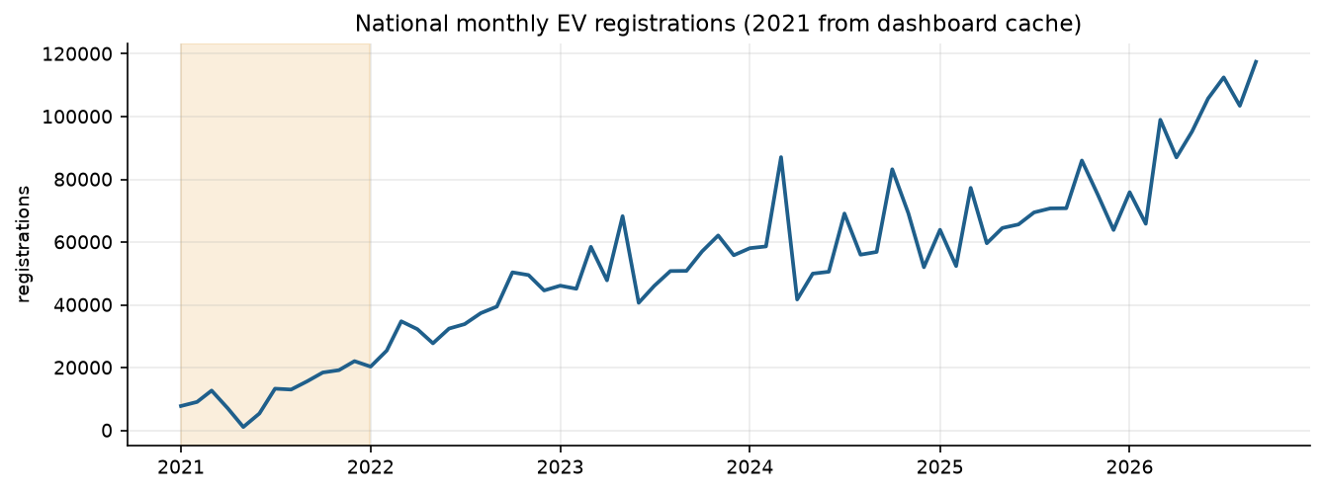
M1 — adoption drivers
Non-EV market IRR 2.72 (p<0.001).
Income IRR 0.56; policy IRR 1.36.
Fuel price is a trend artefact; results hold without it.

Slide 7
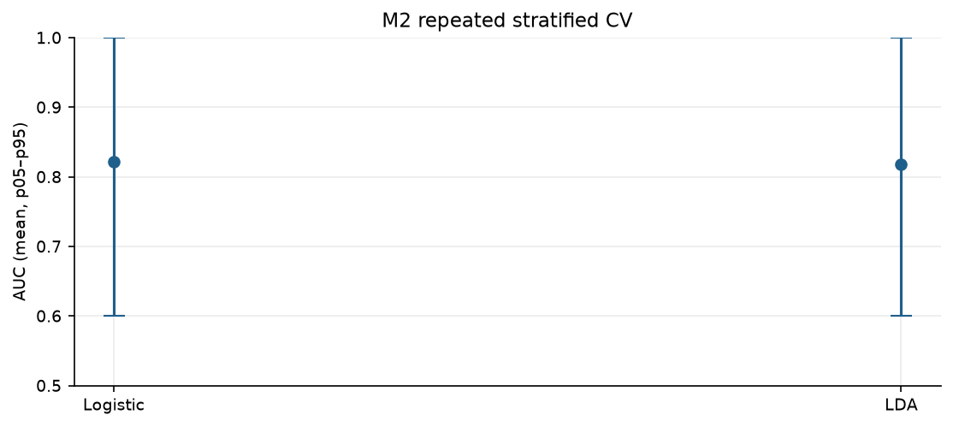
M2 — High/Low demand
Logistic AUC 0.822; LDA 0.818.
LOOCV 76.5% / 78.4%.
No leakage: chargers, EV stock and growth are excluded.

Slide 8
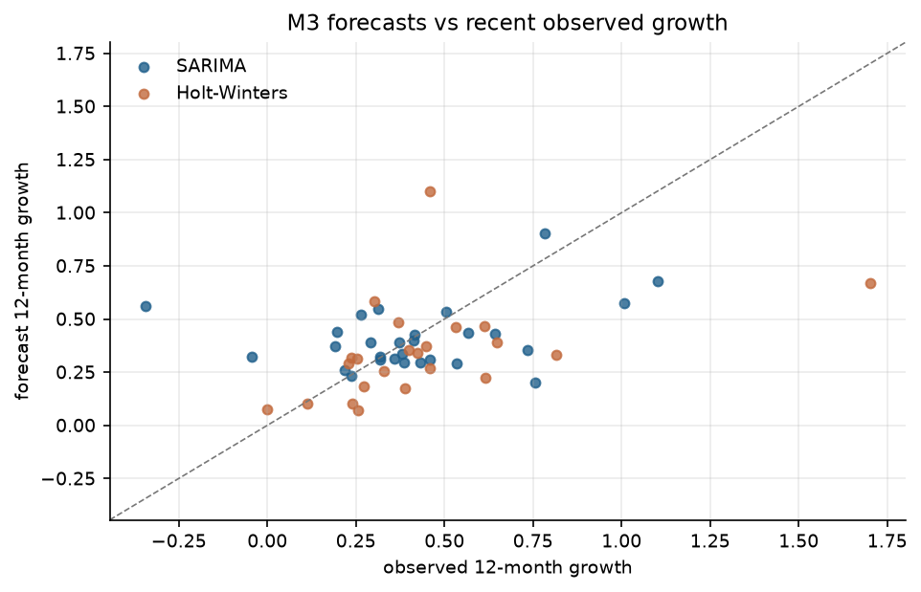
M3 — 12-month forecasts
28 SARIMA / 23 Holt-Winters winners.
All 51 fits pass the quality gate.
2022-only sensitivity: median growth delta 0.033.

Slide 9
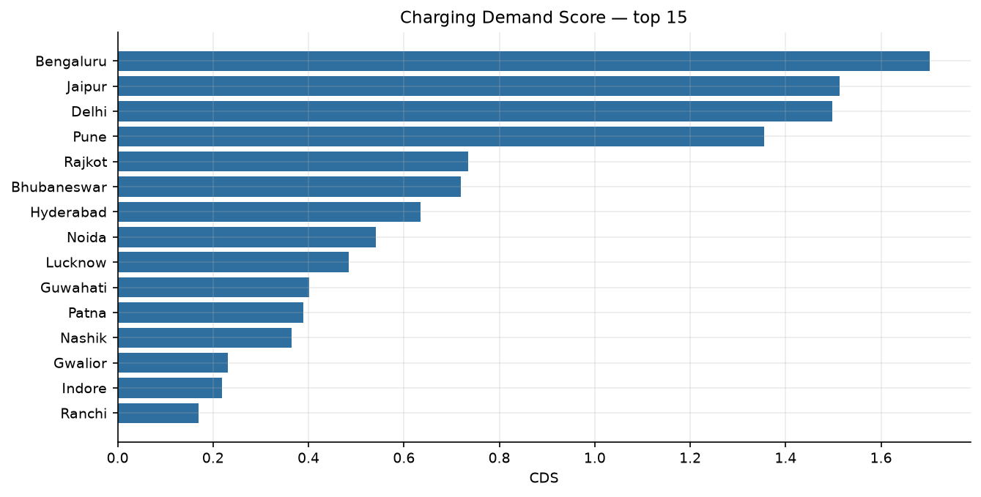
CDS — top 15 hotspots
Top five: Bengaluru, Jaipur, Delhi, Pune, Rajkot.
2 Critical, 2 High.
Weight perturbations keep 14–15 of 15.

Slide 10
Limitations
Policy rubric unfilled: 0/30 states verified against PDFs.
Seven cities use municipal boundaries; populations are now verified.
Eight cities show a >1.5× 2021→2022 seam.
Chargers are one snapshot; no monthly supply series.

Slide 11
Recommendations
Verify policy and the seven demographic rows before publication.
Use the 10 km fixed-radius supply measure.
Deploy against the top-15 shortlist.
Re-run 2021+2022 sensitivity before quoting forecast growth.

