Slide 1
Customer Booking Prediction
Machine Learning Model Analysis & Insights

Slide 2
KEY FINDINGS & INSIGHTS
Model Accuracy
CV Mean AUC
59.90%
0.5583 ± 0.0044
Test set classification accuracy
5-fold cross-validation robustness
ROC-AUC Score
Booking Rate
0.5648
33.42%
Model discrimination capability
Actual completion rate in dataset

Slide 3
TOP 10 PREDICTIVE FEATURES
Rank | Feature Name | Importance
1 | flight_duration | 0.1450
2 | length_of_stay | 0.1441
3 | days_until_flight | 0.1319
4 | purchase_lead | 0.1283
5 | flight_hour | 0.0846
6 | num_passengers | 0.0662
7 | flight_day | 0.0534
8 | route | 0.0397
9 | sales_channel | 0.0318
10 | booking_origin | 0.0310

Slide 4
MODEL INSIGHTS & INTERPRETATION
Most Important Feature
Flight Duration (14.5%)
Longer flights show different booking behavior patterns
Trip Characteristics
Length of Stay and Purchase Lead are critical
Customers plan differently based on trip duration and advance booking
Add-on Services
Preferred seats and in-flight meals are positive signals
Customers selecting add-ons are more likely to complete bookings
Business Implication
Target retention strategies around flight duration
Optimize add-on offerings for higher completion rates

Slide 5
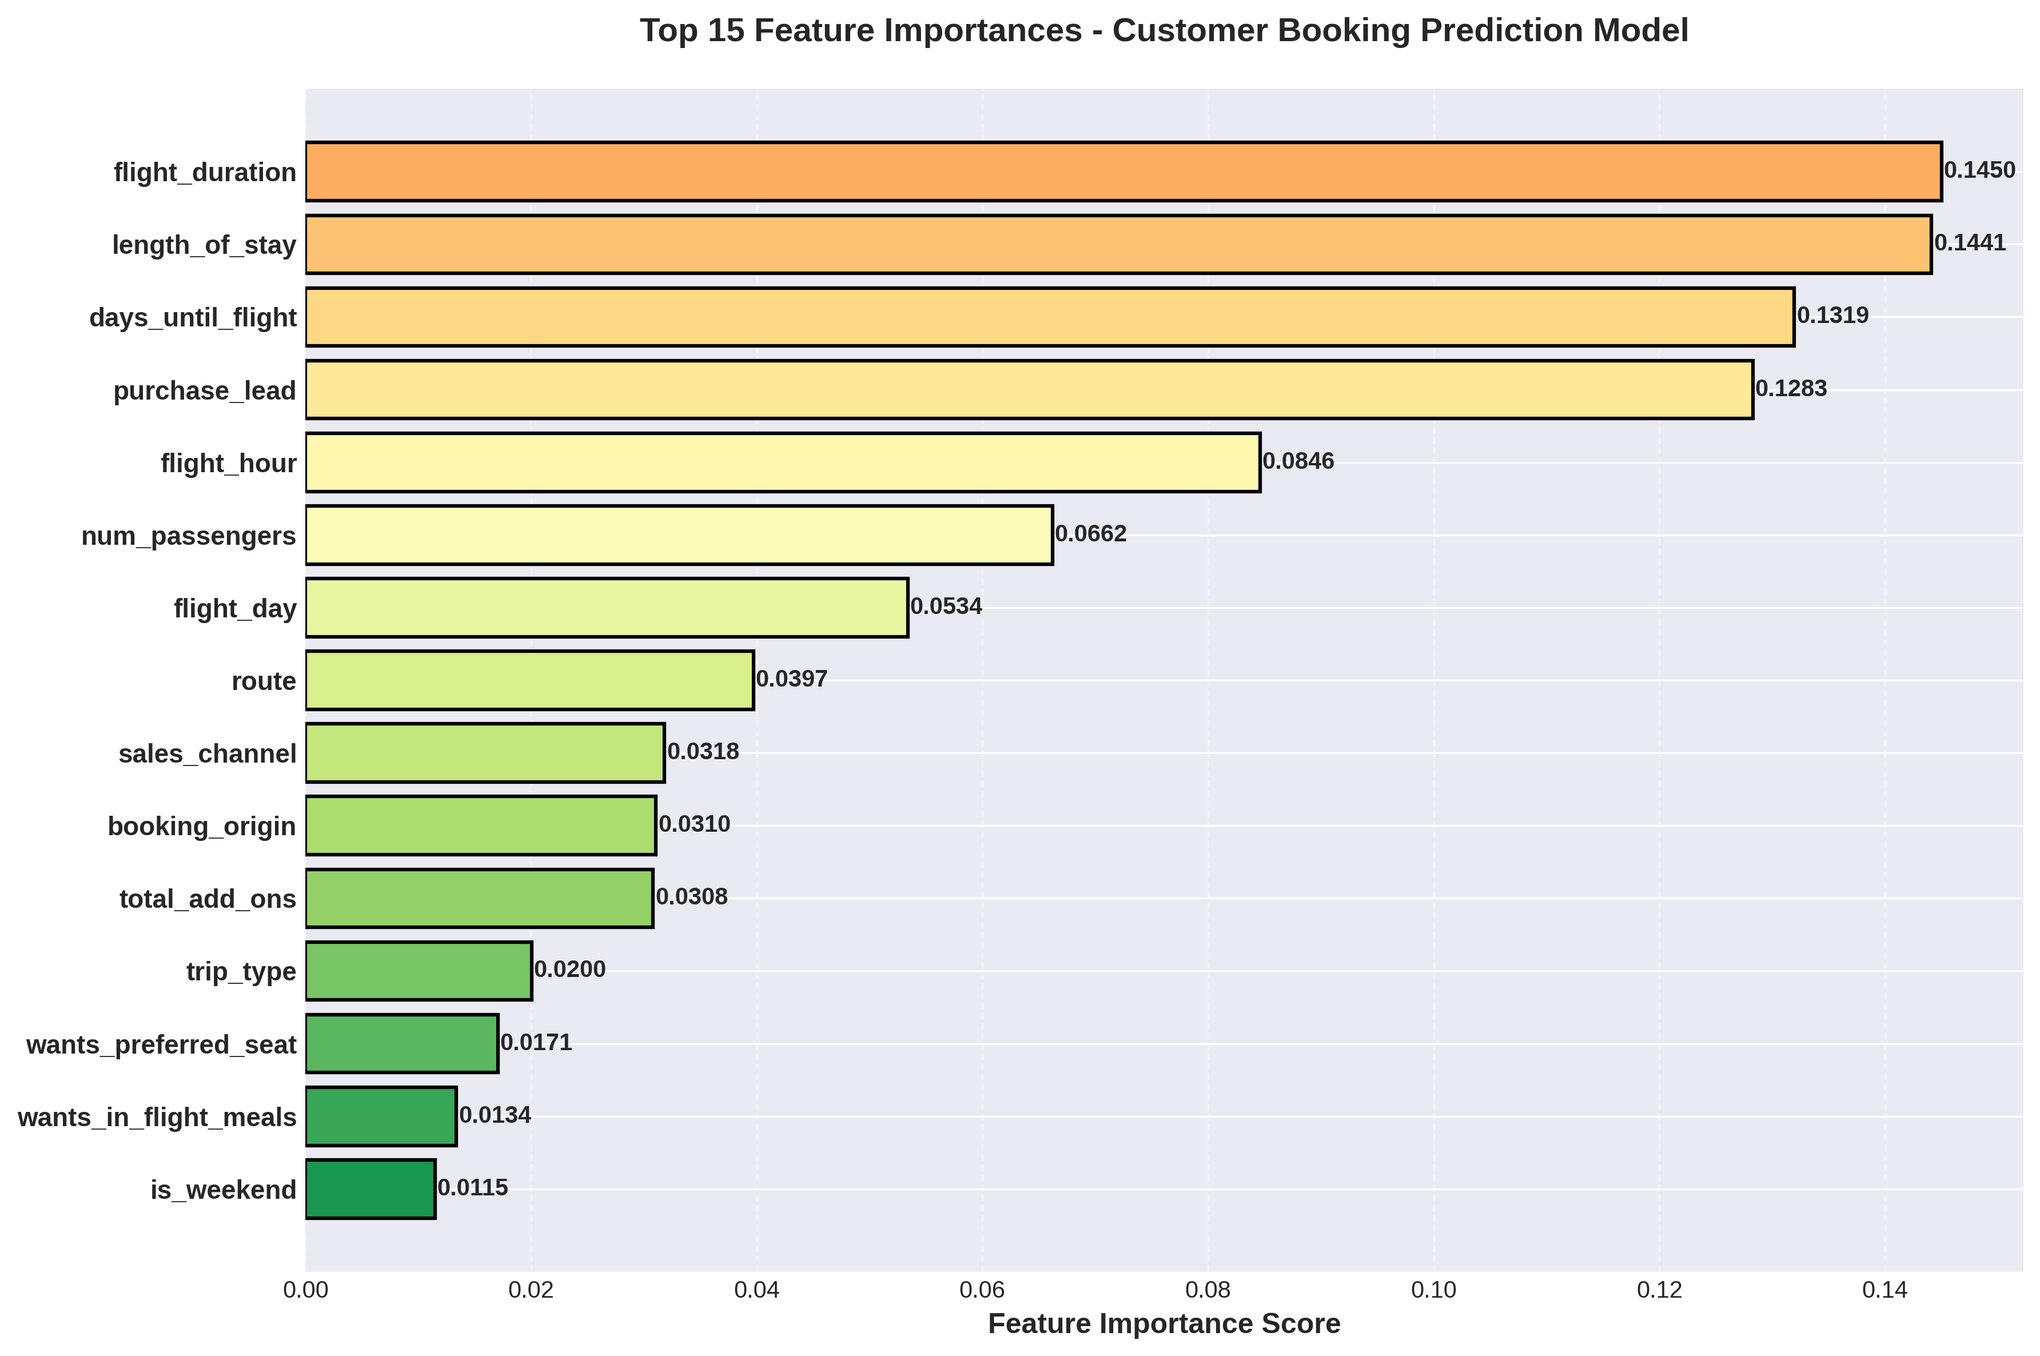
FEATURE IMPORTANCE VISUALIZATION

Slide 6
RECOMMENDATIONS
1
Personalize Flight Options
2
Optimize Add-on Strategy
Use flight duration and trip length insights to
recommend relevant flight combinations
Promote premium seat selections and meals
early in the booking funnel
3
Improve Purchase Timing
4
Deploy Real-Time Predictions
Target customers based on purchase lead time
with timely reminders and incentives
Integrate model into booking platform to identify
at-risk sessions and trigger interventions

Slide 7
Random Forest model successfully identifies key factors driving booking completions
Ready for deployment across sales and marketing channels

