Slide 1
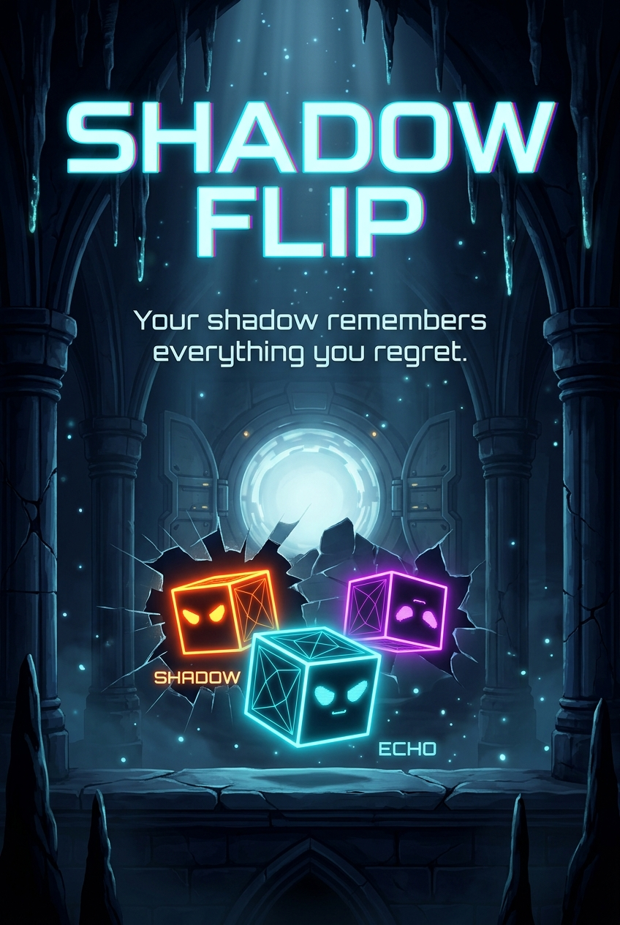
SHADOW FLIP // REVERSAL PROTOCOL
SYS.DEV // TEMPORAL SIMULATION
SHADOW FLIP
"Your shadow remembers everything you regret."
A temporal puzzle platformer built around time-reversal mechanics.
To breach recursive containment chambers, you must record your path, release your past shadow, and flip the arrow of time.
TIME REVERSAL

Slide 2



SHADOW FLIP // REVERSAL PROTOCOL
SYS.DEV // TEMPORAL SIMULATION
PRIMARY ENTITY // CYBER PROJECTION
CHARACTERS
ECHO (ACTIVE PLAYER)
CYBERNETIC PROJECTION MATRIX
SHADOW (CHRONO CLONE)
FORWARD TEMPORAL REPLAY
REVERSE SHADOW
TIME-INVERTED TRAJECTORY

Slide 3
SHADOW FLIP // REVERSAL PROTOCOL
SYS.DEV // TEMPORAL SIMULATION
SYSTEM DIRECTIVES // INTERFACE MANUAL
COMMAND & CORE MOTTO
MISSION MOTTO & CORE OBJECTIVE
"Reach Point A to Point B by cooperating with your past and reversing the arrow of time."
You cannot walk the exit path alone. Use your forward Shadow and time-reversed Shadow to trigger remote airlock plates.
[A] / [D]
LOCOMOTION
Move Left & Right across sector floors and platforms.
[W] / [▲]
VERTICAL JUMP
Jump over barriers and gaps (~75px clearance). Decoupled from deploy.
[SPACE]
DEPLOY SHADOW
Release past recording. Shadow runs forward in time to hit plates.
[F]
SHADOW FLIP
Time-reverse shadow: rewinds backward and scales vertical cliffs.

