Slide 1


Project micro credit
Micro Credit Loan Use Case

Slide 2
ABOUT THE CASE STUDY.
A Microfinance Institution (MFI) is an organization that offers financial services to low income populations. MFS becomes very useful when targeting especially the unbanked poor families living in remote areas with not much sources of income. The Microfinance services (MFS) provided by MFI are Group Loans, Agricultural Loans, Individual Business Loans and so on. Many microfinance institutions (MFI), experts and donors are supporting the idea of using mobile financial services (MFS) which they feel are more convenient and efficient, and cost saving, than the traditional high-touch model used since long for the purpose of delivering microfinance services. Though, the MFI industry is primarily focusing on low income families and are very useful in such areas, the implementation of MFS has been uneven with both significant challenges and successes. Today, microfinance is widely accepted as a poverty-reduction tool, representing $70 billion in outstanding loans and a global outreach of 200 million clients. We are working with one such client that is in Telecom Industry. They are a fixed wireless telecommunications network provider. They have launched various products and have developed its business and organization based on the budget operator model, offering better products at Lower Prices to all value conscious customers through a strategy of disruptive innovation that focuses on the subscriber. They understand the importance of communication and how it affects a person’s life, thus, focusing on providing their services and products to low income families and poor customers that can help them in the need of hour. They are collaborating with an MFI to provide micro-credit on mobile balances to be paid back in 5 days. The Consumer is believed to be defaulter if he deviates from the path of paying back the loaned amount within the time duration of 5 days. For the loan amount of 5 (in Indonesian Rupiah), payback amount should be 6 (in Indonesian Rupiah), while, for the loan amount of 10 (in Indonesian Rupiah), the payback amount should be 12 (in Indonesian Rupiah). The sample data is provided to us from our client database. It is hereby given to you for this exercise. In order to improve the selection of customers for the credit, the client wants some predictions that could help them in further investment and improvement in selection of customers.

Slide 3
Exercise
Build a model which can be used to predict in terms of a probability for each loan transaction, whether the customer will be paying back the loaned amount within 5 days of insurance of loan. In this case, Label ‘1’ indicates that the loan has been payed i.e. Non- defaulter, while, Label ‘0’ indicates that the loan has not been payed i.e. defaulter.
Points to Remember:
There are no null values in the dataset.
There may be some customers with no loan history.
The dataset is imbalanced. Label ‘1’ has approximately 87.5% records, while, label ‘0’ has approximately 12.5% records.
For some features, there may be values which might not be realistic. You may have to observe them and treat them with a suitable explanation.
You might come across outliers in some features which you need to handle as per your understanding. Keep in mind that data is expensive and we cannot lose more than 7-8% of the data.

Slide 4
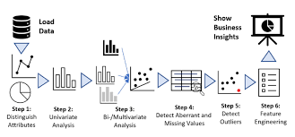

EXPLORATORY DATA ANALYSIS (EDA)
Exploratory Data Analysis (EDA) is an approach to analyze the data using visual techniques. It is used to discover trends, patterns, or to check assumptions with the help of statistical summary and graphical representations.
Before EDA the data is downloaded and has been called using essential libraries for the purpose of visualization and analysis.

Slide 5

How to do EDA
These are certain steps that are to be performed in EDA:-
Downloading the dataset.
Observe your dataset.
Find any missing values or the null values.
Find the shape of your dataset.
Organizing a dataset.
Understanding variables.
Visual representation of the data for better understanding using seaborn and matplotlib libraries.
Describing the data.
Identify relationships (correlation) in your dataset.

Slide 6
EDA
Before EDA the data is downloaded FROM CSV file and has been called using essential libraries for the purpose of visualization and analysis in the variable (df).
Then the shape is found using the required code which is 209593 rows and 37 columns.
Then the null values present in the data is found using the required code which are then treated using imputation techniques(if there are null values).
Then the unique values are found in the particular columns using required code.
Then we find the duplicate values present in the dataset which is 0

Slide 7
Then we do the visualization of the data using essential libraries (Seaborn and Matplotlib).
Then for describing and finding correlation in the data we will do the encoding of it in order to make is understandable and readable for the computer so that the processing can be done perfectly.
Then describing of the data comes .
Then checking for outliers.
The comes finding correlation of the data.
Then removing outliers.
Then checking the skewness in the data and removing it.
Then we’ll do the further process of training and building model (finding best random state, creating train test split and fitting in various algorithms)
Then we’ll do cross validation.
Then we’ll do the hyperparameter tunning.
Then we’ll print the ROC AUC curve
These all steps have been done in the jupyter.

Slide 8

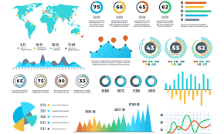
visual representation of the data (eda)

Slide 9
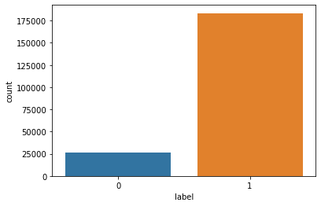
1. Column - label
This graph tells whether the user paid back the credit amount within 5 days of issuing the loan{1:success, 0:failure}
1 183431 people successfully paid
0 26162 people failed to pay

Slide 10
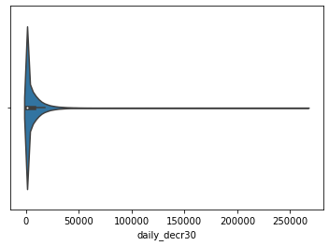
Column-2 daily_decr30
this graph tells Daily amount spent from main account, averaged over last 30 days (in Indonesian Rupiah)
most of them didn't spend the money and the mosr least spent amt is 4489.362000 by 1 person

Slide 11
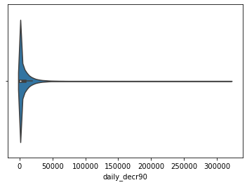
Column-3 daily_decr90
this graph tells Daily amount spent from main account, averaged over last 90 days (in Indonesian Rupiah)
most of the people 4063 Daily amount spent from main account, averaged over last 90 days (in Indonesian Rupiah) is 0 and least number of people i.e 1 Daily amount spent from main account, averaged over last 90 days (in Indonesian Rupiah) is 4534.820

Slide 12
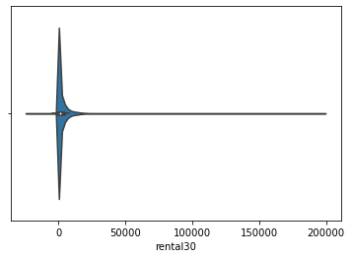
Column-4 rental30
this graph tells Average main account balance over last 30 days
most of them had an average main acct balance acct balance of 0.00 over last 30 days around 7566 people and least of the avg main acct balance was 483.92

Slide 13
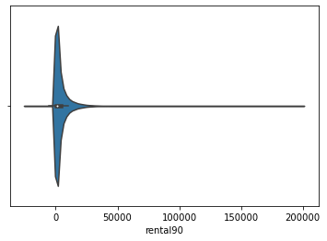
rental90
this graph tells Average main account balance over last 90 days
most of the users Average main account balance over last 90 days is 0.0 and least number of people i.e 1 have Average main account balance over last 90 days as 984.58

Slide 14
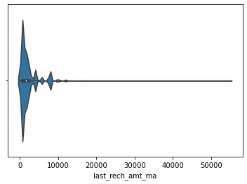
Column- last_rech_amt_ma
this graph tells Amount of last recharge of main account (in Indonesian Rupiah)
most of the people 56297 have done 1539 Amount of last recharge of main account (in Indonesian Rupiah) and least number of people i.e 1 has done 10454 Amount of last recharge of main account (in Indonesian Rupiah)

Slide 15

Column -cnt_ma_rech30
this graph tells Number of times main account got recharged in last 30 days
most of the people 37238 recharged main account 1 number of times in last 30 days and least number of people that recharged the account were 1 with number of recharges as 63 times the whole list is calculated above using essential codes of value count.

Slide 16
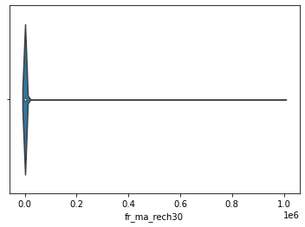
Column- fr_ma_rech30
this graph tells the Frequency of main account recharged in last 30 days
most of the people 78683 have 0 frequency of main account recharged in last 30 days and highest Frequency of main account recharged in last 30 days is 967338.131624 by 1 users

Slide 17
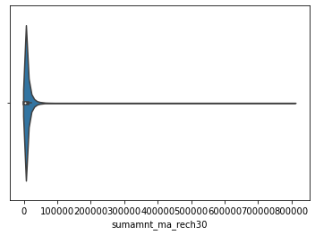
Column- sumamnt_ma_rech30
this graph tells Total amount of recharge in main account over last 30 days (in Indonesian Rupiah)
most of the people 27979 have done 0 Total amount of recharge in main account over last 30 days (in Indonesian Rupiah) and least number of people i.e 1 have done 12154.0 Total amount of recharge in main account over last 30 days (in Indonesian Rupiah)

Slide 18
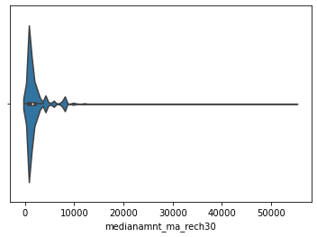
Column- medianamnt_ma_rech30
this graph tells Median of amount of recharges done in main account over last 30 days at user level (in Indonesian Rupiah)
most of the users 47769 have Median of amount of recharges done in main account over last 30 days at user level (in Indonesian Rupiah) as 1539.0 and least number of people with Median of amount of recharges done in main account over last 30 days at user level (in Indonesian Rupiah) as 10963.5 is 1.

Slide 19

Column - medianmarechprebal30
this graph tells Median of main account balance just before recharge in last 30 days at user level (in Indonesian Rupiah)
most of the users 30680 have Median of main account balance just before recharge in last 30 days at user level (in Indonesian Rupiah) as 0.0 and least number of people with Median of main account balance just before recharge in last 30 days at user level (in Indonesian Rupiah) as 71.370000 is 1.

Slide 20
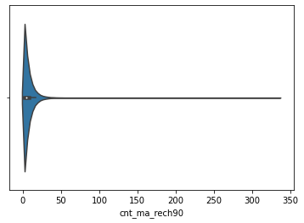
Column - cnt_ma_rech90
this graph tells Number of times main account got recharged in last 90 days
most of the people 27898 recharged main account 1 number of times in last 90 days and least number of people that recharged the account were 1 with number of recharges as 120 times the whole list is calculated above using essential codes of value count.

Slide 21
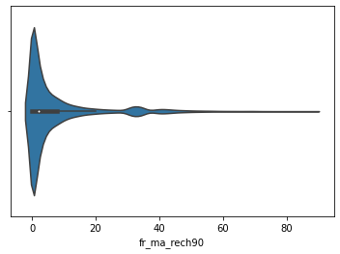
Column- fr_ma_rech90
this graph tells Frequency of main account recharged in last 90 days
most of the people 65753 have 0 frequency of main account recharged in last 90 days and highest frequency of main account recharged in last 90 days is 88 by 5 users

Slide 22
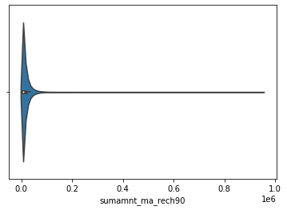
Column - sumamnt_ma_rech90
this graph tells Total amount of recharge in main account over last 90 days (in Indonasian Rupiah)
most of the people 20950 have done 0 Total amount of recharge in main account over last 90 days (in Indonasian Rupiah) and least number of people i.e 1 have done 17941 Total amount of recharge in main account over last 90 days (in Indonasian Rupiah)

Slide 23

Column - medianamnt_ma_rech90
this graph tells the Median of amount of recharges done in main account over last 90 days at user level (in Indonasian Rupiah)
most of the people 45780 have Median of amount of recharges done in main account over last 90 days at user level (in Indonasian Rupiah) of 1539.0 and least number of people i.e 1 have Median of amount of recharges done in main account over last 90 days at user level (in Indonasian Rupiah) as 10963.5

Slide 24
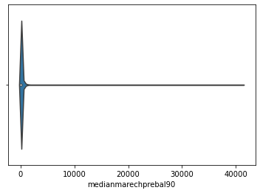
Column-medianmarechprebal90
this account tells the Median of main account balance just before recharge in last 90 days at user level (in Indonasian Rupiah)
most of the people had median of main account balance just before recharge in last 90 days at user level (in Indonasian Rupiah) as 0.0 and least number of people i.e 1 have Median of main account balance just before recharge in last 90 days at user level (in Indonasian Rupiah) as 392.20

Slide 25
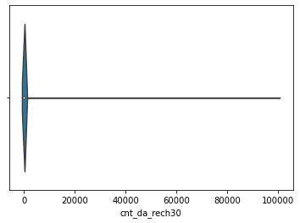
Column -cnt_da_rech30
this graph tells the Number of times data account got recharged in last 30 days
most of the people 205479 recharged account 0 number of times and least number of people that recharged the account were 1 with number of recharges as 61 times the whole list is calculated above using essential codes of value count.

Slide 26

Column-fr_da_rech30
this graph tells Frequency of data account recharged in last 30 days
most of the users frequency of data account recharged in last 30 days comes out to be 0 around 208014 people and the highest frequency of data account recharge in 30 days is done by only 1 frequency is 51 times the whole list is calculated above using value counts code.

Slide 27

Column - cnt_da_rech90
0 204226
1 4173
2 556
3 227
4 150
5 74
6 49
7 36
8 30
9 18
14 10
12 7
11 7
13 6
10 6
16 4
18 3
15 2
20 1
25 1
28 1
30 1
22 1
38 1
19 1
27 1
17 1
this graph tells the Number of times data account got recharged in last 90 days
most of the people 204226 recharged account 0 number of times and least number of people that recharged the account were 1 with number of recharges as 17 the whole list is calculated above using essential codes of value count.

Slide 28
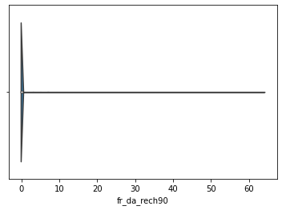
Column- fr_da_rech90
this graph tells the Frequency of data account recharged in last 90 days
most of the users frequency of data account recharged in last 90 days comes out to be 0 around 208728 people and the highest frequency of data account recharge in 90 days is done by only 1 frequency is 64 times the whole list is calculated above using value counts code.

Slide 29
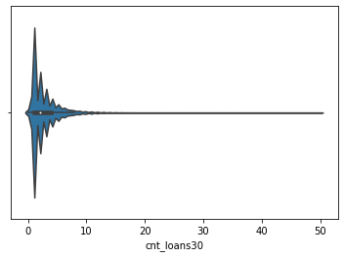
Column- cnt_loans30
this graph tells Number of loans taken by user in last 30 days
most of the users took 1 loan around 83432 people and least number of people i.e 1 took 35 numbers of loan the whole list is present above calculated using value counts code. In jupyter notebook.

Slide 30
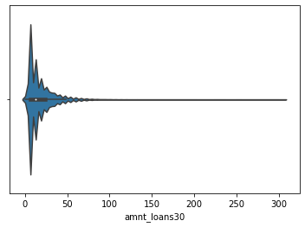
Column - amnt_loans30
this graph tells the Total amount of loans taken by user in last 30 days
most of the people took total amt of loan of 6 around 76620 users and the least number of people i.e 1 took total amount of loan of 306

Slide 31

Column- maxamnt_loans30
this graph tells maximum amount of loan taken by the user in last 30 days
most of the people around 179193 took loan of maximum amt of 6.000000 and least number of people that took loan of 96927.243252 amt is 1

Slide 32

Column- medianamnt_loans30
this graph tells the Median of amounts of loan taken by the user in last 30 days
mostly the median of amounts of loan taken by the users in last 30 days is 0.0 this is of 195445 people
then followed by median of 1.0 for 7149 people
then 0.5 for 6538 people
then 2.0 for 420 people
then 1.5 for 38 people
then 3.0 for 3 people

Slide 33

Column - cnt_loans90
this graph tells the Number of loans taken by user in last 90 days
most of the people around 83432 took only 1 loan and least no. of people took that is one took 35 numbers of loan

Slide 34
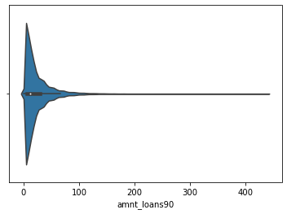
Column - amnt_loans90
this graph tells Total amount of loans taken by user in last 90 days
most of them around 69131 people took total amount of loans of 6 then followed by 12 , 18 , 24, 30 and so on and the least individual that took total amount of loans of 426 amount is 1

Slide 35
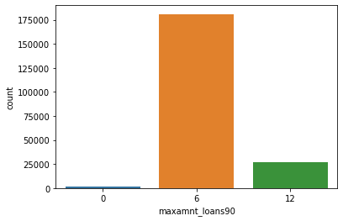
Column - maxamnt_loans90
this graph tells maximum amount of loan taken by the user in last 90 days
mostly people around 180945 took loan of maximum amt 6
then 26605 people of maximum amt 12
very few people didn't took loan around 2043

Slide 36

Column- medianamnt_loans90
this graph tells the Median of amounts of loan taken by the user in last 90 days
Median of amounts of loan taken by the user in last 90 days is 0.0 with taking most of the people into consideration around 197424 people and with leasr people into consideration the median is 3.0

Slide 37
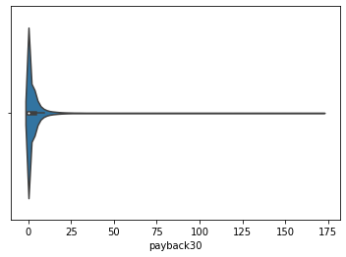
Column- payback30
this graph tells Average payback time in days over last 30 days
average of most of the people payback time in days is is 0 around 106712 people and the most average no. of days took to pay back is around 6 days

Slide 38
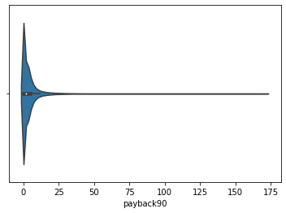
Column - payback90
this graph tells Average payback time in days over last 90 days
average of most of the people payback time in days is is 0 around 95699 people and the most average no. of days took to pay back is around 26 days

Slide 39
Pre-processing of the dataset
After the visualization the outliers were checked but not removed as the percentage of data loss was 100% so outliers were left this was done using z score.
Then the split was made.
Then the skewness was checked and removed using YEO-JOHNSON technique

Slide 40
Training of the model
After the EDA and Pre-processing the best random state was find with max accuracy.
Various classification algorithms were used to determine the best fit model , algorithms such as-
Decision tree classifier
Random forest classifier
Knn classifier
The best fit model was Random Forest classifier. It is giving the accuracy score of 95.5610374388399

Slide 41
Cross validation
After the training of the model we’ve done the cross validation
And the best CV was for random forest classifier so we’ll continue with this model only cv score was = 0.8787884954086792

Slide 42

Understanding and conclusion
We conclude that RandomForestclassifier is the best fit model among all.
We get a cross val score of 0.8787884954086792
Accuracy score of 95.5610374388399
There are various factors that lead to default in payment of micro credit loan .

Slide 43

Thank you

