Slide 1

Why Buffer Overflows Matter
Introduction and workshop

Slide 2
Content
About …
Overview
What is a buffer overflow?
Do Buffer overflows still matter?
Statistics
High-Level Exploit Steps
Finding Buffer Overflows
Identify the Vulnerable Condition
Determine EIP Offset
Develop Exploit
Defenses

Slide 3
About …
This course:
Kirt Cathey, Principal at SysRisk, will walk us through all parts of buffer overflows and explains the significance of this condition. The talk covers basics to describe buffer and heap overflows, discuss some vulnerability statistics, then spend some time in a virtual environment to demonstrate how a buffer overflow is exploited to inject malware into vulnerable application.
For those who want to follow along, the exploit will be developed on Ubuntu 16 32-bit machine in a VMware VM.
Kirt Cathey:
Kirt Cathey, Principal at SysRisk, has worked most of his career in Japan, covering IT risk and security has managed or participated a variety of security projects ranging from security infrastructure implementations, NIST framework implementations to very hands-on malware analysis in incident response and red team organization and strategizing. With over 22 years of experience in security operations and consulting for multi-national financial technology clients, telecommunications, software, and pharmaceutical industries. He co-authored the Internal Audit Handbook (2005, Japanese), developed WorkPapers software, weAudit software, and has participated in various audit and security automation projects throughout his career. Kirt is fluent in spoken and written Japanese and holds current ECSA, CISSP, CISM, CISA, and CIA certifications.

Slide 4
Overview – What is a buffer overflow?
A buffer overflow condition exists if more data is input into a smaller buffer than it can hold, or when a program puts data in a memory area past a buffer.
Buffer – sequential section of allocated memory
Buffer Overflow – Writing more data to a buffer that is greater than the size of the buffer allocated.
Two Basic Types
Simple Memory Overflow
char buff[10] = {0};
strcopy(buff, “This string will definitely overflow the buffer”);
Heap Overflow
char *ptr = (char*) malloc(10);
ptr[10] = ‘c’;
Buffer Overflow Conditions:
Corrupt data
Crash the program
Provide an opening to inject malicious code

Slide 5
Overview – Do buffer overflows still matter?
Difficult to find
Analysis tools, methodologies, and fuzzing tools make identification easier
… but still an expert skill
Difficult to exploit
With ROP, stack brute forcing, ret2lib, eggshell, and other skills combined, exploit research continues to advance
Even when new exploit capability or PoC is discovered, rarely immediately shared unless found through proper exploit research
Still quite common and most common software vulnerability
One of the safest and undetectable ways to gain foothold after gaining basic systems access.
… so yes, they do matter.

Slide 6
Overview – Noted 2019 Overflows
CVE ID | Vulnerability Type(s) | Update Date | Score | Gained Access Level | Access | Complexity | Authentication | Conf. | Integ. | Avail. | Details
CVE-2019-1010305 | Overflow | 8/23/2019 | 4.3 | None | Remote | Medium | Not required | Partial | None | None | libmspack 0.9.1alpha is affected by: Buffer Overflow. The impact is: Information Disclosure. The component is: function chmd_read_headers() in libmspack(file libmspack/mspack/chmd.c). The attack vector is: the victim must open a specially crafted chm file. The fixed version is: after commit 2f084136cfe0d05e5bf5703f3e83c6d955234b4d.
CVE-2019-1010301 | DoS Overflow | 8/12/2019 | 4.3 | None | Remote | Medium | Not required | None | None | Partial | jhead 3.03 is affected by: Buffer Overflow. The impact is: Denial of service. The component is: gpsinfo.c Line 151 ProcessGpsInfo(). The attack vector is: Open a specially crafted JPEG file.
CVE-2019-1010300 | Overflow | 7/22/2019 | 5 | None | Remote | Low | Not required | None | None | Partial | mz-automation libiec61850 1.3.2 1.3.1 1.3.0 is affected by: Buffer Overflow. The impact is: Software crash. The component is: server_example_complex_array. The attack vector is: Send a specific MMS protocol packet.
CVE-2019-1010295 | Overflow Mem. Corr. | 7/16/2019 | 7.5 | None | Remote | Low | Not required | Partial | Partial | Partial | Linaro/OP-TEE OP-TEE 3.3.0 and earlier is affected by: Buffer Overflow. The impact is: Memory corruption and disclosure of memory content. The component is: optee_os. The fixed version is: 3.4.0 and later.
CVE-2019-1010293 | Mem. Corr. | 7/16/2019 | 7.5 | None | Remote | Low | Not required | Partial | Partial | Partial | Linaro/OP-TEE OP-TEE 3.3.0 and earlier is affected by: Boundary crossing. The impact is: Memory corruption of the TEE itself. The component is: optee_os. The fixed version is: 3.4.0 and later.
CVE-2019-1010292 | Overflow Mem. Corr. | 7/22/2019 | 7.5 | None | Remote | Low | Not required | Partial | Partial | Partial | Linaro/OP-TEE OP-TEE Prior to version v3.4.0 is affected by: Boundary checks. The impact is: This could lead to corruption of any memory which the TA can access. The component is: optee_os. The fixed version is: v3.4.0.
https://www.cvedetails.com/vulnerability-list/year-2019/vulnerabilities.html, October 20, 2020

Slide 7
Overview – Overflow Relative Statistics
https://www.cvedetails.com

Slide 8
Buffer Overflow Attack Profiles (Generally)
DoS
Code Exec
Memory Corruption
DoS follows buffer overflow vulnerabilities
Buffer overflows are the easiest form of DoS target
Many buffer overflows are detected due to DoS attacks
Taking a buffer overflow (or SEH) from PoC to exploit has become rather trivial
ASLR, DEP, and other OS/code defenses are still bypassed
DoS BO == CE (generally)
Buffer overflow and SEH are memory corruption
Gaining shell access corrupts program memory handling
Impact on data corruption is initially unknown

Slide 9
Why Buffer Overflow Attacks?
With so many attack vectors, why bother with binary manipulation?
Very low footprint:
Bypasses most malware detection
Manipulating an existing binary (that is running with escalated privileges)
Perfect for privilege escalation, once foothold is gained
Many remote possibilities
Harder to find, but easier to exploit in most cases

Slide 10
Hands-on Requirements:
You are more than welcome to join the following slides by setting up a virtual system, or you can just watch. There is no requirement to do the hands-on exercise, so you can just watch the steps and try on your own as well.
Knowledge:
Basic Linux command line capability
Comfortable with basic Python (or similar scripting language)
How to setup and run a virtual machine in Vmware or VirtualBox
Software:
OS – Ubuntu 16.04.6 LTS x86
OSBOXES download link: https://www.osboxes.org/ubuntu-16-04-6-and-server-images-available-for-virtualbox-and-vmware/
Vmware or VirtualBox virtual environment
Git in the Ubuntu instance: #sudo apt install git
GNU Debugger in the Ubuntu instance (if not already available)
#apt install gdb
Peda in the Ubuntu instance: https://github.com/longld/peda
#git clone https://github.com/longld/peda.git ~/peda
#echo “source ~/peda/peda.py” >> ~/.gdbinit

Slide 11
Preliminary Setup
Download and setup the file to exploit
#wget https://github.com/kirtcathey/BSidesTokyo2020/files.tar
#cp files.tar ~/Desktop/lab/.
#cd ~/Desktop/lab
#tar –xvf ~/Desktop/lab/files.tar
Disable ASLR on the Ubuntu instance
#echo 0 | sudo tee /proc/sys/kernel/randomize_va_space
Increase core dump limit (to support further dump analysis)
#ulimit –c unlimited
Set “unknown” program SUID bit
#sudo chmod u+s ~/Desktop/lab/unknown
ZERO

Slide 12
High-Level Exploit Steps

Slide 13
Finding Buffer Overflows
No spaces!
Find binaries
SUID executables: #find / -perm –u=s –type f 2>/dev/null
Find/observe for program inputs
Find EIP offset and create a simple script to push large strings into inputs (Python is your friend, but any language is fine)
Watch the program reaction
Commonly throws an overflow or heap exception
May throw other errors – such as structured exception handler (SEH) exception
Use a debugger to see how registers are overwritten with large input strings
If registers (especially ESP/EIP) are overwritten, then most likely you can gain control of EIP
ESP – execution stack pointer
EIP – execution instruction pointer

Slide 14
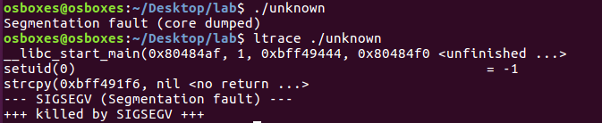
Finding Binaries and Simple Analysis
Find binaries
SUID executables: #find / -perm –u=s –type f 2>/dev/null
2) Run the program and conduct other analysis
!!! Look into the strcpy() function !!!
These functions are listed in order of execution.
strcpy() is well known for being vulnerable to buffer overflows. The segmentation fault is due to providing no input so throws a copy from null source exception. If we provide input to the program, it just prints it back through stdout.

Slide 15
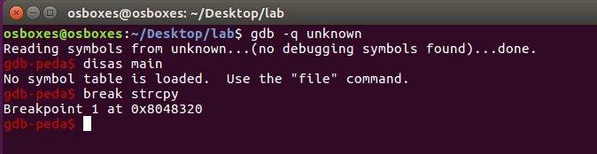
Identify Vulnerable Condition
Run the executable within a debugger (gdb)
Check the contents of main for exploitable libs…
We can see that the file was stripped here:

Slide 16
Identify Vulnerable Condition (cont’d)
Run the executable within a debugger (gdb)
Check the contents of main for exploitable libs…
We can see that the file was stripped here:
Again, run the executable within a debugger (gdb)
Since it is stripped there are no internal libraries to exploit, but we can exploit a vulnerable function – strcpy()
Set a breakpoint on strcpy

Slide 17

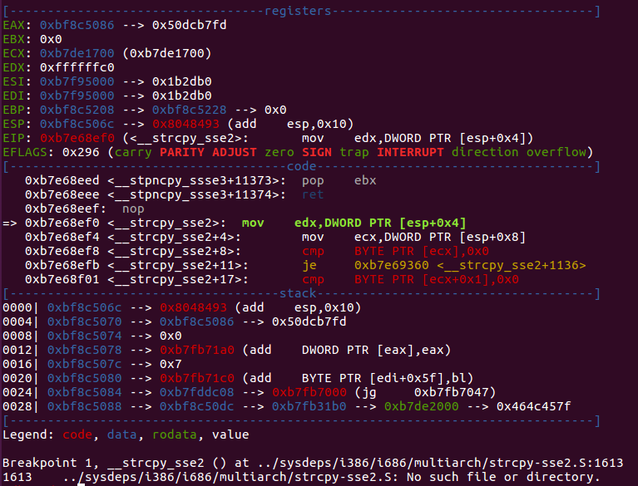
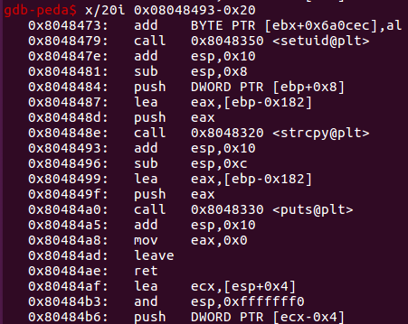

Identify Vulnerable Condition (cont’d)
Run within the debugger to the breakpoint, then examine the executable stack pointer (ESP)
Seems to be an argument to the program itself…
Seems to be second argument to strcpy()… prints out whatever is input (load effective address)

Slide 18
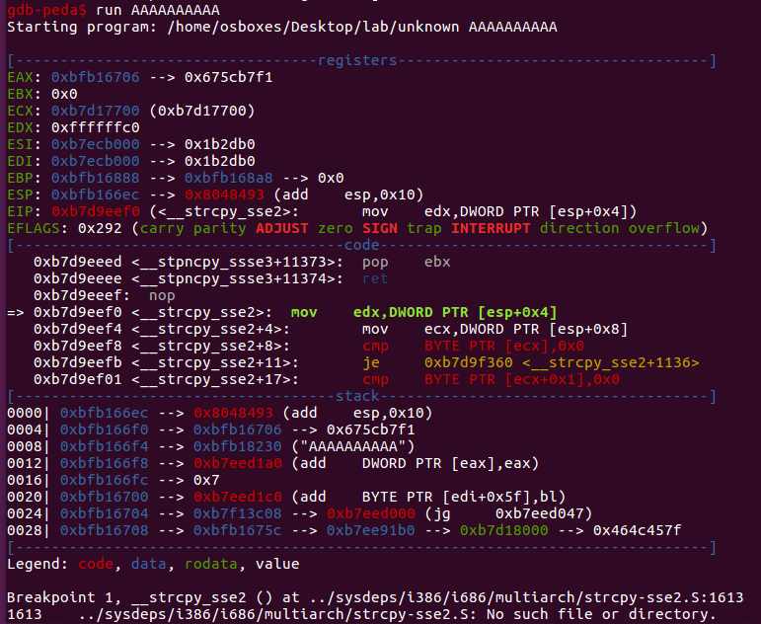

Identify Vulnerable Condition (cont’d)
Run within the debugger to the breakpoint, and provide input and run to breakpoint and examine
Second argument that is written back to stdout()

Slide 19
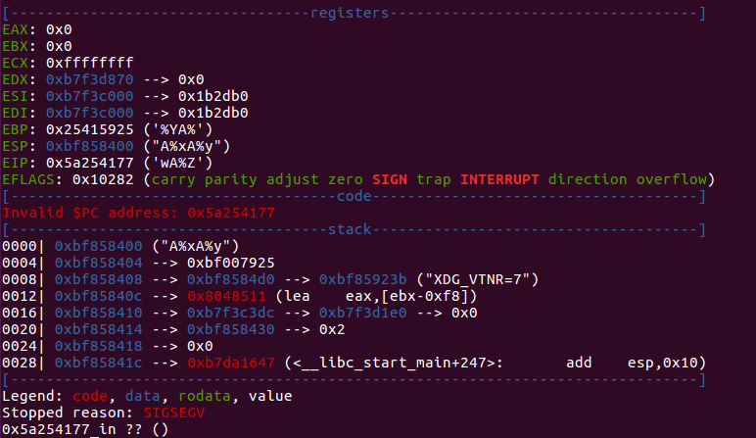
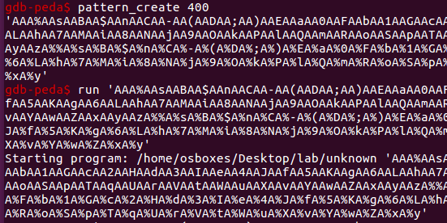

Determine EIP Offset
Start the debugger with the binary loaded and create a pattern
gdb-peda$ pattern_create 400
Calculate the pattern offset
gdb-peda$ pattern_offset 0x5a254177
Now we know that the offset up to the overflow condition is 390 characters!! So, let’s use this information to try and take control of EIP.

Slide 20
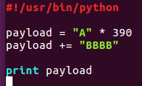
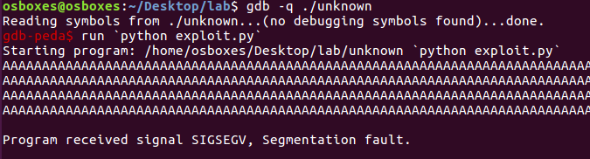

Determine EIP Offset (cont’d)
Create a python script to inject 390-plus characters
Backticks!
Our “BBBB” characters precisely overwrite EIP.

Slide 21
Develop a Script To Exploit The Binary

Slide 22
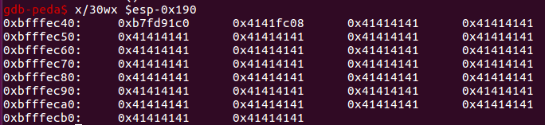
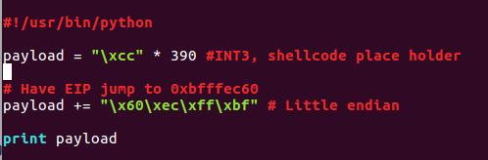
Exploit Development
Little endian, so the buffer displays backwards!!
First, let’s inspect the crash condition closer
Our buffer starts at 0xbfffec40 + 0x6 (bytes) = 0xbfffec46
Develop a script with the following structure/inputs:
(NOPs)+(shellcode)+(EIP address that points to beginning of the buffer)
Let’s input some breakpoints “\xcc” as a buffer placeholder to break once EIP address is called in our exploit. This will support the initial debugging process. If execution does not stop, or break, then EIP jump to the wrong location. Let’s jump to address oxbfc97af0, because it is comfortably within the buffer.

Slide 23
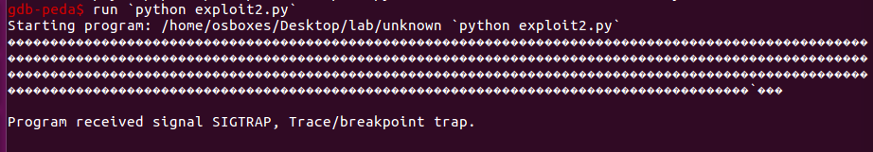
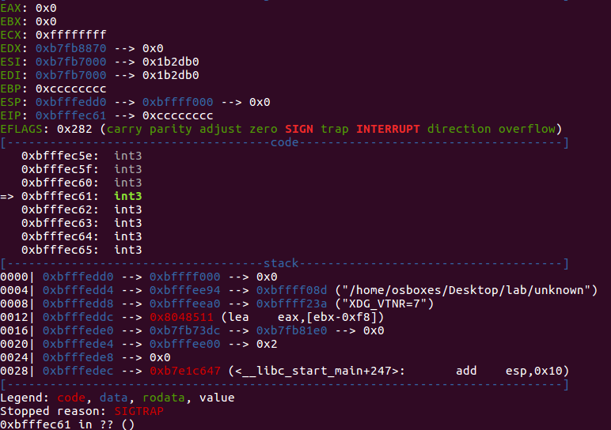
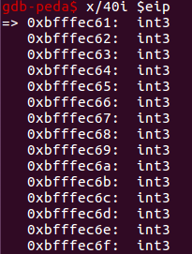
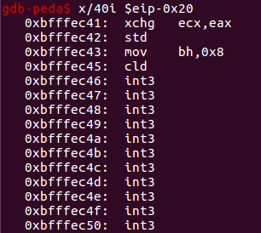
Exploit Development (cont’d)
Stops at first address past EIP (INT3)
We have now identified that we have buffer space before and after EIP to insert simple shell code…

Slide 24
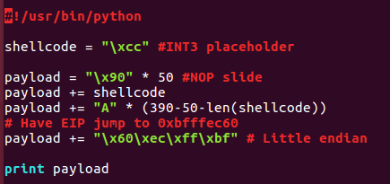
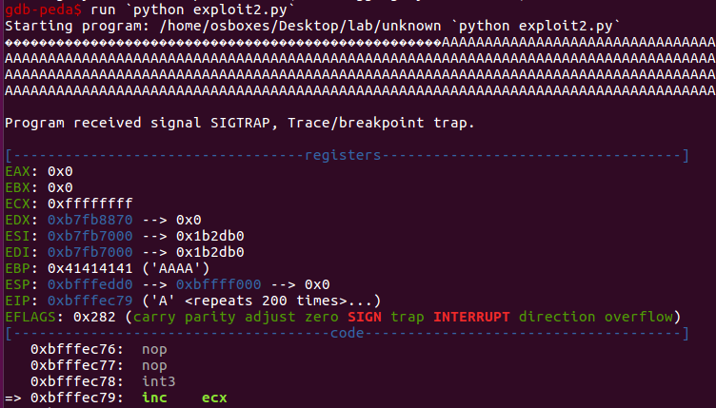
Exploit Development (cont’d)
To further develop our exploit,
Insert a “NOP slide” into the first 50 bytes and see what happens
Now we control EIP and program execution flow!!
One final step, insert shell code …

Slide 25
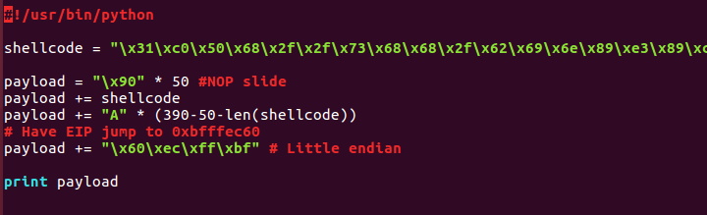
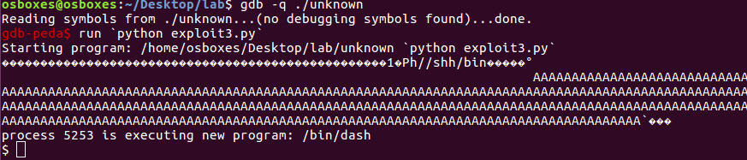
Exploit Development (cont’d)
To finalize our exploit,
Insert a “NOP slide” into the first 50 bytes and see what happens
Insert shell code (provided) and try to get shell
But we can only get this far within GDB… try the exploit outside of GDB and see.
Needs some additional analysis, so let’s observe the core dump file.

Slide 26

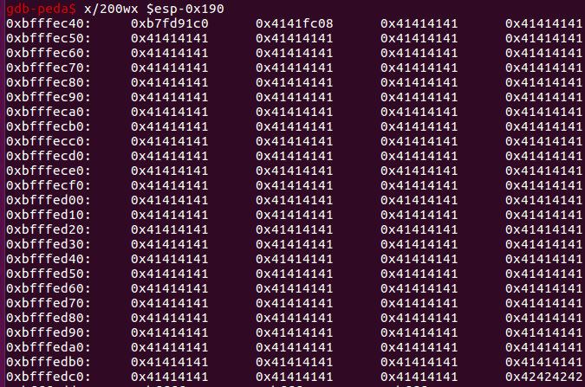
Exploit Development (cont’d)
Examine the core dump
#ulimit –c unlimited
#cp unknown uncopy
#./uncopy `python exploit3.py` or #./uncopy < exploit3.py
If you cannot get a proper dump file, go back and analyze the stack!!
No reason to run code all the at the top of the stack. There is a lot of room so pull it down further.

Slide 27
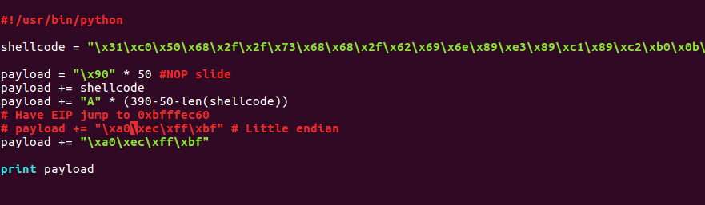
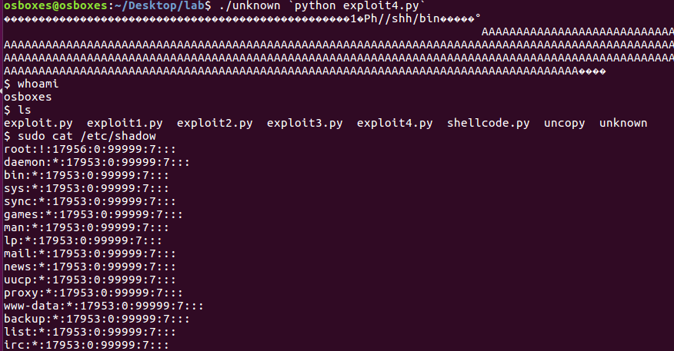
Exploit Development (cont’d)
Pulled the EIP address further down the stack!!

Slide 28
Defenses
ASLR – Address Space Layout Randomization
Randomizes the address spaces for libraries that are called
The relative offsets within libraries are constant, plus
If the randomization entropy is low, can brute force initial library call
DEP – Data Execution Prevention
System-level memory protection (prevents execution of code in designated data areas of the stack), built-in to the OS
Can be bypassed with return-oriented programming, or organizing gadgets, by using existing push and return combinations to call executable portions of the stack
SEHOP - Structured Exception Handler Overwrite Protection
Helps to stop malicious code in the event an overflow condition turns into a structured exception handling error
Various work-arounds, but most notably on Windows systems – the egg method

Slide 29
https://sysrisk.com/files/WhyBufferOverflowsMatter_JP.pptx

