Slide 1
Textual descriptions of STEM images to aid Visually-impaired
Kirthanaa Raghuraman
Raghuram Janakiraman
Abraham Daniel

Slide 2
Why?
To aid people with visual impairment to utilize academic papers
People with visual impairment cannot utilize Research papers until the contents are converted to auditory form
In order to convert the Research papers to auditory form we have to convert the charts (in image format) to text.

Slide 3
Why? Continued.
So far, the work of converting the visual data to textual form has been done manually by human workforce.
Services like Amazon’s Mechanical Turk provides human workforce which could be utilized to extract information from the the charts
The manual way of doing it is time consuming and expensive.

Slide 4
Proposed System
Our system tries to automate this process to a certain extent by answering the following questions.
Questions
What kind of chart is it?
What are the values associated with the entities in the chart (eg. X-axis categories)

Slide 5
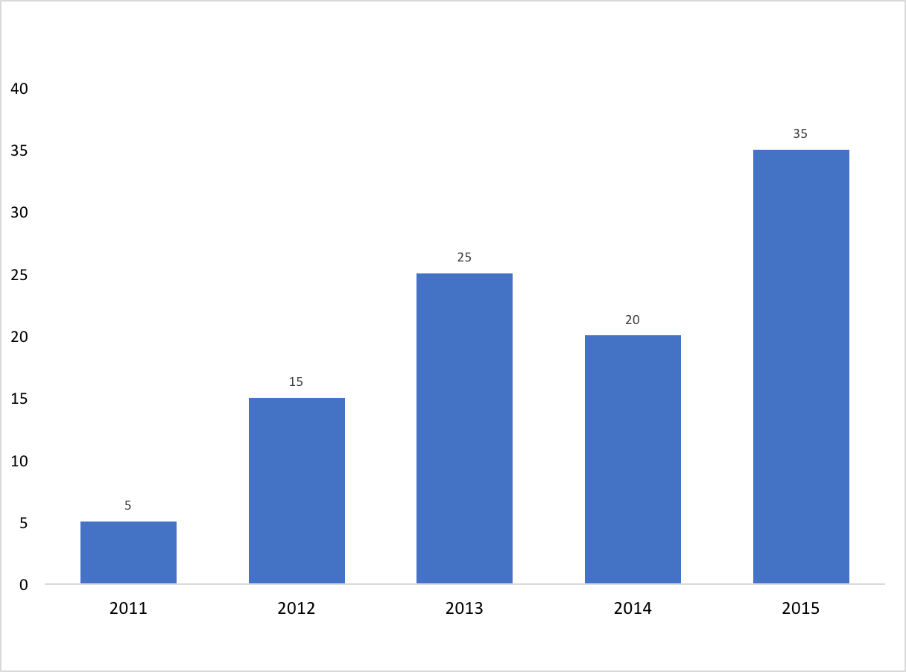
Expectations
Input Chart
Expected output:
Type: Bar Chart
Data:
2011 - 5
2012 - 15
2013 - 25
2014 - 20
2015 – 35

Slide 6
Pipeline
We have divided the system into two parts as mentioned below
Part 1 : Classify chart based on its type (eg. Bar chart, Pie chart etc)
Part 2 : Extract information from chart.
Preprocess images
Feed images to CNN
Classify images into chart category
Extract information from charts
Display text

Slide 7
Classification of charts – Using CNN
The models developed were trained as follows:
Training dataset: 1200 images
Test dataset : 300 images
No of categories: 10 (bar charts, pie charts, scatter plot, maps, venn diagrams, area graphs, line graphs, pareto chart, radar plot, table)

Slide 8
Models developed
We came up with few models using CNN and they were designed/trained on Tensorflow.
We also used a pre-developed Inception architecture to train a model for our classification task .

Slide 9
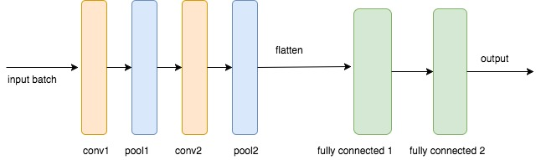
Iteration 1:
We started with a simple supervised model for the task.
Input batch: Batch size – 100, image size – 50x50 , input dimensions - [100,50,50,1]
Conv1: padding – same, no of filters – 32, kernel size – 5x5 , output dimensions - [100, 50, 50, 32]
Pool1: stride size – 2, type – maxpool, output dimensions - [100, 25, 25, 32]
Conv2: padding – same, no of filters – 64, kernel size – 5x5 , output dimensions - [100, 50, 50, 64]
Pool2: stride size – 2, type – maxpool, output dimensions - [100, 13, 13, 64]
Flatten: flatten the output of conv layers , o/p - [ 100, 13*13*64]
Fully connected 1: no of nodes – 1024, o/p - [100, 1024]
Fully connected 2 ( output ): no of nodes – 10 , o/p - [100,10]
Output: softmax function to convert scores(logits) to probabilities
Cost function : cross entropy with labelset

Slide 10
Iteration 1 Model stats:
After 100 epochs of training,
Accuracy reported on training set – 80%
Accuracy reported on test set – 45%
Observations: seem to over fit, not generalizing very well.

Slide 11
Iteration 2:
To avoid overfitting, we used dropouts.
We found that there was too much loss of info in pictures and hence increased resolution of images to 100x100.
Also, in general, to learn better features through convolution, we used autoencoder (unsupervised learning) followed by a classifier .
Autoencoder is used to pre-train the convolution filters to generate the best possible representation in a lower dimension.
Since training set is small (~1000) images, we reduced the number of nodes in fully connected classifier layer to 64.

Slide 12
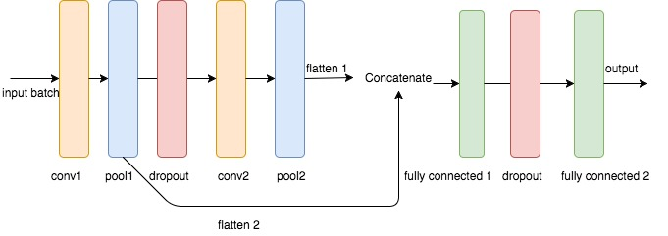
Architecture:
Input batch: Batch size – 100, image size – 100x100 , input dimensions - [100,100,100,1]
Conv1: padding – same, no of filters – 32, kernel size – 7x7 , output dimensions - [100, 100, 100, 32]
Pool1: stride size – 2, type – maxpool, output dimensions - [100, 50, 50, 32]
Dropout: drop few outputs at probability 0.4
Conv2: padding – same, no of filters – 64, kernel size – 7x7 , output dimensions - [100, 50, 50, 64]
Pool2: stride size – 2, type – maxpool, output dimensions - [100, 25, 25, 64]
Flatten 1: o/p - [ 100, 25*25*64] , flatten 2: o/p - [ 100, 50*50*32 ], concatenate : o/p - [ 100, (25*25*64 + 50*50*32)]
Fully connected 1: no of nodes – 5000, o/p - [100, 5000]
Fully connected 2 ( output ): no of nodes – 10000, o/p - [100,10000]
Output: reshape the output tensor to image shape - [100,100,100,1]
Cost function : reduce the reconstruction error

Slide 13
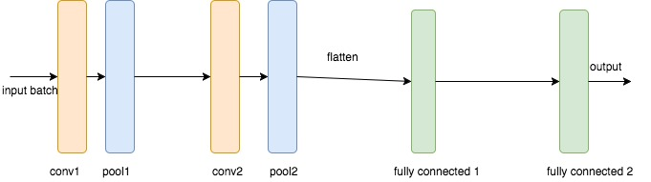
Classifier
The pretrained weights are used as the convolution filters for classifier.
Input batch: Batch size – 100, image size – 100x100 , input dimensions - [100,100,100,1]
Conv1: padding – same, no of filters – 32, kernel size – 7x7 , output dimensions - [100, 100, 100, 32]
Pool1: stride size – 2, type – maxpool, output dimensions - [100, 50, 50, 32]
Conv2: padding – same, no of filters – 64, kernel size – 7x7 , output dimensions - [100, 50, 50, 64]
Pool2: stride size – 2, type – maxpool, output dimensions - [100, 25, 25, 64]
Flatten: flatten the output of conv layers , o/p - [ 100, 25*25*64]
Fully connected 1: no of nodes – 64, o/p - [100, 64]
Fully connected 2 ( output ): no of nodes – 10 , o/p - [100,10]
Output: softmax function to convert scores(logits) to probabilities
Cost function : cross entropy with labelset

Slide 14
Iteration 2 stats:
After 100 epochs of training,
Accuracy reported on training set – 95%
Accuracy reported on test set – 75%
Observations:
Generalizes to certain extent.
Training set seems to be small, we can get better generalization with larger training data.
Increasing resolution to 100x100 helps in learning better features.

Slide 15
Current limitations:
Less training data – larger training data can help in better generalization.
Convolution provides translational invariance and not much scale invariance. One solution maybe to input image in different resolutions (100x100 , 200x200, 400x400) and then combine their classification results.
Limitation in compute power – we could not try out color related features (RGB channel) , we could not try high resolution of images, we could not try out larger no of filters (convolution is computation intensive).

Slide 16
Inception Architecture for Classification
Inception is a deep learning model designed to scale well for huge networks and to be computationally efficient.
We used transfer learning to enhance the model.
Transfer learning - A common prescription to a computer vision problem is to first train an image classification model with the ImageNet Challenge data set, and then transfer this model’s knowledge to a distinct task.

Slide 17
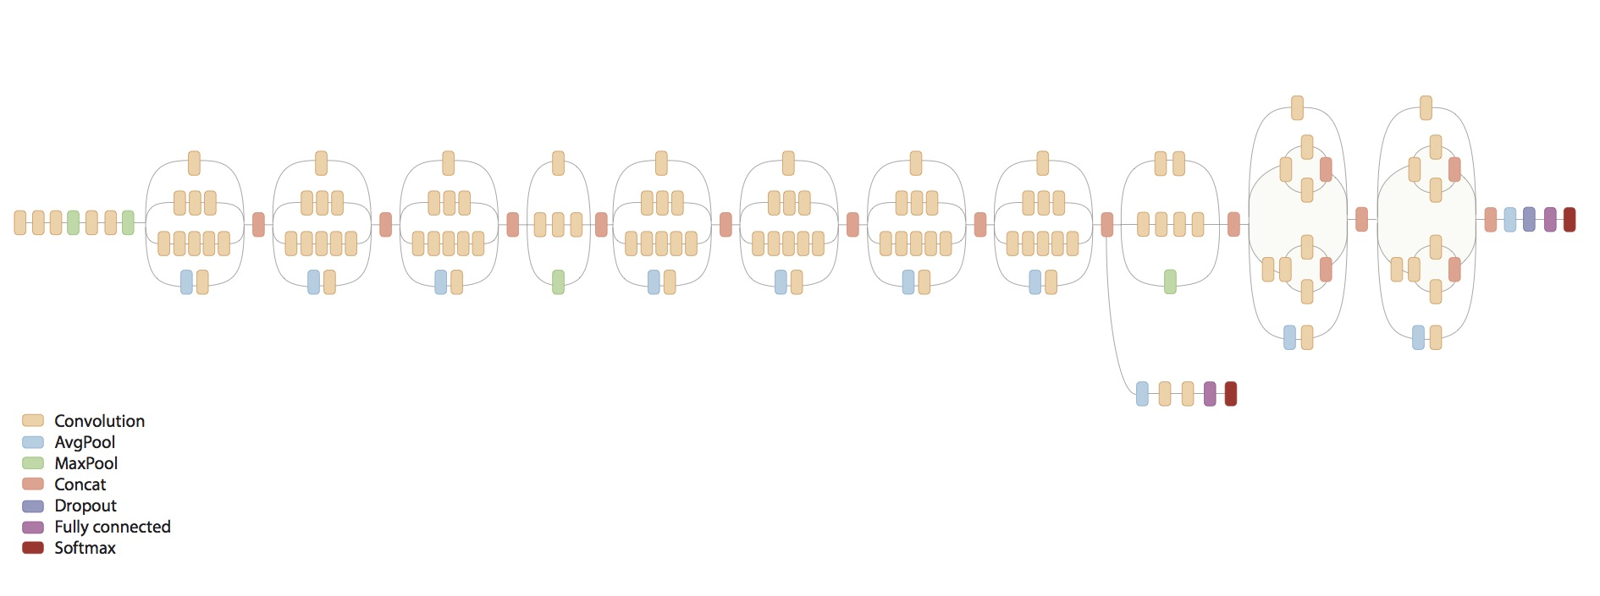
Inception Architecture for Classification

Slide 18
Inception Results
Retrained the last layer of the network.
Achieved an accuracy of 84.72%.
Accuracy relatively low – small dataset.

Slide 19
Information Retrieval from Bar charts
We concentrate on retrieving information from Bar Charts.
There are several types of bar charts –
Single column bar chart
Clustered column chart and
Stacked bar charts.
To make things simple, we have developed algorithm for only 2D single and clustered column bar charts.

Slide 20
Bar charts

Slide 21
Type 1 : 2D Single Column Bar chart
Assumptions:
The X-axis should be at the bottom.
The Y-axis should be on the left.
Labels are below bars for X axis, left of Y axis and axis titles are below and left of the labels for x and y axes respectively.
We aren’t looking for title as most STEM charts have title outside the chart area.
The bars should have only color and should not have patterns.

Slide 22
Algorithm
Convert image to gray scale and find connected components
Text also identified as connected components – so we remove the connected components which have area < 0.5 * mean(area) of all connected components.
Create a bounding box to identify x and y axis labels –x axis labels below the bars and y axis labels to the extreme left of the chart area. If exact values are not available we use a sliding window to traverse up and down the Y-axis to estimate the value.
Scale the image in bounding box to twice its original size.
Use OCR to recognize text in each bounding box.
Map the labels to the bars.

Slide 23

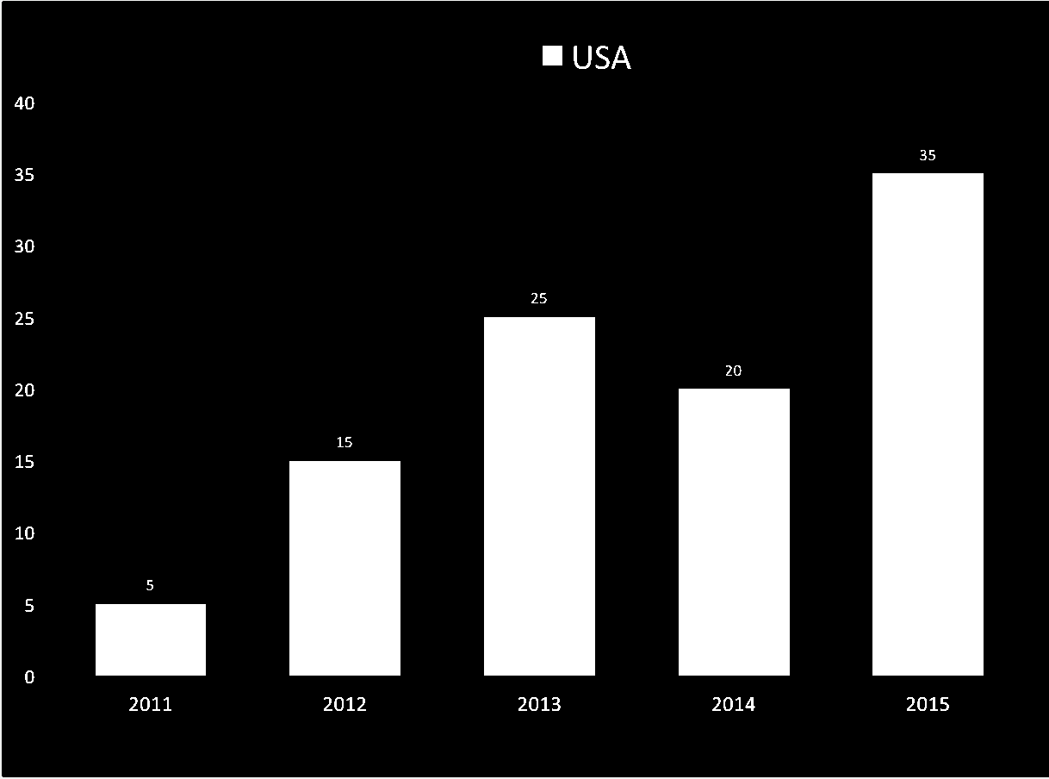
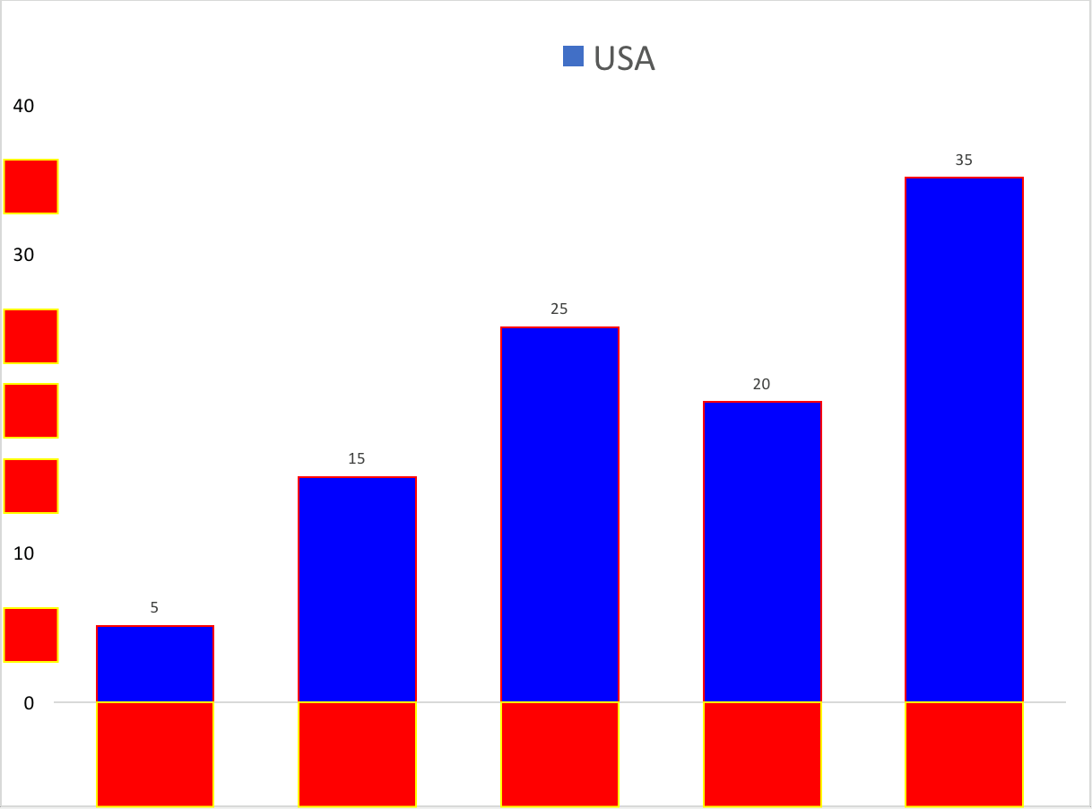
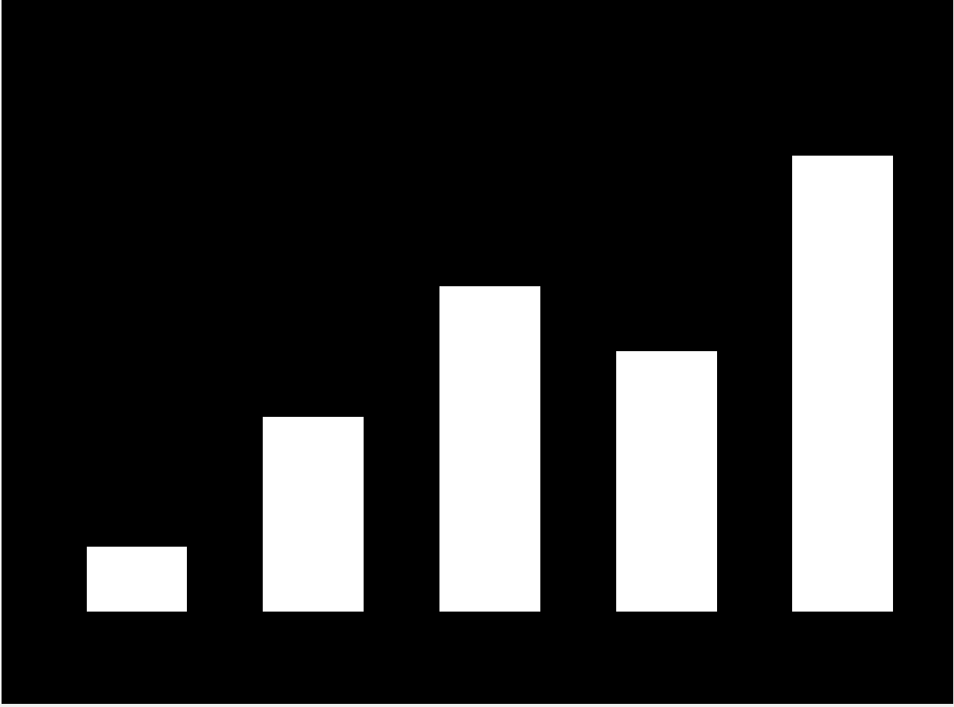
Type 1 : 2D Single Column Bar chart

Slide 24
Type 2 : 2D Clustered Column Bar chart
Assumptions:
Assumptions for Single column bar charts apply here.
Each cluster share the same label on the X Axis.
Algorithm:
Same as previous, except:
Estimating number of bars in a cluster
Calculating bounding boxes for identifying labels for each cluster.

Slide 25
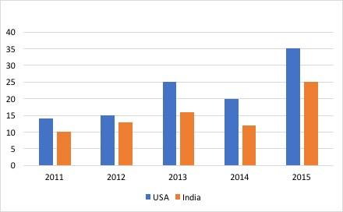
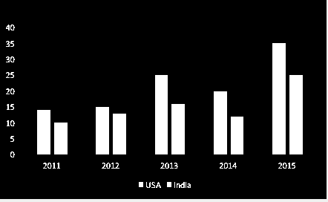
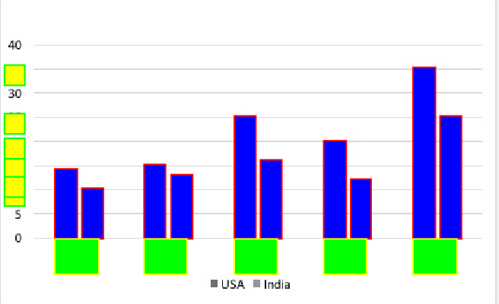
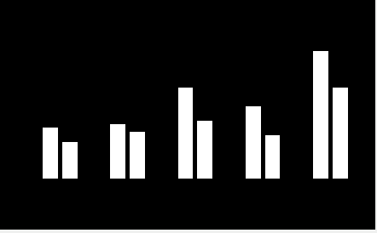
Type 1 : 2D Clustered Column Bar chart

Slide 26
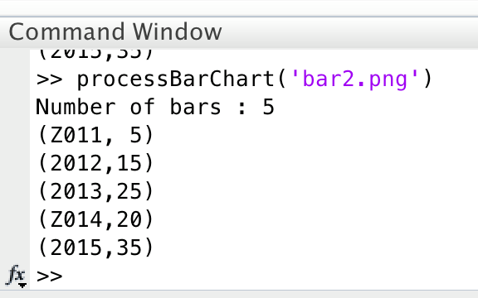
Results
Input Image
Output

Slide 27
Difficulties/Challenges:
Charts:
Charts had varying designs.
The labels in the axis might be at different positions.
OCR:
Text in many charts were not identified correctly – they were either too small or illegible for small values of labels.
2D Clustered charts:
We couldn't come up with any robust algorithms for correlating each bar to the category – Some charts used patterns while others used colors to differentiate clusters.

Slide 28
Future work
Perform classification on a more extensive dataset on machines with GPU support.
Extend the algorithm for other charts – Pie charts, Venn Diagrams, scatter plots etc.
Improve OCR performance by using more robust libraries.
Incorporate Crowd sourcing + algorithms to get more reliable descriptions.
3D charts?

