Slide 1

STARTUP PROPHET
STARTUP PROPHET
PRESENTED BY:
TEAM NO : CSD-B01
SALLA SAHAS 21UK1A6704
GK MANIKUMAR 21UK1A6758
SUDHATI KIRAN 21UK1A6753
AKARAPU JYOTHI 21UK1A6743
PRESENTED BY:
TEAM NO : CSD(B01)
SALLA SAHAS 21UK1A6704
GATTIKOPPULA MANI 21UK1A6758
SUDHATI KIRAN 21UK1A6753
AKARAPU JYOTHI 21UK1A6743

Slide 2
OUTLINE:
INTRODUCTION
OBJECTIVES
VISUALIZING AND ANALYSING DATA
DATA PRE-PROCESSING
MODEL BUILDING
APPLICATION BUILDING
SOFTWARE REQUIREMENTS
CONCLUSION

Slide 3
INTRODUCTION:
A startup or start-up is a company or project begun by an entrepreneur to seek, develop, and validate a scalable economic model. While entrepreneurship refers to all new businesses, including self-employment and businesses that never intend to become registered, startups refer to new businesses that intend to grow large beyond the solo founder. Startups face high uncertainty and have high rates of failure, but a minority of them do go on to be successful and influential. Startups play a major role in economic growth. They bring new ideas, spur innovation, create employment thereby moving the economy. There has been an exponential growth in startups over the past few years. Predicting the success of a startup allows investors to find companies that have the potential for rapid growth, thereby allowing them to be one step ahead of the competition.

Slide 4
OBJECTIVES:
By the end of this project you will:
→ Know fundamental concepts and techniques used for machine learning.
→ Gain a broad understanding about data.
→ Have knowledge on pre-processing the data/transformation techniques and some visualization concepts.

Slide 5
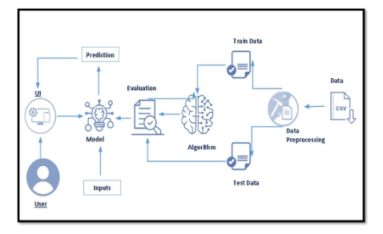
TECHNICAL ARCHITECTURE:

Slide 6
VISUALIZING AND ANALYSING DATA:
As the dataset is downloaded. Let us read and understand the data properly with the help of some visualization techniques and some analysing techniques.
Note: There is n number of techniques for understanding the data. But here we have used some of it. In an additional way, you can use multiple techniques..

Slide 7
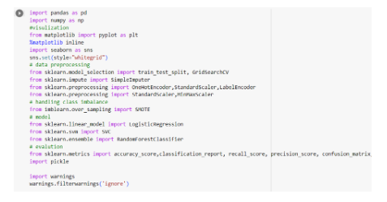
IMPORTING LIBRARIES:

Slide 8
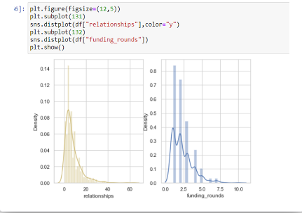
UNIVARIATE ANALYSIS:
In simple words, univariate analysis is underanding the data with single feature.
→ Seaborn package provides a wonderful function distplot.
With the help of distplot, we can find the distribution of the feature.
To make multiple graphs in a single plot, we use subplot.

Slide 9
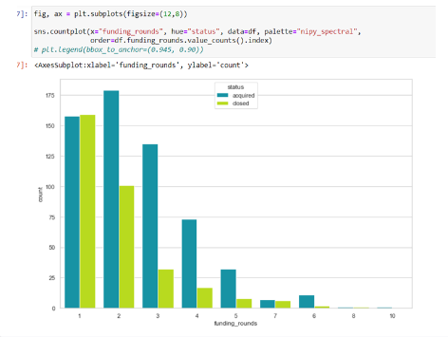
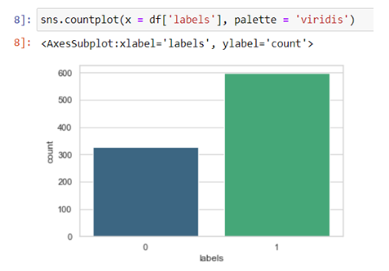
BIVARIATE ANALYSIS:
To find the relation between two features we use bivariate analysis.
Here we are visualizing the relationship between two features.

Slide 10

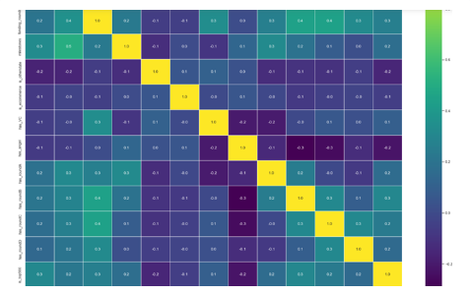
MULTIVARIENT ANALYSIS:
In simple words , multivariate analysis is to find the relation between multiple features.

Slide 11
DATA PRE-PROCESSING:
As we have understood how the data is lets pre-process the collected data.
The download data set is not suitable for training the machine learning model as it might have
so much of randomness so we need to clean the dataset properly in order to fetch good results.
This activity includes the following steps.
→ Handling missing values
→ Handling categorical data
→ Scaling Techniques
→ Handling class imbalance
→ Splitting dataset into training and test set
Note: These are the general steps of pre-processing the data before using it for machine learning.
Depending on the condition of your dataset, you may or may not have to go through all these steps.

Slide 12
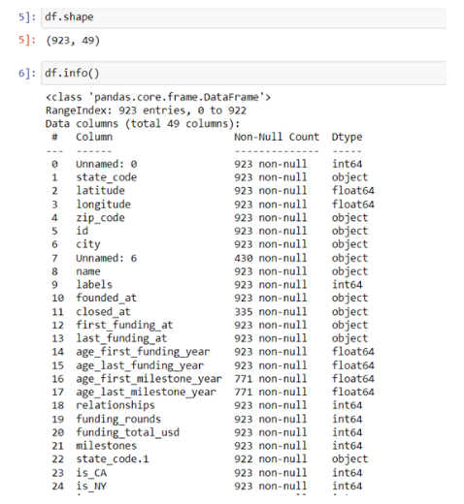
CHECKING FOR NULL VALUES:
Let’s find the shape of our dataset first, To find the shape of our data, df.shape method is used.
To find the data type, df.info() function is used.

Slide 13
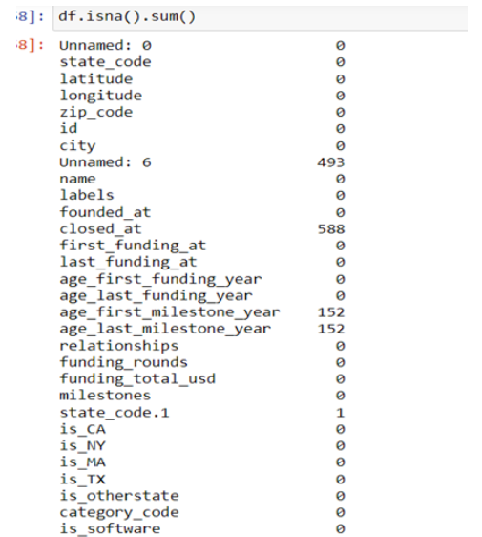
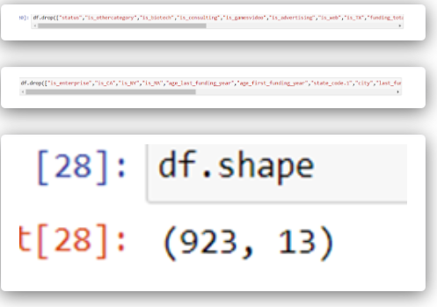
DROPPING NULL VALUES:

Slide 14
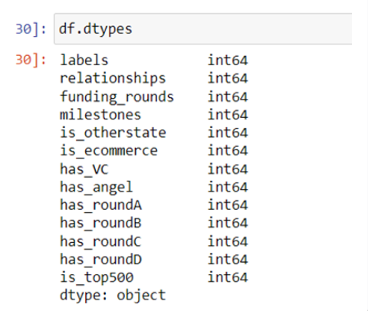
HANDLING CATEGORICAL VALUES:
As we can see our dataset has no categorical data so no need to do anything .

Slide 15

HANDING CLASS IMBALANCE:
Our data is imbalance so by using SMOTE technique to balance the data .
SMOTE (Synthetic Minority Over-sampling Technique) is a technique used to address class imbalance in machine learning datasets, particularly in classification tasks. It aims to balance the distribution of classes by generating synthetic samples for the minority class. SMOTE creates these synthetic samples by interpolating between existing instances of the minority class.

Slide 16
MODEL BUILDING:
Now our data is cleaned and it’s time to build the model. We can train our data on different algorithms. For this project we are applying three classification algorithms. The best model is saved based on its performance.

Slide 17
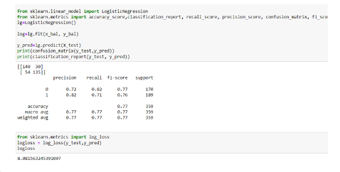
LOGISTIC REGRESSION:
We create a LogisticRegression model .The model is trained on the training data using the fit method.Predictions are made on the test data using the predict method.We calculate the accuracy of the model's predictions using the accuracy_score function. A classification report is printed, providing a more detailed evaluation of the model's performance Accuracy , precision, recall, F1-score, and support.

Slide 18
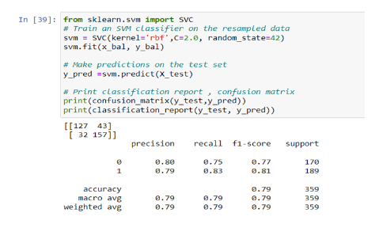
SUPPORT VECTOR MACHINE:
We create code trains a Support Vector Machine (SVM) classifier with a radial basis function (RBF) kernel on a balanced dataset and then evaluates its performance using a confusion matrix and a classification report.
SVCclass from scikit-learn's svm module to use the RBF kernel by setting kernel='rbf'. The C parameter controls the trade-off between maximizing the margin and minimizing the classification error. A larger C value leads to a narrower margin and potentially more accurate classification on the training data. The random_state parameter ensures reproducibility then fit (train) the SVM classifier on the balanced dataset x_bal and y_bal, to make predictions on the test set X_test using the predict method. This produces predicted labels y_pred for the test instances

Slide 19
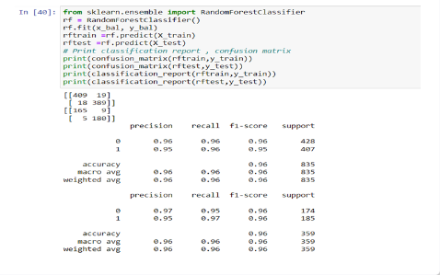
RANDOM FOREST MODEL:
We create a RandomForest model named RF is created and Inside the function, RandomForestClassifier algorithm is initialized and training data is passed to the model with .fit() function. Test data is predicted with .predict() function and saved in new variable. For evaluating the model, confusion matrix and classification report is done.

Slide 20
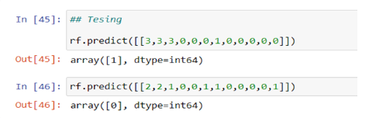

TESTING THE MODEL:
Here we have tested with Random forest algorithm. You can test with all algorithm.With the help of predict() function.
PICKLE MODEL SAVE:
Randomforest given the good accuracy so we the RandF model for pickle model and for wed integeration . by the below code we save the pickle model.

Slide 21
APPLICATION BUILDING:
In this section, we will be building a web application that is integrated to the model we built.
A UI is provided for the uses where he has to enter the values for predictions.
The enter values are given to the saved model and prediction is showcased on the UI.
This section has the following tasks
→ Building HTML Pages
→ Building serverside script
→ Run the web application

Slide 22


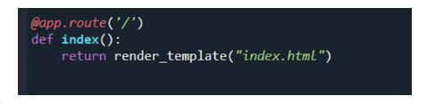
BUILD PYTHON CODE:
Import the libraries:
Load the saved model. Importing flask module in the project is mandatory.
An object of Flask class is our WSGI application.
Flask constructor takes the name of the current module (__name__) as argument.
Render HTML page:

Slide 23
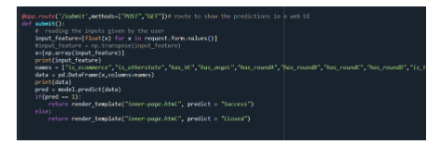
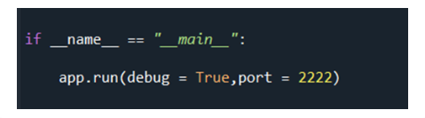
Here we will be using declared constructor to route to the HTML page which we have created earlier.
In the above example, ‘/’ URL is bound with home.html function. Hence, when the home page of the web server is opened in browser,
the html page will be rendered. Whenever you enter the values from the html page the values can be retrieved using POST Method.
Retrieves the value from UI:
This function retrieves all the values from the HTML page using Post request. That is stored in an array.
This array is passed to the model.predict() function. This function returns the prediction.
And this prediction value will rendered to the text that we have mentioned in the inner-page.html(submit.html) page earlier.
Main Function:

Slide 24
SOFTWARE REQUIREMENT:
JUPYTER NOTEBOOK
ANACONDA NAVIGATOR
MACHINE LEARNING TOOLS :-> NUMPY,
->PANDAS,
->MATPLOTLIB,
->SCIKIT-LEARN,
->SEABORN.

Slide 25
OUTPUT:

Slide 26
CONCLUSION:
IN THIS PROJECT WE HAVE PREDICT STARTUP PREDICTION FOR
STARTUP ORGANIZATION.
→ WE HAVE ACHIEVED THIS BY USING MACHINE LEARNING MODEL,
FOR BETTER RESULTS WE USED SVM(SUPPORT VECTOR MACHINE),
RANDOM FOREST MODEL
AND LOGISTIC REGRESSION MACHINE LEARNING ALGORITHM.

