Slide 1
FAKE REVIEW DETECTION USING SENTIMENT ANALYSIS
Anantharam RU PES1201700088
Kirthika Gurumurthy
PES1201700230
UE17CS333 project submission

Slide 2
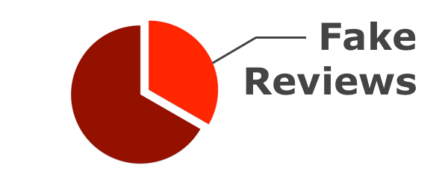
About the project
Project idea:
In recent times , online reviews have become become a primary factor in a consumer’s decision to purchase a service or a product and are an important resource of customer opinion .
Because of this heavy reliance on these reviews , there is an increase in spammers manipulating these reviews for their own gain or to affect their competition .This is known as opinion spam.
The main aim of this project is to identify these deceptive reviews through sentiment analysis (SA) methods.
UE17CS333-Project_Format_2020
2

Slide 3
Uniqueness and analysis
Why you think your project is somewhat uncommon ?
In our project we have employed various methods to detect these deceptive reviews - supervised learning techniques (Naïve Bayes , SVM , Decision Tree ,Random Forest, LSTM, ANN) ,unsupervised learning (k-means) and lexicon based – dictionary method .Some of these models are hybrids using lexical features as input.
We have also done extensive research w.r.t fake reviews and have identified features that are useful for detecting the same such as – review length , ratio of capital letters ,ratio of capital words , count of first pronouns , ratio of verbs to nouns (using POS Tagging) , count of sentiment words (using Bing Liu and Minquing Hu sentiment lexicon) , afinn score , vader score and fake vocabulary construction.
UE17CS333-Project_Format_2020
3

Slide 4
Dataset source and preprocessing done
Dataset source
https://myleott.com/op-spam.html
This corpus consists of truthful and deceptive hotel reviews of 20 Chicago hotels . It is considered as the gold standard for labelled deceptive reviews.
2. Any pre-processing steps performed initially or for feature extraction :
i)Tokenization - Each review was tokenized into words by using the nltk.tokenize module of nltk.
ii)Removal of stopwords – We filtered out words such as “a” , ”the” etc that didn’t add much value as features. (this was only for certain models where the feature ‘count of first personal pronouns did not contribute much to the accuracy).
iii)As a part of feature extraction we performed POS tagging to get the Verbs to Nouns ratio.
iv)We calculated the AFINN score and VADER scores to use them as features.
v)Count of sentiment words was found for the text using using Bing Liu and Minquing Hu sentiment lexicon.
vi)Conversion of words to numeric features using TFIDF.
Vii)Padding of words as features for LSTM.
UE17CS333-Project_Format_2020
4

Slide 5
Literature Review
Finding Deceptive Opinion Spam by Any Stretch of the Imagination by Myleott et al. use n-grams and LIWC features (psychology and computational linguistics features) and a combination of both on Naïve Bayes and SVM classifers to detect fake reviews.
Jindal and Liu (2008) use product review data, and in the absence of gold-standard deceptive opinions, they train models using features based on the review text, reviewer, and product, to distinguish between duplicate opinions (considered deceptive spam) and non-duplicate opinions.
Rodrigo Barbado et al. use review centric features such as TFIDF ,LDA and user centric features such as number of friends, registration date etc as features for Naïve Bayes and Adaboost classifiers.
Lim et al. identified the anomalous rating and review behaviours such as giving unfair ratings to products and reviewing too often, so as to detect spammers
Fei et al. exploit the burstiness nature of reviews to spot review spammer
UE17CS333-Project_Format_2020
5

Slide 6
Literature Review
TITLE AND NAME OF THE AUTHORS | METHODOLOGY | HIGHEST ACCURACY ACHIEVED | BENEFITS AND DRAWBACKS
Detecting opinion spams and fake news using text classification Hadeer Ahmed Issa Traore | Content based detection models ,Reviewer behaviour based detection models | 90 % (n-gram features) | Found that n gram size increased accuracy and used a lot of features to achieve a very high accuracy.However,do not explore semantic features much.
Finding Deceptive Opinion Spam by Any Stretch of the Imagination Myle Ott, Yejin Choi, Claire Cardie, Jeffrey T. Hancock | Use combinations of LIWC and n gram features with SVM and Naïve Bayes | 89 % (LIWC +Bigrams) | developed the first large-scale dataset containing gold-standard deceptive opinion spam.
A Framework for Fake Review Detection in Online Consumer Electronics Retailers Rodrigo Barbado, Oscar Araque, Carlos A. Iglesias | Uses user centric features –personal,social ,trust,review activity and review centric features such as TFIDF | 81 % (AdaBoost) | Have shown that using only the text of the review as a feature is not very effective.But some features used are restrictive to the e-commerce domain.
UE17CS333-Project_Format_2020
6

Slide 7
Literature Review
TITLE AND NAME OF THE AUTHORS | METHODOLOGY | HIGHEST ACCURACY ACHIEVED | BENEFITS AND DRAWBACKS
Fake Review Detection using data mining Md Forhad Hossain | Topic modeling based spam review detection .Also proposes an unsupervised approach called Word Baket Analysis | 89 % (semi supervised SVM –t opic modelling) | Validation of proposed unsupervised approach is based on an assumption that about one third of online reviews are fake.
Negative Deceptive Opinion Spam Myle Ott, Claire Cardie ,Jeffrey T. Hancock | linear Support Vector Machine (SVM) classifiers trained with unigram and bigram term-frequency features | 89 % | Added negative deceptive reviews to the first large-scale dataset containing gold-standard deceptive opinion spam.
Detection of spam reviews: A sentiment analysis approach. Saumya S, Singh J.P. | Random Forest ( RF) on Amazon product reviews. | 91 % | Gives more insight on the working of supervised learning models for fake review detection.
UE17CS333-Project_Format_2020
7

Slide 8
Literature Review
TITLE AND NAME OF THE AUTHORS | METHODOLOGY | HIGHEST ACCURACY ACHIEVED | BENEFITS AND DRAWBACKS
An Effective Statistical Approach to Blog Post Opinion Retrieval. He, B.; Macdonald, C.; He, J.; Ounis | Dictionary based lexicon approach | 78 % | Proposed approach provides an effective performance in retrieving opinionated blog posts
Combining lexicon and learning based approaches for concept-level sentiment analysis. Medinas, A.; Zhang, D.; Levene, M. | Machine learning (ML)+ Lexicon | 82 % | confirm the superiority of the proposed hybrid approach over state-of-the-art systems like SentiStrength
UE17CS333-Project_Format_2020
8

Slide 9
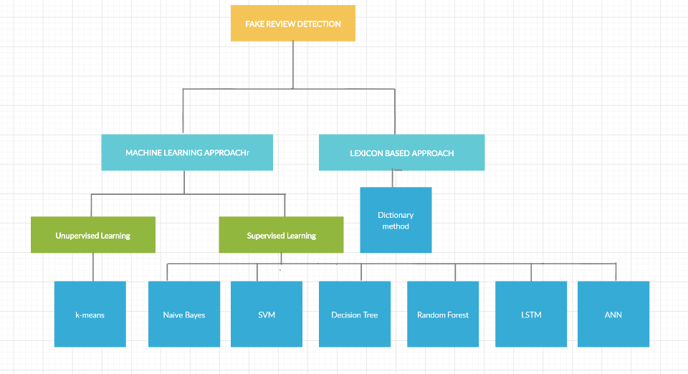
Quantity of work - High level block diagram of our implementation
UE17CS333-Project_Format_2020
9

Slide 10
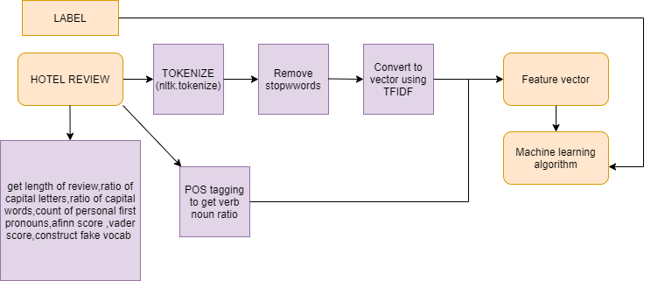
Quantity of work - High level block diagram of our implementation
Flowchart of implementation for supervised learning approach
UE17CS333-Project_Format_2020
10

Slide 11
Quantity of work – the main code modules
Serial no | Code module description | Status (% complete) | What it does ?
1 | Naive Bayes (from scratch) | 100 % | Takes feature vectors for training and is used for classification as truthful/deceptive.
2 | SVM,Decision Tree,Random Forest,LSTM | 100 % | Takes feature vectors for training and is used for classification as truthful/deceptive.
3 | ANN(from scratch) | 100 % | Trained the neural network and used the model to classify fake/truthful reviews
4 | K-means (from scratch) | 100 % | Uses fake vocabulary as the main feature to classify reviews.
5 | Dictionary based method | 100 % | Uses an iterative method to add words to a sentiment list for a lexical based classification of reviews.
UE17CS333-Project_Format_2020
11

Slide 12
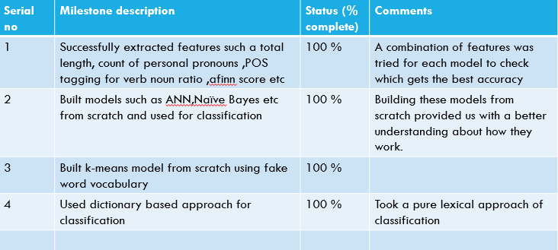
Quality of work – Milestones that are done and working
UE17CS333-Project_Format_2020
12

Slide 13
Results Obtained
TECHNIQUE | CLASSIFIER | ACCURACY | PRECISION | RECALL
SUPERVISED LEARNING | Naive Bayes | 85.416 % | 84 % | 84.75%
 | SVM | 88.75 % | 90 % | 88 %
 | Decision Tree | 71.25 % | 75 % | 66 %
 | Random Forest | 84.375 % | 86 % | 84 %
 | LSTM | 86.25 % | 85 % | 90 %
 | ANN | 87.58% | 87.72 % | 88.75
UNSUPERVISED LEARNING | k-means | 64.79 % | 62.72 % | 72.91 %
LEXICON APPROACH | Dictionary method | 70.825 % | 67.68 % | 75.46 %
UE17CS333-Project_Format_2020
13
Notes:
13

Slide 14
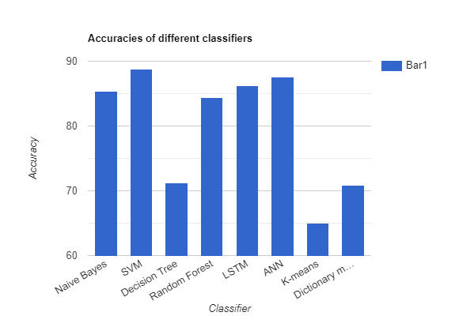
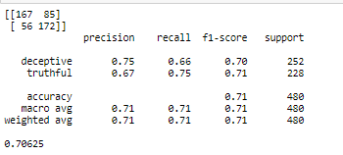
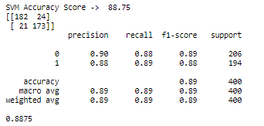
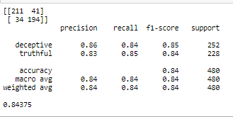
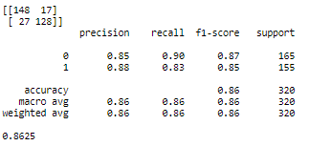
Decision Tree
Random Forest
SVM
LSTM
UE17CS333-Project_Format_2020
14
Notes:
14

Slide 15
Our top three learning in this project
1. Learning # 1 :
We learned a lot about lexicon based features in sentiment analysis and have explored the same.
2. Learning # 2 :
We learned about various approaches to detect fake reviews such as use of psychological linguistic features while reading other research papers.
3. Learning # 3 :
We learned how to construct various features appropriate to the models and learned how to use both lexical and ML approaches to construct hybrids.
UE17CS333-Project_Format_2020
15
Notes:
15

Slide 16
Top Challenges unresolved so far
1. Issue #1
Our classifiers use review centric features .A combination of reviewer centric and review centric features would work much better but we could not find a dataset or source to scrape the same.
2. Issue #2
Labelled data classifying reviews as fake were very difficult to find but we require them to check the accuracy of our models.
3. Issue #3
We have not explored features such as LDA and content similarity yet .
UE17CS333-Project_Format_2020
16

Slide 17
Our Going forward plan (if any)
1.Find sources with more data for classification of fake reviews .
2. Focus on unsupervised learning classification techniques and find other features to get a higher accuracy for the same.
3.Explore more hybrids in terms of combining lexical and ML based approaches.
4. Use ensemble methods such as boosting and bagging or majority voting of the highest accuracy models to form better classifiers.
UE17CS333-Project_Format_2020
17

Slide 18
THANK YOU
UE17CS333-Project_Format_2020
18

