Slide 1
CAR PRICES PREDICTION

Slide 2
INTRODUCTION
A Chinese automobile company Geely Auto aspires to enter the US market by setting up their manufacturing unit there and producing cars locally to give competition to their US and European counterparts.
They have contracted an automobile consulting company to understand the factors on which the pricing of cars depends. Specifically, they want to understand the factors affecting the pricing of cars in the American market, since those may be very different from the Chinese market. The company wants to know:
Which variables are significant in predicting the price of a car
How well those variables describe the price of a car
OBJECTIVE
We are required to model the price of cars with the available independent variables. It will be used by the management to understand how exactly the prices vary with the independent variables. They can accordingly manipulate the design of the cars, the business strategy etc. to meet certain price levels. Further, the model will be a good way for management to understand the pricing dynamics of a new market.

Slide 3
ATTRIBUTES
1. Car_ID - Unique ID for each observation.
2. Symboling - Its assigned insurance risk rating, value +3 indicates that the auto is risky,
-3 that it is pretty safe.
3. carCompany - Name of company
4. fueltype - Car fuel type.
5. aspiration - Aspiration used in car
6. doornumber - Number of doors in a car
7. carbody - body of car
8. drivewheel - type of drive wheel
9. enginelocation - location of car engine
10. wheelbase - Wheelbase of car
11. carlength - length of car
12. carwidth - width of car
13. carheight - height of car
14. curbweight - The weight of a car without occupants or luggage.
15. enginetype - type of engine
16. cylindernumber - cylinder placed in the car.
17. enginesize - size of car.
18. fuelsystem - Fuel system of car.
19. boreratio - Boreratio of car
20. stroke - Stroke or volume inside the engine.
21. compressionratio - compression ratio of car.
22. horsepower - Horsepower
23. peakrpm - car peak rpm
24. citympg - Mileage in city
25. highwaympg - Mileage on highway
26. Price( Dependent Variable) - Price of car

Slide 4
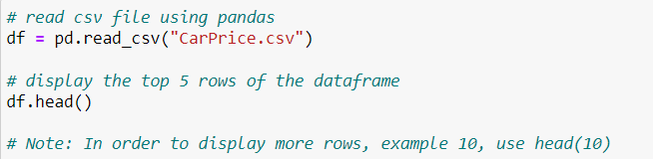
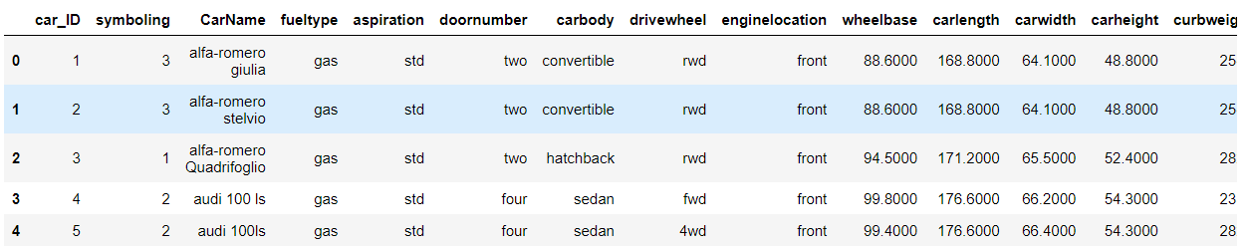
LOADING THE DATASET
OUTPUT

Slide 5
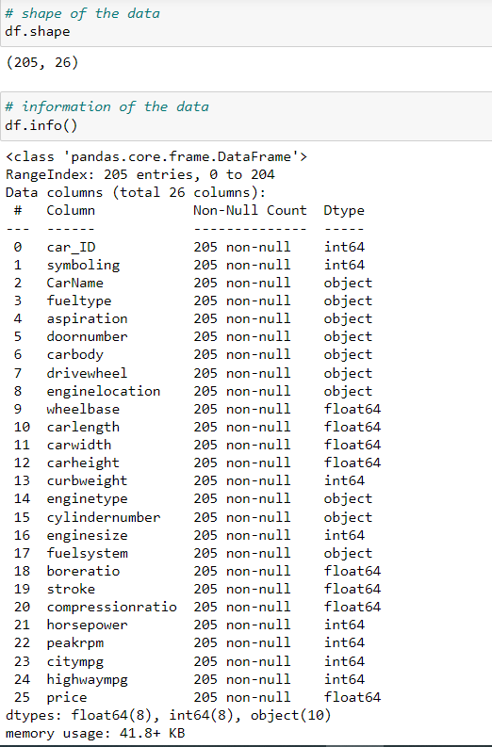
UNDERSTANDING THE DATAFRAME

Slide 6
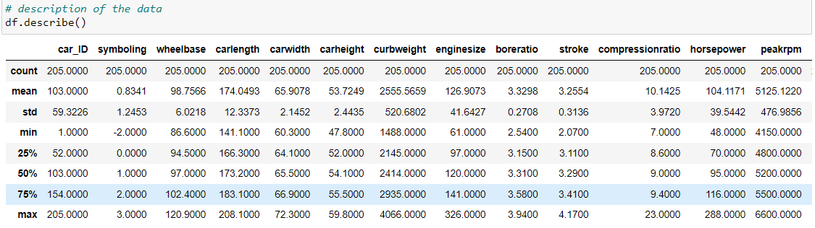

Slide 7
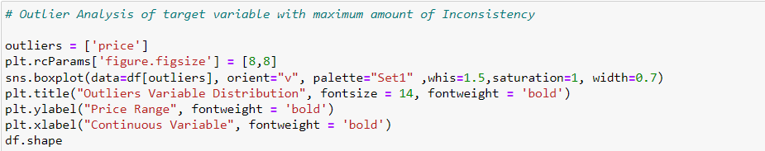
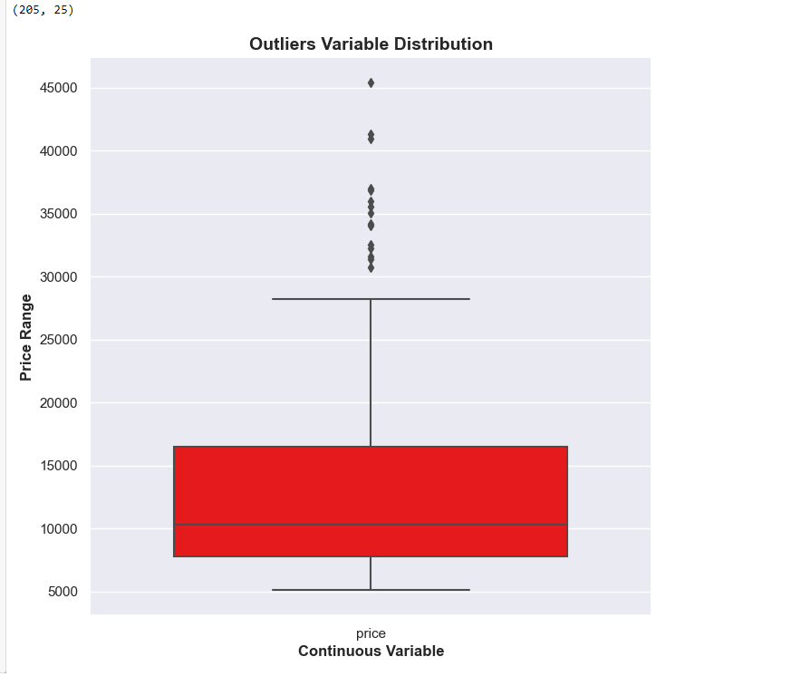
OUTPUT
There are some price ranges above 36000
which can be termed as outliersbut lets not
remove it rather we will use standarization
scaling.

Slide 8
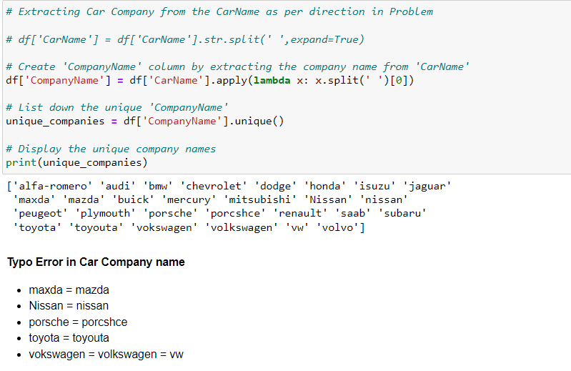

Slide 9
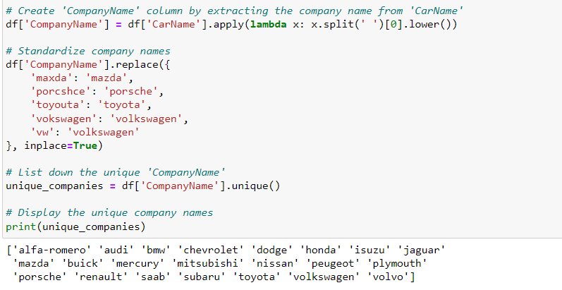
Create “CompanyName” Column

Slide 10
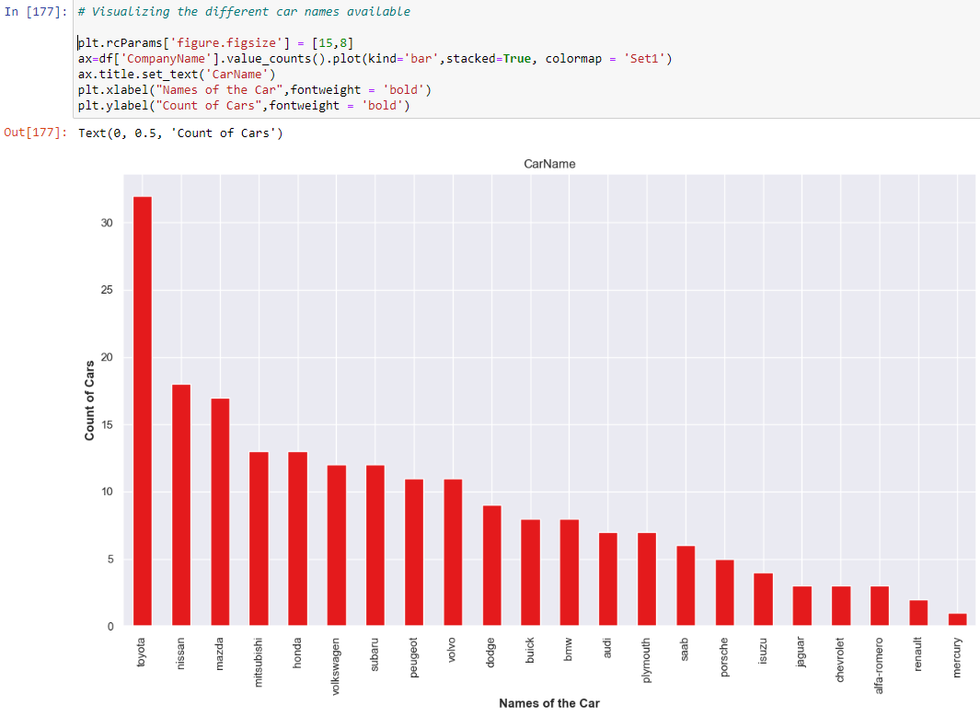
VISUALISING THE DATA Here we will identify if some predictors directly have a strong association with the outcome variable price
Toyota seems to be the most favoured cars.
Mercury seems to be the least favoured cars.

Slide 11
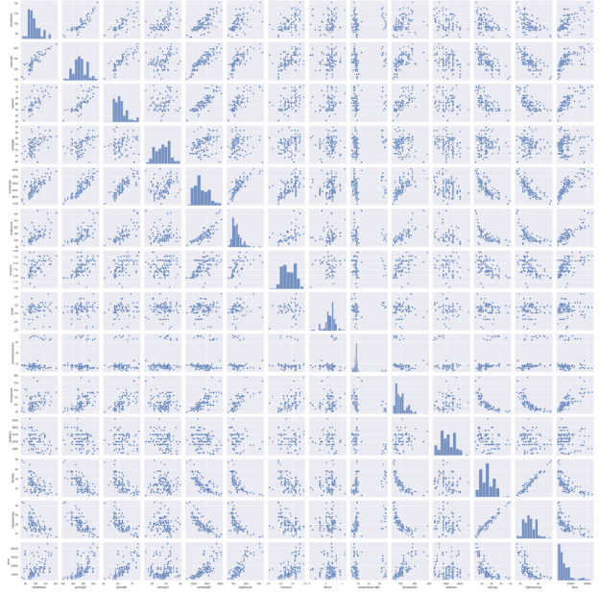
.
ax = sns.pairplot(df[num_col])
carwidth , carlength, curbweight, enginesize, horsepower seems to have a positive correlation with price.
carheight doesn't show any significant trend with price.
citympg , highwaympg - seem to have a significant negative correlation with price.

Slide 12
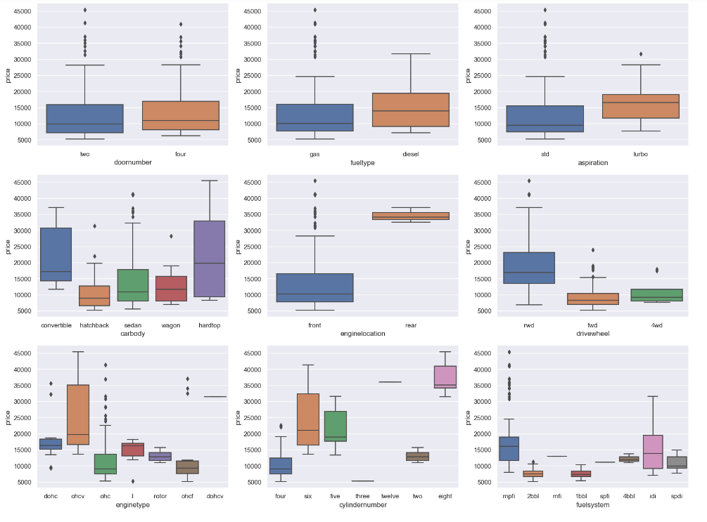
VISUALISING FEW MORE CATEGORICAL VARIABLES Boxplot of all the categorical variables
The cars with fueltype as diesel are comparatively expensive than the cars with fueltype as gas.
All the types of carbody is relatively cheaper as compared to convertible carbody.
The cars with rear enginelocation are way expensive than cars with front enginelocation.
The price of car is directly proportional to no. of cylinders in most cases.
Enginetype ohcv comes into higher price range cars.
DoorNumber isn't affecting the price much.
HigerEnd cars seems to have rwd drivewheel

Slide 13
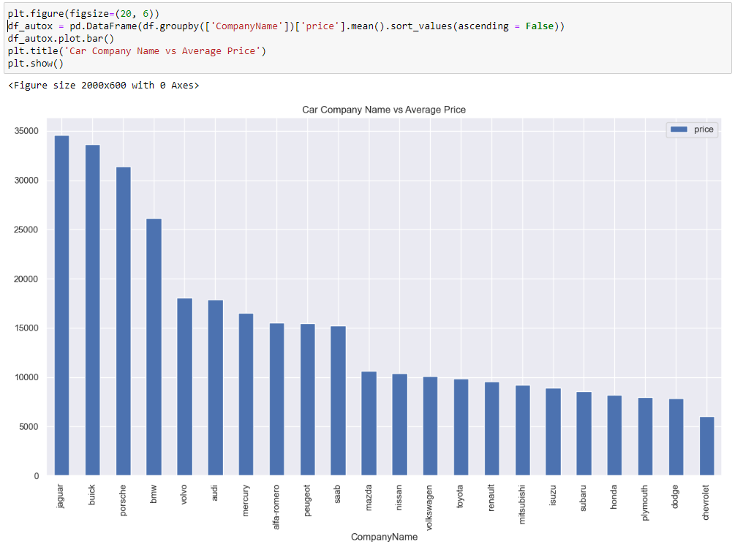
DERIVED METRICES Average Price
INSIGHTS
Jaguar, Buick and porsche seems to have the highest average price.

Slide 14
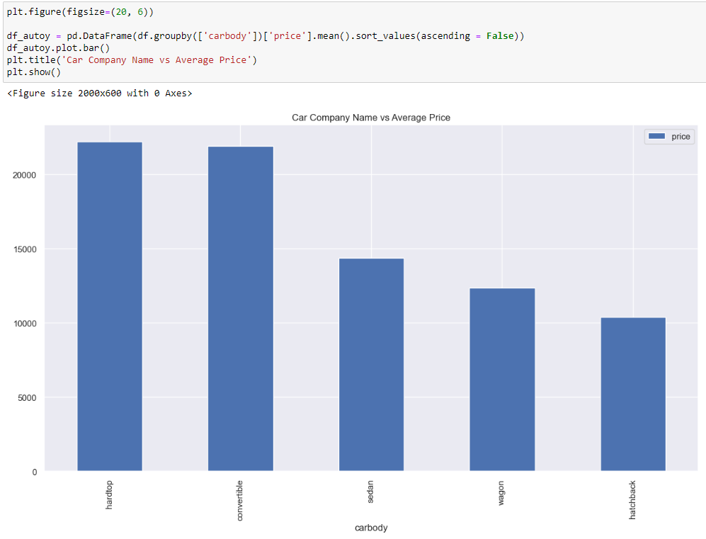
INSIGHTS
Hardtop and convertible seems to have the highest average price.

Slide 15
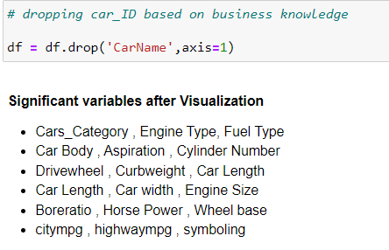
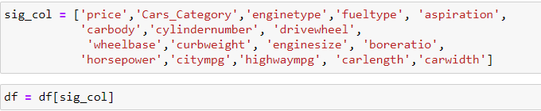

Slide 16
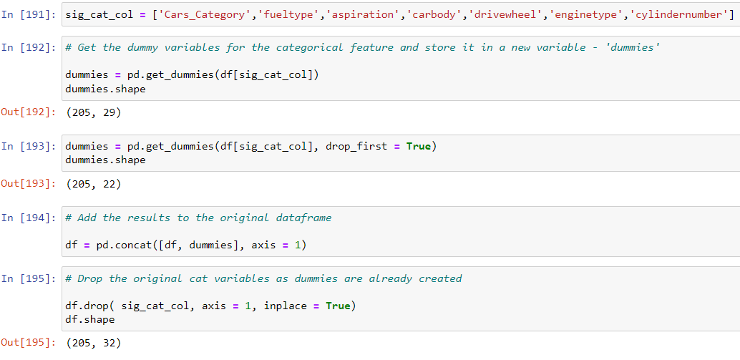
DATA PREPARATION
DUMMY VARIABLES
The variable carbody has five levels. We need to convert these levels into integer. Similarly we need to convert the categorical variables to numeric.
For this, we will use something called dummy variables

Slide 17
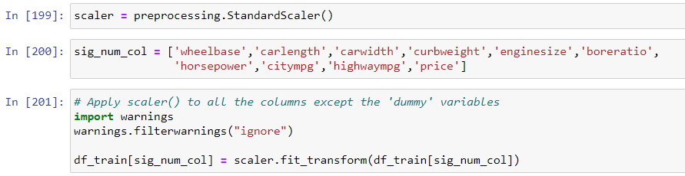
RESCALING THE FEATURES
For Simple Linear Regression, scaling doesn't impact model. So it is extremely important to rescale the variables so that they have a comparable scale. If we don't have comparable scales, then some of the coefficients as obtained by fitting the regression model might be very large or very small as compared to the other coefficients. There are two common ways of rescaling:
Min-Max scaling
Standardisation (mean-0, sigma-1)
Here, we will use Standardisation Scaling.

Slide 18
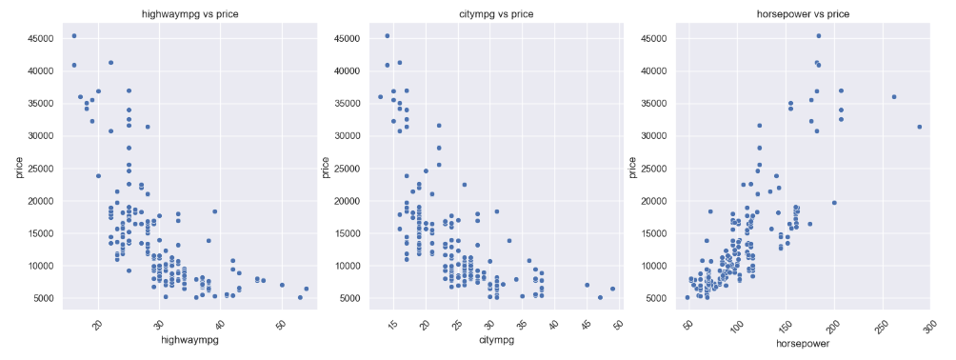
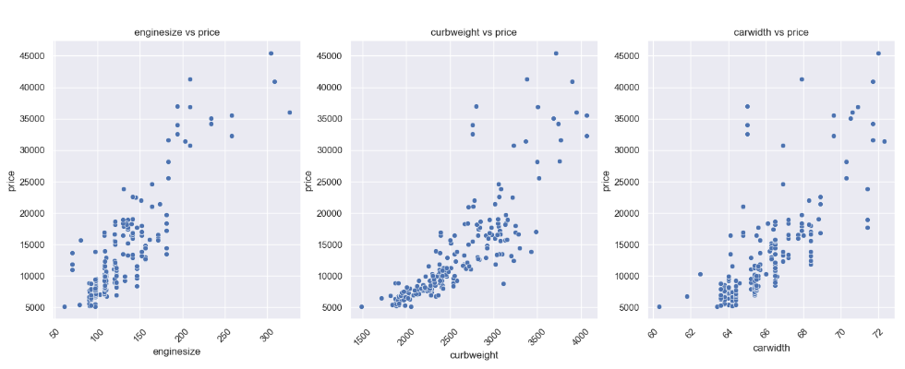
SCATTERPLOT FOR FEW CORRELATED VARIABLES VS PRICE

Slide 19

DIVIDING INTO X AND Y SETS FOR THE MODEL BUILDING
BUILDING A LINEAR MODEL
Sr.No | Variables | R-Squared | Adj (R-Squared)
1 | horsepower | 0.650 | 0.647
2 | horsepower + curbweight | 0.797 | 0.794
3 | horsepower + curbweight + enginesize | 0.819 | 0.815

Slide 20
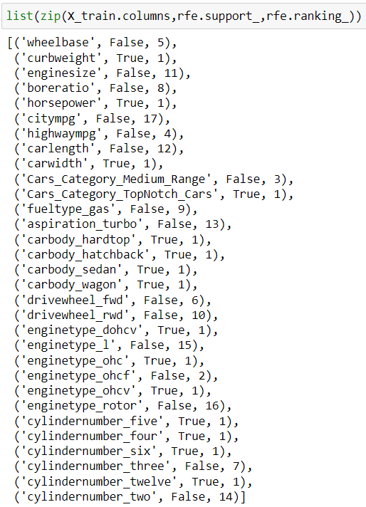
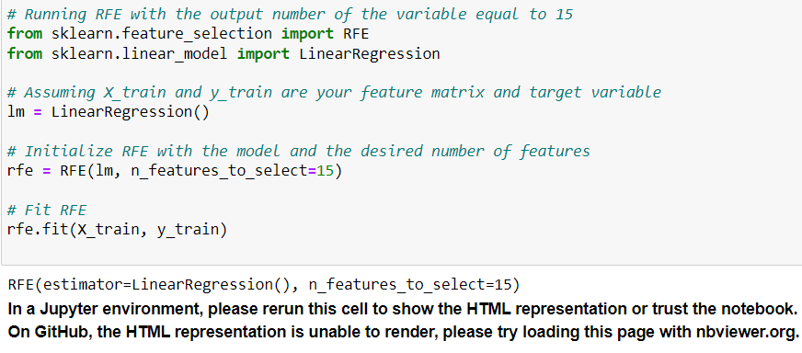
RFE Let's use Recursive feature elimination since we have too many independent variables

Slide 21
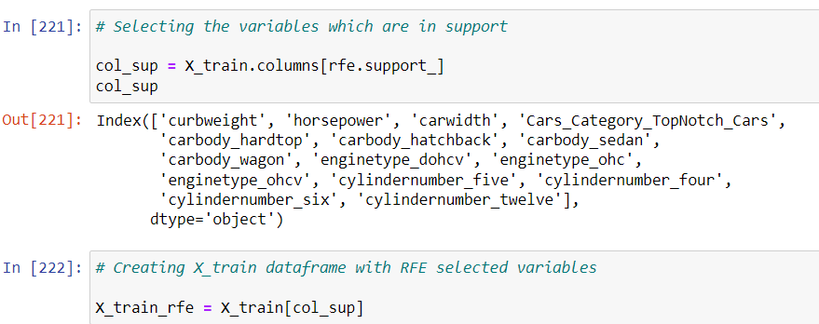
After passing the arbitary selected columns by RFE we will manually evaluate
each models p-value and VIF value. Unless we find the acceptable range for p-values
and VIF we keep dropping the variables one at a time based on below criteria.
High p-value High VIF : Drop the variable
High p-value Low VIF or Low p-value High VIF : Drop the variable with high p-value first
Low p-value Low VIF : accept the variable

Slide 22
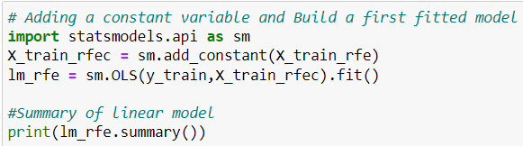
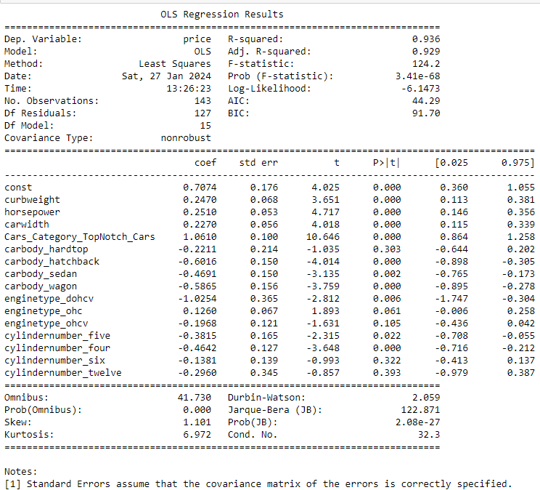
Looking at the p-values,
it looks like some of the
variables aren't really
significant (in the presence
of other variables) and we need to drop it.

Slide 23
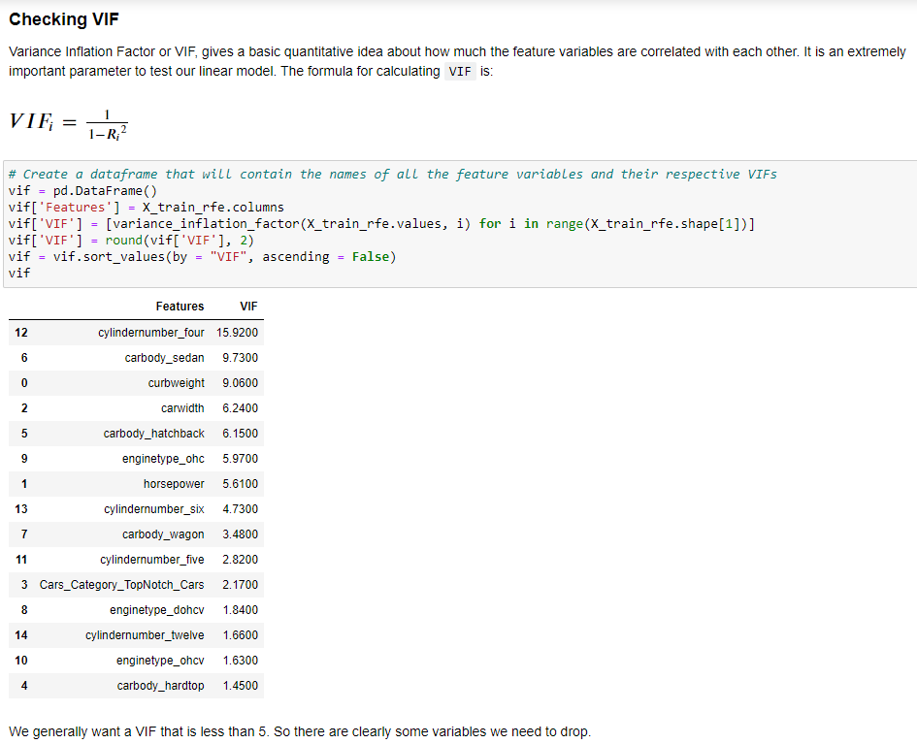

Slide 24
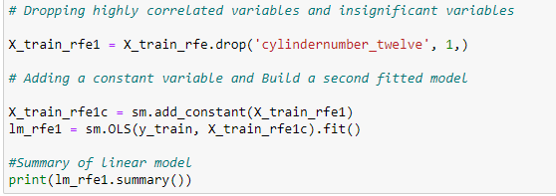
DROPPING THE VARIABLE AND UPDATING THE MODEL Dropping cylindernumber_twelve beacuse its p-value is 0.393 and we want p-value less than 0.05 and hence rebuilding the model

Slide 25
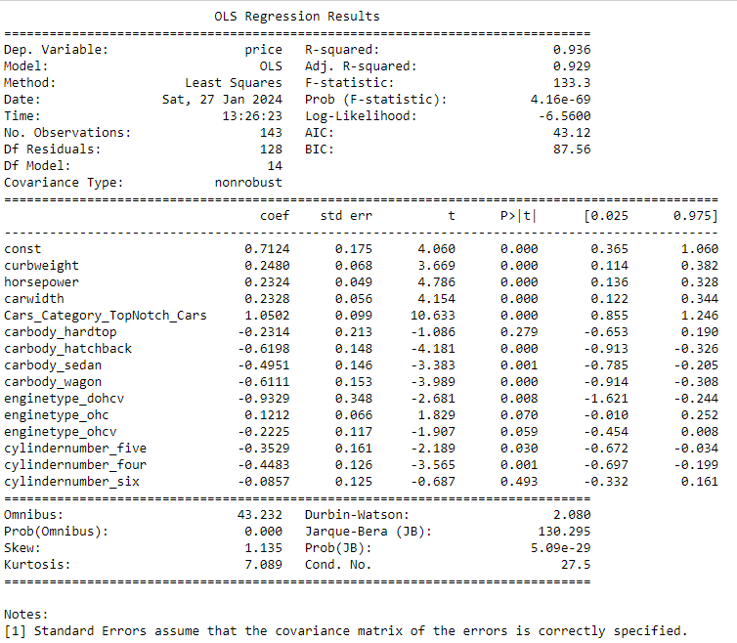

Slide 26
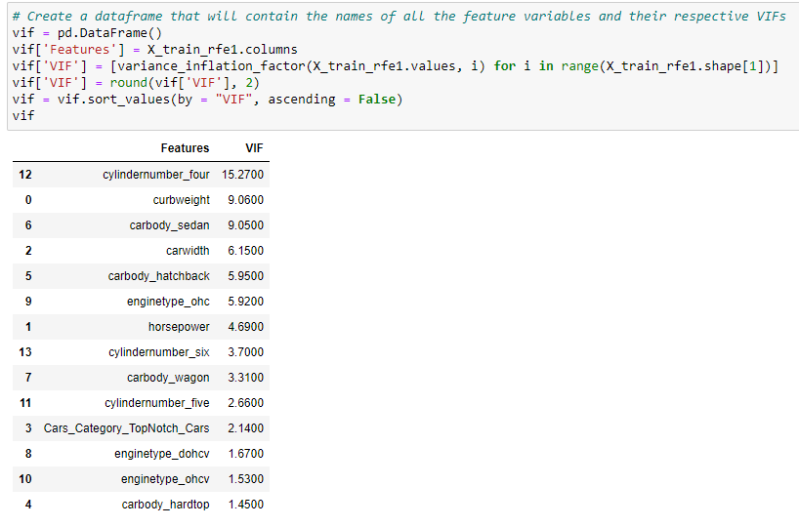
By this way we drop variables which having p-value more than 0.05 and Vif greater than 5.
Every time we get best model with significant variables.

Slide 27
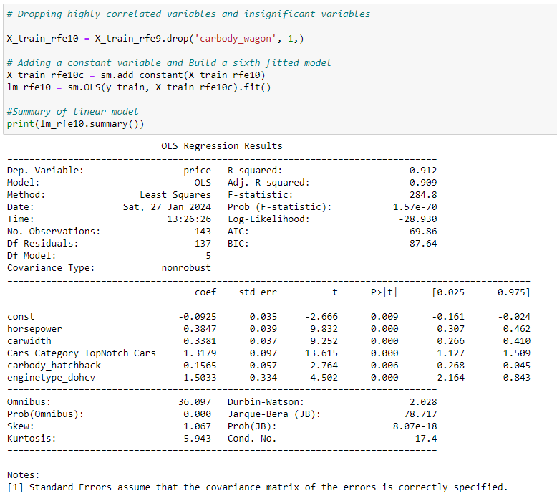

Slide 28
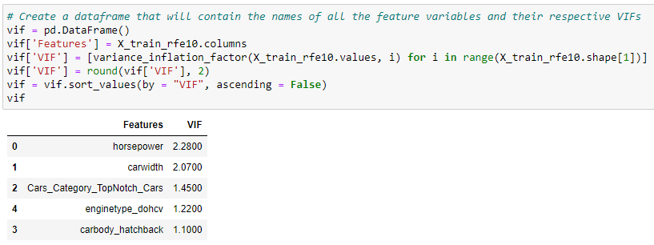
Now the VIFs and p-values both are within an acceptable range. So we can go ahead and make
our predictions using model lm_rfe10 and lm_rfe8.

Slide 29
HERE, WE ARE PROPOSING 3 MODELS WHICH CAN BE USED TO PREDICT THE CAR PRICES.
Model No. | ref Model No | R2 For Train_Set | R2 For Test_Set | No of features
Model I | lm_ref10 | 0.912 | 0.909 | 5
Model II | lm_rfe8 | 0.918 | 0.915 | 7
Model III | lm_rfe9 | 0.913 | 0.909 | 6
For every model:
We check if the error terms are also normally distributed(which is infact, one of the major assumption of linear regression), By ploting histogram of it.
Plot the graph for actual versus predicted values.

Slide 30
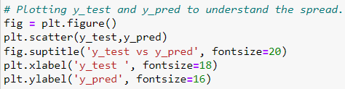
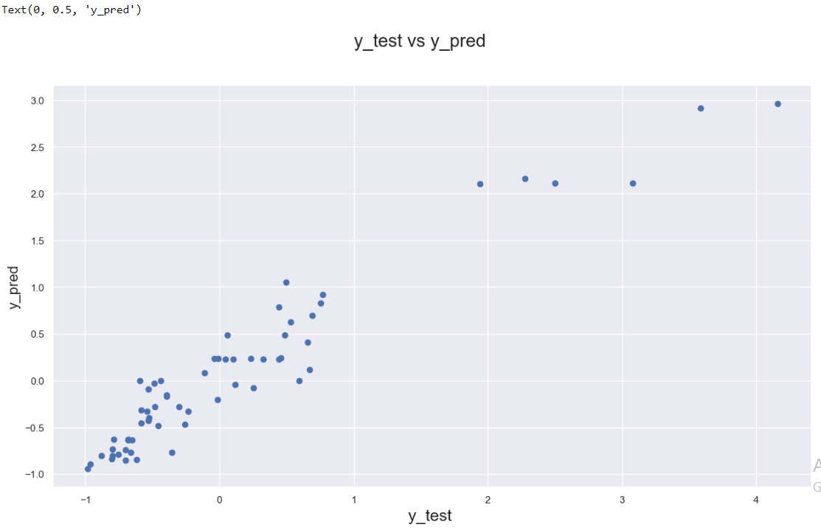
MODEL I EVALUATION Let's now plot the graph for actual versus predicted values

Slide 31

RMSE SCORE
The R2 score of Training set is 0.912 and Test set is 0.909 which is quite close. Hence, We can say that our model is good enough to predict the Car prices using below predictor variables
horsepower
carwidth
Cars_Category_TopNotch_Cars
carbody_hatchback
enginetype_dohcv
MODEL I CONCLUSIONS :
R-sqaured and Adjusted R-squared - 0.912 and 0.909 - 90% variance explained.
F-stats and Prob(F-stats) (overall model fit) - 284.8 and 1.57e-70(approx. 0.0) - Model fit is significant and explained 90% variance is just not by chance.
p-values - p-values for all the coefficients seem to be less than the significance level of 0.05. - meaning that all the predictors are statistically significant.
​

Slide 32
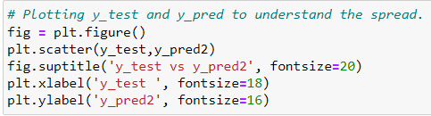

MODEL II EVALUATION
Let's now plot the graph for actual versus predicted values.

Slide 33

RMSE SCORE
The R2 score of Training set is 0.918 and Test set is 0.915 which is quite close. Hence, We can say that our model is good enough to predict the Car prices using below predictor variables
horsepower
carwidth
Cars_Category_TopNotch_Cars
carbody_hatchback
enginetype_dohcv
carbody_sedan
carbody_wagon
MODEL II CONCLUSIONS :
R-sqaured and Adjusted R-squared - 0.918 and 0.915 - 913.53% variance explained.
F-stats and Prob(F-stats) (overall model fit) - 215.9 and 4.70e-70(approx. 0.0) - Model fit is significant and explained 90% variance is just not by chance.
p-values - p-values for all the coefficients seem to be less than the significance level of 0.05. - meaning that all the predictors are statistically significant.

Slide 34
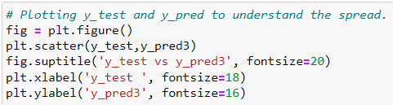

MODEL III EVALUATION
Let's now plot the graph for actual versus predicted values.

Slide 35

RMSE SCORE
The R2 score of Training set is 0.913 and Test set is 0.909 which is quite close. Hence, We can say that our model is good enough to predict the Car prices using below predictor variables
horsepower
carwidth
Cars_Category_TopNotch_Cars
carbody_hatchback
enginetype_dohcv
carbody_sedan
MODEL III CONCLUSIONS:
R-sqaured and Adjusted R-squared - 0.913 and 0.909 - 90.93% variance explained.
F-stats and Prob(F-stats) (overall model fit) - 237.9 and 1.68e-69(approx. 0.0) - Model fit is significant and explained 91.53% variance is just not by chance.
p-values - p-values for all the coefficients seem to be less than the significance level of 0.05. - meaning that all the predictors are statistically significant.

Slide 36
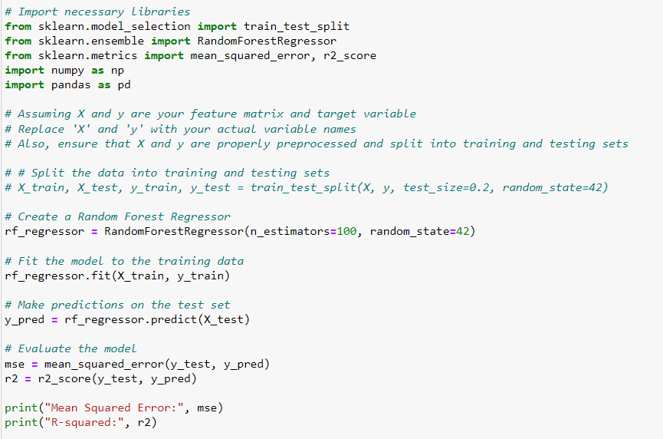
RANDOM FOREST MODEL
Mean Squared Error: 0.10864050636633965
R-squared: 0.9061060862540271
R-squared value is 0.906 it means that model is 90% variance explained

Slide 37
Business Insight with best feature
1.Horsepower Impact on Price: The variable horsepower is a significant predictor of car price in the model. This suggests that the power or performance of the car's engine, as indicated by its horsepower, has a strong influence on its price. For business stakeholders, this emphasizes the importance of engine performance in determining the market value of a car.
2.Car Size (Car Width) Matters: The variable carwidth is included in the model, indicating that the physical dimensions of the car, particularly its width, play a crucial role in determining its price. This could align with consumer preferences for larger or more spacious vehicles, and it implies that car size contributes to perceived value.
3.Top-Notch Cars and Price Premium: The presence of Cars_Category_TopNotch_Cars as a predictor suggests that certain categories of cars, likely those classified as "TopNotch," command a price premium. Businesswise, this could signify that high-end or premium cars with special features, advanced technology, or luxury amenities tend to have higher price tags.
4.Car Body Type Impact: The inclusion of carbody_hatchback as a predictor implies that the type of car body can influence its price. In this case, hatchback cars might have a distinct pricing pattern compared to other body types. This insight could guide marketing and pricing strategies based on the popularity or uniqueness of different car body styles.
5.Special Engine Type (dohcv): The variable enginetype_dohcv indicates that cars with a specific engine type (double overhead camshaft, DOHC, with variable valve timing) have a notable impact on price. This could suggest that advanced or specialized engine technologies contribute to the overall value of a car.

Slide 38
SUMMARY
Understanding Customer Preferences: The identified variables offer insights into customer preferences and priorities when it comes to purchasing cars. For example, customers may place a premium on powerful engines, spacious interiors, certain body styles, or technologically advanced features.
Targeted Marketing Strategies: The business can leverage these insights to tailor marketing strategies. For instance, emphasizing the powerful engines and advanced features of certain car models, highlighting size and spaciousness, and promoting premium categories can be part of targeted marketing campaigns.
Pricing Strategy: The model suggests that certain features and characteristics contribute significantly to a car's perceived value. Adjusting pricing strategies based on these insights can help optimize revenue and align prices with customer expectations. In summary, the identified variables offer valuable insights into the factors influencing car prices. This understanding can inform strategic decisions related to product development, marketing, and pricing, ultimately contributing to the business's competitiveness in the automotive market.
All the models are good enough to predict the carprices which explains the variance of data upto 90% and the model is significant.

Slide 39
THANK YOU

