Slide 1
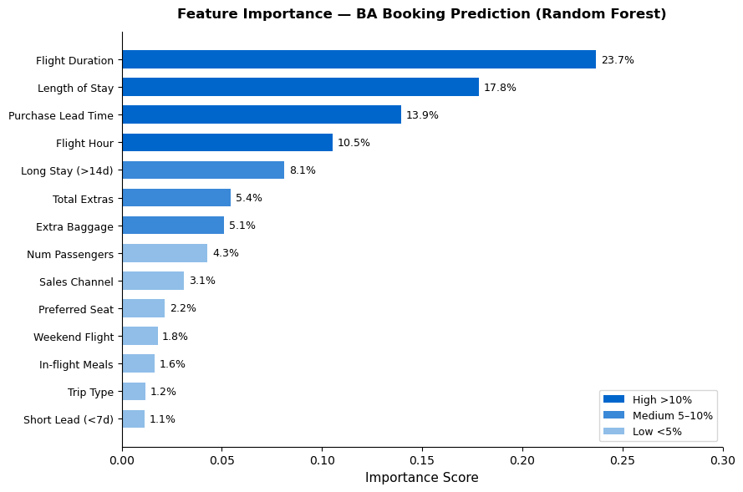
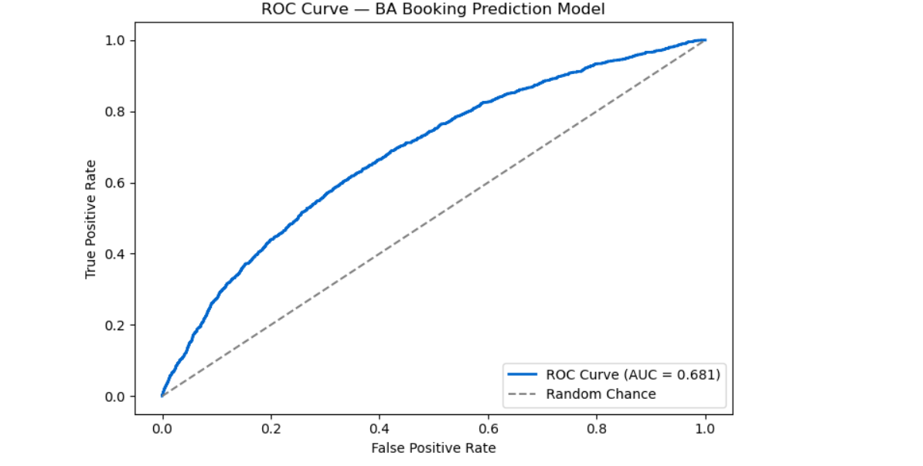
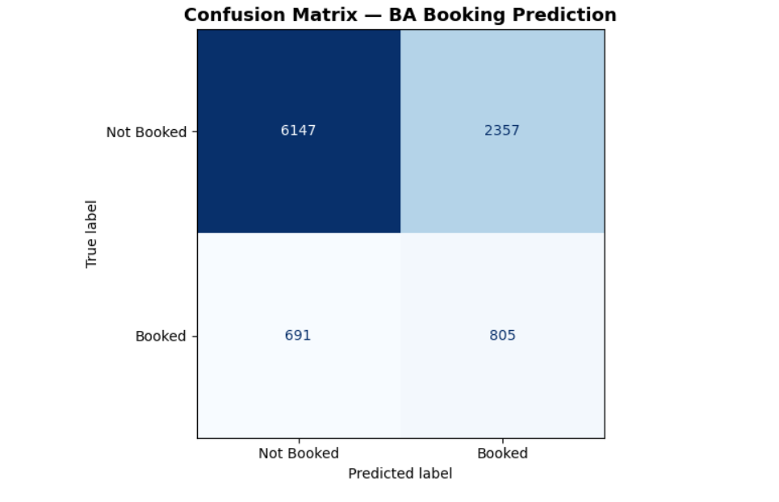
CUSTOMER BOOKING PREDICTION — BRITISH AIRWAYS
Random Forest Model | ROC-AUC: 0.681 | 3-Fold Cross-Validation | 50,000 Records
Key Findings:
• Flight Duration is the #1 predictor (23.7%)
• Length of Stay + Purchase Lead = 31.7% combined
• Add-on selection signals purchase intent
• Internet bookings convert at 15.5% vs Mobile at 10.8%
• Model ROC-AUC: 0.681 - actionable predictive power

