Slide 1

Grocery Store Management

Slide 2
About me
Kirthi Saloni (B.Tech)
I have always been interested in understanding how data can be used to solve real world problems and support better decision making. I enjoy analyzing information, identifying patterns, and discovering meaningful insights from data. What attracts me most to Data Science is its combination of analytical thinking, programming, and problem solving to create practical solutions.
LinkedIn: www.linkedin.com/in/kirthi-saloni
GitHub: https://github.com/kirthisaloni

Slide 3
Objective of the Project
The main goals of this SQL project are:
● To design and implement a relational database for a grocery store.
● To retrieve and manipulate data using SQL queries.
● To perform data analysis for business insights such as top customers, best-selling products, and revenue trends.
● To practice using joins, aggregations, subqueries, and filtering techniques.

Slide 4
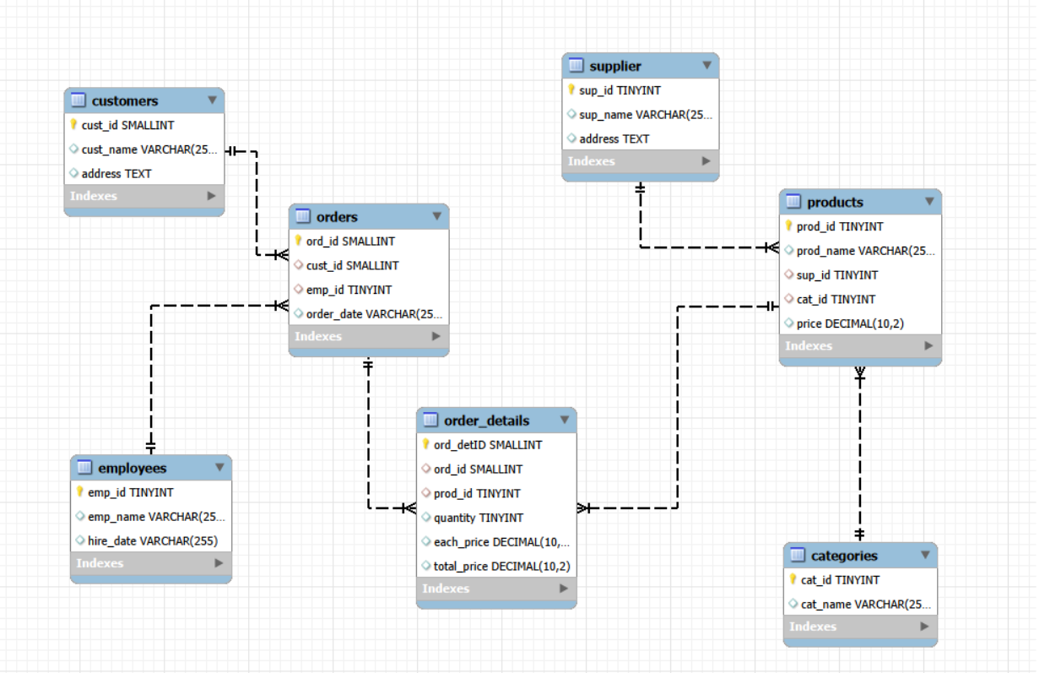
ER diagram

Slide 5


Key Analysis questions
Customer Insights :
How many unique customers have placed orders?
A large number of unique customers placed orders, indicating strong customer engagement.

Slide 6
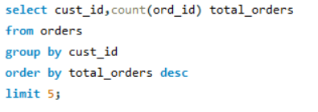
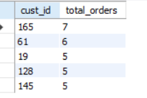
2. Which customers have placed the highest number of orders?
A few customers placed significantly more orders, demonstrating strong customer loyalty.

Slide 7
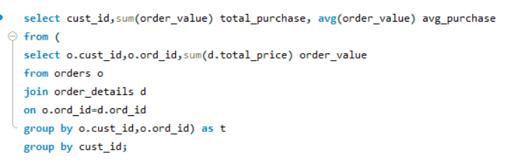
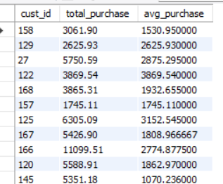
3. What is the total and average purchase value per customer?
Customer spending varies, with some customers contributing higher purchase values than others.

Slide 8
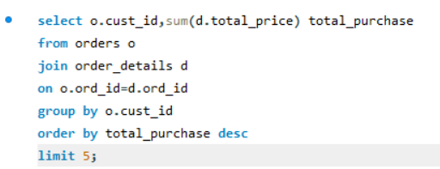
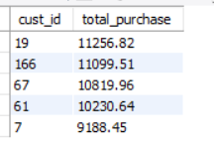
4. Who are the top 5 customers by total purchase amount?
The top 5 customers generated a significant portion of the store's total revenue.

Slide 9
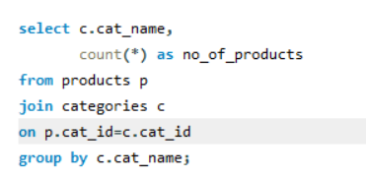
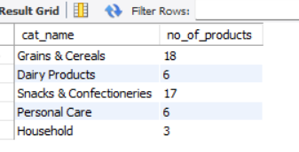
Product Performance
1. How many products exist in each category?
The above code shows the distribution of products across different categories.

Slide 10
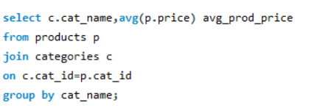
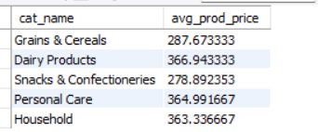
2. What is the average price of products by category?
Average product prices differ across categories, indicating varied pricing strategies.

Slide 11
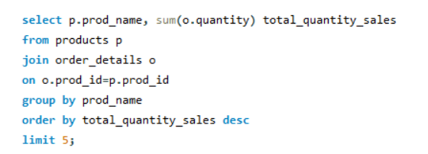
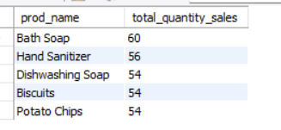
3. Which products have the highest total sales volume (by quantity)?
This code identifies the most frequently purchased products.

Slide 12
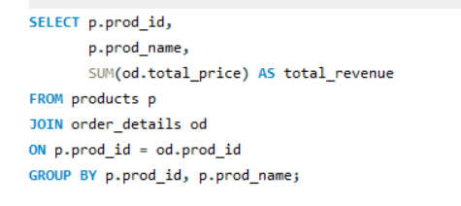
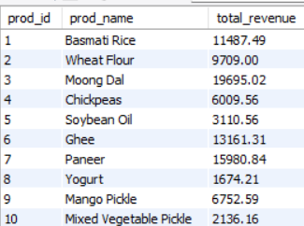
4. What is the total revenue generated by each product?
Revenue is primarily driven by a small number of high performing products.

Slide 13
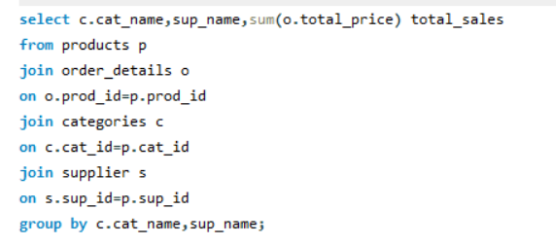
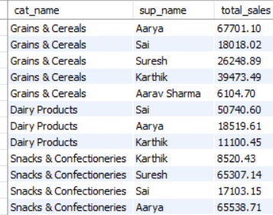
5. How do product sales vary by category and supplier?
Sales performance varies across categories and suppliers, with some combinations generating higher revenue.

Slide 14


Sales and Order Trends
1. How many orders have been placed in total?
The store processed a 300 orders, reflecting steady business activity.

Slide 15
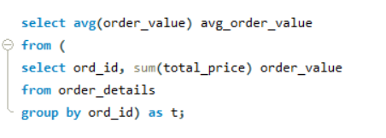

2. What is the average value per order?
The average order value indicates consistent customer spending per transaction.

Slide 16
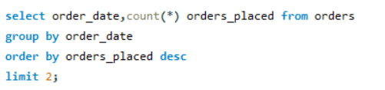
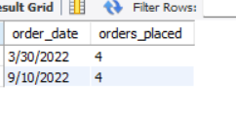
3. On which dates were the most orders placed?
10th of September and 30th of March have experienced higher order volumes, indicating peak shopping periods.

Slide 17
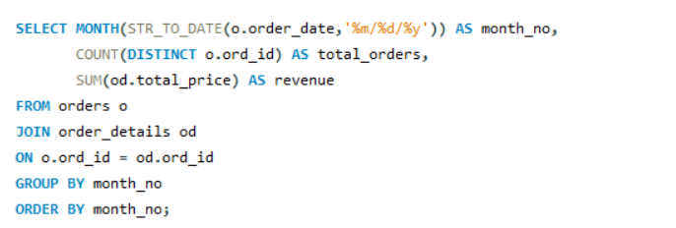
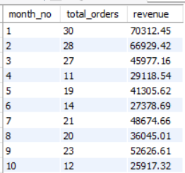
4. What are the monthly trends in order volume and revenue?
Order volume and revenue fluctuate across months, suggesting seasonal sales trends.

Slide 18
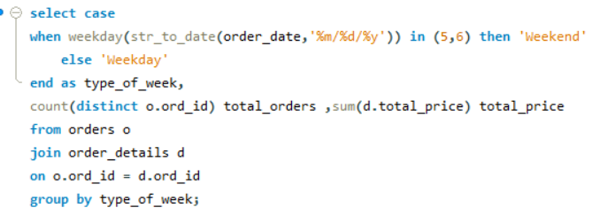
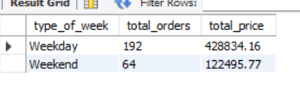
5. How do order patterns vary across weekdays and weekends?
Customer purchasing behavior differs between weekdays and weekends.

Slide 19


Supplier Contribution
1. How many suppliers are there in the database?
The store works with multiple suppliers, ensuring a diverse product supply. There are total 5 suppliers in the database

Slide 20
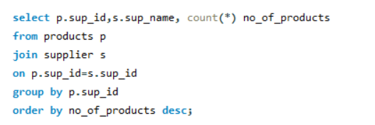
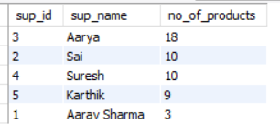
2. Which supplier provides the most products?
Aarya contributes the largest share of products in the inventory.

Slide 21
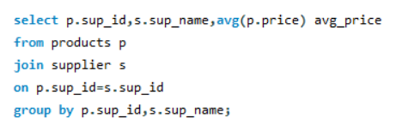
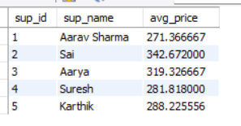
3. What is the average price of products from each supplier?
Average product prices vary among suppliers based on their product offerings.

Slide 22
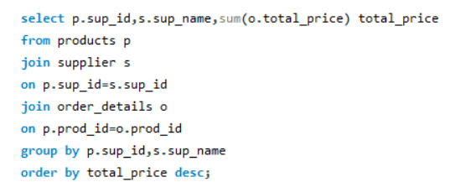
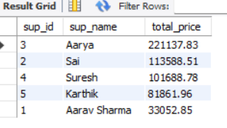
4. Which suppliers contribute the most to total product sales
(by revenue)?
Aarya generate the highest product sales revenue for the store.

Slide 23

Employee Performance
1. How many employees have processed orders?
10 employees have actively participated in processing customer orders.

Slide 24
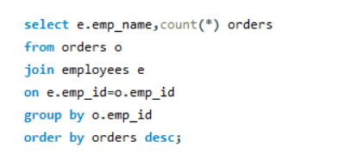
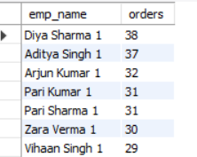
2. Which employees have handled the most orders?
It Identifies employees with the highest order handling workload.

Slide 25
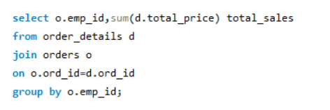
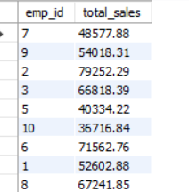
3. What is the total sales value processed by each employee?
Employee contributions to total sales vary based on the orders they processed.

Slide 26
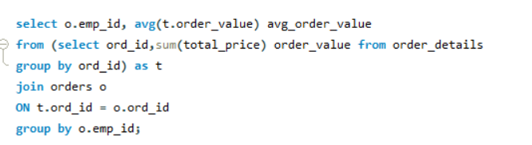
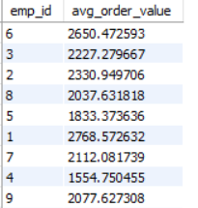
4. What is the average order value handled per employee?
Compares employee performance based on average order value managed.

Slide 27
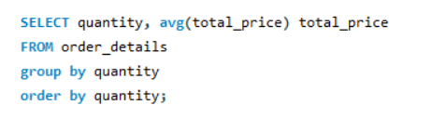
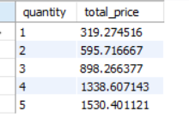
Order Details Deep Dive
1. What is the relationship between quantity ordered and total price?
Higher order quantities generally result in higher total purchase values.

Slide 28
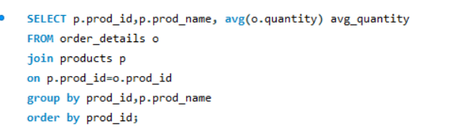
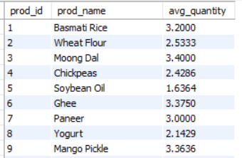
2. What is the average quantity ordered per product?
Average order quantities vary across products, indicating different customer demand levels.

Slide 29
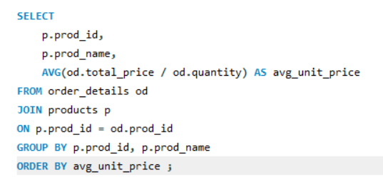
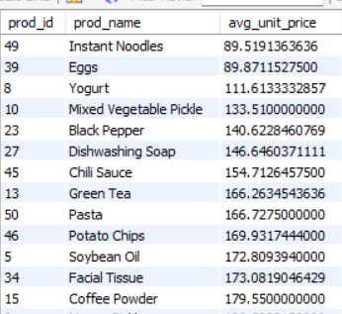
3. How does the unit price vary across products and orders?
Unit prices differ across products, reflecting variations in product type and pricing.

Slide 30
Conclusion
Customer purchasing behavior is not evenly distributed, as a small number of products and customers contribute significantly to total sales.
Sales performance varies across products, categories, suppliers, and time periods, highlighting opportunities to improve inventory management and marketing strategies.
Products with higher order frequency and larger order values generate the highest revenue, making them key contributors to business growth.
Customer demand changes between weekdays and weekends, providing useful insights for planning promotions and managing stock effectively.
Overall, the analysis demonstrates how SQL can transform raw transactional data into meaningful insights that support better inventory management, customer targeting, pricing decisions, and sales planning.

Slide 31
Challenges
Understanding the relationships between different tables and using the correct JOINs to retrieve accurate data.
Maintaining data consistency by using Primary Keys and Foreign Keys correctly.
Writing GROUP BY and aggregate function queries to summarize and analyze data.
Converting date values stored as VARCHAR to analyze sales trends by weekdays, weekends, and months.
Debugging SQL errors and verifying that the query results were accurate and matched the project requirements.

Slide 32

THANK YOU

