Slide 1
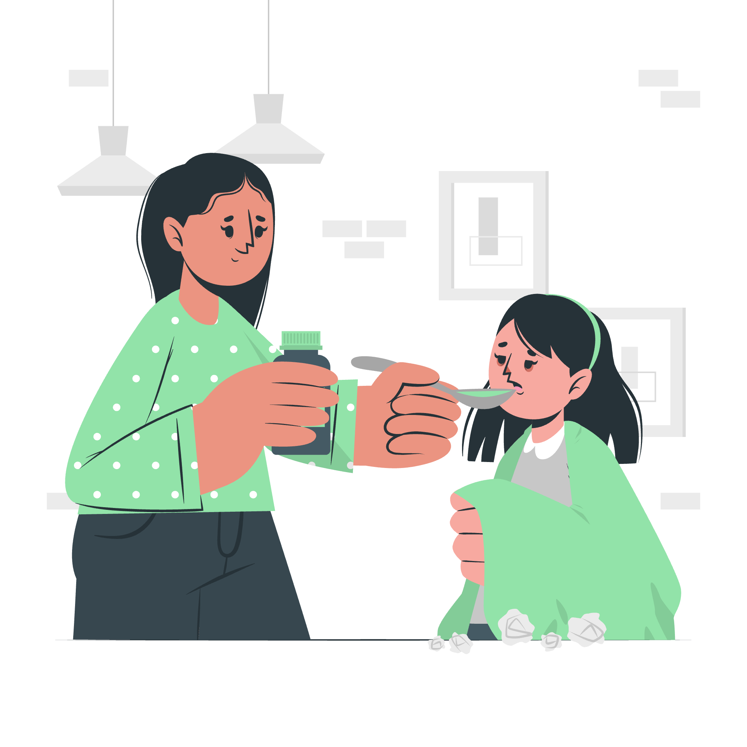
Care trace
An Agentic AI Platform for after hour triage
Team Members: Kirthi Shanbhag , Niyanthri Naresh, Sohail Khan, XinRan Zhang Date : Apr 13 ‘26

Slide 2
Table of contents
01
02
03
04
05
08
Introduction
Code Structure
Architecture
Knowledge Base
06
07
Rule Base Design
Extended Case
Evaluation
Conclusion/Takeaway/Scaling/Future/What Domain can it be applied?

Slide 3

Introduction
Problem Statement After-hours pediatric illness sits in a dangerous gap — too worrying to ignore, rarely clear enough to act on. Parents deciding alone either over-escalate to the ER unnecessarily or delay care that was actually needed. Existing symptom checkers are static and one-directional. General-purpose AI assistants produce fluent but inconsistent answers — reasoning that shifts across turns of the same conversation, making them unsafe to trust for triage.
Our Objective Build CareTrace as a working Neurosymbolic AI agent that produces a safe, actionable triage plan — not just fluent conversation. A clear disposition, crisp escalation thresholds, and reasoning that stays consistent across every turn, regardless of how the parent phrases their concern.
Scope Pediatric febrile illness with GI symptoms and dehydration risk in children under 12. After-hours, caregiver-facing triage only — not a diagnostic tool, not a replacement for clinical care. The agent covers three dispositions: go to the ER now, see a doctor today, or manage safely at home tonight.
Notes:
Open by setting the scene — don't jump to the tech yet. Put the audience in the parent's shoes. It's late, you're tired, your kid is sick, and every option feels either too much or not enough. That helpless 2 AM feeling is the problem we're solving.
The "physician on the phone" framing is the north star. Not a symptom checker, not a search engine — a calm, structured back-and-forth that arrives at a decision. That's a much higher bar than just returning medically accurate text. It means the system has to ask the right questions in the right order, actually commit to a recommendation, and tell you exactly when to change course.
Two things to call out from the objective statement. First, "Neurosymbolic" — this is the key architectural choice. We're not relying on the language model alone for the safety-critical decisions. A deterministic rule engine handles triage logic, and the LLM handles conversation. Each doing what it's actually good at. Second, "consistent across multiple turns" — this is harder than it sounds. LLMs drift. Ask the same clinical question three different ways and you might get three different answers. The rule engine prevents that. The disposition always comes from the same logic, no matter how the conversation unfolds.
Close by transitioning: the next slide shows exactly how that rule engine works under the hood.

Slide 4
Code Structure
Agents
Logic
Parse caregiver text into a small structured case; generate replies, CPG-style medication language, and explanations.
Run deterministic triage rules (ER / urgent / home), record which rules fired, and surface med-related flags.
Graph
Orchestration
Query Neo4j for CPG-aligned concepts; add optional annotations; does not decide disposition by itself.
Wire the turn in order: interpret → graph → rules → explain, including handling missing required fields.

Slide 5
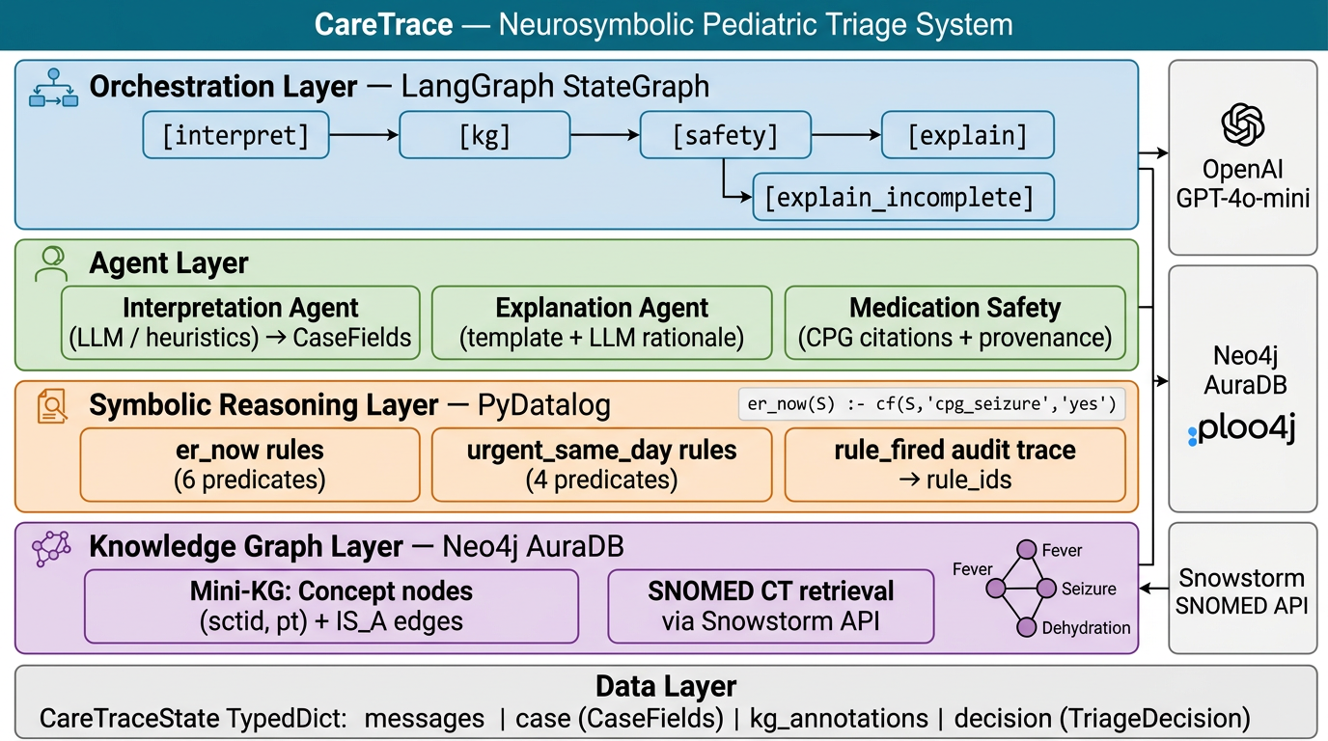
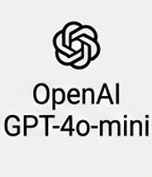
System Architecture
Ollama
Extended case

Slide 6
Knowledge & Rules
Initial presentation with chief complaint
Diagnostic evaluation and investigations
Confirmation of
the diagnosis
Initiation of appropriate treatment
Monitoring response to the treatment
Resolution of presenting symptoms
Follow-up assessment for outcomes
Case discussion and lessons learned

Slide 7
PyDatalog Pediatric Triage Engine
[Deterministic Rule Evaluation Flow]
① INPUT
② FACTS
③ RULES
④ LOGIC
⑤ OUTPUT
age_months / age_years
_case_to_facts()
Converts fields → cf(S, name, val)
er_now(S)
er_now(S)?
→ ER_NOW
ER_NOW
temp_f
urgent_same_day(S)
dehydration_severe = yes
poor fluid + no urine
urgent_same_day?
→ URGENT_SAME_DAY
URGENT
SAME_DAY
alertness
dehydration_risk = yes
one of above
breathing
home_candidate(S)
home_candidate?
→ HOME_MANAGEMENT
on_antibiotic = yes
if current_meds non-empty
HOME
MANAGEMENT
fluid_intake / urine_last_8h
cpg_infant_under_3mo_fever
age<3mo + temp>100.4
rule_fired(S, R)
else
→ OUT_OF_SCOPE
vomiting
cpg_ibuprofen_contraind.
age < 6 months
current_meds
OUT_OF
SCOPE
med_flag(S, M)
required_missing()
→ OUT_OF_SCOPE
incomplete_intake
cpg_fever_duration_3_days
hours ≥ 72
seizure / fever_duration_hours
temp_f = very_high
temp ≥ 104°F
Session-scoped cf(S,name,val) facts · PyDatalog backward-chaining · Rules evaluated once per uuid session
🔔 med_flag predicates: dehydration_avoid_nsaid · antibiotic_review_interactions · ibuprofen_under_6mo · no_routine_antipyretic_under_3mo
Notes:
OVERVIEW (say this first) So what are we looking at here? This is the full decision pipeline — from the moment a parent calls in about their sick kid, all the way to telling them whether to go to the ER, see a doctor today, or manage at home. The whole thing is powered by a logic engine called PyDatalog, which evaluates deterministic rules. No AI guessing — just rules that fire or don't fire based on what the parent tells us. --- ① INPUT — "What we ask the parent" These are the eight pieces of information we collect from the parent or caregiver upfront. Things like: how old is the child, what's their temperature, are they alert and responsive, are they drinking fluids, have they urinated in the last 6-8 hours. This is the raw intake. Nothing gets evaluated until we have these answers. If any of the critical ones are missing, we stop and ask before going any further — that's the "required_missing()" guard you see in the top-right corner. --- ② FACTS — "What the engine derives from those answers" Once we have the raw inputs, _case_to_facts() converts them into a structured form the rule engine can work with. It also derives additional facts automatically. For example: if the child has poor fluid intake AND no urine output, the engine marks dehydration_severe = yes. If the child is under 3 months old with a fever over 100.4°F, it flags cpg_infant_under_3mo_fever. These derived facts encode clinical logic so the rules downstream stay clean and readable. --- ③ RULES — "The actual clinical logic" This is where PyDatalog earns its keep. We have three main predicates: - er_now(S) — fires if ANY hard ER trigger is present: altered alertness, respiratory distress, severe dehydration, seizure, infant with fever, etc. - urgent_same_day(S) — fires for things that need a doctor today but not the ER: very high fever, repeated vomiting with poor intake, fast breathing, or fever lasting more than 3 days. - home_candidate(S) — only fires if the child looks alert, is breathing normally, and is taking some fluids, AND neither of the above rules fired. The rule_fired and med_flag predicates run alongside these — they're used for the audit trail and medication safety checks respectively. --- ④ LOGIC — "How we pick the final answer" Python evaluates the predicates in strict priority order. ER first. If that doesn't fire, check urgent. If that doesn't fire, check home. If nothing fires, we return OUT_OF_SCOPE — which usually means the case is ambiguous and needs a human to look at it. The key thing to stress here: these are mutually exclusive. You can't get "ER + urgent" at the same time. --- ⑤ OUTPUT — "What gets handed back" The final disposition: ER_NOW (red), URGENT_SAME_DAY (amber), HOME_MANAGEMENT (green), or OUT_OF_SCOPE (grey). Each one comes bundled with the list of rule IDs that fired — so there's a full audit trail — and any medication safety flags. --- MED FLAGS (pink footer) These are parallel safety signals that fire independently of the disposition. So even if the outcome is "home management," the system might still flag "don't give ibuprofen — child is under 6 months" or "this child is dehydrated, be cautious with NSAIDs." They don't change the disposition, they just ride alongside it. --- KEY POINT TO LEAVE THEM WITH The whole thing is deterministic and explainable. Every decision can be traced back to exactly which rules fired and why. No black box. That matters a lot in a clinical context where you need to be able to say: "here's why we told that family to go to the ER."

Slide 8
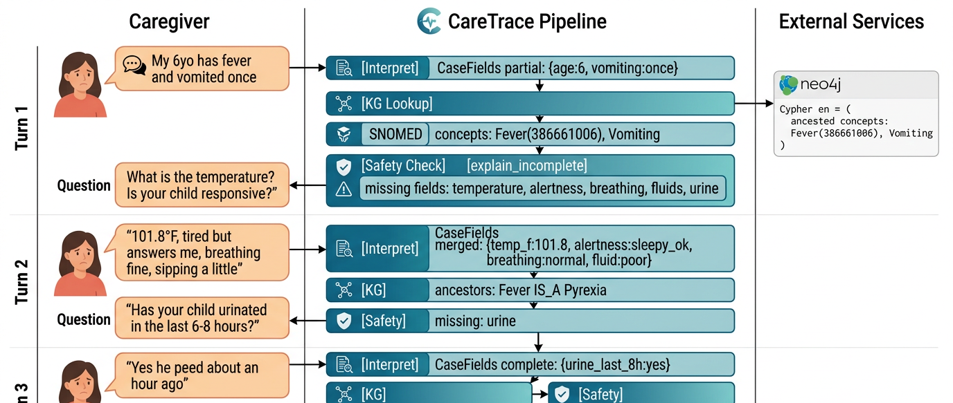
Conversational Flow
Turn 1
Turn 2
Turn 3
Final Disposition

Slide 9
Code structure
Our design :chat-based interaction is enough. Not a Fruont end based ui
Snowmed IDS
Mini Kn woledge graph
Design,
Challenges
system behavior.
Emphasis on:
Safety and constraint handling
Reasoning quality
System integration (not “weak” or superficial connections)

Slide 10
Baseline Model Comparison
 | Age | Gender | M. history | Symptoms | Diagnosis
Patient 1 | 45 | Male | Hypertension | Symptom | Diagnosis 1
Patient 2 | 32 | Female | Asthma | Symptom | Diagnosis 2
Patient 3 | 60 | Male | Diabetes | Symptom | Diagnosis 3
Patient 4 | 50 | Female | None | Symptom | Diagnosis 4
Patient 5 | 28 | Male | None | Symptom | Diagnosis 5
Patient 6 | 70 | Female | Osteoarthritis | Symptom | Diagnosis 6

Slide 11
Baseline Model Comparison
Patient profile
Clinical findings
Diagnostic
Include essential demographic information such as age, gender, and medical history. Describe the patient's chief complaint and the timeline of symptoms leading to the diagnosis
Present an overview of the patient's physical examination findings, laboratory test results and any imaging or diagnostic procedures. Highlight key abnormalities that aid in the diagnosis
Outline the diagnostic process, including the reasoning behind the chosen investigations and tests. Discuss the results, their interpretation and their contribution to reaching the final diagnosis

Slide 12
Evaluation
Differential diagnosis
Treatment
Explore potential diagnoses based on the patient's presentation and relevant findings. Discuss distinguishing features for each and reasons for inclusion/exclusion
Present the confirmed diagnosis and explain diagnostic criteria. Outline the chosen treatment approach and rationale behind it
Clinical course
Lesson learned
Describe the patient's progression, treatment response and any significant events or complications. Summarize the final outcome
Discuss the case's educational value, highlighting unique aspects. Share insights gained, including diagnostic challenges, treatment considerations or disease mechanisms

Slide 13
Conclusion
Challenge
Success
Lessons
Address any diagnostic challenges, emphasizing the importance of thorough and detailed investigation with clinical reasoning
Highlight successful outcomes achieved through the chosen treatment approach, showcasing effectiveness
Summarize valuable lessons learned, providing insights to guide future clinical decision-making and enhance care
Significance
Research
Summary
Emphasize the case's educational value, impact on medical knowledge, professional development, and learning
Identify areas for future investigation that have emerged from the case, stimulating advancements
End with a concise concluding statement, summarizing the overall significance of the case

Slide 14
Thank you
Q&A

Slide 15
Appendix

Slide 16
Illustration and Slide Source
Acknowledgment

Slide 17
Contents of this template
You can delete this slide when you’re done editing the presentation
Fonts | To view this template correctly in PowerPoint, download and install the fonts we used
Used and alternative resources | An assortment of graphic resources that are suitable for use in this presentation
Thanks slide | You must keep it so that proper credits for our design are given
Colors | All the colors used in this presentation
Icons and infographic resources | These can be used in the template, and their size and color can be edited
Editable presentation theme | You can edit the master slides easily. For more info, click here
For more info: Slidesgo | Blog | FAQs
You can visit our sister projects: Freepik | Flaticon | Storyset | Wepik | Videvo

Slide 18
50,000
20,000
5,000
Patients on the study
Received placebo treatment
Had secondary effects

Slide 19
95%
Use percentages in your case report to quantify and communicate the frequency or proportion of important findings or outcomes

Slide 20
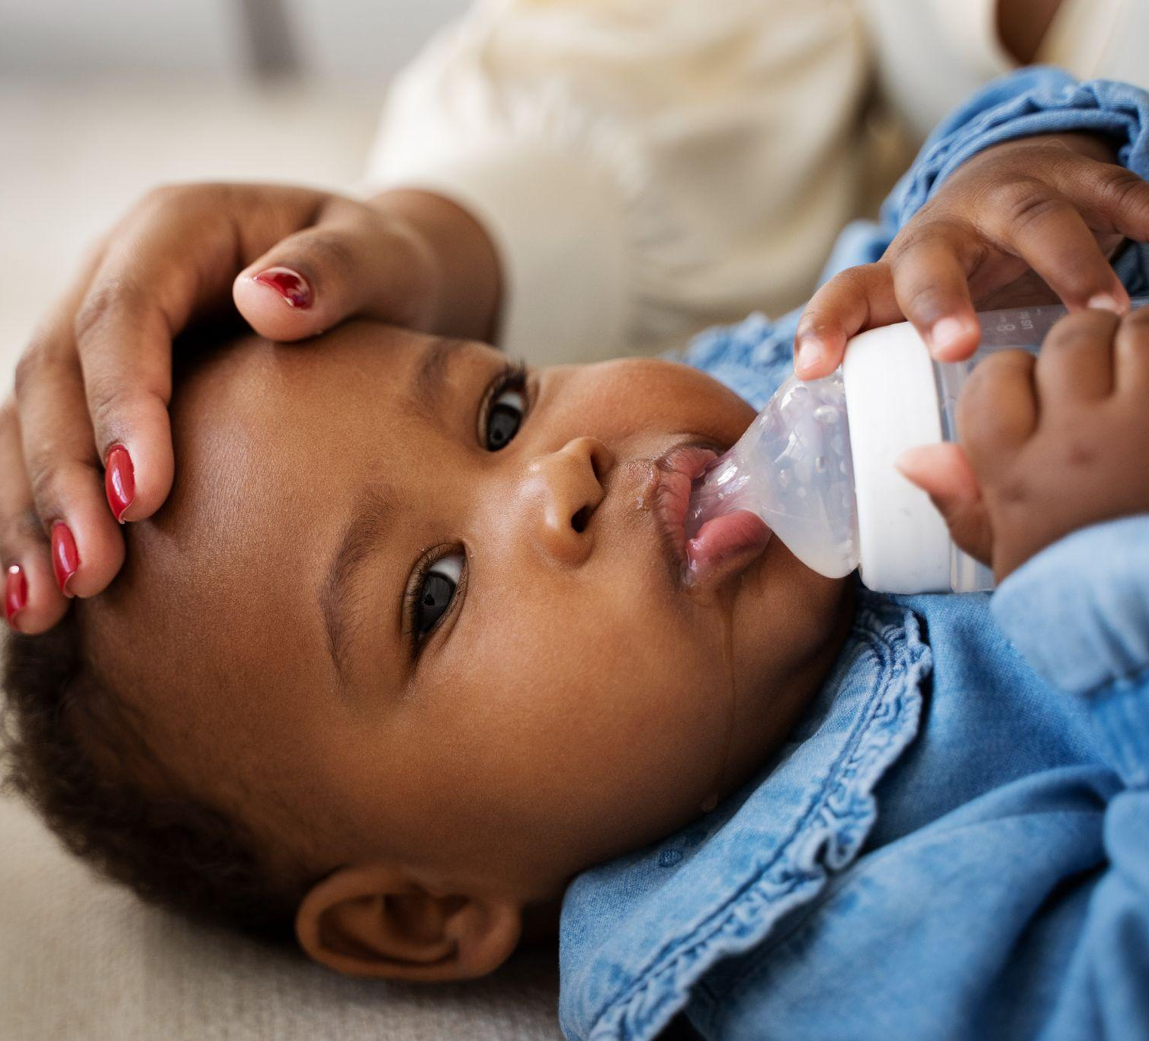
A picture is worth a thousand words
Using an image in your case report enhances visual representation and provides a concise and impactful way to present key findings or illustrate important aspects of the case

Slide 21
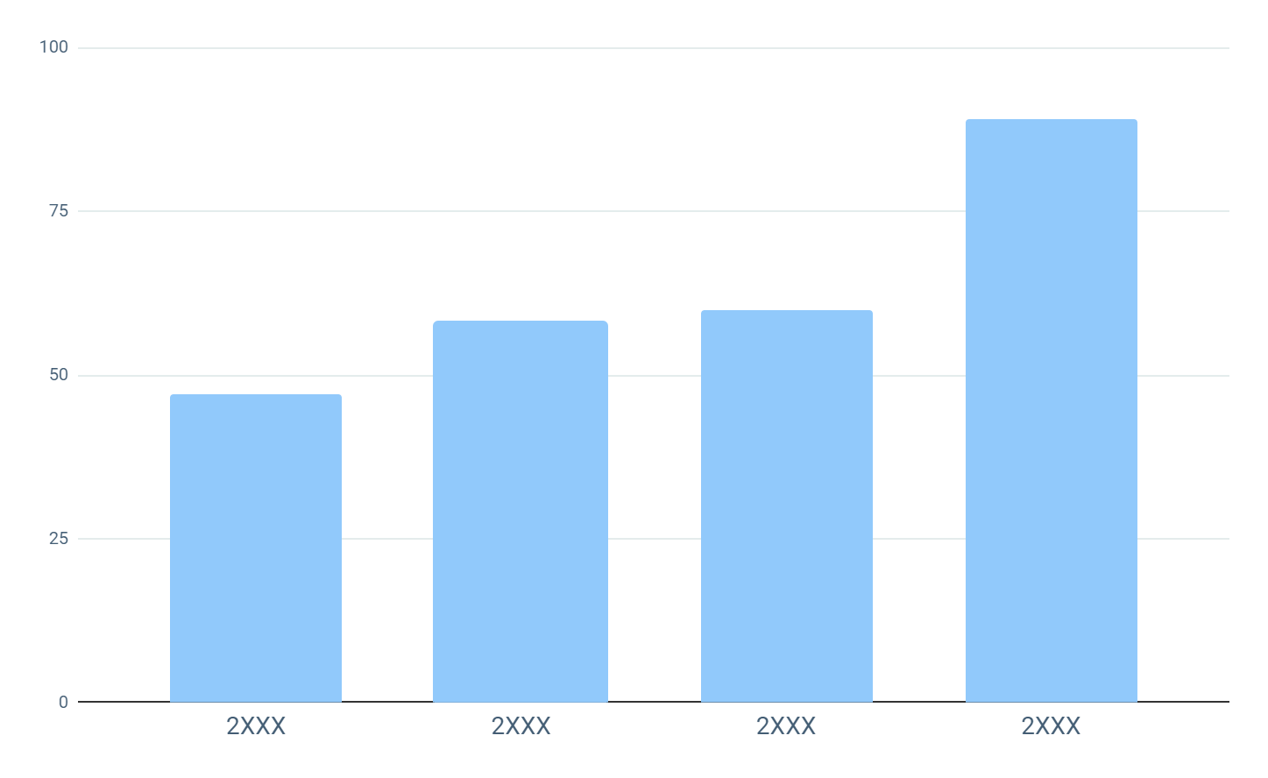
This is a graph
Understanding the numbers
Incorporating a graph in your case report offers several advantages. It allows for the clear visualization and concise representation of data trends, comparisons, or correlations. By presenting information in a visual format, graphs enable readers to quickly grasp and interpret complex findings
Follow the link in the graph to modify its data and then paste the new one here. For more info, click here

Slide 22
Case presentation: medical history
About the patient
Patient’s age | 42 years old
Gender | Female
Medical conditions | Chest pain, shortness of breath
Previous treatments | None reported
Introduction | She has been experiencing these symptoms for the past 2 days, with the pain increasing in intensity and frequency
Key findings
Summarize the most important or relevant aspects of the patient's medical history
Use bullet points to present the key findings in a clear and organized manner
Conclusions
1
In this section, summarize the key findings from the medical history
2
Provide an overview of the implications for the current diagnosis and treatment plan

Slide 23
Discussion
Introduction:
Briefly summarize the main findings and results of the case report
Mention the purpose of the discussion and what will be covered
Main discussion:
Present different perspectives and opinions on the findings, based on the literature and other relevant sources
Use bullet points to highlight key arguments and counterarguments
Address any limitations or weaknesses of the study and suggest potential solutions or areas for further research
Conclusions:
Summarize the key points of the discussion and their implications for clinical practice or future research
Offer any final recommendations or take-home messages for the audience

Slide 24
Outcomes and recommendations
Start
1
2
3
Outcome
Outcome
Outcome
Write your recommendation
Write your recommendation
Write your recommendation
Write your recommendation
Write your recommendation
Write your recommendation
Write your recommendation
Write your recommendation
Write your recommendation
Write your recommendation
Write your recommendation
Write your recommendation

Slide 25





Photo showcase
You can replace the images on the screen with your own work. Just right-click on any of them and select “Replace image”

Slide 26
Fonts & colors used
This presentation has been made using the following fonts:
DM Sans
(https://fonts.google.com/specimen/DM+Sans)
Karla
(https://fonts.google.com/specimen/Karla)
#435d74
#fdfdfd
#91c9fb
#7eccb9
#b9cccb
#e4ecec

Slide 27
Icon pack

