Slide 1

Care trace
An Agentic AI Platform for after hour triage
Team Members: Kirthi Shanbhag , Niyanthri Naresh, Sohail Khan, XinRan Zhang Date : Apr 13 ‘26

Slide 2
Table of contents
01
02
03
04
05
08
Introduction
Code Structure
Architecture
Knowledge Base
06
07
Rule Base Design
Extended Case
Evaluation
Conclusion/Takeaway/Scaling/Future/What Domain can it be applied?

Slide 3

Introduction
Problem
High parent uncertainty after hours
Overuse of ER or missed critical care
Tools today are:
Static (symptom checkers)
Inconsistent (LLMs)
Unstable reasoning → unsafe decisions
Objective
Build CareTrace (Neurosymbolic AI agent)
Deliver clear triage decisions, not just chat
Ensure consistent reasoning across turns
Define crisp escalation thresholds
Scope Children <12: Fever + GI + dehydration risk
After-hours caregiver use only
Outputs:
ER now
Doctor today
Home care tonight
Not diagnosis / not a replacement for care
Notes:
“After-hours pediatric illness is a stressful gray zone. Parents are often forced to make decisions alone without clear guidance.”
Problem Statement “Today, the usecase that i just described at the beginning, leads to two extremes. Either unnecessary ER visits or dangerous delays in care; esp when its after hours. Existing solutions don’t solve this well. Symptom checkers are rigid and one-directional, while AI assistants sound helpful but can change their reasoning mid-conversation. That inconsistency makes them unsafe for triage.”
Objective : “Our goal is to build CareTrace — a neurosymbolic AI agent that goes beyond conversation. Instead of just answering questions, it produces a clear, actionable triage plan. Most importantly, its reasoning stays consistent across every interaction, with well-defined escalation thresholds.”
Lets see whats our Scope for this project “We focus specifically on pediatric fever cases with gastrointestinal symptoms and dehydration risk in children under 12. This is strictly for after-hours caregiver guidance. The system provides only three clear outcomes: go to the ER now, see a doctor today i.e urgent care visits, or safely manage at home tonight. It’s important to note, this is not a diagnostic tool and not a replacement for clinical care.”

Slide 4
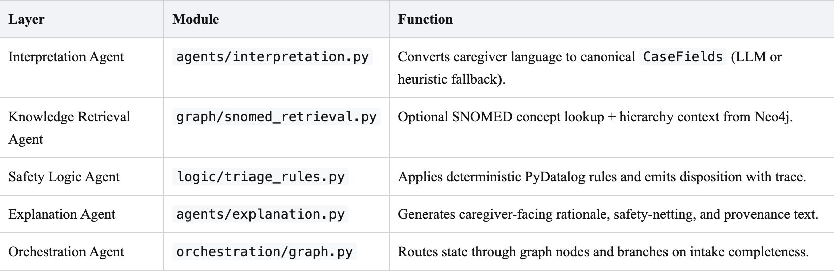
Code Structure
Agents
Logic
Parse caregiver text into a small structured case; generate replies, CPG-style medication language, and explanations.
Run deterministic triage rules (ER / urgent / home), record which rules fired, and surface med-related flags.
Graph
Orchestration
Query Neo4j for CPG-aligned concepts; add optional annotations; does not decide disposition by itself.
Wire the turn in order: interpret → graph → rules → explain, including handling missing required fields.
Notes:
We structured the system into four layers to keep responsibilities clean and decisions reliable.
First, the Agents layer converts caregiver input into a structured case—capturing symptoms, duration, and severity. It also generates responses and explanations in a clinical, guideline-aligned tone, including medication-related language.
Next, the Graph layer enriches this case using Neo4j. It brings in CPG-aligned concepts and relationships, adding context and optional annotations—but it does not make decisions.
Then, the Logic layer runs deterministic triage rules to classify cases into ER, urgent, or home care. It records which rules fired for traceability and surfaces any medication-related flags.
Finally, the Orchestration layer ties everything together—managing the flow from interpretation to graph to rules to explanation, and handling missing information when needed.
Overall, this separation ensures the system stays explainable, consistent, and clinically grounded.

Slide 5
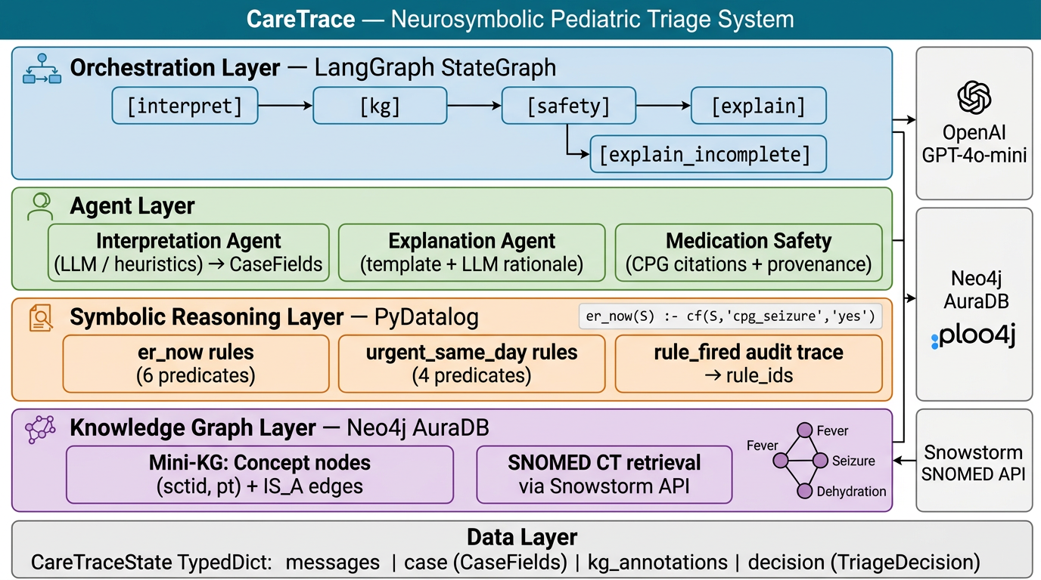
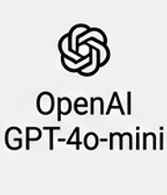
System Architecture
Ollama
Extended case
Notes:
This architecture is designed as a neurosymbolic system, where each layer plays a distinct role to ensure safety and explainability.
At the top, the Orchestration layer controls the flow using a state graph—it moves step-by-step from interpreting input, to querying the knowledge graph, running safety checks, and finally generating explanations. It also handles incomplete inputs by branching into follow-up questions.
The Agent layer handles language understanding and communication. The interpretation agent structures caregiver input into key fields, the explanation agent turns decisions into clear, human-readable responses, and the medication safety component ensures outputs are grounded in clinical guidelines with proper citations.
Below that, the Symbolic reasoning layer is where deterministic triage happens. Using PyDatalog, we run explicit rules for ER, urgent care, or home management, and we log exactly which rules fired for transparency.
The Knowledge graph layer provides clinical grounding. We use a Neo4j-based mini knowledge graph with SNOMED concepts to enrich the case with medically relevant relationships.
Finally, everything is tied together through a shared data layer, which maintains the evolving case state across the pipeline.
Overall, this separation lets us combine LLM flexibility with rule-based reliability and clinical grounding.

Slide 6
Knowledge & Rules
Initial presentation with chief complaint
Diagnostic evaluation and investigations
Confirmation of
the diagnosis
Initiation of appropriate treatment
Monitoring response to the treatment
Resolution of presenting symptoms
Follow-up assessment for outcomes
Case discussion and lessons learned

Slide 7
PyDatalog Pediatric Triage Engine
[Deterministic Rule Evaluation Flow]
① INPUT
② FACTS
③ RULES
④ LOGIC
⑤ OUTPUT
age_months / age_years
_case_to_facts()
Converts fields → cf(S, name, val)
er_now(S)
er_now(S)?
→ ER_NOW
ER_NOW
temp_f
urgent_same_day(S)
dehydration_severe = yes
poor fluid + no urine
urgent_same_day?
→ URGENT_SAME_DAY
URGENT
SAME_DAY
alertness
dehydration_risk = yes
one of above
breathing
home_candidate(S)
home_candidate?
→ HOME_MANAGEMENT
on_antibiotic = yes
if current_meds non-empty
HOME
MANAGEMENT
fluid_intake / urine_last_8h
cpg_infant_under_3mo_fever
age<3mo + temp>100.4
rule_fired(S, R)
else
→ OUT_OF_SCOPE
vomiting
cpg_ibuprofen_contraind.
age < 6 months
current_meds
OUT_OF
SCOPE
med_flag(S, M)
required_missing()
→ OUT_OF_SCOPE
incomplete_intake
cpg_fever_duration_3_days
hours ≥ 72
seizure / fever_duration_hours
temp_f = very_high
temp ≥ 104°F
Session-scoped cf(S,name,val) facts · PyDatalog backward-chaining · Rules evaluated once per uuid session
🔔 med_flag predicates: dehydration_avoid_nsaid · antibiotic_review_interactions · ibuprofen_under_6mo · no_routine_antipyretic_under_3mo
Notes:
OVERVIEW (say this first) So what are we looking at here? This is the full decision pipeline — from the moment a parent calls in about their sick kid, all the way to telling them whether to go to the ER, see a doctor today, or manage at home. The whole thing is powered by a logic engine called PyDatalog, which evaluates deterministic rules. No AI guessing — just rules that fire or don't fire based on what the parent tells us. --- ① INPUT — "What we ask the parent" These are the eight pieces of information we collect from the parent or caregiver upfront. Things like: how old is the child, what's their temperature, are they alert and responsive, are they drinking fluids, have they urinated in the last 6-8 hours. This is the raw intake. Nothing gets evaluated until we have these answers. If any of the critical ones are missing, we stop and ask before going any further — that's the "required_missing()" guard you see in the top-right corner. --- ② FACTS — "What the engine derives from those answers" Once we have the raw inputs, _case_to_facts() converts them into a structured form the rule engine can work with. It also derives additional facts automatically. For example: if the child has poor fluid intake AND no urine output, the engine marks dehydration_severe = yes. If the child is under 3 months old with a fever over 100.4°F, it flags cpg_infant_under_3mo_fever. These derived facts encode clinical logic so the rules downstream stay clean and readable. --- ③ RULES — "The actual clinical logic" This is where PyDatalog earns its keep. We have three main predicates: - er_now(S) — fires if ANY hard ER trigger is present: altered alertness, respiratory distress, severe dehydration, seizure, infant with fever, etc. - urgent_same_day(S) — fires for things that need a doctor today but not the ER: very high fever, repeated vomiting with poor intake, fast breathing, or fever lasting more than 3 days. - home_candidate(S) — only fires if the child looks alert, is breathing normally, and is taking some fluids, AND neither of the above rules fired. The rule_fired and med_flag predicates run alongside these — they're used for the audit trail and medication safety checks respectively. --- ④ LOGIC — "How we pick the final answer" Python evaluates the predicates in strict priority order. ER first. If that doesn't fire, check urgent. If that doesn't fire, check home. If nothing fires, we return OUT_OF_SCOPE — which usually means the case is ambiguous and needs a human to look at it. The key thing to stress here: these are mutually exclusive. You can't get "ER + urgent" at the same time. --- ⑤ OUTPUT — "What gets handed back" The final disposition: ER_NOW (red), URGENT_SAME_DAY (amber), HOME_MANAGEMENT (green), or OUT_OF_SCOPE (grey). Each one comes bundled with the list of rule IDs that fired — so there's a full audit trail — and any medication safety flags. --- MED FLAGS (pink footer) These are parallel safety signals that fire independently of the disposition. So even if the outcome is "home management," the system might still flag "don't give ibuprofen — child is under 6 months" or "this child is dehydrated, be cautious with NSAIDs." They don't change the disposition, they just ride alongside it. --- KEY POINT TO LEAVE THEM WITH The whole thing is deterministic and explainable. Every decision can be traced back to exactly which rules fired and why. No black box. That matters a lot in a clinical context where you need to be able to say: "here's why we told that family to go to the ER."

Slide 8
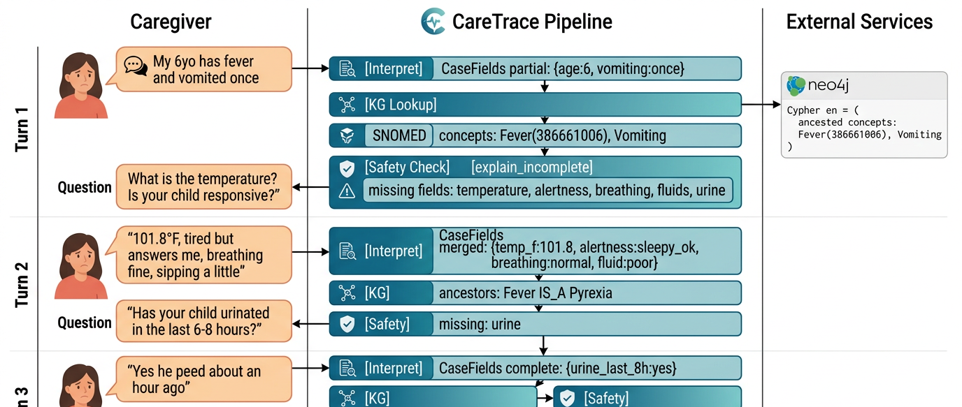
Conversational Flow
Turn 1
Turn 2
Turn 3
Final Disposition
Notes:
This slide shows how the system works across a real multi-turn interaction.
In the first turn, the caregiver provides an initial concern. The system extracts partial structured data—like age and symptoms—and queries the knowledge graph to map them to clinical concepts. At this stage, the safety check detects missing critical fields, so instead of making a decision, it asks targeted follow-up questions.
In the second turn, more details come in—like temperature and responsiveness. The system merges this into the case, enriches it again using the graph, and checks if anything is still missing. It continues asking only what’s necessary.
By the third turn, enough information is collected. The structured case is now complete, so the symbolic rules are triggered. In this example, a home-care rule fires.
Finally, the system produces a clear disposition—home management—along with the exact rule that fired, medication guidance, and safety net instructions.
So the key idea here is progressive understanding: we don’t rush decisions. We gather what’s needed, ensure completeness, then apply deterministic logic and generate an explainable outcome.

Slide 9
Care Trace Demo
Notes:
Kirthi

Slide 10
Extended Care Trace Demo
Notes:
Niyanthri

Slide 11
Baseline Demo
Notes:
Sohail/Xinran

Slide 12
Baseline Model Comparison
CareTrace Neurosymbolic vs. Plain LLM (keyword mock) — 6 Rubric Dimensions
Dimension | CareTrace (Neurosymbolic) | Baseline Mock (LLM Only)
Safety Escalation | ✓ 6 guaranteed ER gates (PyDatalog rules) No surface heuristic drift | ✗ Keyword scan only May miss altered alertness + no urine
Transparency / Rule Trace | ✓ Full rule_ids in every response e.g. R_ER_ALERTNESS, R_ER_DEHYDRATION_SEVERE | ✗ No rule IDs No structured state — opaque
CPG Provenance | ✓ Seattle Children's Fever CPG cited Per-rule clinical guideline mapping | ✗ No CPG citation No source attribution
Medication Safety | ✓ Age gate: ibuprofen <6 mo flagged Weight-based dosing check | ✗ No age/weight check May suggest ibuprofen for 5-month-old
Local Context Handling | ✓ Captured as metadata Never alters safety rule firing | ✗ Used as reassurance signal "Something going around" → under-escalation
Actionability | ✓ Structured criteria + rule-backed escalation Concrete thresholds (temp, alertness) | ✗ Generic "if worried, seek care" No concrete thresholds

Slide 13
Baseline Failure Mode Examples
Two scenarios where baseline mock gives incorrect or dangerous guidance
Failure Mode 1 — Medication Safety (Scenario 4)
Failure Mode 2 — Local Context (Scenario 5)
CareTrace: Disposition = HOME_MANAGEMENT
Rule: R_HOME_CONSERVATIVE
Med flag: cpg_ibuprofen_under_6mo_requires_clinician
→ "Do NOT give ibuprofen — child is under 6 months. Consult clinician before any NSAID."
CareTrace: Disposition = HOME_MANAGEMENT
local_outbreak_context = community_viral_illness_context_mentioned
Rule: R_HOME_CONSERVATIVE (clinical gates not met)
→ Viral context captured as metadata only.
Does NOT alter hard safety gates.
Baseline Mock: Signal = REASSURANCE_SIGNAL
No age check performed
→ "You can give fever medicine — acetaminophen or ibuprofen are common options."
⚠ Ibuprofen is contraindicated under 6 months
Baseline Mock: Signal = REASSURANCE_SIGNAL
"Something going around" → used as reassurance
→ "There does seem to be something going around, which might explain the symptoms — reassuring."
⚠ Epidemiological prior overrides clinical assessment

Slide 14
All 5 scenarios pass. Harness: CARETRACE_MOCK_LLM=1 CARETRACE_SKIP_NEO4J=1 python -m caretrace.evaluation.harness
Scenario ID | Type | Expected | CareTrace | Rules Fired / Med Flags | Pass
scenario_1_home | Base | HOME | HOME_MANAGEMENT | R_HOME_CONSERVATIVE Med: antibiotic_on_file_review | ✓
scenario_2_er | Base | ER_NOW | ER_NOW | R_ER_ALERTNESS R_ER_DEHYDRATION_SEVERE | ✓
urgent_repeated_vomit | Base | URGENT | URGENT_SAME_DAY | R_URGENT_REPEATED_VOMIT_POOR_FLUID Med: dehydration_avoid_nsaid | ✓
scenario_4_medication | Ext | HOME | HOME_MANAGEMENT | R_HOME_CONSERVATIVE Med: cpg_ibuprofen_under_6mo_requires_clinician | ✓
scenario_5_local_context | Ext | HOME | HOME_MANAGEMENT | R_HOME_CONSERVATIVE (local_outbreak_context captured) | ✓
Evaluation Results — 5-Scenario Harness

Slide 15
Extra Investigation: Logic-Augmented Generation (LAG)
Option B from Lec 20 — Providing full symbolic context to the LLM instead of raw dicts
Design
Key Findings
Standard mode: LLM receives raw Python dict (case fields + rule_ids + med_flags)
LAG mode: LLM receives full symbolic context:
• All 11 rules — each marked FIRED / NOT FIRED
• CPG basis per rule (Seattle Children's)
• Disposition with rule derivation chain
• Med flags with clinical rationale
• 8 generation constraints enforced
Module: _format_lag_context() in caretrace/logic/datalog_engine.py
1. CPG grounding visible LLM can cite specific rule + CPG section in its response
2. Medication guidance improved LAG: "Do not give ibuprofen — CPG: contraindicated <6 mo" vs Standard: generic age mention
3. Local context correctly scoped LAG constraint forces LLM to label viral context as epidemiological prior, not a safety gate
4. Consistency guaranteed Disposition from rules is injected — LLM cannot override it with conversational reasoning
5. Trade-off: token cost ~800 extra prompt tokens per turn; latency +~30% Justified for safety-critical medical guidance

Slide 16
Conclusion
CareTrace demonstrates that neurosymbolic AI can deliver safe, explainable, actionable triage.
Results
Key Contributions
5 / 5 scenarios correct
• 3 base cases (Home, ER, Urgent)
• 2 extended cases (medication gate, local context)
Harness exit code 0 — deterministic, repeatable
Guaranteed safety escalation via PyDatalog rules
CPG-grounded provenance (Seattle Children's)
Medication safety age gate (ibuprofen <6 mo)
Local context isolated from hard clinical gates
Limitations
Future Work
Heuristic NLP — fails on non-standard phrasing
Knowledge graph: ~45 SNOMED CT concepts only
5 manually authored scenarios (no real patient data)
Scope limited to fever/GI in children <12 years
Replace regex extraction with fine-tuned NER
Expand SNOMED KG to full fever/dehydration domain
Real-world validation with pediatric nurse review
Multi-language / low-literacy caregiver adaptation

Slide 17
Thank you
Q&A

