Slide 1
Project title
CAPSTONE PROJECT
Presented By:
Student Name- KIRTI DANDRE
College Name- IES College of Technology Bhopal, Madhya Pradesh
Department - CSE
Branch - Artificial Intelligence & Machine Learning

Slide 2
OUTLINE
Introduction
Problem Statement
Proposed Solution
System Approach
Dataset Description
Data Preprocessing
Feature Extraction
Machine Learning Model
Training &Testing
System Architecture & Development
Results
Application Architecture
Advantages
Conclusion
Future Scope
References

Slide 3
INTRODUCTION
In today’s digital world, information spreads very quickly through social media, websites, and news platforms. Students find it difficult to verify the authenticity of online news. While this helps people stay informed, it also increases the spread of fake news.
Fake news refers to false or misleading information presented as real news. It is created intentionally to mislead people, influence opinions, and create confusion in society.
Due to the large amount of online content, manual verification of news is difficult. There is a need for an intelligent system that can analyze both offline datasets and live online news.

Slide 4
Problem Statement
The rapid growth of social media platforms has made it easier for fake news to spread within seconds. Students find it difficult to verify the authenticity of online news. People often believe and share fake information without verifying it, which can lead to:
Public confusion
Social unrest
Misinformation
Damage to reputation
Manual verification of news is time-consuming and unreliable. Hence, there is a strong need for an automated system that can accurately detect fake news.

Slide 5
Proposed Solution
We propose an AI-based system that uses Macine Learning &Natural Language Processing techniques to analyze news articles . The system will:
Take news text as input
Preprocess the text
Extract meaningful features
Train a machine learning model
Predict whether the news is real or fake
Uses NLP and Machine Learning for text analysis
Classifies news as real or fake
Fetches live news using News API
Provides real-time verification for students
This automated approach reduces human effort and improves accuracy.

Slide 6
System Approach
        Data Collection : Collect real and fake news articles from online datasets for training the model & Live News API.
        Data Cleaning and Preprocessing : Remove unwanted symbols, stopwords, and convert text into clean and readable format.
        Text Normalization : Convert text into a standard form by making it lowercase and removing extra spaces.
        Feature Extraction : Convert text data into numerical form using TF-IDF technique.
        Model Training : Train the machine learning model using labeled real and fake news data.
        Testing and Evaluation : Test the trained model and measure its accuracy and performance.
        Live News Fetching using API.
        Prediction : Predict whether the given news is real or fake based on trained model.
The overall working of the system includes the following steps:
Data Collection-
Data Cleaning & Preprocessing
Text Normalization
Feature Extraction
Model Training
Testing & Evaluation
Prediction
Live News Fetching using API

Slide 7
DATASET DESCRIPTION
The dataset used in this project consists of two CSV files:
True.csv – Contains real news articles
Fake.csv – Contains fake news articles
The dataset includes:
News headlines and articles
News labels (Real or Fake)
Total number of records: 44,000+ news articles
This dataset is suitable for training and testing machine learning models.

Slide 8
DATA PREPROCESSING
Data preprocessing is a crucial step in NLP.
The following preprocessing techniques are used:
Converting text to lowercase
Removing punctuation and special characters
Removing stopwords
Removing empty and null values
Text normalization
This improves the quality of data and increases model accuracy.

Slide 9
FEATURE EXTRACTION
Machine learning models cannot understand text directly.
Therefore, we use TF-IDF (Term Frequency – Inverse Document Frequency) vectorization technique.
TF-IDF:
Converts text into numerical form
Gives importance to meaningful words
Reduces the effect of common words
This helps the model understand the context of the news.

Slide 10
MACHINE LEARNING MODEL
In this project, we use Logistic Regression as the classification model.
Logistic Regression is suitable for text classification problems because:
It is simple and fast
Works well with large datasets
Provides high accuracy
Easy to implement and interpret
The model learns from training data and predicts labels for new news articles.

Slide 11
TRAINING AND TESTING
Dataset is split into training and testing data. The dataset is divided into two parts:
80% Training Data
20% Testing Data
The model is trained on training data and evaluated using testing data.
This helps to measure the performance and reliability of the system.

Slide 12
SYSTEM ARCHITECTUR E & DEVELOPMENT
User Input (News Text)
⬇
Text Preprocessing(Cleaning, Stopwords Removal, Normalization)
Feature Extraction(TF-IDF Vectorization)
⬇
Machine Learning Model(Logistic Regression Classifier)
⬇
Prediction Result(Real News / Fake News)

Slide 13
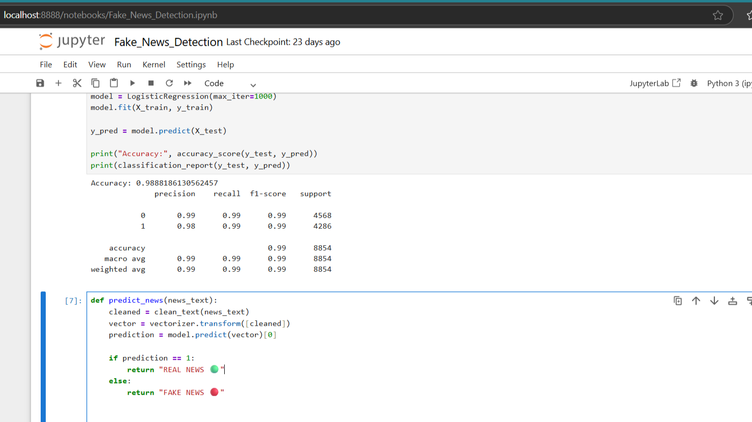
ResulTS
After training and testing the model, the following results were obtained:
Accuracy: 98.8%
High Precision and Recall
Low error rate
The model achieved high accuracy in detecting fake and real news. It can successfully classify both dataset-based news and real-time online news fetched through API.
This proves the effectiveness of the proposed system.

Slide 14
APPLICATION ARCHITECTURE
User enters news text
Text preprocessing cleaning
TF-IDF feature extraction
Machine Learning model
Prediction: Real or Fake

Slide 15
ADVANTAGES
Real-time fake news detection
Easy to use
Helps students verify news authenticity
Supports live news verification using API
Fast and reliable predictions
Reduces manual verification
Helps control misinformation
Can be integrated with websites and apps

Slide 16
Conclusion
This project successfully implements an AI-based fake news detection system using NLP, Machine Learning, and News API. It helps students verify online news and promotes digital awareness.
The use of NLP and machine learning helps in understanding textual data effectively. The system is accurate, efficient, and reliable, making it suitable for real-world applications..

Slide 17
Future scope
In the future, the system can be improved by:
Using deep learning models like LSTM and BERT
Integrating with social media platforms
Supporting multiple languages
Improving accuracy further
Mobile application integration

Slide 18
REFERENCES
Fake and Real News Dataset, Kaggle https://www.kaggle.com/datasets/clmentbisaillon/fake-and-real-news-dataset
Scikit-learn Documentation (Machine Learning Library) https://scikit-learn.org/stable/
3. Natural Language Processing Tutorial, GeeksforGeeks https://www.geeksforgeeks.org/natural-language-processing-nlp-tutorial/
4. TF-IDF Explanation, Analytics Vidhya https://www.analyticsvidhya.com/blog/2021/09/what-is-tf-idf/
5. Logistic Regression – Scikit-Learn https://scikit-learn.org/stable/modules/linear_model.html
6. Fake News Detection using Machine Learning – IEEE https://ieeexplore.ieee.org/document/8622048
7. News API (https://newsapi.org)

Slide 19
Github link
Github Link : https://github.com/kirti-dandre/Fake_News_Detector.git

Slide 20
THANK YOU

