Slide 1
PriceSense: SQL-Driven Pricing Intelligence Framework
AI Palette | IIT Guwahati Summer Project 2026
Presented by:
Name - Kirti Dandre
College Name – IES College of Technology Bhopal
Branch – CSE AIML

Slide 2
Agenda
Introduction
Problem Statement
Dataset Overview & and Data Cleaning
Revenue Analysis
Customer Segment Analysis
Product Pricing Analysis
Geographic Pricing Analysis
Strategic Recommendations
Conclusion

Slide 3

Pricing is one of the most critical business decisions for any product-based company. For a D2C nutrition brand launching high-protein snacks, incorrect pricing can lead to: Reduced customer demand Lower profit margins Poor competitive positioning The PriceSense project aims to solve this challenge using SQL-driven pricing intelligence by analyzing transactional, customer, product, and geographic data.
INTRODUCTION

Slide 4
PROBLEM STATEMENT
Businesses often rely on intuition rather than data when deciding product prices.
Objective: To design a SQL-based pricing intelligence system for identifying optimal pricing strategies.
Challenges
Price sensitivity varies across customers
Regional purchasing behavior differs
Premium products may be underpriced
Low-performing products may be overpriced

Slide 5
DATASET & DATA CLEANING
This project uses four structured datasets:
Transactions → purchase records
Consumer Insights → customer demographic information
Product Metadata → product details and categories
Geography Occasion → regional and occasion-based purchase data
Data Preprocessing Included
Removing negative price entries
Removing invalid quantities
Eliminating duplicate transactions

Slide 6
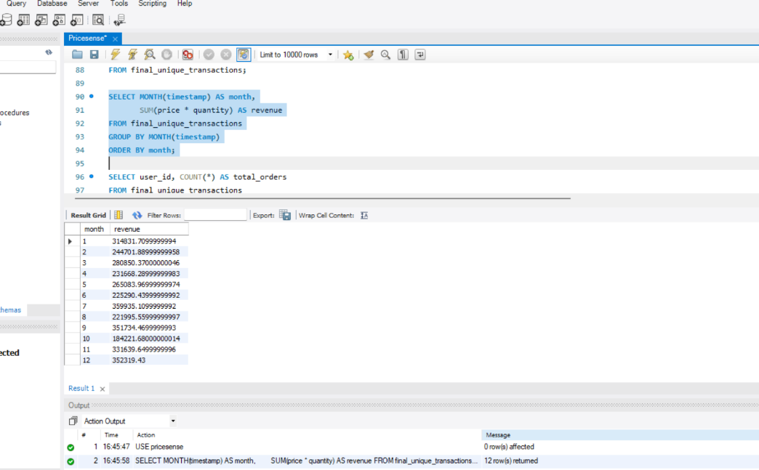
Revenue Analysis
Revenue analysis was performed to measure the total sales generated from customer purchases. Based on the cleaned transaction dataset, the total revenue generated was ₹ 33,64,272.57, indicating overall business performance and sales strength.

Slide 7
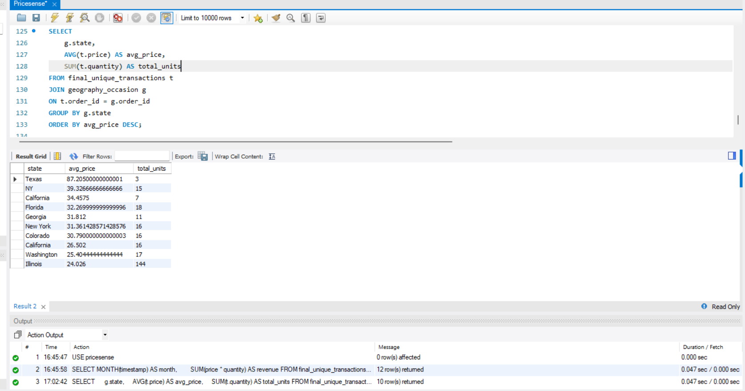
CUSTOMER SEGMENT ANALYSIS
Customer segment analysis helps identify purchasing behavior across different income groups. The analysis shows that medium-income customers contributed the highest purchasing activity, making them the most valuable customer segment. This insight helps improve targeted marketing and pricing strategies.
Key Insight: Medium-income customers showed the highest engagement and purchase volume.

Slide 8
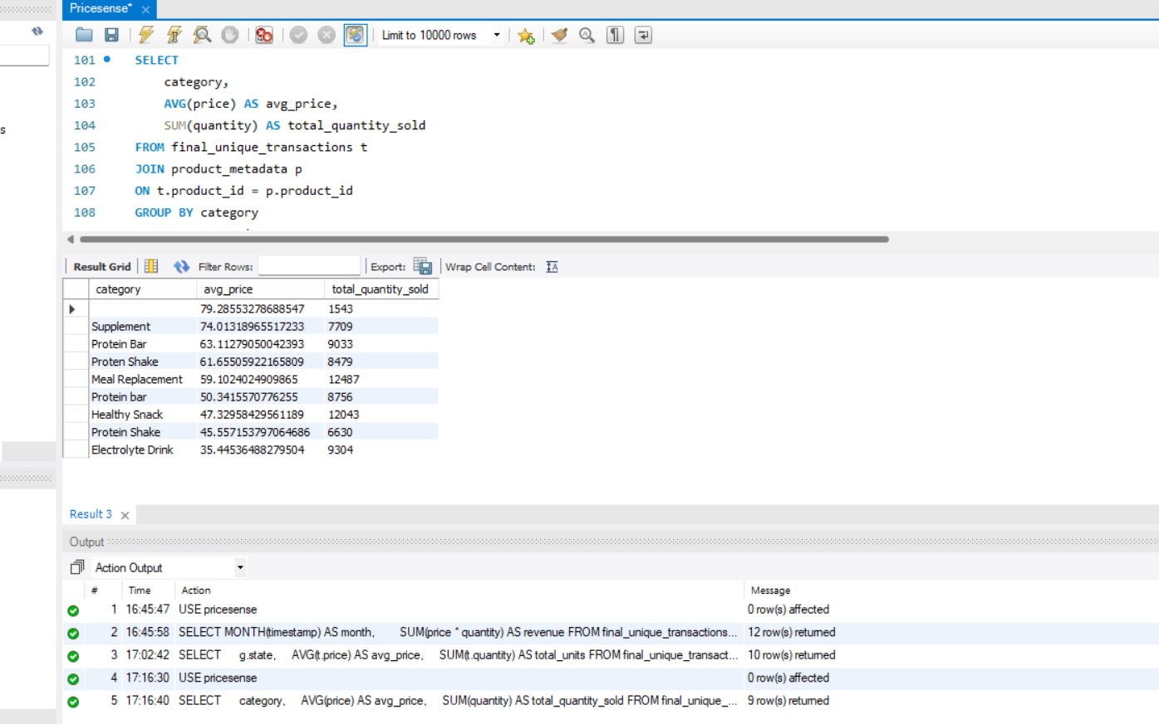
PRODUCT PRICING ANALYSIS
Product pricing analysis compares average pricing across product categories to identify high-performing products. The analysis shows that some categories have higher average prices along with strong sales volume, indicating premium product demand and customer preference.
Key Insight: Premium-priced product categories generated strong sales performance.

Slide 9
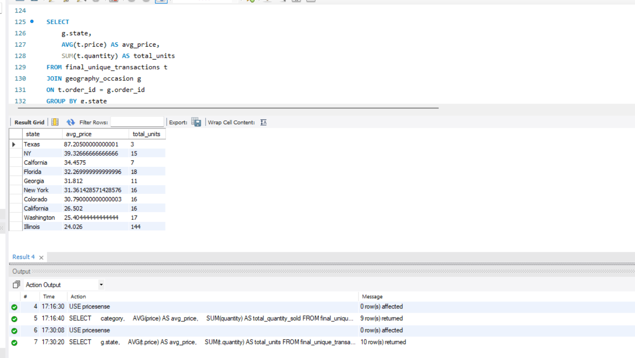
GEOGRAPHIC PRICING ANALYSIS
Geographic pricing analysis helps understand pricing performance across different locations. The analysis shows variation in average product prices between states, helping identify high-value markets and opportunities for region-specific pricing strategies.
Key Insight: Some states showed higher average pricing, indicating better pricing opportunities in those regions.

Slide 10
STRATEGIC RECOMMENDATIONS
Based on analysis finding, the following recommendations are proposed:
Implement dynamic pricing strategies
Target medium-income customer segments
Focus on premium-performing product categories
Apply region-specific pricing optimization
Strengthen high-demand market positioning
Dynamic Pricing
Product Positioning
Customize pricing according to regional sales behavior.
Adjust prices based on customer demand patterns.
Geographic Optimization
Identify premium and high-performing product categories.

Slide 11
CONCLUSION
PriceSense demonstrates how SQL analytics can transform raw transactional data into valuable pricing intelligence.
This project enables businesses to:
Improve pricing decisions
Optimize revenue growth
Understand customer behavior
Support data-driven business decisions

Slide 12
Thank you

