Slide 1
Getting started with “Yo Teams”
Microsoft 365 UK User Group July 2020
Kirti Prajapati
SharePoint & Office 365 Architect
Microsoft MVP

Slide 2
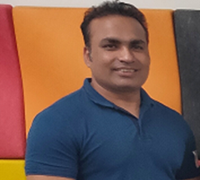




Kirti Prajapati
SharePoint Architect | Consultant
MCTS
O365, SharePoint & Office Dev Specialist
Speaker | Blogger | Author | Trainer
Organizer of Ahmedabad SharePoint User Group
kirti.Prajapati@gmail.com
linkedin.com/in/kirtiprajapati
@kirtipprajapati
Facebook.com/kirti.prajapati.7374

Slide 3
Agenda
Why Yo Teams
Prerequisites
How to use it
Demo

Slide 4
Why Yo Teams
Microsoft Teams Tabs
Including support for Single-Sign-On Tabs
Microsoft Bot Framework Bots
Microsoft Teams Message extensions and actions
Microsoft Teams and Outlook connectors
Microsoft Teams outgoing web hooks

Slide 5
Prerequisites
Install 3 packages using npm:
npm install yo gulp-cli typescript --global
Install the generator
npm install generator-teams --global
Use the preview version for the latest and greatest features if you want using :
npm install generator-teams@preview --global

Slide 6
Demo

Slide 7
Q & A

Slide 8
Thank You

