Slide 1
Database & Queries
Joachim
15/6/2015

Slide 2
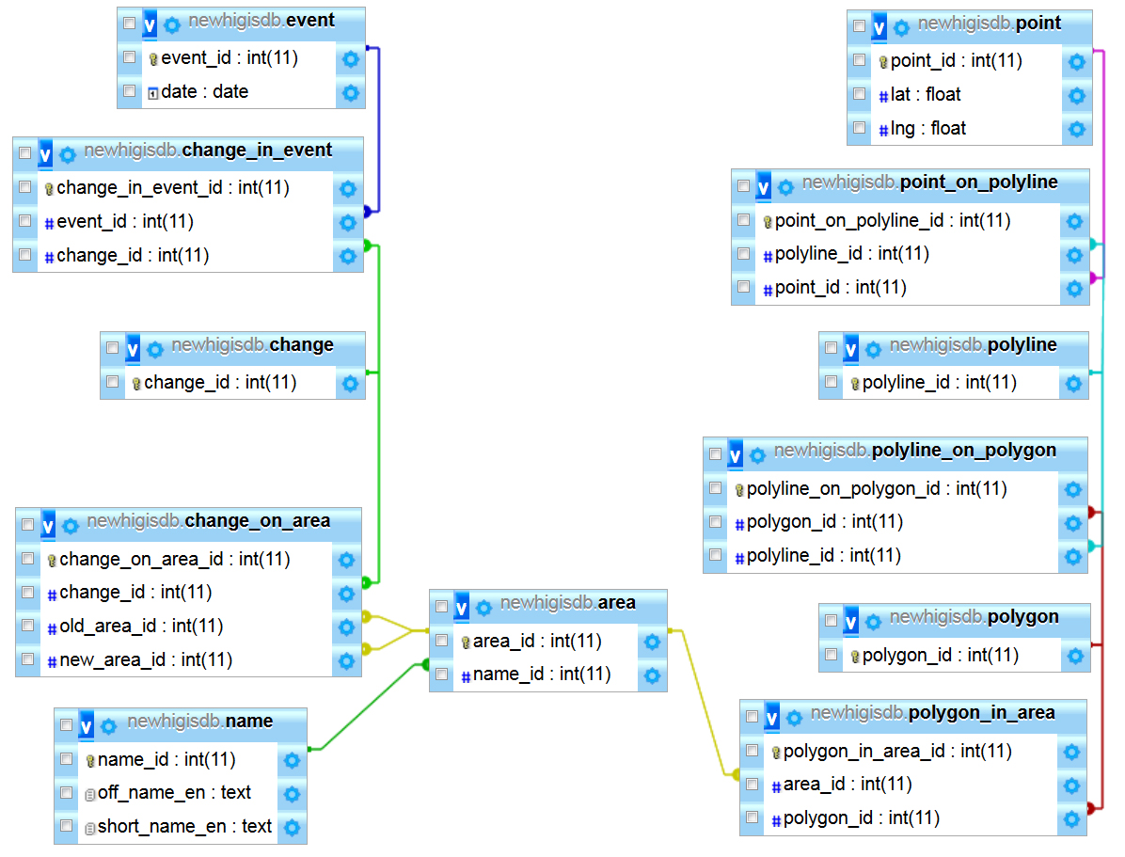

Slide 3
Recall – Types of changes
Old_area_id | New_area_id | Result
1 | N | Split
N | 1 | Join/Union
2 | 2 | Border change
1 | 1 | Name change

Slide 4
Queries
Designed to either:
Show the borders of a specific country or,
Split a country into several other or,
Merge several countries into one or,
Change country name
Revert changes if needed (efficiency)
Real SQL queries to be (hopefully) shown on Thursday

