Slide 1
REPORT ON CUSTOMER SATISFACTION AND RETENTION
By – Kirti Sharma

Slide 2
OVERVIEW
Customer data of retail store for 2yrs.
The retail store deals in 5 product categories – Electronics, Sports, Clothing, Home & Garden and Toys.
Aim is to find different parameters to find pattern in customer purchase, increase customer satisfaction and retention.

Slide 3
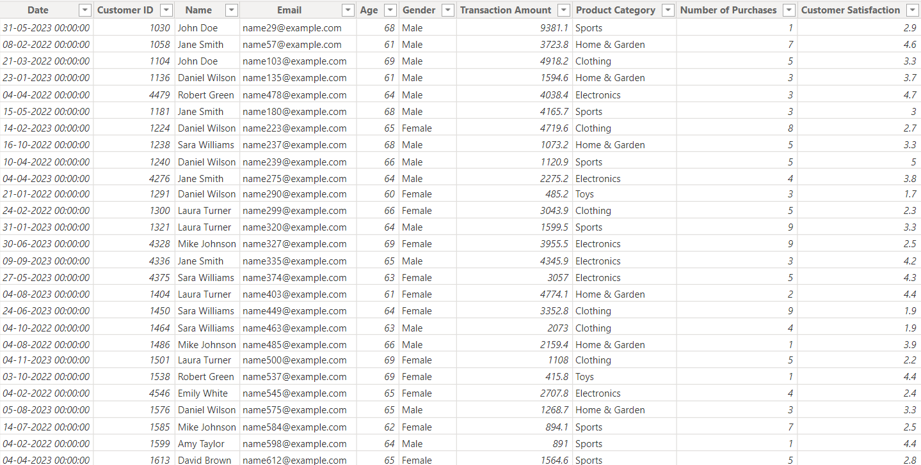
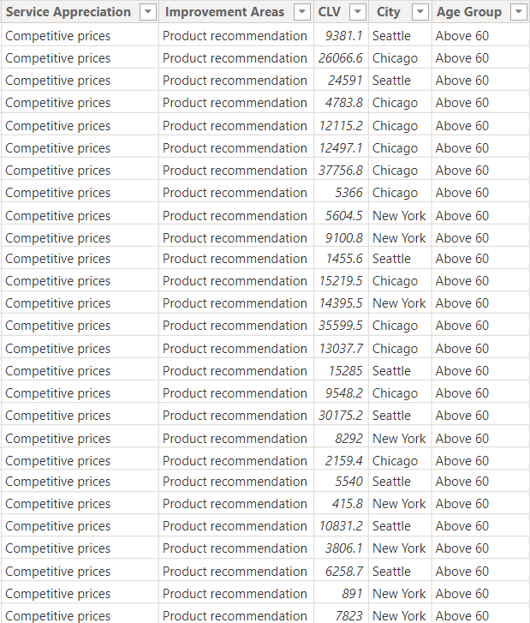
SAMPLE DATASET

Slide 4
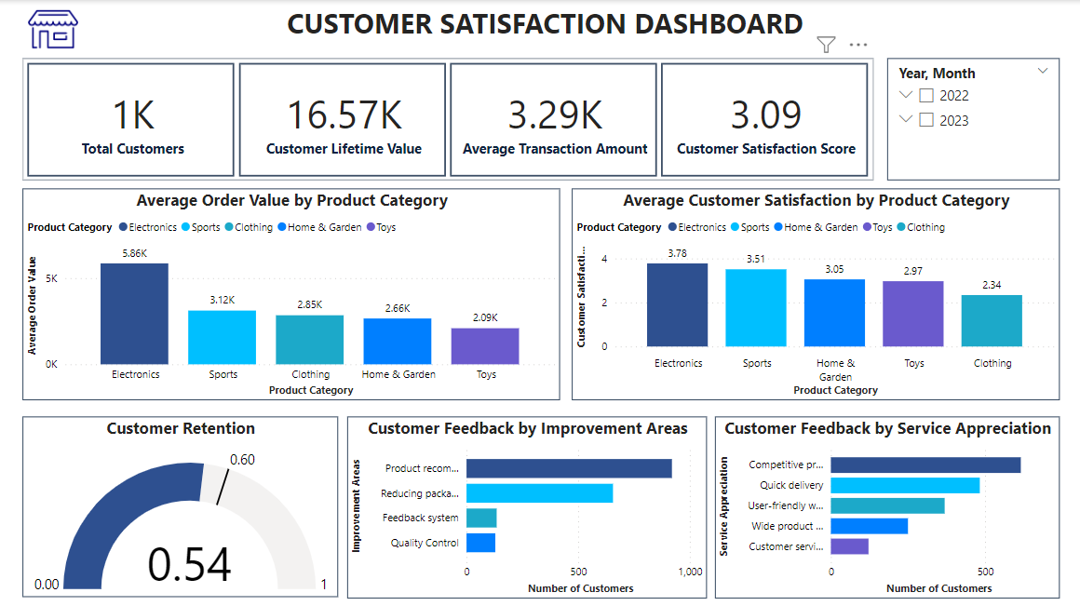
POWER BI DASHBOARD – PAGE1

Slide 5
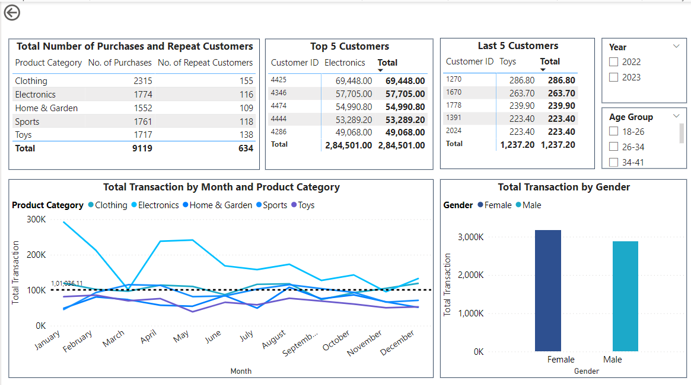
POWER BI DASHBOARD – PAGE 2

Slide 6
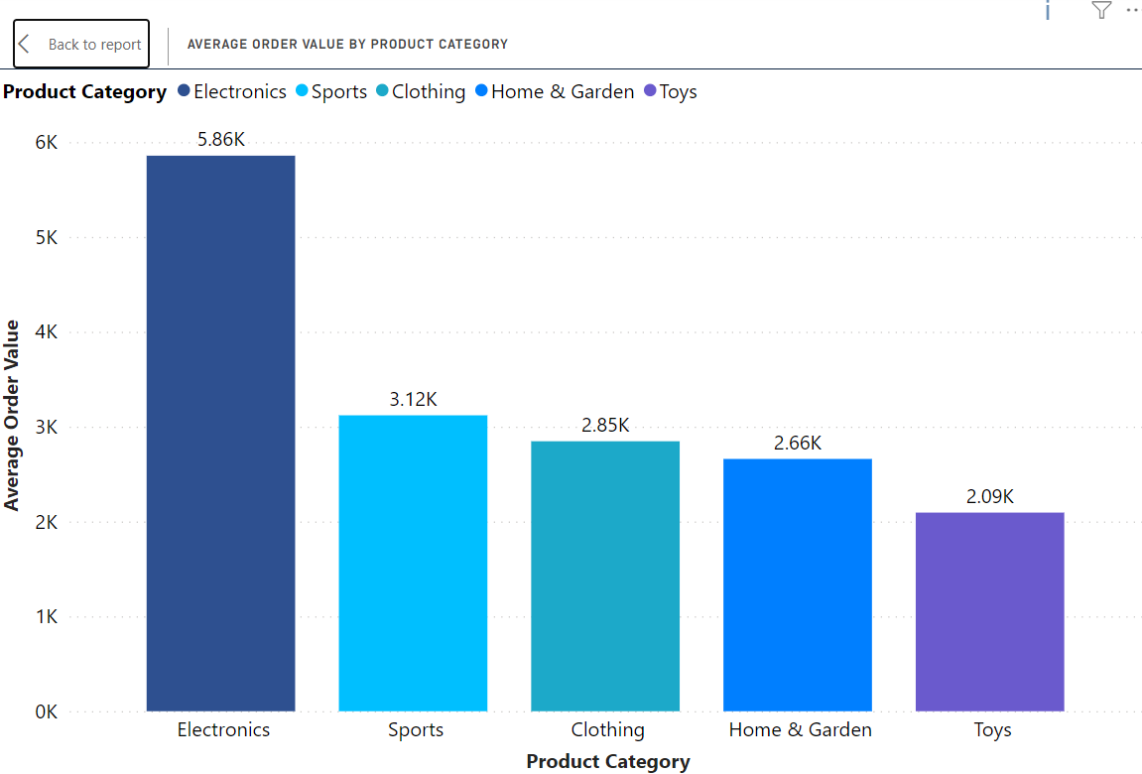
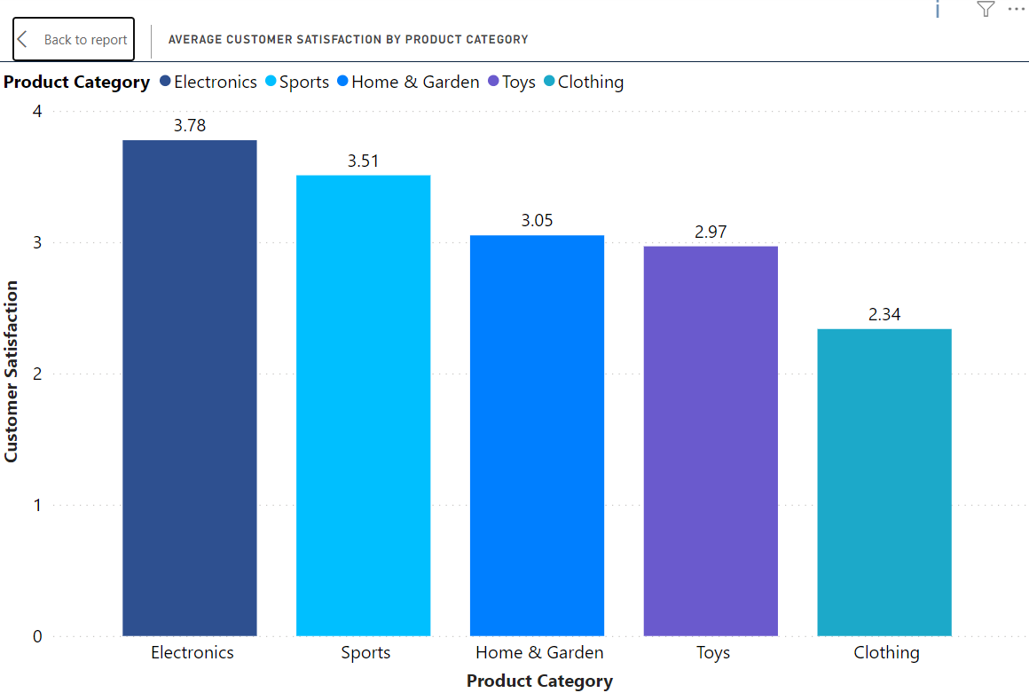
POWER BI GRAPHS - 1

Slide 7
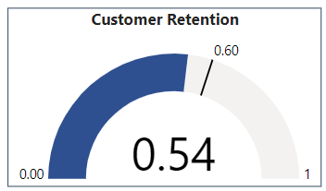
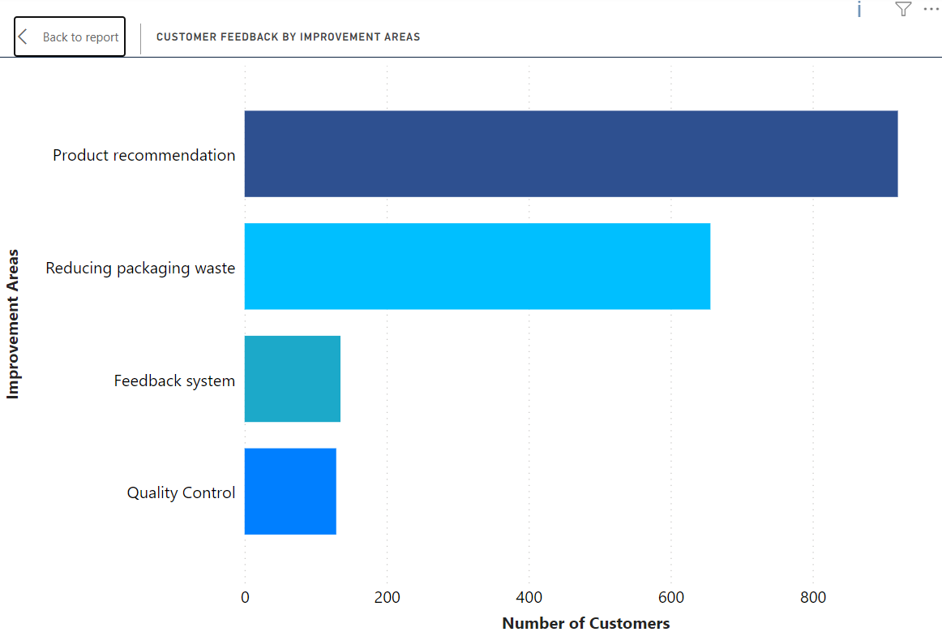
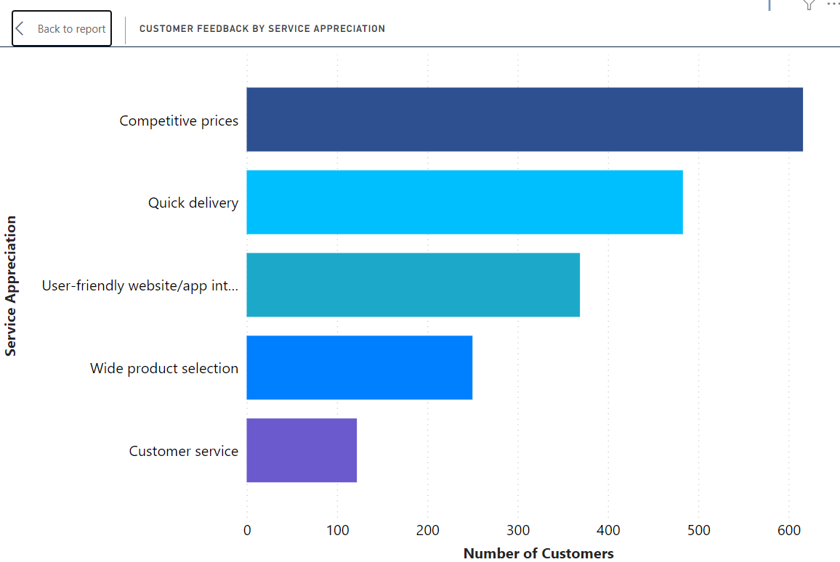
POWER BI GRAPHS - 2

Slide 8
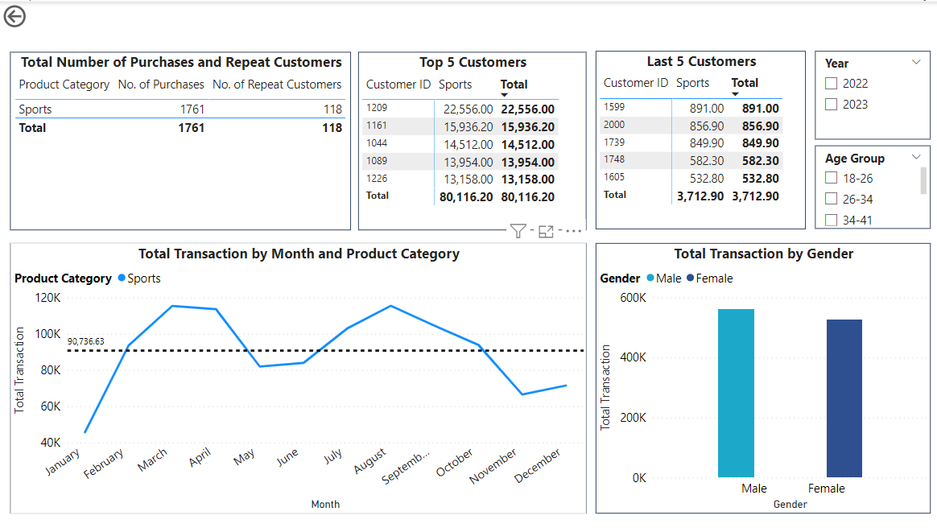
POWER BI GRAPHS - 3

Slide 9
KEY FINDINGS
Customer Retention to be increased by 0.6 in order to attain the target.
Customer Satisfaction can be increased by working on parameters like Product Recommendation, Packaging, Feedback System and Quality control.
Customer Satisfaction on Clothing and Toys seems lower than average customer satisfaction.
Need to increase number of repeat customers.
Need to increase product sales in Home & Garden and Toys product categories.

Slide 10
THANK YOU

