Slide 1
Faculty Development Program Network Science:Foundation of Social Network Analysis
Module I
3 Dec 2018
Vasudha Bhatnagar
Deptt. Of Computer Science
University of Delhi

Slide 2
Roadmap
Introduction to Network Science
Mathematics of Network Science
Characterizing Nodes in Networks
Characterizing Networks

Slide 3
What is Network Science?
An academic tool to study and analyze complex systems
Examples of complex systems
Nature : climate, organism, human brain, ecosystem
Society : economy, collaboration, friendships
Infrastructure: telecommunication system, internet, power grids, WWW, transport
Notes:
One may debate its precise beginning, but by all accounts the field has emerged as a separate discipline only in the 21st century.

Slide 4
What makes these systems Complex?
Composed of many components which interact with each other
Collective behavior of the system is the outcome of complex interaction among components
Interaction among components is non-linear dependence, competition, adaptation
Behavior of a component may impact several other components directly or indirectly
Behavior of the system is difficult to be inferred from the knowledge of properties or behavior of its components
The whole is more than the sum of its parts - Aristotle
Notes:
Complex systems are systems whose behavior is intrinsically difficult to model due to the dependencies, competitions, relationships, or other types of interactions between their parts or between a given system and its environment.
Consequently difficult to predict
distinct properties that arise from these relationships, such as nonlinearity, emergence, spontaneous order, adaptation, and feedback loops,
Because such systems appear in a wide variety of fields, the commonalities among them have become the topic of their own independent area of research

Slide 5
System | Components
Human brain | Neurons with different functions
Ecosystem | Plant species, animal species, water bodies, soil, rocks
Economy | Financial institutions, private, public, companies, individuals
Collaboration | Business, academic, research
Power grid | Power generating station, transmitting stations, transformers, distribution points, houses

Slide 6
Modelling Complex Systems
Graph data model is most popular
Distinct elements of the system are represented by nodes (or vertices)
Interactions between the elements are links (or edges)
Network vividly encodes the interactions between the system components
Possible to get insights into complex systems by understanding the underlying graphs aka networks
Notes:
Both graph theory and complex systems are old areas. Availability of network data is the main reason for surge in iinterest

Slide 7
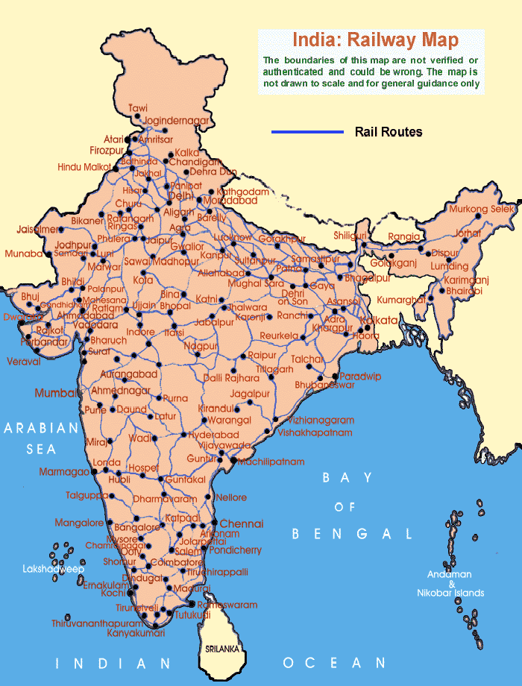
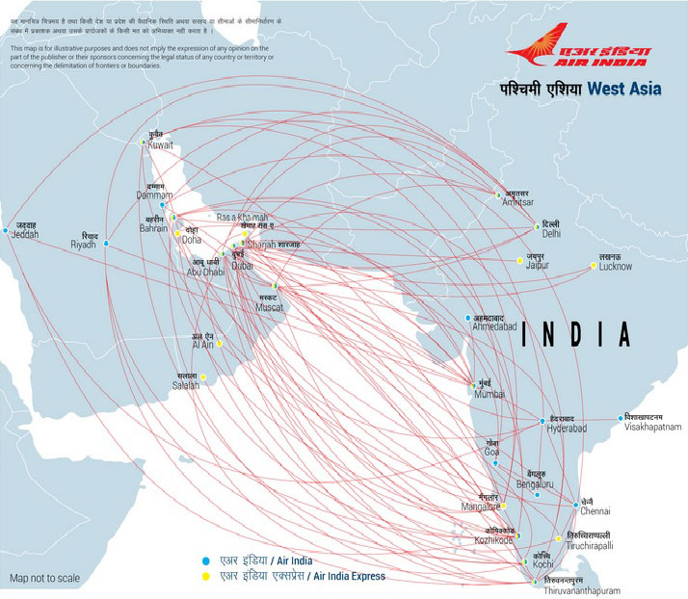
Transport System
Notes:
When network acts as a transportation system, a local failure shifts loads to other nodes. If the extra load is negligible, the system can seamlessly absorb it, and the failure goes unnoticed. If, however, the extra load is too much for the neighboring nodes, they will too tip and redistribute the load to their neighbors. In no time, we are faced with a cascading event, whose magnitude depends on the position and the capacity of the nodes that failed initially.

Slide 8

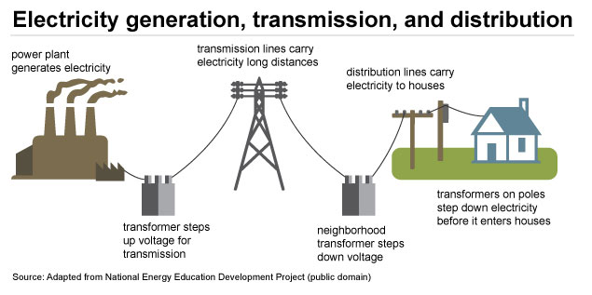
Technological Systems

Slide 9
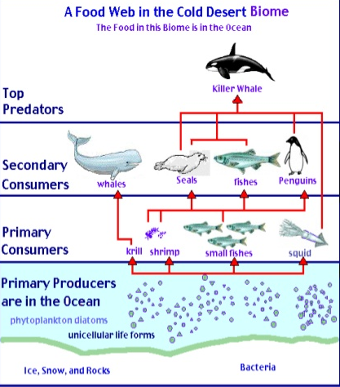
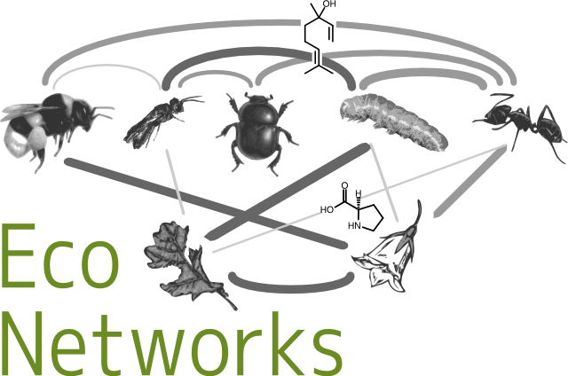
Ecological Systems
Analyzing ecological networks of species interactions (2017)

Slide 10




Social Systems
Political Affiliations
International Trade
Education and Research
Economic transactions

Slide 11
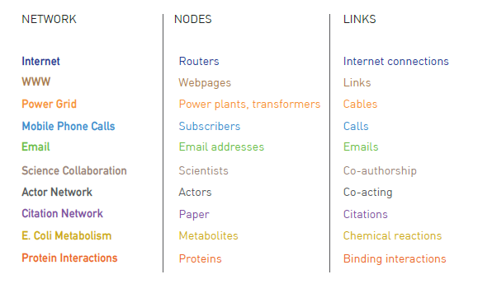
Ref: Albert-László Barabási, Network Science, Cambridge University Press, 2015

Slide 12
Why Graph data model?
Graph G = (V, E) , permits modeling of real world objects along with relationships
Solid theoretical background (Graph Theory)
Extensively used as tool by sociologists since 1930's
Availability of cheap computational power makes it possible to model large complex networks and understand dynamics of contemporary networks

Slide 13
Key discovery of Network Science
Architecture of networks emerging in various domains of science, nature, and technology are similar to each other
Common set of mathematical tools can be used to explore these systems
Processes that generated these networks differ greatly, yet governed by the same organizing principles

Slide 14
Interesting questions
What are the patterns of information flow in the network?
How does the influence flow in the network?
Who are the important actors in the Network?
How many significantly large groups exist in the network?
How was the network generated?
Is it possible to predict new links?

Slide 15
Interesting questions
Information Spreading
What are the patterns of information flow in the network?
How does the influence flow in the network?
Who are the important actors in the Network?
How many significantly large groups exist in the network?
How was the network generated?
Is it possible to predict new links?
Finding central nodes
Community Detection
Generative Models
Link Prediction

Slide 16
NETWORK SCIENCE : "the study of network representations of physical, biological, and social phenomena leading to predictive models of these phenomena." ⁻⁻⁻ United States National Research Council

Slide 17
Roadmap
Introduction to Network Science
Mathematics of Network Science
Characterizing Nodes in Networks
Characterizing Networks

Slide 18
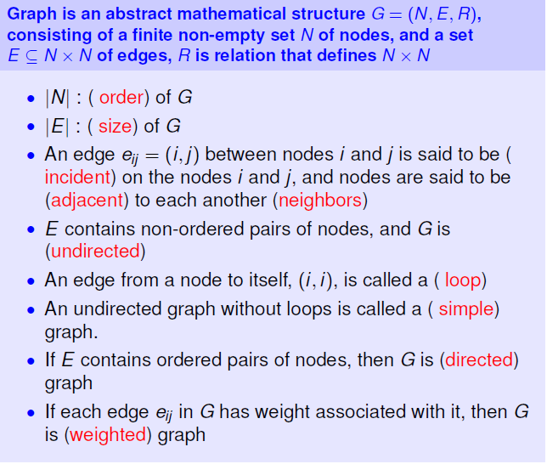
Mathematics of Network Science (Quick Review of Graph Theory)

Slide 19
N = { w, x, y, z }
E = { (w,x), (x,y), (x,z), (y,z) }
Order (G) : |N| = 4
Size (G) : |M| = 4
x and y are adjacent (neighbor) nodes.
x
y
w
z

Slide 20
Edge Types
Directed
Undirected
x
y
x
y
Loop
Multiple Edges
x
x
y

Slide 21
Basic Graph Types
Simple undirected Graph
Simple directed Graph
x
y
x
y
z
z
Multigraph
Weighted Graph
w1
x
y
x
y
w2
w3
z
z

Slide 22
Edge Labeled Graph
Complete Graph
Each vertex is adjacent to each other vertex
a
x
y
b
c
z
w
Set of vertices can be decomposed into two disjoint sets such that no two vertices within the same set are adjacent
Vertex-Labeled Graph
Bipartite Graph
x
y
x
y
z
z
w

Slide 23
Regular Graph
Complete Graph
Each vertex has same degree.
x
y
x
y
z
w
z
w
2 - regular
z

Slide 24
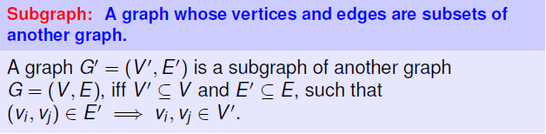
Subgraph
V1
V2
V1
V2
V2
V3
V4
V5
V6
V4
V5
V4
V5
V6
V7
V8
Number of subgraphs of G?
V8
V7
Graph G
Two example subgraphs

Slide 25
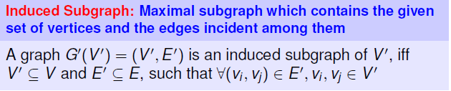
Induced Subgraph
V1
V2
V1
V2
V2
V3
V4
V5
V6
V4
V5
V4
V5
V6
Induced Subgraph of
{V2, V4, V5, V7, V8}
Induced Subgraph of {V1, V2, V4, V5, V8}
V7
V8
V8
V7
Original Graph G

Slide 26
Clique
A clique of a graph is a maximal complete subgraph
(k nodes & k(k-1)/2 edges).
V1
V2
V1
V2
V3
V4
V5
V6
V3
V4
V5
V6
V7
V8
V7
V8
Original Graph
Clique of size 4

Slide 27
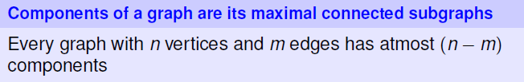
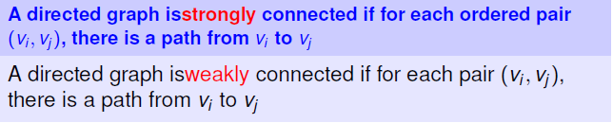
Connected Component

Slide 28
Strongly Connected
Weakly Connected
If there is a (directed) path between all ordered pairs of vertices.
If there exists a path between node pairs only by considering edges as undirected.
x
y
x
y
x
y
z
z
z
Number of Components = 3
Number of components = 1

Slide 29
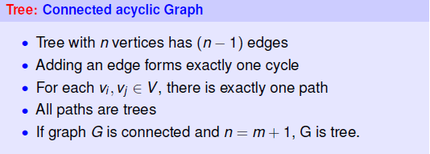
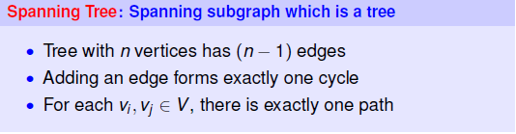
Tree Graph
n-1

Slide 30
Spanning Trees
Minimum Spanning Tree: has minimum weight than all other spanning trees of the same graph
A complete undirected graph can have maximum N^{N-2} spanning trees
V1
V2
V1
V2
V1
V2
V3
V4
V5
V6
V3
V4
V5
V6
V3
V4
V5
V6
V7
V8
V7
V8
V7
V8
Original Graph
Two examples of Spanning Trees.

Slide 31
Basic Graph Traversal
V1
V2
V1
V2
V2
V3
V4
V5
V6
V4
V5
V4
V5
V6
V7
V8
V8
V7
A walk may traverse a vertex or an edge any number of times.
Length of Walk = 5
Length of Walk = 4

Slide 32
OPEN WALK
CLOSED WALK
V1
V1
V2
V2
V1
V1
V2
V2
V3
V4
V5
V6
V3
V4
V5
V6
V3
V4
V5
V6
V3
V4
V5
V6
V7
V8
V7
V8
V7
V8
V7
V8
Open walk of length = 4
Closed walk of length = 5

Slide 33
Trail : Walk where no edge is traversed more than once.
Tour : Closed trail
V1
V1
V2
V2
V1
V1
V2
V2
V3
V4
V5
V6
V3
V4
V5
V6
V3
V4
V5
V6
V3
V4
V5
V6
V7
V8
V7
V8
V7
V8
V7
V8
( V1, V4, V7, V8, V5, V4)
( V1, V4, V7, V8, V5, V4 , V3, V1)

Slide 34
Path : Walk where nodes and edges are distinct.
Cycle : Closed path.
V1
V1
V2
V2
V1
V1
V2
V2
V3
V4
V5
V6
V3
V4
V5
V6
V3
V4
V5
V6
V3
V4
V5
V6
V7
V8
V7
V8
V7
V8
V7
V8
No node is repeated except the endpoint in cycle
( V1, V4, V7, V8, V5)
( V1, V4, V7, V8, V5, V1)

Slide 35
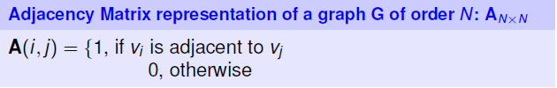
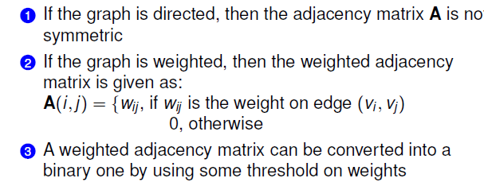
Representing Graphs
Adjacency List: Cost effective for sparse graphs
Edge List: List of edges, along with properties

Slide 36
Modelling Data as Graph
Explicit Relationships
Friendship, Batch-mates, Co-author, Co-actor, Co-citation
Same capacity, Same specification
Feeds-on, Depends-on, Same-habitat
Implicit Relationships
Correlations
Similarity computation
Application specific similarity definition and threshold
Multiple graphs from same dataset

Slide 37
Twitter Graph
Nodes
– Users, hashtag, media, tweet
• Links
– people create tweets
– people respond to tweets
– they mention other users
– User follows user

Slide 38
Text graphs
Words as Nodes
Co-occurance as links
Polysemy or Synonymy as links
Similar part-of-speech tags as links
Sentences as Nodes
Semantic similarity as links (may be weighted)
Entailment as links (may be weighted)

Slide 39
Roadmap
Introduction to Network Science
Mathematics of Network Science
Characterizing Nodes
Characterizing Networks

Slide 40

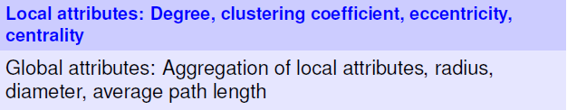
Characterization in Networks

Slide 41
Characterizing Nodes
Describes embedding of the node in G
Understand local topology
Insights into the nature of nodes
Insights into functionality of the node

Slide 42
Degree
Number of edges incident on a node
V1
V2
V1 V2 V3 V4 V5 V6 V7 V8
4 3 2 4 4 1 2 2
V3
V4
V5
V6
V7
V8

Slide 43
Centrality
Indicates importance of vertices within a graph wrt prominence/ structural importance/ critical position/ popularity
Useful for identifying
influential person(s) in a social network
key infrastructure nodes in the Internet or urban networks
super-spreaders of disease
Session dedicated to different measures

Slide 44
Degree Centrality
Higher the degree – higher the importance.
V1
V2
V1 V4 V5 V2 V3 V7 V8 V6
4 4 4 3 2 2 2 1
V1
V3
V4
V4
V5
V6
V5
V7
V8

Slide 45
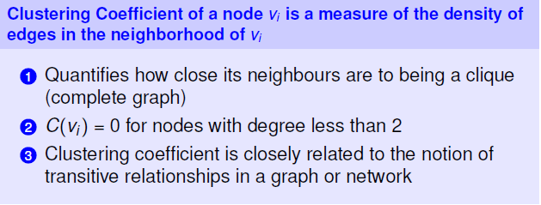
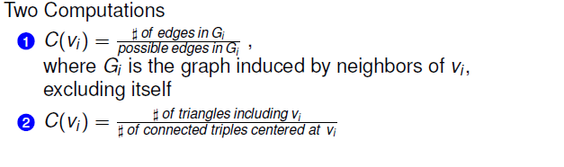
Clustering Coefficient
Quantifies cohesion - “how many of my friends are friends”

Slide 46
Star:
Ring:
Complete:
i
i
i
i
c_{i} = 0
c_{i} = 0
c_{i} = 1
V1
V2
V1
c_{V4} = 2 / (4(4-1)/2)
V3
V4
V5
V6
V3
V4
V5
= 1 / 3
V7
V8
V7

Slide 47

Eccentricity
V1 V2 V3 V4 V5 V6 V7 V8
Ecc: 2 3 3 3 2 4 4 3
V1
V1
V2
V2
1
1
1
2
1
V3
V3
V4
V4
V5
V5
V6
V6
Radius of graph = min (Ecc) = 2
2
2
V7
V7
V8
V8
Diameter of graph = max (Ecc) = 4

Slide 48
Efficiency of pair of nodes
V1
V1
V2
V2
1/1=1
V3
V3
V4
V5
V6
Smaller the distance between the nodes, more efficient is the communication.
V7
V7
V8
1/3=0.33

Slide 49
Roadmap
Introduction to Network Science
Mathematics of Network Science
Characterizing Nodes in Networks
Characterizing Networks

Slide 50
Characterizing Networks
Gives insights into topological properties of network
Functionality determined by structure
How does the information flow?
Which nodes control the information flow?
Which regions of the network are relatively dense?
Which nodes are influential?

Slide 51
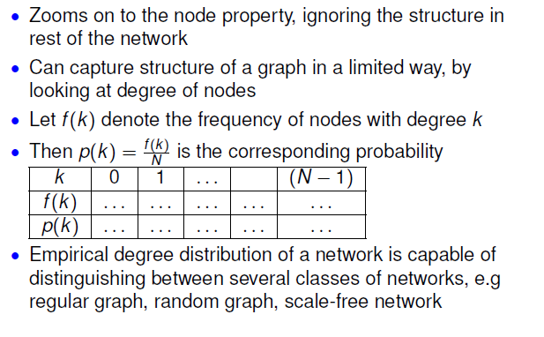
Degree Distribution

Slide 52
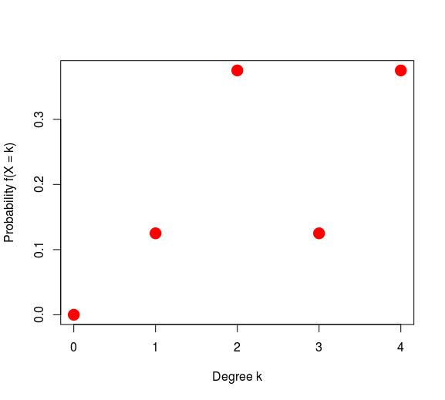
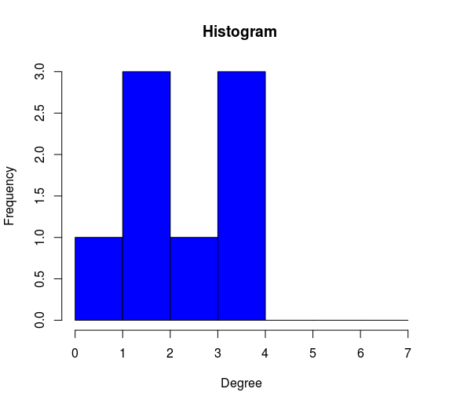
Degree Distribution
k 0 1 2 3 4
N_{k} 0 1 3 1 4
F_{k} 0 0.125 0.375 0.125 0.375
V1
V2
V3
V4
V5
V6
V7
V8
V1 V4 V5 V2 V3 V7 V8 V6
4 4 4 3 2 2 2 1

Slide 53
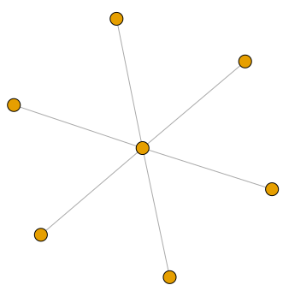
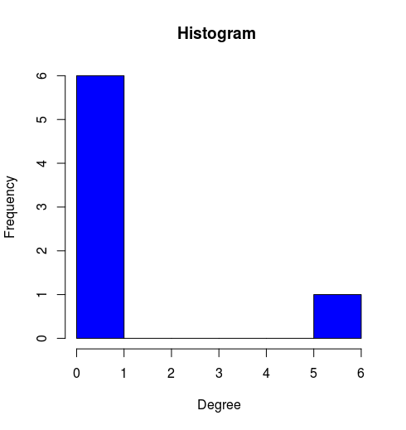
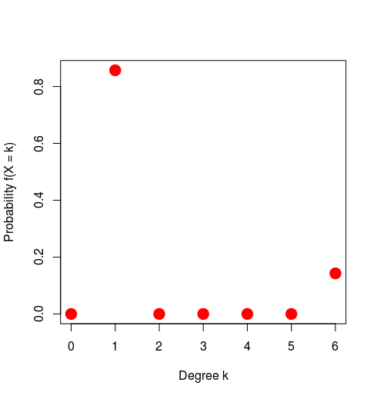
Degree Distribution of Star Graph
k 0 1 2 3 4 5 6
N_{k} 0 6 0 0 0 0 1
f_{k} 0 0.85 0 0 0 0 0.14

Slide 54
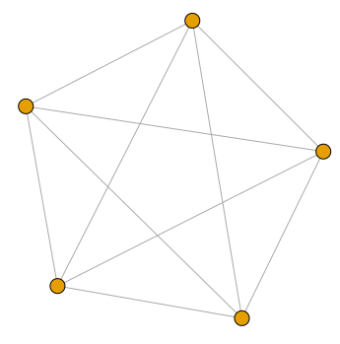
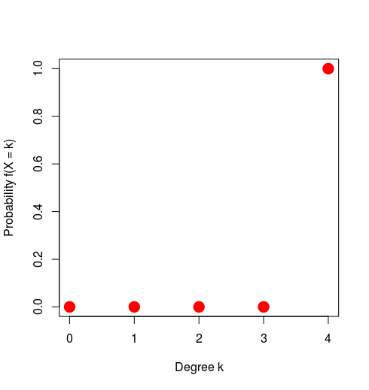
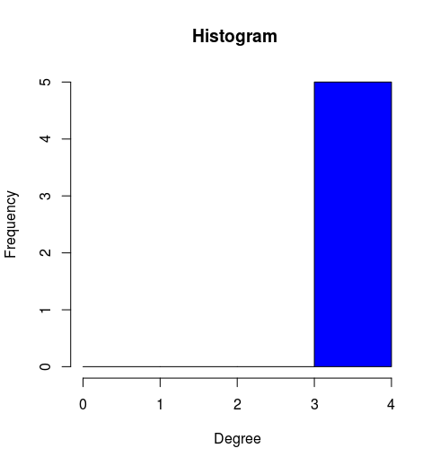
Degree Distribution of Complete Graph
k 0 1 2 3 4
N_{k} 0 0 0 0 5
F_{k} 0 0 0 0 1

Slide 55
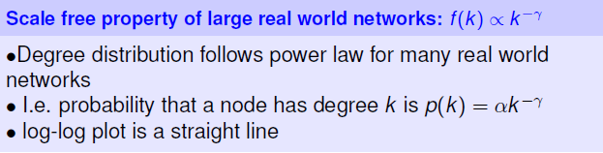
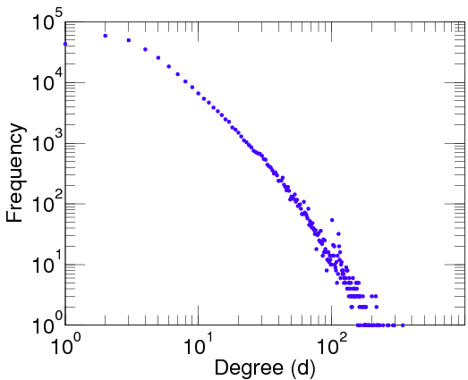
Degree Distribution of Real Networks
Degree Distribution:
DBLP co-authorship Network

Slide 56
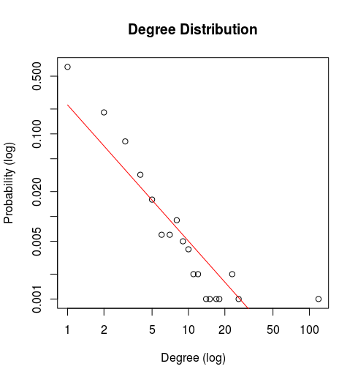
Plot and Fit the power law distribution:
"γ = 1.65"

Slide 57
Density of Network
Density(G) = existing edges/possible edges
Possible edges = N(N - 1)/2
V1
V2
V1
V3
V4
V5
V6
V3
V4
V7
V8
Density = 11 / [8(8-1)/2]
= 0.3928571
Density = 3 / [3(3-1)/2]
= 1

Slide 58
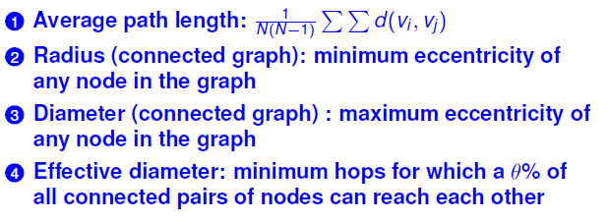
Shortest Path based Metrics

Slide 59
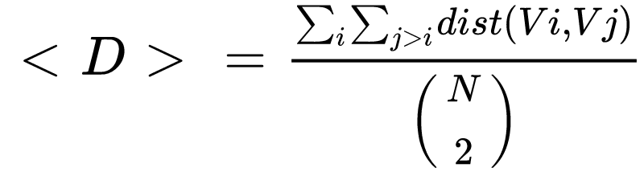
Average path length
V1
V2
Path Length Matrix
V1 V2 V3 V4 V5 V6 V7 V8
V1 0 1 1 1 1 2 2 2
V2 1 0 2 2 1 1 3 2
V3 1 2 0 1 2 3 2 3
V4 1 2 1 0 1 3 1 2
V5 1 1 2 1 0 2 2 1
V6 2 1 3 3 2 0 4 3
V7 2 3 2 1 2 4 0 1
V8 2 2 3 2 1 3 1 0
V3
V4
V5
V6
V7
V8
Average path length
Average Path Length <D> = 2* 52 / 8(8-1)
= 1.857

Slide 60
Diameter and Radius
Radius : Minimum Eccentricity
Diameter : Maximum Eccentricity
V1
V2
Radius of graph = min (Ecc) = 2
V3
V4
V5
V6
Diameter of graph = max (Ecc) = 4
V7
V8

Slide 61
90- percentile Effective Diameter
The diameter of a graph G is sensitive to outliers
Effective diameter is more robust
Defined as the minimum number of hops for which a large fraction, typically 90%, of all connected pairs of nodes can reach each other

Slide 62


Clustering coefficient (Global)

Slide 63
Resources
https://www.distributed-systems.net/index.php/books/gtcn/
http://networksciencebook.com/
Many Graph theory books available online

Slide 64
Thanks

