Slide 1

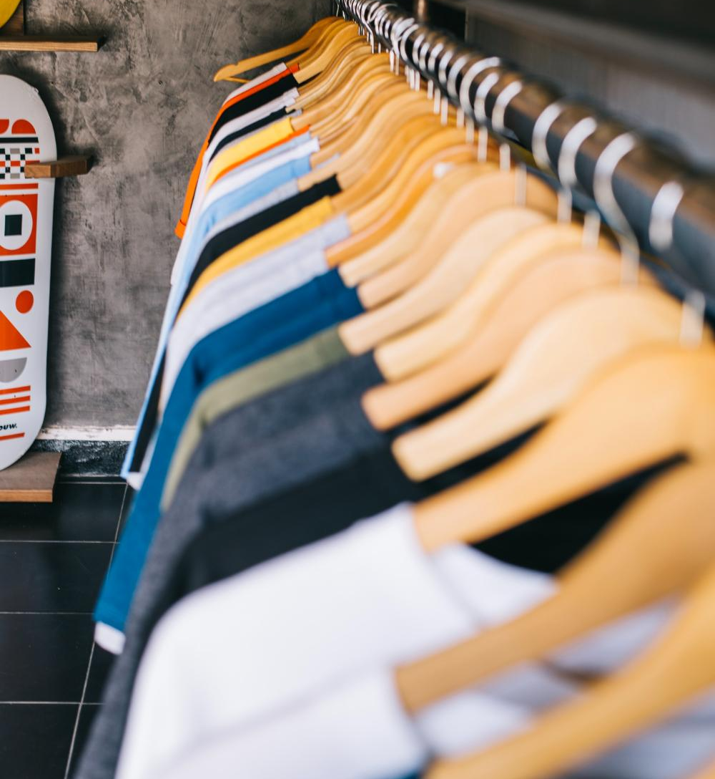
SHEIN Men’s 1K Fashion Insights

Slide 2
Table of contents
Introduction
Objective
7 Steps of machine learning
Steps used in EDA & Data Preprocessing
EDA Insights
Correlation table
Data Insights
ML Algorithms
Results
Best Model
Data Source
Vote of thanks

Slide 3
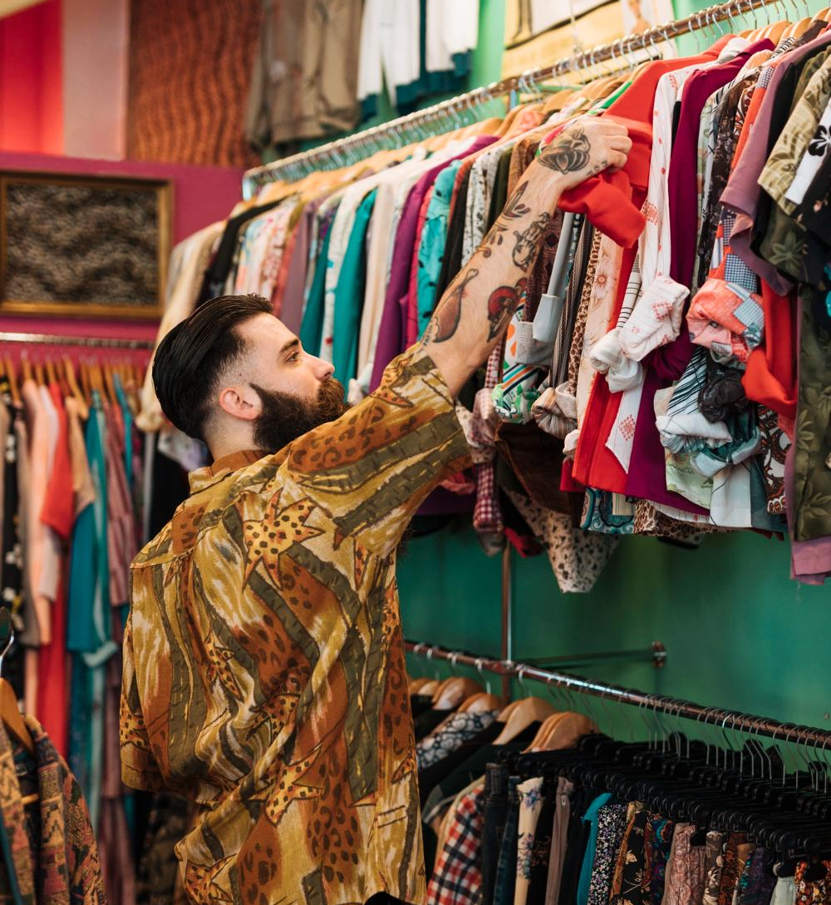
Introduction
SHEIN is a global fashion and lifestyle e-retailer committed to making the beauty of fashion accessible to all. They use on-demand manufacturing technology to connect suppliers to our agile supply chain, reducing inventory waste and enabling us to deliver a variety of affordable products to customers around the world. From our global offices, they reach customers in more than 150 countries. Shein is a Chinese Singaporean fast fashion retailer. Founded in Nanjing, China, in October 2008 as ZZKKO by entrepreneur Chris Xu, Shein grew to become the world's largest fashion retailer as of 2022. The company is headquartered in Singapore.

Slide 4
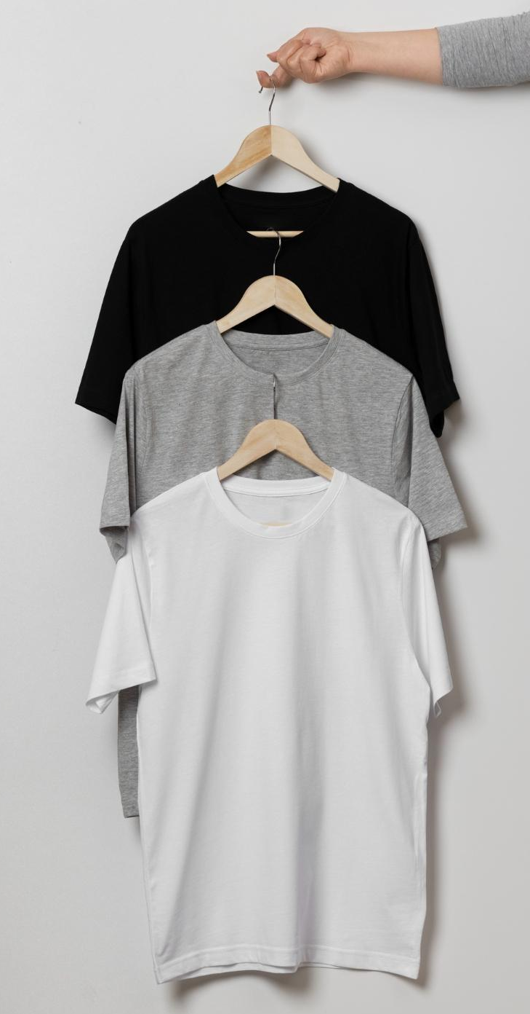
Objective
The primary objective of this project is to utilize machine learning algorithms to extract actionable insights from the SHEIN Men's Fashion Insight dataset. Specifically, we aim to:
Analyze pricing trends and identify optimal pricing strategies.
Predict sales performance based on product attributes and pricing.
Generate personalized product recommendations for customers.
Explore correlations between product attributes, customer reviews, and sales performance.

Slide 5
Dataset Overview: This dataset, titled "👔 Shein Men's 1K Fashion Insights", provides a comprehensive look into the fashion trends of Shein's men's apparel. It contains 1000 entries, each representing a unique product with detailed attributes.
Data Science Applications: This dataset is a valuable resource for data scientists interested in fashion trends, consumer behavior, and retail analytics. It can be used for exploratory data analysis, trend forecasting, customer segmentation, and recommendation systems.
Column Descriptors: The dataset includes columns such as 'product_id', 'sku', 'url', 'title', 'color', 'sale_price', 'retail_price', 'discount_percentage', 'category_name', 'category_id', 'description', 'reviews_count', and 'average_rating'. Each column provides specific information about the product, from its ID and SKU to its color, price details, category, and customer reviews.
Acknowledgements: We extend our gratitude to Shein for making their product data accessible, and to Kaggle for providing a platform for sharing and exploring such datasets. Their contributions to the data science community are invaluable.

Slide 6
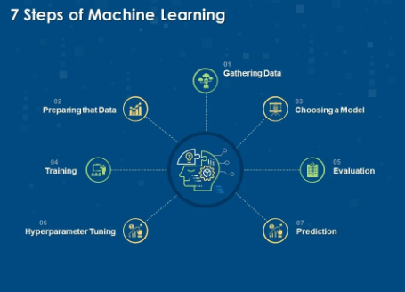

Slide 7
Steps Used in EDA & Data Preprocessing
Pre - EDA
Imported necessary Libraries
Import Dataset
Comprehended the description of the datset.
Created a copy of the original dataset on which cleaning has been done.
Columns
Checking bifurcation of columns into object datatype & non-object datatype.
Renaming some columns.
Values
Checking distinct values of each column.
Replacing some categories names to limited category.
EDA
Univariate Analysis of Categorical columns through FREQUENCY DISTRIBUTION.

Slide 8
Pre-Processing Steps
Handling Null values
Handling Duplicates
Feature Engineering
Outlier Treatment
Checking for Multicolinearity
Checking for Normality
Label Encoding for categorical features

Slide 9
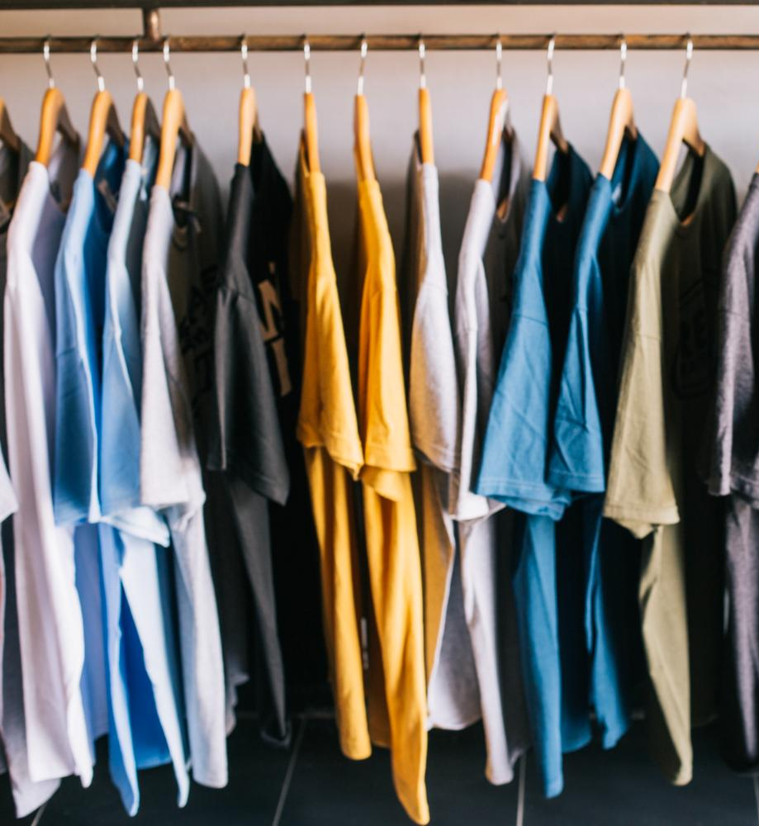
EDA Insights

Slide 10
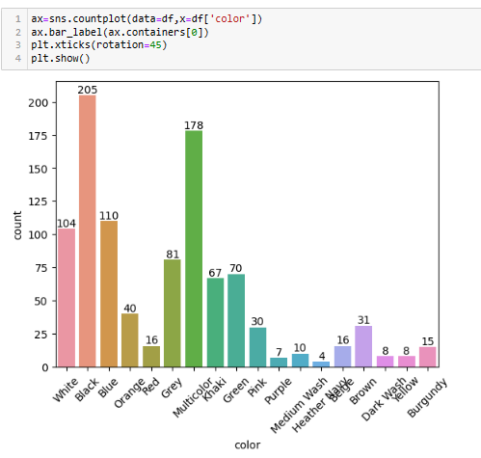
Insight 1
It looks like SHEIN prefer black, multicolor and white color cloths most or the demand of these colors are very high in the market.

Slide 11
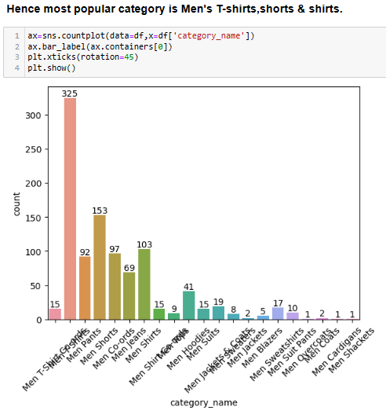
Insight 2
Hence most popular category is Men’s
T-shirts, shorts & shirts.

Slide 12
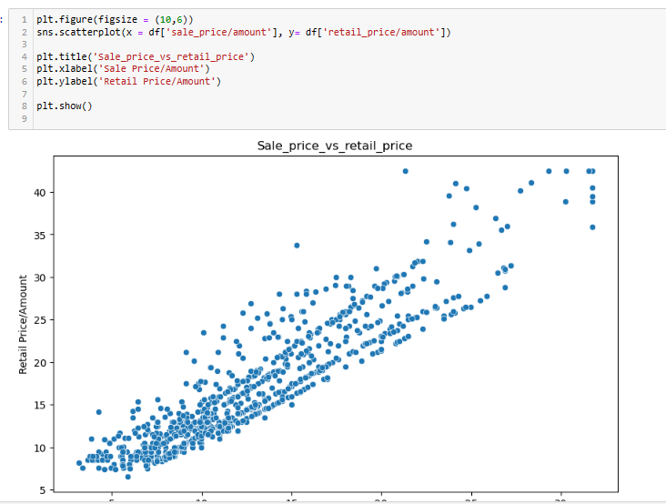
Insight 3
Hence there is a positive correlation b/w sale price & retail price

Slide 13
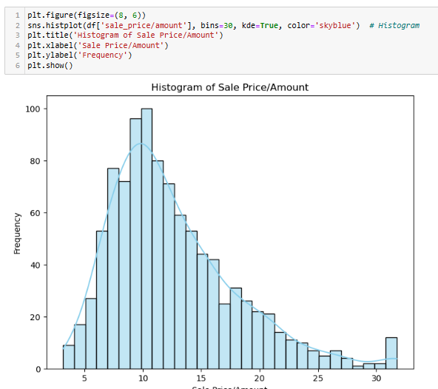
Insight 4
The graph shows that the Sales Price/Quantity data is generally concentrated around 10. This indicates that most of the products are sold around this price and 10 is an average price. However, we also see that products sold at prices in the range 10-20 are quite common.These products may be slightly more expensive than 10 and may account for a significant proportion of total sales.Products sold at prices above 30 are quite rare.

Slide 14
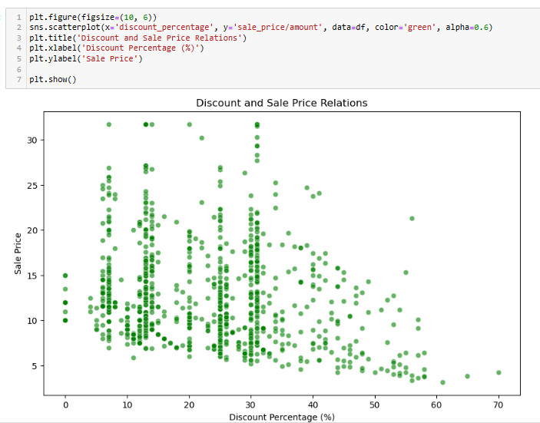
Insight 5
The fact that most of the products are priced around 10 may indicate that a customer base with high price sensitivity is addressed.The presence of products priced in the range of 20-30 may indicate a desire to appeal to different price segments.The scarcity of products cheaper than 10 or more expensive than 50 may indicate that these price ranges are not suitable for the target audience or that there is a stock problem.The information in the histogram can be used to create new product development strategies. For example, given that products priced around 10 are in demand, new products can be developed in this price range.Likewise, given that products priced in the 20-30 range are also in demand, products with different features or higher quality products can be developed in this price range.

Slide 15
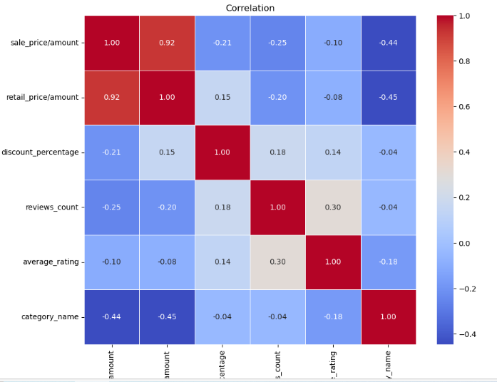
Correlation

Slide 16
Data Insights
Sale Price:
The average sale price of products is approximately 12.65, with a standard deviation of 5.75.
Sale prices range from 3.17 to 60.49, indicating a wide variation in pricing.
Retail Price:
The average retail price of products is approximately 16.55, with a standard deviation of 7.59.
Retail prices range from 6.59 to 69.79, showing a significant range in pricing.
Discount Percentage
The average discount percentage offered on products is approximately 22.74%, with a standard deviation of 12.73%.
Discount percentages range from 0% to 70%, indicating varying levels of discounting.
Average Rating:
The average rating of products is approximately 4.67
Ratings range from 0 to 5

Slide 17
Data Insights
The highest discounted product is titled "Manfinity Homme Men's Knitted Heart Embroidery Sweatshirt" and it is available in white color. It has a sale price of 4.26, compared to a retail price of 14.19, resulting in a discount of 70%.
There is a significant peak around a sale price of 10, with over 120 occurrences. suggesting that a significant number of products fall within this price range
The distribution is skewed to the right, indicating that the majority of products have lower sale prices, while fewer products command higher prices
The category with the highest frequency is Men T-Shirts, with more than 200 occurrences. This suggests that these t-shirts are in high demand
Black has the highest count, indicating it is a popular color.
Other common colors include white,khaki and multicolors also
Many colors have relatively low counts (less than 50), suggesting they are less popular.
Most products have high ratings, with a significant number receiving a perfect 5.0 rating.
There are very few products with low ratings, indicating general customer satisfaction
The scatterplot shows a positive correlation between sale price and retail price.

Slide 18
Data Insights
As the retail price increases, the sale price tends to increase as well.
Customers are willing to pay more for items with higher retail prices.
Most data points are concentrated in the range of 10 to 40 for retail price and 10 to 30 for sale price.
This concentration suggests that many items are being sold at or below their retail price
There are a few outliers where the sale price is significantly higher than expected based on the retail price.
These outliers could represent premium or unique items that customers are willing to pay
The top revenue-generating categories are predominantly men's apparel, with "Men T-Shirts" leading in total revenue, followed closely by "Men Jeans" and "Men T-Shirt Co-ords." Other popular categories include "Men Pants," "Men Shorts," and "Men Polo Shirts"

Slide 19
ML Algorithms
Linear Regression
Ridge
Lasso
Decision Tree Regressor
Random Forest
XG Boost

Slide 20
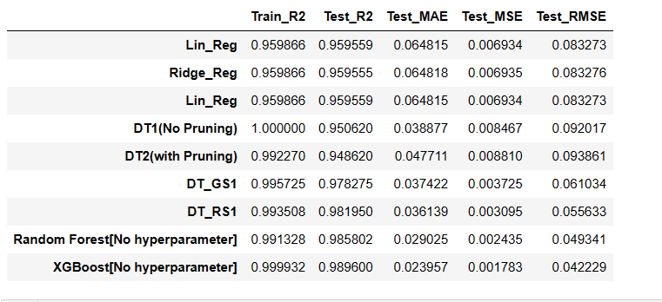
Tabulate all results

Slide 21
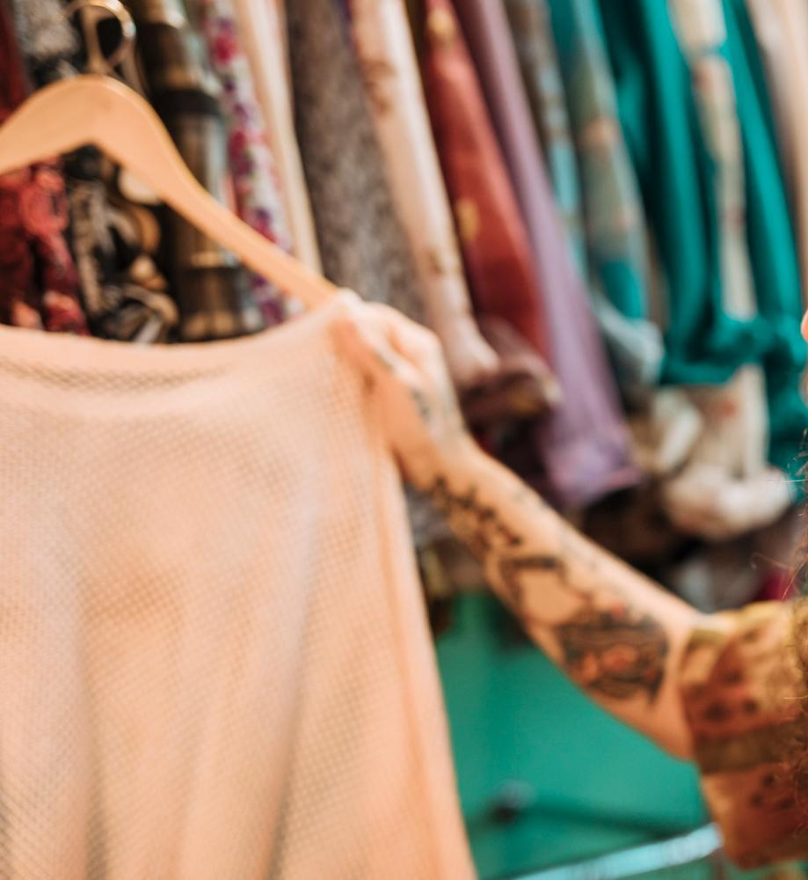
Best Model - XGBoost
XGBoost builds a predictive model by combining the predictions of multiple individual models, often decision trees, in an iterative manner. The algorithm works by sequentially adding weak learners to the ensemble, with each new learner focusing on correcting the errors made by the existing ones.
This results with train accuracy with 99.99% & test accuracy 98.96% with minimal MSE.

Slide 22
Data Source: -
Kaggle
Software used : -
Python for Data Cleaning & model implementation
Power point for presentation

Slide 23
THANK YOU!!!
Submitted By –
Kirti Agarwal
PGA 37

