Slide 1
Position Salary Prediction
Linear vs Polynomial Regression

Slide 2
Objective
Predict salary for Level 6.5 using regression models

Slide 3
Dataset
Position, Level, Salary

Slide 4
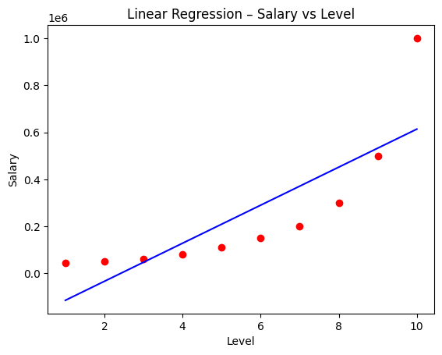
Linear Regression
Underfits the salary trend

Slide 5
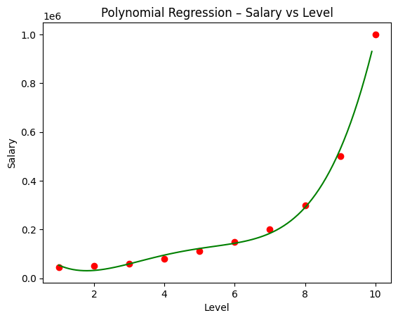
Polynomial Regression
Captures non-linear relationship

Slide 6
Model Comparison
Polynomial Regression performs better
Linear R²: 0.669
Linear RMSE: 163388.74
Polynomial R²: 0.997
Polynomial RMSE: 14503.23

Slide 7
Business Impact
Supports fair salary decisions

