Slide 1

AI-POWERED INTELLIGENT SALES FORECASTING PLATFORM USING PREDICTIVE ANALYTICS – GROUP 1
INFOSYS SPRINGBOARD INTERNSHIP PROJECT
Team C
01
02
03
Nimisha Mishra -Project Lead + AI/ML Engineer
Kirti Chandra Nayak -Backend Developer
Nadiminti Tharun -DataBase Engineer
04
05
Jhansi Oruganti -Frontend Developer
Arijeet Dhaka -QA Engineer

Slide 2

PROBLEM & SOLUTION
Problem Statement & Solution
Current Sales Challenges
Our Solution: SalesGenie
Manual lead research consuming hours per prospect, diverting rep time from selling
Difficulty prioritizing high-value prospects amid noisy pipelines
An AI-powered B2B sales intelligence and CRM platform that transforms raw prospect information into actionable sales intelligence, enabling sales teams to work smarter and close faster.
End-to-End Platform Flow
Generic, ineffective outreach messaging yielding low response rates
Missed follow-ups and lost opportunities from poor tracking
Lead
Intelligence
Scoring
Outreach
Scattered sales information across multiple disconnected systems
Recommendation
Conv. Intelligence
Analytics
Each stage is AI-augmented, ensuring every handoff enriches the lead records.

Slide 3


ARCHITECTURE
System Architecture Overview
Tech Stack
Core Platform Modules
Lead Management & Prospect Database
Lead Intelligence & Company Analysis
User Layer
Browser access with role-based security
Capture, organize, and maintain structured prospect records as the foundation for all downstream AI
AI-driven deep analysis of company context, market position, and strategic signals
Streamlit Frontend
Responsive UI for all six platform modules
AI Outreach Generation
Lead Scoring & Recommendation Engine
Industry-specific, LLM-powered personalized messaging at scale
Predictive fit scoring and prioritization for pipeline focus
FastAPI Backend
REST API layer for module logic and data flow
Conversation Intelligence & CRM Integration
Dashboard & Sales Analytics
Real-time forecasting, KPI visualization, and performance reporting
Automated call analysis and CRM data synchronization

Slide 4
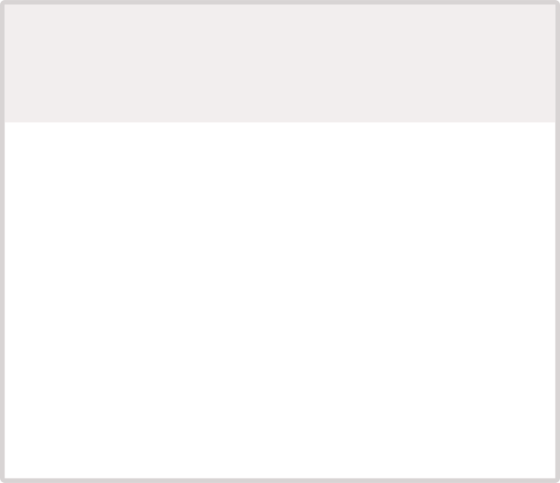








MODULE 1
Module 1: Lead Management & Prospect Database
Purpose
Module 1 Workflow
Centralized lead management system that captures, organizes, and maintains comprehensive prospect information as the foundation for all downstream AI modules. Without clean, structured data at this layer, no AI enrichment downstream can perform reliably.
Update
Manage
Core Capabilities
Status and notes updated in real-time as interactions progress
Search, filter, and segment the prospect database with precision
Lead Creation
Prospect Information
Add new prospects with structured, validated data entry across all required fields
Contact details, company information, and precise industry classification
Store
Create Lead
Lead Status Tracking
Notes & History
Normalized records persisted to the relational database layer
Sales rep enters prospect details via the Streamlit UI form
Pipeline states: New → Contacted → Qualified → In-Progress → Closed
Full interaction history and contextual notes attached to every lead record

Slide 5
MODULE 1 — EXAMPLE
Module 1: Prospect Database Example
Sample Lead Profile — Salesforce
Database Feature Set
Field
Value
Advanced Search & Filtering
Lead Status Management
Company
Salesforce
Pipeline stage tracking with full audit trail — every status transition is logged with timestamp and user attribution
Multi-dimensional search across company name, industry, size, status, and custom fields for rapid prospect discovery
Industry
Technology / SaaS
Company Size
Enterprise (5,000+ employees)
Website
salesforce.com
Lead Status
Qualified
Custom Field Architecture
Structured Records for AI
Contact Role
Sales Development Representative
Detailed lead profiles with extensible custom fields tailored to specific verticals and sales motions
All prospect data normalized and structured for direct consumption by Modules 2–6 without transformation overhead
Notes
Recent Series funding; expanding into AI/ML solutions

Slide 6
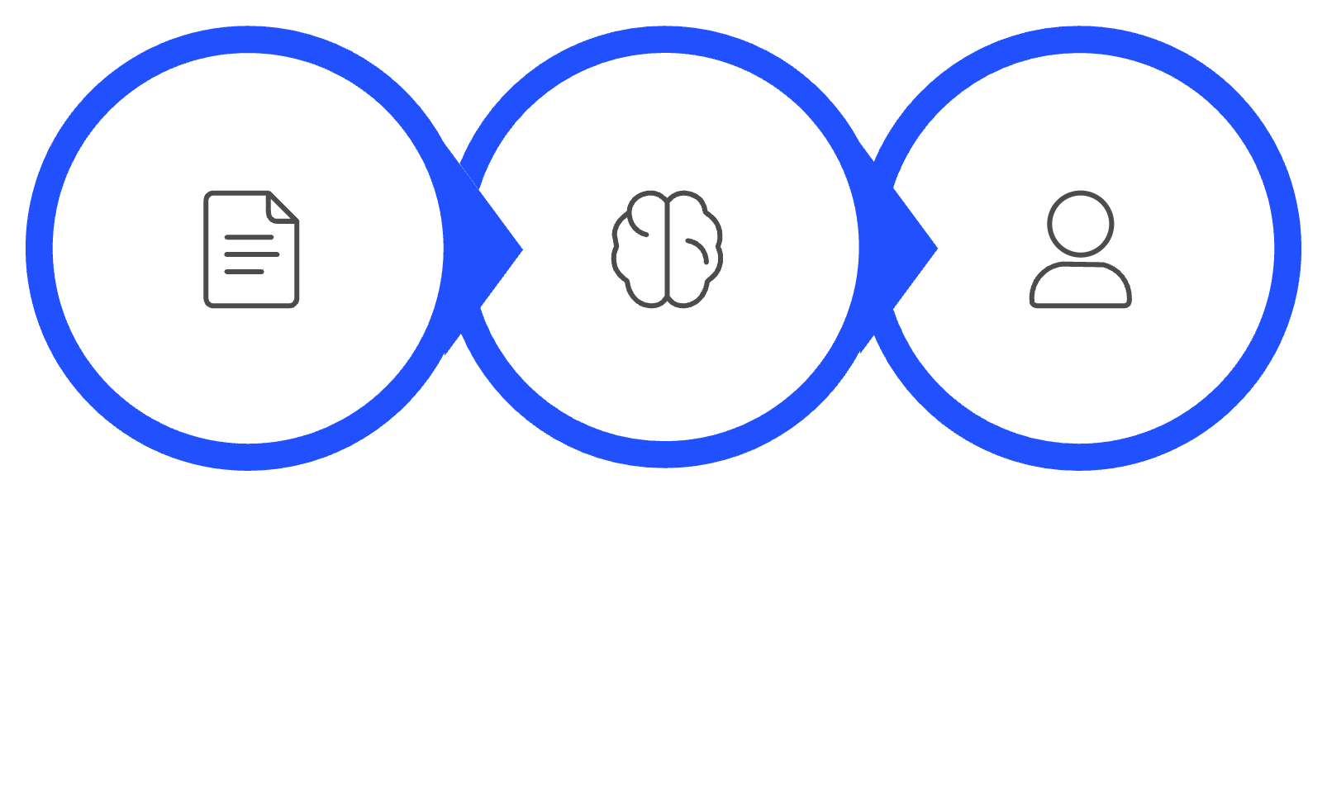
MODULE 2
Module 2: Lead Intelligence & Company Analysis
Transform raw company information into structured, actionable intelligence that informs all downstream AI decisions and sales strategies — eliminating hours of manual research per account.
Analysis Dimensions
Intelligence Pipeline
Industry Analysis
Company Size & Scale
Sector trends, market position, and competitive landscape mapping
Revenue estimates, employee count, and growth trajectory indicators
Business Profile
Technology Environment
Products, services, target markets, and core business model breakdown
Current tech stack, infrastructure maturity, and digital transformation stage
Company Input
AI Analysis
Structured Profile
Rich, multi-dimensional company intelligence flows directly into Module 3 (Outreach Generation) and Module 4 (Lead Scoring), enabling personalized messaging and accurate opportunity prioritization without manual analyst intervention.

Slide 7


MODULE 2 — OUTPUT
Module 2: AI Lead Intelligence Card
Intelligence Card Components
From Raw Data to Decision-Ready Intelligence
1
2
Raw Lead Data
Executive Summary
Strengths
Company name, industry, size, website, and contextual notes from Module 1
Concise, LLM-generated overview of the prospect and the strategic sales opportunity
Key competitive advantages, market position, and capability highlights relevant to the sales angle
AI Analysis
LLM processing across all five analysis dimensions — industry, scale, profile, tech, context
3
4
Challenges
Business Insights
Lead Intelligence Card
Current pain points, business obstacles, and operational gaps that SalesGenie's offering can address
Strategic priorities, expansion signals, and growth opportunities identified from public data
Structured, rep-ready intelligence card surfaced directly in the Streamlit UI

Slide 8

MODULE 3
Module 3: AI Outreach Generation
Generate personalized, industry-specific outreach messages that resonate with each prospect's unique business context and challenges — powered by LLM prompt engineering at scale.
Personalization Framework
Industry-Specific Messaging Examples
🖥 Technology
🏦 Finance
Deliver to Sales Rep
Lead Profile
Messaging centered on AI adoption, cloud scalability, and competitive innovation velocity — speaking the language of CTOs and engineering leaders
Emphasis on security posture, regulatory compliance, and risk management frameworks — addressing the priorities of CFOs and compliance officers
Ready-to-send personalized copy
Prospect role and pain points
LLM Processing
Personalized Outreach Message
Company Context
🏥 Healthcare
Groq LLM
Org size, goals, tech stack
Focus on data protection (HIPAA), operational efficiency, and measurable patient outcome improvements for clinical and administrative buyers
Industry-Specific Prompt Engineering
Industry Intelligence
Crafted instructions for LLMs
Trends, benchmarks, challenges

Slide 9

MODULE 4
Lead Scoring & Recommendation Engine
Lead Data + Company Intelligence
Profiles and firmographics
Next Best Action
Data Flow Pipeline
AI/ML Lead Scoring
Recommended move
Predictive fit model
Recommendation Engine
Lead Score
Maps to actions
Value score

Slide 10
MODULE 4
Lead Scoring & Recommendation Engine
Lead Data + Company Intelligence
Profiles and firmographics
Next Best Action
Data Flow Pipeline
AI/ML Lead Scoring
Recommended move
Predictive fit model
Recommendation Engine
Lead Score
Maps to actions
Value score

Slide 11

MODULE 4
Recommendation Engine — WHEN + WHERE + WHAT
Three inputs combine into one Next Best Action.
⏱ WHEN
📡 WHERE
💬 WHAT
Follow-up timing
Channel mix
Content strategy
Priority
Engagement
Status
Stage
History
Email
Phone
LinkedIn
Demo
Pain points
Needs
Tech stack
Value prop
CTA
WHEN + WHERE + WHAT = NEXT BEST ACTION

Slide 12


MODULE 5
Conversation Intelligence & CRM Integration
Structured Outputs
Executive Summary
Key Points
Short strategic recap.
Main themes and context.
Transcript
Backend
Pain Points
Requirements
Structured Prompt
Customer challenges.
Business and technical needs.
LLM Analysis
Action Items
Next steps and owners.

Slide 13
MODULE 5
Summarization & Action Item Extraction
Key Insights Extracted
Action Items Generated
Executive Summary
Customer Pain Points
Action
Owner
Timeline
Conversation overview and opportunity
Send integration info
Sales Rep
Before next meeting
Key challenges and problems
Share security info
Sales Rep
Before next meeting
Requirements
Customer Interests
Business and technical needs
Products, features, solutions
Schedule technical discussion
Sales Rep
Next week
Important Discussion Points
Core topics and context
"It doesn't just summarize — it identifies next steps."

Slide 14




MODULE 6
Secure Access & Sales Dashboard
Role-based login gives a real-time view of sales metrics.
Login / Authentication
SalesGenie Dashboard
Lead Overview
Pipeline Metrics
Recent Activities
Leads, scores, and status.
Stage tracking and progress.
Outreach and conversation updates.

Slide 15




MODULE 6
Unified Sales Analytics & End-to-End Workflow
Data Sources
Key Metrics
Leads & Qualification
Pipeline Stages
Lead & Company Data
Scoring & Outreach
Activity & Engagement
AI Insights
Insights & Conversations
Unified Dashboard

Slide 16
Thank You

