Slide 1
Possible collaboration and contributions towards LIGO-India
V. Jha
S. P. Behera
R. Sehgal
Kirtikesh Kumar
(NPD, BARC)
Complementary measurements of supernova neutrinos using coherent Neutrino elastic scattering using neutrino detector and Gravitational waves in LIGO-INDIA

Slide 2
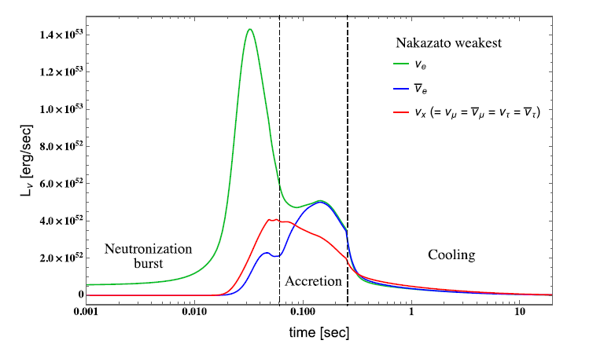
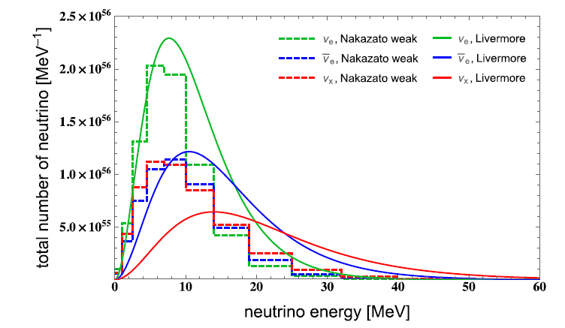
Neutrinos – GW combined measurements:
Low energy neutrinos from Supernova are responsible for carrying most of the energy of collapse and provide unique insights into stellar evolution
Time integrated Supernova Neutrinos spectra
Supernova Neutrinos time evolution

Slide 3
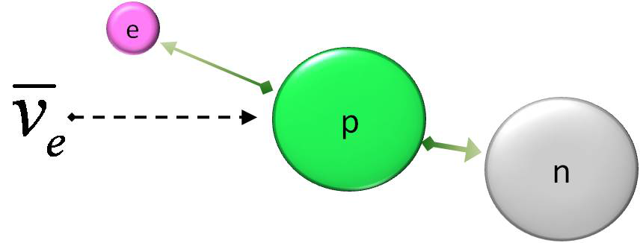
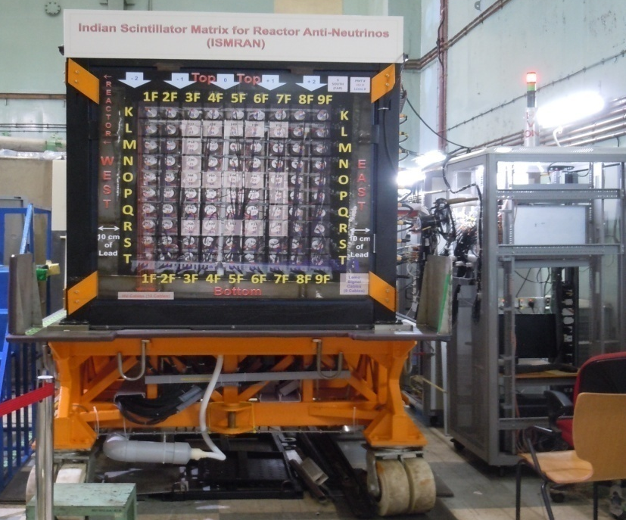
Feasibility studies of measurements of neutrinos by IBD :
Presently engaged in Antineutrino measurements at Dhruva reactor (100 MW reactor with Nat U core with D₂O moderation at BARC, Mumbai) using Indian Scintillator Matrix for Reactor Anti-Neutrinos (ISMRAN) placed at 13m from core centre
Plans for building large detector for antineutrino measurements at Kudankulam (2 x 3GWth operational, 4 more planned )
Expected count rates for supernova neutrinos 5 counts in 30T detector – seems unfeasible unless we build mega kT detectors
Digital
DAQ

Slide 4
India based Coherent Neutrino Nucleus Scattering Experiment (ICNSE) at Apsara-U :
Collaboration among BARC, NISER Bhubaneshwar and TAMU-USA to build 10-30 Kg Ge detector operating at mK
Advantages of CENNS : High cross sections (σ ~ N²)
It is an excellent probe for “Physics Beyond Standard Model” :
Sterile neutrino oscillations
Non-standard interaction
Magnetic moment of neutrino
Quantum Coherency
Application : Reactor monitoring
Background for dark matter searches
Core-collapse Supernovae
Dynamics of stellar explosion
Several other fundamental topics
Detectors for CENNS :
Phonon (Cryogenic Si, Ge , other material )
Ionization (Ge, Si)
Scintillating crystal (CsI, NaI), Noble liquid)

Slide 5
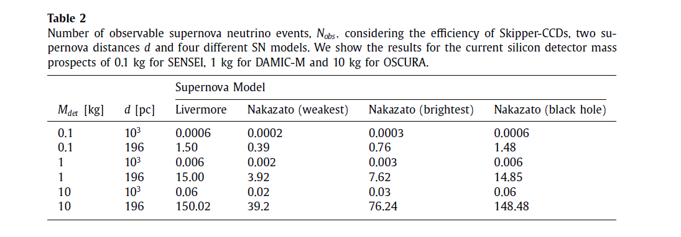
Feasibility studies of measurements of neutrinos by CENNS :
The CENNS measurements can be augmented, as we have proposal towards setting up a 100 kg Ge detector at an underground facility in Vizag.
Expertise in GEANT-4 based Simulation studies of detector responses and optimization of Radiation shielding design and simulation
Data Acquisition and analysis of large data and efficient management of data storage

