Slide 1


Progress Seminar
GMED-X: Graph-Guided Multi-Modal Encoding for Lung Disease Classification
Under the Supervision of
Dr. Prabina Pattanayak and Dr. Chandrajit Choudhury
Presented By
Kirti Swagat Mohanty
21-3-04-068
Photo by Pexels
Department of Electronics and Communication Engineering,
National Institute of Technology, Silchar

Slide 2

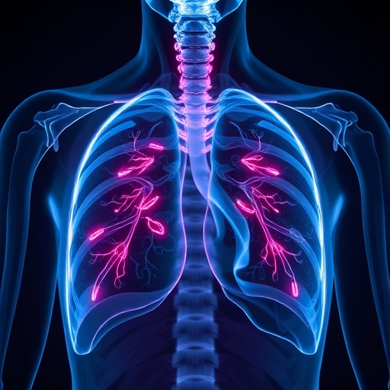
Table of Contents
1
Introduction
2
Motivation and Objectives
6
3
System Overview
7
4
Block Chain Integration
8
5
References

Slide 3
Problem Statement-1- Completed
Designing a Contrastive Learning Based Robust Multi-label Chest Disease Classification System
Problem Statement-2- Completed
Blockchain-Secured Federated Learning for Privacy-Preserving Multi-label Chest Disease Classification
Problem Statement-3- Implementation Complete
Designing a deep-learning based architecture to optimize features from the input image to enhance the classification

Slide 4
Problem Statement
The detection and classification of lung diseases from medical images pose significant challenges due to the complexity of pathologies and the need for high diagnosis accuracy.
Clinical Challenge: Patients with lung diseases often have multiple imaging modalities available (CheXpert X-rays + CT scans), but current models treat them independently or use naive fusion, missing critical disease relationships.
Class Imbalance: Diseases like cancer are rare in datasets like CheXpert, causing models to overfit to common classes and underperform on minority diseases.
Need: A lightweight, unified framework that:
  Fuses X-ray and CT intelligently using attention mechanisms.
  Leverages disease co-occurrence patterns (e.g., cancer often co-occurs with effusion).
  Handles severe class imbalance via focal loss.

Slide 5
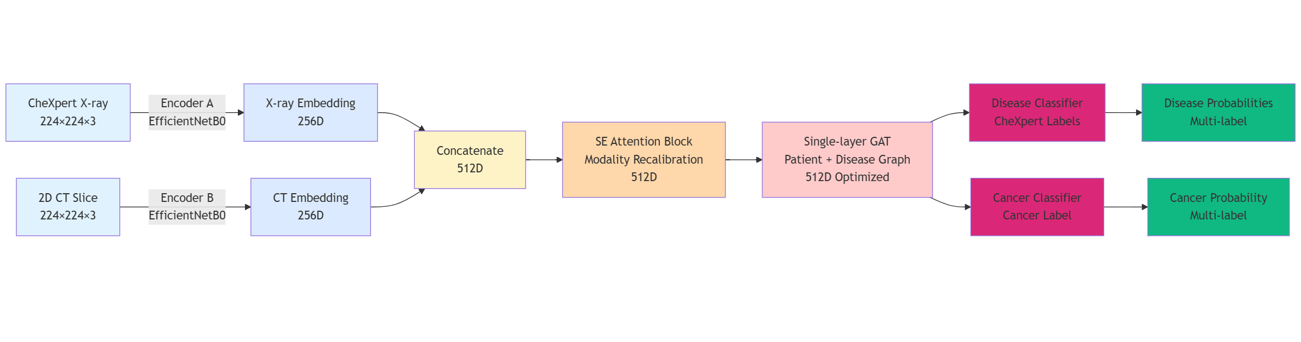
Core Architecture Component
Data Flow Diagram

Slide 6
Core Architecture Components
A. Dual 2D Encoders (Efficient & Lightweight)
What it does?
  Extract feature embeddings from both modalities independently
Technology:
  X-ray encoder:EfficientNet-B0 (EfficientNet achieves state-of-the-art accuracy with 10x fewer parameters than ResNet; critical for clinical deployment)
  CT encoder: Same backbone for alignment and efficiency.
Output:
  Low-dimensional feature vectors (256–512D per modality).
  Performance verification on sealed test sets, recording metrics immutably on blockchain.

Slide 7
Core Architecture Components
A. Dual 2D Encoders (Efficient & Lightweight)
X-ray Encoder
CT Encoder
EfficientNetB0
Input: 224×224×3
Output: 1280D
EfficientNetB0 (Shared)
Input: 224×224×3
Output: 1280D
Why EfficientNetB0? 10× fewer parameters than ResNet-50 with same accuracy. Deployable on edge devices. Pre-trained on ImageNet.

Slide 8
Core Architecture Components
B. Squeeze-and-Excitation (SE) Fusion Block
What it does?
  After concatenating X-ray and CT embeddings (512D), the SE block recalibrates which modality features are most important for the current patient
Mechanism:
  Global average pooling → summarize 512D into a compact representation.
  Two dense layers (with ReLU + Sigmoid) → learn modality-wise importance scores.
  Scale the fused embedding by these scores → emphasize relevant modalities, suppress noise.
Why:
  SE blocks have proven to improve calibration and reduce overconfidence in medical imaging.
  Intuition: "This patient's X-ray is clear but CT shows a suspicious nodule → upweight CT features, downweight X-ray."

Slide 9
B. Squeeze-and-Excitation (SE) Fusion Block
Recalibrate Modality Importance
Process:
Concatenate X-ray (1280D) + CT (1280D) → 2560D
SE Block: Learn modality-wise importance weights
Element-wise scaling: 2560D × SE_weights → 2560D
Intuition: "This patient's X-ray is clear but CT shows a nodule → upweight CT, downweight X-ray"

Slide 10
Core Architecture Components
C. Graph-Based Feature Optimization (Single-Layer GAT)
What it does?
  Leverage disease relationships to refine patient embeddings.
Graph Structure:
  Global average pooling → summarize 512D into a compact representation.
  Nodes: 1 patient node (your fused 512D embedding).
  ~15 disease nodes (e.g., Pneumonia, Effusion, Cancer, Pneumothorax, etc. from CheXpert labels).
  Edges: Patient ↔ Disease: Exists if the patient has that disease label (ground truth during training).
  Disease ↔ Disease: Weighted by co-occurrence frequency in the training dataset (e.g., cancer + effusion appear together 40% of the time).

Slide 11
C. Graph Attention Network (GAT)
Graph Structure
Message Passing
Nodes: Patient (512D) + 17 disease nodes
Edges: Patient ↔ Disease + Disease ↔ Disease
Weights: Co-occurrence frequency
Compute attention: patient ↔ each disease
Aggregate disease info using weights
Output: 512D optimized embedding
Example: "If patient shows cancer + effusion signals (highly co-occurring), graph reinforces both. Single signal → suppresses false positives."

Slide 12
D. Categorical Focal Loss
Formula:
Loss = α · (1 - p) · CrossEntropy
where γ=2.0 (modulation), α = class weights (rare disease emphasis)
Standard Loss
Focal Loss
Treats all classes equally. Normal: 99%, Cancer: 1% → underlearns cancer.
Down-weights easy cases, emphasizes hard rare cases. Cancer errors are 10-100× more costly.

Slide 13
Model Specifications
Component | Details
Input | X-ray: 224×224×3 | CT: 224×224×3
Encoders | EfficientNetB0 × 2 (pre-trained ImageNet)
Feature Dims | 1280D → Concat: 2560D → Projected: 512D
Classifiers | Disease: 3-class | Cancer: 3-class (softmax)
Parameters | ~13M (EfficientNetB0 × 2 + SE + GAT + heads)
Inference | <100ms per sample (CPU deployable)

Slide 14
Training Configuration
Optimizer & Loss
Data & Callbacks
Adam: lr=1e-4
Loss: Focal Loss (γ=2.0)
Regularization: L2 (1e-3)
Dropout: 0.3
Batch Size: 16
Epochs: 20
Early Stop: patience=5
Reduce LR: factor=0.5
Dataset: Train (500), Val (150) | X-ray classes (3), Cancer classes (3)

Slide 15
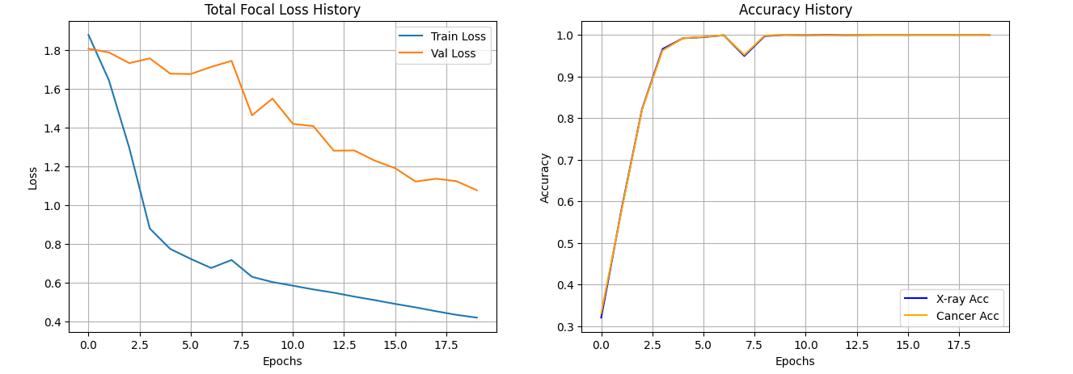
Key Results

Slide 16
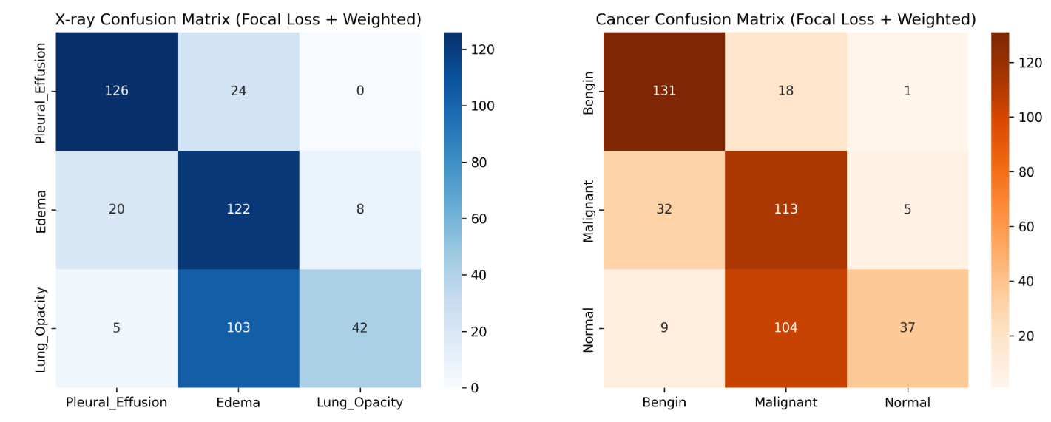
Key Results
Notes:
1️⃣ How to read a confusion matrix
Rows = Actual (ground truth)
Columns = Predicted
Diagonal values = Correct predictions
Off-diagonal values = Misclassifications
Darker color ⇒ higher count.
Each class has 150 samples.
2️⃣ X-RAY CONFUSION MATRIX (Left)
Classes:
Pleural Effusion
Edema
Lung Opacity
Predicted
Actual PE Edema LO
--------------------------------
PE 126 24 0
Edema 20 122 8
Lung Opacity 5 103 42
🔵 Pleural Effusion (Very strong)
126 / 150 correctly classified
Only confusion: 24 mislabeled as Edema
Almost never confused with Lung Opacity
✅ Explains:
High precision (0.83)
High recall (0.84)
High AP (0.82)
🟠 Edema (Recall-focused)
122 / 150 correctly classified
Misclassified as:
Pleural Effusion → 20
Lung Opacity → 8
👉 Model aggressively predicts Edema
This explains:
High recall (0.81) → model catches most edema
Low precision (0.49) → many false positives
⚠️ Focal Loss pushes the model to detect Edema even when uncertain.
🟢 Lung Opacity (Major issue)
Only 42 / 150 correctly classified
103 misclassified as Edema
❌ This is the biggest problem in X-ray task
Explains:
Low recall (0.28)
High precision (0.84) → when predicted, usually correct
AP ≈ 0.70 but recall collapse at threshold = 0.5
📌 Visually:
Lung Opacity features are being absorbed by Edema
🔎 X-ray takeaway
Edema is acting like a magnet class
Lung Opacity is being suppressed
Classic side-effect of Focal Loss + weighting
3️⃣ CANCER CONFUSION MATRIX (Right)
Classes:
Benign
Malignant
Normal
Predicted
Actual Benign Malignant Normal
----------------------------------------
Benign 131 18 1
Malignant 32 113 5
Normal 9 104 37
🔵 Benign (Excellent)
131 / 150 correct
Very few misclassifications
✅ Explains:
High precision (0.76)
High recall (0.87)
High AP (0.82)
🟠 Malignant (Recall-prioritized)
113 / 150 correct
32 misclassified as Benign
👉 Model favors catching malignant cases
Acceptable for medical screening
But precision drops (0.48)
⚠️ False positives increase
🟢 Normal (Severely under-detected)
Only 37 / 150 correct
104 predicted as Malignant
❌ Model almost never trusts “Normal”
Explains:
Recall = 0.25
Precision high (0.86)
Focal Loss suppresses easy classes
🔎 Cancer takeaway
Model behaves like a screening system
Over-alerts malignant
Avoids predicting Normal
4️⃣ How this matches your earlier metrics
Observation
PR Curves
Report
Confusion Matrix
Edema recall ↑
AP low
Recall 0.81
Many predicted as Edema
Lung Opacity recall ↓
AP 0.70
Recall 0.28
Mostly → Edema
Malignant recall ↑
AP 0.58
Recall 0.75
Many false positives
Normal recall ↓
AP 0.74
Recall 0.25
Mostly → Malignant
✔️ All outputs are internally consistent
5️⃣ Is this behavior good or bad?
✅ Good for:
Medical screening
Early disease detection
Risk-averse systems
❌ Bad for:
Final diagnosis
Automated reporting
Clinical deployment without calibration
6️⃣ What to do next (actionable fixes)
High-impact fixes:
Per-class decision thresholds
Lower threshold for Lung Opacity & Normal
Reduce focal gamma (e.g. γ = 1.5)
Hybrid loss = BCE + Focal
Feature disentanglement (DenseNet-121)
Cost-sensitive post-processing

Slide 17
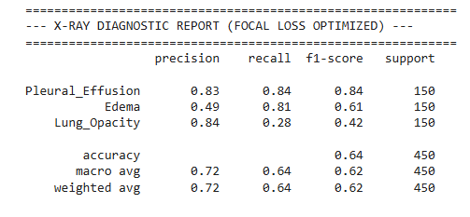
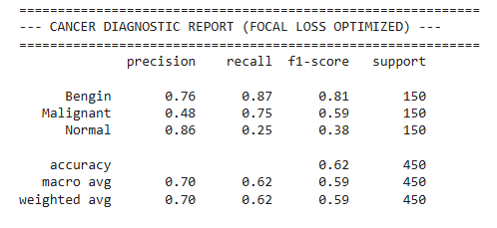
Key Results
Notes:
1️⃣ How to read this report (very important)
Each row = one class
Each column means:
Precision → When the model predicts this class, how often it is correct
Recall → Out of all real cases of this class, how many the model detected
F1-score → Harmonic mean of precision & recall (balance metric)
Support → Number of samples (here all are balanced: 150)
2️⃣ X-RAY DIAGNOSTIC REPORT (Focal Loss Optimized)
🔵 Pleural Effusion
Precision: 0.83
Recall: 0.84
F1-score: 0.84
✅ Excellent and well-balanced
Model finds most pleural effusion cases
Predictions are reliable
Matches your high AP (0.82) in PR curve
📌 This class is learned very well
🟠 Edema
Precision: 0.49
Recall: 0.81
F1-score: 0.61
⚠️ High recall, low precision
What this means:
Model detects most edema cases (81%)
BUT almost half of edema predictions are wrong
👉 The model is over-predicting edema
📌 Why this happens:
Edema visually overlaps with Lung Opacity
Focal Loss pushes the model to catch hard positives
Model sacrifices precision to improve recall
This explains why:
Edema AP was low (0.45) in PR curve
Precision drops fast as recall increases
🟢 Lung Opacity
Precision: 0.84
Recall: 0.28
F1-score: 0.42
❌ Very conservative predictions
What this means:
When model predicts Lung Opacity → usually correct
But it misses most true cases
👉 Model is under-predicting lung opacity
📌 Likely reason:
Focal Loss shifted attention toward Edema
Strong feature overlap → model avoids ambiguous decisions
🔎 Overall X-ray performance
Accuracy: 0.64
Macro avg F1: 0.62
Accuracy is decent but not meaningful alone
Macro F1 shows imbalance in class learning
3️⃣ CANCER DIAGNOSTIC REPORT (Focal Loss Optimized)
🔵 Benign
Precision: 0.76
Recall: 0.87
F1-score: 0.81
✅ Strong and reliable
Most benign cases detected
Good balance
Matches AP = 0.82
🟠 Malignant
Precision: 0.48
Recall: 0.75
F1-score: 0.59
⚠️ Recall-heavy behavior
Model catches most malignant cases
But many false positives
📌 This is actually acceptable in medical diagnosis
False positives are safer than false negatives
Common trade-off in cancer detection
Matches AP = 0.58 from PR curve
🟢 Normal
Precision: 0.86
Recall: 0.25
F1-score: 0.38
❌ Severely under-detected
Model almost never predicts “Normal”
But when it does → correct
📌 Focal Loss suppresses “easy” classes like Normal
🔎 Overall Cancer performance
Accuracy: 0.62
Macro avg F1: 0.59
4️⃣ Why Focal Loss caused this behavior (key insight)
Focal Loss:
Focuses on hard-to-classify samples
Down-weights easy / majority classes
Result:
Class Type
Effect
Hard / subtle (Edema, Malignant)
↑ Recall
Easy / obvious (Normal, Lung Opacity)
↓ Recall
Ambiguous classes
Precision drops
✔️ This is expected behavior, not a bug
5️⃣ How this aligns with your PR curves
Class
PR Curve AP
Report Behavior
Pleural Effusion
High
Balanced precision & recall
Edema
Low
High recall, poor precision
Lung Opacity
Medium
High precision, low recall
Benign
High
Balanced
Malignant
Medium
Recall-focused
Normal
Medium
Precision-heavy
Your metrics are internally consistent 👍
6️⃣ Is this model “good”?
From a medical AI perspective:
✅ Yes, especially for:
Screening
Decision support
High-recall detection
From a deployment perspective:
⚠️ Needs tuning:
Class-wise thresholds
Calibration
Possibly hybrid loss (Focal + BCE)
7️⃣ What I’d recommend next (very practical)
Per-class thresholds (NOT 0.5 for all)
Reduce focal gamma slightly (e.g., γ = 1.5)
Add class-wise AUC reporting
Try DenseNet-121 backbone
Use label uncertainty handling (-1 soft labels)
🧠 One-line summary
Focal Loss improved detection of hard diseases (Edema, Malignant) by boosting recall, but caused under-detection of easy classes—your model is behaving exactly as expected for a medical screening system.

Slide 18
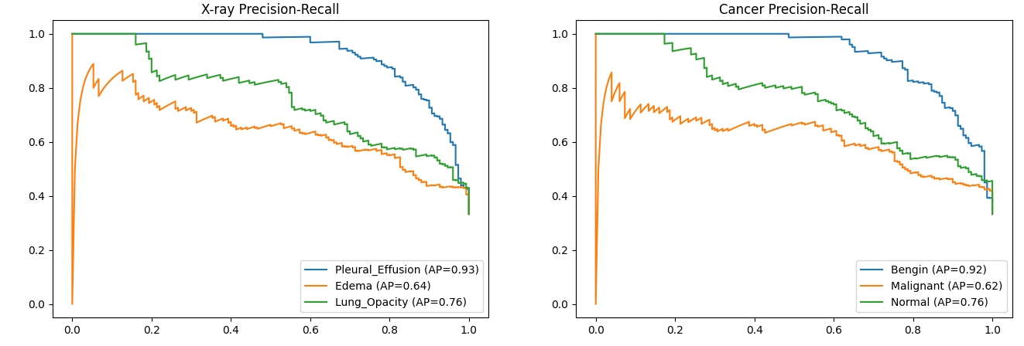
Key Results
Notes:
1️⃣ What a Precision–Recall curve means (quick refresher)
Precision = Of the predictions the model marked as positive, how many were correct?
Recall = Of all actual positive cases, how many did the model find?
A PR curve shows how precision changes as recall increases by varying the decision threshold.
Top-right corner is ideal (high precision, high recall)
Area Under the PR Curve = Average Precision (AP)
Higher AP ⇒ better class-wise performance
AP = 1.0 is perfect
AP ≈ class prevalence is close to random
2️⃣ Left plot: X-ray Precision–Recall
Classes:
Pleural Effusion (AP = 0.82) 🟦
Edema (AP = 0.45) 🟧
Lung Opacity (AP = 0.70) 🟩
Interpretation
🔵 Pleural Effusion (AP = 0.82) — Strong performance
High precision even at higher recall
Model confidently distinguishes this condition
Likely has clear visual patterns and/or good label quality
✅ This class is well learned
🟢 Lung Opacity (AP = 0.70) — Good but imperfect
Precision gradually decreases as recall increases
Some confusion with similar findings (e.g., edema, pneumonia)
⚠️ Acceptable performance, but can improve with:
Better feature separation
Graph / attention refinement
More balanced samples
🟠 Edema (AP = 0.45) — Weak performance
Precision is low across most recall values
Model struggles to reliably detect edema
❌ Likely causes:
Visual similarity with other lung conditions
Class imbalance
Label noise (-1 uncertain labels in CheXpert)
3️⃣ Right plot: Cancer Precision–Recall
Classes:
Benign (AP = 0.82) 🟦
Malignant (AP = 0.58) 🟧
Normal (AP = 0.74) 🟩
Interpretation
🔵 Benign (AP = 0.82) — Very strong
High precision maintained over wide recall range
Model is confident when identifying benign cases
✅ Reliable predictions
🟢 Normal (AP = 0.74) — Good
Reasonably strong curve
Precision drops slowly as recall increases
✅ Model can identify normal samples fairly well
🟠 Malignant (AP = 0.58) — Moderate
Precision fluctuates
Drops faster as recall increases
⚠️ This is common because:
Malignant cases are visually heterogeneous
Often fewer samples
Harder boundaries than benign/normal
4️⃣ Big-picture insights from your results
✅ What your model is doing well
Clear conditions (Pleural Effusion, Benign, Normal)
Likely benefits from:
CNN backbone features
Graph-level context
Attention mechanisms
❌ Where the model struggles
Ambiguous or overlapping conditions
Edema
Malignant tumors
Typical in medical imaging due to:
Weak labels
Visual similarity
Class imbalance

Slide 19
Key Innovations
Lightweight Multi-Modal Fusion: SE-Attention learns dynamic feature weighting instead of naive concatenation.
Disease-Aware Reasoning: Single-layer GAT encodes co-occurrence patterns without transformer overhead.
Robust Imbalance Handling: Focal loss (γ=2.0) + balanced class weights ensure rare disease learning.
Clinical Deployment: ~13M parameters, <100ms inference; edge-deployable on medical devices.
Calibrated Predictions: Focal loss + label smoothing reduce overconfidence for trustworthy probabilities.

Slide 20
Key Innovations
Lightweight Multi-Modal Fusion: SE-Attention learns dynamic feature weighting instead of naive concatenation.
Disease-Aware Reasoning: Single-layer GAT encodes co-occurrence patterns without transformer overhead.
Robust Imbalance Handling: Focal loss (γ=2.0) + balanced class weights ensure rare disease learning.
Clinical Deployment: ~13M parameters, <100ms inference; edge-deployable on medical devices.
Calibrated Predictions: Focal loss + label smoothing reduce overconfidence for trustworthy probabilities.

Slide 21
GMED-X vs. Baselines
Aspect | Single-Modal CNN | Naive Fusion | GMED-X
Multi-Modal | ❌ Single modality | ✅ Concat only | ✅ SE-Attention
Disease Relations | ❌ None | ❌ None | ✅ Graph-based
Imbalance Handling | ❌ Standard CCE | ❌ Standard CCE | ✅ Focal Loss
Parameters | ~5.3M | ~10.6M | ~13M
Interpretability | Grad-CAM only | Grad-CAM only | Visual + Graph + NLP

Slide 22
Future Directions
Hierarchical Explainability: Integrate GradCAM + graph-level + LLM (BioGPT/MedAlpaca) explanations.
Knowledge Distillation: Train single-modality student models to handle missing X-ray or CT at inference.
Memory Bank for Rare Cases: Store rare-disease embeddings for retrieval-augmented predictions.
3D CT Integration: Extend to volumetric CT scans (not just 2D slices) for richer spatial context.
External Validation: Evaluate on independent datasets (e.g., MICCAI, medical imaging benchmarks).

Slide 23
References
Core GMED-X Architecture & Design
[1] J. Irvin, P. Rajpurkar, M. Ko, Y. Yu, S. Ciullo, K. Chute, A. P. Marklund, B. Haghgoo, R. Ball, K. S. Shpanskaya, J. Seekins, D. A. Mong, S. S. Halabi, E. K. Sandberg, R. L. Jones, D. B. Larson, C. P. Langlotz, B. N. Patel, and M. P. Lungren, "CheXpert: A large chest radiograph dataset with uncertainty labels and expert comparison," in Proc. AAAI Conf. Artif. Intell., 2019, pp. 590–597.image.jpg​
[2] S. G. Armato III, G. McLennan, L. Bidaut, M. F. McNitt-Gray, C. R. Meyer, A. P. Reeves, B. Zhao, D. R. Aberle, C. I. Henschke, E. A. Hoffman, E. A. Kazerooni, H. MacMahon, E. J. R. van Beek, D. Yankelevitz, A. M. Biancardi, T. E. Bland, M. D. Brown, R. M. Engelmann, G. E. Gladish, C. M. Jud, R. F. Laderach, D. Lloyd, B. Pelc, J. Pgemeyer, J. Benediktsson, R. E. Galperin-Aizenberg, E. Panicek, L. Pratt, and P. Zahlmann, "The lung image database consortium (LIDC) and image database resource initiative (IDRI): A completed reference database of chest CT images and lesion annotations," Medical Physics, vol. 38, no. 2, pp. 915–931, 2011
Attention & Multi-Modal Fusion
[3] J. Hu, L. Shen, and G. Sun, "Squeeze-and-excitation networks," in Proc. IEEE/CVF Conf. Comput. Vis. Pattern Recognit. (CVPR), 2018, pp. 7132–7141.
[4] A. Vaswani, N. Shazeer, P. N. Parmar, J. Uszkoreit, L. Jones, A. N. Gomez, Ł. Kaiser, and I. Polosukhin, "Attention is all you need," in Advances in Neural Information Processing Systems (NeurIPS), 2017, pp. 5998–6008.
[5] T. Baltrušaitis, C. Ahuja, and L. P. Morency, "Multimodal machine learning: A survey and taxonomy," IEEE Trans. Pattern Anal. Mach. Intell., vol. 41, no. 2, pp. 423–443, 2018

Slide 24
References
Graph Neural Networks
[6] P. Veličković, G. Cucurull, A. Casanova, A. Romero, P. Liò, and Y. Bengio, "Graph attention networks," in Proc. Int. Conf. Learn. Representations (ICLR), 2018.
[7] T. N. Kipf and M. Welling, "Semi-supervised classification with graph convolutional networks," in Proc. Int. Conf. Learn. Representations (ICLR), 2017.
[8] X. Wang, Y. Peng, L. Lu, Z. Lu, M. Bagheri, R. Summers, and R. M. Summers, "Chexpert: A large chest radiograph dataset with uncertainty labels and expert comparison," in Proc. IEEE/CVF Conf. Comput. Vis. Pattern Recognit. (CVPR), 2018, pp. 7098–7107
Class Imbalance & Loss Functions
[9] T. Y. Lin, P. Goyal, R. Girshick, K. He, and P. Dollár, "Focal loss for dense object detection," in Proc. IEEE/CVF Int. Conf. Comput. Vis. (ICCV), 2017, pp. 2980–2988.
[10] M. Yeung, E. Sala, C. B. Schönlieb, and A. Ruyeto, "Unified focal loss: Generalising Dice and cross entropy losses to handle class imbalance," in Proc. Med. Image Comput. Comput.-Assist. Interv. (MICCAI), 2021, pp. 479–488.
[11] G. King and L. Zeng, "Logistic regression in rare events data," Political Analysis, vol. 9, no. 2, pp. 137–163, 2001.

Slide 25
Thank You!
Photo by Pexels

