Slide 1


Progress Seminar
Blockchain-Enabled Secure and Transparent Lung Disease Classification in Medical Imaging
Under the Supervision of
Dr. Prabina Pattanayak and Dr. Chandrajit Choudhury
Presented By
Kirti Swagat Mohanty
21-3-04-068
Photo by Pexels
Department of Electronics and Communication Engineering,
National Institute of Technology, Silchar

Slide 2


Table of Contents
1
Introduction
2
Motivation and Objectives
6
3
System Overview
7
4
Block Chain Integration
8
5
References

Slide 3
Problem Statement-1- Completed
Designing a Contrastive Learning Based Robust Multi-label Chest Disease Classification System
Problem Statement-2- Implementation Completed
Blockchain-Secured Federated Learning for Privacy-Preserving Multi-label Chest Disease Classification
Problem Statement-3- Yet to Start
Designing a deep-learning based architecture to optimize features from the input image to enhance the classification

Slide 4
Introduction & Background
The detection and classification of lung diseases from medical images pose significant challenges due to the complexity of pathologies and the need for high diagnosis accuracy.
However , widespread clinical deployment of AI models is impeded by data sharing barriers arising from privacy regulations and institutional silos, which prevent pooling of diverse, multi-institutional datasets essential for robust model generalization.
Model provenance and trust issues, as centralized repositories lack immutable audit trails to verify that submitted model updates or weights have not been tampered.
Block chain technology addresses these challenges by providing:
  Decentralization: Eliminates single points of failure, enabling hospitals and research institutes to contribute model updates without relinquishing data ownership.
  Immutability: Cryptographic chaining of blocks ensures that once a model hash is recorded, it cannot be altered, enabling verifiable provenance for every model version and audit ready logs of submissions and accesses.
  Smart Contracts: Automate model registration, validation triggers and access control, enforcing predefined rules without interventions.

Slide 5
Research Motivation and Objectives
Motivation
Clinical AI for lung-disease classification demands large, diverse imaging datasets, yet privacy regulations (HIPAA, GDPR) and institutional silos prevent cross-site data sharing.
Federated learning addresses raw-data privacy but offers no immutable audit trail for model updates, leaving provenance and trust gaps in collaborative AI pipelines.
Centralized model repositories risk tampering, version drift, and unilateral control—undermining reproducibility and regulatory compliance.
On-chain storage of full neural networks is infeasible due to block-size limits; off-chain IPFS solutions introduce their own access-control and integrity challenge.

Slide 6
Research Motivation and Objectives
Objectives
Design smart contracts that:
  Register model submissions on-chain, embedding cryptographic hashes for immutable provenance.
  Automate performance triggers (e.g., AUC, F1 thresholds) via oracle-fed validation events.
  Enforce role-based access (contributors, aggregator, end users).
Integrate IPFS for off-chain storage of model weights and explainability artifacts, ensuring:
  Deterministic retrieval via content identifiers (CIDs) stored on-chain.
  Encryption-before-pinning and proxy re-encryption key management for HIPAA-compliant data confidentiality.
Implement multi-layer validation mechanisms encompassing:
  Cryptographic integrity checks (SHA-256 hash matching) between on-chain records and IPFS downloads.
  Performance verification on sealed test sets, recording metrics immutably on blockchain.
Demonstrate a reference architecture that:

Slide 7
Research Motivation and Objectives
Objectives
4. Demonstrate a reference architecture that:
  Tracks model workflow end-to-end (training → upload → verify → aggregate → deploy).
  Provides audit-ready logs for regulatory and clinical governance.
  Ensures scalability through a hybrid on-chain/off-chain design without sacrificing throughput.

Slide 8
Covered Objectives
Decentralized Control & Audit of Model Operations: Design a permissioned blockchain to replace the centralized server, allowing edge nodes to publish encrypted model updates as transactions that are verified and ordered by consensus.
  ✅ Smart Contract Model Registry: The contract maintains on-chain records for model uploads, including storing the uploader's address, model identifiers, and IPFS hashes. This
  provides traceability, integrity, and auditability of each model version.
  ✅ Vendor (Participant) Whitelisting: Only whitelisted addresses can use certain contract functions, enforcing role-based access and some governance.
  ✅ No centralized Federated Learning Server: While not a full decentralized federated learning controller, on-chain storage of model metadata replaces traditional
  ` centralized registries in FL.
Secure Aggregation and Privacy:
✅ No On-chain Data/Update Aggregation: The smart contract stores model hashes and metadata, but does not aggregate FL updates on-chain nor enforce secure
aggregation protocols (e.g., homomorphic encryption, secure enclaves, or additive masking).
✅ Data Privacy: No raw data or gradients are ever uploaded; the only reference on-chain is the IPFS hash of trained model binaries or snapshots.
✅ Integrity: The blockchain ensures that each model upload or update can be immutably traced to the uploader.

Slide 9
Covered Objectives Contd..
3. Confidentiality, Integrity, Traceability:
✅ Confidentiality: Direct model contents are stored on IPFS, not the blockchain itself. Patient data never leaves hospital boundaries, aligning with privacy requirements.
  ✅ Integrity & Traceability: Every transaction (upload, whitelist, role assignment) is permanently logged, so model provenance is always auditable to participants.
4. Governance Mechanisms:
✅ Whitelisting/Vendor Governance : Administrators can whitelist or remove vendors on-chain, but there are no tokenomics, rewards, or penalties implemented in the contract

Slide 10
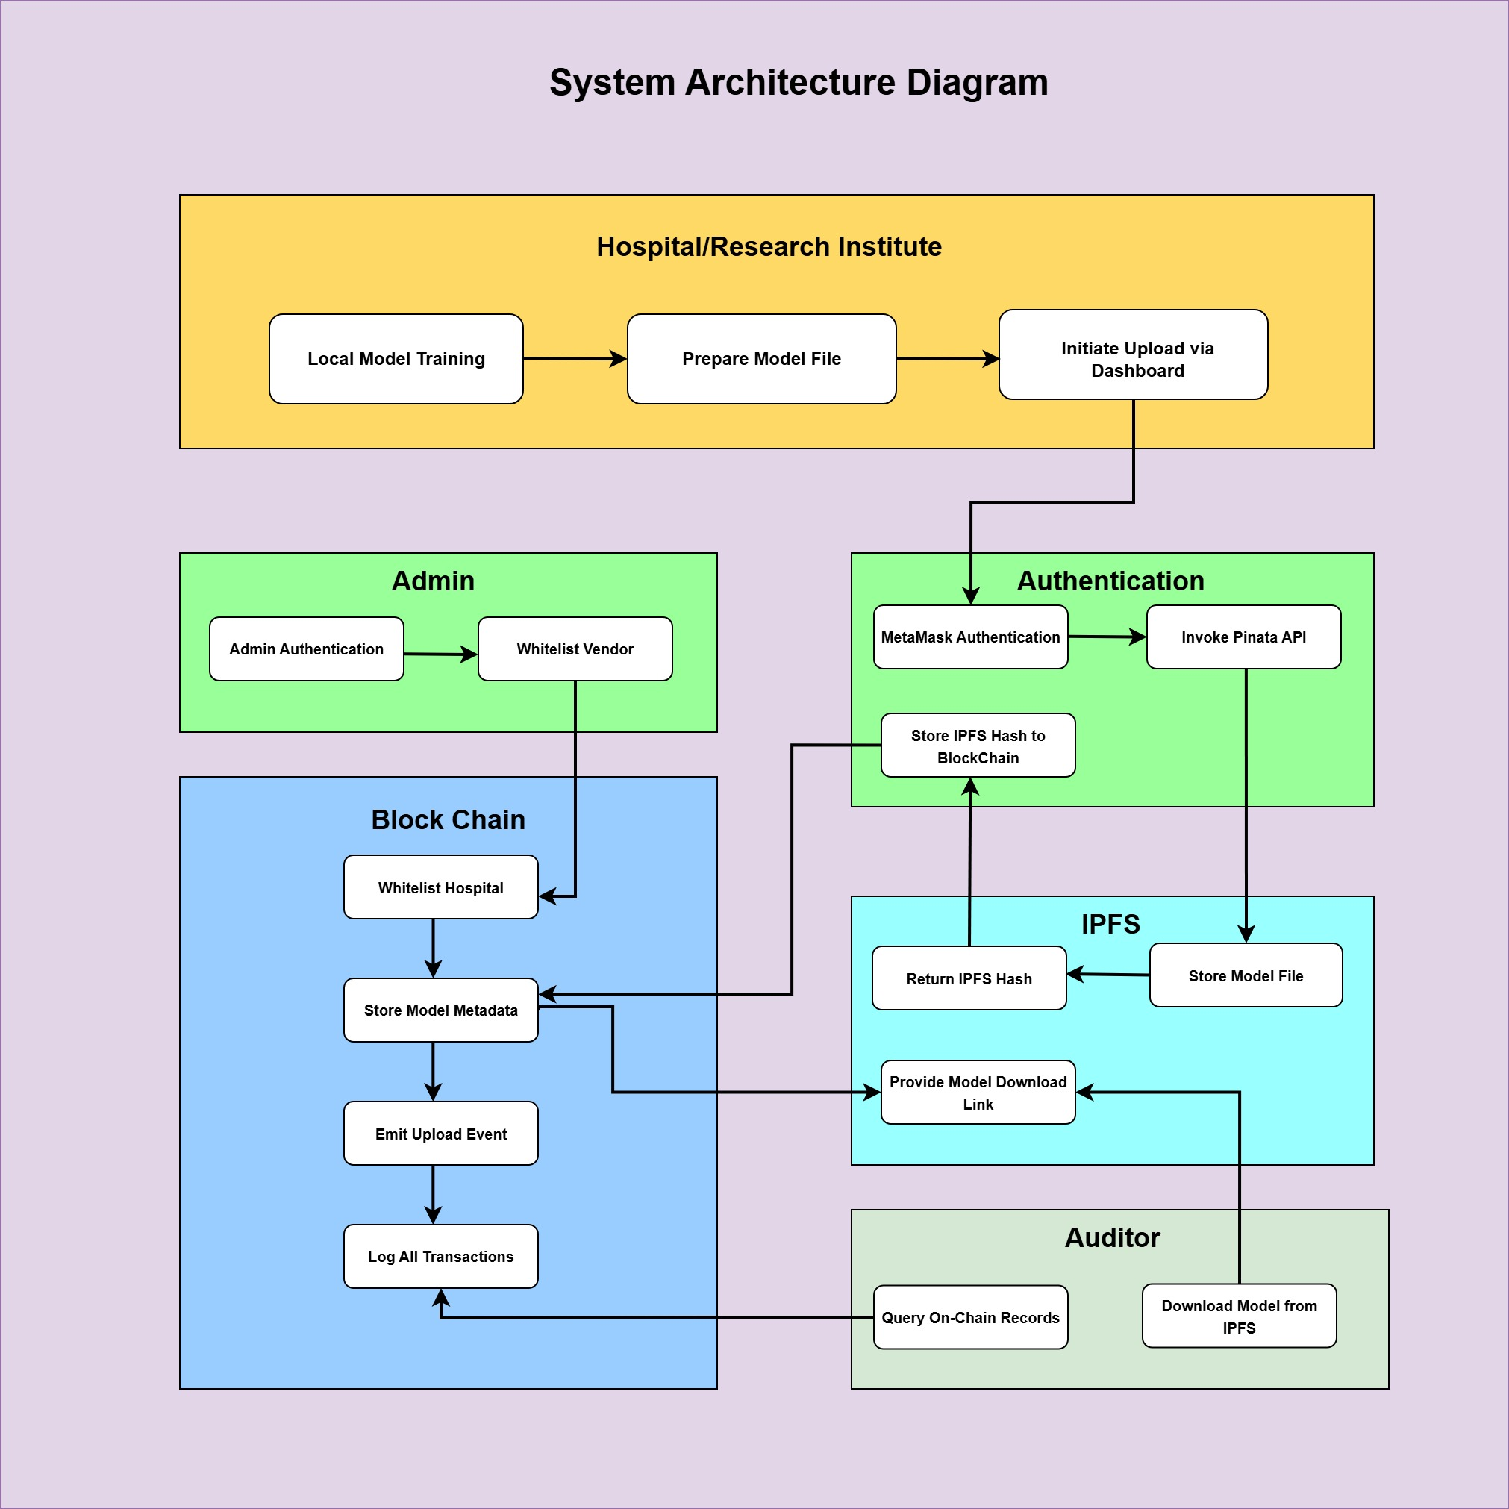
System Architecture Overview
Notes:
Key Components & Data Flow:
Contributor Nodes
Local model training on-site hospitals or clinics
Each node uses its private imaging data (CT/X-ray) to train an identical neural network
Outputs: encrypted model weights and performance metrics
Off-Chain Storage (IPFS)
Contributor pins encrypted model files to IPFS, obtaining a Content Identifier (CID)
IPFS handles large binaries, provides deduplication and decentralized availability
Only the CID and metadata (file size, timestamp) are referenced on-chain
Blockchain Ledger
Smart Contract: Model Registration
– Records CID, SHA-256 hash of the model, contributor ID, and timestamp
– Emits an event for “new submission” listeners
Smart Contract: Validation Trigger
– Watches for performance metrics from an oracle
– Automatically flags models passing predefined thresholds (e.g., AUC > 0.90)
Smart Contract: Access Control (SCR-BAC)
– Defines roles (Contributor, Aggregator, End User) and dynamic risk policies
– Grants or revokes permissions based on cumulative risk scores
Aggregator Node
Listens to “validated” events, pulls model weights from IPFS via CID
Verifies integrity: recomputes SHA-256 hash and compares to on-chain record
Aggregation logic: weighted averaging or quality-aware causal weighting
Produces a new global model, encrypts and re-pins to IPFS, publishes new CID
End User Access
End users (clinicians, edge devices) query the blockchain for the latest verified CID
Retrieve the aggregated model from IPFS, decrypt using proxy re-encryption keys
Deploys model locally for inference on new lung imaging data

Slide 11
DApps- Decentralized Application
A Decentralized Application (DApp) is an app that interacts with a blockchain through smart contracts, typically offering:
  A web frontend (often JavaScript frameworks like React)
  Blockchain-based authentication (wallets such as MetaMask)
  Direct calls to one or more smart contracts for core functions (no central backend server for main workflows)
  Use of decentralized storage (e.g., IPFS) for files or metadata
DApp Components in our work:
Module | File Name | Reason/Description
Model Uploader | ModelUploader.js | Uploads ML models to IPFS, interacts with blockchain smart contract, requires MetaMask.
Block Chain Connection | BlockchainConnect.js | Handles wallet connections, checks account and network, required for blockchain DApp interactions.
Model Registry | AIModelRegistryABI.json | Defines the smart contract interface; the backend logic for decentralized registry and audit.

Slide 12
Blockchain Smart Contract
1. Whitelist Hospital
Purpose: Manages approved participant access.
Functionality:
  Keeps a mapping (whitelistedVendors[address]) of which hospital/participant addresses are authorized to interact with the contract.
  Only whitelisted accounts can upload models or perform restricted operations.
2. Store Model Metadata
Purpose: Registers AI model versions and their storage references.
Functionality:
  Accepts a model name and an IPFS hash when a hospital uploads a new model.
  Records this pairing (storeModel(string modelName, string modelHash)) along with the address of the uploader.
  Ensures the traceability and transparency of every submitted model.

Slide 13
Blockchain Smart Contract
3. Emit Events
Purpose: Provides an immutable audit trail and system transparency.
Functionality:
  Emits events on critical actions such as:
    ModelStored: Triggered when new model metadata is recorded.
    VendorWhitelisted: Announced whenever a hospital/participant is authorized.
    VendorRemoved: Indicates removal of participant's authorization.
4. Log All Transactions
Purpose: Ensures transparency, compliance, and accountability..
Functionality:
  Every model upload, vendor whitelist/removal, and admin action is written to the blockchain.
  The log is public and immutable, enabling compliance reviews and dispute resolution.

Slide 14
How these work together
Admin manages whitelisting and roles.
Hospitals (when whitelisted) can upload models (metadata only), triggering on-chain events.
Auditors/External Users can verify every transaction, download model artifacts by IPFS hash, and confirm participant status—all through the public blockchain.
These sub-blocks collectively enforce trust, security, and auditability in your decentralized federated learning ecosystem.
Sub-Block | Blockchain Integration Role
Whitelist Hospital | Access control and permission management
Store Model Metadata | Decentralized registry of model submissions
Emit Events | Transparent audit trail of key actions
Role Management | Assignment and enforcement of user/admin vendor rights
Log All Transactions | Immutable, public activity and state logging
Verification & Querying | Public checks for permissions, models, and role status

Slide 15
Auditor
1. Query On-Chain Records
Purpose: Allows auditors and other users to access and review the blockchain ledger to examine every approved action.
Functionality:
  Retrieve immutable logs of all model uploads (including model name, IPFS hash, and uploader).
  Track participant whitelisting, removals, and admin actions through events.
  Verify timestamps and sequence of transactions for compliance and auditing.
2. Download Model from IPFS
Purpose: Enables retrieval of the actual machine learning models for evaluation, validation, or research purposes.
Functionality:
  Uses publicly stored IPFS hashes (from blockchain registry) to fetch model binaries directly from decentralized storage.
  Can cross-check that the on-chain hash matches the file content, validating authenticity.
Notes:
The "Auditor" block represents participants or external users who independently validate, query, and interact with the on-chain federated learning system for assurance, transparency, and discovery. Each sub-block within the "Auditor" lane serves a specific role in fostering trust, compliance, and decentralized access.

Slide 16
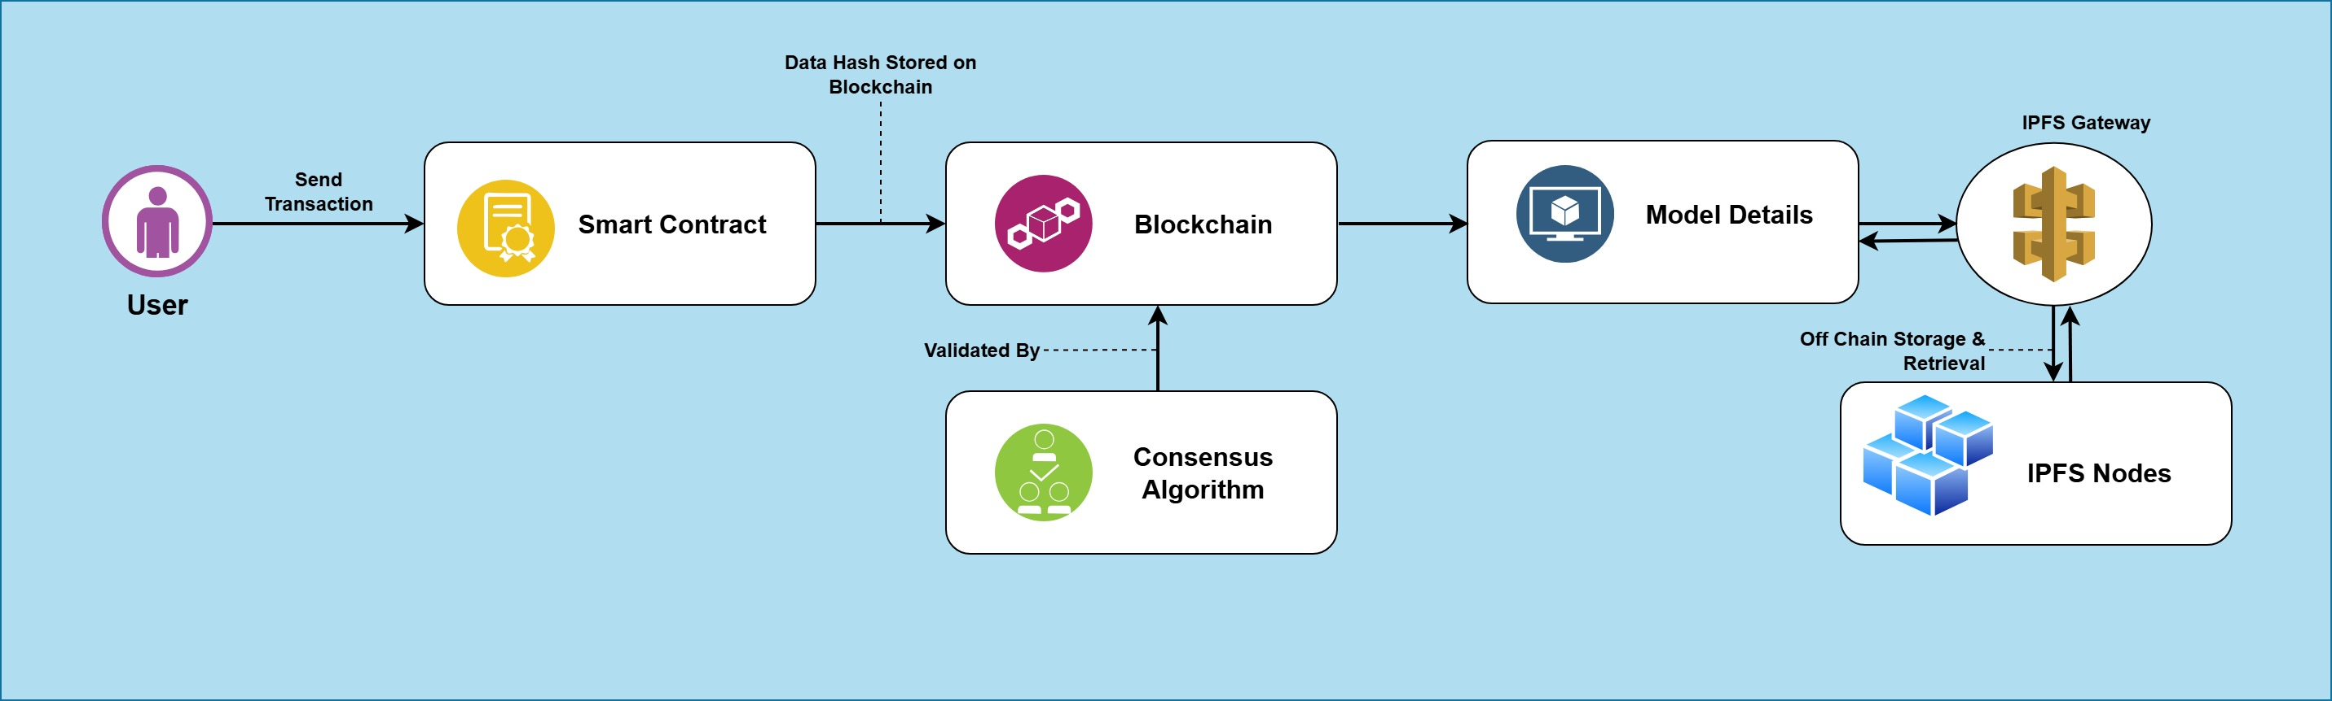
Blockchain Data Flow

Slide 17
IPFS – Inter Planetary File System
It is a peer-to-peer, content-addressed protocol and network designed to create a decentralized, resilient, and verifiable file storage and sharing system.
Content Addressing and CIDs
Traditional web protocols (HTTP/HTTPS) use location-based addressing, where a URL points to a specific server and path.
IPFS uses content-based addressing: each file (or data “object”) is cryptographically hashed to produce a Content Identifier (CID).
The CID uniquely represents the file’s content: any change in the file yields a new CID.
To retrieve data, peers query the network for the CID instead of a URL.
Data Chunking and Merkle DAG
When a file is added to IPFS:
  It is split into fixed-size blocks.
  Each block is hashed, producing its own CID.
  Blocks are organized into a Merkle Directed Acyclic Graph (DAG), enabling efficient versioning, deduplication, and integrity verification.

Slide 18
IPFS - InterPlanetary File System
Distributed Hash Table (DHT)
IPFS nodes form a peer-to-peer network. A Distributed Hash Table (DHT) maps CIDs to the addresses of nodes storing the corresponding blocks.
To fetch a CID, a node locates peers advertising that CID in the DHT, then downloads blocks in parallel from multiple sources.
Benefits of IPFS
Decentralization & Resilience: Files are served by any node holding the data; no single point of failure or censorship.
Integrity & Immutability: Content addressing and Merkle DAG ensure tamper resistance—any alteration breaks the CID chain.
Versioning: Merkle DAG inherently tracks historical versions; each update yields a new CID, while preserving links to prior versions.
Efficiency: Parallel block downloads from multiple peers accelerate retrieval, and deduplication conserves bandwidth and storage.

Slide 19
IPFS in my work
Our work, holds a sophisticated IPFS Integration as follows:
Step | Process | Technology
1. File Upload | User Selects AI Model | React File Input, Form Data
2. IPFS Storage | Upload to Pinata via API | Pinata Cloud API, JWT Authentication
3. Hash Generation | IPFS generates unique CID | Content Addressing (CID)
4. Blockchain Storage | Store model name and IPFS hash | Smart Contract, ether js
5. File Retrieval | Download via IPFS Gateway | Gateway URL with blob handling
The IPFS implementation provides:
Decentralized Storage: Files distributed across IPFS network
Content Integrity: Cryptographic hashing ensures file authenticity
Cost Efficiency: Only hash stored on-chain, reducing blockchain storage costs
Availability: Files accessible as long as pinned on IPFS nodes
Notes:
JWT (JSON Web Token) authentication is a stateless, secure method for verifying users and granting access to protected resources—especially in web applications and APIs.
What Is JWT?
A JWT is a compact, digitally signed token that carries user identity and claims. It’s made up of three parts:
Header – Specifies the signing algorithm (e.g., HS256)
Payload – Contains user data and claims (e.g., user ID, roles, expiration)
Signature – Ensures integrity using a secret key or public/private key pair
Example JWT:
eyJhbGciOiJIUzI1NiIsInR5cCI6IkpXVCJ9. eyJzdWIiOiIxMjM0NTY3ODkwIiwibmFtZSI6IkphbmUgRG9lIiwiaWF0IjoxNjk3MjM5MDIyfQ. 5CerSPBCrO_3WdiyPjR7HoWBOeXsuq2AcfplJeG7erc 🚀 How JWT Authentication Works
Login: User submits credentials (e.g., email & password)
Token Issued: Server verifies credentials and returns a signed JWT
Client Stores Token: Typically in localStorage or cookies
Authenticated Requests: Client sends JWT in the Authorization header (Bearer <token>)
Server Verifies: Server checks the token’s signature and claims before granting access
Why Use JWT?
Stateless: No need to store sessions on the server
Tamper-Proof: Signature ensures data integrity
Cross-Platform: Works across mobile, web, and microservices
Built-in Expiry: Tokens can expire automatically
Security Tips
Always use HTTPS to transmit tokens
Set short expiration times
Store tokens securely (e.g., HttpOnly cookies)
Validate token signature and claims on every request
If you’d like, I can show you how to implement JWT in Node.js or Spring Boot—or even compare it with OAuth2. Want to go deeper?

Slide 20
Consensus Algorithm
A consensus algorithm is a protocol used by distributed systems and blockchains to ensure that all network participants (nodes) agree on a single, valid version of the system's data—despite the presence of failures or malicious actors. Its primary function is to maintain integrity, prevent double spending, and enable decentralized trust.
Why Is Consensus Essential?
• Agreement: Ensures all nodes record the same transactions and data.
• Security: Protects against fraud, conflicting records, and attacks.
• Decentralization: Operates without relying on a central authority.
• Fault Tolerance: Handles failures, network delays, or compromised participants.
Polygon’s Proof of Stake (PoS)
Validators lock up (stake) MATIC tokens.
Selection of validators is proportional to their stake.
Block Approval: Validators propose and validate new blocks.
Security: Misbehavior (fraudulent validation) can cause loss of staked funds.
Efficiency: Lower energy consumption and faster throughput than PoW.
How Consensus Fits in Blockchain Applications
Data Flow Steps:
1. Transaction Submission: A user’s request (e.g., storing AI model data) is broadcast to the network.
2. Validation: Nodes (validators/miners) verify the transaction follows protocol rules.
3. Block Formation: A valid transaction is bundled into a block proposal.
4. Network Agreement: The consensus mechanism determines whether to accept the block.
5. Chain Update: Once agreed, the block becomes part of an immutable chain.
6. Finality: Updates are finalized; the state is updated across all nodes.
Key Benefits
• Prevents Double Spending: Ensures each transaction is unique and non-duplicatable.
• Enables Decentralization: Makes it possible for anyone to participate, removing single points of control.
• Scales Trust: Allows global participants to agree on history without prior relationships.
.

Slide 21
How Consensus Algorithm Fits in Blockchain Application
Data Flow Steps:
1. Transaction Submission: A user’s request (e.g., storing AI model data) is broadcast to the network.
2. Validation: Nodes (validators/miners) verify the transaction follows protocol rules.
3. Block Formation: A valid transaction is bundled into a block proposal.
4. Network Agreement: The consensus mechanism determines whether to accept the block.
5. Chain Update: Once agreed, the block becomes part of an immutable chain.
6. Finality: Updates are finalized; the state is updated across all nodes.
Key Benefits
Prevents Double Spending: Ensures each transaction is unique and non-duplicatable.
Enables Decentralization: Makes it possible for anyone to participate, removing single points of control.
Scales Trust: Allows global participants to agree on history without prior relationships.
.

Slide 22
References
[1] A. Sharma, R. K. Kaushal, and N. Kumar, “A comprehensive assessment of blockchain technology in the healthcare industry and techniques to store medical image,” in 2024 Third International Conference on Electrical, Electronics, Information and Communication Technologies (ICEEICT), 2024, pp. 1–6, doi: 10.1109/ICEEICT61591.2024.10718467.
[2] Y. Fu, X. Niu, L. Zhou, X. Cai, F. R. Yu, N. Cheng, and C. Li, “A hierarchical blockchain-enabled secure aggregation algorithm for federated learning in IoV,” IEEE Internet of Things Journal, vol. 12, no. 5, pp. 5876–5889, Mar. 2025, doi: 10.1109/JIOT.2024.3489032.
[3] D. Bouslimi, G. Coatrieux, M. Cozic, and C. Roux, “A joint encryption/watermarking system for verifying the reliability of medical images,” IEEE Transactions on Information Technology in Biomedicine, vol. 16, no. 5, pp. 891–899, Sep. 2012, doi: 10.1109/TITB.2012.2207730.
[4] P. Liu, Q. He, Y. Chen, S. Jiang, B. Zhao, and X. Wang, “A lightweight authentication and privacy-preserving aggregation for blockchain-enabled federated learning in VANETs,” IEEE Transactions on Consumer Electronics, vol. 71, no. 1, pp. 1274–1287, Feb. 2025,
[5] J. Li, J. Sun, F. Li, X. Yang, and Y. Wang, “BIFLC: A blockchain and IPFS-based multi-consensus federated learning framework,” in 2023 26th International Conference on Computer Supported Cooperative Work in Design (CSCWD), 2023, pp. 1–6,

Slide 23
References
[6] J. Indumathi, A. Shankar, M. R. Ghalib, J. Gitanjali, Q. Hua, Z. Wen, and X. Qi, “Block chain-based Internet of Medical Things for uninterrupted, ubiquitous, user-friendly, unflappable, unblemished, unlimited health care services (BC IoMT U6 HCS),” IEEE Access, vol. 8, pp. 216856–216871, 2020, doi: 10.1109/ACCESS.2020.3040240.
[7] B. C. Priya, M. Dhanalakshmi, B. T. Kumar Reddy, A. Rohith and B. R. Reddy, "Block chain Based Inter-Organizational Secure File Sharing System," 2024 International Conference on Computational Intelligence for Security, Communication and Sustainable Development (CISCSD), Port Blair, India, 2024, pp. 230-235, doi: 10.1109/CISCSD63381.2024.00059.
[8] N. Nezhadsistani, N. S. Moayedian, and B. Stiller, “Blockchain-enabled federated learning in healthcare: Survey and state-of-the-art,” IEEE Access, vol. 13, pp. 119922–119941, 2025
[9] R. Kumar, A. A. Khan, J. Kumar, Zakria, N. A. Golilarz, S. Zhang, Y. Ting, C. Zheng, and W. Wang, “Blockchain-federated-learning and deep learning models for COVID-19 detection using CT imaging,” IEEE Sensors Journal, vol. 21, no. 14, pp. 16301–16314, Jul. 2021, doi: 10.1109/JSEN.2021.3076767.

Slide 24
Thank You!
Photo by Pexels

