Slide 1

COMPREHENSIVE SEMINAR
Abhinaba Dey
Registration No. 18-3-04-120
Date - 28/02/2020
Supervisor Dr. Prabina Pattanayak
Electronics & communication Engineering

Slide 2
Content
Details of Course Work
Grades Obtained
Description of Course Work
  Research Methodology
  Linear Algebra and Random Process
  Advanced Digital Communication
  Signal Processing
  Communication Networks
  Digital Signal Processors
  Wireless Communication
Broad Area of Research Interest
Conclusion
28th February 2020

Slide 3
Courses Undertaken
Sl. No. | Name of the course | Subject code | Credit | Grade obtained
1. | Research Methodology | IC 001 | 6 | AB
2. | Linear Algebra and Random Processes | EC 535 | 8 | AA
3. | Signal Processing | EC 536 | 6 | BB
4. | Advanced Digital Communication | EC 537 | 6 | AB
5. | Communication Networks | EC 542 | 6 | AA
6. | Digital Signal Processors | EC 543 | 6 | BB
7. | Wireless Communication | EC 572 | 6 | AA
Total credit completed |  |  | 44
CPI obtained |  |  | 9.18
28th February 2020

Slide 4
COURSE I
IC 001: Research Methodology
  Course Instructors:
    Prof. G. Das, Professor Dept. of Humanities
    Prof. N. Sinha, Professor Dept. of EE
    Prof. B. K. Roy, Professor Dept. of EE
    Prof. A. Roy, Professor, Dept. of Physics
    Prof. M. A. Ahmed, Professor, Dept of Civil
28th February 2020

Slide 5
Outline
RESEARCH METHODOLOGY
Research
Objectives of Research
Type of research
Stages of research
Writing a research paper
What is stress?
Stress Management
Time Management
28th February 2020

Slide 6

RESEARCH METHODOLOGY
Research
What is Research?
The systematic investigation and study of materials and sources in order to establish facts and reach new conclusions.
Research Methodology:
Explains the procedures by which researchers go about their work of describing, explaining and predicting phenomenon.
Involves learning of the various techniques for conducting experiments, tests and surveys.
28th February 2020

Slide 7
RESEARCH METHODOLOGY
Objectives of Research
Objectives of Research
To discover new facts.
To find solutions to scientific, nonscientific and social problems.
To analyze an event or process or phenomenon to identify the cause and effect relationships.
To develop new scientific tools, concepts and theories.
28th February 2020

Slide 8
RESEARCH METHODOLOGY
Types of Research
Types of Research
Based on application
Type of information sought
Based on paradigm shift
Basic
Qualitative
Applied
Quantitative
Normal
Revolutionary
28th February 2020
Notes:
Revolutionary: new scientific theory to replace a problematic paradigm

Slide 9
RESEARCH METHODOLOGY
Stages of research
Selection of the research domain
Literature survey and reference collection
Assessment of current status of the topic chosen
Formulation of hypothesis
Checking of hypothesis
Research design
Interpretation of result
Report
Actual investigation
Data analysis
28th February 2020

Slide 10
RESEARCH METHODOLOGY
Writing a research paper
Abstract
  Clear and concise explaining bright idea
Introduction
  Crucially important. Problem importance and related works’ pros and cons
Methodology and Design
  A new design for addressing the problems pointed in Intro
Results
  Usefulness of proposed design by evidencing by the achieved results
Conclusion
  What has done in work and what can be done in future
References
  Should follow single style through the article and list of references
“Short, Clear Title, Standard Format, Good writing style and Perfect referencing”.
28th February 2020

Slide 11
What is Stress?
RESEARCH METHODOLOGY
Stress can be defined as our mental, physical, emotional, and behavioural reactions to any perceived demands or threats.
Causes of stress
Time management problems
Loss of interest in research
Health problems
Conflicts with supervisor
Problems writing up thesis
28th February 2020

Slide 12

Managing stress
RESEARCH METHODOLOGY
Positive attitude
Meditation
Physical exercise
Prepare To-Do list
Having enough sleep at night
Be Social
Accepting failure Fig 1 : Stress Management[3]
28th February 2020

Slide 13

RESEARCH METHODOLOGY
Time Management
The act or process of planning.
What should be done
  Break the plan for months and weeks
  Prepare TO – DO list
  Be organized
  Have enough sleep each night
  Fig 2: Time Management. [4]
28th February 2020

Slide 14
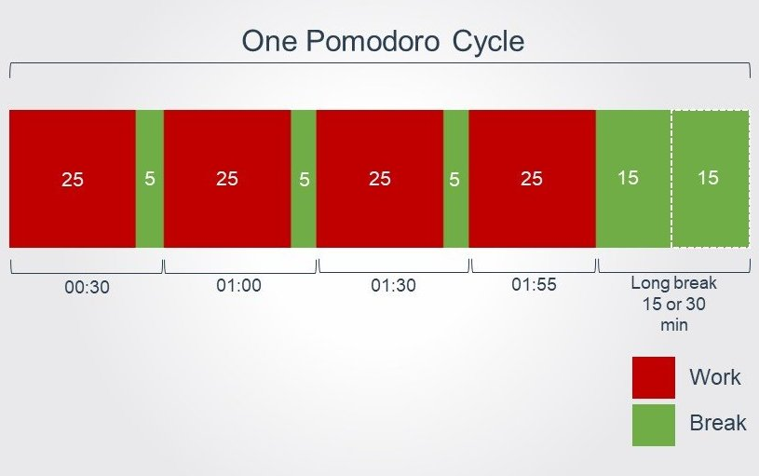
What should be done for Time Management?
RESEARCH METHODOLOGY
Pomodoro:
  Frequent breaks make the user more productive as long as they stay committed to not to distract.
Pareto analysis:
  80% of tasks can be completed in 20% of the disposable time.
  The remaining 20% of tasks will take up 80% of the time.
  Fig 3. Pomodoro Technique. [5]
28th February 2020

Slide 15
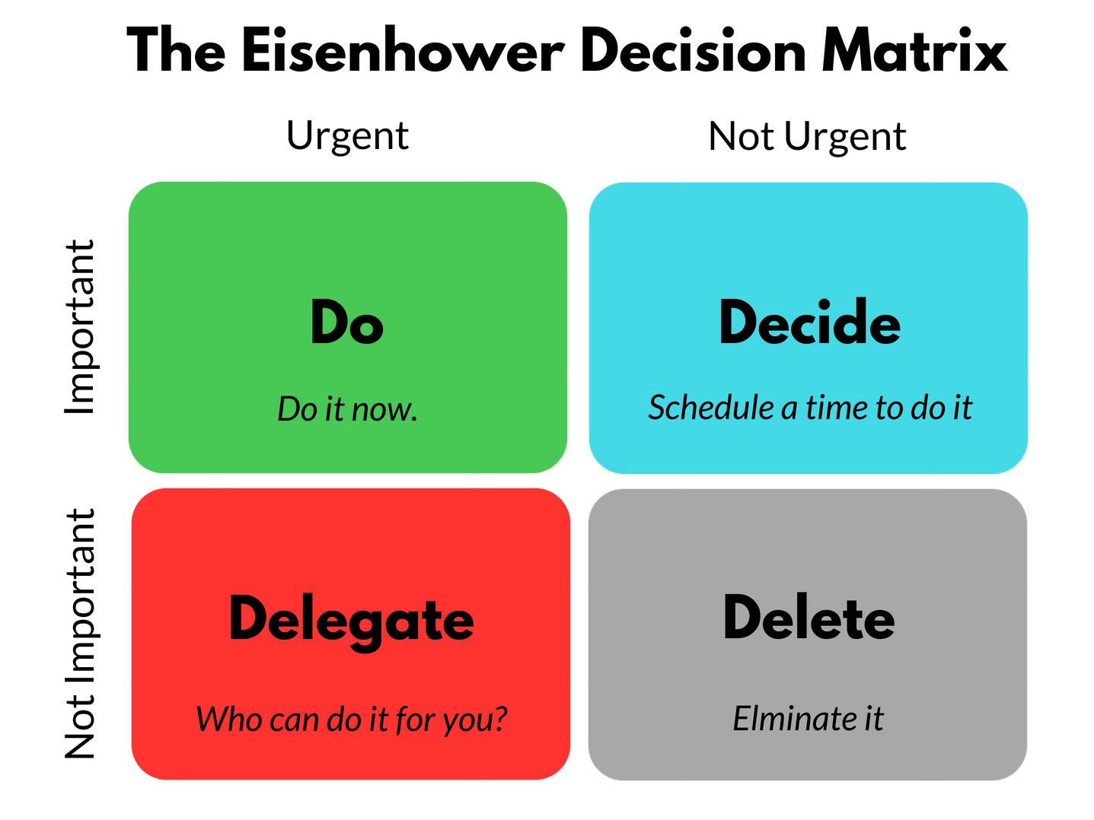
RESEARCH METHODOLOGY
The Eisenhower Method:
Fig 4 : Eisenhower distribution [6]
28th February 2020

Slide 16
References
RESEARCH METHODOLOGY
C.R. Kothari, “Research Methodology”, New Age International Publishers, 2nd Edition 2004.
S. Rajasekar, P. Philominathan,V. Chinnathambi,“ResearchMethodology”, Cornell University Library, pp. 1-53, (2013).
https://innovinc-services.com/stress-management accessed on 20th February 2020.
https://hrtopics.com/prioritizing-and-using-time-management-skills-to-get-more-done-every-day/ accessed on 20th February 2020.
https://francescocirillo.com/pages/pomodoro-technique accessed on 20th February 2020.
https://luxafor.com/the-eisenhower-matrix/ accessed on 20th February 2020.
28th February 2020

Slide 17
Description of course-II
EC 535: Linear Algebra and Random Process
Course Instructor:
Dr. R.H.Laskar, Associate professor,
Dept. of Electronics and Communication Engineering
28th February 2020

Slide 18
Outline
Linear Algebra and Random Process
Linear Systems
Vectors and Vector Spaces
Matrices
Linear Transformation
Eigenvalues and Eigenvectors
Dot and Inner products
Random Variables
Probability Distribution and Probability Density Functions
28th February 2020

Slide 19
Linear Systems
Linear Algebra and Random Process
A linear system is a mathematical model of a system based on the use of a linear operator which follows the additives and scaling property.
A linear system of m equations in n variables is given by
A solution of a linear equation is a sequence of numbers which can be substituted for the variables.
28th February 2020

Slide 20
Vectors and Vector Spaces
Linear Algebra and Random Process
The concept of a vector is regarded as an object with both magnitude and direction.
A vector space is a set vectors which satisfy the operations of addition and scalar multiplication.
Addition Scalar Multiplication
W is called a subspace of vector space V if W is itself a vector space under addition and scalar multiplication inherited from V.
28th February 2020

Slide 21
Matrices
Linear Algebra and Random Process
A matrix is a rectangular array of numbers, symbols, or expressions, arranged in rows and columns.
The matrix operations includes addition, subtraction, multiplication and inverse of a matrix.
The matrix multiplication is non-commutative, i.e. .
An invertible matrix has only one inverse, i.e. the inverse is unique.
The inverse of a invertible matrix is also invertible. Its inverse is the original matrix.
An n×n matrix is called elementary if it can be obtained from the identity matrix I_{n} by using one and only one elementary row operation.
28th February 2020

Slide 22
Linear Transformation
Linear Algebra and Random Process
If V, W are two vector spaces. A linear transformation from W is a transformation T : V → W, such that
Linear transformations are transformations between vectors spaces that preserves vector addition and scalar multiplication operations.
A B A B
f f
one – to – one onto
.
.
.
.
.
.
.
.
.
.
.
.
.
28th February 2020

Slide 23
Eigenvalues and Eigenvectors
Linear Algebra and Random Process
Let A be an n x n matrix. A nonzero vector v is an eigenvector of A if for some scalar
The scalar λ is called Eigenvalue of A corresponding to the eigenvector v.
For λ to be the eigenvalues of A, the condition to be satisfied is
If an n×n matrix A is similar to a diagonal matrix D, it is called diagonalizable. We also say that A can be diagonalized. This means there exists an invertible n×n matrix P such that P⁻¹AP is a diagonal matrix D.
The process of finding matrices P and D as described is called diagonalization, and we say
that P and D diagonalize A.
28th February 2020

Slide 24
Dot and Inner products
Linear Algebra and Random Process
The scalar or dot product of two non-zero vectors a⃗ and b⃗ , denoted by a⃗ .b⃗ is
where θ is the angle between a⃗ and b⃗ and 0 ≤ θ ≤ π as shown in the figure below.
An inner product is a generalization of the dot product. In a vector space, it is a way to multiply vectors together, with the result of this multiplication being a scalar.
28th February 2020

Slide 25
Random Variables
Linear Algebra and Random Process
In probability and statistics, a random variable, is described informally as a variable whose values depend on outcomes of a random phenomenon.
Mean of a random variable:
Mean of a random variable shows the location or the central tendency of the random variable. It is represented in terms of expectation. It is calculated as,
28th February 2020

Slide 26
Probability Distribution and Probability Density Function
Linear Algebra and Random Process
In probability theory and statistics, a probability distribution is a mathematical function that provides the probabilities of occurrence of different possible outcomes in an experiment. It is denoted by F(x).
Probability density is a function of a continuous random variable, whose integral across an interval gives the probability that the value of the variable lies within the same interval. It is denoted by f(x).
The relation between them is given by:
28th February 2020

Slide 27
References
Linear Algebra and Random Process
Nakos, George, and David Joyner. Linear algebra with applications. PWS Publishing Company, 1998.
Papoulis, Athanasios, and S. Unnikrishna Pillai. Probability, Random Variables, and Stochastic Processes. McGraw-Hill Kogakusha, Tokyo, 9th edition,1965
28th February 2020

Slide 28
Description of course-III
SIGNAL PROCESSING
  EC 536: Signal Processing
  Course Instructor:
    Dr. R.K.Karsh, Assistant professor,
    Dept. of Electronics and Communication Engineering
28th February 2020

Slide 29
Outline
SIGNAL PROCESSING
Signals
Systems
Fourier Transform
Discrete Fourier Transform
Z Transform
Filters
FIR and IIR filter
28th February 2020

Slide 30
Signals
SIGNAL PROCESSING
Based on the nature and characteristics in the time domain, signals may be broadly classified as:
Continuous time signal
Discrete time signal
Both continuous and discrete time signal can be further broadly classified into :
Periodic and non periodic signal
Deterministic and random signal
Energy and power signal
Causal and non causal signals
28th February 2020

Slide 31
Systems
SIGNAL PROCESSING
Systems can be classified as :
Continuous time systems
Discrete time systems
Systems are further classified on the basis of their properties as :
Stable and unstable system
Linear and non linear system
Time variant and time invariant system
Causal and non causal systems
Static and dynamic system
Invertible and non invertible system
28th February 2020

Slide 32
Fourier Transform
SIGNAL PROCESSING
Both periodic and aperiodic signals can be represented in frequency domain from time domain using Fourier transform.
Continuous time Fourier transform (CTFT).
Condition for existence of CTFT is
Discrete time Fourier transform (DTFT).
Condition for existence of DTFT is
28th February 2020

Slide 33
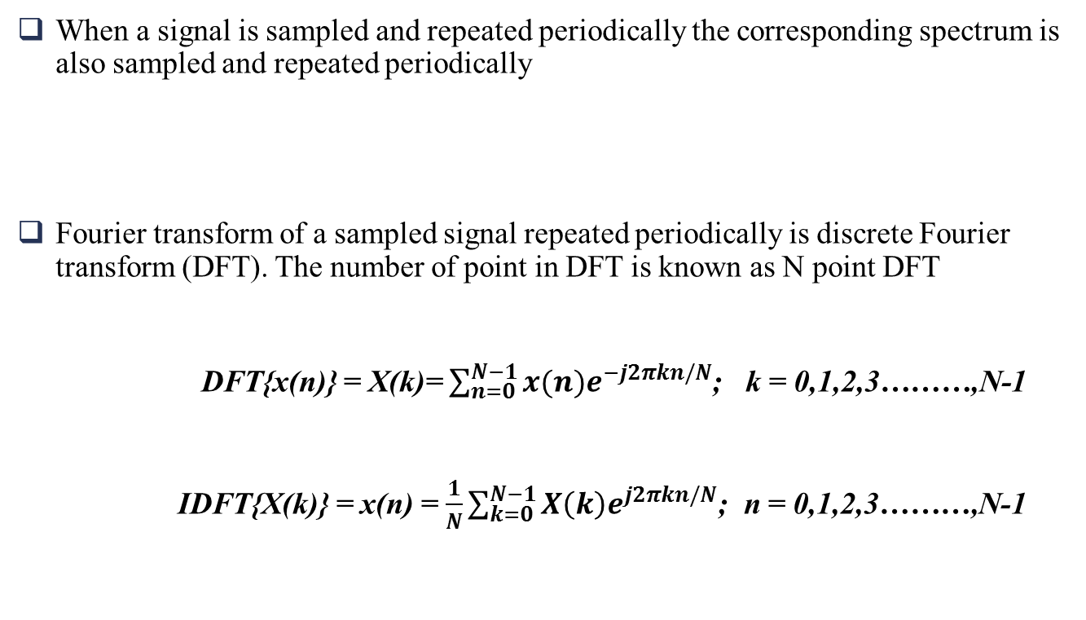
Discrete Fourier Transform
SIGNAL PROCESSING
When a signal is sampled and repeated periodically the corresponding spectrum is also sampled and repeated periodically
Fourier transform of a sampled signal repeated periodically is discrete Fourier transform (DFT). The number of point in DFT is known as N point DFT
DFT{x(n)} = X(k)= $\sum_{n=0}^{N−1}{x(n)e^{−j2πkn/N}}$; k = 0,1,2,3………,N-1
IDFT{X(k)} = x(n) = $\frac{1}{N}\sum_{k=0}^{N−1}{X\left(k\right)e^{j2πkn/N}}$; n = 0,1,2,3………,N-1
28th February 2020

Slide 34

Z Transform
SIGNAL PROCESSING
Z transform of x(n) is given by:
X(z) = $\sum_{−∞}^{∞}{x(n)}$Z^{-n}
putting z = r$e^{jω}$
X(z) = $\sum_{−∞}^{∞}{x\left(n\right)r}$^{-n}e^{-j}$ωn$
At r =1, Z transform behaves as DTFT
ROC of Z transform
Z transform is guaranteed to converge if r^{-n}x(n) is absolutely summable, i.e
28th February 2020

Slide 35
Filters
SIGNAL PROCESSING
Analog filter
  It process and generate analog signal.
  It is constructed by active or passive electronic components.
  Analog filter is described by a differential equation.
  Frequency response of an analog filter can be modified by changing the components.
Digital filter
  It process and generate digital data.
  It consist of elements like adder, multiplier and delay unit.
  Digital filter is described by difference equation.
  Frequency response can be changed by changing the filter coefficients
28th February 2020

Slide 36
Finite Impulse Response (FIR) Filter
SIGNAL PROCESSING
FIR filters are always stable.
Finite Impulse Response (FIR) filters use past input samples only.
Memory requirement and execution time are high.
Example:
Difference equation:
Z-transform:
Transfer function:
28th February 2020

Slide 37
Infinite Impulse Response (IIR) Filter
SIGNAL PROCESSING
An infinite impulse response (IIR) filter is a digital filter that depends linearly on a finite number of input samples and a finite number of previous filter outputs.
The high computational efficiency of IIR filters, with short delays, often make the IIR popular as an alternative.
Example:
Difference equation:
Z-transform:
Transfer function:
28th February 2020

Slide 38
References
SIGNAL PROCESSING
Proakis, John G. Digital signal processing: principles algorithms and applications. Pearson Education India, 2001.
Oppenheim Alan, V., et al. Signals and systems. ISBN-10, Pearson press, USA (1996).
28th February 2020

Slide 39
Description of course-IV
ADVANCED DIGITAL COMMUNICATION
  EC 538: Advanced Digital Communication
  Course Instructor:
  Dr. A.Hossain, Assistant professor,
  Dept. of Electronics and Communication Engineering
28th February 2020

Slide 40
Content
ADVANCED DIGITAL COMMUNICATION
Elements of a digital communication system
Error function and Q function
Detection error of different encoding scheme
Matched filter
Optimum linear detection
Probability of error for different modulation scheme
Non coherent detection
28th February 2020

Slide 41
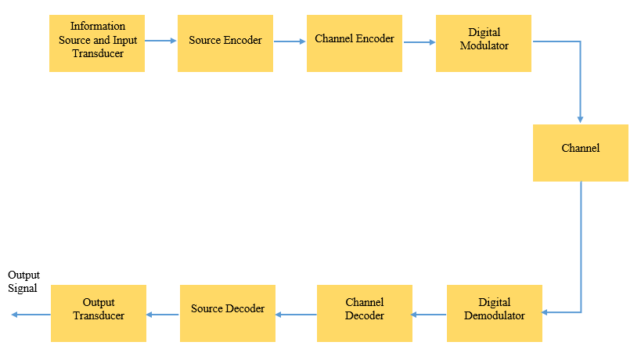
Elements of a digital communication system
ADVANCED DIGITAL COMMUNICATION
Fig. 5. Basic Elements of a Digital Communication System
28th February 2020

Slide 42
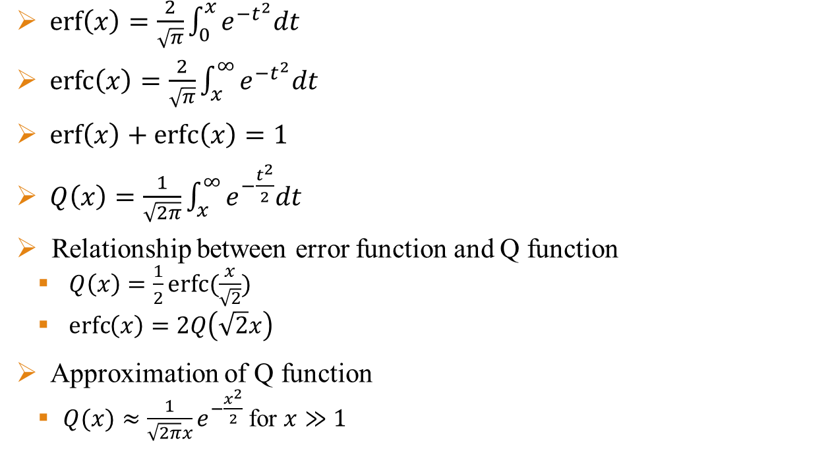
Error function and Q function
ADVANCED DIGITAL COMMUNICATION
$\operatorname{erf}\left(x\right)=\frac{2}{\sqrt{π}}\int_{0}^{x}{e^{−t^{2}}dt}$
$\operatorname{erfc}\left(x\right)=\frac{2}{\sqrt{π}}\int_{x}^{∞}{e^{−t^{2}}dt}$
$\operatorname{erf}\left(x\right)+\operatorname{erfc}\left(x\right)=1$
$Q\left(x\right)=\frac{1}{\sqrt{2π}}\int_{x}^{∞}{e^{−\frac{t^{2}}{2}}dt}$
Relationship between error function and Q function
  $Q\left(x\right)=\frac{1}{2}erfc⁡(\frac{x}{\sqrt{2}})$
  $\operatorname{erfc}\left(x\right)=2Q\left(\sqrt{2}x\right)$
Approximation of Q function
  $Q(x)≈\frac{1}{\sqrt{2π}x}e^{−\frac{x^{2}}{2}}$ for $x≫1$
28th February 2020

Slide 43

Properties of error function and Q function
ADVANCED DIGITAL COMMUNICATION
$Q\left(0\right)=\frac{1}{2}$
$Q\left(−∞\right)=1$
$Q\left(∞\right)=0$
$Q\left(x1\right)<Q\left(x2\right), when x1>x2$
$Q\left(−x\right)=1−Q(x)$
$\operatorname{erf}\left(0\right)=$ 0
$\operatorname{erf}\left(∞\right)=$ 1
$\operatorname{erf}\left(−x\right)=−\operatorname{erf}\left(x\right)$
28th February 2020

Slide 44
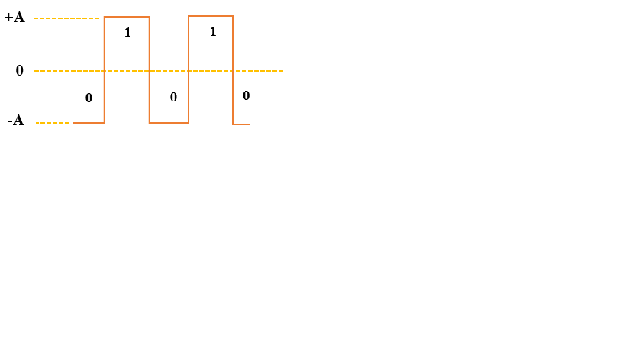
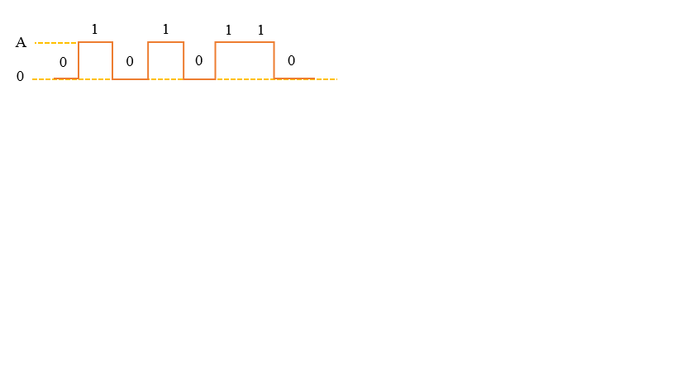
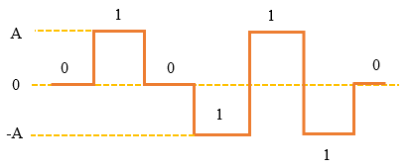
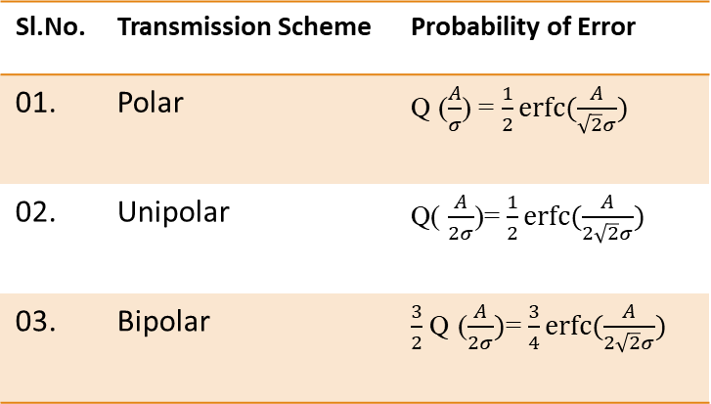
Detection error of different encoding scheme
ADVANCED DIGITAL COMMUNICATION
Polar Transmission
Unipolar Transmission
Fig. 6. Polar Signal
Fig. 7. Unipolar Signal
Bipolar/ Alternative Mark Inversion (AMI) Transmission
Sl.No. | Transmission Scheme | Probability of Error
01. | Polar | Q ($\frac{A}{σ}$) = $\frac{1}{2}\operatorname{erfc}{(\frac{A}{\sqrt{2}σ})}$
02. | Unipolar | Q( $\frac{A}{2σ}$)= $\frac{1}{2}\operatorname{erfc}{(\frac{A}{2\sqrt{2}σ})}$
03. | Bipolar | $\frac{3}{2}$ Q ($\frac{A}{2σ})$= $\frac{3}{4}\operatorname{erfc}{(\frac{A}{2\sqrt{2}σ})}$
Fig. 8. Bipolar Signal
28th February 2020

Slide 45
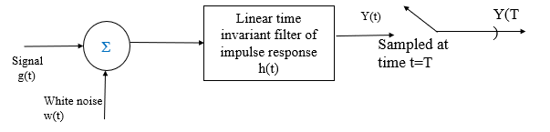

Matched filter
ADVANCED DIGITAL COMMUNICATION
The matched filter is the optimal linear filter for maximizing the signal to noise ratio (SNR) in the presence of additive White Gaussian noise.
A matched filter is obtained by correlation of received signal with p(t). Similarity measures the sign of the correlation and decide whether +p(t) or –p(t) was transmitted.
Impulse response of matched filter $h\left(t\right)=kp(T−t)$ where T= pulse duration, k= system gain
Fig. 9. Block diagram of matched filter
28th February 2020

Slide 46
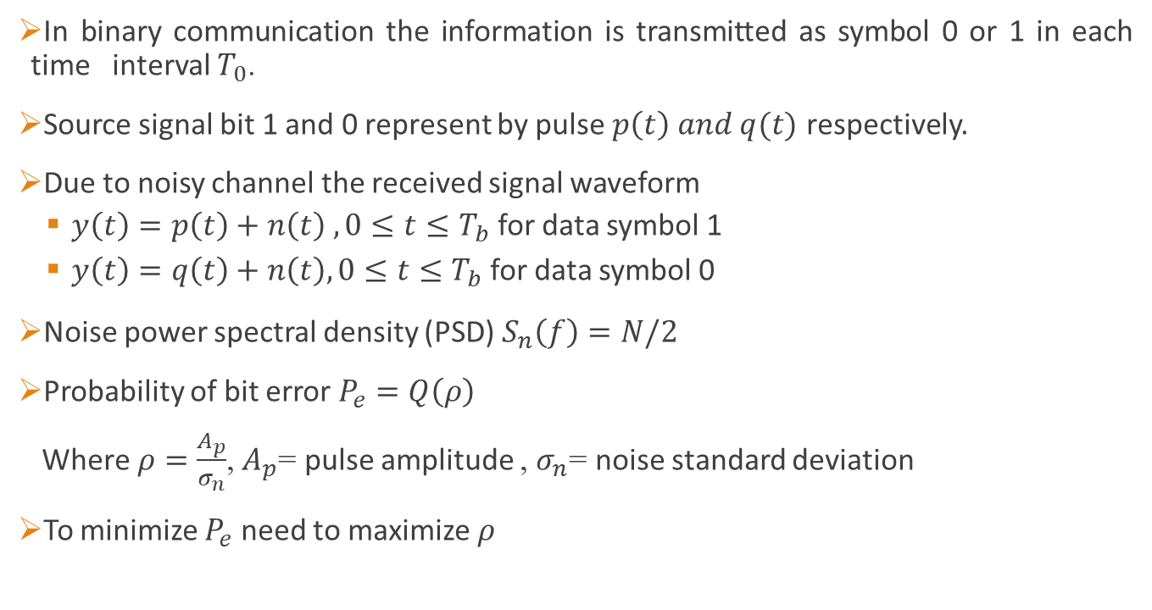
Optimum linear detection
ADVANCED DIGITAL COMMUNICATION
In binary communication the information is transmitted as symbol 0 or 1 in each time interval $T_{0}$.
Source signal bit 1 and 0 represent by pulse $p\left(t\right) and q(t)$ respectively.
Due to noisy channel the received signal waveform
  $y\left(t\right)=p\left(t\right)+n\left(t\right) ,0≤t≤T_{b}$ for data symbol 1
  $y\left(t\right)=q\left(t\right)+n\left(t\right), 0≤t≤T_{b}$ for data symbol 0
Noise power spectral density (PSD) $S_{n}\left(f\right)=N/2$
Probability of bit error $P_{e}=Q\left(ρ\right)$
Where $ρ=\frac{A_{p}}{σ_{n}}$, $A_{p}$= pulse amplitude , $σ_{n}$= noise standard deviation
To minimize $P_{e}$ need to maximize $ρ$
28th February 2020

Slide 47

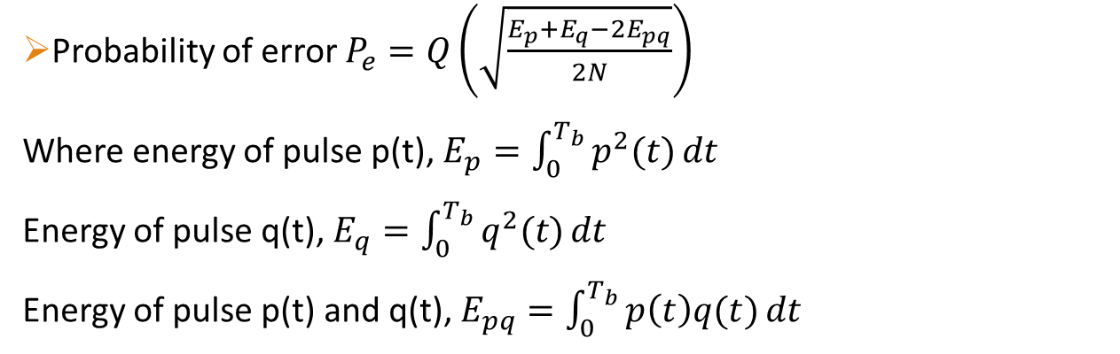
Optimum linear detection…
ADVANCED DIGITAL COMMUNICATION
Σ
Matched
Filter
y
Decision
Device
m =1 if y>λ
Signal
S(t)
Sampled at time t=$T_{b}$
m =1 if y<λ
Threshold
λ
AWGN
N(t)
Fig . 10. Block diagram of optimum receiver
Probability of error $P_{e}=Q\left(\sqrt{\frac{E_{p}+E_{q}−2E_{pq}}{2N}}\right)$
Where energy of pulse p(t), $E_{p}=\int_{0}^{T_{b}}{p^{2}(t)}dt$
Energy of pulse q(t), $E_{q}=\int_{0}^{T_{b}}{q^{2}(t)}dt$
Energy of pulse p(t) and q(t), $E_{pq}=\int_{0}^{T_{b}}{p\left(t\right)q(t)}dt$
28th February 2020

Slide 48
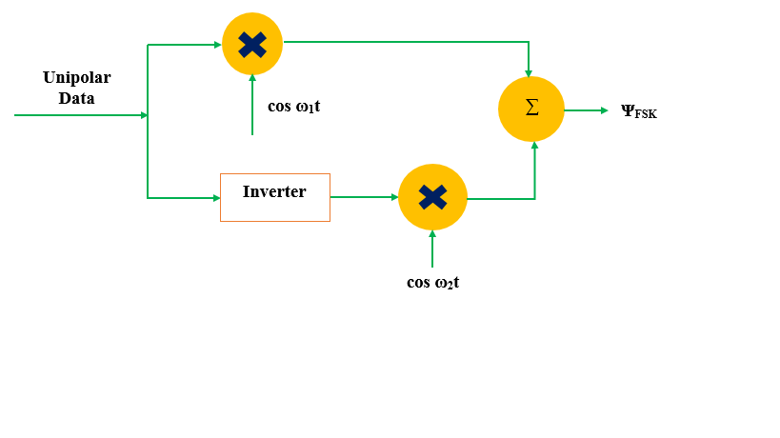
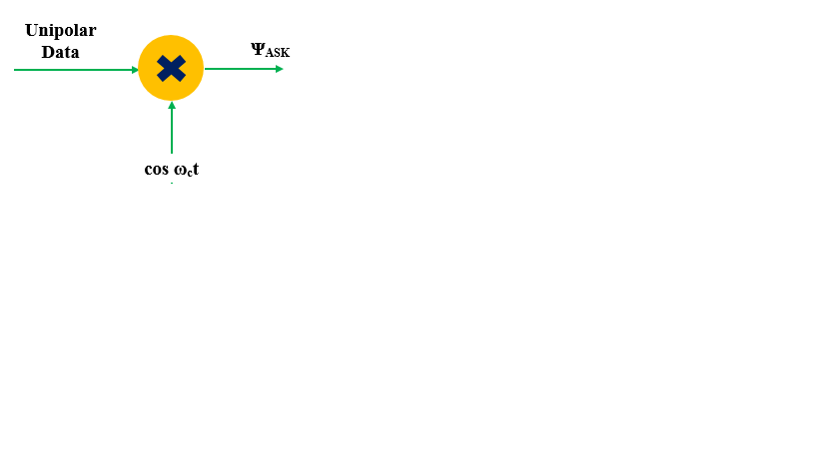
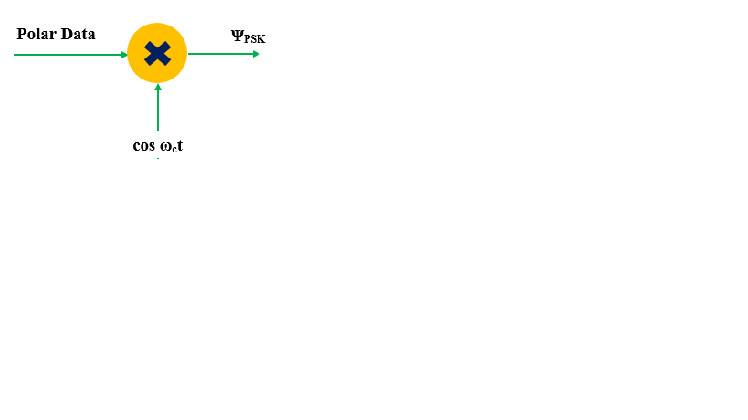
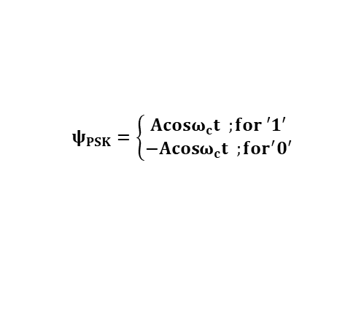
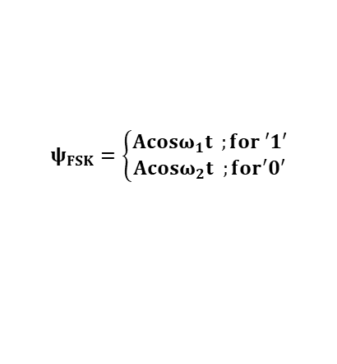
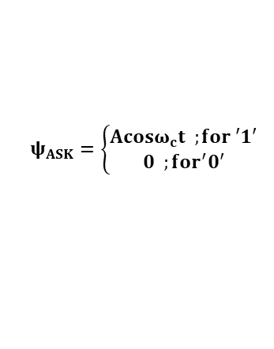
Digital Modulation Techniques
ADVANCED DIGITAL COMMUNICATION
Generation:
ASK FSK
BPSK
$$ψ_{ASK}=\left\{\begin{aligned}Acosω_{c}t ;for ′1′ \\ 0 ;for^{′}0′\end{aligned}\right.$$
$$ψ_{FSK}=\left\{\begin{aligned}Acosω_{1}t ;for ′1′ \\ Acosω_{2}t ;for^{′}0′\end{aligned}\right.$$
$$ψ_{PSK}=\left\{\begin{aligned}Acosω_{c}t ;for ′1′ \\ −Acosω_{c}t ;for^{′}0′\end{aligned}\right.$$
28th February 2020

Slide 49
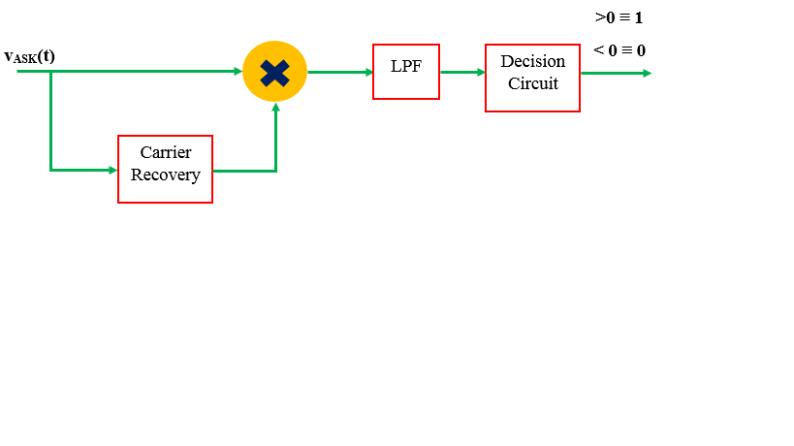
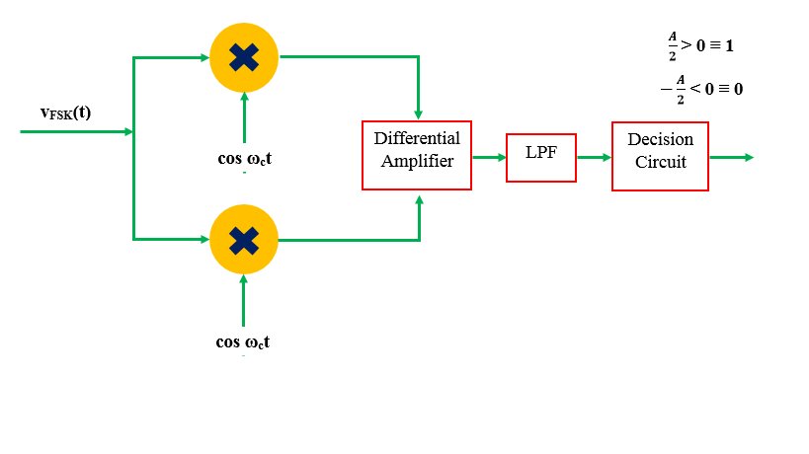
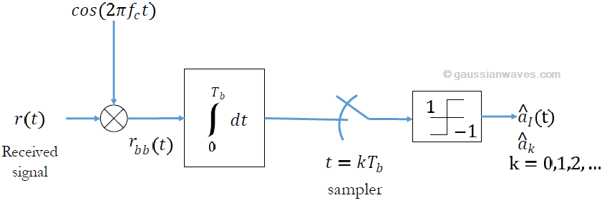
ADVANCED DIGITAL COMMUNICATION
Detection:
ASK Detection (Coherent):
FSK Detection (Coherent)
BPSK Detection (Coherent):
28th February 2020

Slide 50
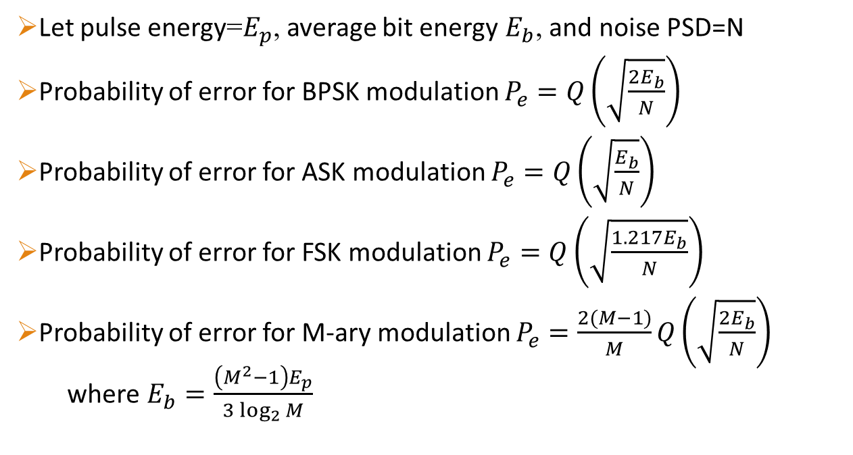
Probability of error for different modulation scheme
ADVANCED DIGITAL COMMUNICATION
Let pulse energy=$E_{p}$, average bit energy $E_{b}$, and noise PSD=N
Probability of error for BPSK modulation $P_{e}=Q\left(\sqrt{\frac{2E_{b}}{N}}\right)$
Probability of error for ASK modulation $P_{e}=Q\left(\sqrt{\frac{E_{b}}{N}}\right)$
Probability of error for FSK modulation $P_{e}=Q\left(\sqrt{\frac{{1.217E}_{b}}{N}}\right)$
Probability of error for M-ary modulation $P_{e}=\frac{2(M−1)}{M}Q\left(\sqrt{\frac{2E_{b}}{N}}\right)$
  where $E_{b}=\frac{\left(M^{2}−1\right)E_{p}}{3\log_{2}{M}}$
28th February 2020

Slide 51
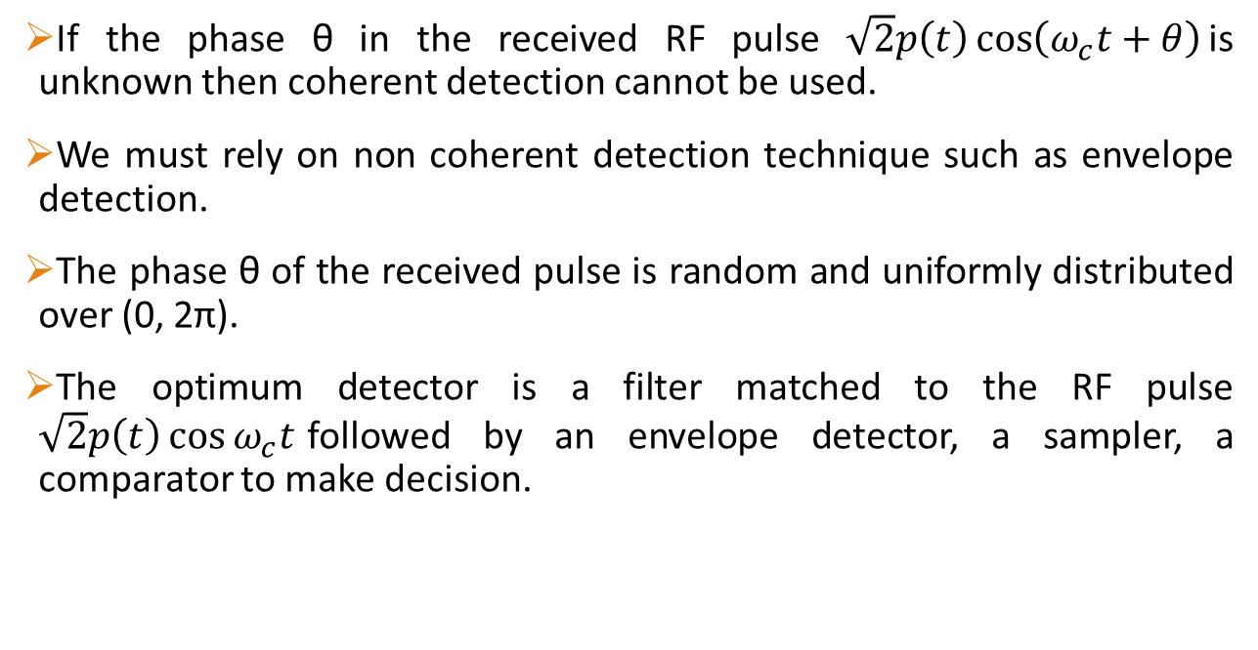
Non coherent detection
ADVANCED DIGITAL COMMUNICATION
If the phase θ in the received RF pulse $\sqrt{2}p\left(t\right)\cos\left(ω_{c}t+θ\right)$is unknown then coherent detection cannot be used.
We must rely on non coherent detection technique such as envelope detection.
The phase θ of the received pulse is random and uniformly distributed over (0, 2π).
The optimum detector is a filter matched to the RF pulse $\sqrt{2}p\left(t\right)\cos{ω_{c}t}$followed by an envelope detector, a sampler, a comparator to make decision.
28th February 2020

Slide 52
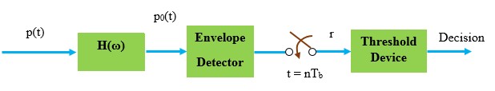
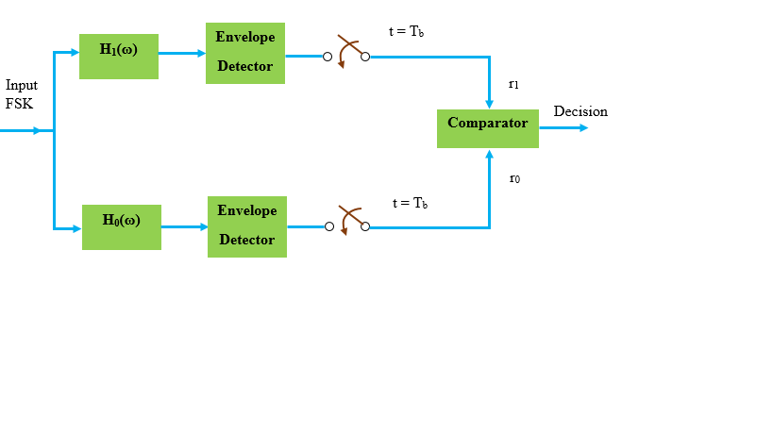

Non coherent detection…
ADVANCED DIGITAL COMMUNICATION
ASK (Non Coherent)
Fig. 11. Non- Coherent Detection of ASK
FSK (Non Coherent)
The decision is m=1 if$r_{1}>r_{0}$ and
m=0 if $r_{1}<r_{0}$
Fig. 12. Non-Coherent Detection of FSK
28th February 2020

Slide 53
References
ADVANCED DIGITAL COMMUNICATION
Haykin S. Digital Communications. Wiley, 1988.
Proakis John G. Fundamentals of Communication Systems. ISBN-10, Pearson press, 1996.
Lathi B.P., Ding Z. Modern Digital and Analog Communication Systems. Oxford, 1988.
28th February 2020

Slide 54
Description of course-V
COMMUNICATION NETWORKS
  EC 542: COMMUNICATION NETWORKS
  Course Instructor:
  Dr. A.Hossain, Assistant professor,
  Dept. of Electronics and Communication Engineering
28th February 2020

Slide 55
Content
COMMUNICATION NETWORKS
OSI Model
Error Detection
Error Correction
Different ARQ techniques
Random Access Protocols
  ALOHA
  CSMA
Bellman-Ford Algorithm
Threats to Network Security
28th February 2020

Slide 56
OSI Model
COMMUNICATION NETWORKS
Application Layer
Human-computer interaction layer, where applications can access the network services.
Presentation Layer
Ensures that data is in usable format and is in encrypted form.
Session Layer
Maintains connection and is responsible for controlling ports and sessions.
Transport Layer
Transmits data using transmission protocols TCP and UDP
Network Layer
Decides which physical path will take the data.
Datalink Layer
Defines the format of data on the network.
Physical Layer
Transmits raw bit streams over the physical medium.
28th February 2020

Slide 57
Error Detection
COMMUNICATION NETWORKS
Whenever a message is transmitted, it may get scrambled by noise or data may get corrupted.
To avoid this, we use error-detecting codes which are additional data added to a given digital message to help us detect if an error occurred during transmission of the message.
A simple example of error-detecting code is parity check.
Parity checking at the receiver can detect the presence of an error if the parity of the receiver signal is different from the expected parity.
That means, if it is known that the parity of the transmitted signal is always going to be "even" and if the received signal has an odd parity, then the receiver can conclude that the received signal is not correct.
28th February 2020

Slide 58
Error Correction
COMMUNICATION NETWORKS
Once detected using parity check, an error must be corrected.
Two basic approaches to error correction are available, which are,
  Automatic Repeat Query (ARQ)
  Forward Error Correction (FEC)
Automatic Repeat Query (ARQ)
  ARQ procedures require the transmitter to resend the portions of the exchange in which error(s) has been detected.
Forward Error Correction (FEC)
  FEC techniques employ special codes that allow the receiver to detect and correct a limited number of errors without referring to the transmitter.
28th February 2020

Slide 59
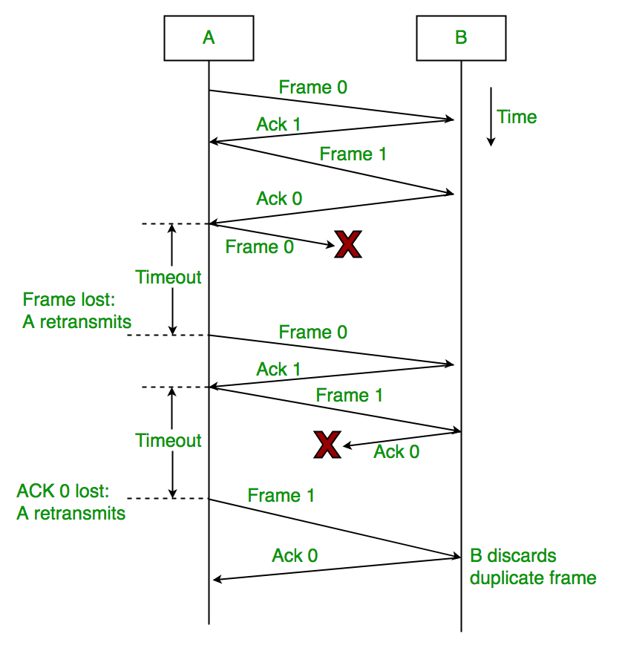
Different ARQ Techniques
COMMUNICATION NETWORKS
Stop-and-wait ARQ
The sender sends a frame and wait for an acknowledgement from the receiver.
If the frame gets lost or corrupted, or the acknowledgement gets delayed, the sender retransmits the frame.
The process is slow and inefficient.
Fig. 12. Stop-and-Wait ARQ
28th February 2020

Slide 60
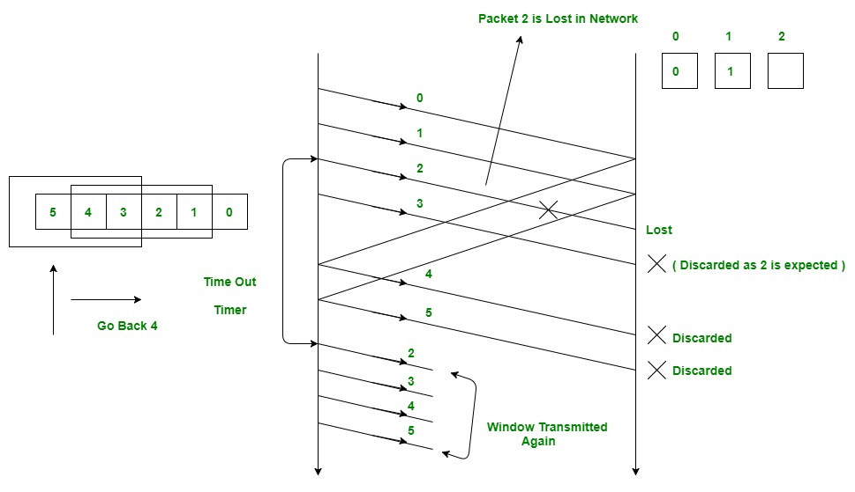
Different ARQ Techniques…
COMMUNICATION NETWORKS
Go-back-n ARQ
The sender sends frames in sequence and receives acknowledgements simultaneously from the receiver.
On detecting the error, the receiver discards the current frame and ignores any further frames.
The receiver notifies the sender about the sequence number of the frame it expects to receive.
Fig. 13. Go-back-n ARQ
28th February 2020

Slide 61
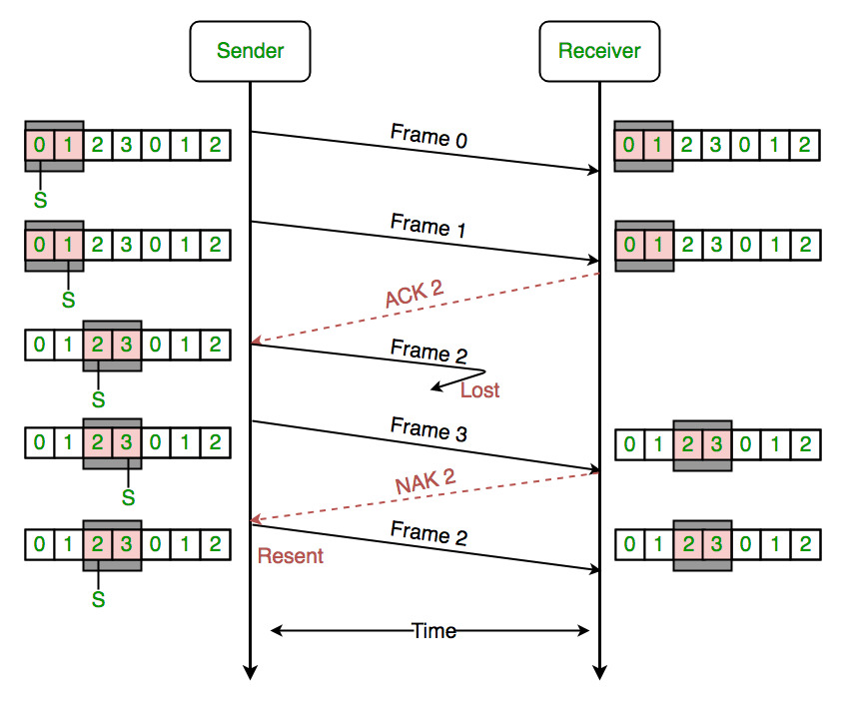
Different ARQ Techniques…
COMMUNICATION NETWORKS
Selective-repeat ARQ
The sender only repeats those frames those have been corrupted or lost during transmission, or the acknowledgement of correct reception has been lost.
The repeated frame is received by the receiver out of sequence, and it is the receiver’s job to rearrange the frames in proper sequence.
It has the highest efficiency.
Fig. 14. Selective-repeat ARQ
28th February 2020

Slide 62
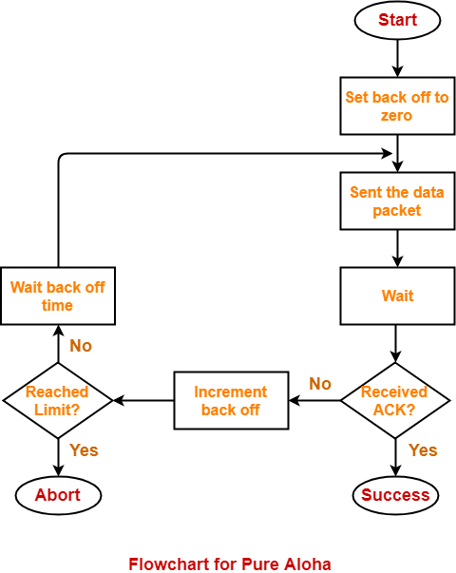
Random Access Protocols
COMMUNICATION NETWORKS
Pure ALOHA
In this aloha, any station can transmit the data at any time.
In Pure Aloha, Probability of successful transmission of data packet
In pure aloha, maximum efficiency = 18.4 %
28th February 2020

Slide 63
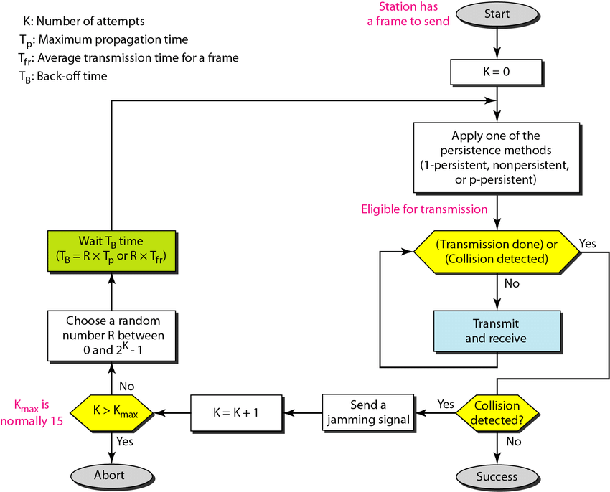
Random Access Protocols…
COMMUNICATION NETWORKS
CSMA/CD
CSMA/CD (Carrier Sense Multiple Access/ Collision Detection) is a media-access control method that was widely used in Early Ethernet technology/LANs.
It is one such technique where different stations that follow this protocol agree on some terms and collision detection measures for effective transmission.
This protocol decides which station will transmit when so that data reaches the destination without corruption.
Fig. 15. CSMA-CD flowchart
28th February 2020

Slide 64
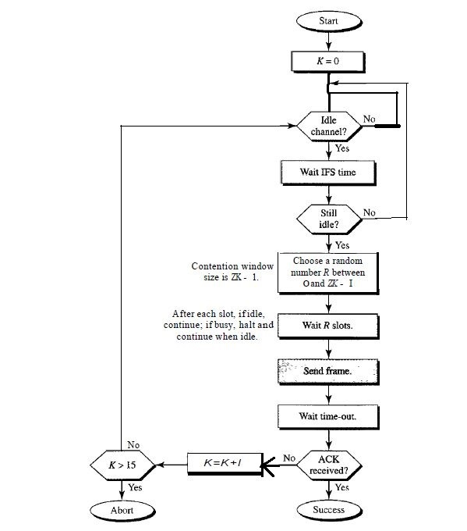
Random Access Protocols…
COMMUNICATION NETWORKS
CSMA/CA
Carrier Sense Multiple Access with Collision Avoidance (CSMA/CA) is a network protocol for carrier transmission that operates in the Medium Access Control (MAC) layer.
In contrast to CSMA/CD (Carrier Sense Multiple Access/Collision Detection) that deals with collisions after their occurrence, CSMA/CA prevents collisions prior to their occurrence.
Fig. 16. CSMA-CA flowchart
28th February 2020

Slide 65
Threats to Network Security
COMMUNICATION NETWORKS
Eavesdropper : Information transmitted over network is not secure and can be observed and recorded by eavesdropper. This information can be replayed in attempts to access the service.
Client Imposter : Imposter can attempt to gain unauthorized access to a server, like, a bank account or a database of personal records.
Replay
Request
Client
Server
Response
Request
Client Imposter
Server
Response
28th February 2020

Slide 66
Threats to Network Security…
COMMUNICATION NETWORKS
Server Imposter : An imposter can incorporate a legitimate server and gain sensitive information from a client, for instance, a bank account number and associated password.
Man-in-the-middle : An imposter manages to place itself as the man in the middle, convincing the server that it is the legitimate client and the client that it is the legitimate client.
Request
Client
Server Imposter
Response
Request
Request
Client
Man-in-the-middle
Server
Response
Response
28th February 2020

Slide 67
References
COMMUNICATION NETWORKS
Forouzan B.A. Data Communications and Networking. Mc.Graw Hills, 4th edition. 2007.
Tanenbaum A.S. Computer Networks. Pearson. 2002.
https://www.geeksforgeeks.org/collision-detection-csmacd/ accessed on 24th February 2020.
28th February 2020

Slide 68
Description of course-VI
DIGITAL SIGNAL PROCESSOR
  EC 543: DIGITAL SIGNAL PROCESSOR
  Course Instructor:
  Dr. R.Murugan, Assistant professor,
  Dept. of Electronics and Communication Engineering
28th February 2020

Slide 69
Content
DIGITAL SIGNAL PROCESSOR
Harvard Architecture
Pipelining and Parallelism
TMS320C64xx architecture
Memory
Interrupts
DMA (Direct Memory Access)
Timers
28th February 2020

Slide 70
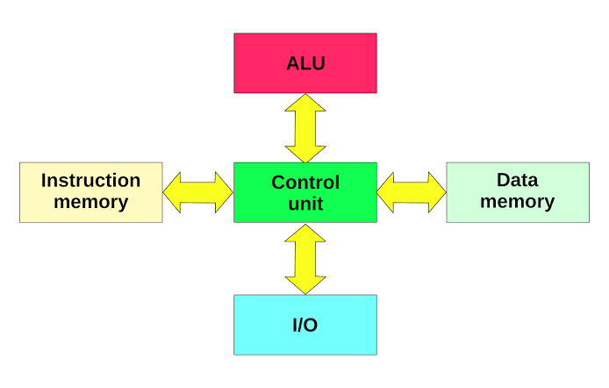
Harvard Architecture
DIGITAL SIGNAL PROCESSOR
This architecture employs entirely separate memory systems to store instructions and data.
The CPU fetches the next instruction and load or store data simultaneously and independently.
Fig. 17. Harvard Architecture
28th February 2020

Slide 71
Parallel Processing
DIGITAL SIGNAL PROCESSOR
F0
Functional unit F
Parallel Processing is a mode of operation in which a process is split into parts, which are executed simultaneously on different processors attached to the same computer.
T0
F0F1F2
F1
Functional unit F
T1
F2
Functional unit F
T2
Max(T0,T1,T2)
28th February 2020

Slide 72
Pipelining
DIGITAL SIGNAL PROCESSOR
T2T1T0
Function unit F0
Function unit F1
Function unit F2
T0
T1
T2
T1
T2
T0
T2
T0
T1
Pipelining allows storing and executing instructions in an orderly manner. It is a technique where multiple instructions are overlapped during execution.
28th February 2020

Slide 73
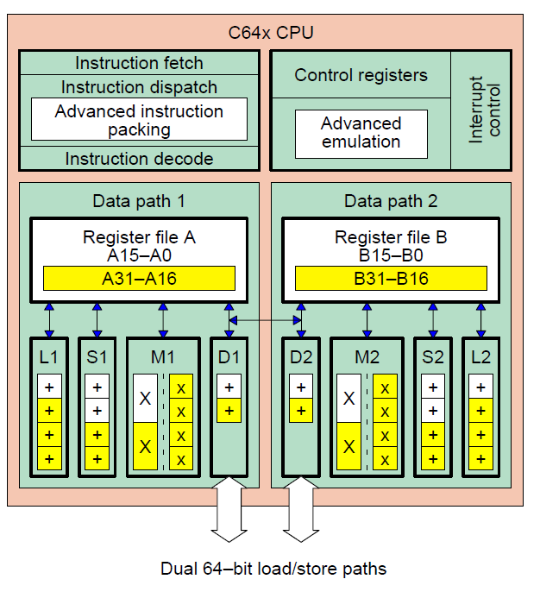
TMS320C64xx CPU architecture
DIGITAL SIGNAL PROCESSOR
The C6000 CPU components consist of:
Two general-purpose register files (A and B)
Eight functional units (.L1, .L2, .S1, .S2, .M1, .M2, .D1, and .D2)
Two load-from-memory data paths (LD1 and LD2)
Two store-to-memory data paths (ST1 and ST2)
Two data address paths (DA1 and DA2)
Two register file data cross paths (1X and 2X)
Fig. 18. TMS320C64xx CPU
28th February 2020

Slide 74
Two-level memory architecture of TMS320C64xx
DIGITAL SIGNAL PROCESSOR
Cache RAM
L1 Program Cache Controller
Data
Address
Snoop Address
Program Address
Data Address
C64 CPU
L2 Cache Controller
RAM
Program Fetch
Data Path A
Data Path B
EDMA
DA1
LD1
DA2
ST2
ST1
LD2
Data
Address
Snoop Address
Cache RAM
L1 Data Cache Controller
Data
28th February 2020

Slide 75
Direct Memory Access (DMA)
DIGITAL SIGNAL PROCESSOR
Direct memory access (DMA) is a feature of processors that allows certain hardware subsystems to access main system memory (random-access memory), without intervention from the central processing unit (CPU).
This feature is useful at any time that the CPU cannot keep up with the rate of data transfer, or when the CPU needs to perform work while waiting for a relatively slow I/O data transfer.
Processors that have DMA channels can transfer data to and from devices with much less CPU overhead than processors without DMA channels.
28th February 2020

Slide 76
Interrupts
DIGITAL SIGNAL PROCESSOR
It can be used internally or externally. It stops the current CPU process so that it can perform a required task initiated by the interrupt.
Total 8 interrupt-control registers (ICR) are there:-
  Control Status Register (CSR)
  Interrupt Enable Register (IER)
  Interrupt Flag Register (IFR)
  Interrupt Set Register (ISR)
  Interrupt Clear Register (ICR)
  Interrupt Service Table Pointer (ISTP)
  Interrupt Return Pointer (IRP)
  Non-Maskable IRP (NRP)
28th February 2020

Slide 77
Timers
DIGITAL SIGNAL PROCESSOR
It is an ‘ON-CHIP’ counter that can be used to periodically generate the CPU interrupt.
The timer is driven by a pre-scalar which gets decremented by 1 at the onset of every CPU clock cycle.
Each time the counter decrements to 0, a timer interrupt TINT is generated and the counter is reloaded with the period value.
Timer Address | Register Name | Description
0024H | TIM | Timer Registers
0025H | PRD | Timer Period Register
0026H | TCR | Timer Control Register
28th February 2020

Slide 78
References
DIGITAL SIGNAL PROCESSOR
Chassaing R. Digital Signal Processing and Applications with the C6713 and C6416 DSK. Wiley, 2004.
http://www.ti.com/lit/ug/spru395b/spru395b.pdf accessed on 23rd February, 2020.
28th February 2020

Slide 79
Description of course-VII
WIRELESS COMMUNICATION
  EC 538: Wireless Communication
  Course Instructor:
  Dr. P.Pattanayak, Assistant professor,
  Dept. of Electronics and Communication Engineering
28th February 2020

Slide 80
Content
WIRELESS COMMUNICATION
Antenna Configurations
MIMO channel Model
Channel state information (CSI)
Spatial Diversity Gain
Spatial Multiplexing
Zero–Forcing (ZF) Receiver
Minimum mean–square error (MMSE) Receiver
V–BLAST/ successive interference cancellation
28th February 2020

Slide 81
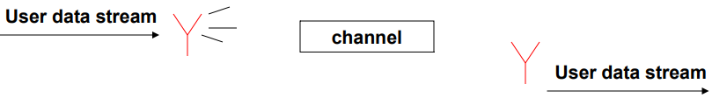
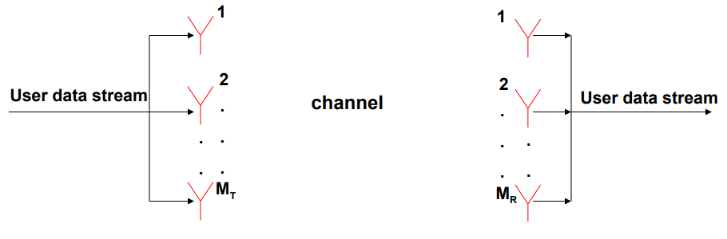
Antenna Configurations
WIRELESS COMMUNICATION
Single-Input-Single-Output (SISO) antenna system
Use multiple transmit and multiple receive antennas.
This system promises enormous data rates
28th February 2020

Slide 82
MIMO channel Model
WIRELESS COMMUNICATION
h₁₁
h₁₂
User data stream
.
.
User data stream
.
.
.
.
Channel Matrix H
S
TRANSMITTED VECTOR
y
RECEIVED
VECTOR
H =
28th February 2020

Slide 83
Channel state information (CSI)
WIRELESS COMMUNICATION
CSI refers to known information used for channel estimation.
Type:
Channel state information at transmitter (CSIT)
Channel state information at receiver (CSIR)
Indirect methods for CSIT :
Based on the channel reciprocity principle.
By using feedback from the receiver.
28th February 2020

Slide 84
Spatial Diversity Gain
WIRELESS COMMUNICATION
  Signal copies are transferred from multiple antennas or received at more than one antenna.
By sending the same information through different paths, multiple independently-faded replicas of the data symbol can be obtained at the receiver end. Hence, more reliable reception is achieved.
Probability of error
signal to noise ratio for a SISO system.
d is the total number of independent signal paths.
Transmit Antennas
abc
abc
abc
Spatial Diversity
abc
28th February 2020

Slide 85
Spatial Multiplexing
WIRELESS COMMUNICATION
Each spatial channel carries independent information, there by increasing the data rate of the system.
Transmit Antennas
c
abc
Spatial Multiplexing
b
a
28th February 2020

Slide 86
Zero–Forcing (ZF) Receiver
WIRELESS COMMUNICATION
Received Signal
Estimated signal
Where, is a pseudo–inverse.
Significantly reduced receiver complexity.
Noise enhancement problem.
28th February 2020

Slide 87
Minimum mean–square error (MMSE) Receiver
WIRELESS COMMUNICATION
Received Signal
Estimated signal
Minimizes the overall error due to noise and mutual interference.
Equivalent to the zero–forcing receiver at high SNR.
Simplifies to matched filter receiver at low SNR.
28th February 2020

Slide 88
V–BLAST/ successive interference cancellation
WIRELESS COMMUNICATION
Received Signal
Estimated signal
(interference cancellation)
etc…
Q is a quantization matrix, satisfying
28th February 2020

Slide 89
References
WIRELESS COMMUNICATION
Tse, David, and Pramod Viswanath, Fundamentals of wireless communication. Cambridge university press, 2005.
Goldsmith, Andrea. Wireless communications. Cambridge university press, 2005
28th February 2020

Slide 90
Motivation
Research Methodology
Helped in planning my research approach.
Made me aware about the procedures by which I should define my research problem.
Signal Processing/Digital Signal Processors
The algorithms we will be designing for the wireless channels will be implemented using a digital signal processor only. Hence, an overall knowledge of processor architecture and related signal processing would be beneficial for optimizing the algorithms accordingly.
Advanced Digital Communication
Got insights about certain performance metrics like probability of error and bit error rate, that can be used in my research.
28th February 2020

Slide 91
Motivation…
Linear Algebra and Random Process
Wireless Channels are modelled in Matrix form.
Noise present in wireless channel are generally taken as Gaussian noise whose characteristics are crucial in determining the system throughput.
Wireless Communication
Massive MIMO is basically my broad research area, hence, all the concepts studied in this subject are of utmost important for me.
Communication Networks
As my work is on Physical Layer, hence the knowledge gained about the functions and roles performed by this layer will be helpful in my research.
28th February 2020

Slide 92

November 2019
28th February 2020

