Slide 1
Chapter 9: Morphological Image Processing
Digital Image Processing
Notes:
Department of Computer Engineering, CMU

Slide 2
Mathematic Morphology
used to extract image components that are useful in the representation and description of region shape, such as
  boundaries extraction
  skeletons
  convex hull
  morphological filtering
  thinning
  pruning

Slide 3
Mathematic Morphology
mathematical framework used for:
pre-processing
  noise filtering, shape simplification, ...
enhancing object structure
  skeletonization, convex hull...
Segmentation
  watershed,…
quantitative description
  area, perimeter, ...

Slide 4
Z² and Z³
set in mathematic morphology represent objects in an image
  binary image (0 = white, 1 = black) : the element of the set is the coordinates (x,y) of pixel belong to the object  Z²
gray-scaled image : the element of the set is the coordinates (x,y) of pixel belong to the object and the gray levels  Z³

Slide 5
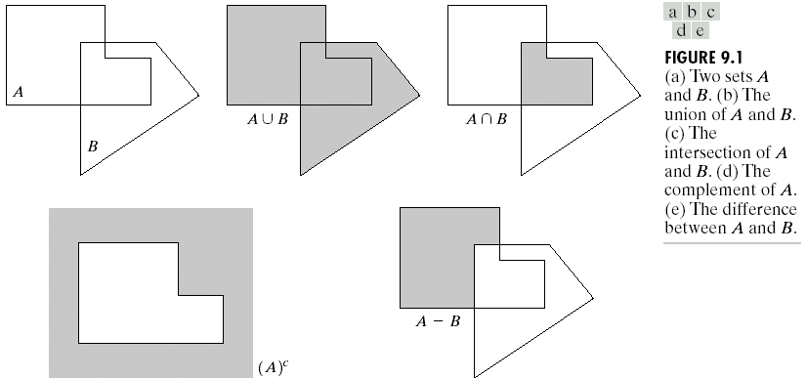
Basic Set Theory

Slide 6
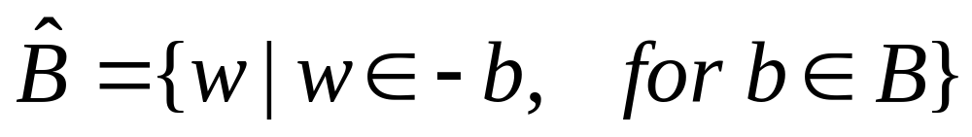
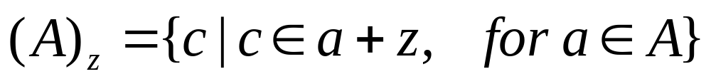
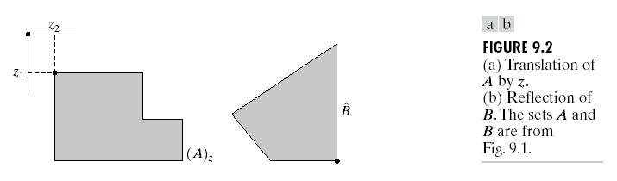
Reflection and Translation

Slide 7
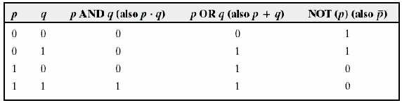
Logic Operations

Slide 8
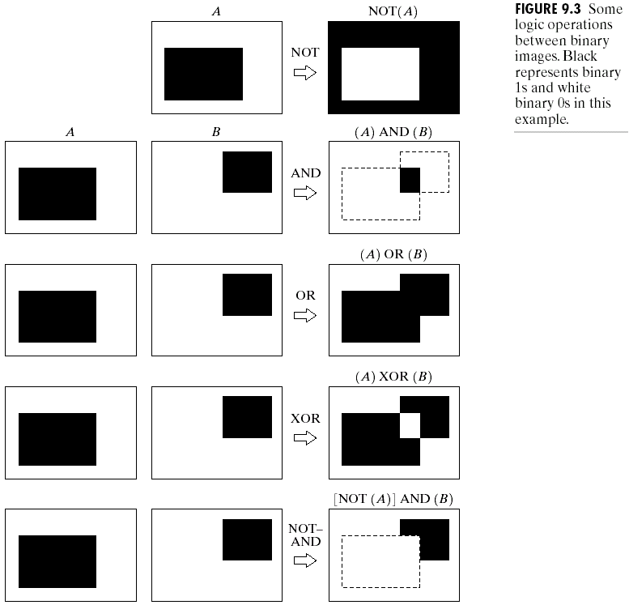
Example

Slide 9

Structuring element (SE)
small set to probe the image under study
for each SE, define origo
shape and size must be adapted to geometric
properties for the objects

Slide 10
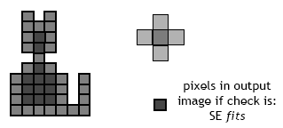
Basic idea
in parallel for each pixel in binary image:
  check if SE is ”satisfied”
  output pixel is set to 0 or 1 depending on used operation

Slide 11
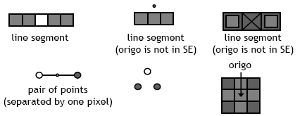
How to describe SE
many different ways!
information needed:
  position of origo for SE
  positions of elements belonging to SE

Slide 12


Basic morphological operations
Erosion
Dilation
combine to
  Opening object
  Closening background
keep general shape but smooth with respect to

Slide 13

Erosion
Does the structuring element fit the set?
erosion of a set A by structuring element B: all z in A such that B is in A when origin of B=z
shrink the object

Slide 14
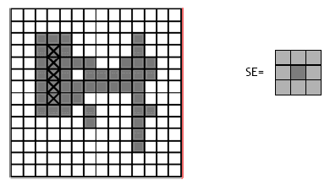
Erosion

Slide 15
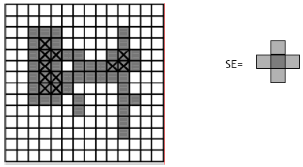
Erosion

Slide 16
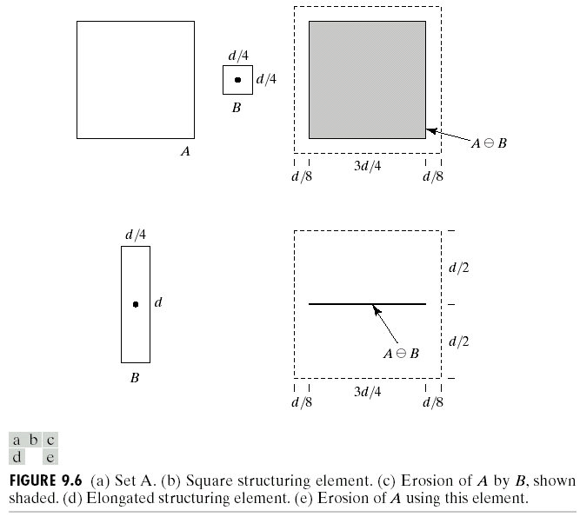
Erosion

Slide 17
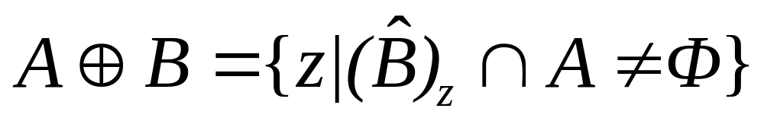
Dilation
Does the structuring element hit the set?
dilation of a set A by structuring element B: all z in A such that B hits A when origin of B=z
grow the object

Slide 18
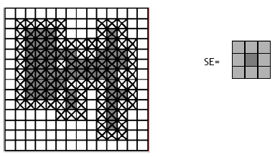
Dilation

Slide 19
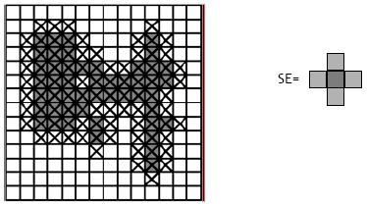
Dilation

Slide 20
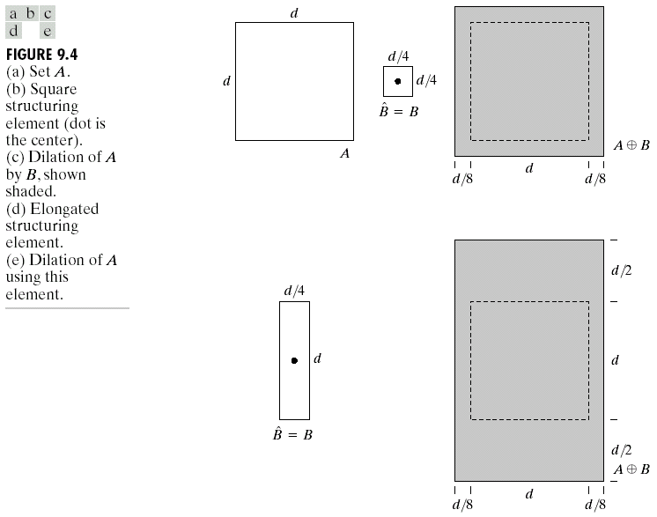
Dilation
B = structuring element

Slide 21
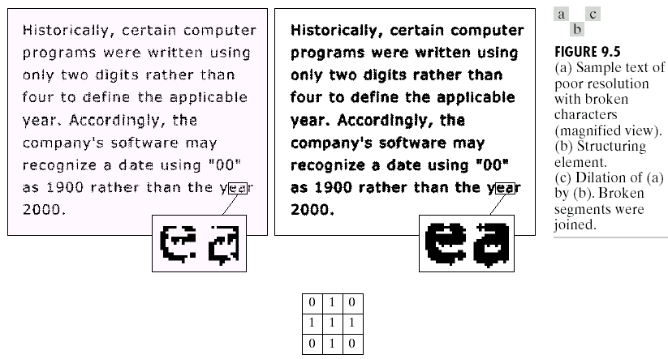
Dilation : Bridging gaps

Slide 22
useful
erosion
  removal of structures of certain shape and size, given by SE
Dilation
  filling of holes of certain shape and size, given by SE

Slide 23
Combining erosion and dilation
WANTED:
  remove structures / fill holes
  without affecting remaining parts
SOLUTION:
combine erosion and dilation
(using same SE)

Slide 24
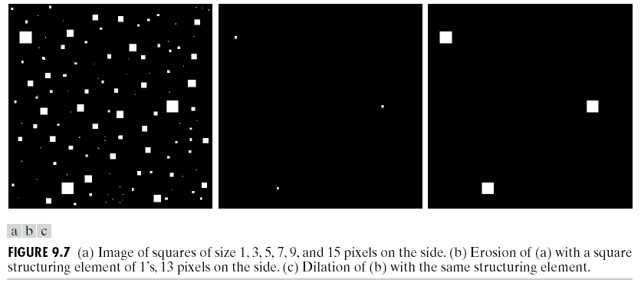
Erosion : eliminating irrelevant detail
structuring element B = 13x13 pixels of gray level 1

Slide 25
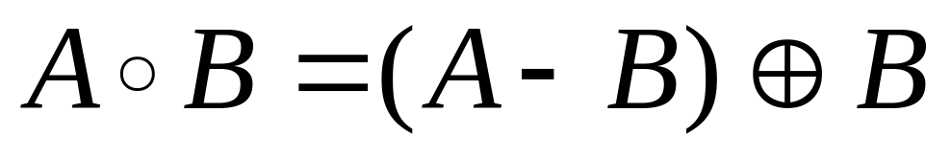
Opening
erosion followed by dilation, denoted ∘
eliminates protrusions
breaks necks
smoothes contour

Slide 26

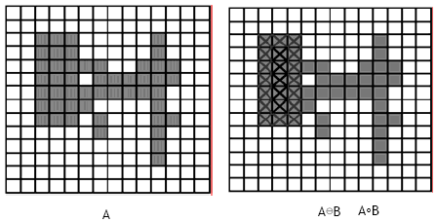
Opening

Slide 27

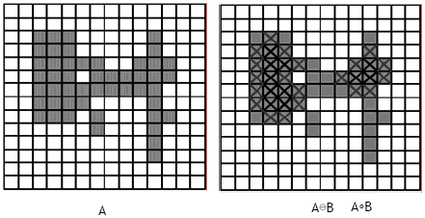
Opening

Slide 28
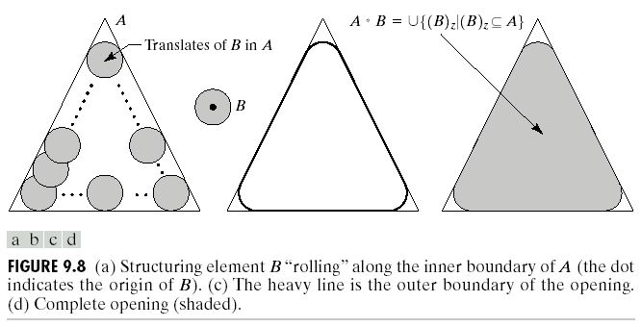
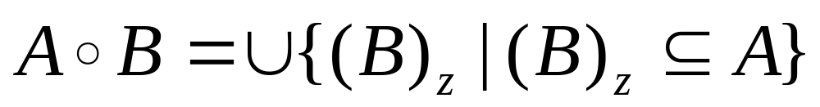
Opening

Slide 29
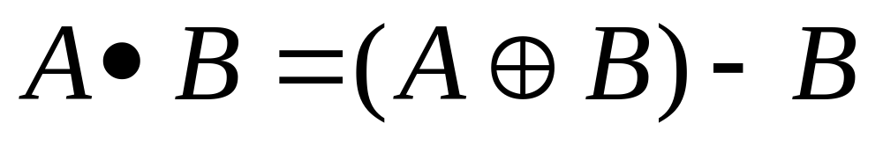
Closing
dilation followed by erosion, denoted •
smooth contour
fuse narrow breaks and long thin gulfs
eliminate small holes
fill gaps in the contour

Slide 30

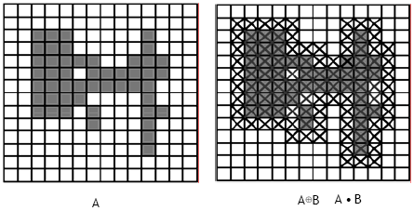
Closing

Slide 31

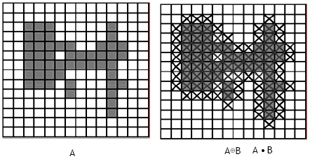
Closing

Slide 32
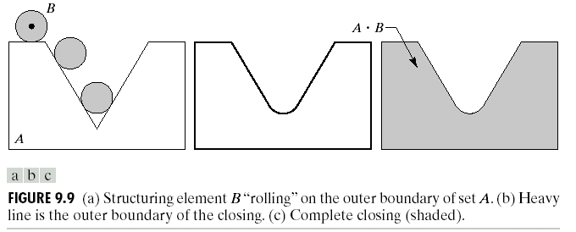
Closing

Slide 33
Properties
Opening
A°B is a subset (subimage) of A
If C is a subset of D, then C °B is a subset of D °B
(A °B) °B = A °B
Closing
A is a subset (subimage) of A•B
If C is a subset of D, then C •B is a subset of D •B
(A •B) •B = A •B
Note: repeated openings/closings has no effect!

Slide 34
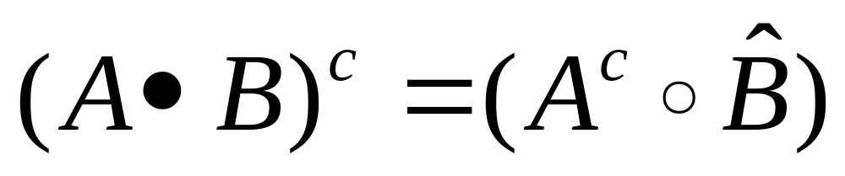
Duality
Opening and closing are dual with respect to complementation and reflection

Slide 35
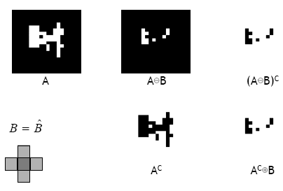

Slide 36
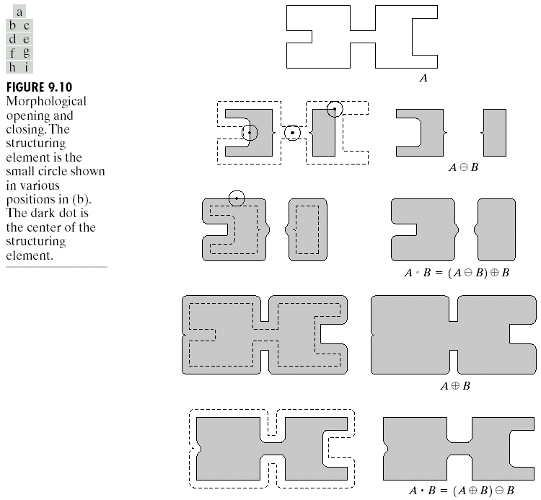

Slide 37

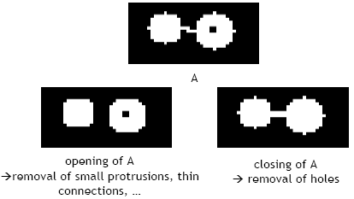
Useful: open & close

Slide 38
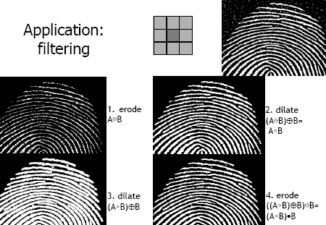
Application: filtering

Slide 39

Hit-or-Miss Transformation ⊛ (HMT)
find location of one shape among a set of shapes ”template matching
composite SE: object part (B1) and background part (B2)
does B1 fits the object while, simultaneously, B2 misses the object, i.e., fits the background?

Slide 40
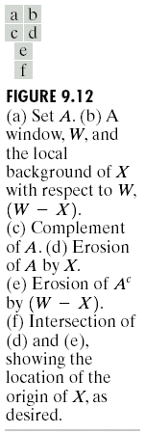
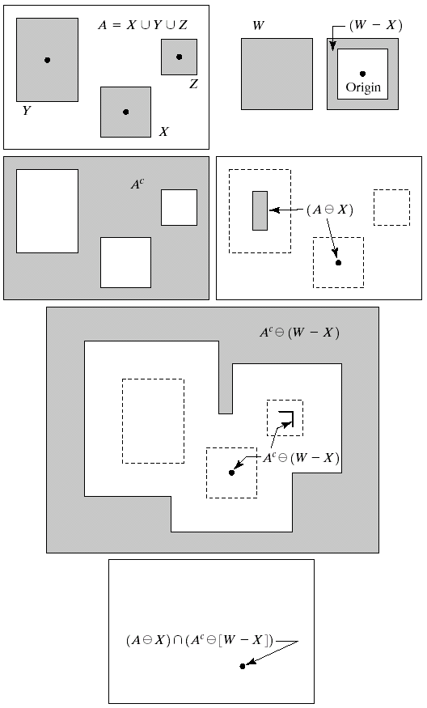
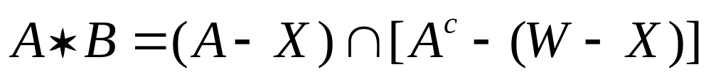
Hit-or-Miss Transformation

Slide 41
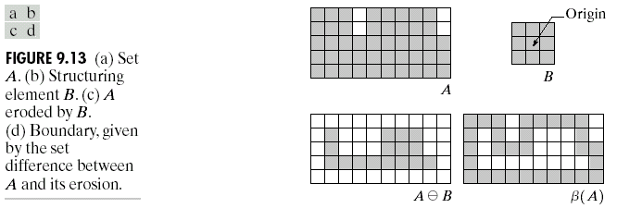
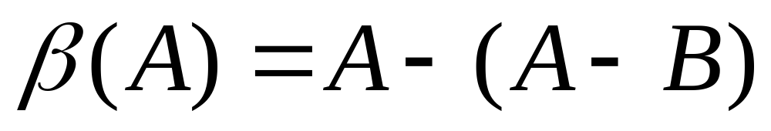
Boundary Extraction

Slide 42
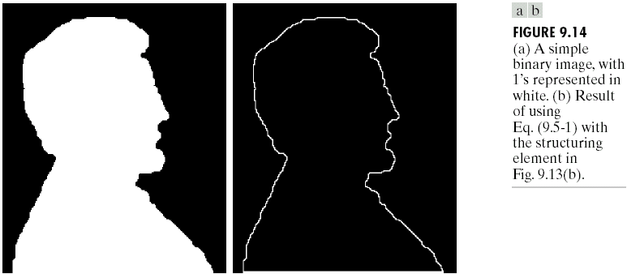
Example

Slide 43
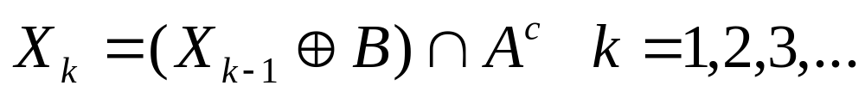
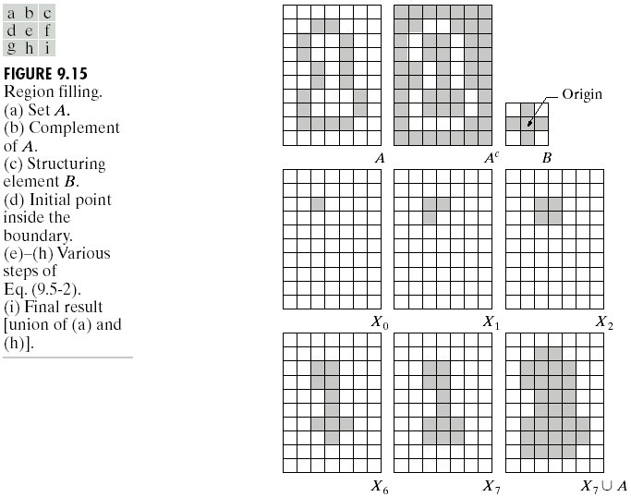
Region Filling

Slide 44
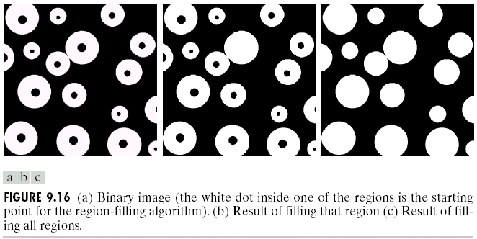
Example

Slide 45
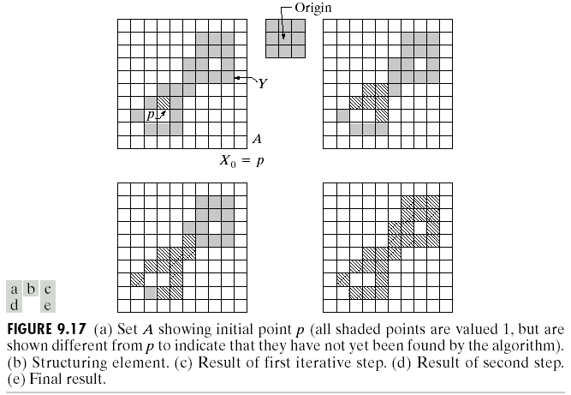
Extraction of connected components

Slide 46
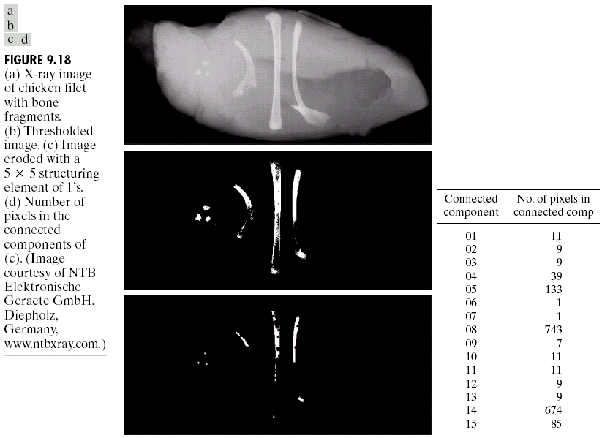
Example

Slide 47
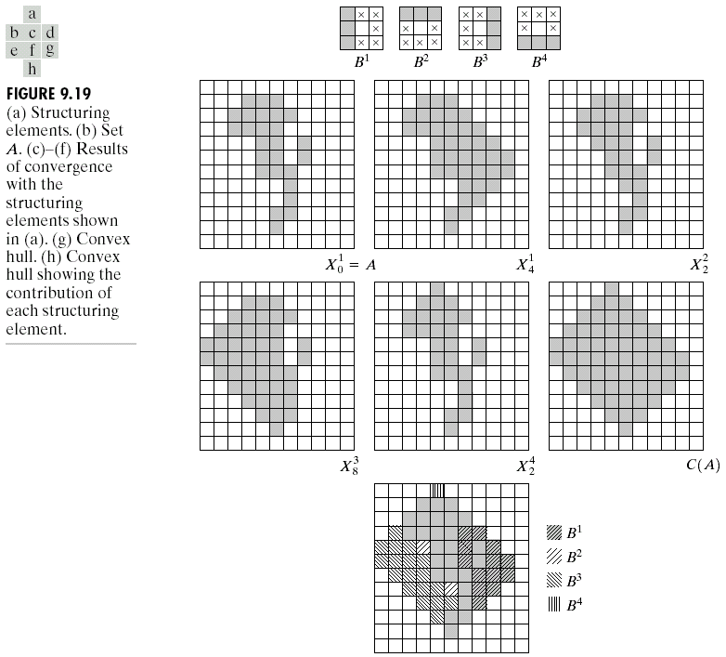
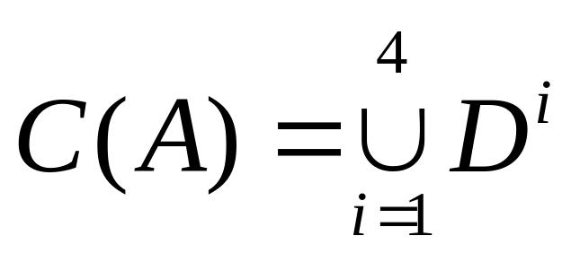
Convex hull
A set A is is said to be convex if the straight line segment joining any two points in A lies entirely within A.

Slide 48
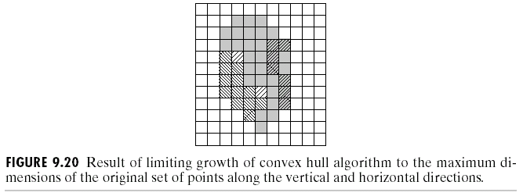

Slide 49
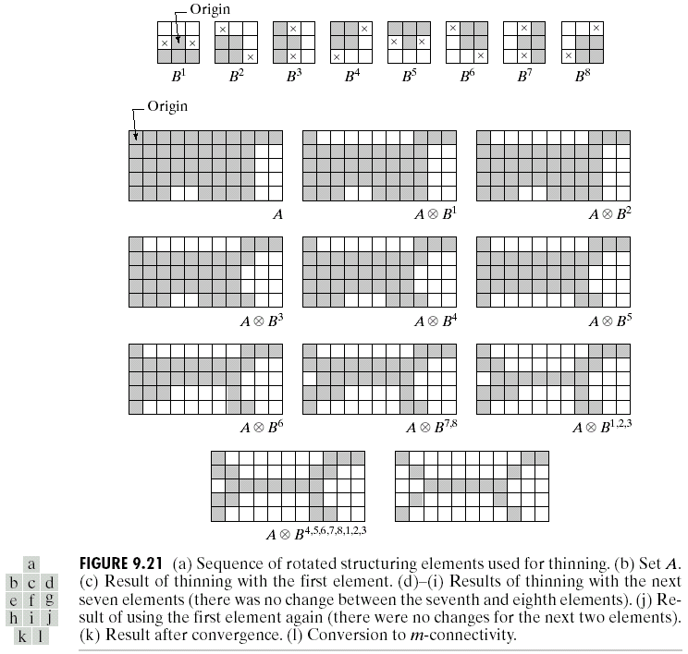
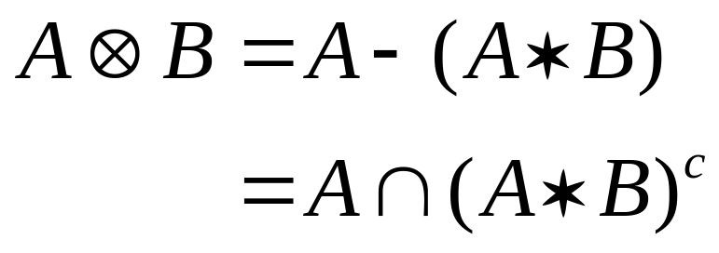
Thinning

Slide 50

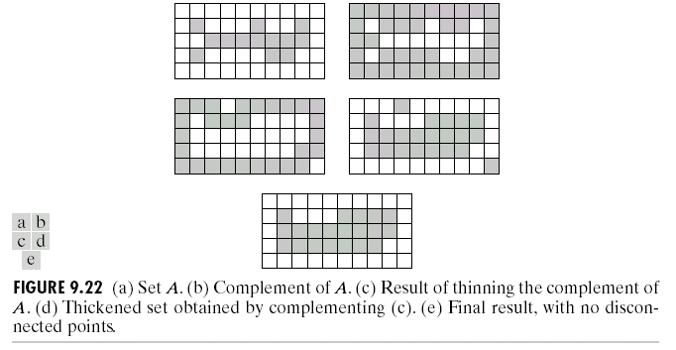
Thickening

Slide 51
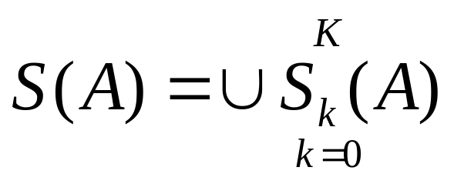
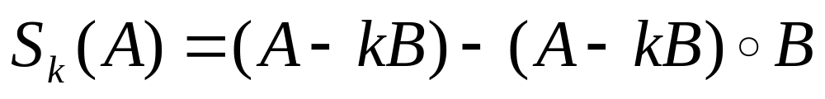



Skeletons

Slide 52


Slide 53





Pruning
H = 3x3 structuring element of 1’s

Slide 54


Slide 55


Slide 56


Slide 57


Slide 58

5 basic structuring elements

