Slide 1
Image Compression

Slide 2
Why Do We Need Compression?
Requirements may outstrip the anticipated increase of storage space and bandwidth
For data storage and data transmission
  DVD
  Video conference
  Printer
The bit rate of uncompressed digital cinema data exceeds 1 Gbps

Slide 3
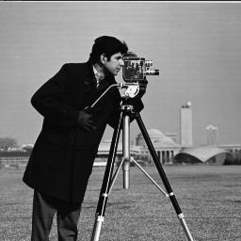
Why Can We Compress?
Spatial redundancy
  Neighboring pixels are not independent but correlated
Temporal redundancy

Slide 4
(Bandwidth Compression vs. Bit Rate Reduction)
Image Compression
Reduction of the number of bits needed to
represent a given image or it’s information
Image compression
exploits the fact that all images are not
equally likely
Exploits energy gaps in signal

Slide 5
Information vs Data
REDUNDANTDATA
INFORMATION
DATA = INFORMATION + REDUNDANT DATA

Slide 6
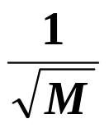
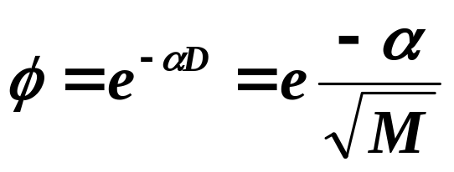
An Image Model-Ref: J.B.O’Neal
Picture size is one unit wide by one unit high
Width 1 Unit
M=Number of Samples
D=Spacing Between Samples =
Correlation Between Adjacent Samples
Height 1 Unit
1/2
M
D
M
1/2

Slide 7
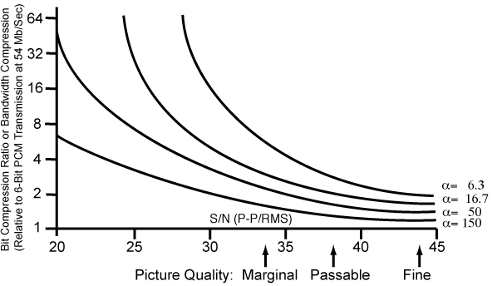
Compression As It Relates To Image Content
-1
Picture Correlation Distance
•Portrait 6.3
(Fills 1/2 Frame)
•Typical 16.7
(Moderate Detail)
•100 People 50
•2000 People 150

Slide 8
INTERFRAME and INTRAFRAME PROCESSING
Point to Point
Interframe Processing
Predictive Encoding
Line to Line
Intraframe
Processing

Slide 9
BIT RATE = NQF
N = NUMBER OF PIXELS
Q = QUANTIZATION BITS/PIXEL
F = FRAME RATE
Channel Bit Rate
N Q F
Compression Ratio = 10 LOG

Slide 10
REDUCING
CREATES
N
Reduced Resolution
Q
Contouring (Artifacts)
F
Image Blur
We need More Sophisticated Approaches

Slide 11
Selected Methods for compression
LPC
Delta Modulation
Bit plane encoding
Transform encoding
Standards
  JPEG
  MPEG

Slide 12
PREDICTIVE CODING
• Predictive Coding
transmit the difference between
estimate of future sample &
the sample itself.
- Delta modulation
- DPCM
- Adaptive predictive coding
- Differential frame coding

Slide 13
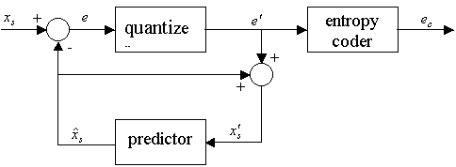
Differential Pulse Code Modulation (DPCM)

Slide 14
SIMPLE DELTA MODULATION
+
x(t)
ε(t)
+
-
y (t)
f (t)
∫

Slide 15
SIMPLE DELTA MODULATION
y(t)
x(t)
f(t)
t

Slide 16
BIT PLANE ENCODING
a b c d e f
a
b
c
d
e
f

Slide 17
TRANSFORM CODING
• Transform Coding
- transform image
- code the coefficients of the transform
- transmit them
- reconstruct by inverse transform
• Benefits
- transform coeff. relatively uncorrelated
- energy is highly compacted
- reasonable robust relative to
channel errors

Slide 18
Potential Bit Rate Reduction
for 525 Line Video Imagery
TYPE
OPERATIONS
COMMENTS
Decrease N
(from 512 to 256)
Resolution
4:1
Dynamic Range
of Display
Decrease Q
6:5
Decrease F
Frame Rate
Flicker Results
Image Blurring
6:1
(30 Fps 5 Fps)
Delta Modulation
Point to Point
Redundancy
2:1 3:1
6 Bits/Pixel to
2 Bits/Pixel

Slide 19
TYPE
OPERATIONS
COMMENTS
Adaptive Intraframe
PCM - Delta
Intraframe
Redundancy
5:1
6 Bits/Pixel to
1.2 Bits/Pixel
Optimal Transform
Encoding
12:1
6 Bits/Pixel to
1.2 Bits/Pixel
Intraframe
Redundancy
JPEG
Intraframe
Redundancy
27:1
Interframe
Processing
Frame to Frame
Redundancy
Hundreds to
one

Slide 20
COMPRESSION/COST RATIO RANKING
Compression/
Cost Ratio
Compression/ Vs.
6-Bit PCM
RANK
Technique
1 “D”
Δ MOD
3.0
3.0
1 “D”
Adaptive
Δ MOD
1.1
3.3
2 “D”
W-H
Transform
0.454
12.7
1 “D”
DPCM
0.429
3.0

Slide 21
Hybrid Techniques
Delta Modulation of transform coefficients
Variable scan rate techniques
Contour encoding
JPEG and MPEG

Slide 22
Lossless or Lossy Compression
Lossless compression
  There is no information loss, and the image can be reconstructed exactly the same as the original
  Applications: Medical imagery, Archiving
Lossy compression
  Information loss is tolerable
  Many-to-1 mapping in compression eg. quantization
  Applications: commercial distribution (DVD) and rate constrained environment where lossless methods can not provide enough compression ratio

Slide 23
Standards
JPEG
MPEG

Slide 24
Why Do We Need International Standards?
International standardization is conducted to achieve inter-operability .
  Only syntax and decoder are specified.
  Encoder is not standardized and its optimization is left to the manufacturer.
Standards provide state-of-the-art technology that is developed by a group of experts in the field.
  Not only solve current problems, but also anticipate the future application requirements.

Slide 25
What Is JPEG?
"Joint Photographic Expert Group". Voted as international standard in 1992.
Works with color and grayscale images, e.g., satellite, medical, ...
Lossy and lossless

Slide 26
JPEG
(Intraframe coding)
First generation JPEG uses DCT+Run length Huffman entropy coding.
Second generation JPEG (JPEG2000) uses wavelet transform + bit plane coding + Arithmetic entropy coding.

Slide 27
Why DCT Not DFT?
DCT is similar to DFT, but can provide a better approximation with fewer coefficients
The coefficients of DCT are real valued instead of complex valued in DFT.

Slide 28
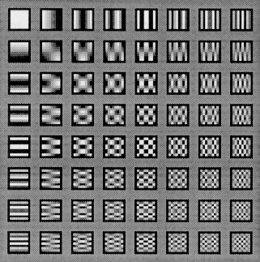
The 64 (8 X 8) DCT Basis Functions
Each 8x8 block can be looked at as a weighted sum of these basis functions.
The process of 2D DCT is also the process of finding those weights.
Notes:
This is another explanation of 2D DCT.

Slide 29
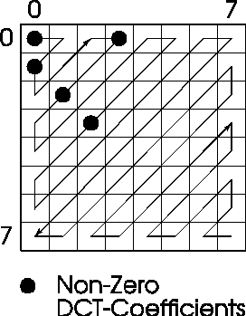
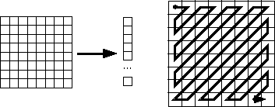
Zig-zag Scan DCT Blocks
Why? -- To group low frequency coefficients in top of vector.
Maps 8 x 8 to a 1 x 64 vector.

Slide 30

Original

Slide 31

JPEG
27:1

Slide 32

JPEG2000
27:1

Slide 33
JPEG Compression Example
Original image
  512 x 512 x 8 bits
    = 2,097,152 bits
JPEG
  27:1 reduction
    =77,673 bits

Slide 34
What Is MPEG ?
"Motion Picture Expert Group", established in 1990 to create standard for delivery of audio and video.
MPEG-1 : target VHS quality on a CD-ROM (320 x 240 + CD audio @ 1.5 Mbits/sec) .

Slide 35
MPEG
(Interframe Coding)
Temporal DPCM is used to remove temporal redundancy first.
The motion compensated error is coded with DCT+Run length Huffman entropy coding.

Slide 36
MPEG
Temporal redundancy
  Prediction along the motion trajectories (motion compensation prediction)

Slide 37
Motion Estimation
The accuracy of motion estimation has a big influence on coding efficiency.
Motion estimation is a very time-consuming work.
Some fast algorithms are needed.

Slide 38
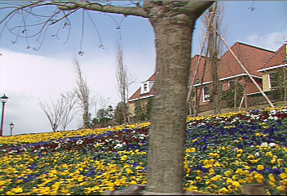
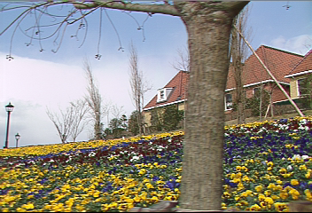
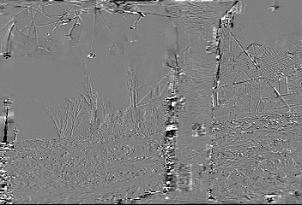
Motion Compensated Prediction
First frame
Second frame

Slide 39
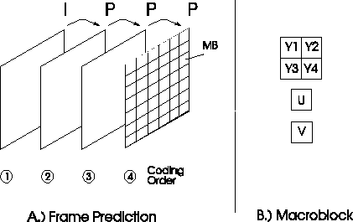
MPEG-1
I frame — Intra-coded frame
P frame — Inter-coded frame or Predicted frame

